Slide 1
Line Bias: exploiting gambling line data
Mike Zaic
@focustrate

Slide 2
Bio (for the purposes of this)
I like numbers and data.
I am not a data scientist.
I don’t gamble on sports.
I am in no way affiliated with the National Football League or any gambling institution.
I’m just a guy… take this for what it’s worth.

Slide 3
What is a “line”?
and who cares?

Slide 4
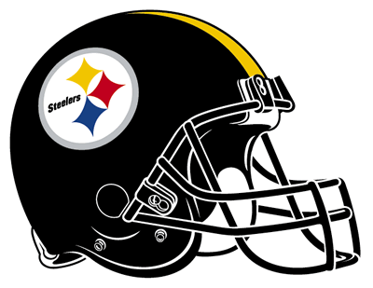

How does gambling work?
0
“the line”
Bookie tries to even the money on both sides.

Slide 5
Moving the line
more
money
initially
on
Steelers
- 2.5
0
“the line”

Slide 6
Final point spread
Steelers -2.5
(they have to win by more than 2.5)
Saints +2.5
(they get 2.5 points added to their score)

Slide 7
Final Score: Steelers 27, Saints 14
Saints cover? NO
14 + 2.5 < 27
Steelers cover? YES
27 – 2.5 > 14

Slide 8
Line Bias!
Public got it waaaaay wrong in this game.
Bias = team score + spread – vs score
Steelers:
27 + (- 2.5) – 14 = 10.5
Saints:
14 + 2.5 – 27 = -10.5

Slide 9
In other words
Steelers beat the spread by 10.5 points. They were under-bet.
Saints would have needed 10.5 points to beat the spread. They were over-bet.

Slide 10
What can we do with that?
Look at all of the lines and final scores from 1978 on and potentially use the data to our advantage… of course.

Slide 11
Line Biases
Collected data
Looked at 3 types of biases:
Overall home/away
Team vs. team
Team

Slide 12
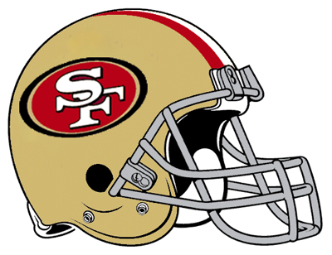

Real life: Sunday, Nov 10
49ers -6.5
Panthers +6.5

Slide 13
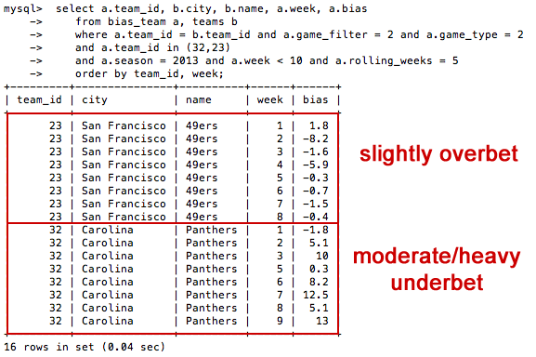
Team Biases

Slide 14
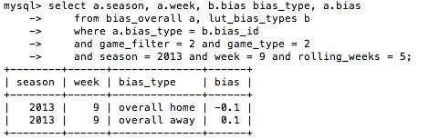
Any overall biases?

Slide 15
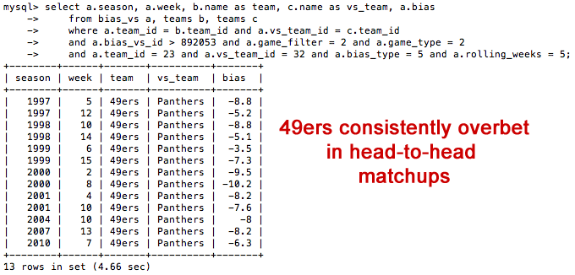
What about head to head?

Slide 16
Bet the Panthers!
Panthers consistently underbet heavily all season and in head-to-head matchups against the 49ers.

Slide 17
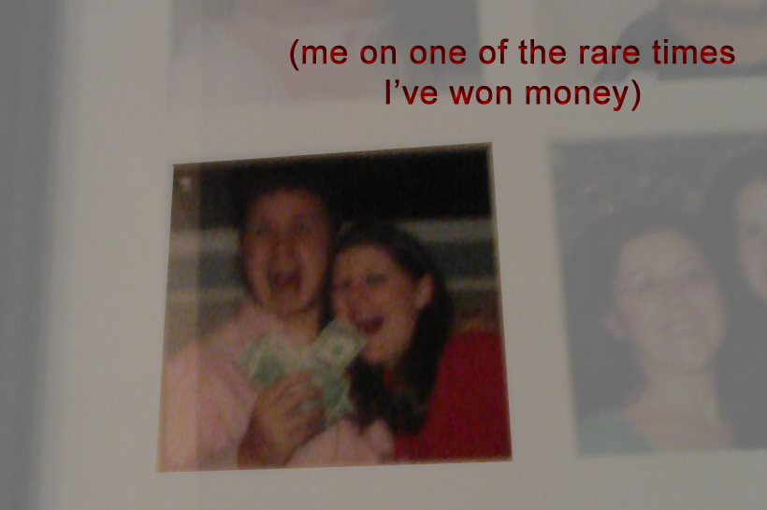
Final Score: 49ers 9, Panthers 10

Slide 18
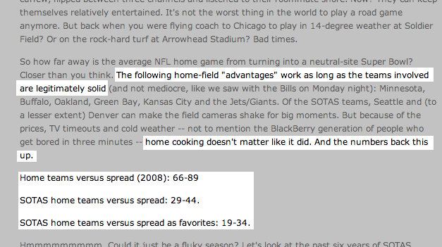
This type of thing works.
http://sports.espn.go.com/espn/page2/story?page=simmons/partone/081121

Slide 19
Opportunities
Look at not just regular season; also pre- and post-
Dig into:
Better modeling
Simulations
Bankroll management based on confidence
Types of biases
Teaser bets – allow you to move the line!

Slide 20

Thanks!
http://www.slideshare.net/focustrate/line-bias-exploiting-gambling-line-data

