Slide 1
Mixing Low Latency with Analytical Workloads for Customer Experience Management
Neil Ferguson, Development Lead, NICE Systems

Slide 2

Introduction
Causata was founded in 2009 and developed Customer Experience Management software
Based in Silicon Valley, but with engineering team in London
Causata was acquired by NICE Systems in August 2013

Slide 3
Talk will mostly focus on our HBase-based data platform:
Challenges we encountered migrating from our proprietary data store
Performance optimizations we have made
General observations about using HBase in production

Slide 4
NICE / Causata Overview
Two main use cases, and therefore access patterns for our data
Real-time offer management:
  Involves predicting something about a customer based on their profile
  For example, predicting if somebody is a high-value customer when deciding whether to offer them a discount
  Typically involves low latency (< 50 ms) access to an individual customer’s profile

Slide 5
NICE / Causata Overview
Analytics
  Involves getting a large set of profiles matching certain criteria
  For example, finding all of the people who have spent more than $100 in the last month
  Involves streaming access to large samples of data (typically millions of rows / sec per node)
  Often ad-hoc
Both on-premise and SAAS

Slide 6
Some History
Started building our platform around 4 ½ years ago
Started on MySQL
  Latency too high when reading large profiles
  Write throughput too low with large data sets
Built our own custom-built data store
  Performed well (it was built for our specific needs)
  Non-standard; maintenance costs
Moved to HBase last year
  Industry standard; lowered maintenance costs
  Can perform well!

Slide 7
Our Data
All data is stored as Events, which have the following:
  A type (for example, “Product Purchase”)
  A timestamp
  An identifier (who the event belongs to)
  A set of attributes, each of which has a type and value(s), for example:
    “Product Price -> 99.99
    “Product Category” -> “Shoes”, “Footwear”
Only raw data is stored (not pre-aggregated)
Typical sizes are 10s of TB

Slide 8
Our Storage
Event table (row-oriented):
  Stores data clustered by user profile
  Used for low latency retrieval of individual profiles for offer management, and for bulk queries for analytics
Index table (“column-oriented”):
  Stores data clustered by attribute type
  Used for bulk queries (scanning) for analytics
Identity Graph:
  Stores a graph of cross-channel identifiers for a user profile
  Stored as an in-memory column family in the Events table

Slide 9
Maintaining Locality
Data locality (with HBase client) gives around a 60% throughput increase
  Single node can scan around 1.6 million rows / second with Region Server on separate machine
  Same node can scan around 2.5 million rows / second with Region Server on the local machine

Slide 10
Maintaining Locality
Custom region splitter: ensures that (where possible), event tables and index tables are split at the same point
  Tables divided into buckets, and split at bucket boundaries
Custom load balancer: ensures that index table data is balanced to the same Region Server as event table data
All upstream services are locality-aware

Slide 11
Querying Causata
For each customer who has spent more than $100, get product views in the last week from now:
SELECT C.product_views_in_last_week
FROM Customers C
WHERE C.timestamp = now()
AND total_spend > 100;

Slide 12
Querying Causata
For each customer who has spent more than $100, get product views in the last week from when they purchased something:
SELECT C.product_views_in_last_week
FROM Customers C, Product_Purchase P
WHERE C.timestamp = P.timestamp
AND C.profile_id = P.profile_id
AND C.total_spend > 100;

Slide 13
Query Engine
Raw data stored in HBase, queries typically performed against aggregated data
  Need to scan billions of rows, and aggregate on the fly
Many parallel scans performed:
  Across machines (obviously)
  Across regions (and therefore disks)
  Across cores

Slide 14
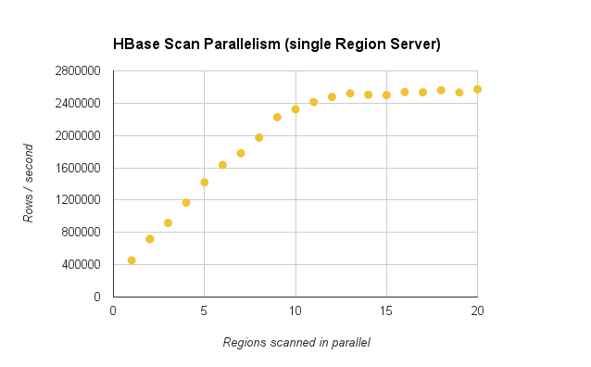
Parallelism
Single Region Server, local client, all rows returned to client, disk-bound workload (disk cache cleared before test), ~1 billion rows scanned in total, ~15 bytes per row (on disk, compressed), 2 x 6 core Intel(R) X5650 @ 2.67GHz, 4 x 10k RPM SAS disks, 48GB RAM

Slide 15
Query Engine
Queries can optionally skip uncompacted data (based on HFile timestamps)
  Allows result freshness to be traded for performance
Multiple columns combined into one
  Very important to understand exactly how data is stored in HBase
  Trade-off between performance and ease of understanding
Shortcircuit reads turned on
  Available from 0.94
  Make sure HDFS checksums are turned off (and HBase checksums are turned on)

Slide 16
Request Prioritization
All requests to HBase go through a single thread pool
This allows requests to be prioritized according to sensitivity to latency
“Real-time” (latency-sensitive) requests are treated specially
Real-time request latency is monitored continuously, and more resources allocated if deadlines are not met

Slide 17
Major Compactions
Major Compactions can stomp all over other requests, affecting real-time performance
We disable automatic major compactions and schedule them for off-peak times
Regions are compacted individually, allowing time-bounded incremental compaction

Slide 18

HBase in Production
HBase is relatively young, in database years
  Distributed computing is hard
  Writing a database is hard
  Writing a distributed database is very very hard

Slide 19
HBase in Production
HBase is operationally challenging
  There are quite a few moving parts
  Configuration is difficult
  Error messages aren’t always clear (and are not always something that we need to worry about)
  Monitoring is important
  Operations folks need to be trained adequately
  Choose your distro carefully
HBase doesn’t cope very well if you try to throw too much at it
  May need to throttle the rate of insertion (though it can cope happily with tens of thousands of rows per region server)
  Limit the size of insertion batches

Slide 20
HBase in Production
By choosing HBase you are choosing consistency over availability
AVAILABILITY
CONSISTENCY
PARTITION TOLERANCE
HBASE

Slide 21
HBase in Production
Expect some of your data to be unavailable for periods of time
  Failure detection is difficult!
  Data is typically unavailable for between 1 and 15 minutes, depending on your configuration
  You may wish to buffer incoming data somewhere
  Consider the impact of unavailability on your users carefully

Slide 22
We’re Hiring!
We’re hiring Java developers, Machine Learning developers, and a QA lead in London to work on our Big Data platform
Email me, or come and talk to me

Slide 23
THANK YOU
Email: neil.ferguson at nice dot com
Web: www.nice.com

