Slide 1
Using Mathematics to Identify Duplicates in Data
Stefan Franczuk PhD
UK Big Data Lead
Cognizant EIM Practice
Cognizant

Slide 2











About Cognizant and Me
As of June 30, 2013
……………….
164,300 employees
globally
Founded in 1994
(CTSH, Nasdaq)
……………………….
……………………….
12,000+ Projects in
40 countries
Headquarters
Teaneck, NJ
……………….……….……….
…………………….…………..….….
25+ Regional
sales offices
1100
active customers
……………………………….
………………….…..
50+ Global Delivery Centers
Market Capital
Over $20 billion
……………………………….
Me
2

Slide 3
Now that you are here… a confession
There isn’t actually much maths…
It’s just probabilities. They are quite easy

Slide 4
A Quick Maths Problem
The consecutive Birthday Problem
How big a group do you need to gather to find a 50% probability that TWO people will share the same birthday? What about a 99% probability?
Answers and working out at the end
Clue – it is not 365/2...
Win a Prize! *
* No actual Prizes will be given
4

Slide 5
Matching - The Crux of the Problem
How do you know that two ‘things’ are actually the same ‘thing’?
Or
How do you know if two ‘people’ are the same person?
What is it that uniquely identifies something?
We do it intuitively
5

Slide 6
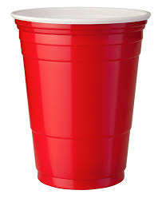

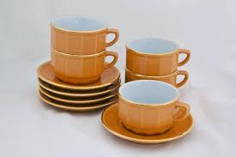
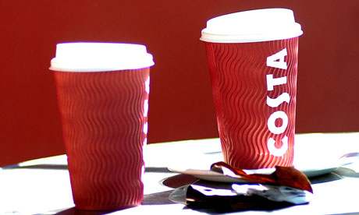
These are all cups… are they not? Does it matter?
It matters if you sell, make, stock cups etc.
We instinctively assign attributes to these cups

Slide 7
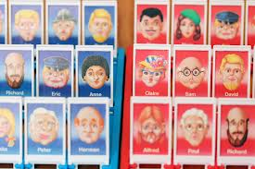
And what about people?
Entry 1
John J Smith
Male
02/11/69
25 West Street, London
Entry 2
JJ Smith
M
11/02/69
15 East Road, London

Slide 8
Overview of Data Matching Note – I am NOT going to talk about different data matching tools There will be sweets though…
This problem has actually been around for over 60 years...
An early BIG Data problem?
Formalised in the 60’s in the seminal work of Fellegi and Sunter
First use – the US census bureau
Its called ‘Record Linkage’ – how are records from different data sets linked together? Or De-duplication
What properties help identify duplicates?

Slide 9
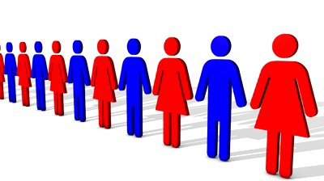
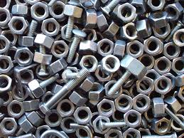
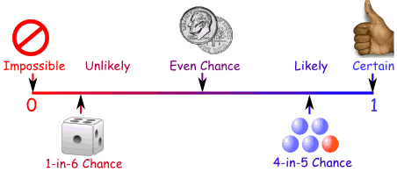
Unique Identifiers
Need to identify properties that are unlikely to change
Associate and weight probabilities for each property
Can be people or things
Things change
They get misidentified
What changes? name, address?

Slide 10
Record Linkage
NOTE: Record linkage is highly sensitive to the quality of the data being linked. Data should first be ‘standardised’
2 sorts of linkage-
Deterministic Record Linkage
Based on number of identifiers that match
Probabilistic Record Linkage
Based on the probability that a number of identifiers match

Slide 11

Probabilistic Data Matching
Sometimes called ‘fuzzy matching’
But, it is NOT fuzzy logic...
FUZZY Logic is actually:
A type of logic that recognizes more than simple true and false values.
With fuzzy logic, propositions can be represented with degrees
of truthfulness and falsehood.
For example, the statement, today is sunny, might be:
100% true if there are no clouds - 80% true if there are a few clouds
50% true if it's hazy - 0% true if it rains all day
…Its NOT about probabilities…

Slide 12
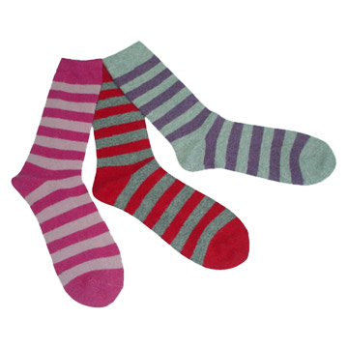
The “Matching the Socks” problem
A simple example, imagine tidying up your sock draw (try it with your kids at home)
Matching from a great big pile of jumbled-up socks will take some time
Why not sort them first into ‘similar’ piles i.e. colours (Blocking)
Then match them up from the piles of ‘similar’ types
Apply to the ‘real’ world…
Now we are getting somewhere... “Block then Match”
The only way to sort through LARGE data sets
But... How do we Match?
Let’s have a DEMO - We can do this a couple of ways

Slide 13
Matching – How do you do it??
Can apply to any ‘object’ BTW (socks, people, widgets)
Firstly, Select attributes within the data collection that may be suitable for blocking, taking care with the size of the blocks.
Then identify ‘attributes’ that are unlikely to change
Assign a Match type for each – lots of different ways to match
Next calculate the RELATIVE weight for each match attribute
Then calculate the probabilities for matching and un-matching those fields
Finally assign an algorithm for adjusting the relative weight for each attribute
WARNING
Bit of maths coming in a slide or 2… still time to leave…

Slide 14
Let’s go over that again…
Standardise the Data
Pick Attributes that are unlikely to change
Block
Match via probabilities – lots of different match types
Assign Weights to the matches
Add it all up – get a TOTAL weight
Plot a distribution
Tune the Matching
Then filter and/or auto-match

Slide 15
Bit of Theory – you were warned – Too late now

Slide 16
Bit of Theory – what did that actually mean?
Imagine TWO records in some application
Each of those records has a number of characteristics
In the complete set of records there are two sub-sets
One where the records match
One where the records DON’T match
Records have a number of characteristics that either agree or don’t agree with other records
We can assign probabilities to each characteristic
The total Probability suggest the records either belong to a matched set or an unmatched set

Slide 17
Matching Example – what does it look like?
Name 1 | Phonetic encoding | Name 2 | Phonetic encoding | Match | Match value
Brown | BRWN | Browne | BRWN | 4 match with 4 | 1
Smith | SMTH | Smythe | SMYTH | 4 match with 5 | 0.8
White | WHT | Whyte | WHYT | 3 match with 4 | 0.75
Jones | JNS | James | JMS | 2 match with 3 | 0.67
Smith | SMTH | Small | SMLL | 2 match with 4 | 0.5
Smith | SMTH | Brown | BRWN | 0 match with 4 | 0
Match
On Names
Match
Type
Match Field | Match Type | Relative Max Weight
First name | Phoenitic Uncertainty Fname | 10
Last name | Phoenetic Uncertainty Lname | 8
Middle name | Phoenic Uncertainty Fname | 4
Sex | Keystroke error | 6
DOB | Date Transposition | 9
Weight
The
Matches
(Importance)
 | Person 2 | Person 2 | Max Weight | Match Value | Weight
First name | John | Jon | 10 | 0.75 | 7.5
Middle Name | James | J | 4 | 0.33 | 1.32
Last name | Smith | Smith | 8 | 1 | 8
Sex | M | M | 6 | 1 | 6
DOB |  |  | 9 | 1 | 9
 |  |  | 37 |  | 31.82
Do
The Sums
TOTAL
Weight

Slide 18
A BAD Matching example
 | Person 1 | Person 2 | Max Weight | Match Value | Weight
First name | John | Jonas | 10 | 0.67 | 6.7
Middle Name | James |  | 4 | 0 | 0
Last name | Smith | Smythe | 8 | 0.8 | 6.4
Sex | M | M | 6 | 1 | 6
DOB |  |  | 9 | 0 | 0
 |  |  | 37 |  | 19.1
We can set Thresholds for auto MATCH and UNMATCH

Slide 19
Its more than just Names, Sex, DOB etc.
Can assign other attributes
For people – use addresses etc
Other ‘Unique Identifiers’
NI Number
NHS Number
Customer Number
Stock Number etc.
Need a ‘Data Dictionary’
Street = Str = St
Other languages from English

Slide 20
Data Distribution – what does it look like?
Automatically
Matched
Matched Data
Match
Threshold
???
What to do?
Relative Weight
Unmatch
Threshold
Automatically
Un-Matched
(unlinked)
Unmatched Data
Data

Slide 21
How does that work in real life?
Imagine a hospital database containing 1 million records
How many of those patients are duplicates?
Indeed, how many of those patients are dead? (tells you 2 things about the hospital)
Business need to identify ALL those matches and ‘clean’ the database
How do you then ‘clean’ the DB?
Wentworth Hospital, Sydney – found 50,000 potential matches
One medical records clerk can’t check more than 10 records per day
Team of 5 = 3 years work?
Note, organisations like hospitals are unlikely to do auto matching. They are exceptional

Slide 22


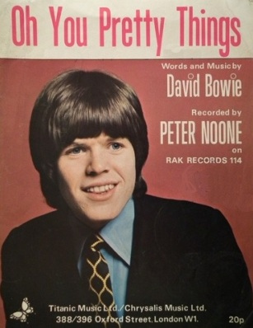
Another Real-World Example
“Oh You Pretty Things” written & recorded by David Bowie is on 5 different Bowie Albums
Written by?
Words/Music?
Recorded by?
Album
Musicians?
Vinyl/CD/digital?
Originally recorded
by Peter Noone –
but written by Bowie
Other cover versions around
Which track was played?
Is it the same as another one?
Need to identify who gets the royalties

Slide 23
Other real-world examples
The NHS Spine
Various healthcare institutions
Irish Health Card
Stock control
Parts warehouse – Huge engineering company
Insurance Records
Credit card applications
Identifying duplicates, intentional or not
Fraudulent/multiple/duplicate applications

Slide 24
Example - What the fraudsters do
First - Steal your identity
Then make multiple applications in a short time period
Or make slightly different application over a longer period
Now becomes a Data Matching Problem

Slide 25
The future of Data Matching
Big Data has increased the problem MASSIVELY
It’s simple. More data = More duplicates
Requirements for real time matching
Hierarchical Data Matching – it’s about Context!
Use of External Data
Unstructured (non-standardised) data
Multi-channels - Multi-domains
BIG Data = Need to match Large sets of complicated unstructured data in real-time

Slide 26
Big Data Matching
There are tools out there doing Data matching on Big Data
There are prototypes (one called called Dedoop - Deduplication with Hadoop)
Whoever wins this race will take the prize

Slide 27
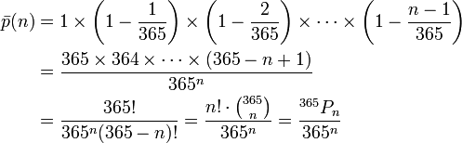
Answer to Quick Maths Problem
How big a group do you need to gather to find a 50% probability that TWO people will share the same birthday???
50% probability - 23 people
However, 99% probability is reached with just 57 people
100% with 367
27

Slide 28


Thank You
Any questions?
Stefan.franczuk@cognizant.com
@stefanfranczuk

