Slide 1

Scaling by Cheating
Approximation, Sampling and Fault-Friendliness for Scalable Big Learning
Sean Owen / Director, Data Science @ Cloudera

Slide 2


Two Big Problems

Slide 3
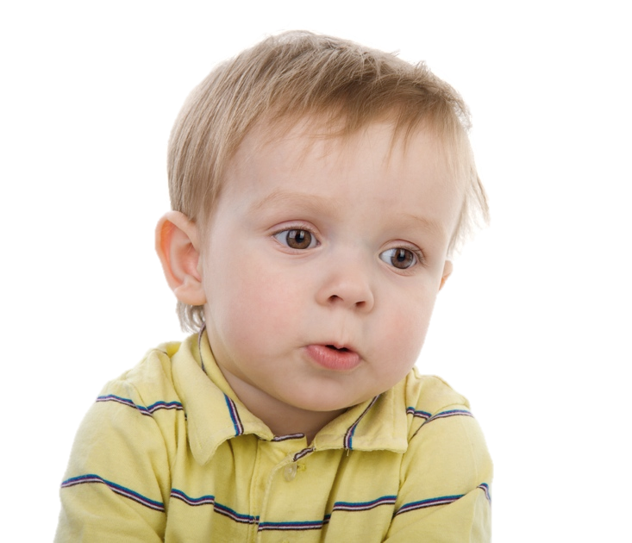
Grow Bigger
“
Today’s big is just tomorrow’s small. We’re expected to process arbitrarily large data sets by just adding computers. You can’t tell the boss that anything’s too big to handle these days.
“ Make quotes look
interesting or different.”
”
David, Sr. IT Manager

Slide 4

And Be Faster
“
Speed is king. People expect up-to-the-second results, and millisecond response times. No more overnight reporting jobs. My data grows 10x but my latency has to drop 10x.
“ Make quotes look
interesting or different.”
”
Shelly, CTO

Slide 5
Two Big Solutions

Slide 6
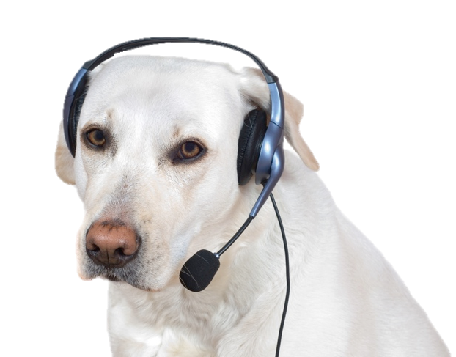
Plentiful Resources
“
Disk and CPU are cheap, on-demand. Frameworks to harness them, like Hadoop, are free and mature. We can easily bring to bear plenty of resources to process data quickly and cheaply.
“ Make quotes look
interesting or different.”
”
“Scooter”, White Lab

Slide 7
Cheating
Not Right, but Close Enough

Slide 8


Kirk What would you say the odds are on our getting out of here?
Spock Difficult to be precise, Captain. I should say approximately seven thousand eight hundred twenty four point seven to one.
Kirk Difficult to be precise? Seven thousand eight hundred and twenty four to one?
Spock Seven thousand eight hundred twenty four point seven to one.
Kirk That's a pretty close approximation.
Star Trek, “Errand of Mercy” http://www.redbubble.com/people/feelmeflow

Slide 9
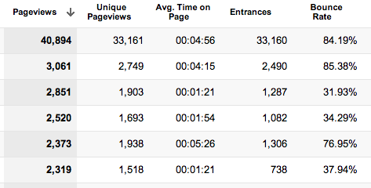
When To Cheat Approximate
Only a few significant figures matter
Least-significant figures are noise
Only relative rank matters
Only care about “high” or “low”
Do you care about 37.94% vs simply 40%?

Slide 10
Approximation

Slide 11
The Mean
Huge stream of values: x₁ x₂ x₃ … *
Finding entire population mean µ is expensive
Mean of small sample of N is close: µ_{N} = (1/N) (x₁ + x₂ + … + x_{N})
How much gets close enough?
* independent, roughly normal distribution

Slide 12
“Close Enough” Mean
Want: with high probability p, at most ε error µ = (1± ε) µ_{N}
Use Student’s t-distribution (N-1 d.o.f.) t = (µ - µ_{N}) / (σ_{N}/√N )
How unknown µ behaves relative to known sample stats
t

Slide 13
“Close Enough” Mean
Critical value for one tail t_{crit} = CDF⁻¹((1+p)/2)
Use library like Commons Math3: TDistribution.inverseCumulativeProbability()
Solve for critical µ_{crit} CDF⁻¹((1+p)/2) = (µ_{crit} - µ_{N}) / (σ_{N}/√N )
µ “probably” at most µ_{crit}
Stop when (µ_{crit} - µ_{N}) / µ_{N} small (<ε)
t

Slide 14
Sampling

Slide 15

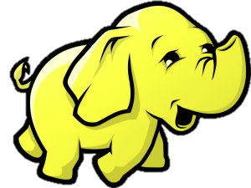

Slide 16
Word Count: Toy Example
Input: text documents
Exactly how many times does each word occur?
Necessary precision?
Interesting question?
Why?

Slide 17
Word Count: Useful Example
About how many times does each word occur?
Which 10 words occur most frequently?
What fraction are Capitalized?
Hmm!

Slide 18

Common Crawl
s3n://aws-publicdatasets/common-crawl/ parse-output/segment/*/textData-*
Count top words, Capitalized, zucchini in 35GB subset
github.com/srowen/commoncrawl
Amazon EMR 4 c1.xlarge instances

Slide 19
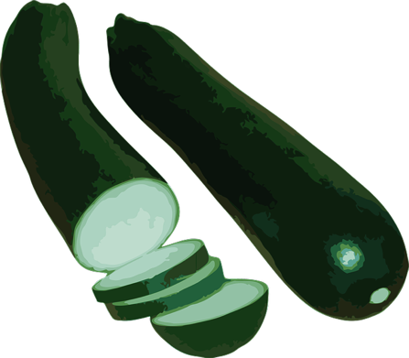
Raw Results
40 minutes
40.1% Capitalized
Most frequent words: the and to of a in de for is
zucchini occurs 9,571 times

Slide 20
Sample 10% of Documents
21 minutes
39.9% Capitalized
Most frequent words: the and to of a in de for is
zucchini occurs 967 times, (➔ 9,670 overall)
...
if (Math.random() >= 0.1) continue;
...

Slide 21
Stop When “Close Enough”
CloseEnoughMean.java
Stop mapping when % Capitalized is close enough
10% error, 90% confidence per Mapper
18 minutes
39.8% Capitalized
...
if (m.isCloseEnough()) { break; }
...

Slide 22
Fault-Friendliness

Slide 23
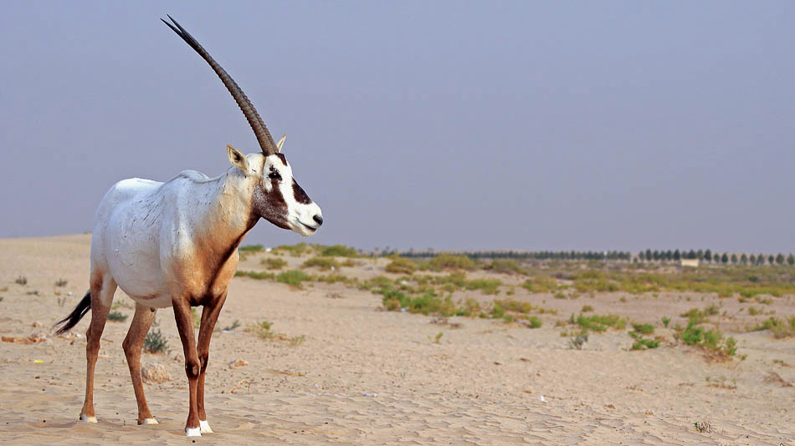
Oryx (α)

Slide 24
Oryx (α)
Computation Layer
Offline, Hadoop-based
Large-scale model building
Serving Layer
Online, REST API
Query model in real-time
Update model approximately
Few Key Algorithms
Recommenders ALS
Clustering k-means++
Classification Random decision forests

Slide 25
Not A Bank

Slide 26
Oryx (α)
No Transactions!

Slide 27
Serving Layer Designs For …
Fast Availability
Fast “99.9%” Durability
Independent replicas
Need not have a globally consistent view
Clients have consistent view through sticky load balancing
Push data into durable store, HDFS
Buffer a little locally
Tolerate loss of “a little bit”

Slide 28
If losing 90% of the data might make <1% difference here, why spend effort saving every last 0.1%?

Slide 29
Resources
Oryx github.com/cloudera/oryx
Apache Commons Math commons.apache.org/proper/commons-math/
Common Crawl example github.com/srowen/ commoncrawl
sowen@cloudera.com

Slide 30



