Slide 1

7 Fun Things to do with MapReduce
Chris Hillman – Teradata Data Scientist
Christopher.hillman@teradata.com
@chillax7

Slide 2


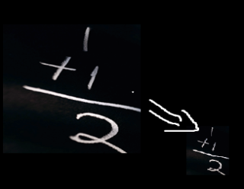
Agenda
Map Tasks
Face Detection
Character Recognition
Speech to Text
Shuffling
Mass Spectrometer processing
Reducers
Text Mining
Actual Mining
Cluster Building

Slide 3
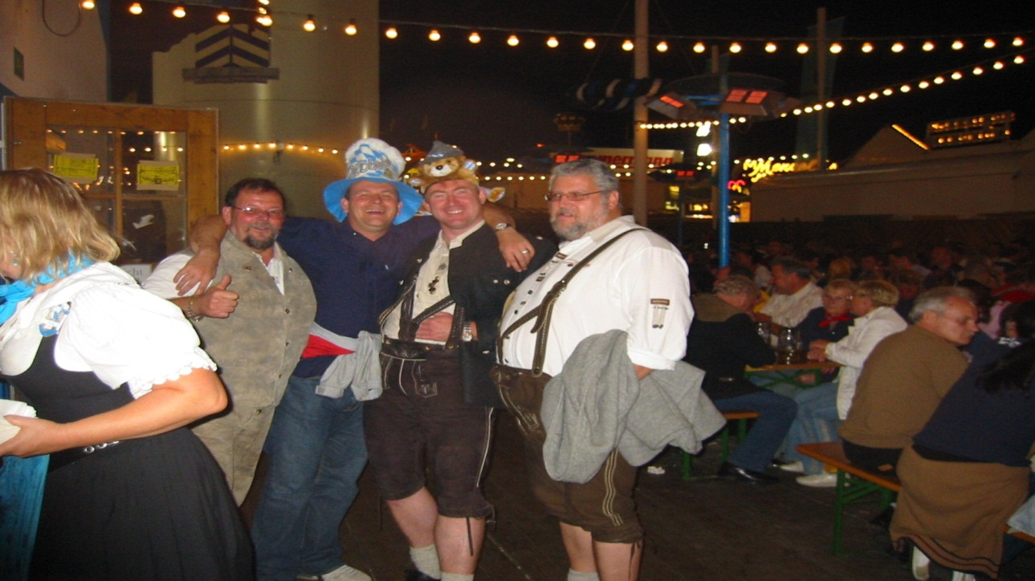
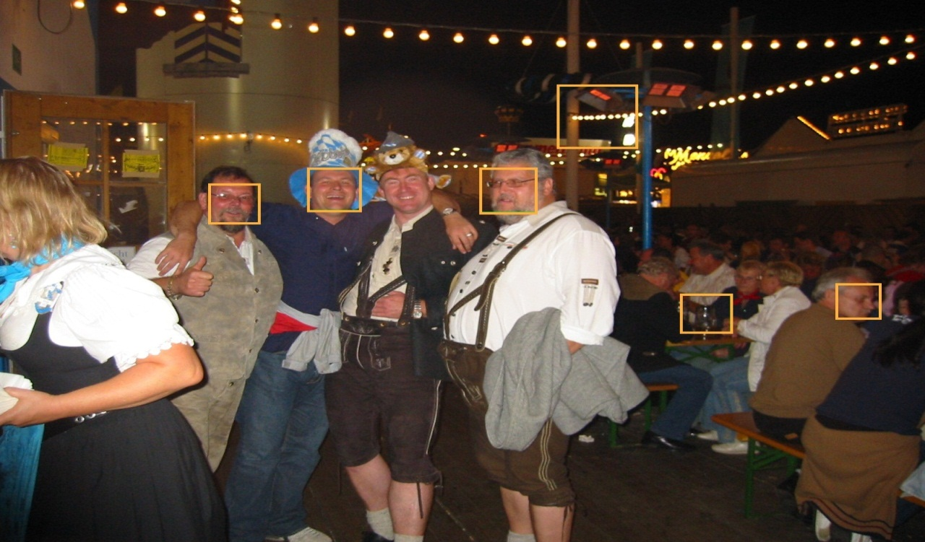
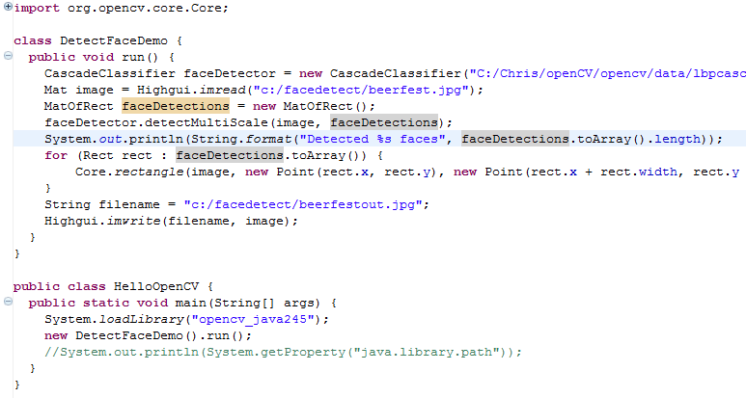
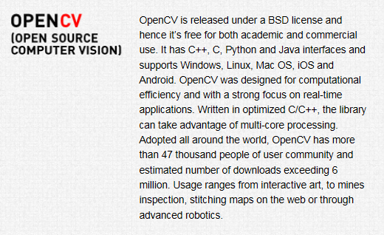

Face Detection in Images
Step
Step 1.
Get a good Open Source Library
Step 2.
Check the Example Code
@chillax7

Slide 4
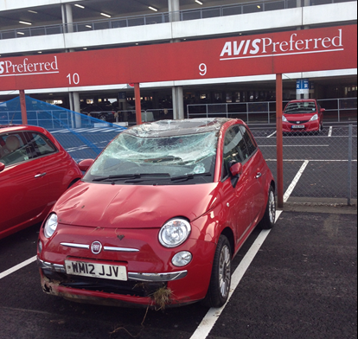
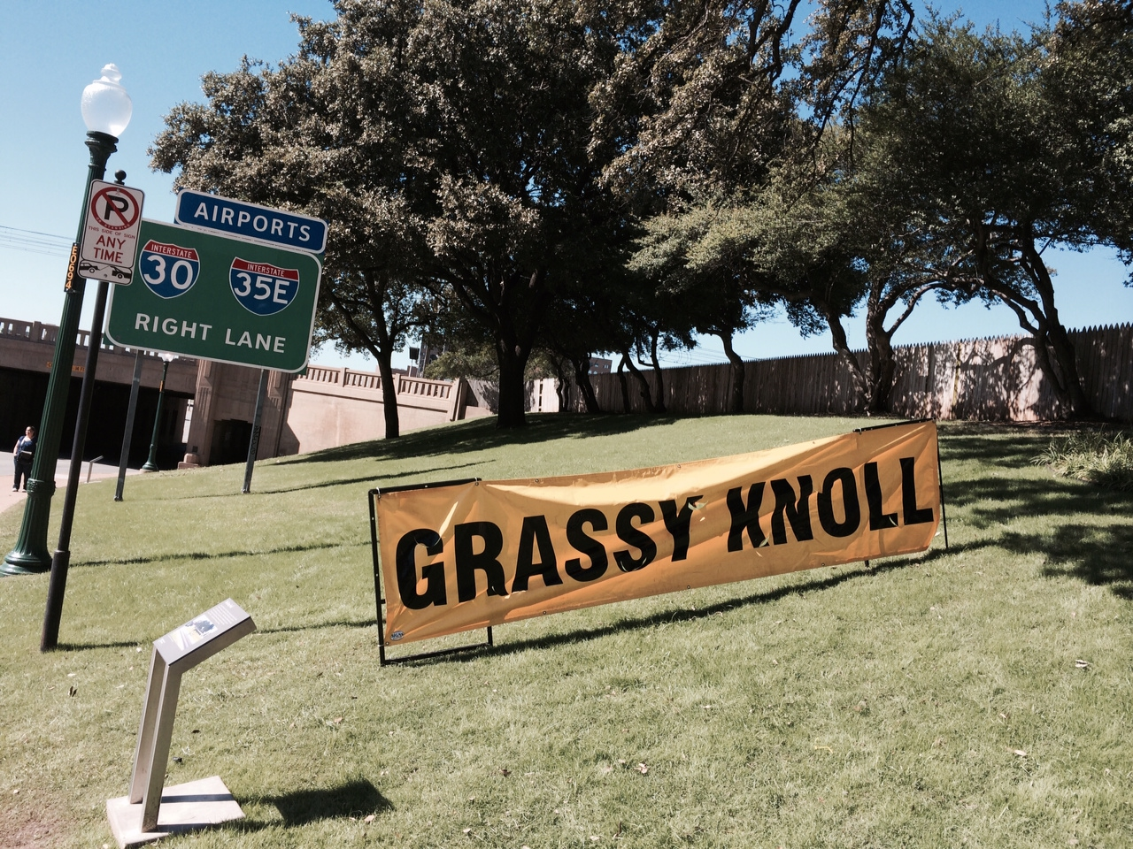
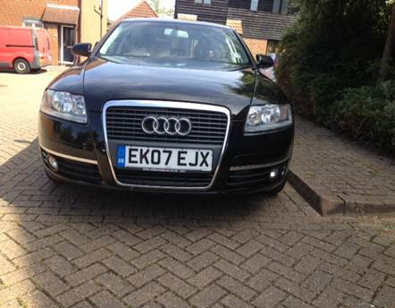
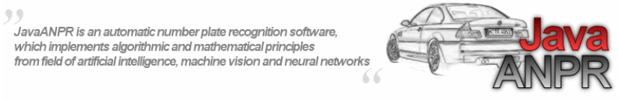

Character Recognition
Step
More Complex Task than Face Detection
SELECT *
FROM RecognizeNumberPlate(
ON anpr.vehiclelogs
imagecol('recognizedobject'));
@chillax7

Slide 5
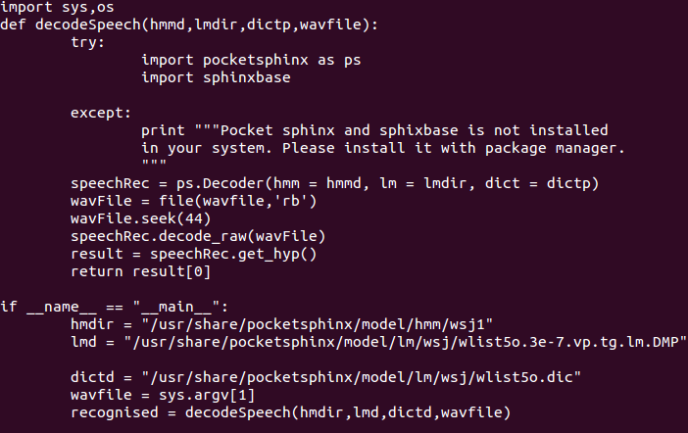
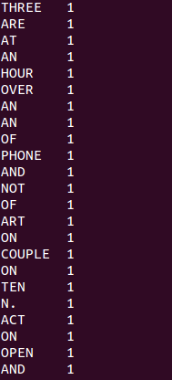
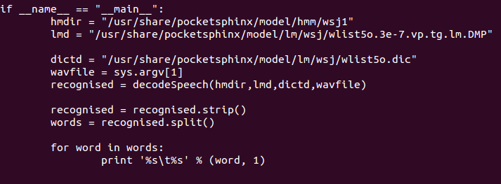

Speech to Text
How about counting words in a recorded wav file?
Step
Fed up with word count examples?
@chillax7

Slide 6
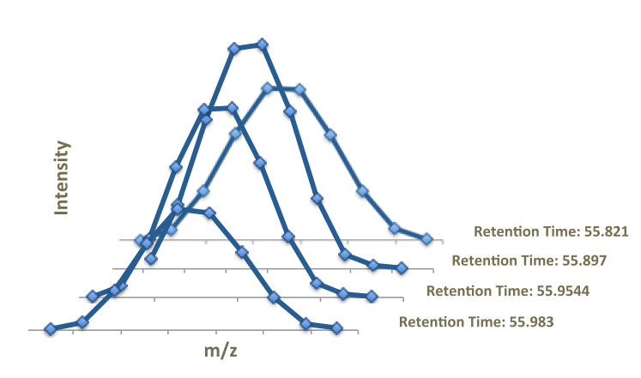
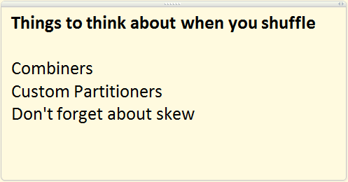
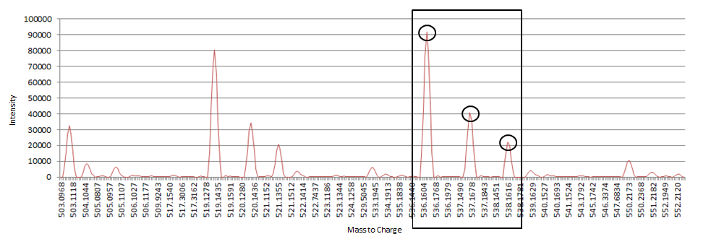
Proteomics
Step
Mass Spectrometers
Create a lot of data….
In XML format….
It’s nasty to work with
@chillax7

Slide 7
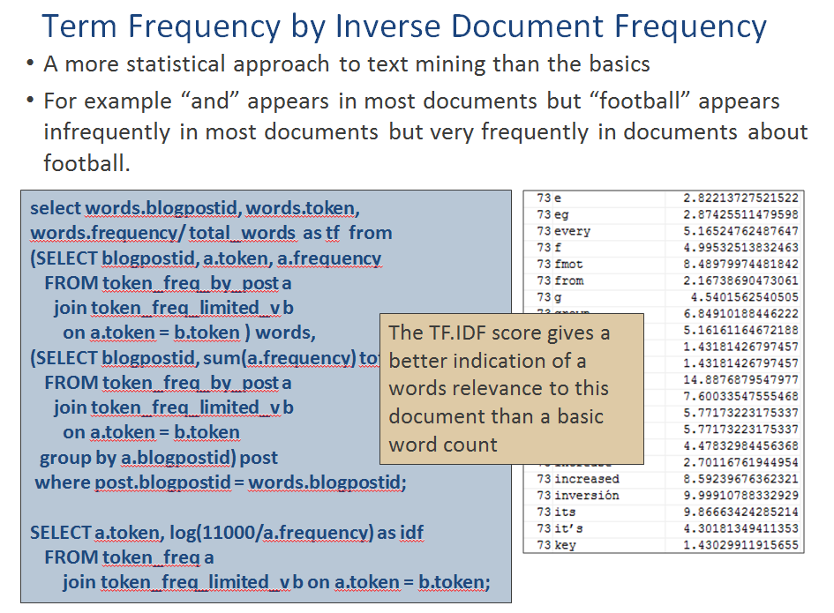
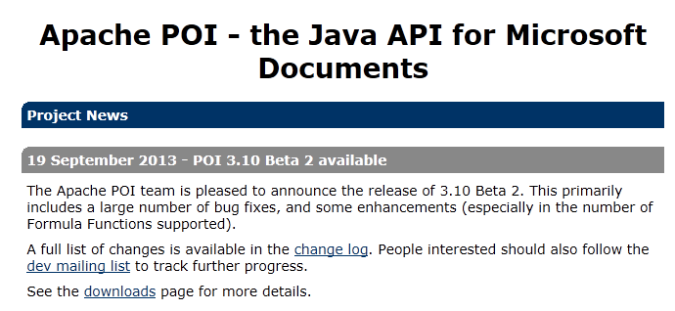
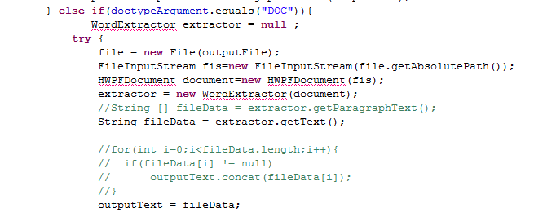
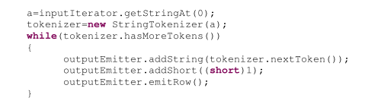
Text Mining
Step
First phases are map tasks
Text Extraction and
Parsing
@chillax7

Slide 8
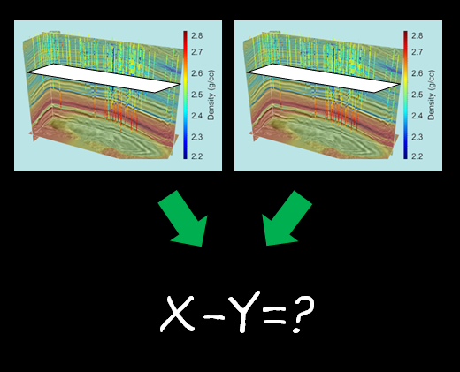
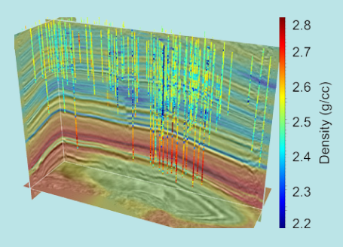
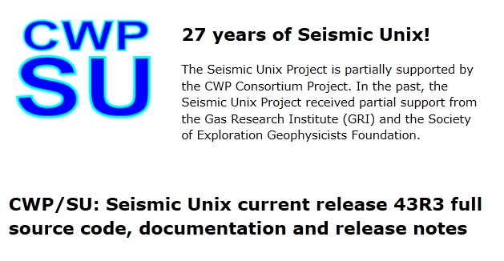
Actual Mining
Step
Comparing Seismic surveys taken at different points in time??
@chillax7

Slide 9
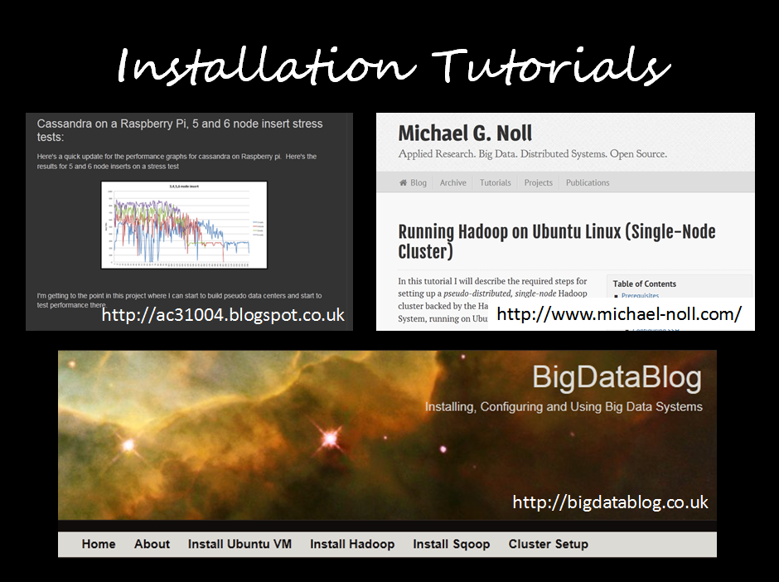
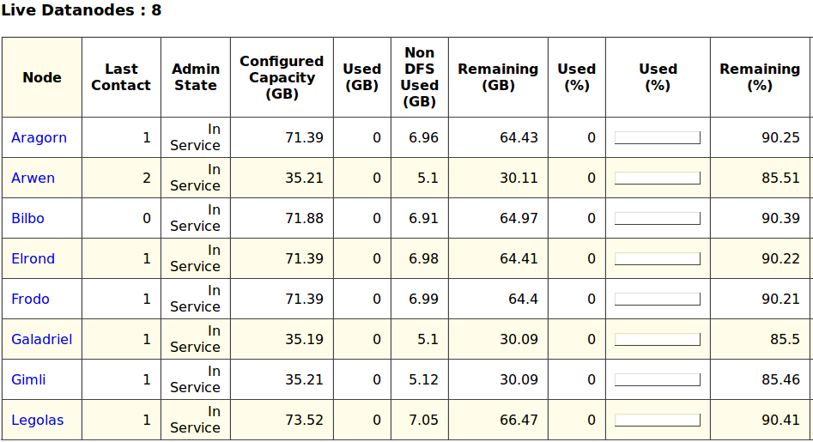
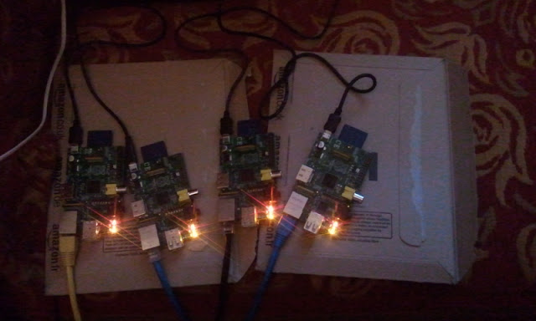
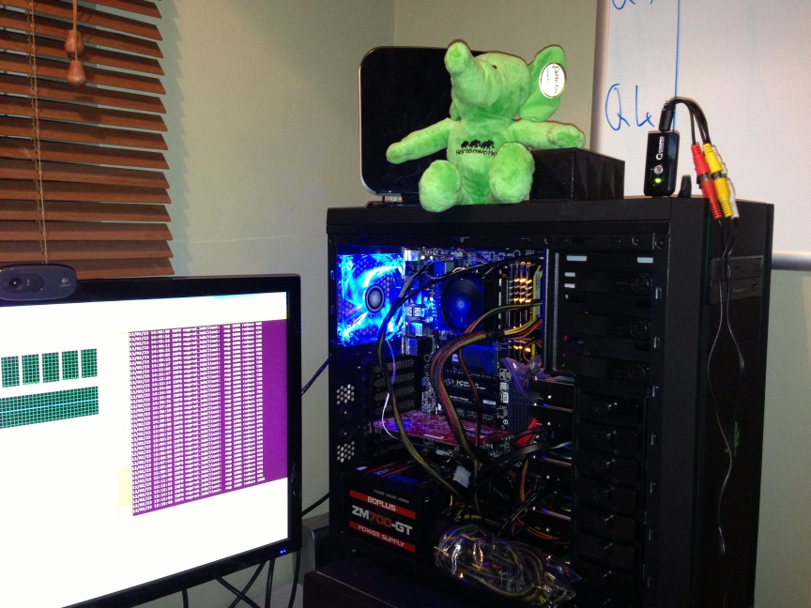
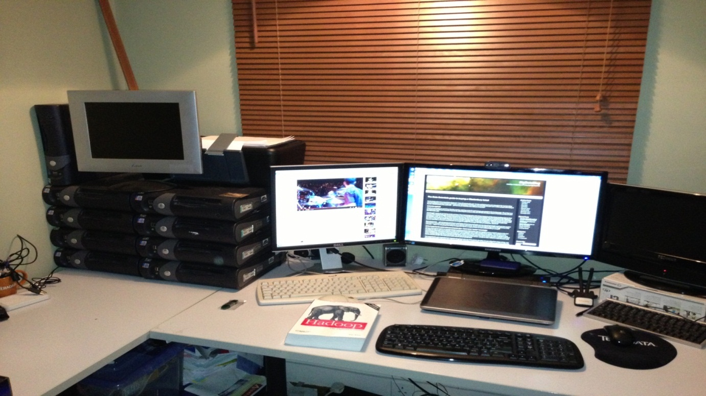

Cluster Building
Physical or Virtual?
Physical – more fun, looks impressive, harder to build, maintain, use, cost of power
Virtual – performance? Easier to test, try different versions, configurations
Why Build your own cluster?
It’s fun
You learn lots
It gets you invited to parties
Step
@chillax7

Slide 10
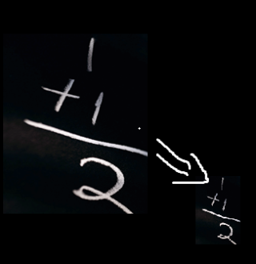
Thank you
Chris Hillman
Christopher.hillman@teradata.com
@chillax7
www.bigdatablog.co.uk
=
+
+

