Slide 1

Spark: High-Speed Analytics for Big Data
Patrick Wendell
Databricks
Spark.incubator.apache.org

Slide 2
What is Spark?
Fast and expressive distributed runtime compatible with Apache Hadoop
Improves efficiency through:
General execution graphs
In-memory storage
Improves usability through:
Rich APIs in Scala, Java, Python
Interactive shell
Up to 10× faster on disk, 100× in memory
2-5× less code
Notes:
Put high-level distributed collection stuff here?

Slide 3












Project History
Spark started in 2009, open sourced 2010
Today: 1000+ meetup members
code contributed from 24 companies

Slide 4
Today’s Talk
Spark Streaming real-time
Shark
SQL
MLLib
machine learning
GraphX
graph
…
Spark

Slide 5
Why a New Programming Model?
MapReduce greatly simplified big data analysis
But as soon as it got popular, users wanted more:
More complex, multi-pass analytics (e.g. ML, graph)
More interactive ad-hoc queries
More real-time stream processing
All 3 need faster data sharing across parallel jobs

Slide 6
Data Sharing in MapReduce
HDFS read
HDFS write
HDFS read
HDFS write
iter. 1
iter. 2
. . .
Input
HDFS read
query 1
result 1
query 2
result 2
query 3
result 3
Input
. . .
Slow due to replication, serialization, and disk IO
Notes:
Each iteration is, for example, a MapReduce job

Slide 7
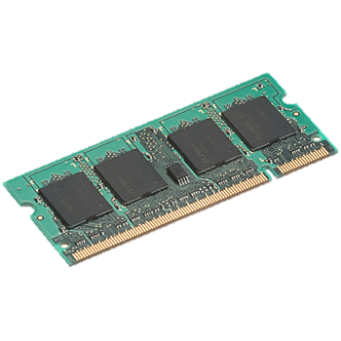
Data Sharing in Spark
iter. 1
iter. 2
. . .
Input
query 1
one-time processing
query 2
query 3
Input
Distributed memory
. . .
10-100× faster than network and disk

Slide 8
Spark Programming Model
Key idea: resilient distributed datasets (RDDs)
Distributed collections of objects that can be cached in memory across cluster
Manipulated through parallel operators
Automatically recomputed on failure
Programming interface
Functional APIs in Scala, Java, Python
Interactive use from Scala & Python shells

Slide 9
Example: Logistic Regression
Goal: find best line separating two sets of points
random initial line
+
+
+
+
+
+
–
+
+
–
–
–
+
+
–
–
–
–
–
–
target
Notes:
Note that dataset is reused on each gradient computation

Slide 10
Example: Logistic Regression
val data = spark.textFile(...).map(readPoint).cache()
var w = Vector.random(D)
for (i <- 1 to ITERATIONS) {
val gradient = data.map(p =>
(1 / (1 + exp(-p.y*(w dot p.x))) - 1) * p.y * p.x
).reduce(_ + _)
w -= gradient
}
println("Final w: " + w)
Notes:
Key idea: add “variables” to the “functions” in functional programming

Slide 11
Logistic Regression Performance
110 s / iteration
first iteration 80 s
further iterations 1 s
Notes:
100 GB of data on 50 m1.xlarge EC2 machines

Slide 12
Some Operators
map
filter
groupBy
sort
union
join
leftOuterJoin
rightOuterJoin
reduce
count
fold
reduceByKey
groupByKey
cogroup
cross
zip
sample
take
first
partitionBy
mapWith
pipe
save
...

Slide 13
Execution Engine
General task graphs
Automatically pipelines functions
Data locality aware
Partitioning aware to avoid shuffles
B:
A:
F:
Stage 1
groupBy
C:
D:
E:
join
Stage 2
map
filter
Stage 3
= RDD
= cached partition
Notes:
NOT a modified version of Hadoop

Slide 14
In Python and Java…
// Python:
lines = sc.textFile(...) lines.filter(lambda x: “ERROR” in x).count()
// Java:
JavaRDD<String> lines = sc.textFile(...); lines.filter(new Function<String, Boolean>() { Boolean call(String s) { return s.contains(“error”); } }).count();

Slide 15
There was Spark … and it was good
Spark

Slide 16
Generality of RDDs
DStream’s: Streams of RDD’s
RDD-Based
Tables
RDD-Based Matrices
RDD-Based Graphs
Spark Streaming real-time
Shark
SQL
MLLib
machine learning
GraphX
graph
RDDs, Transformations, and Actions
Spark

Slide 17
Spark Streaming

Slide 18
Spark Streaming: Motivation
Many important apps must process large data streams at second-scale latencies
Site statistics, intrusion detection, online ML
To build and scale these apps users want:
Integration: with offline analytical stack
Fault-tolerance: both for crashes and stragglers
Efficiency: low cost beyond base processing

Slide 19

Traditional Streaming Systems
Separate codebase/API from offline analytics stack
Continuous operator model
Each node has mutable state
For each record, update state & send new records
mutable state
input records
push
node 1
node 3
input records
node 2

Slide 20
Challenges with ‘record-at-a-time’ for large datasets
Fault recovery is tricky and often not implemented
Unclear how to deal with stragglers or slow nodes
Difficult to reconcile results with offline stack

Slide 21
Observation
Functional runtime like Spark can provide fault tolerance efficiently
Divide job into deterministic tasks
Rerun failed/slow tasks in parallel on other nodes
Idea: run streaming computations as a series of small, deterministic batch jobs
Same recovery schemes at much smaller timescale
To make latency low, store state in RDDs
Get “exactly once” semantics and recoverable state

Slide 22
Discretized Stream Processing
batch operation
t = 1:
input
pull
immutable dataset (stored reliably)
immutable dataset (output or state);
stored in memory as RDD
t = 2:
input
…
…
…
stream 1
stream 2

Slide 23
Programming Interface
views
ones
counts
Simple functional API views = readStream("http:...", "1s") ones = views.map(ev => (ev.url, 1)) counts = ones.runningReduce(_ + _)
Interoperates with RDDs
// Join stream with static RDD counts.join(historicCounts).map(...)
// Ad-hoc queries on stream state counts.slice(“21:00”,“21:05”).topK(10)
t = 1:
map
reduce
t = 2:
. . .
= RDD
= partition
Notes:
Less code / split

Slide 24
Inherited “for free” from Spark
RDD data model and API
Data partitioning and shuffles
Task scheduling
Monitoring/instrumentation
Scheduling and resource allocation

Slide 25
Generality of RDDs
DStream’s: Streams of RDD’s
RDD-Based
Tables
RDD-Based Matrices
RDD-Based Graphs
Spark Streaming real-time
Shark
SQL
MLLib
machine learning
GraphX
graph
RDDs, Transformations, and Actions
Spark

Slide 26
Shark
Hive-compatible (HiveQL, UDFs, metadata)
Works in existing Hive warehouses without changing queries or data!
Augments Hive
In-memory tables and columnar memory store
Fast execution engine
Uses Spark as the underlying execution engine
Low-latency, interactive queries
Scale-out and tolerates worker failures
First release: November, 2012

Slide 27
Generality of RDDs
DStream’s: Streams of RDD’s
RDD-Based
Tables
RDD-Based Matrices
RDD-Based Graphs
Spark Streaming real-time
Shark
SQL
MLLib
machine learning
GraphX
graph
RDDs, Transformations, and Actions
Spark

Slide 28
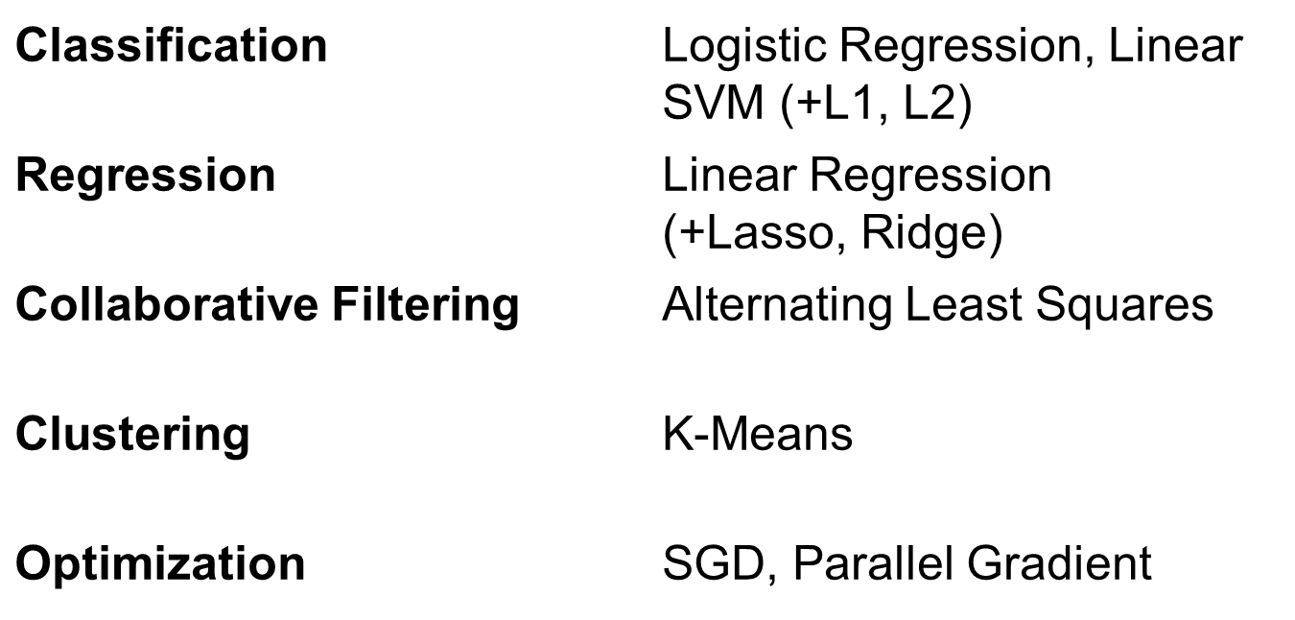
MLLib
Provides high-quality, optimized ML implementations on top of Spark

Slide 29
Generality of RDDs
DStream’s: Streams of RDD’s
RDD-Based
Tables
RDD-Based Matrices
RDD-Based Graphs
Spark Streaming real-time
Shark
SQL
MLLib
machine learning
GraphX
graph
RDDs, Transformations, and Actions
Spark

Slide 30
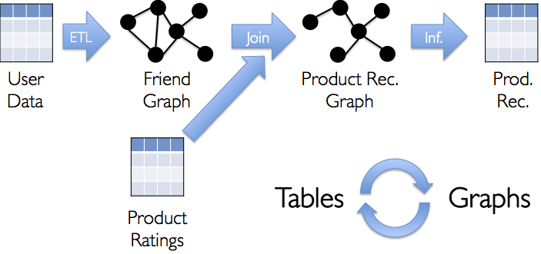
GraphX (alpha)
Cover “full lifecycle” of graph processing from ETL -> graph creation -> algorithms -> value extraction
https://github.com/amplab/graphx

Slide 31
Benefits of Unification: Code Size
non-test, non-example source lines

Slide 32
Benefits of Unification: Code Size
Shark
non-test, non-example source lines

Slide 33
Benefits of Unification: Code Size
Streaming
Shark
non-test, non-example source lines

Slide 34
Benefits of Unification: Code Size
GraphX
Streaming
Shark
non-test, non-example source lines

Slide 35
Performance
SQL[1]
Streaming[2]
Graph[3]
[1] https://amplab.cs.berkeley.edu/benchmark/
[2] Discretized Streams: Fault-Tolerant Streaming Computation at Scale. At SOSP 2013.
[3] https://amplab.cs.berkeley.edu/publication/graphx-grades/

Slide 36
Benefits for Users
High performance data sharing
Data sharing is the bottleneck in many environments
RDD’s provide in-place sharing through memory
Applications can compose models
Run a SQL query and then PageRank the results
ETL your data and then run graph/ML on it
Benefit from investment in shared functioanlity
E.g. re-usable components (shell) and performance optimizations

Slide 37
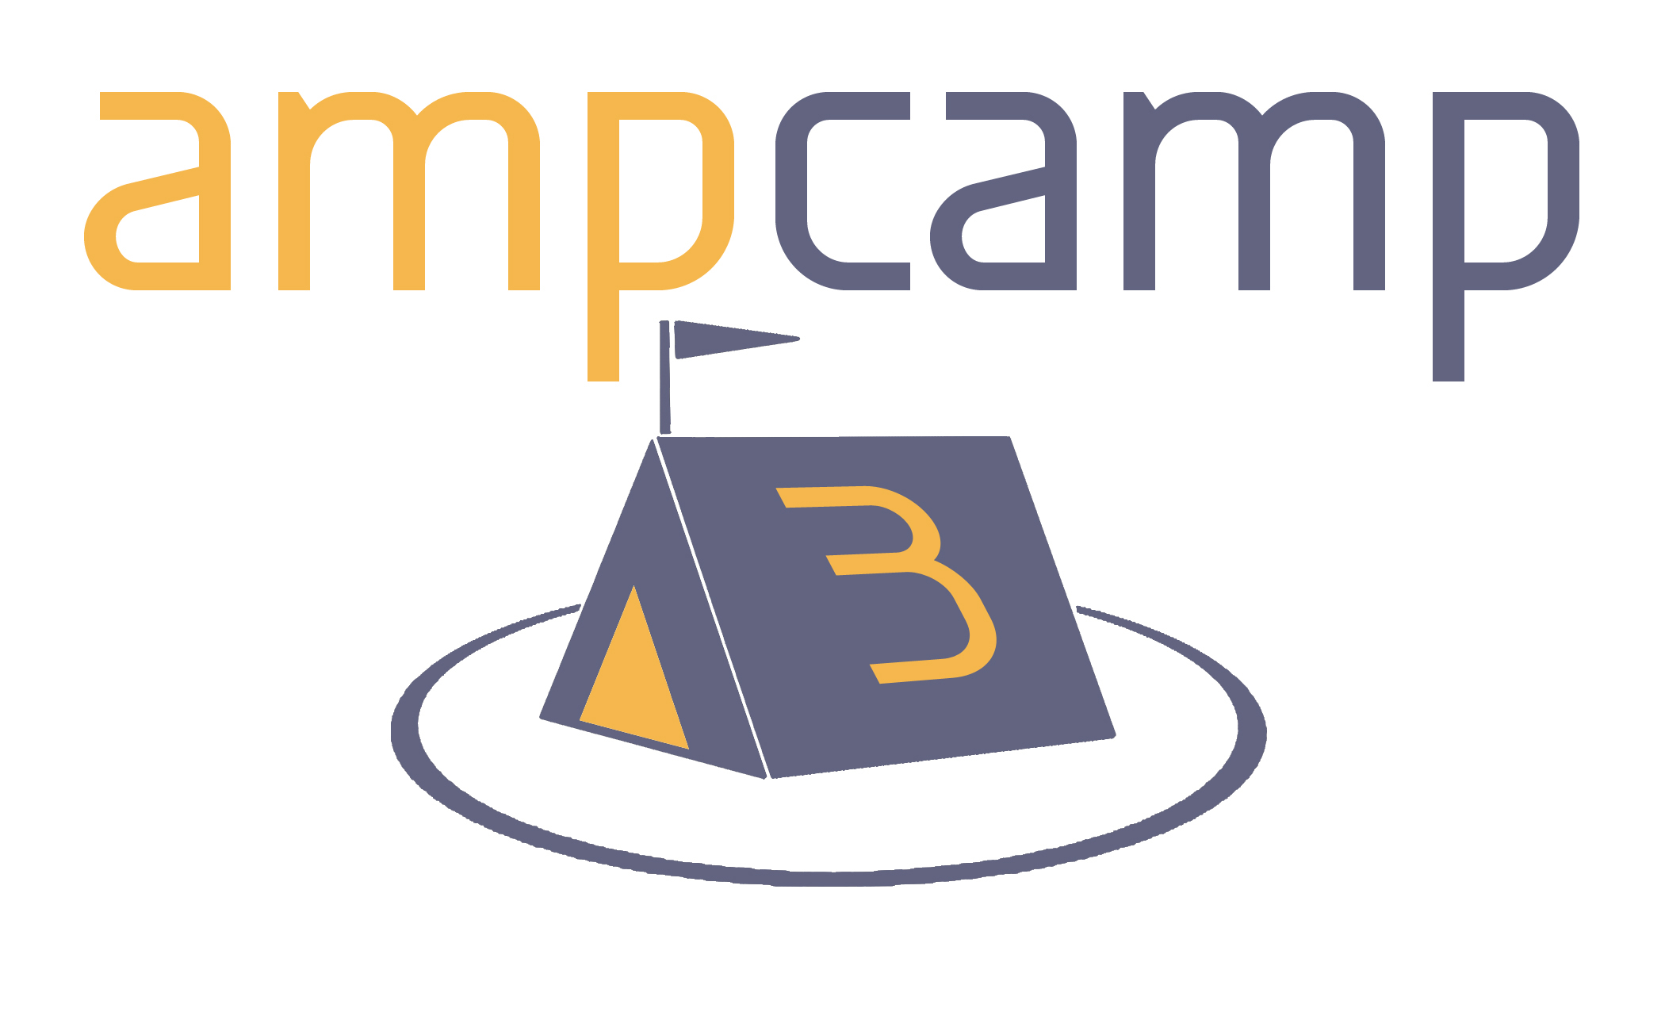
Getting Started
Visit spark.incubator.apache.org for videos, tutorials, and hands-on exercises
Easy to run in local mode, private clusters, EC2
Spark Summit on Dec 2-3 (spark-summit.org)
Online training camp: ampcamp.berkeley.edu

Slide 38

Conclusion
Big data analytics is evolving to include:
More complex analytics (e.g. machine learning)
More interactive ad-hoc queries
More real-time stream processing
Spark is a platform that unifies these models, enabling sophisticated apps
More info: spark-project.org

Slide 39
Backup Slides

Slide 40
Behavior with Not Enough RAM

