Slide 1
Taming the ETL beast How LinkedIn uses metadata to run complex ETL flows reliably
Rajappa Iyer
Strata Conference, London, November 12, 2013

Slide 2

`whoami`
Data Infrastructure @ LinkedIn since 2011
Prior to that:
Director of Engineering at Digg
Enterprise Data Architect at eBay
www.linkedin.com/in/rajappaiyer/

Slide 3
Outline of talk
Background and Context – The Why
Challenges with Data Delivery – The What
Metadata to the Rescue – The How
Q&A

Slide 4

LinkedIn: The World’s Largest Professional Network
Connecting Talent ⬄ Opportunity. At scale…
259M+
2 new
100M+
3M+
Members Worldwide
Members Per Second
Monthly Unique Visitors
Company Pages

Slide 5

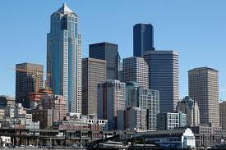

Data Driven Products and Insights
Products for Members
(Professionals)
Data,
Platforms,
Analytics
Products for Enterprises
(Companies)
Insights
(Analysts and Data Scientists)

Slide 6

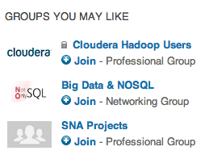
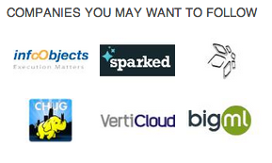

Products for Members

Slide 7
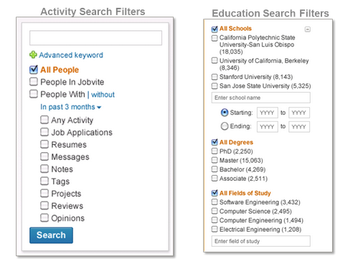
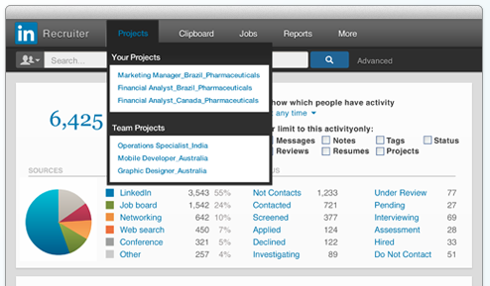
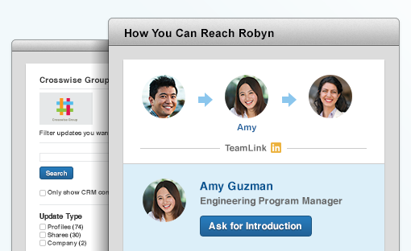
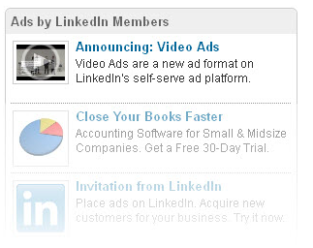
Products for Enterprises
Hire - Talent Solutions
Sell - Sales Navigator
Market - Marketing Solutions

Slide 8
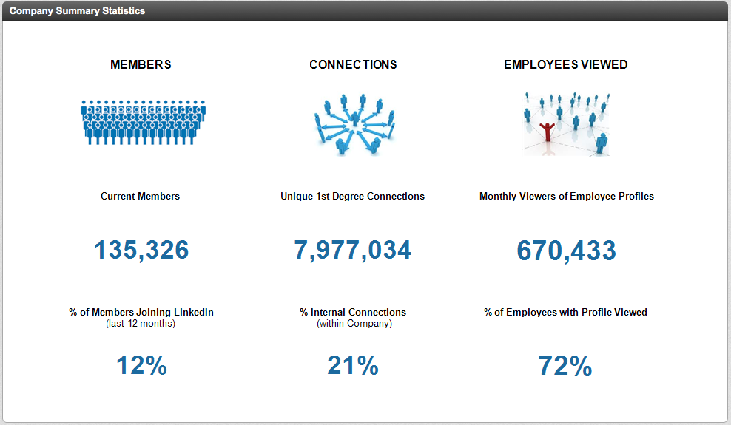
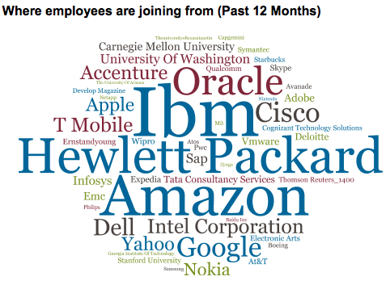
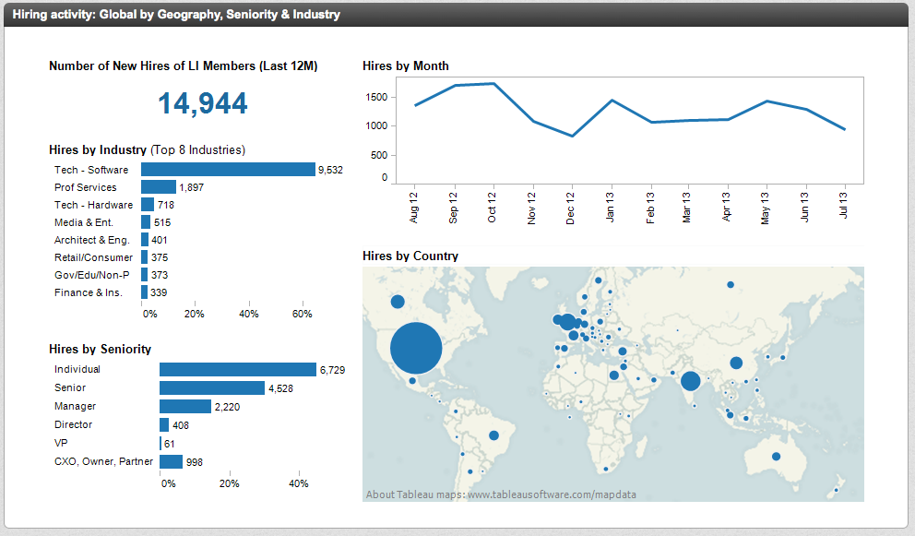
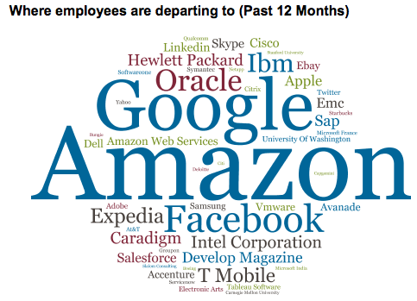
Examples of Insights

Slide 9
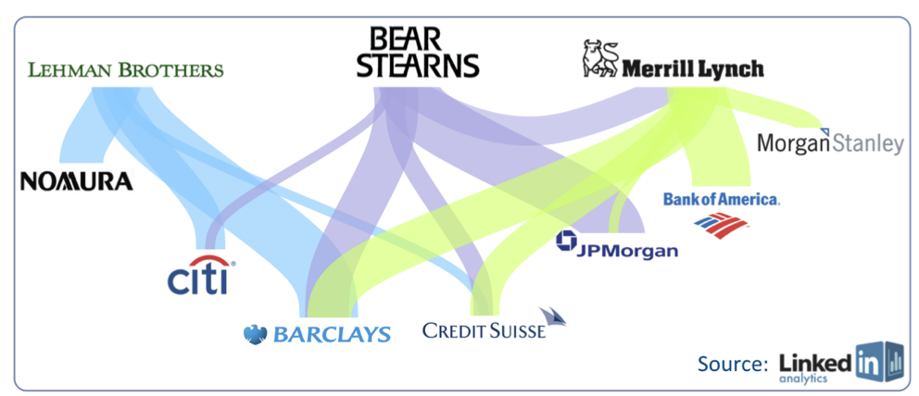
Example of Deeper Insight
Job Migration After Financial Collapse

Slide 10
Data is critical to LinkedIn’s products It needs to be delivered in a reliable and timely manner

Slide 11
A Simplified Overview of Data Flow

Slide 12
Components of typical ETL jobs
Ingress / Egress of message-oriented data
Logs and clickstream data
Ingress / Egress of record-oriented data
Database data
Transformations
Select, project, join
Aggregations
Partitioning
Cleansing and data normalization
Schema conversions – e.g., Nested JSON to Relational
Notes:
Filter, aggregation, partition, normalization, joins

Slide 13
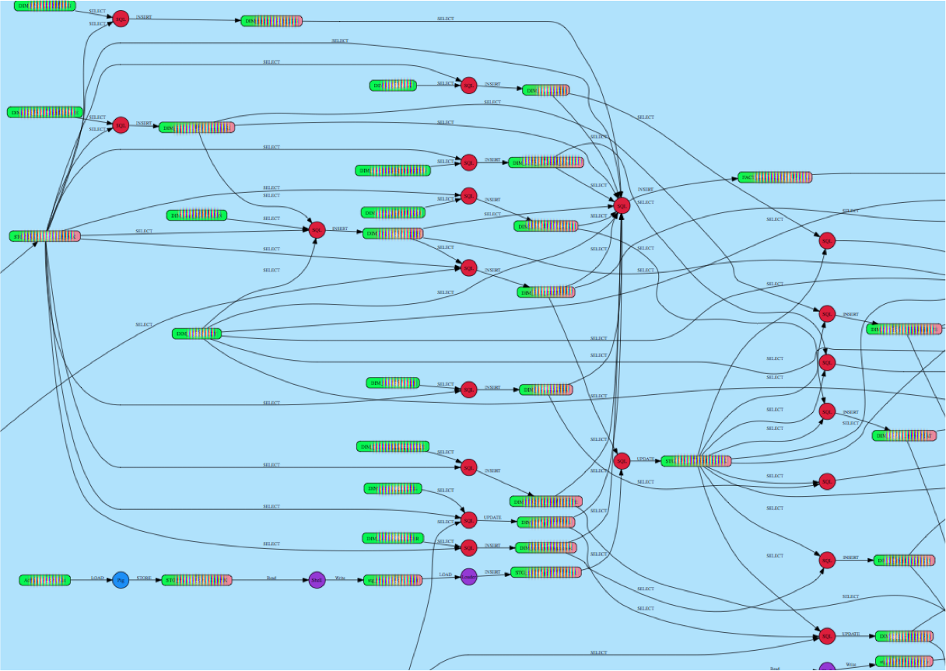
An Example ETL Flow

Slide 14
Challenges
Complex process dependencies
Some flows are over 30 levels deep
Flows may span multiple platforms (Hadoop, RDBMS etc.)
Complex data dependencies
Multiple flows may consume a data element
Multiple data elements feed into a single flow
Can be viewed as “data sync barriers”
Recovery
Restartable flows that pick up from last checkpoint
Catch up mode to compensate for downtime
Monitoring and Alerting
Prioritization of “important” flows for ops attention
Who do you call when things fail?

Slide 15
Metadata to the rescue
What metadata is collected?
Process dependencies
Data dependencies
Execution history and data processing statistics
How is it used?
Drives the ETL framework with lots of functionality
Check for data availability
Retries and restarts
Standardized error reporting / alerting
Prioritized view of business critical flows

Slide 16
Metadata: Process Dependencies
Capture process dependency graph
Also capture metadata such as process owners, importance, SLA etc.
Capture stats for each execution of a workflow
Time of execution
Execution status
Pointer to error logs
Alert on delayed processes
Based on execution history

Slide 17
Metadata: Data Dependencies
For each flow, capture input and output data elements
For each flow execution, capture stats on data element
Number of records or messages processed
Error counts
Watermarks
Can be time based or sequence based
This can be per flow as more than one flow can consume a data element

Slide 18
Metadata: Data Elements
Simple catalog of data elements
Name, physical location, owner etc.
Data elements can have logical names
Names resolve to one or more physical entity
Logical names can represent useful collections
E.g., data as of a particular interval
Data element availability can trigger processes
E.g., kick off hourly process when hourly data is complete and available
Enables data driven ETL scheduling

Slide 19
Putting it all together
ETL applications
Dashboards,
Reports
Data Availability Status
ETL Framework
Scheduler
Checkpoint Execution State
Retry / Resume
Name resolver
Execution History
Data Check
Statistics (process and data)
Alerting / Monitoring
Log Parsers
Data Lineage
Metadata Management System

Slide 20
Questions?
More at data.linkedin.com
Come Work on Challenging Data Infrastructure problems - We’re Hiring

