Slide 1


Social Media Metrics:
How to Measure and Optimize Your Marketing Efforts
Andy Cotgreave
Social Content Manager, Tableau
@acotgreave
Notes:
Hello and thank you for joining this Social Media webinar. This is the first in a series of marketing-related webinars we are running through November and December. I’ll be sharing details of them at the end of this session. I hope you can attend all of them.
I’m Andy Cotgreave, Social Content Manager for tableau. It’s my job to track and monitor the conversation about Tableau and data visualisation across social channels, and ensure that the content we create for social channels is engaging and shared by our customers.

Slide 2
Social Media Metrics: agenda
The social media explosion
The data challenge
3 case studies
Notes:
Thank you for joining today’s webinar. We’ll be looking at these four things – culminating in a Tableau demo showing how anyone can connect to data, explore it using an easy to use drag drop interface and answer questions as quickly as you can think of them

Slide 3
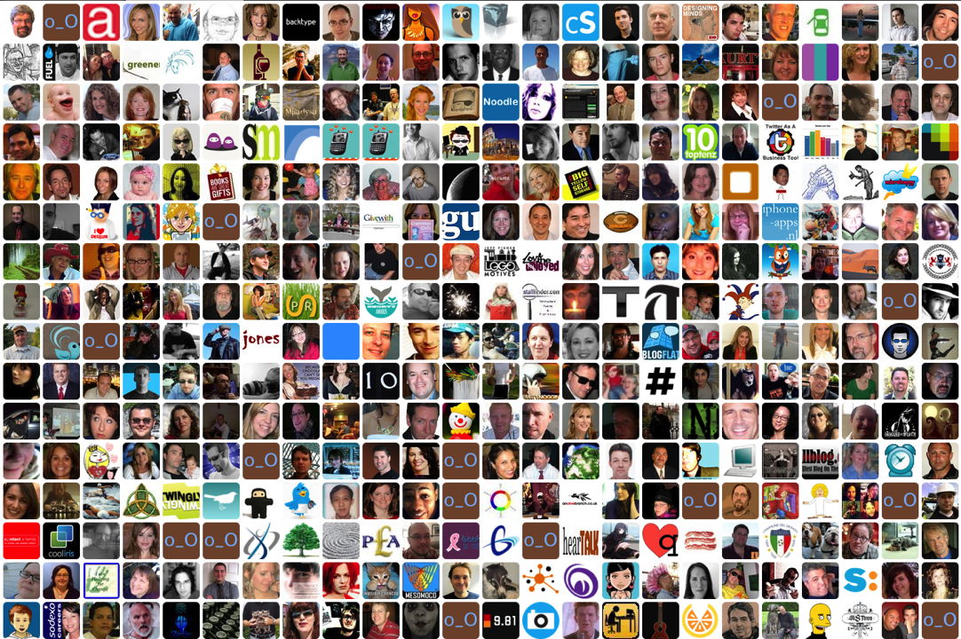
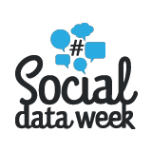
32M Facebook users in UK
1 in 6 people in UK on Twitter
78% of European Internet Users on Facebook
13mins of every UK Internet hour is Social
Notes:
Stats:
http://press.experian.com/United-States/Press-Release/experian-marketing-services-reveals-27-percent-of-time-spent-online-is-on-social-networking.aspx
More interesting stats: http://growingsocialmedia.com/social-media-statistics-and-facts-of-2013-infographic/

Slide 4
Do you?

Slide 5
There are only two sources of competitive advantage:
the ability to learn more about
our customers faster
than the competition and the ability to turn that learning into action faster than the competition
- Jack Welch, Former CEO, GE

Slide 6
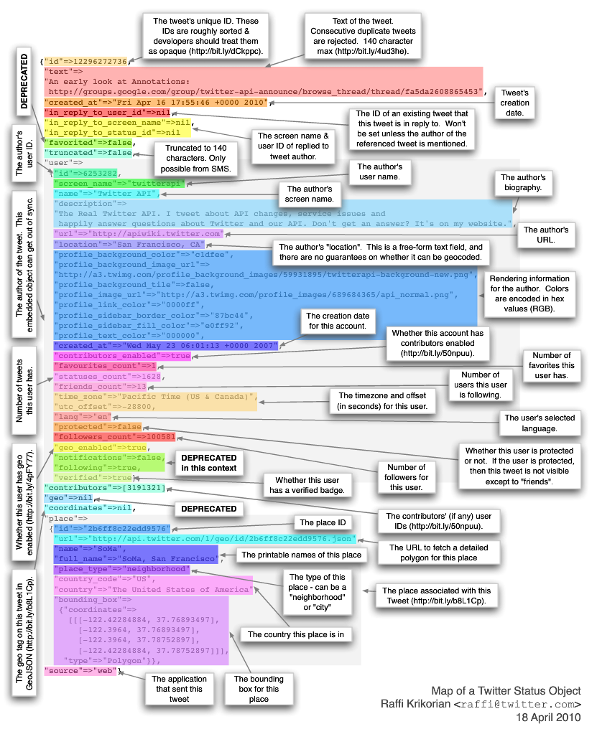
Anatomy of a single tweet

Slide 7

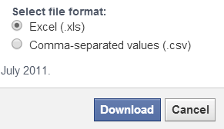


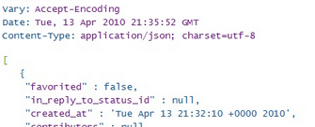


Great. So where’s the data?
Notes:
we accept there is business value from tracking social media data. How do you get it?
Well – herein lies one challenge: there’s vast volumes of it and it’s hard to get it all in one place. You’ll end up with many different datasets from different sources – isn’t it hard to manage all of this? well – not if you can blend and explore all of these datasets easily.
The full scope of collecting data is beyond the scope of this session, but here are 4 ways we at Tableau collect data.
Download it direct from the channel – this example is from Facebook and we’ll come back to it later
Scrape it. There are some great services such as If This Then That, Scraperwiki or Import.Io that allow you, in some cases with no programming expertise to start harvesting social data that is easy to export
Using APIs. APIs are ways to connect, programmatically, to social channels. This does require programming expertise but it allows you and your organisations to collect the data you want in a very specific manner.
Finally you could use data providers such as Datasift. Datasift connects directly to the firehoses of twitter, facebook, bitly and more. Services like datasift allow you to connect to huge amounts of data, enriched with sentiment and demographics, and it automatically gets stored in big data technologies such as Google Big Query.

Slide 8
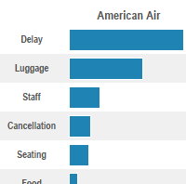

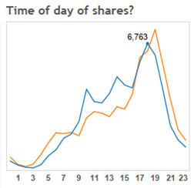
Social Media Metrics: case studies
Empowered customers
Measuring campaign success
Do people engage with you?
Notes:
Although it might seem daunting, getting the data is surprisingly easy. And once you have it, you should be free to ask any question you like.
Given we can only choose a few things in our short time together – these are the things we’re going to look at. The first two we will show you some finished dashboards that allows you to identify issues and opportunities, and what decisions these can help you make.
In the final example, we’ll look at how to build these things from scratch

Slide 9

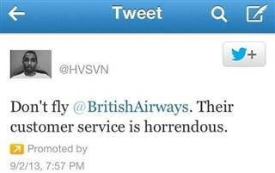
1. Empowering Customers like never before
Notes:
The BA story was a big story covered globally, a nice way to show how consumers are empowered - : http://www.bbc.co.uk/news/technology-23943480 One person has a lot of power on Social Media.
This example is a great one – BA lost his bags and he paid for a promoted tweet campaign until he got his bags back. BA was left with egg on its face and faced a barrage of negative publicity as a result.
This is an extreme example of a mishandled social media problem
How can you use analytics to mitigate these risks?

Slide 10
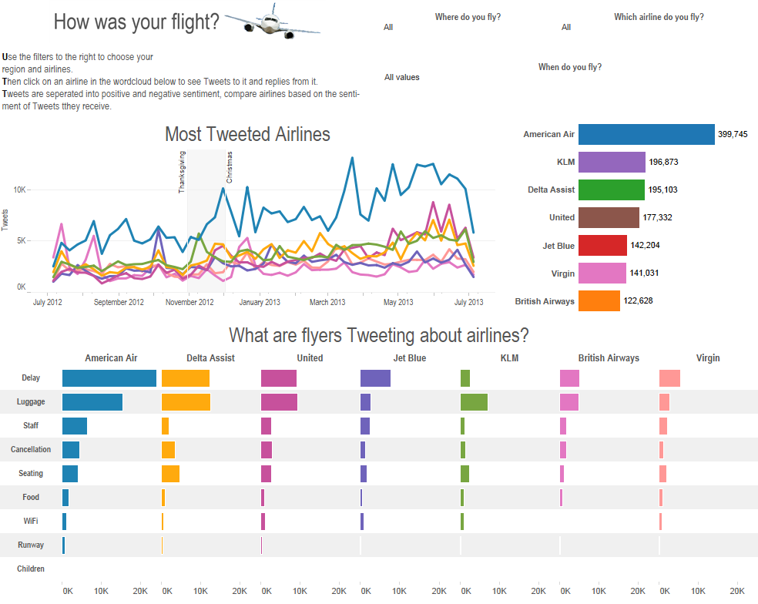
1. Empowered customers
Notes:
Well, let’s have a look. Here’s a dashboard tracking conversations and topics on twitter for different airlines for one year.
What does this allow us to do in marketing? It’s an example of how you can look at an aggregated conversation about airlines.
Let’s look at a few things of note that, if I was working at an airline, I might take action on:
Click the American Airlines bar – has way the biggest tweet volume about delays. The airline obviously has to try and address that but will also need a robust social media management campaign to mitigate the volume of negative sentiment about this.
Click KLM luggage KLM – lots of people tweet about luggage: as an airline manager, this might be indicating that there is a problem. We can drill into this and see which users are talking about luggage. As a social media manager, my job would be to try and placate these people, especially those with high klout/followers

Slide 11


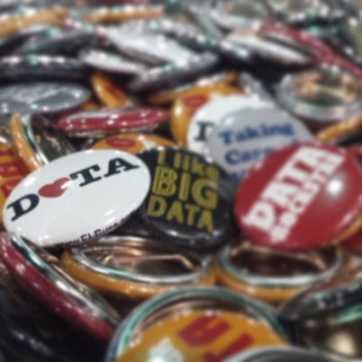
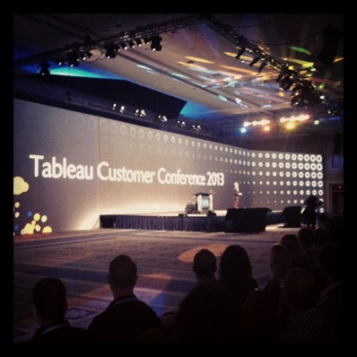
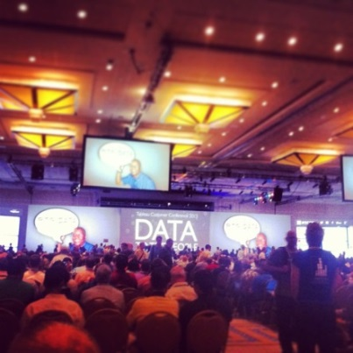

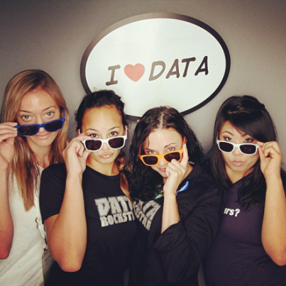
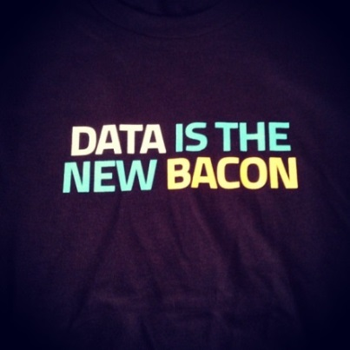
2. Measuring campaign success
#tcc13

Slide 12
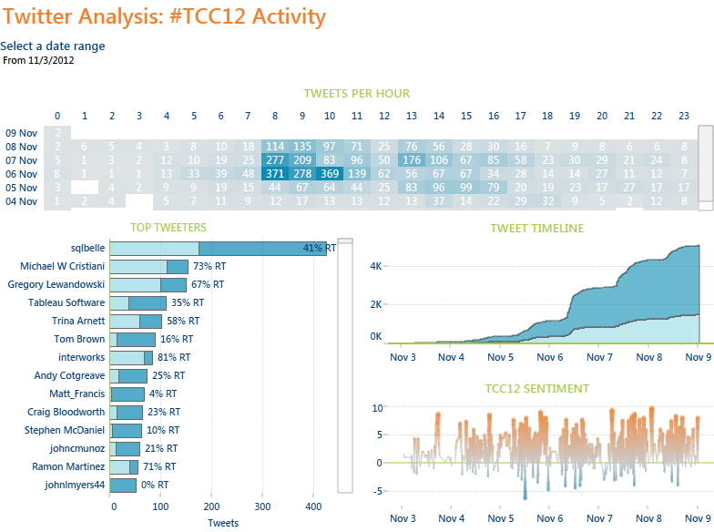
2. Measuring campaign success
Notes:
And here is an example of how this can be analysed visually. We host a large annual conference and we track twitter to see how well the conference is received by our audience. We also look to see who are the influencers, and what the senitment is during different periods of the conference.
What’s really important to marketing is to ensure that we can ask questions as they arise. This dashboard allows us to see what’s happening, but the power, as we’ll see, comes from being able to quickly connect to the social data, wherever it is, and use a drag and drop, easy to use interface to ask questions at the speed of thought.
Sure – you can pay third parties to deliver precanned reports for you, and these can be great: they do answer the questions. But those questions are ones someone else decided to ask for you. And if your question is slightly different, then how do you get that answer? You can’t, or it becomes very expensive. Imagine if you, or anyone in your business, without any programming or advanced technical skills could explore their data visually to answer questions.

Slide 13

3. Do people engage with you?
Notes:
Another great way to track social data is to see how many people engage with your content.
As marketers, we spend a huge amount of time creating what we hope is engaging content that will go viral.
Red Bull are masters at this. It is easy to forget that they are a drinks company. Why?
Click.

Slide 14
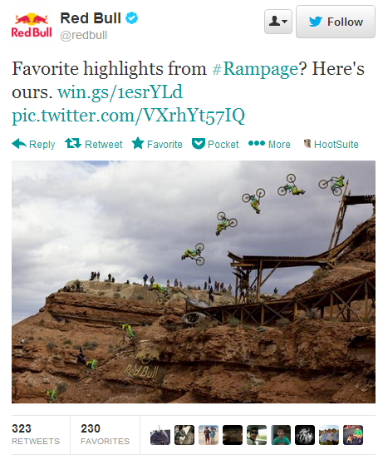
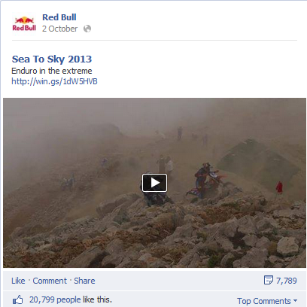

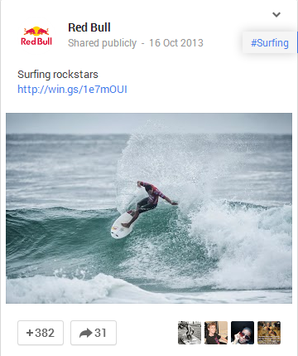
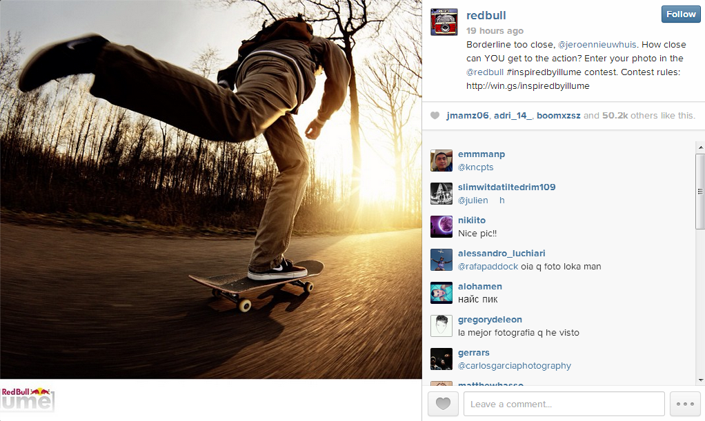
http://win.gs/1e7mOUI
Notes:
Because their social presence is all about active, extreme lifestyle.
Who’s ever watched a Red Bull video on a social media channel?
In fact is Red Bull a media company that sells drinks? Or a drinks company that makes media? Whichever – it’s created an amazing lifestyle brand to support a drinks business.
It has 42 million combined followers across Twitter, Facebook, Instagram, G+
Given the number of followers and the number of shares, how do you track this huge volume of fast data?
Their media is all shared using bitly – a link shortening service. By analysing that data, what can we learn?
Let’s have a look and then see what the data tells us.

Slide 15
Demo

Slide 16
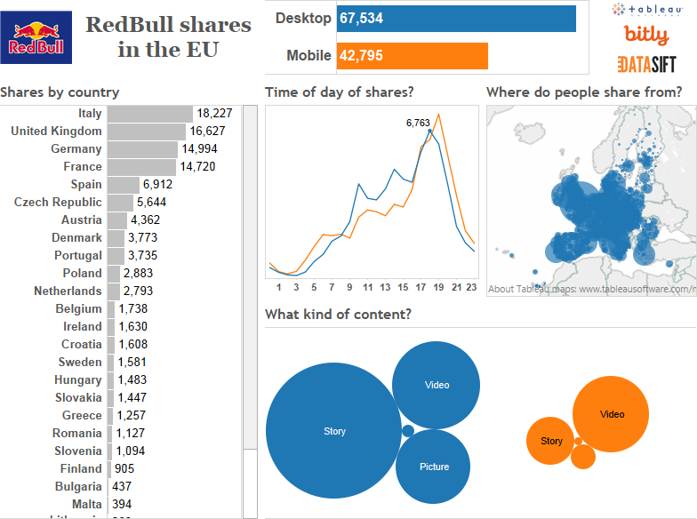
Notes:
Let’s lkook at their data.
This dashboard shows the number of views of Red Bull media by country in the EU. It breaks down the time of day of shares, the city and the type of content.
We can make some great marketing decisions as a result of this.
In the United Kingdom, you can see that most views are on mobile devices, and that they are videos. This informs our content strategy.
Contrast this with France. Here we see also that there is a bigger dip in views in the middle of the day – this kind of information helps us decide when, in each territory, we should launch or promote our content.
We’ll see in the final example how quick and easy it is to make dashboard likes this.

Slide 17
Social Media Metrics: case studies
Empowered customers
Measuring campaign success
Do people engage with you?
Notes:
Here’s what we saw: Social Media analytics enables empowerment, measurement and engagement – all helped with analytics

Slide 18
Social Media Metrics:
How to Measure and Optimize Your Marketing Efforts
Andy Cotgreave
Social Content Manager, Tableau
@acotgreave

