Slide 1
Anomaly Detection with Apache Spark
A Gentle Introduction
Sean Owen // Director of Data Science

Slide 2

✗
www.flickr.com/photos/sammyjammy/1285612321/in/set-72157620597747933

Slide 3
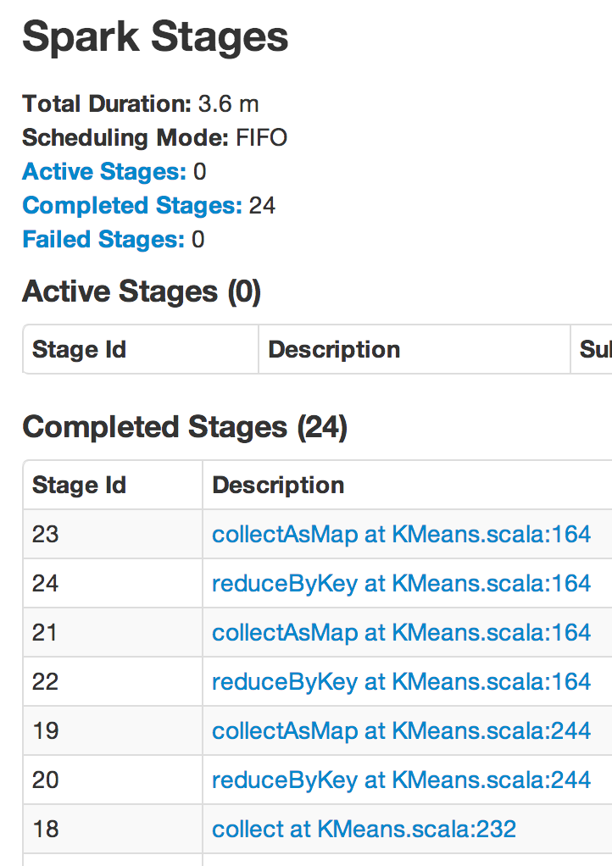
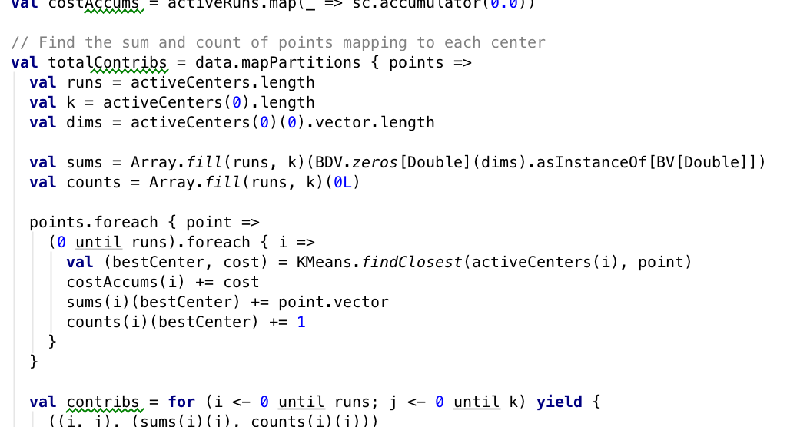
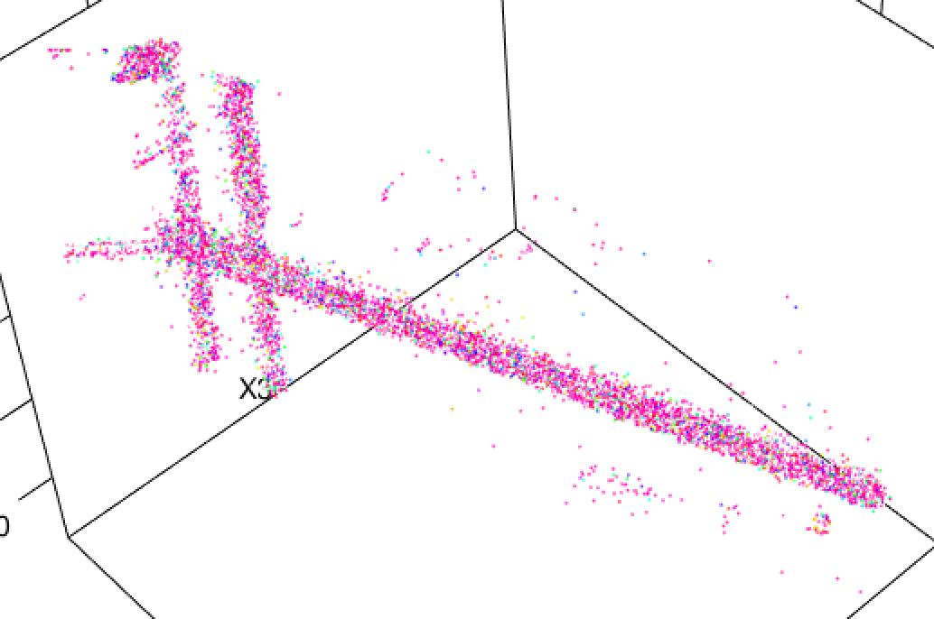
✔

Slide 4

Unknown Unknowns
Looking for things we don’t know
we don’t know
  Failing server metrics
  Suspicious access patterns
  Fraudulent transactions
Search among anomalies
Labeled, or not
  Sometimes have examples of
  “important” or “unusual”
  Usually not
streathambrixtonchess.blogspot.co.uk/2012/07/rumsfeld-redux.html

Slide 5
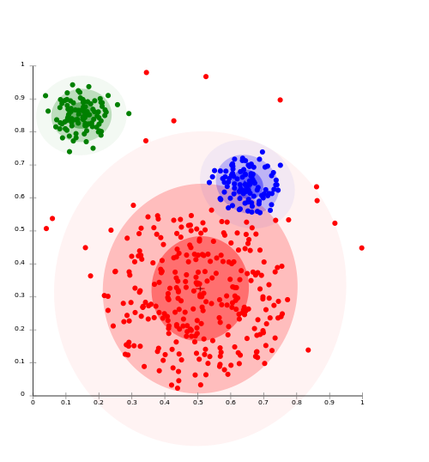
Clustering
Find areas dense with data
(conversely, areas without data)
Anomaly = far from any cluster
Unsupervised learning
Supervise with labels to
improve, interpret
en.wikipedia.org/wiki/Cluster_analysis

Slide 6
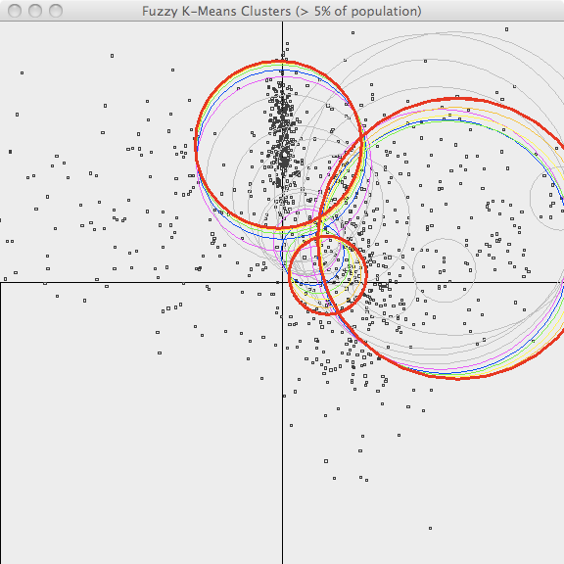
K-Means++
Assign points to nearest center, update centers, iterate
Goal: points close to nearest
cluster center
Must choose k = number of clusters
++ means smarter starting point
mahout.apache.org/users/clustering/fuzzy-k-means.html

Slide 7
KDD Cup 1999
Data Set

Slide 8

KDD Cup 1999
Annual ML competition
www.sigkdd.org/kddcup/index.php
1999: Network intrusion detection
4.9M network sessions
Some normal; many known attacks
Not a realistic sample!

Slide 9

Service
Bytes Received
0,tcp,http,SF,215,45076,
0,0,0,0,0,1,0,0,0,0,0,0,0,0,0,0,1,1,
0.00,0.00,0.00,0.00,1.00,0.00,0.00,
0,0,0.00,0.00,0.00,0.00,0.00,0.00,
0.00,0.00,normal.
% SYN errors
Label

Slide 10

Apache Spark: Something for Everyone
Scala-based
  “Distributed Scala”
  Expressive, efficient
  JVM-based
Consistent Scala-like API
  RDDs for everything
  RDD works like immutable Scala collection
  Like Apache Crunch is Collection-like
… but Java/Python APIs too
Inherently Distributed
Hadoop-friendly
  Works on existing data (HDFS, HBase, Kafka)
  With existing resources (YARN)
  ETL no longer separate
Interactive REPL
  Familiar model for R, Python devs
  Exploratory, not just operational
MLlib

Slide 11
Clustering, Take #0
Just Do It

Slide 12

> spark-shell
val rawData = sc.textFile("/user/srowen/kddcup.data")
rawData.first()
...
res3: String = 0,tcp,http,SF,215,45076,0,0,0,0,0,1,0,0,0,0,0,0,0,0,0,0,1,1,0.00,0.00,0.00,0.00,1.00,0.00,0.00,0,0,0.00,0.00,0.00,0.00,0.00,0.00,0.00,0.00,normal.

Slide 13
0,tcp,http,SF,215,45076,
0,0,0,0,0,1,0,0,0,0,0,0,0,0,0,0,1,1,
0.00,0.00,0.00,0.00,1.00,0.00,0.00,
0,0,0.00,0.00,0.00,0.00,0.00,0.00,
0.00,0.00,normal.

Slide 14

val labelsAndData = rawData.map { line =>
val buffer = line.split(',').toBuffer
buffer.remove(1, 3)
val label = buffer.remove(buffer.length-1)
val vec = Vectors.dense(buffer.map(_.toDouble).toArray)
(label, vec)
}
val data = labelsAndData.values.cache()
import org.apache.spark.mllib.clustering._
val kmeans = new KMeans()
val model = kmeans.run(data)

Slide 15
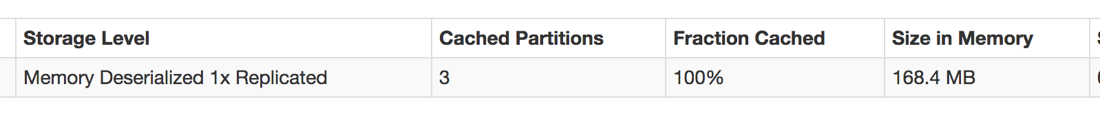
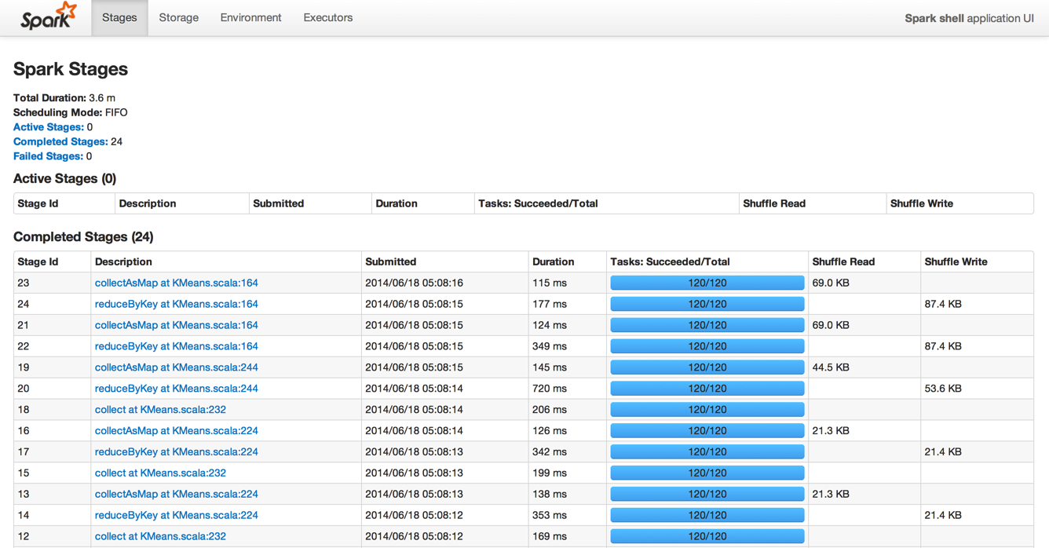

Slide 16
0 back. 2203
0 buffer_overflow. 30
0 ftp_write. 8
0 guess_passwd. 53
0 imap. 12
0 ipsweep. 12481
0 land. 21
0 loadmodule. 9
0 multihop. 7
0 neptune. 1072017
0 nmap. 2316
0 normal. 972781
0 perl. 3
0 phf. 4
0 pod. 264
0 portsweep. 10412
0 rootkit. 10
0 satan. 15892
0 smurf. 2807886
0 spy. 2
0 teardrop. 979
0 warezclient. 1020
0 warezmaster. 20
1 portsweep. 1

Slide 17
Clustering, Take #1
Choose k

Slide 18

def distToCentroid(v: Vector, model: KMeansModel) = {
val centroid = model.clusterCenters(model.predict(v))
distance(centroid, datum)
}
def clusteringScore(data: RDD[Vector], k: Int) = {
val kmeans = new KMeans()
kmeans.setK(k)
val model = kmeans.run(data)
data.map(d => distToCentroid(d, model)).mean()
}
(5 to 40 by 5).map(k => (k, clusteringScore(data, k)))

Slide 19

( 5,1938.858341805931)
(10,1689.4950178959496)
(15,1381.315620528147)
(20,1318.256644582388)
(25, 932.0599419255919)
(30, 594.2334547238697)
(35, 829.5361226176625)
(40, 424.83023056838846)

Slide 20
( 30,862.9165758614838)
( 40,801.679800071455)
( 50,379.7481910409938)
( 60,358.6387344388997)
( 70,265.1383809649689)
( 80,232.78912076732163)
( 90,230.0085251067184)
(100,142.84374573413373)
kmeans.setRuns(10)
kmeans.setEpsilon(1.0e-6)
(30 to 100 by 10).par.map(k =>
(k, clusteringScore(data, k)))

Slide 21
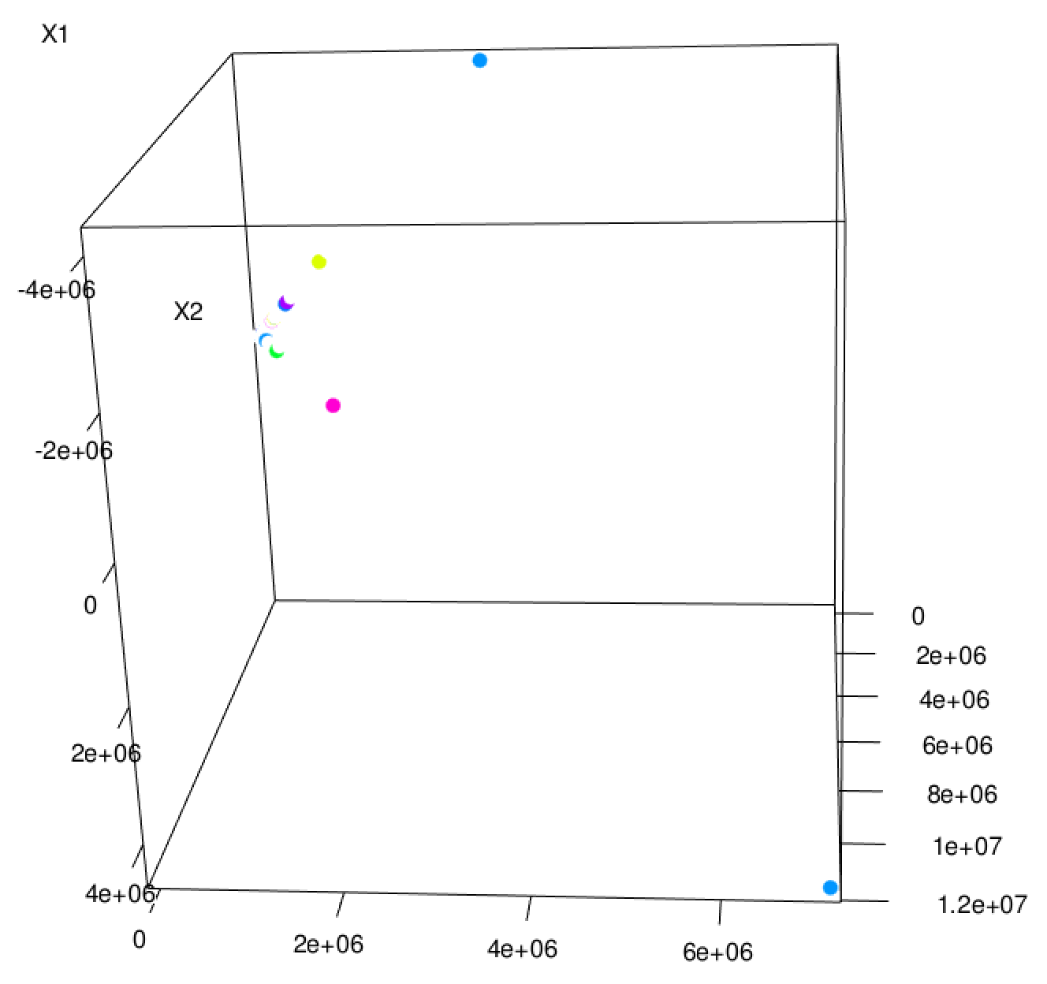


Slide 22
Clustering, Take #2
Normalize

Slide 23
Standard Scores
x_{i} - μ_{i}
Standard or “z” score
σ (standard deviation):
normalize away scale
µ (mean):
doesn’t really matter here
Assumes normalish distribution
σ_{i}

Slide 24
val dataArray = data.map(_.toArray)
val numCols = dataArray.first().length
val n = dataArray.count()
val sums = dataArray.reduce((a,b) => a.zip(b).map(t => t._1 + t._2))
val sumSquares = dataAsArray.fold(new Array[Double](numCols))(
(a,b) => a.zip(b).map(t => t._1 + t._2 * t._2)
)
val stdevs = sumSquares.zip(sums).map {
case(sumSq,sum) => math.sqrt(n*sumSq - sum*sum)/n
}
val means = sums.map(_ / n)
def normalize(v: Vector) = {
val normed = (v.toArray, means, stdevs).zipped.map(
(value, mean, stdev) => (value - mean) / stdev)
Vectors.dense(normed)
}

Slide 25
( 60,0.0038662664156513646)
( 70,0.003284024281015404)
( 80,0.00308768458568131)
( 90,0.0028326001931487516)
(100,0.002550914511356702)
(110,0.002516106387216959)
(120,0.0021317966227260106)

Slide 26
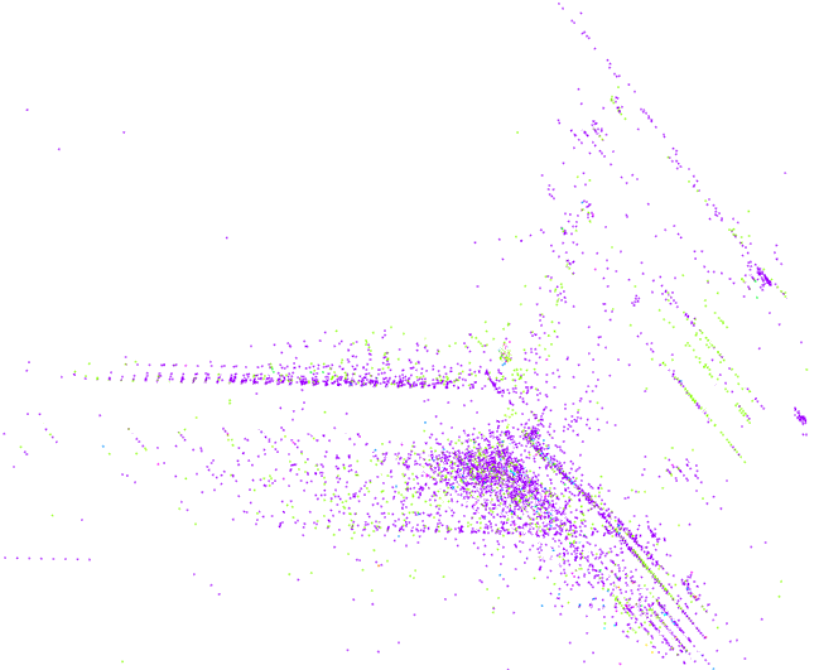

Slide 27
Clustering, Take #3
Categoricals

Slide 28
One-Hot / 1-of-n Encoding
…,tcp,…
…,udp,…
…,icmp,…
…,1,0,0,…
…,0,1,0,…
…,0,0,1,…

Slide 29
( 80,0.038867919526032156)
( 90,0.03633130732772693)
(100,0.025534431488492226)
(110,0.02349979741110366)
(120,0.01579211360618129)
(130,0.011155491535441237)
(140,0.010273258258627196)
(150,0.008779632525837223)
(160,0.009000858639068911)

Slide 30
Clustering, Take #4
Labels & Entropy

Slide 31
Using Labels With Entropy
Information theory concept
Measures mixed-ness
Function of label proportions, p_{i}
Good clusters have
homogeneous labels
Homogeneous =
low entropy =
good clustering
Σ
- p_{i} log p_{i}
Σ
p_{i} log (1/p_{i})

Slide 32
def entropy(counts: Iterable[Int]) = {
val values = counts.filter(_ > 0)
val n: Double = values.sum
values.map { v =>
val p = v / n
-p * math.log(p)
}.sum
}
def clusteringScore(...) = {
...
val labelsAndClusters =
normalizedLabelsAndData.mapValues(model.predict)
val clustersAndLabels = labelsAndClusters.map(_.swap)
val labelsInCluster =
clustersAndLabels.groupByKey().values
val labelCounts = labelsInCluster.map(
_.groupBy(l => l).map(_._2.size))
val n = normalizedLabelsAndData.count()
labelCounts.map(m => m.sum * entropy(m)).sum / n
}

Slide 33
(80,1.0079370754411006)
(90,0.9637681417493124)
(100,0.9403615199645968)
(110,0.4731764778562114)
(120,0.37056636906883805)
(130,0.36584249542565717)
(140,0.10532529463749402)
(150,0.10380319762303959)
(160,0.14469129892579444)

Slide 34
0 back. 6
0 neptune. 821239
0 normal. 255
0 portsweep. 114
0 satan. 31
...
90 ftp_write. 1
90 loadmodule. 1
90 neptune. 1
90 normal. 41253
90 warezclient. 12
...
93 normal. 8
93 portsweep. 7365
93 warezclient. 1

Slide 35
Detecting An Anomaly

Slide 36

Evaluate with Spark Streaming
Streaming
Streaming
Alert

Slide 37
val distances = normalizedData.map(
d => distToCentroid(d, model)
)
val threshold = distances.top(100).last
val anomalies = normalizedData.filter(
d => distToCentroid(d, model) > threshold
)

Slide 38
flag
count / srv count
0,tcp,http,S1,299,26280,0,0,0,1,0,1,0,1,0,0,0,0,0,0,0,0,15,16,0.07,0.06,0.00,0.00,1.00,
0.00,0.12,231,255,1.00,0.00,0.00,0.01,0.01,
0.01,0.00,0.00,normal.
dst_host_count /
dst_host_srv_count
Anomaly?

Slide 39
Thank You!
sowen@cloudera.com
@sean_r_owen

