Slide 1
Building an intelligent big data app in 30 minutes
Strata Barcelona
Nov 2014
David Talby | Claudiu Barbura
SVP Engineering | Sr. Director, Engineering
@davidtalby | @claudiubarbura

Slide 2
Agenda
Demo: FindFraud application
Demo: data pipeline, apis
Architecture
BDAS++

Slide 3
Infrastructure
Design Principles
Build, run & monitor end-to-end workflows
Same code for batch and streaming modes
Abstract away direct access to infrastructure
Unified REST API’s for cross-cutting concerns
Whole System
Ingestion
Data Workflows
Spark SQL REST API
Unified Security
Unified Config.
Monitoring & Logging
Starting Point
Hadoop
Spark
Tachyon
Mesos
ZooKeeper
Cassandra

Slide 4
Analytics
Design Principles
Declarative feature & model generation
Same code for local, distributed & serving layers
Experimentation & model optimization is key
Provide a very broad algorithmic toolbox
Whole System
Feature Engineering Framework
Visualized Metrics
Distributed Featurization & Training
Proprietary Modeling Algorithms
Publish Models as REST API’s
Online Learning REST API’s
Starting Point
IPython
Pandas
Scikit-learn, pybrain, nltk, …
Hive, Shark, Spark SQL

Slide 5
Application
Design Principles
Build app UI against REST API’s from Day One
Separate servers for analytics & app end users
Abstract away direct access to infrastructure
Whole System
Feature Engineering Framework
Modeling Workflows
Visualized Metrics
Distributed Feature Generation
Distributed Training
Publish Models as REST API’s
Starting Point
Cassandra
Lucene &
SolrCloud
PostgreSQL
TomCat,
Spray.io, Node.js

Slide 6
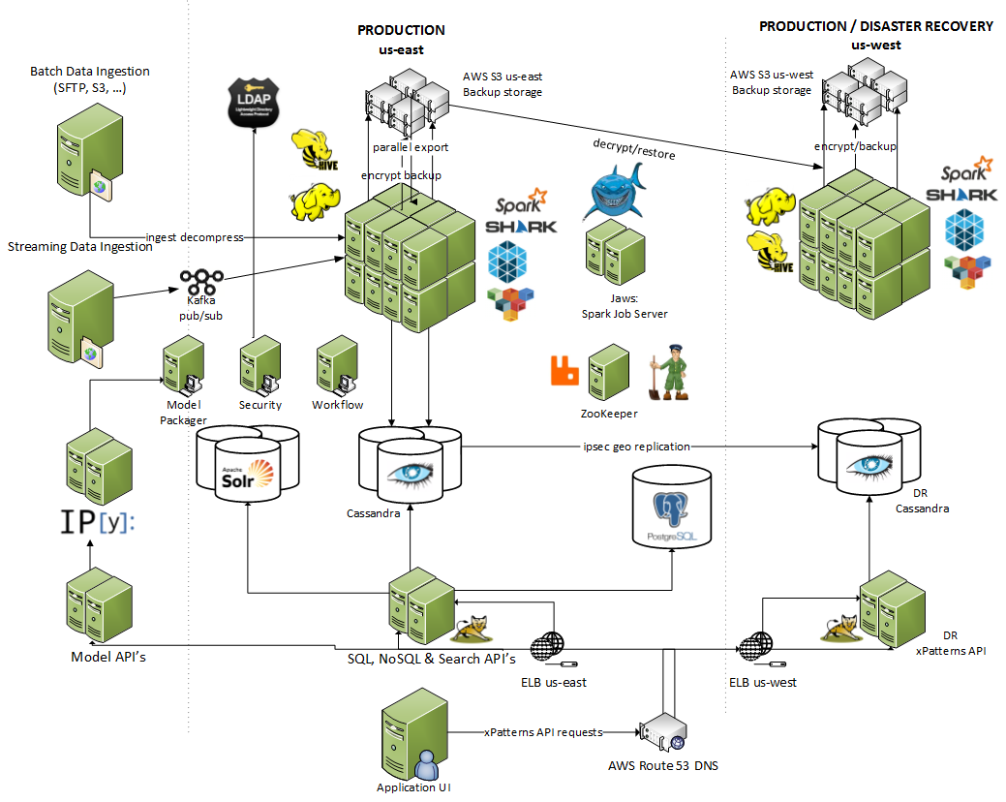
Let’s Build Something

Slide 7
Open Source Contribs
Jaws, http spark sql rest service
http://github.com/Atigeo/http-spark-sql-server
  Backward compatible with Shark and Spark 0.x stack
Spark Job Server
  multiple Spark contexts in same JVM, job submission in Java + Scala
  https://github.com/Atigeo/spark-job-rest
Mesos framework starvation bug
  submitted patch… detailed Tech Blog link soon at http://xpatterns.com
Tachyon patch (https://github.com/amplab/tachyon/pull/482)

Slide 8



Thank you!
@atigeo
linkedin.com/
company/atigeo
Blog:
xpatterns.com
David Talby | Claudiu Barbura
SVP Engineering | Sr. Director, Engineering
@davidtalby | @claudiubarbura

