Slide 1
Configuring a secure, multitenant cluster for the enterprise
James Kinley // Principal Solutions Architect

Slide 2
About me
James Kinley
  Principal Solutions Architect, EMEA
  Hadoop user since 2010
  Clouderan since 2012
  Background in UK defence industry and cyber security
  github.com/jrkinley
  jameskinley.tumblr.com
  @jrkinley
  uk.linkedin.com/in/jameskinley

Slide 3
Introduction: Data Hub Objectives
Sharing Data
better insight
Sharing Compute
better utilisation and performance
Consolidated Operations
reduced cost and complexity
Notes:
Sharing Data
Single repository for all data
Organisation-wide view of data gives better insight
Effective sharing of datasets when permitted, isolation of datasets when not
Sharing Compute
Allocation of resource is dynamic, optimised, and just-in-time
Leading to better utilisation of cluster resources and better performance for individual requests (bursting)
Across workloads (batch processing, interactive SQL, enterprise search, and advanced analytics)
Consolidated Operations
Amortise (repay) administrative overhead
Reduce cost and complexity

Slide 4
Multitenancy in Hadoop refers to a set of features that enable multiple groups from within the same organisation to share the common set of resources in a cluster without negatively impacting service-levels, violating security constraints, or even revealing the existence of each other, all via policy rather than physical separation.
Notes:
Multiple groups (departments, projects, users)
Common set of resources (storage and compute)
Security constraints (e.g. data protection policy)

Slide 5
Multitenant Cluster Architecture
Security & Governance
  HDFS Information Architecture (IA)
  Authentication
  Authorisation
  Auditing
  Quota management
Resource Isolation & Management
  Static partitioning
  Dynamic partitioning
  Impala admission control
PARTNER LOGO

Slide 6
Security & Governance
HDFS Information Architecture: file and directory structure
Authentication: proves users are who they say they are
[Kerberos, Identity Management (LDAP)]
Authorisation: determines what users can see and do
[HDFS Permissions, RBAC (Apache Sentry), Encryption]
Auditing: determines who did what, and when
[Cloudera Navigator]
Notes:
Identity Management (user account propagation)
Cloudera Navigator (end-2-end governance)
Auditing
Metadata
Lineage
Lifecycle management (i.e. data retention)

Slide 7
Security & Governance
HDFS Information Architecture (IA)
drwxr-x---+ tadmin tgroup /users/{tenantId}
drwxr-x--- tadmin tgroup /users/{tenantId}/archive
drwxrwx---+ tadmin hive /users/{tenantId}/warehouse
drwxrwx---+ tadmin hive /users/{tenantId}/warehouse/{db}/{table}/{partition}
drwxr-x---+ tadmin tgroup /users/{tenantId}/landing
drwxrwx--- tadmin tgroup /users/{tenantId}/processing
drwxr-x--- {tuser} tgroup /users/{tenantId}/processing/{jobId}
drwxr-x--- {tuser} tgroup /users/{tenantId}/processing/{jobId}/input
drwxr-x--- {tuser} tgroup /users/{tenantId}/processing/{jobId}/output

Slide 8
Security & Governance
Authentication: Kerberos & LDAP
drwxr-x---+ tadmin tgroup /users/{tenantId}
drwxr-x--- tadmin tgroup /users/{tenantId}/archive
drwxrwx---+ tadmin hive /users/{tenantId}/warehouse
drwxrwx---+ tadmin hive /users/{tenantId}/warehouse/{db}/{table}/{partition}
drwxr-x---+ tadmin tgroup /users/{tenantId}/landing
drwxrwx--- tadmin tgroup /users/{tenantId}/processing
drwxr-x--- {tuser} tgroup /users/{tenantId}/processing/{jobId}
drwxr-x--- {tuser} tgroup /users/{tenantId}/processing/{jobId}/input
drwxr-x--- {tuser} tgroup /users/{tenantId}/processing/{jobId}/output
Notes:
LDAP Integration
Typically done at OS-level and HDFS uses shell-based group mapping
User accounts propagated to all hosts
PAM_LDAP
SSSD
Centrify
VAS/QAS

Slide 9
Security & Governance
Authorisation: HDFS permissions
drwxr-x---+ tadmin tgroup /users/{tenantId}
drwxr-x--- tadmin tgroup /users/{tenantId}/archive
drwxrwx---+ tadmin hive /users/{tenantId}/warehouse
drwxrwx---+ tadmin hive /users/{tenantId}/warehouse/{db}/{table}/{partition}
drwxr-x---+ tadmin tgroup /users/{tenantId}/landing
drwxrwx--- tadmin tgroup /users/{tenantId}/processing
drwxr-x--- {tuser} tgroup /users/{tenantId}/processing/{jobId}
drwxr-x--- {tuser} tgroup /users/{tenantId}/processing/{jobId}/input
drwxr-x--- {tuser} tgroup /users/{tenantId}/processing/{jobId}/output

Slide 10
Security & Governance
Authorisation: HDFS extended ACLs
drwxr-x---+ tadmin tgroup /users/{tenantId}
drwxr-x--- tadmin tgroup /users/{tenantId}/archive
drwxrwx---+ tadmin hive /users/{tenantId}/warehouse
drwxrwx---+ tadmin hive /users/{tenantId}/warehouse/{db}/{table}/{partition}
drwxr-x---+ tadmin tgroup /users/{tenantId}/landing
drwxrwx--- tadmin tgroup /users/{tenantId}/processing
drwxr-x--- {tuser} tgroup /users/{tenantId}/processing/{jobId}
drwxr-x--- {tuser} tgroup /users/{tenantId}/processing/{jobId}/input
drwxr-x--- {tuser} tgroup /users/{tenantId}/processing/{jobId}/output
Give “tingest” user permission over the landing directory:
$ hdfs dfs -setfacl -m user:tingest:rwx /users/{tenantId}/landing
Give “hive” group permission over the landing directory:
$ hdfs dfs -setfacl –m group:hive:rwx /users/{tenantId}/landing
Notes:
POSIX Access Control Lists (Hadoop 2.4)
An ACL provides a way to set different permissions for specific named users or named groups, not only the file's owner and the file's group

Slide 11

Security & Governance
Authorisation: Apache Sentry (incubating)
  Fine-grained, role-based access control (RBAC)
  Users can see only the data and metadata to which they have been granted the privilege
  Currently works with Apache Hive, Cloudera Impala, and Cloudera Search
  File or Service (GRANT/REVOKE) based policy providers
  Role-based privilege model
    {user} > {groups} > {roles} > object > privilege
    object = {server, database, table, URI}
    privilege = {select, insert, all}
  Supports grant permission delegation for multitenant clusters

Slide 12
Security & Governance
Authorisation: Apache Sentry (incubating)
drwxr-x---+ tadmin tgroup /users/{tenantId}
drwxr-x--- tadmin tgroup /users/{tenantId}/archive
drwxrwx---+ tadmin hive /users/{tenantId}/warehouse
drwxrwx---+ tadmin hive /users/{tenantId}/warehouse/{db}/{table}/{partition}
drwxr-x---+ tadmin tgroup /users/{tenantId}/landing
drwxrwx--- tadmin tgroup /users/{tenantId}/processing
drwxr-x--- {tuser} tgroup /users/{tenantId}/processing/{jobId}
drwxr-x--- {tuser} tgroup /users/{tenantId}/processing/{jobId}/input
drwxr-x--- {tuser} tgroup /users/{tenantId}/processing/{jobId}/output
Delegate grant and revoke privilege to tenant’s admin role:
> GRANT ALL ON DATABASE {db} TO ROLE {tadmin} WITH GRANT OPTION;

Slide 13
Security & Governance
Authorisation: Encryption
  Network encryption (HDFS and MR)
  At-rest encryption for HDFS
    Cloudera Navigator Encrypt & KeyTrustee (Gazzang)
    Project Rhino (Cloudera + Intel)
      HDFS-level encryption (HDFS-6134 + HADOOP-10150)
      Encryption zones (HDFS-6386)
      Hardware-accelerated (HADOOP-10693)
Notes:
Encryption
Compliance regulations: EU Data Protection Directive
Gazzang
OS-level encryption
Enterprise-grade key management (Navigator Key Trustee)
Navigator Encrypt
Encrypt DN directory in Linux file system
Provided by kernel module
Process-based ACLs (i.e. only DN can access encrypted directory)
Project Rhino
HDFS-level encryption (Encryption Zones)
Integrated with Navigator Key Trustee
Better for multitenant type environment
Hardware-accelerated
Unusable if there is a significant performance penalty
Uses AES instruction set available on Intel processors
HDFS will be able to provide access to encrypted data with minimal performance impact

Slide 14
Security & Governance
Authorisation: HDFS encryption zone
drwxr-x---+ tadmin tgroup /users/{tenantId}
drwxr-x--- tadmin tgroup /users/{tenantId}/archive
drwxrwx---+ tadmin hive /users/{tenantId}/warehouse
drwxrwx---+ tadmin hive /users/{tenantId}/warehouse/{db}/{table}/{partition}
drwxr-x---+ tadmin tgroup /users/{tenantId}/landing
drwxrwx--- tadmin tgroup /users/{tenantId}/processing
drwxr-x--- {tuser} tgroup /users/{tenantId}/processing/{jobId}
drwxr-x--- {tuser} tgroup /users/{tenantId}/processing/{jobId}/input
drwxr-x--- {tuser} tgroup /users/{tenantId}/processing/{jobId}/output

Slide 15
Security & Governance
Governance: HDFS disk quota management
  Restrict tenants use of storage
  Prevents misuse of the shared filesystem
  HDFS supports two quota mechanisms
    Disk space quotas
    Name quotas
Notes:
Restrict tenants disk usage
Prevent users from accidently or maliciously consuming too much disk space within the cluster
Disk space quotas: disk space limits on a per directory basis
Name quotas: limits the number of files and subdirectories within a particular directory. Helps administrators control the NN metadata

Slide 16
Security & Governance
Governance: HDFS disk quota management
drwxr-x---+ tadmin tgroup /users/{tenantId}
drwxr-x--- tadmin tgroup /users/{tenantId}/archive
drwxrwx---+ tadmin hive /users/{tenantId}/warehouse
drwxrwx---+ tadmin hive /users/{tenantId}/warehouse/{db}/{table}/{partition}
drwxr-x---+ tadmin tgroup /users/{tenantId}/landing
drwxrwx--- tadmin tgroup /users/{tenantId}/processing
drwxr-x--- {tuser} tgroup /users/{tenantId}/processing/{jobId}
drwxr-x--- {tuser} tgroup /users/{tenantId}/processing/{jobId}/input
drwxr-x--- {tuser} tgroup /users/{tenantId}/processing/{jobId}/output

Slide 17

Resource Isolation & Management
Dividing up finite cluster resource to ensure predictable behaviour
Goals:
  Guarantee service levels for critical workflows
  Support fair allocation of resources between different groups of users
  Prevent users from depriving other users access to the cluster
Notes:
Analogy
Messi, Neymar, and Suarez pop out for Pizza after training
They do not have enough money to buy a large Pizza each, so they put their money together to buy one;
Once they have the Pizza they agree on a policy to share the Pizza;
Because the Pizza has 10 slices, they agree that Messi can eat 4 slices, and Neymar and Suarez can eat 3 each;
They can eat in parallel, but can only eat one slice at a time.

Slide 18
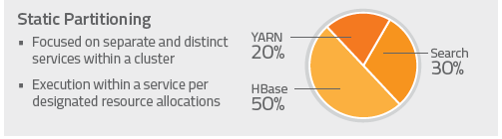
Resource Isolation & Management
Static partitioning
  Static service pools
  Statically partition resource for HBase, HDFS, Impala, Search, and YARN
  Enforced by Linux cgroups

Slide 19
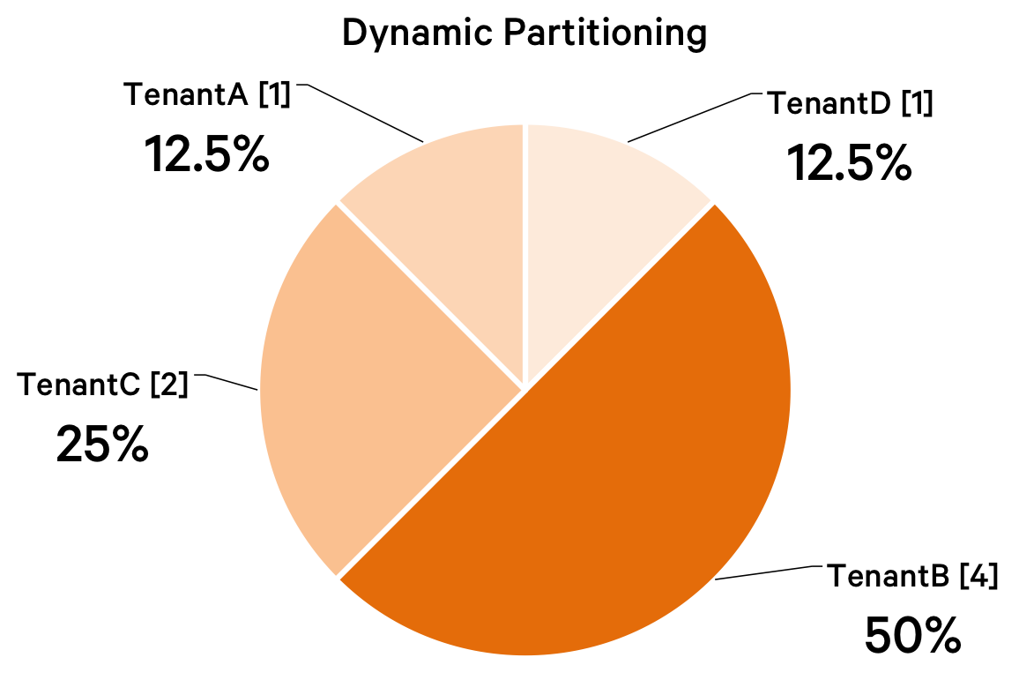
Resource Isolation & Management
Dynamic partitioning
  Dynamic resource pools
  Dynamically apportion resource [statically] allocated to Impala and YARN
  Named pool of resource + scheduling policy
  Resource allocation based on weight
  User to pool placement policy
  ACLs
  SLOs (use of pre-emption)

Slide 20

Resource Isolation & Management
Impala admission control
  Limits concurrent queries and memory usage
  Additional queries are queued
  Configured per pool
    max_requests
    mem_limit
    max_queued
  Avoids resource oversubscription (OOM) during heavy usage
  Pool placement policy mechanism same as YARN RM
  Use with static partitioning (independently from YARN)
  Or integrate with YARN for resource management via Llama

Slide 21
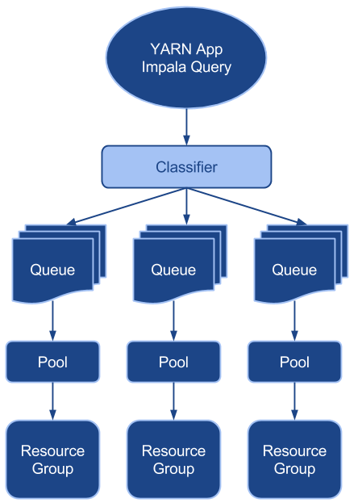
Resource Isolation & Management
Classification
  User to pool placement rules
  Based on user, group, or specified tag:
  MR: mapreduce.job.queuename
  Impala: REQUEST_POOL
Notes:
I.e. route tenants users based on their AD group membership

Slide 22
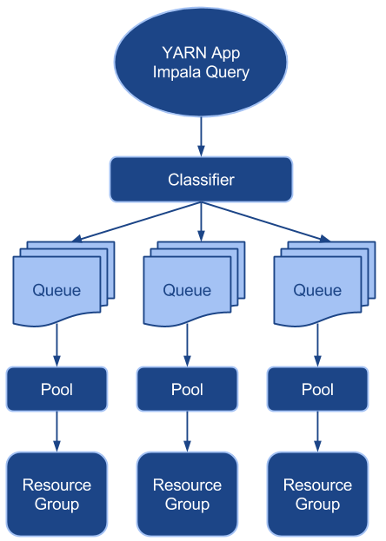
Resource Isolation & Management
Queues
  YARN
    Max running apps
    Max memory
    Max vcores
  Impala admission control
    Max running queries
    Max memory
    Max queue size
Notes:
Impala
Incoming queries are executed, queued, or rejected
Queue if too many queries or not enough memory
Reject if queue is full

Slide 23
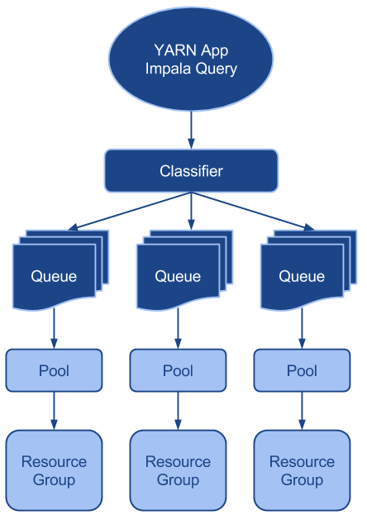
Resource Isolation & Management
Dynamic resource pools
  Scheduling policy
    Dominant Resource Fairness (DRF)
    Fair Scheduler (FAIR)
    First-in, First-out (FIFO)
  Recommendations:
    Disable undeclared pools
    Enable the default pool
Notes:
Disabling undeclared pools
When user does not specify a pool
When enabled, a pool is created on-the-fly with the name of the user that submitted the request
When disabled, the default pool is used instead
Enabling the default pool
When user specifies pool that doesn’t exist
When disabled, the pool is created on-the-fly with the default settings
When enabled, the default pool is used instead

Slide 24
Thank you.

