Slide 1
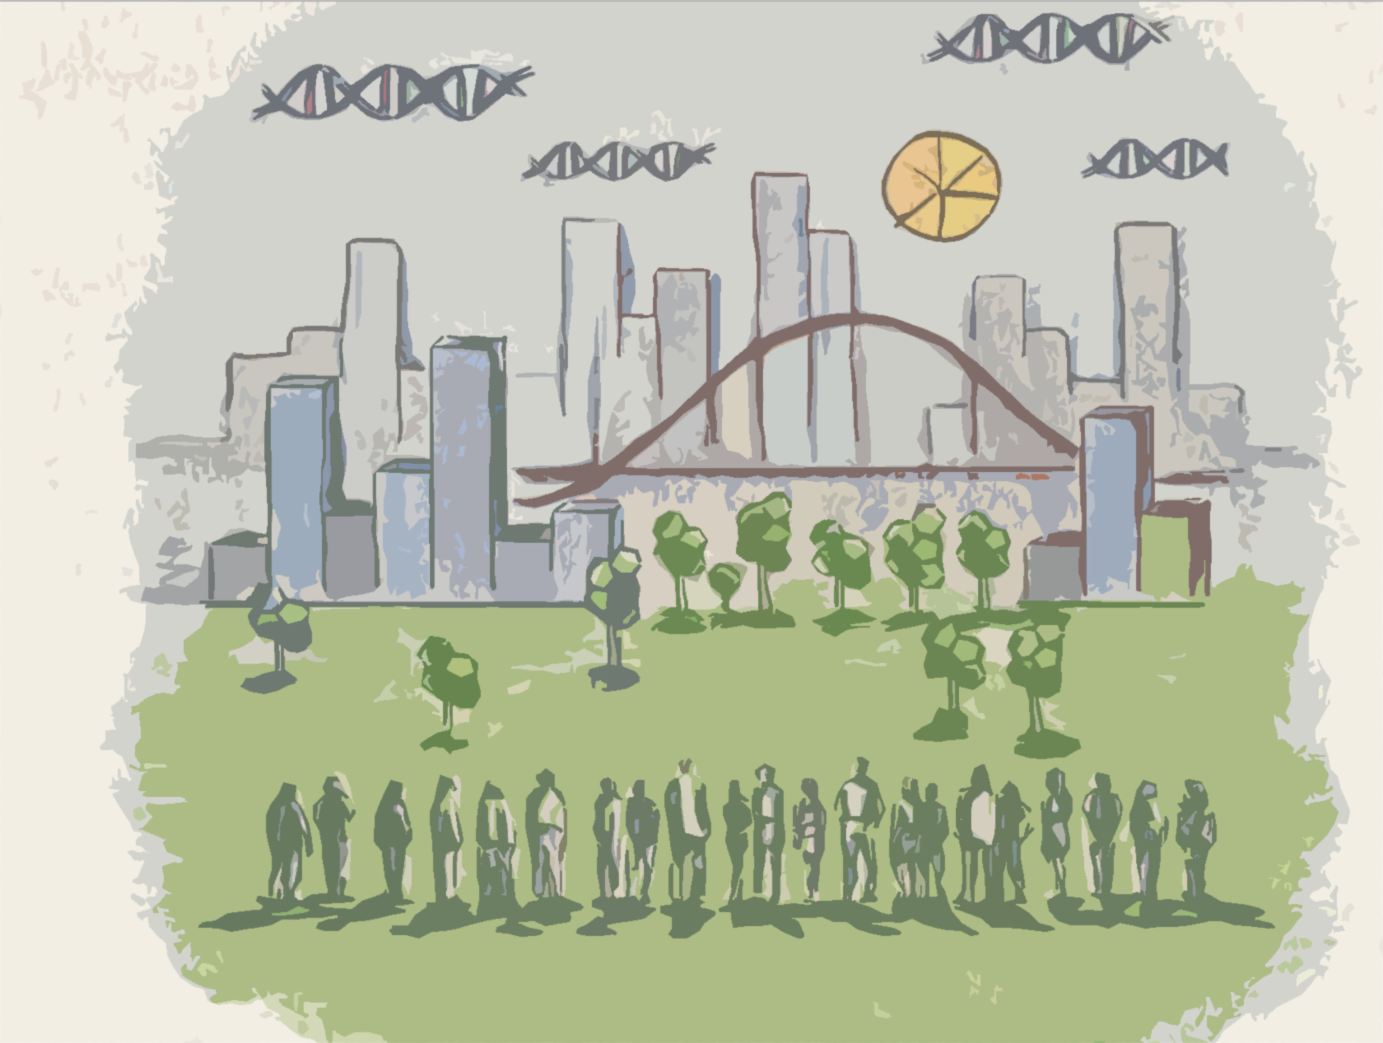




Model Workers
Juan Mateos-Garcia, Nesta
Strata Hadoop 2014, Barcelona
21/11/2014

Slide 2




We have many case studies about the benefits of data, and examples of good practices to create more value from it
How much of this is generalisable? To answer that question, we need to create more data about data

Slide 3

Nesta: The UK Innovation foundation

Slide 4

Me
@JMateosGarcia
Background
Economist (R > Stata)
Innovation studies
Research projects on…
Open Source communities
Video games development
Digital skills
Use web data to map innovative industries
Use and impact of data in UK businesses
Data Skills

Slide 5

“Data is the innovation story of our time”
Erik Brynjolfsson
What are the levels of adoption?
What are the impacts?
What are the drivers and barriers?

Slide 6

The burning questions we are looking at
What are the benefits from adoption?
Are they spread across sectors?
Answers relevant for policy and business
What skills create value from data
What are the good practices?

Slide 7
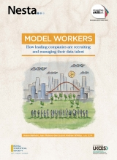
Skills for the data driven economy project
Data
Outputs
Qualitative interviews with 45 industry experts (CTO, HR, Data scientists etc.) in 6 sectors (Creative media, Finance, ICT, Manufacturing, Pharmaceuticals, Retail.)
Survey of 404 medium and large UK businesses where data plays a role in operation, matched with financial data 2013-2008. Questions about data pipeline, data talent, and data practices.
Work in progress

Slide 8
Descriptives: Average is average
Data inputs
% routinely using
data source X
Analysis
% with
Analytical capability X
% with
major benefits in
area X
due to analysis
Business
Benefits

Slide 9
We segment companies depending on their data input and use
Data inputs
Data volume
Data variety
Data for decision-making
Cluster analysis
Doers
14.5%
Hoarders
23.2%
Mixers
32.3%
Deniers
30%
% using big data volumes |  | 40% | 100% | 0 | 2%
% Using >4 sources regularly |  | 14% | 4% | 7% | 0
% making decisions on data & analysis |  | 100% | 10.3% | 4% | <1%
Found in sectors like… |  | Finance | ICT | Creative | Manufacturing

Slide 10
All industries are doing it, but some more than others
More web-active sectors more data-active. What will happen to Manufacturing as IOT becomes pervasive?

Slide 11
“Not (just) what you do to data …
…but also what you do with it
More data -> More analytical capabilities
More data -> Product innovation as well as process innovation + automation

Slide 12
And the bottom-line?
We are modelling the productivity (and profitability and growth) of the companies in the sample, controlling for their sector, size, human capital, and levels of innovation
Business
Benefits
Not causal evidence…but consistent with the idea that the data revolution has tangible benefits across sectors, especially for companies that are most data-driven in their decisions

Slide 13

From the what to the how: people and practices
Find talent
Manage projects
Build teams
Place teams

Slide 14


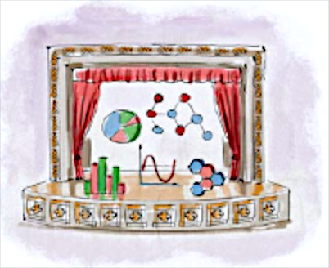


Looking for the perfect analyst
Analysis + computing
Talent lacks skills + experience
Domain knowledge + Business savvy
Hard
to
find!
Find talent
Talent without the right mix of skills
Storytelling + team-working
Creativity + curiosity
Internal
capacity issues

Slide 15
Find talent
More than half of those recruiting analysts report issues (especially around domain knowledge, mix of skills and experience. How are they addressing this data talent crunch?
  They are building up their data credibility
  Working with universities
  They are going where the talent is
Notes:
Statement
2/3 users recruiting undergrads
NB 2/3 big data recruiting undergrads, 1/3 working with universities to sort skills gaps
75% participating in meetups etc.

Slide 16
DATA DOERS
Hiring undergraduates 68%
PhDs 45%
Involved in meet-ups 78%
Involved in online communities 38%
Using universities for training 30%
Find talent

Slide 17

Businesses are responding to the lack of ‘unicorns’ by building teams with the right capabilities.
They try to strike the right balance between generalists & specialists
They build diverse teams
They develop a shared language and acquire tools
Build teams

Slide 18
DATA DOERS
Who consider team diversity important 87%
With teams formed of people with
skills across more than one area 71% Who consider ability to work with other
disciplines essential in new talent 43%
Build teams

Slide 19
Centralise
Embed
+ | Critical mass + Learning | Relevance + access to information
- | Ivory tower | Fragmentation + silos
Place teams
? | Build strong interfaces outside the team Secondments/rotation Self-service | Communities of practice and centres of excellence Develop standards

Slide 20
DATA DOERS
With centralised data-teams 21%
With embedded data-teams 63%
Who get analysts to work in different
areas of the business 61%
Who bring analysts from across the business
together 59%
Place teams

Slide 21
Recognition that many data projects are innovation projects, and many data analysts are creative workers.
Enable exploration and variety
…but also put in place robust management structures and processes
We are exploring complementarities between management practices, team competencies, project sources and outcomes
Manage projects
Notes:
More than half of users/hoarders give employees time to explore new areas, and offer project variety.
Critically, they also set metrics at the beginnings of projects (64%) and ethical review processes. They are 2x as likely as ‘deniers’ to have well-defined career paths for analysts (still less than half do),

Slide 22
DATA DOERS
Who give employees time to develop
exploratory projects 47%
With a clear career path for analysts 45%
Who judge success with metrics defined
in advance 64%
Who have an ethical review process for
projects 66%
Manage projects

Slide 23
Implications
Most businesses still operating in small data mode
Data doers use data to innovate as well as increase efficiency
Strong evidence of impact ➔For those who put their data to work
Strong evidence of skills shortages (“data scientists”)
Good practices are emerging to find talent, build teams, place teams and manage projects.
Our job now is to go from data and evidence to impact: practical programmes and policy interventions
More research using longitudinal, observational, experimental data.

Slide 24
Thank you
@JMateosGarcia
Juan.mateos-garcia@nesta.org.uk

