Slide 1
Predictive Analytics in the Cloud:
Predicting Football
Jordan Tigani
Google

Slide 2
Predict outcome of World Cup matches using Google Cloud Platform
Problem Statement

Slide 3
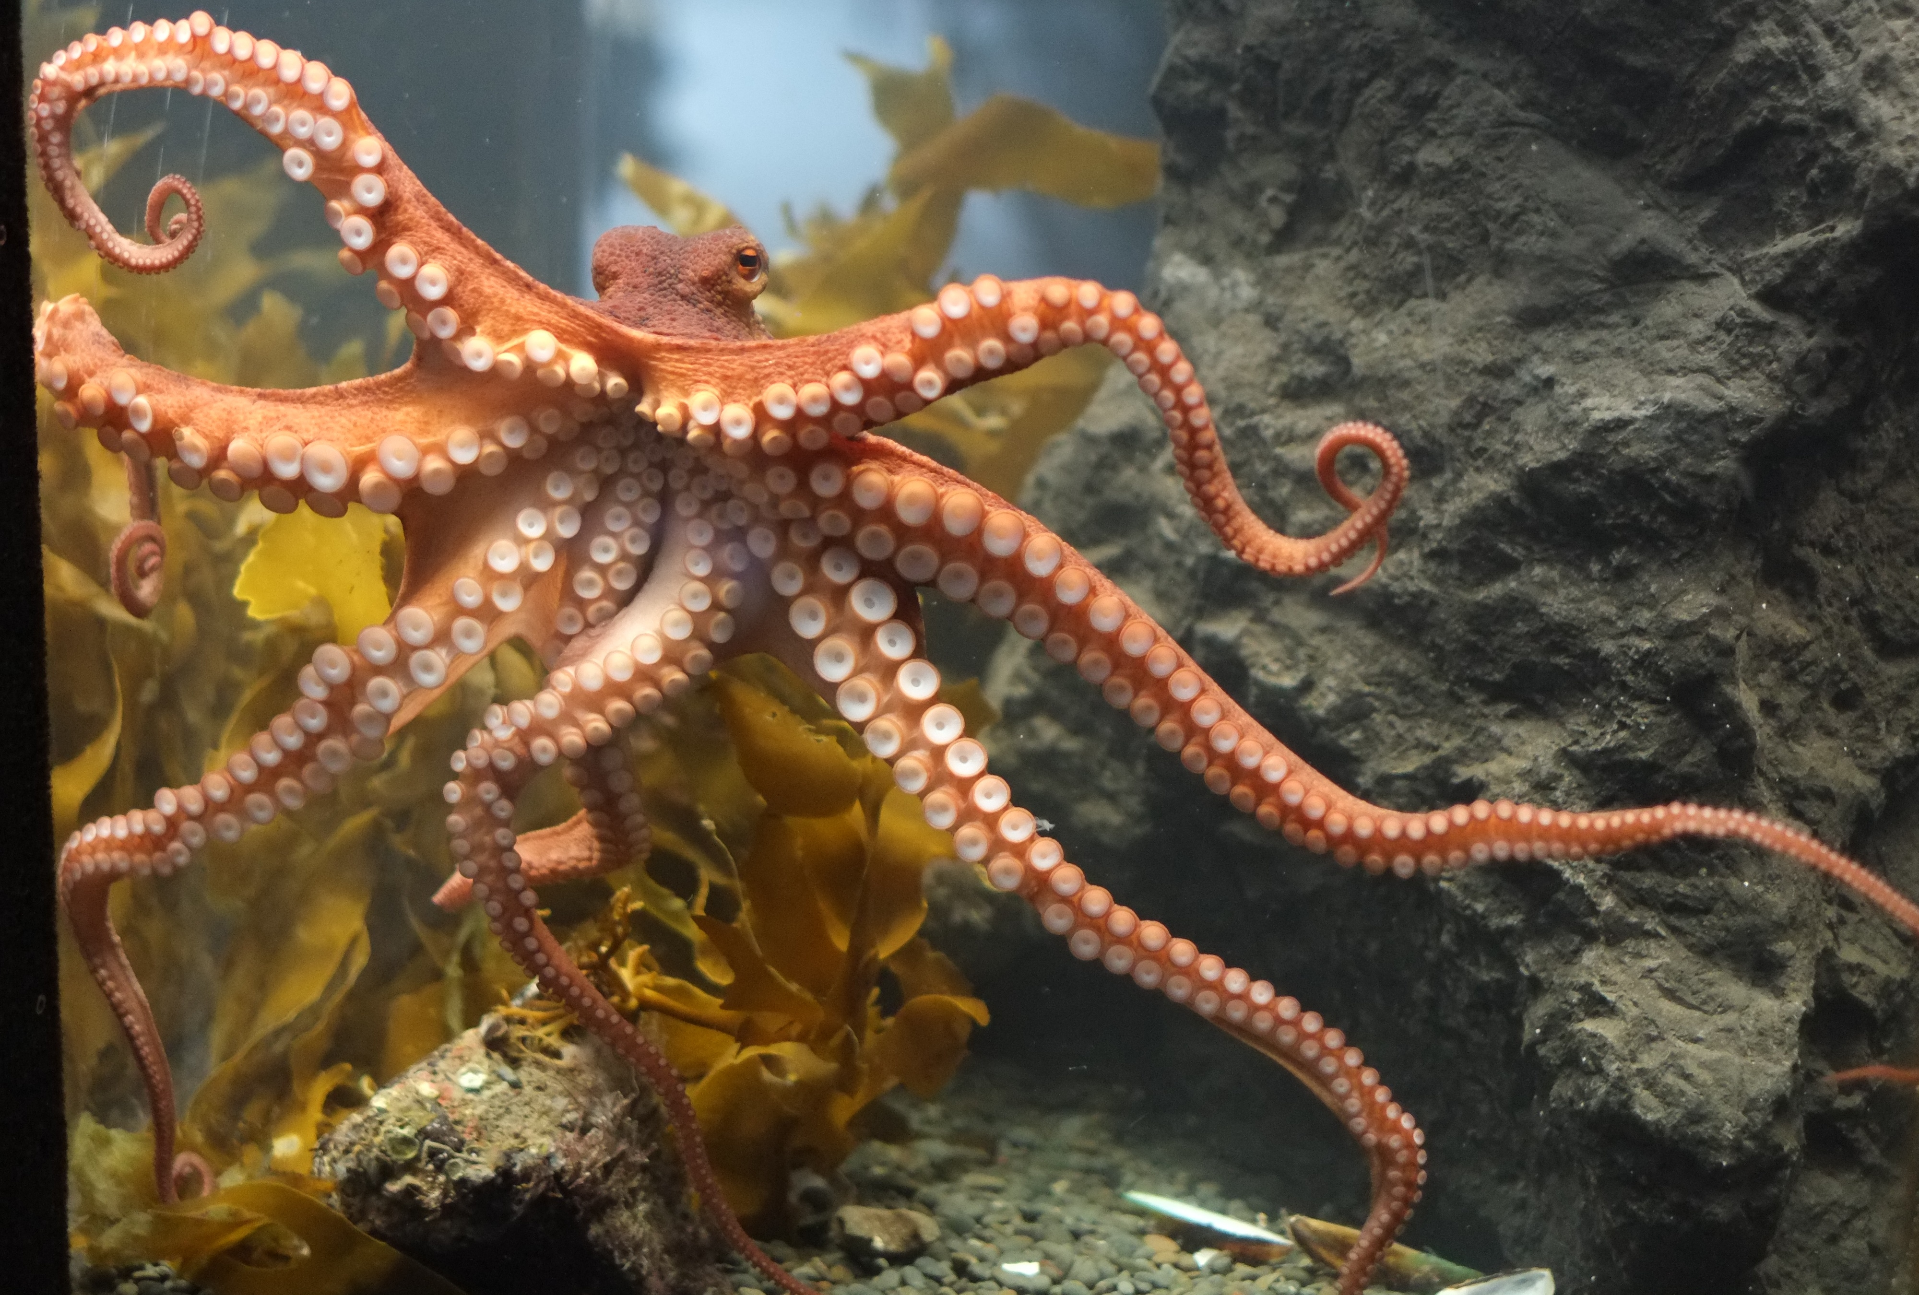
Paul the Octopus: 11/13
Notes:
http://commons.wikimedia.org/wiki/File:Octopus_at_Kelly_Tarlton's.jpg
Wikipedia public domain

Slide 4
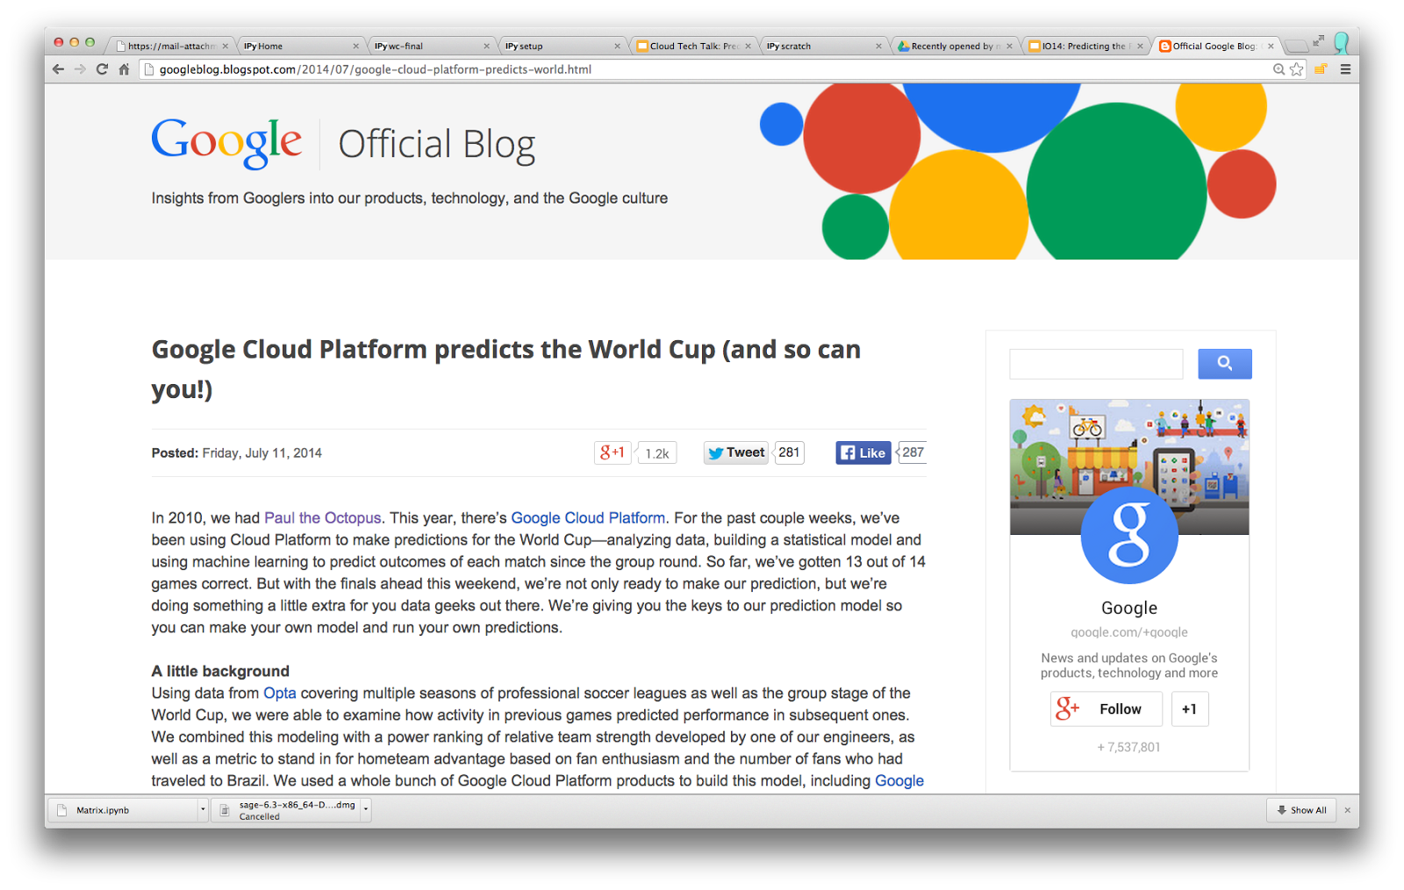

Slide 5
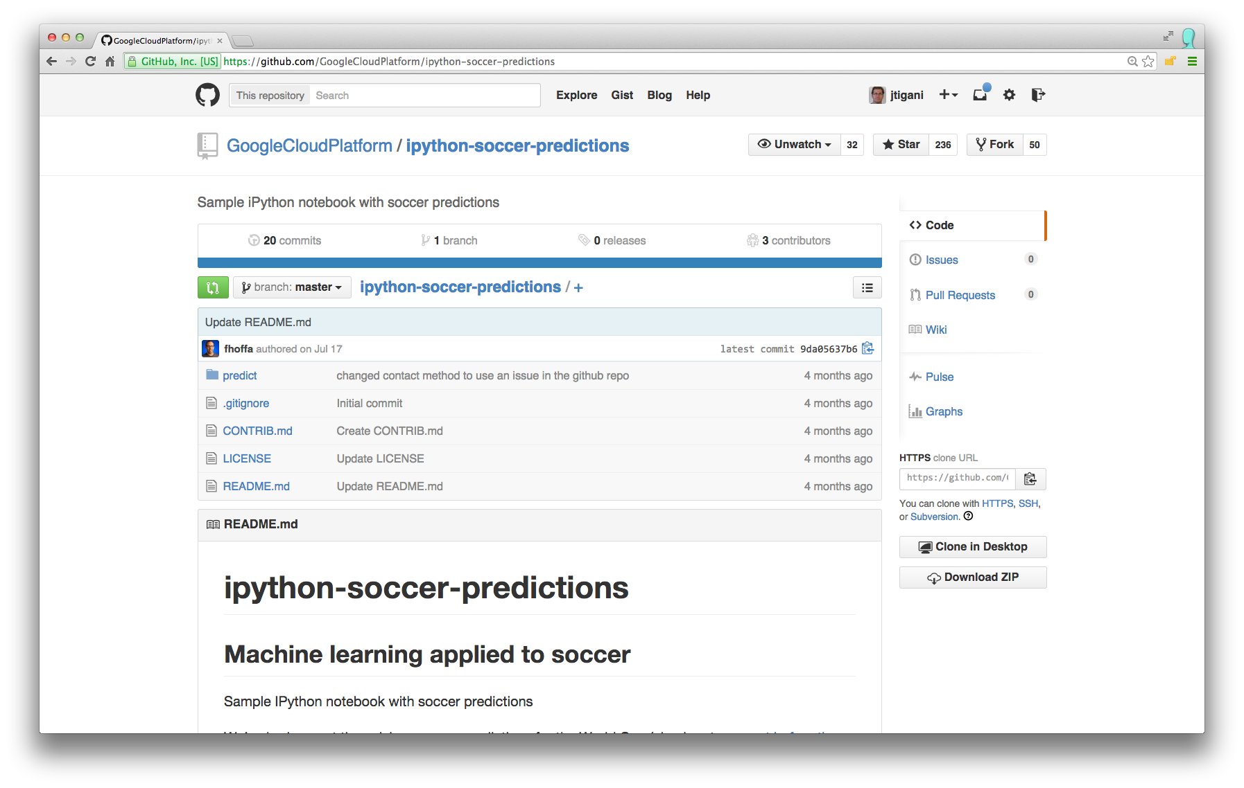
Notes:
TODO: Change to Github slide

Slide 6
IANAMLE
(I am not a machine learning expert)

Slide 7
IANAMLE
(I am not a machine learning expert)
… but I did out-predict a bavarian mollusk

Slide 8

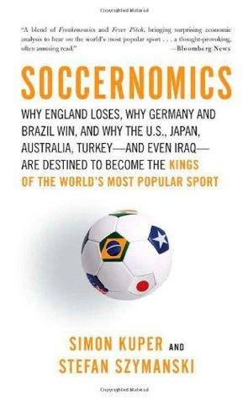
RTFM

Slide 9
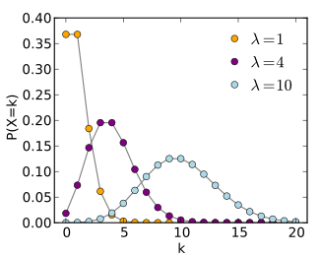
Notes:
http://upload.wikimedia.org/wikipedia/commons/thumb/1/16/Poisson_pmf.svg/325px-Poisson_pmf.svg.png

Slide 10
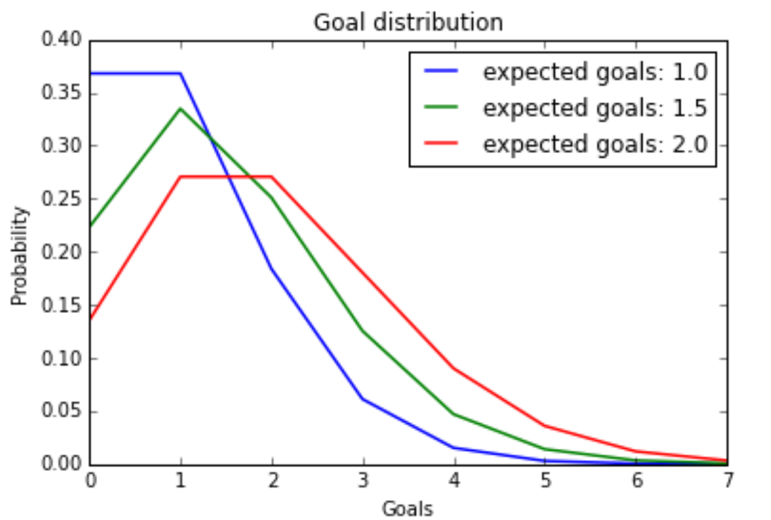
Notes:
Chart generated in iPython with pylab

Slide 11
Expected Goals(A) = 1.0
Expected Goals(B) = 1.5
P(A>B) = .25

Slide 12
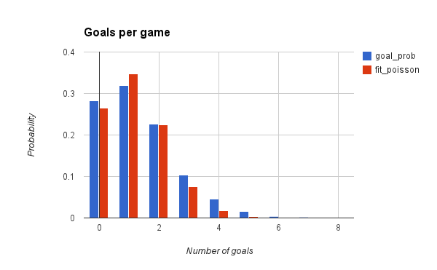
Notes:
Chart generated in google spreadsheets from own data.

Slide 13
tools

Slide 14
Google Cloud Platform
Dataflows to ingest raw data
BigQuery for feature computation
Compute Engine to run ML
Cloud Storage to transfer data

Slide 15
Open Source
Pandas to manipulate data
StatsModels / Scikit.learn for ML
Docker / Kubernates to launch
iPython to tie it all together

Slide 16
data modeling

Slide 17
Group A Winner
Group B Runner-up
Group B Winner
Quarterfinal #1
Group A Runner-up
Group C Winner
Semifinal #1
Group D Runner-up
Group D Winner
Quarterfinal #2
Group C Runner-up
Final
Group E Winner
Group F Runner-up
Group F Winner
Quarterfinal #3
Group E Runner-up
Group G Winner
Semifinal #2
Group H Runner-up
Group H Winner
Quarterfinal #4
Group G Runner-up
Notes:
Graphic Hand drawn in PPT

Slide 18
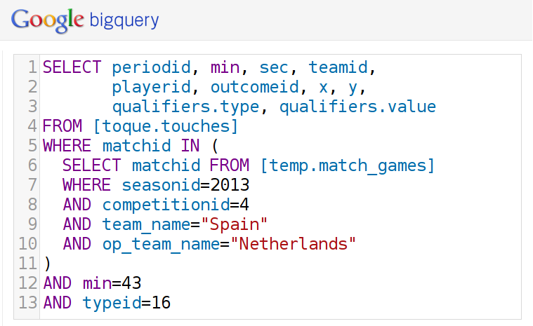
Notes:
http://espn.go.com/video/clip?id=11078816

Slide 19
type | qualifier | value
15 | Head
17 | Zone of pitch | Box-centre
22 | Regular Play
29 | Assisted
55 | Related event ID | 327
56 | Center
81 | Goal mouth zone | High Right
102 | Goal mouth y | 46.5
103 | Goal mouth z | 20.3
117 | Lob
154 | Intentional assist
215 | Individual Play
230 | GK X Coordinate | 4.2
231 | GK Y Coordinate | 50
periodid | 1
min | 43
sec | 25
playerid | 12297
x | 84.8
y | 50.9
Notes:
Screenshot from author’s presentation at google I/O 2014

Slide 20
feature selection

Slide 21
+ attacking passes
+ power
+ home team
+ expected goals
- corner kicks
- saves

Slide 22
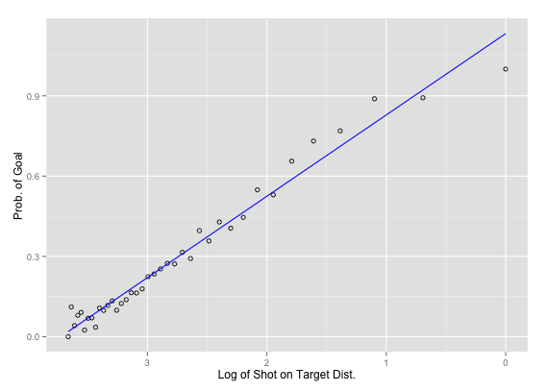
Notes:
Chart generated in R

Slide 23
machine learning

Slide 24
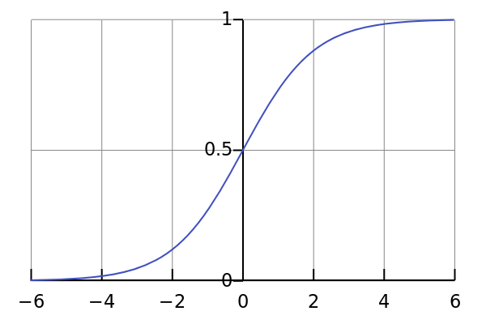
Notes:
Wikipedia public domain. http://en.wikipedia.org/wiki/Logistic_regression#mediaviewer/File:Logistic-curve.svg

Slide 25
Logistic Regression
import statsmodels.api as sm
x_train['intercept'] = 1.0
logit = sm.Logit(y_train, x_train)
model = logit.fit_regularized(
method = 'l1', alpha=16.0)
…
x_test['intercept'] = 1.0
predictions = model.predict(x_test)

Slide 26
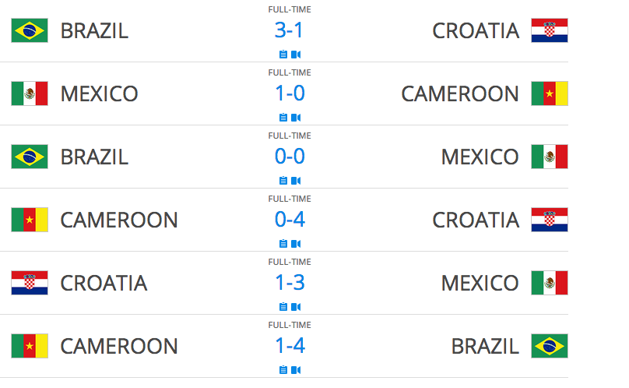
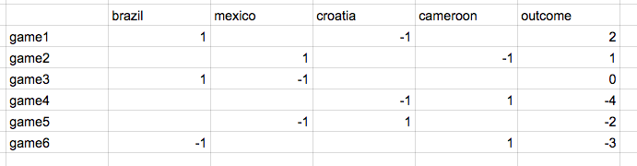
Notes:
Chart from wikipedia

Slide 27
Computing Power
model = sm.Logit(
target, df).fit_regularized(
method = 'l1', alpha=1.5)
params = model.params
del params['intercept']
params.sort(ascending=False)
np.exp(params)
cBr = [ 1, 0, 1, 0, 0, -1]
cMe = [ 0, 1, -1, 0, -1, 0]
cCr = [-1, 0, 0, -1, 1, 0]
cCa = [ 0, -1, 0, 1, 0, 1]
cGd = [ 2, 1, 0, -4, -2, -3]
d = {'brazil': pd.Series(cBr),
'mexico': pd.Series(cMe),
'croatia': pd.Series(cCr),
'camaroon': pd.Series(cCa)}
df = pd.DataFrame(d)
df['intercept'] = 1.0
target = pd.Series(cGd)

Slide 28
Computing Power (Out)
brazil 2.075934
mexico 1.075559
croatia 1.000000
camaroon 0.302167
dtype: float64

Slide 29
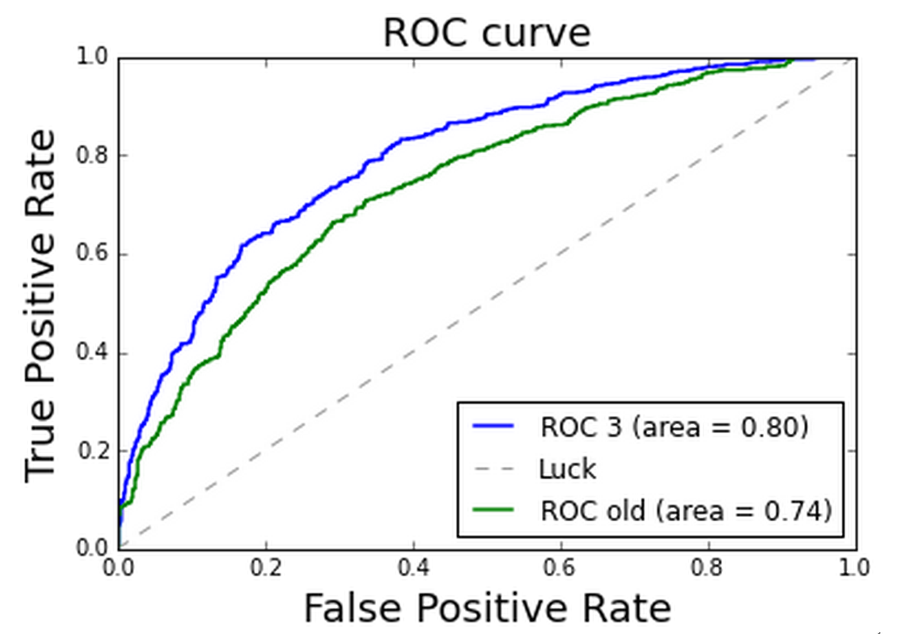
0.265378
0.347445
0.224255
0.075108
0.017535
0.003275
0.000521
0.000074
0.000009
Notes:
Chart generated in iPython

Slide 30
How did we do?

Slide 31
Round of 16: 8/8
Quarterfinals: 3/4
Semi-finals: 2/2
Third: 0/1 Final: 1/1
Total: 14/16

Slide 32
14/16 = 88%
That’s great, right?

Slide 33
what does it mean to be right?

Slide 34
prediction: predestination or probability?

Slide 35
with a random oracle:
P(14+/16) < 0.2%

Slide 36
football is only really predictable at around 70%
http://physics.ucsd.edu/do-the-math/2014/06/tuning-in-on-noise/

Slide 37
with a perfect oracle:
P(14+/16) < 10%
P(16/16) < 0.4%

Slide 38
what went wrong?

Slide 39
data bugs

Slide 40
Naive Goal Computation
SELECT matchid, teamid, COUNT(*) as goals
FROM [toque.touches]
WHERE typeid = 16
GROUP BY matchid, teamid

Slide 41
SELECT matchid, teamid, goals + delta as goals, timestamp as timestamp
FROM (
SELECT goals.matchid as matchid,
goals.teamid as teamid,
goals.goals as goals,
goals.timestamp as timestamp,
if (cr.cnt is not NULL, INTEGER(cr.cnt),
INTEGER(0)) - if (de.cnt is not NULL, INTEGER(de.cnt), INTEGER(0)) as delta
FROM (
SELECT matchid, teamid, SUM(goal) as goals,
MAX(TIMESTAMP_TO_USEC(timestamp)) as timestamp,
FROM (SELECT matchid, teamid, goal, game, timestamp,
FROM (SELECT matchid, teamid,
if (typeid == 16 and periodid != 5, 1, 0) as goal,
if (typeid == 34, 1, 0) as game,
eventid, timestamp,
FROM [toque.touches]
WHERE typeid in (16, 34))
) GROUP BY matchid, teamid) goals
LEFT OUTER JOIN (
SELECT games.matchid as matchid,
games.teamid as credit_team,
og.teamid as deduct_team,
og.own_goals as cnt
FROM (
SELECT matchid, teamid, count(*) as own_goals
FROM [toque.touches]
WHERE typeid = 16 AND qualifiers.type = 28
GROUP BY matchid, teamid) og
JOIN (SELECT matchid, teamid,
FROM [toque.touches]
GROUP BY matchid, teamid) games
ON og.matchid = games.matchid
WHERE games.teamid <> og.teamid) cr
ON goals.matchid = cr.matchid and goals.teamid = cr.credit_team
LEFT OUTER JOIN (
SELECT games.matchid as matchid,
games.teamid as credit_team,
og.teamid as deduct_team,
og.own_goals as cnt
FROM (
SELECT matchid, teamid, count(*) as own_goals
FROM [toque.touches]
WHERE typeid = 16 AND qualifiers.type = 28
GROUP BY matchid, teamid) og
JOIN (SELECT matchid, teamid, FROM [toque.touches]
GROUP BY matchid, teamid) games
ON og.matchid = games.matchid
WHERE games.teamid <> og.teamid) de
ON goals.matchid = de.matchid and goals.teamid = de.deduct_team)
Actual Goal Computation

Slide 42
Goal Computation Snafus
...
SELECT matchid, teamid,
if (typeid == 16 and periodid != 5, 1, 0) as goal,
if (typeid == 34, 1, 0) as game,
...
SELECT matchid, teamid, count(*) as own_goals
FROM [toque.touches]
WHERE typeid = 16 AND qualifiers.type = 28
GROUP BY matchid, teamid

Slide 43
design bugs

Slide 44
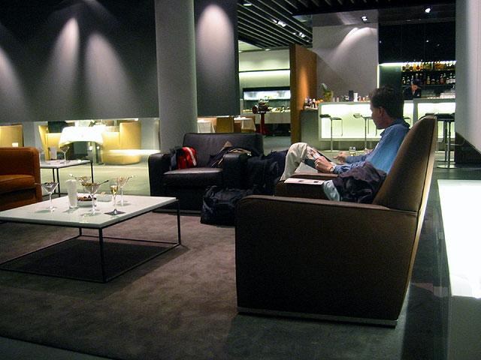
Notes:
Source: Wikipedia. http://upload.wikimedia.org/wikipedia/commons/2/2f/Fra_lh_firstterminal_seating.jpg

Slide 45
we still need better tools!

Slide 46
thank you!
e-mail: tigani@google
twitter: @jrdntgn
g+: +jordantigani
Office hour:
11:20-11:50 Table A

Slide 47
Backup

Slide 48
I haz machine learning, you can too!

Slide 49
we got lucky!
(so did everyone else who was predicting)

Slide 50
ReadTweetBatches
Lag 1s
Overall lag 1s
ExtractTweets
Lag 1s
Overall lag 2s
TweetSentiment
Translate
Lag 7s
Overall lag 9s
Tag
Lag 1s
Overall lag 10s
Sentiment
Lag 11s
Overall lag 21s
AverageHappiness .
Lag 3s
Overall lag 24s
HappiestTweets .
Lag 3s
Overall lag 24s
JASONify
Lag 1s
Overall lag 25s
JASONify
Lag 1s
Overall lag 25s
WriteToPubsub
Lag 1s
Overall lag 26s
WriteToPubsub
Lag 1s
Overall lag 26s
Notes:
Screenshot from google dataflows

Slide 51
Launching a VM
gcloud compute instances create $1 \
--image container-vm-v20140731 \
--image-project google-containers \
--zone us-central1-a \
--machine-type n1-standard-1 \
--scopes storage-full bigquery datastore sql \
--metadata-from-file google-container-manifest=preview_vm.yml \
startup-script=preview_vm_startup.sh

Slide 52
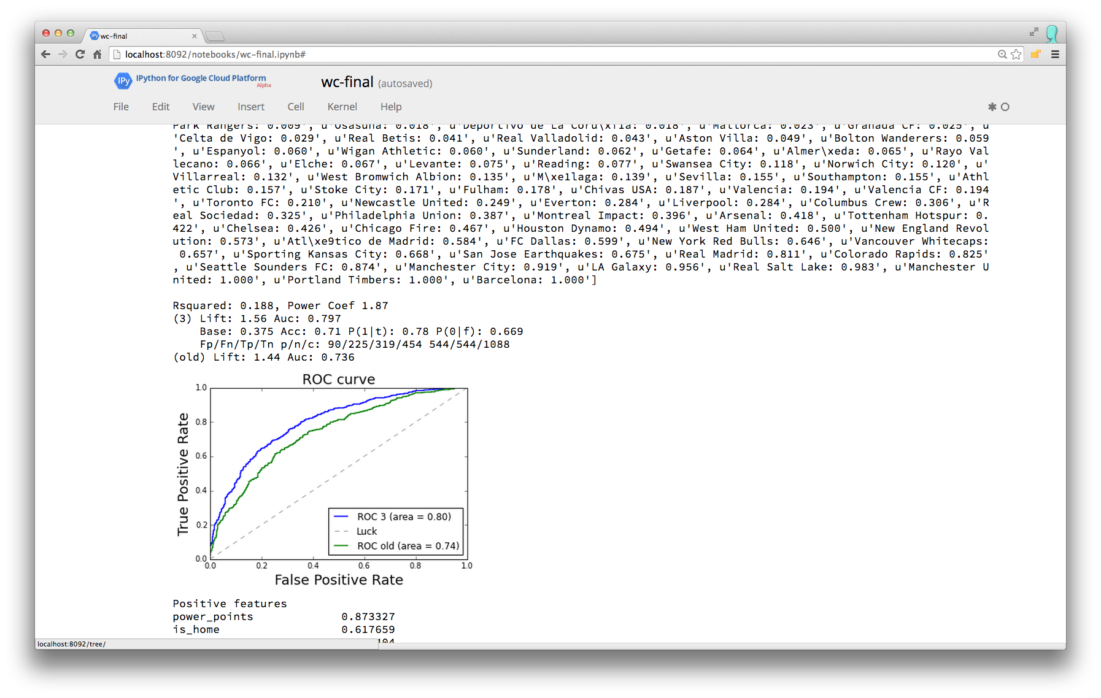
Notes:
Screenshot from iPython

Slide 53
When in doubt, ask the experts
Notes:
TODO: Recreate chart

Slide 54

Notes:
https://www.flickr.com/photos/tt2times/2568645910/in/photostream/
CreativeCommons v2.0

