Slide 1



Search Query Categorization at Scale
Alex Dorman, CTO
alex at magnetic dot com
Michal Laclavik, Sr. Data Scientist
michal.laclavik at magnetic dot com

Slide 2
















About Magnetic
First company to focus 100% on applying search intent to display
Proprietary media platform and targeting algorithm
One of the largest aggregators of intent data
Display, mobile, video and social retargeting capabilities
Strong solution for customer acquisition and retention
2

Slide 3

Search Data - Natural and Navigational
Natural Searches and Navigational Searches
Navigational Search:
“iPad Accessories”
Natural Search:
“iPhone”

Slide 4
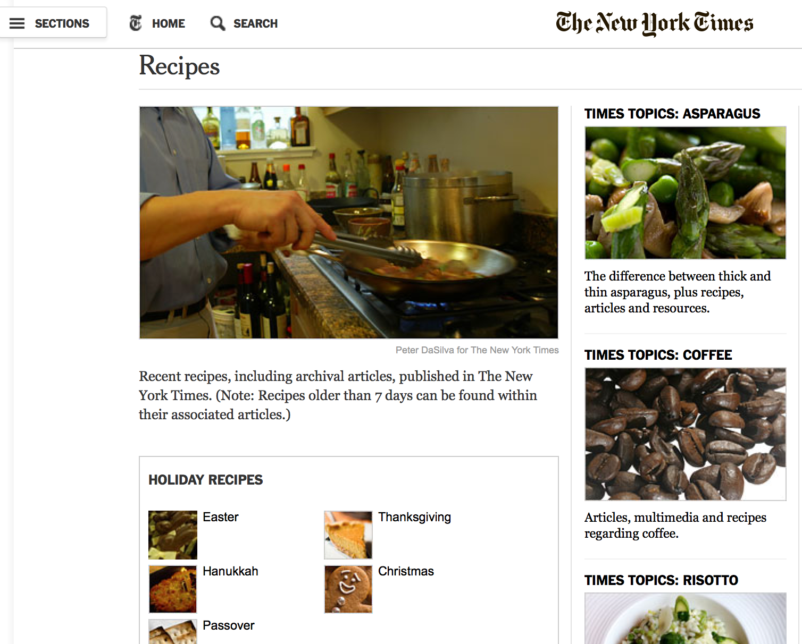
Search Data – Page Keywords
Page keywords from article metadata:
“Recipes, Cooking, Holiday Recipes”

Slide 5
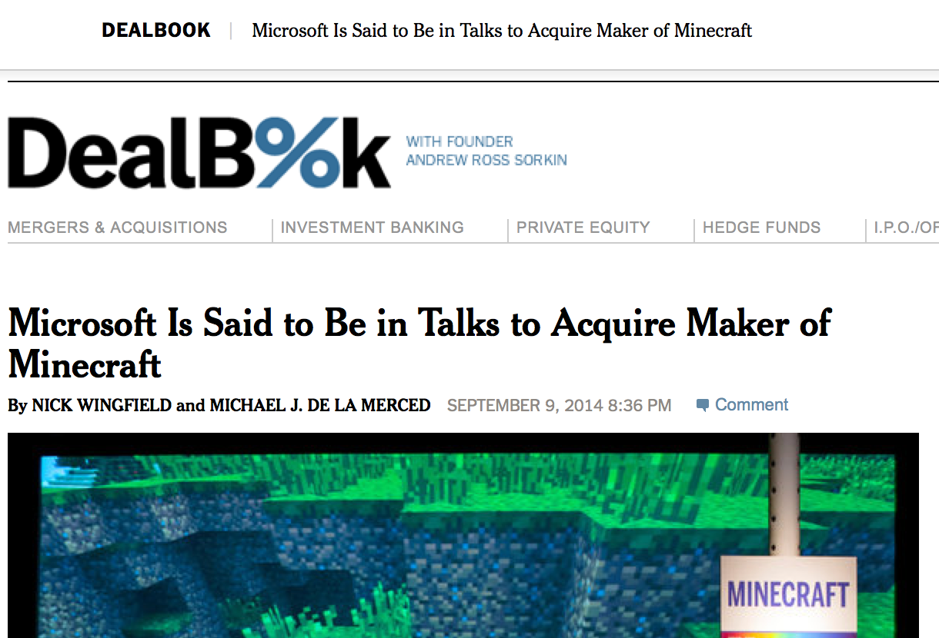
Search Data – Page Keywords
Article Titles:
“Microsoft is said to be in talks to acquire Minecraft”

Slide 6
Search Data – Why Categorize?
Targeting categories instead of keywords = Scale
Use category name to optimize advertising as an additional feature in predictive models
Reporting by category is easier to grasp as compared to reporting by keyword

Slide 7
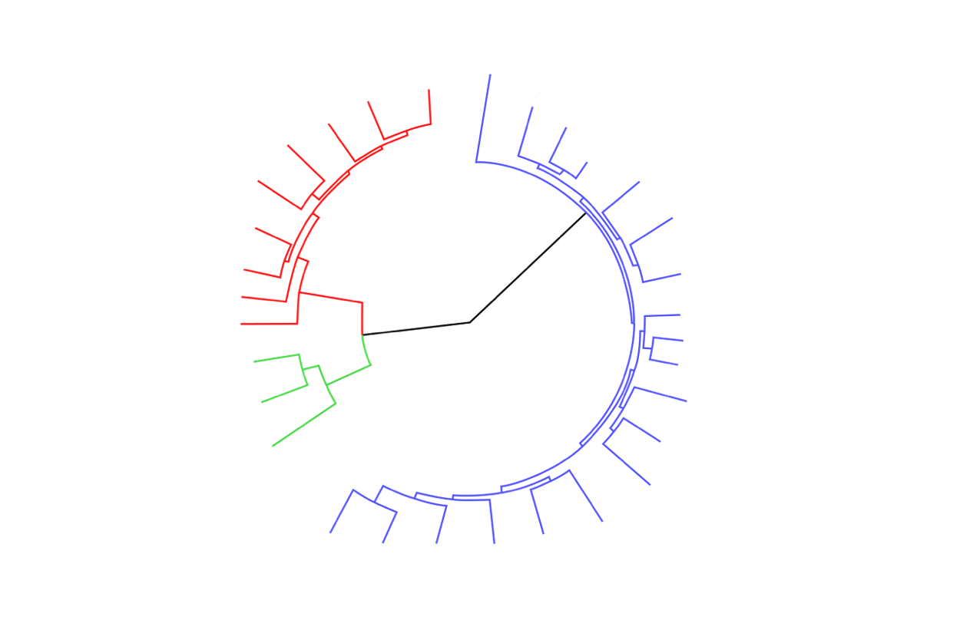

Query Categorization Problem
Input: Query
Output: Classification into a predefined taxonomy
?

Slide 8
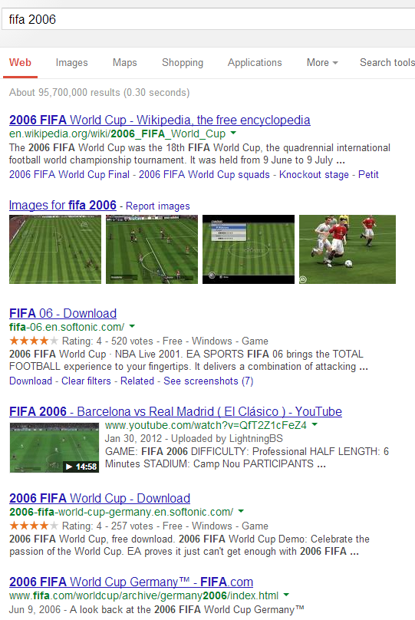
Query Categorization
Usual approach:
  Get results for query
  Categorize returned documents
Best algorithms work with the entire web (search API)
Query | Categories
apple | Computers \ Hardware Living \ Food & Cooking
FIFA 2006 | Sports \ Soccer Sports \ Schedules & Tickets Entertainment \ Games & Toys
cheesecake recipes | Living \ Food & Cooking Information \ Arts & Humanities
friendships poem | Information \ Arts & Humanities Living \ Dating & Relationships

Slide 9

Long Time Ago …
Relying on Bing Search API:
  Get search results using the query we want to categorize
  See if some category-specific “characteristic“ keywords appear in the results
  Combine scores
  Not too bad....

Slide 10
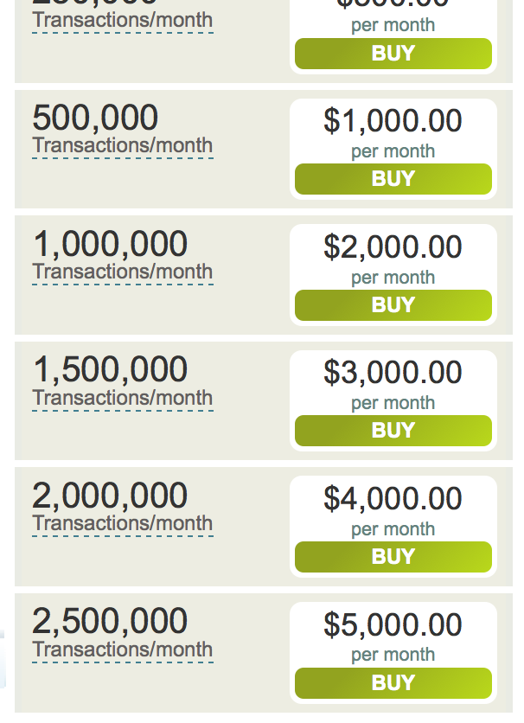
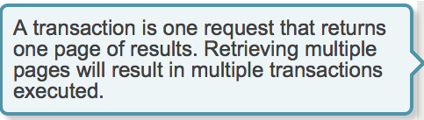
Long Time Ago …
... But ....
.... We have ~8Bn queries per month to categorize ....
$2,000 * 8,000 = Oh My!

Slide 11

Our Query Categorization Approach – Take 2
Use web replacement – Wikipedia

Slide 12
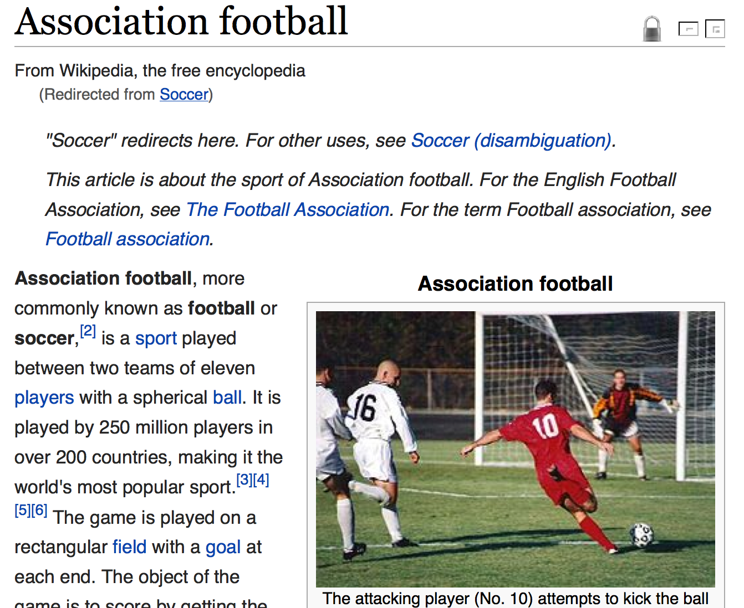
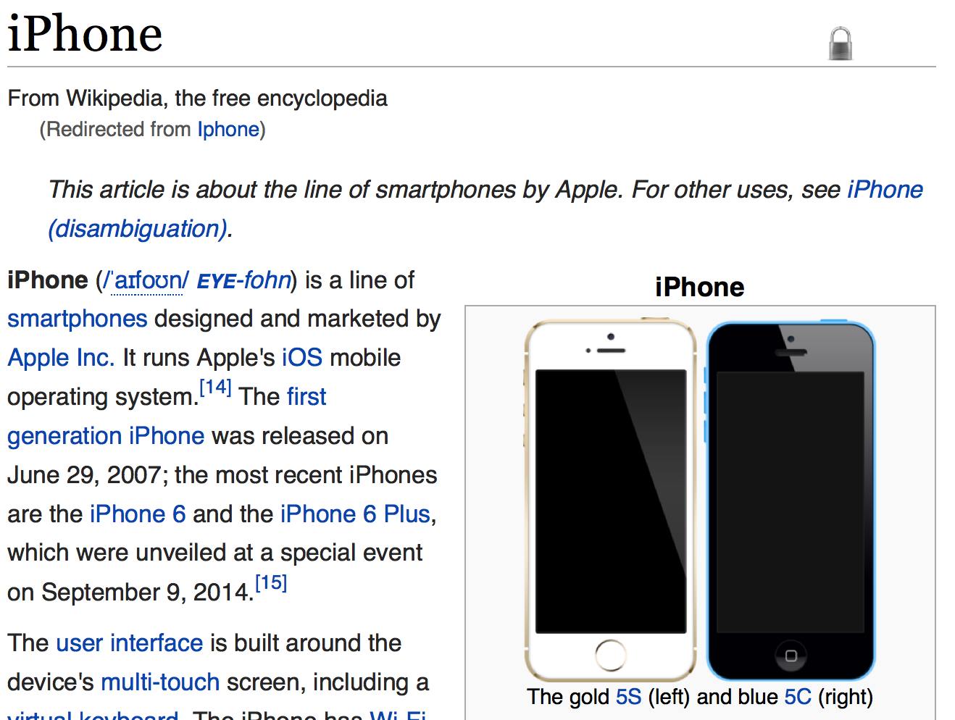
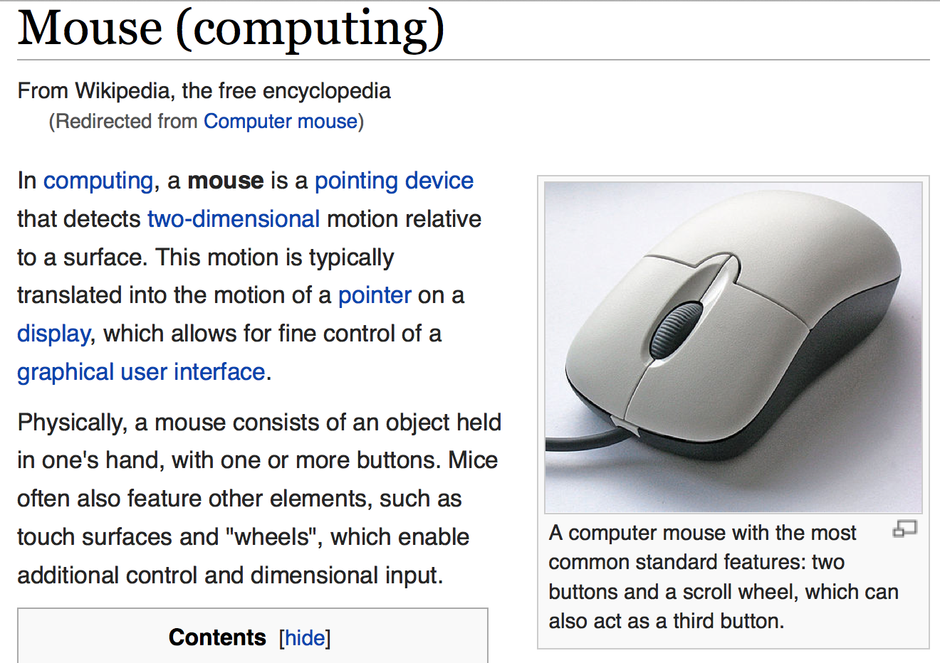
Our Query Categorization Approach – Take 2
A
Assign a category to each Wikipedia document (with a score)
Load all documents and scores into an index
Search within the index
Compute the final score for the query
B
C
C
B
C

Slide 13
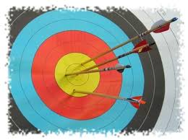
Measuring Quality

Slide 14
Measuring Quality
Precision is the fraction of retrieved documents that are relevant to the find
Recall is the fraction of the documents that are relevant to the query that are successfully retrieved.

Slide 15
Measuring Quality
Measure result quality using F1 Score:

Slide 16

Measuring Quality
Prepare test set using manually annotated queries
10,000 queries annotated by crowdsourcing to Magnetic employees

Slide 17

Step-by-Step
Let’s go into details
17

Slide 18

Query Categorization - Overview
A
Assign a category to each Wikipedia document (with a score)
Load all documents and scores into an index
Search within the index
Compute final score for the query
How?
B
C
C
B
C

Slide 19
Step-by-Step
Create Map
Category: {seed documents}
Parse Wikipedia:
Document:
{title, redirects, anchor text, etc}
Compute N-grams:
Category: {n-grams: score}
Categorize Documents
Document:
{title, redirects, anchor text, etc} {category: score}
Preparation Steps
Build index
Query
Search within index
Combine scores from each document in results
Real Time Query Categorization
Query: {category: score}
19

Slide 20
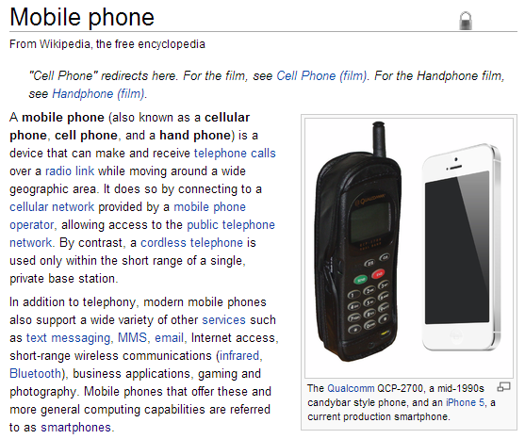
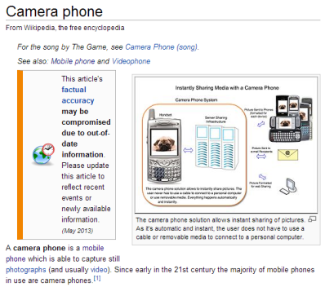
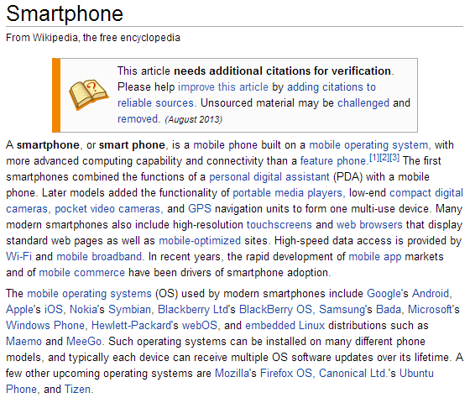
Step By Step – Seed Documents
Each category represented by one or multiple wiki pages (manual mapping)
Example: Electronics & Computing\Cell Phone
  Mobile phone
  Smartphone
  Camera phone

Slide 21
N-grams Generation From Seed Wikipages
Wikipedia is rich on links and metadata.
We utilize links between pages to find “similar concepts”.
Set of similar concepts is saved as list of n-grams

Slide 22
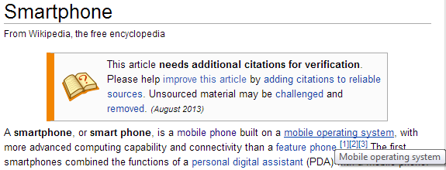
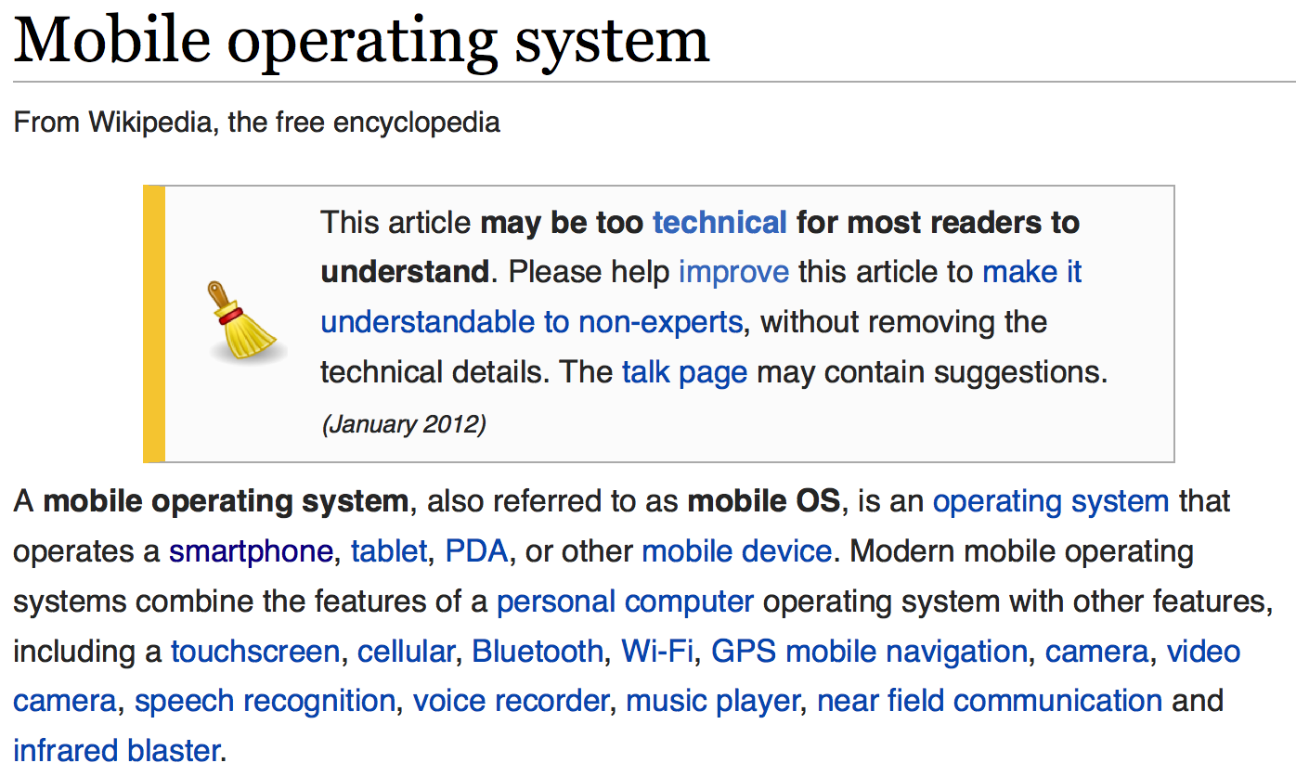
N-grams Generation From Seed Wikipages and Links
Mobile phone 1.0
Smartphone 1.0
Camera phone 1.0
Mobile operating system 0.3413
Android (operating system) 0.2098
Tablet computer 0.1965
Comparison of smartphones 0.1945
Personal digital assistant 0.1934
IPhone 0.1926
For each link we compute similarity of linked page with the seed page (as cosine similarity)

Slide 23
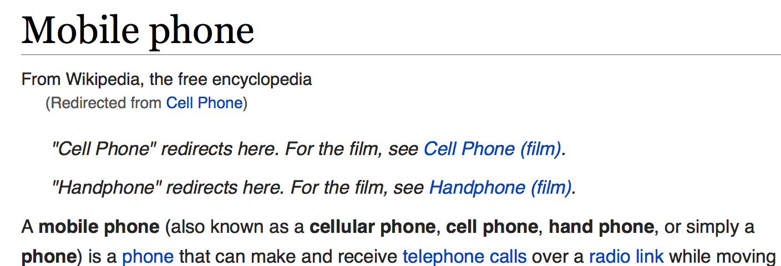
Extending Seed Documents with Redirects
There are many redirects and alternative names in Wikipedia.
For example “Cell Phone” redirects to “Mobile Phone”
Alternative names are added to the list of n-grams of this category
Mobil phone 1.0
Mobilephone 1.0
Mobil Phone 1.0
Cellular communication standard 1.0
Mobile communication standard 1.0
Mobile communications 1.0
Environmental impact of mobile phones 1.0
Kosher phone 1.0
How mobilephones work? 1.0
Mobile telecom 1.0
Celluar telephone 1.0
Cellular Radio 1.0
Mobile phones 1.0
Cellular phones 1.0
Mobile telephone 1.0
Mobile cellular 1.0
Cell Phone 1.0
Flip phones 1.0
…..

Slide 24
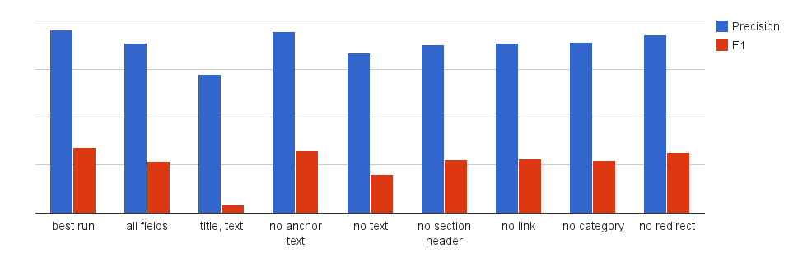
Creating index – What information to use?
Some information in Wikipedia helped more than other
We’ve tested combinations of different fields and applied different algorithms to select approach with the best results
Data Set for the test – KDD 2005 Cup “Internet User Search Query Categorization” – 800 queries annotated by 3 reviewers

Slide 25
Creating index – Parsed Fields
Fields for Categorization of Wikipedia documents:
  title
  abstract
  db_category
  fb_category
  category

Slide 26
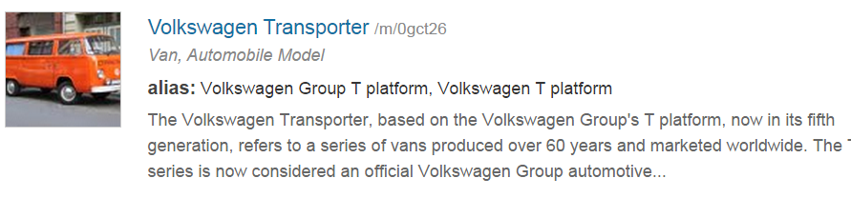
What else goes into the index– Freebase, DBpedia
Some of Freebase/DBpedia categories are mapped to Magnetic Taxonomy (manual mapping)
(Freebase and DBpedia have links back to Wikipedia documents)
Examples:
  Arts & Entertainment\Pop Culture & Celebrity News:
  Celebrity; music.artist; MusicalArtist; …
  Arts & Entertainment\Movies/Television:
  TelevisionStation; film.film; film.actor; film.director; …
  Automotive\Manufacturers:
  automotive.model, automotive.make

Slide 27
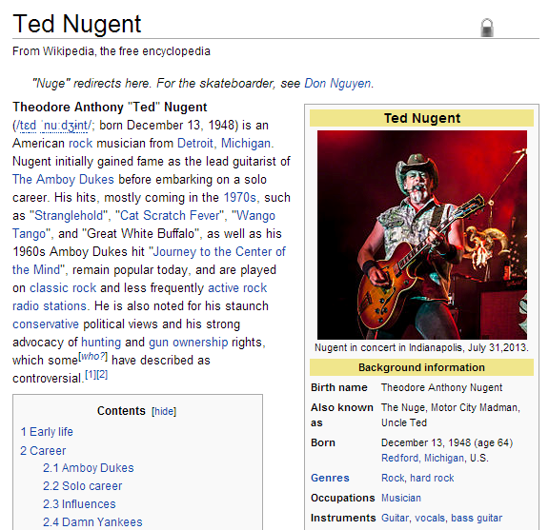
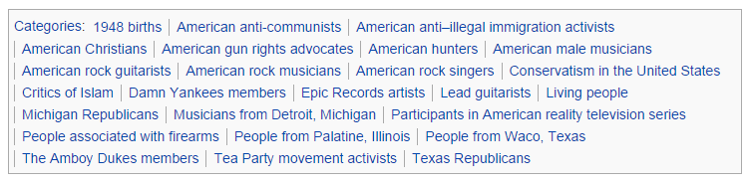
Wikipedia page categorization: n-gram matching
Ted Nugent
Theodore Anthony "Ted" Nugent ( ; born December 13, 1948) is an American rock musician from Detroit, Michigan. Nugent initially gained fame as the lead guitarist of The Amboy Dukes before embarking on a solo career. His hits, mostly coming in the 1970s, such as "Stranglehold", "Cat Scratch Fever", "Wango Tango", and "Great White Buffalo", as well as his 1960s Amboy Dukes …
Article abstract
rock and roll, 1970s in music, Stranglehold (Ted Nugent song), Cat Scratch Fever (song), Wango Tango (song), Conservatism in the United States, Gun politics in the United States, Republican Party (United States)
Additional text from abstract links

Slide 28

Wikipedia page categorization: n-gram matching
Categories of Wikipedia Article

Slide 29
Wikipedia page categorization: n-gram matching
Found n-gram keywords with scores for categories
rock musician - Arts & Entertainment\Music:0.08979
Advocate - Law-Government-Politics\Legal:0.130744
christians - Lifestyle\Religion and Belief:0.055088;
- Lifestyle\Wedding & Engagement:0.0364
gun rights - Negative\Firearms:0.07602
rock and roll - Arts & Entertainment\Music:0.104364
reality television series
- Lifestyle\Dating:0.034913;
- Arts&Entertainment\Movies/Television:0.041453
...

Slide 30

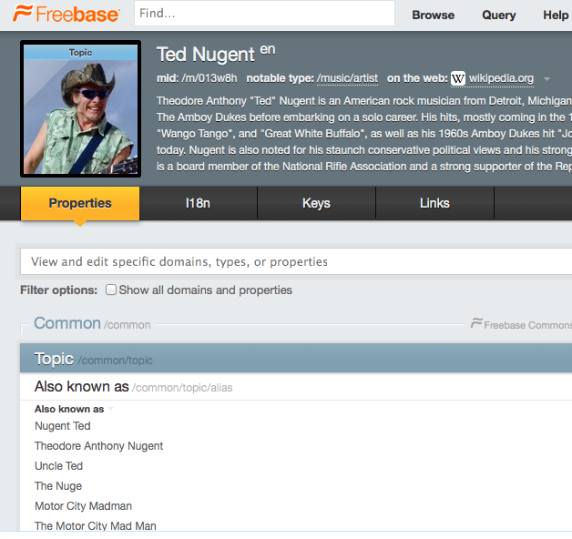

Wikipedia page categorization: n-gram matching
book.author - A&E\Books and Literature:0.95
Musicgroup - A&E\Pop Culture & Celebrity News:0.95;
- A&E\Music:0.95
tv.tv_actor - A&E\Pop Culture & Celebrity News:0.95;
- A&E\Movies/Television:0.95
film.actor - A&E\Pop Culture & Celebrity News:0.95;
- A&E\Movies/Television:0.95
…
DBpedia, Freebase mapping
base.livemusic.topic; user.narphorium.people.topic; user.alust.default_domain.processed_with_review_queue; common.topic; user.narphorium.people.nndb_person; book.author; music.group_member; film.actor; … ; tv.tv_actor; people.person; …
Freebase Categories found and matched
MusicalArtist; MusicGroup; Agent; Artist; Person
DBpedia Categories found and matched

Slide 31
Wikipedia page categorization: results
Document: Ted Nugent
Arts & Entertainment\Pop Culture & Celebrity News:0.956686
Arts & Entertainment\Music:0.956681
Arts & Entertainment\Movies/Television:0.954364
Arts & Entertainment\Books and Literature:0.908852
Sports\Game & Fishing:0.874056
Result categories for document combined from:
text n-gram matching
DBpedia mapping
Freebase mapping

Slide 32
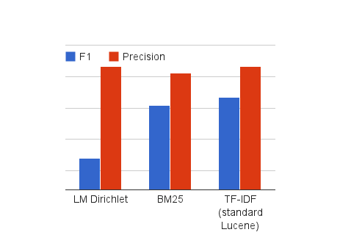
Query Categorization
Take search fields
Search using standard Lucene’s implementation of TF/IDF scoring
Get results
Filter results using alternative name
Combine remaining document pre-computed categories
Remove low confidence score results
Return resulting set of categories with confidence score

Slide 33
Query Categorization: search within index
Searching within all data stored in Lucene index
Computing categories for each result normalized by Lucene score
Example: “Total recall Arnold Schwarzenegger”
List of documents found (with Lucene score):
  1. Arnold Schwarzenegger filmography; score: 9.455296
  2. Arnold Schwarzenegger; score: 6.130941
  3. Total Recall (2012 film); score: 5.9359055
  4. Political career of Arnold Schwarzenegger; score: 5.7361355
  5. Total Recall (1990 film); score: 5.197826
  6. List of awards and nominations received by Arnold Schwarzenegger; score: 4.9710693
  7. California gubernatorial recall election; score: 4.9665976
  8. Patrick Schwarzenegger; score: 3.2915113
  9. Recall election; score: 3.2077827
  10. Gustav Schwarzenegger; score: 3.1247897

Slide 34
Prune Results Based on Alternative Names
Searching within all data stored in Lucene index
Computing categories for each result normalized by Lucene score
Example: “Total recall Arnold Schwarzenegger”
List of documents found (with Lucene score):
  1. Arnold Schwarzenegger filmography; score: 9.455296
  2. Arnold Schwarzenegger; score: 6.130941
  3. Total Recall (2012 film); score: 5.9359055
  4. Political career of Arnold Schwarzenegger; score: 5.7361355
  5. Total Recall (1990 film); score: 5.197826
  6. List of awards and nominations received by Arnold Schwarzenegger; score: 4.9710693
  7. California gubernatorial recall election; score: 4.9665976
  8. Patrick Schwarzenegger; score: 3.2915113
  9. Recall election; score: 3.2077827
  10. Gustav Schwarzenegger; score: 3.1247897
Alternative Names:
total recall (upcoming film),
total recall (2012 film), total recall,
total recall (2012), total recall 2012
”Total recall Arnold Schwarzenegger”

Slide 35
Prune Results Based on Alternative Names
Matched using alternative names
  1. Arnold Schwarzenegger filmography; score: 9.455296
  2. Arnold Schwarzenegger; score: 6.130941
  3. Total Recall (2012 film); score: 5.9359055
  4. Political career of Arnold Schwarzenegger; score: 5.7361355
  5. Total Recall (1990 film); score: 5.197826
  6. List of awards and nominations received by Arnold Schwarzenegger; score: 4.9710693
  7. California gubernatorial recall election; score: 4.9665976
  8. Patrick Schwarzenegger; score: 3.2915113
  9. Recall election; score: 3.2077827
  10. Gustav Schwarzenegger; score: 3.1247897

Slide 36
Retrieve Categories for Each Document
  2. Arnold Schwarzenegger; score: 6.130941
  Arts & Entertainment\Movies/Television:0.999924
  Arts & Entertainment\Pop Culture & Celebrity News:0.999877
  Business:0.99937
  Law-Government-Politics\Politics:0.9975
  Games\Video & Computer Games:0.986331
  3. Total Recall (2012 film); score: 5.9359055
  Arts & Entertainment\Movies/Television:0.999025
  Arts & Entertainment\Humor:0.657473
  5. Total Recall (1990 film); score: 5.197826
  Arts & Entertainment\Movies/Television:0.999337
  Games\Video & Computer Games:0.883085
  Arts & Entertainment\Hobbies\Antiques & Collectables:0.599569

Slide 37
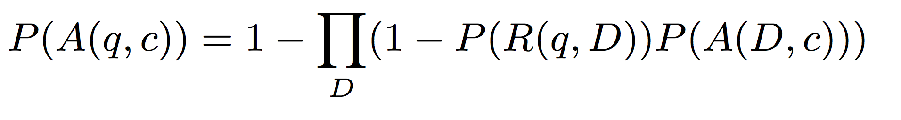
Combine Results and Calculate Final Score
“Total recall Arnold Schwarzenegger”
Arts & Entertainment\Movies/Television:0.996706
Games\Video & Computer Games:0.960575
Arts & Entertainment\Pop Culture & Celebrity News:0.85966
Business:0.859224
Notes:
If P(A(x,c)) is the probability that entity (query or document) x should be assigned to category c, than we can combine scores from multiple documents using following formula:
P(R(q, D)) is the probability that query q is related to the document D
P(A(D, c)) is the probability that document D should be assigned to category c

Slide 38
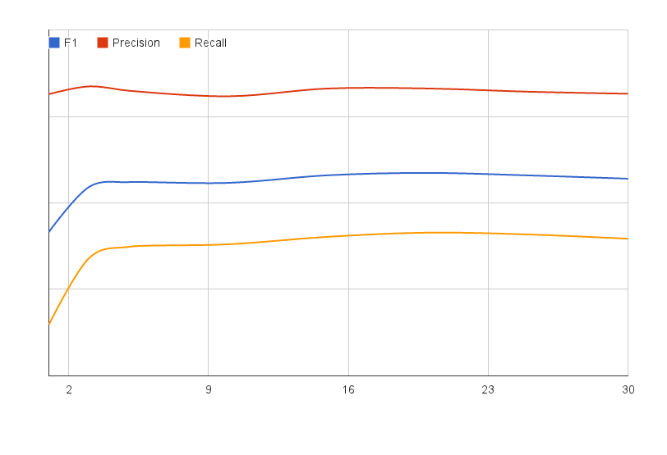
Combining Scores
Should we limit number of documents in result set?
Based on research we decided to limit to the top 20

Slide 39
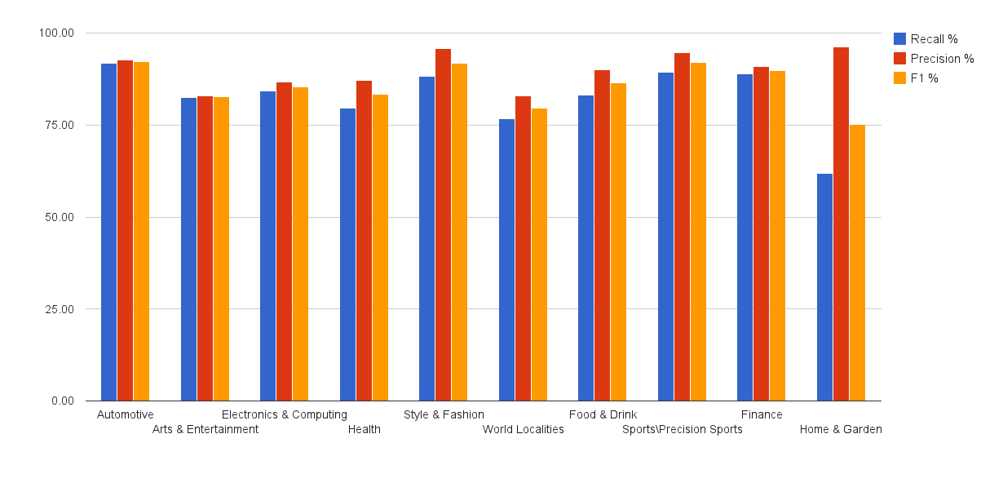
Precision/Recall
Based on 10,000 queries annotated by crowdsourcing to Magnetic employees

Slide 40
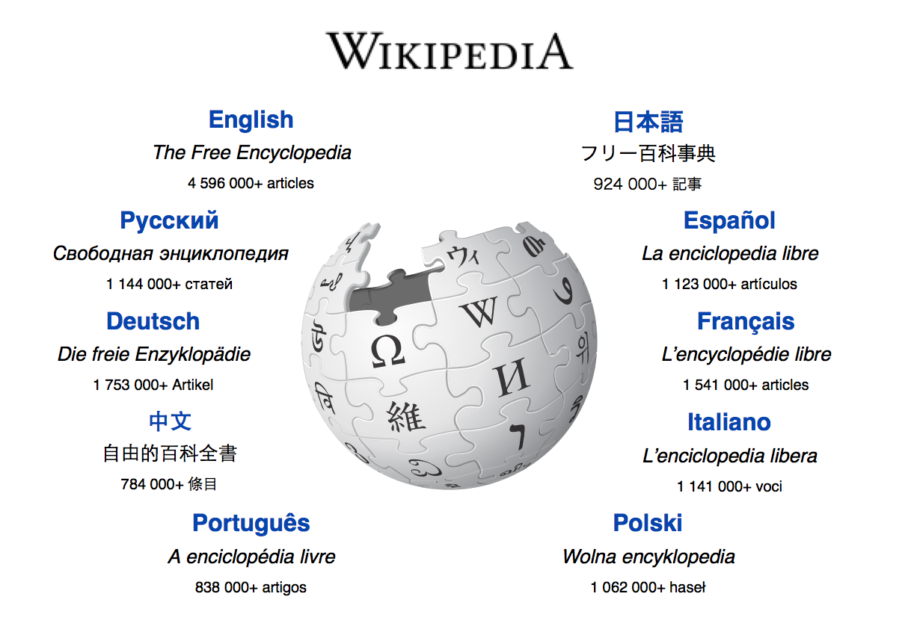
Categorizing Other Languages
1 000 000+ Documents:
Deutsch
English
Español
Français
Italiano
Nederlands
Polski
Русский
Sinugboanong Binisaya
Svenska
Tiếng Việt
Winaray

Slide 41

Categorizing Other Languages
In development: First tests on Spanish
Combining indexes for multiple languages into one common index
Challenges:
  Many international terms in queries (brands, product names, places …)
  About 30% of queries use ASCII instead of special language characters where they should be used
  Same terms mean different things in different languages and cultural context.
  Foreign Wikipedias are much smaller:
    Should we extend knowledge base behind Wikipedia?
    We need to accommodate other sources of alternative names to do proper search result filtering, e.g. link anchors or section headers

Slide 42




Query Categorization: Scaling Up
Hadoop MR pipeline
Map
In-Map Cache
Cache
(Varnish)
Solr Search Engine
Map
In-Map Cache
Index
Load Balancer
Real-Time Applications
DBpedia Dump
Freebase Dump
Wikipedia
Dump
Preprocessing workflow on Hadoop
Categorize Wikipedia documents
Build Solr index
Every 2 weeks

Slide 43
Query Categorization: Scale
Setup:
6 Solr/Varnish servers (16 cores, 64GB RAM)
Processing one hour of Search data we collect from our Data Providers:
45M rows file
120-map Hadoop job
Results:
Executed in 10 minutes
Peak throughput 100,000 records per second
Up to 90% in-map cache hit rate
Additional 80% Varnish cache hit rate
1000 req/sec for one Solr/Varnish server
300 categorizations/sec per server if Varnish is disabled

Slide 44
Lessons Learned
Invest time in manually annotated “control” dataset. Have more than one person annotating the same query.
You don’t have to have whole Internet indexed or be a big company to implement large-scale, multilingual categorization
Sometimes less is more. Focusing on abstracts and links in documents helped us to improve precision
Invest in data processing workflow automation.
Know your data. Tailor your technical solution to your data

Slide 45
Q&A
Q & A

