Slide 1
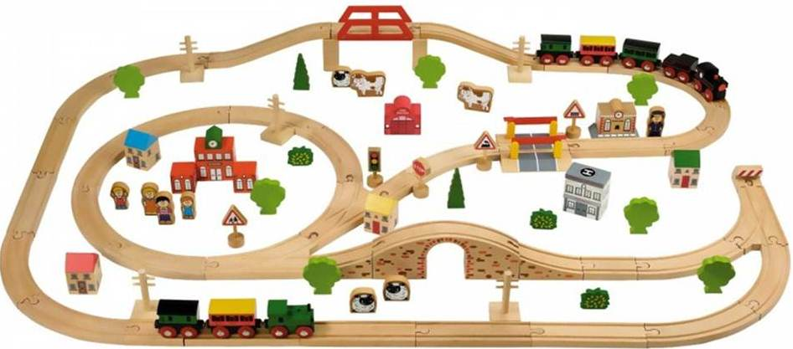
The Internet of Trains
Dr. Frank Säuberlich
Director Advanced Analytics
Teradata International

Slide 2

The Internet of Trains
Introduction – challenges in rail transportation
Digiltilization and the advent of mobility data services
Use Case Example: predictive maintenance for regional trains
Questions and Feedback

Slide 3
Introduction
Challenges in rail transportation
Rail manufacturing is a low-margin, high-risk industry. Operating conditions can change dramatically over the long lifecycles in rail (10-year vehicle delivery cycles, 30-year operating cycles).
In Europe, each country has adopted its own systems for rail transport. Incompatibility among the various information systems and processes on trains, and between trains and the wayside, creates a complex networking environment.
Need for differentiation: Rail industry expansion, liberalization, and increased competition are driving the need for rail companies to innovate to capture new market share.

Slide 4
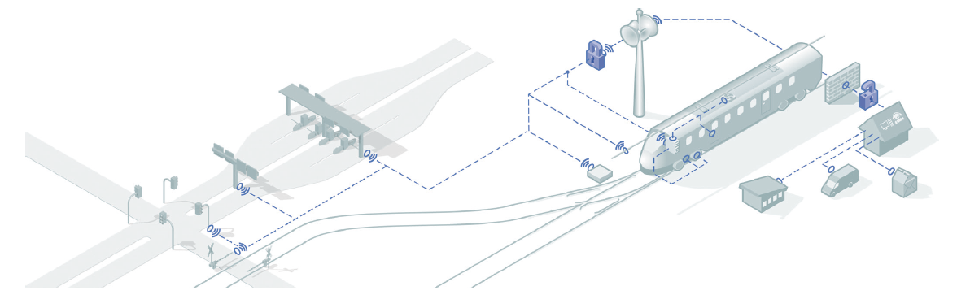
Digitalization
reflects reality and allows deeper system understanding
Capturing processes is the beginning of analytical examination and creates an integrated, deeper understanding of systems
If you know the system, you can use it more efficiently – this is possible by remote-based condition monitoring
Latest technique and expert knowledge increase mobility system availability
Global field data is analyzed as basis for the “Mobility Data Services”

Slide 5
Mobility Services
The future of maintenance already in operation today
Technical complexity
Reliability / performance guarantees
New business models
Maintenance driven by actual condition
Transfer of diagnostic data and remote monitoring
Service according to predicted status of system
Failure-prediction through analysis of patterns and trends
Maintenance before failure occurs
Based on fixed intervals and visual inspection
Corrective maintenance after incidents occurred
Time
Reactive
Maintenance
Preventive Maintenance
Condition-based Maintenance
Predictive Maintenance
Next Generation Maintenance
Continuous optimization of existing technology and projects
Consequent push of innovations and technological progress

Slide 6
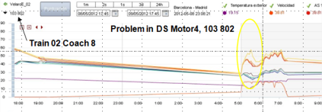
Digitalization creates real value
Success story from High-Speed Trains in Spain
High-speed trains in Spain successfully compete with planes
“Performance-based-maintenance” concept with flexible intervals
Only one of 2,300 rides is noticeable delayed – substantial criterion for business success since passengers are fully reimbursed with fare when delay is over 15 minutes
Continuously winning passengers from plane between major cities in Spain
Predictive Maintenance approach
Sensors measure constantly key parameters of e.g. the traction motor bearings
Analytics on the data enables a stable incident prediction
Abnormal patterns trigger an inspection ticket for the train and prevent failure on the track

Slide 7
Project Example 1
UK regional train
Large European train operator wanted to leverage engine sensor data to predict train failure
Started with a small training set consisting of roughly one million sensor log observations and several thousand Engineer reports describing failure / fix
Process was to: correlate sensor and engineering data; classify sensor readings; “sessionize” the data into relevant intervals; model the target variable (engine problem Y/N)

Slide 8
Data Overview
Train fleet
27 trains in the data set
Engine problems
Data set of all motor related problems from engineer reports; filtered and categorized into relevancy groups for prediction using business expert feedback; categories used: 0 = non relevant, 1 = normal, 2 = very relevant
Sensor readings (1 full year)
Cyclical sensor readings from trains (captured every 5 minutes).

Slide 9
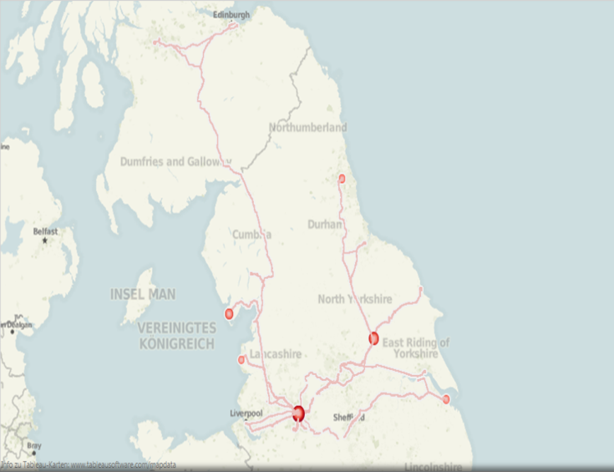
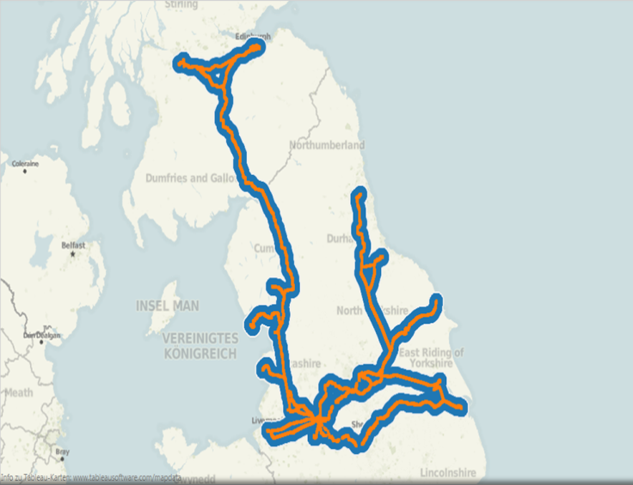
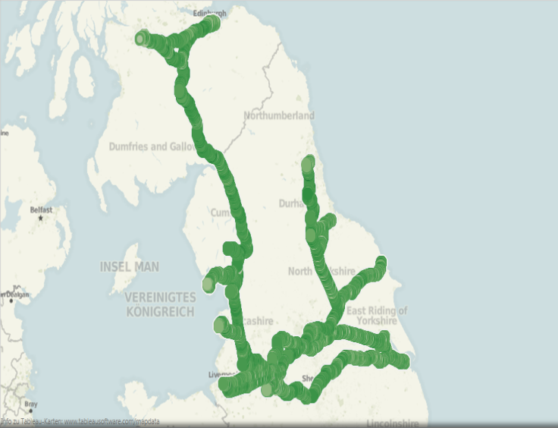
Exploratory Analytics
Using Sensor Data GPS location information
Mapping of number sensor readings
Where do engine failures happen?
Map readings of individual sensors

Slide 10
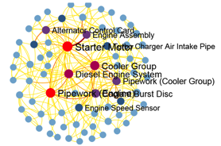
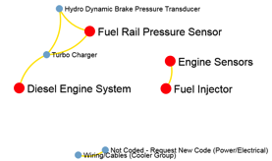
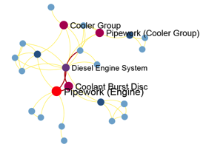
Exploratory Analytics
Using Aster Affinity Function
All engine problems
Relevant = 1
Relevant = 2
Nodes represent single repair codes;
A line between nodes means that the two connected repair codes have appeared in the same train at least once (thicker lines mean more occurrences);
This analysis supports the identification of components that fail in combination - and variables that are likely to be useful in predicting the target variable.

Slide 11
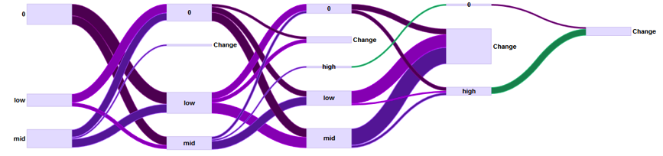
Exploratory Analytics
Using Aster nPath function
Pathing the predictive variables identified in the affinity analysis leads to further insight;
For example, a daily pattern of Engine Temperature readings of mid – low – mid often appears 3 days ahead of engine failure.
We used this approach to identify the most relevant groupings of „low – mid – high“ for individual sensors

Slide 12
Analytics – Predictive Modeling
Using Decision Tree Algorithm
Engine temperature high daily pct <=0.222
Coolant temperature high daily pct <=0.204
Gear Power output low daily percentage <=0.44
Gear Oil Temp high daily percentage <= 0.256
Gear Power output low daily percentage <=0.628
We have used a decision tree algorithm to predict Engine Failures on the hourly aggregated data set
The algorithm used was a random forest algorithm as available in Aster
Node 0
Failure Pct
3.55%
Node 1
Failure Pct
3.41%
Node 286
Failure Pct
46.32%
Node 2
Failure Pct
3.20%
Node 269
Failure Pct
15.98%
Node 287
Failure Pct
0.00%
Node 288
Failure Pct
100.00%

Slide 13
Analytics – Predictive Modeling
Model Accuracy
High degree of accuracy of the predictive model
Very similar results on training and test (holdout) data sets (no overfitting)
Confusion Matrix on Training and Test Data Sets
 |  | prediction |  |  |  |  | prediction
 | Training Data Set | no failure | failure |  |  | Test (holdout) Data Set | no failure | failure
actual | no failure | 99% | 1% |  | actual | no failure | 99% | 1%
 | failure | 13% | 87% |  |  | failure | 16% | 84%

Slide 14
Project Example 2
Regional Trains in Benelux
Analysis on Workshop Reports and Diagnostic Events (not cyclical)
>10000 Workshop Reports
>70m Diagnostic Events (>40bn data sets since initial commissioning)
Exploratory Approach
Understand timelines, failure categories, etc
Develop method to prioritize components for further analysis
Association/Sequence Analysis on combined Failure and Diagnostic Data
Are there patterns of diagnostic codes happening before Failures?
Look at groups of Diagnostic Codes as well as sequences of diagnostic codes
Identify rules with Confidence values, which represent a failure probability given the Diagnostic pattern found
Start on high level of Failures („Failure with component replaced“) then do the same analysis for individual components

Slide 15
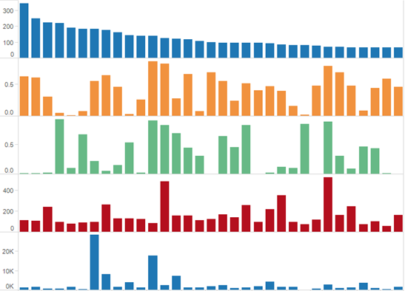
Prioritization of Components
Using selected KPI‘s
Number of occurrences (failures)
Percentage of occurrences of
Priority A or B
Percentage of component changes
Average downtime (min)
Average overall repair effort (min)

Slide 16
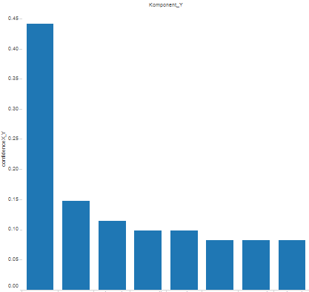
Multiple Component Fails Analysis
Component Y
Multiple fails are co-occurring fails
Failure happens in the same train within a certain time period (e.g. month)
Potential causes
Associated failures
Serial failures (Comp. is associated with itself)
Random co-occurrence
Non-critical failure reported late
Potential benefit: Clustering of Spare Part Orders/Proposals
Confidence (X,Y)
Y₁ Y₂ Y₃ Y₄ Y₅ Y₆ Y₇ Y₈

Slide 17
Association/Sequence Analysis
We have used Teradata Warehouse Miner‘s Association and Sequence Analysis algorithms to identify rules of the following type
Associations:
Code_{X1}, Code_{X2}...,Code_{Xn} ⇒ Failure
Sequences:
Code_{X1}→ Code_{X2}→...→Code_{Xn} ⇒ Failure
With Support and Confidence measures
Support = how often does rule appear in data set
Confidence = the percentage of trains for which diagnostic codes on left side appear that have a failure the next month
→ Failure probability given Diagnostic pattern

Slide 18
Exemplary Results
Association Analysis
Associations (3 to 1): ITEM1, ITEM2, ITEM3 ⇒ ITEM4
Lift: measures how much the probability of R is increased by the presence of L in an item group.
Z-score: measures how statistically different the actual result is from the expected result
ITEM1 | ITEM2 | ITEM3 | ITEM4 | LSUPPORT | RSUPPORT | SUPPORT | CONFIDENCE | LIFT | ZSCORE
dcode5 | dcode8 | dcode38 | Failure | 0.0318 | 0.3668 | 0.0201 | 0.6316 | 1.72 | 2.71
dcode38 | dcode70 | dcode84 | Failure | 0.0394 | 0.3668 | 0.0226 | 0.5745 | 1.57 | 2.37
dcode8 | dcode38 | dcode70 | Failure | 0.0452 | 0.3668 | 0.0251 | 0.5556 | 1.51 | 2.31
dcode8 | dcode70 | dcode84 | Failure | 0.0410 | 0.3668 | 0.0226 | 0.5510 | 1.50 | 2.14
dcode8 | dcode38 | dcode84 | Failure | 0.0662 | 0.3668 | 0.0343 | 0.5190 | 1.41 | 2.26
dcode8 | dcode13 | dcode38 | Failure | 0.0427 | 0.3668 | 0.0209 | 0.4902 | 1.34 | 1.47
dcode8 | dcode38 | dcode19 | Failure | 0.1089 | 0.3668 | 0.0461 | 0.4231 | 1.15 | 1.08
dcode8 | dcode38 | dcode7 | Failure | 0.1089 | 0.3668 | 0.0444 | 0.4077 | 1.11 | 0.78
dcode8 | dcode7 | dcode19 | Failure | 0.0838 | 0.3668 | 0.0335 | 0.4000 | 1.09 | 0.56
dcode38 | dcode7 | dcode19 | Failure | 0.0838 | 0.3668 | 0.0327 | 0.3900 | 1.06 | 0.39

Slide 19
Powerful Predictive Modelling
Bottom AND top line impact
Value creation
Increased uptime through significant reduction of unplanned downtime
Extension/flexibility of maintenance intervals
Reduced labour: quicker root cause analysis, improved first time fix rate etc
More mileage with less cars, increased utilisation of assets
Improved plannability allows streamlined SCM
Maintenance can be performed at the least costly location, with the right resources
Provide uptime guarantees, performance based contracting
Increased service contract capture rate, higher portion of recurring revenues of total service revenue
Service as key differentiator
Prediction enables
Cost reduction through
Increased revenue opportunities

Slide 20
Thank you very much!

