Slide 1
Understanding your Unicorns: Data Science Team Building in Action
Kim Nilsson
PhD, Managing Director pivigo academy
@kimknilsson

Slide 2
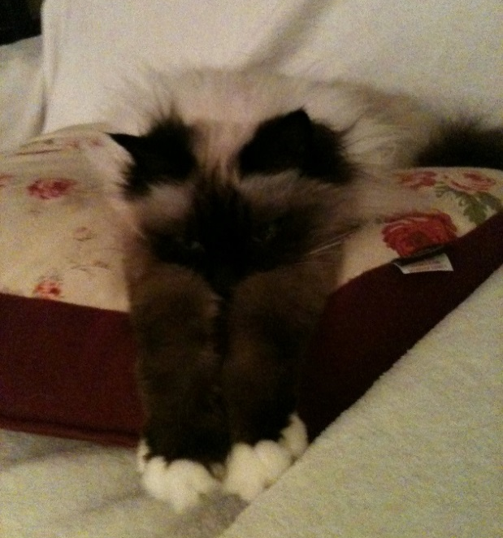
And relax…

Slide 3
Data scientist – sexiest job of 21st century?
The problem with [waiting to hire] is that the advance of big data shows no signs of slowing. If companies sit out this trend’s early days for lack of talent, they risk falling behind as competitors and channel partners gain nearly unassailable advantages.
Davenport & Patil, HBR
~5% compound growth in analytics jobs in the banking industry 2010 – 2015
Accenture
Up to 360’000 more analytics staff needed in the UK alone by 2020
SAS and Tech Partnership
Organizations are constantly making decisions based on gut instinct, loudest voice and best argument – sometimes they are even informed by real information. The winners and the losers in the emerging data economy are going to be determined by their Data Science teams.
Booz Allen Hamilton
63% of respondents say demand for Data Scientists will outstrip supply over next five years.
EMC Data Scientist study

Slide 4
But we are all looking for…
Expert in Statistics: Bayes, Decision-tree, Time series, Monte-Carlo…
Expert in Coding: Python, Java, R, Hadoop…
Five years Experience Machine-Learning
Expert in Database Management: SQL, NoSQL, Oracle, MongoDB…
Data visualisation pro
Communication skills like a TED speaker
Business skills of an MBA graduate
…[add your favourite criterion here]…

Slide 5


But we are all looking for…
Expert in Statistics: Bayes, Decision-tree, Time series, Monte-Carlo…
Expert in Coding: Python, Java, R, Hadoop…
Five years Experience Machine-Learning
Expert in Database Management: SQL, NoSQL, Oracle, MongoDB…
Data visualisation pro
Communication skills like a TED speaker
Business skills of an MBA graduate
…[add your favourite criterion here]…

Slide 6
The Ultimate Data Team Universe
Data Engineers
Data Scientists
Data Business Analysts
Hard coding skills
Maths/Analytics/Statistics
Business analysis/intelligence

Slide 7
The Ultimate Data Team Universe
Data Engineers
Database management
Hadoop
Data crunching
Data warehousing
Data Scientists
Data analysis
Visualisations
Machine-learning
Statistics
Data Business Analysts
Reporting
Interface to the business
Ownership of targets
Project management

Slide 8
The Ultimate Data Team Universe
Computer science
Engineering
Data Engineers
Database management
Hadoop
Data crunching
Data warehousing
Natural science
Analytical backgrounds
Data Scientists
Data analysis
Visualisations
Machine-learning
Statistics
Finance
Business degrees
Data Business Analysts
Reporting
Interface to the business
Ownership of targets
Project management

Slide 9
The Ultimate Data Team Universe
Computer science
Engineering
Data Engineers
Database management
Hadoop
Data crunching
Data warehousing
Natural science
Analytical backgrounds
Data Scientists
Data analysis
Visualisations
Machine-learning
Statistics
Finance
Business degrees
Data Business Analysts
Reporting
Interface to the business
Ownership of targets
Project management
Communication
Team

Slide 10
Team building: Ideal size of teams & Personalities
Ideal size of teams anywhere from 4 – 9
Belbin: 4 – 6
Scrum: 7 ± 2
A good team is made up of different personalities
MBTI
Belbin

Slide 11
Team building: MBTI
Four preferences, 16 “types”
Team members with different types need to be understanding of others’ preferences
Extrovert / Introvert “I relax…” by myself / in the company of others | Sensing / iNtuition “I make decisions…” using logical arguments / by gut feeling
Thinking / Feeling “I believe in…” justice and objectivity / mercy and trusting others | Judging / Perception “I like to…” plan and be goal-oriented / be flexible and impulsive

Slide 12
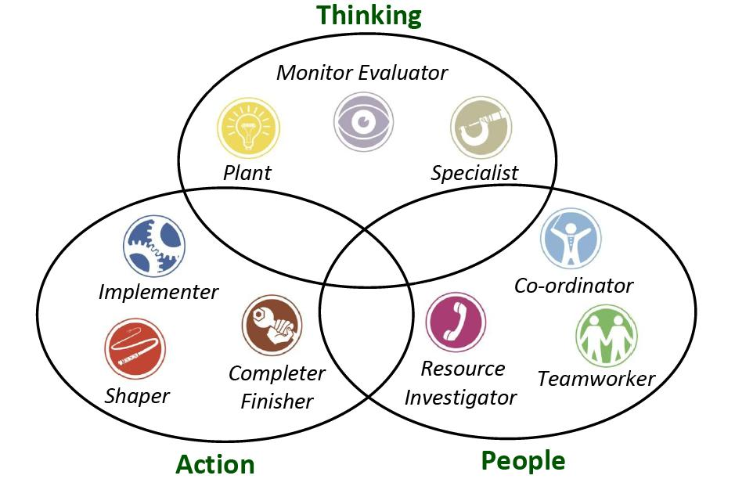
Team building: Belbin
Nine team roles
Effective teams have a good mix of all types
Be aware of weaknesses of types, and when they cross the line to unacceptability
Thinking
Action
People

Slide 13

A real use case of Belbin in an analytics team
Insurance business with 1200 employees in 26 lines of business, spread geographically
Business Analytics practice
Team of 18
1. All 18 took the Belbin test
2. Training on the Belbin theory
3. Results handed out: majority Resource Investigators and Specialists, a few Completer Finishers and one Plant
Communication was chaotic and unstructured

Slide 14




A real use case of Belbin in an analytics team
Insurance business with 1200 employees in 26 lines of business, spread geographically
Business Analytics practice
Team of 18
1. All 18 took the Belbin test
Explores opportunities and develops contacts
Searches our errors. Polishes and perfects
Provides skills and knowledge in rare supply
Generates ideas and solves difficult problems
2. Training on the Belbin theory
3. Results handed out: majority Resource Investigators and Specialists, a few Completer Finishers and one Plant
Communication was chaotic and unstructured

Slide 15
Belbin use case: Map roles onto work flow
Exploratory Data Analysis
Implementation
Run
Build
Validate/Test

Slide 16
Belbin use case: Map roles onto work flow
Exploratory Data Analysis
Implementation
Run
Build
Validate/Test
Impl.
Team manager
RI
SP
SP
CF
EDA
RI
SP
CF
SP
RI
SP
CF
RI
Run

Slide 17
Belbin use case: Lessons learned
Do it – it works!
Team got better customer satisfaction scores than any other department
Diffuses tension, greater understanding of behaviour
Plants are people too, bring them in
Arrange work flow and work environment to suit the preferred roles

Slide 18




Team cycle
Forming – Storming – Norming – Performing
?
Advisable to give teams a time with less pressure initially
Allocate harder problems / increased pressure once “performing phase” has been reached
Monitor teams in storming phase

Slide 19
Team communication
Teams that work well:
Have regular feed-back sessions
Ensure all members agree on ground-rules
Have respect for each other
Acknowledge diversity
Address team issues explicitly

Slide 20

Potential snags
Ladder of inference
You never ask Dave for advice or help
Action
Beliefs
People similar to Dave cannot be trusted
Conclude
Dave cannot be trusted
He did
what??
Assume
You assume Dave is cutting corners and being sloppy
Filter
You know it is company policy to unit test everything
Data Selection
You notice Dave has not performed his unit tests for two weeks
Data Input
You sit next to Dave every day

Slide 21
Motivation and training
Wheel of work
The right people want continuous learning and innovation
Job satisfaction
Learning & Development
Change
Work-life balance
Reward & Recognition
Purpose & Passions
Career
Relationships

Slide 22
Specific motivation and training
The right people want continuous learning and innovation
How?
Internal hackathons on work time
Encourage meet-ups
Encourage employees to suggest new technologies/methodologies
Be open to suggestions!
Scrum / Agile
Internal mentoring
Social events (but not forced)

Slide 23
Finding the right skills: Recruitment
What I look for in a CV:
Degrees – PhD, University, Date, Subject
Technical skills – programming languages, statistical techniques
Overall look/format
Any work experience?
I do NOT exclude those with publication lists, no work experience etc. as they could be supermotivated and talented

Slide 24
Finding the right skills: Interviewing
Interview strategy:
Ask really basic questions around technical skills
Test quick learning, motivation, team-work, creativity
Tell me about a time when you had to learn a new concept quickly
What motivates you?
Ask interviewee what he/she has researched online, anything they found particularly interesting
What unique skills or knowledge do you think you will bring to the team?
Team-working skills – ask a “scenario” type question
If you had a sample of our data, what are the first three things you would do?

Slide 25
On-boarding Academics
S2DS, Science to Data Science, saw 83 analytical PhDs and academics working on 23 projects with 22 companies “internship-style”
Culture shock was evident:
Deadlines and deliveries
Teamwork
Rewards
Networking and business behaviour
Once obstacles overcome, results phenomenal in short time!

Slide 26

Kim Nilsson
kim.nilsson@pivigo.com
@kimknilsson

