Slide 1
Addressing Legacy Risks with Hadoop
30 October 2013
Ravi Hubbly
Principal Architect
Lockheed Martin Corporation

Slide 2
Who am I?
Build and support data solutions for Lockheed Martin’s customers
Customers are primarily Government Federal agencies
Support internal research and development initiatives
Spent last 3 years focused on so called Big data problems
Why am I here?
Share my experience in enabling Enterprise IT incorporate emerging Big Data solutions
Notes:
Experience:
Love IT solutions to address business needs.
Especially Healthcare solutions.

Slide 3
Business Needs
Descriptive Analytics
Predictive Analytics
Prescriptive Analytics
DATA
Clinical, Claims, Monitoring, others
How are we doing?
What might happen in the future?
Best course of action given objectives, requirements & constraints
How many claims did we pay today?
Which of tomorrow’s claims might be requesting an Emergency Room (ER) admission?
What would be effective steps to reduce probability of ER admission?
Today: Analytics is about what happened
Tomorrow: Analytics will be how we do business

Slide 4
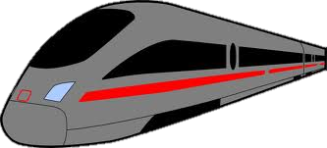
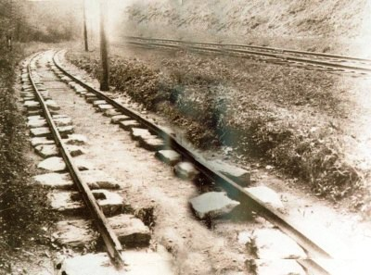
Organization Challenge
Run high speed train on old railroad?
Outcome is nothing but Disaster!

Slide 5
Legacy environment looks like this?
1
Process
Process
1
2
Process
Process
3
Process
Process
4
4
Process
Process
5
Process
Process
6
Process
Process
6
7
Process
Process
…
Process
Process
…
Process
Process
3
Source Systems
Known / Shadow Processes
Data Warehouse / Mart
Data Known / Shadow Processes
Derived Data Mart
Shadow Processes
Target
Systems

Slide 6
Realize Big Data value
Collaborative analytics
New and improved analytics
Reap Benefits of low cost, high performing environment
Build out foundation to handle Data challenges “Big Data Enabled”
TIME

Slide 7
Misunderstandings
New capabilities can be implemented using legacy data foundation
“It is about processing unstructured data, social media data, etc. My data is structured hence not applicable.”
“It is all for new algorithms such as machine learning (recommendation engines), predictive and prescriptive. I do not have such needs.”
“It is not to address my existing data management problem.”
“I do not have big budget to do big data.”

Slide 8
Observation
Big Data tools is a game changer. It addresses both unstructured and structured data.
Advanced algorithm needs are not only reason for Big Data. Big Data tools optimize existing environment.
Big Data tools compliment existing tools to provide solid foundation for analytics.
You do not need Big budget to implement Big Data.

Slide 9
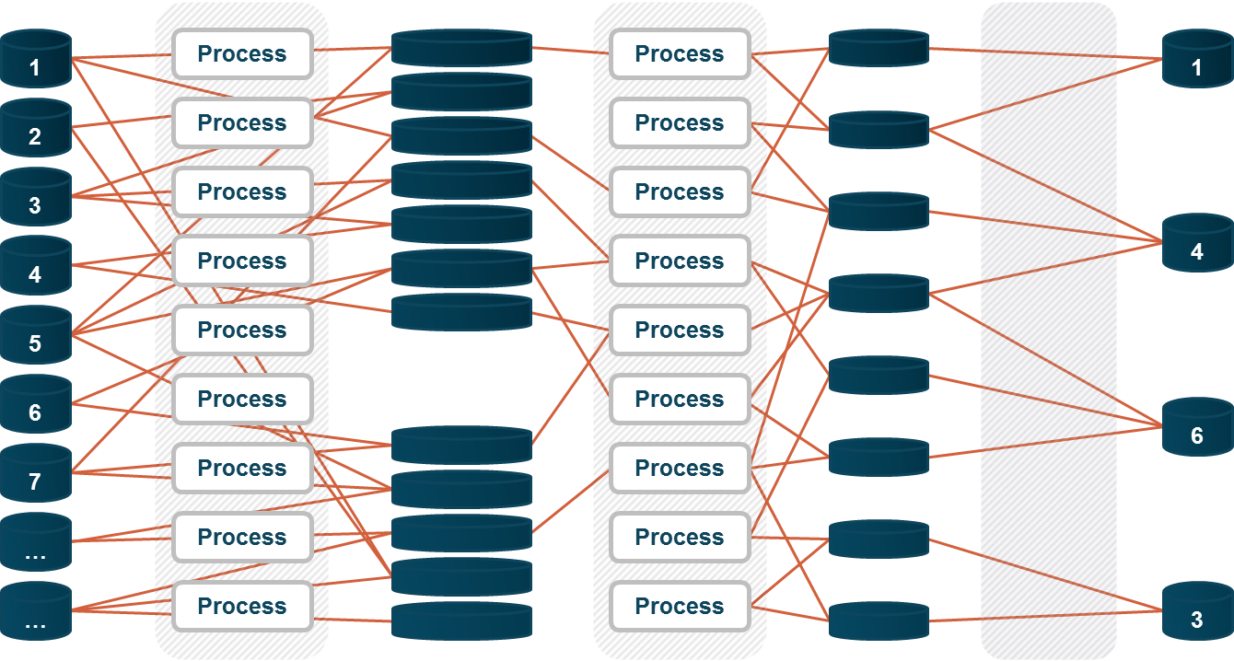
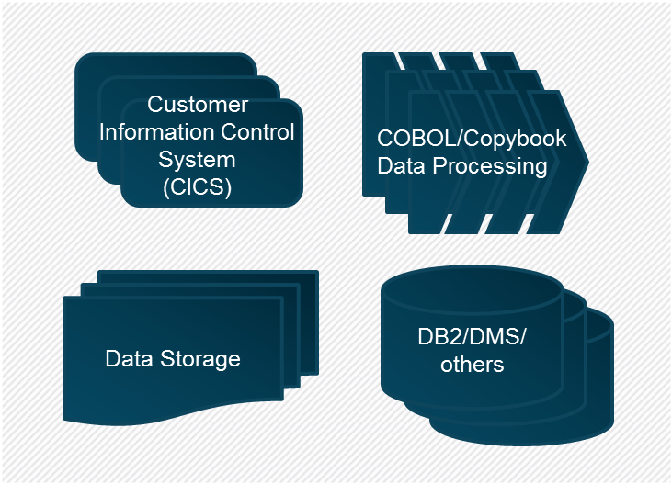
Data Foundation – Ready for Big Data
Data Integration
ETL/ELT Jobs
Data Warehouse
Operational
Systems
Mainframe
Business
Intelligence
Mainframe
Transform
Process
Analysis/
Query
Store
Hadoop

Slide 10
Cost and Feature comparison
Cost of Managing 1TB of Data
$20,000 – $100,000
$15,000 – $80,000
$250 – $2,000
Mainframe
EDW
Hadoop
Scalability |  |  | 
Performance |  |  | 
Reliability |  |  | 
Agility |  |  | 
Skills Supply |  |  | 
Data from “Leveraging Mainframe Data with Hadoop” by Syncsort and Cloudera Oct 2013, link

Slide 11
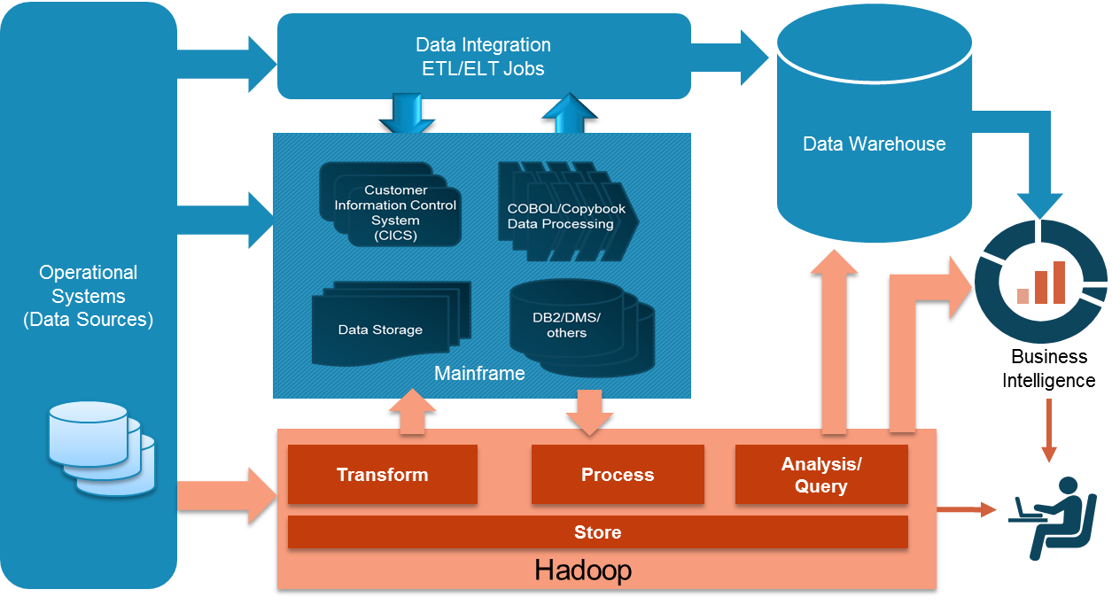
Foundation Projects
Target opportunities associated with
Mainframe processes
Data Integration Processes
Data warehouse opportunities
Long running processes & reports
Storage/Backup/Archive
Enable new capabilities such as
New Data exploration/collaboration
Maintain focus on Data Management
Data Definitions including Metadata Management
Data Provenance
Data Stewardship

Slide 12
Mainframes Presence
Mainframes are critical
Major Government services including Medicare, Social Security, and Treasury
Worlds top 25 Banks
Worlds top 9 insurance company
23 of 25 Top retail companies
Mainframes are valued
Reliability: Mainframe is stable and is known to run for months without any downtime
Centralized: Easy to manage, control and is more secured
Huge data processing capabilities
Years of built and tested business logic
* Some data from “Leveraging Mainframe Data with Hadoop” by Syncsort and Cloudera Oct 2013, link

Slide 13
Mainframe Components
Characteristics
One Big Central System
Highly reliable (99.999%)
Batch processing
Data schema independence
Stores data mainly as files
Tape Backups
Transaction system (CICS)
CICS
CICS
Customer Information Control System
(CICS)
COBOL/Copybook
Data Processing
Data Storage
DB2/DMS/
others
Tape
Backup

Slide 14
Working with Mainframe is getting Harder
Business
Challenges
Mainframe expertise is retiring
Legacy applications have poor documentation
Difficult to adapt to changing business needs
Crumbling with increasing data volume, velocity, & variety
Integration Challenges
Inherently difficult to integrate
Batch processing
Data conversion and sharing is hard
Security Challenges
Hosts mission critical sensitive data
Difficult to install new software especially for data extraction
Cost Challenges
Mainframe data is (expensive) Big Data
Any processing on the mainframe even file transfers costs CPU cycles (Million Instructions Per Second - MIPS)

Slide 15
Opportunity
Processing
Mainframe processing is expensive and cost directly relates to MIPS
Any MIPS reduction = Instant Operation Expense (OpEx) Savings
Storage
Mainframe storage is expensive can be $100k/TB
Uses expensive Tape based backup
Uses custom data types such as EBCDIC, packed decimal
Hadoop Opportunity
Reduces cost in processing and storage
Can ingest any data types hence ready for Mainframe data
Address data volume, velocity, and variety challenges
Reduce risk with Subject Matter Expert (SME) availability

Slide 16
Why Apache Hadoop?*
CORE HADOOP COMPONENTS
Apache Hadoop is a platform for data storage and processing that is…
Scalable
Fault tolerant
Open source
Hadoop Distributed File System (HDFS)
File Sharing & Data Protection Across Physical Servers
MapReduce
Distributed Computing Across Physical Servers
Has the Flexibility to Store and Mine Any Type of Data
Ask questions across structured and unstructured data that were previously impossible to ask or solve
Not bound by a single schema
Excels at
Processing Complex Data
Scale-out architecture divides workloads across multiple nodes
Flexible file system eliminates ETL bottlenecks
Scales
Economically
Can be deployed on commodity hardware
Open source platform guards against vendor lock
*Slide taken from Cloudera’s overview of Apache Hadoop

Slide 17
Interesting Similarities between Hadoop and Mainframe
Both are one central system supporting various applications
Both are built to be highly reliable systems
Primary processing paradigm is Batch Processing (Data processing and Analytics)
Primary data storage is file based
Metadata is separate from data. Hence schema on read is influenced
Mainframe
HADOOP
Others
JCL
OOZIE
Others
COBOL Programs
MAPREDUCE Jobs
(PIG Programs)
COPYBOOKS
HIVE Meta store
Data Files
Data Files

Slide 18
Data Foundation Initiatives
Move to Batch Processing to Hadoop
Leverage legacy code mining/analysis tools
Utilize step by step iterative approach
Implement good data integration between Mainframe and Hadoop
Leverage automation tools
Attain immediate cost savings in storage and improved performance
Focus on migrating Archive + Backup from Tape to Hadoop
Provide common data services such as EBCDIC to ASCII
Enable Hadoop as the more effective Data Distribution services provider

Slide 19
Migration
Mainframe
HADOOP
Programs
JCL
OOZIE
COBOL Programs
Code Migration
MAPREDUCE Jobs
(PIG Programs)
Metadata
COPYBOOKS
HIVE Meta store
Metadata Migration
Data
Data Files
Data
movement
Data Files

Slide 20
Automate Mainframe Data Ingestion and Query
Copybooks
EBCDIC + Packed Decimal Data
Mainframe
01 FIN-REC.
03 NAME PI
03 STAT PIC
03 IMGMD PI
0010 0001 1010 0011 0110 1110 1010 0111 0011 0101 0100 1010
Metadata
ASCII Data
Build Time Tools
<FinancialRecord
<Name width
<Status widt
<IMG-MD />
<Name>Jerry Sinfiel
<Status>Available</
<IMG-MD>
<Location>30.
Map-Reduce
ETL Job
Hadoop Metastore
HIVE/
PIG/
IMPALA
Create Hadoop Schema
User access
Automation Tools
Hadoop

Slide 21
Process for Optimization
Optimize data analytics environment with Hadoop
Periodic (annual/bi-annual)
Profile
Prioritize & Plan
Migrate
Validate
Analyze all of the workload
Queries
Reports
Objects
User Communities
Jobs
Identify workloads based on:
Risk
Complexity
User impacts
Use prioritization framework to quantify
Utilize automation in migration of logic & data:
Move objects
Move workloads
Move users
Verify Results:
Evaluate performance
Side-by-side “burn-in” period
Cut over

Slide 22
Target Analytics Environment
Analytics Environment
Enterprise Data Repository
External
Data Sources
Big Data Store &
Compute
Workspace (adhoc analytics)
Analytic Tools of choice
Clinical Trials
Workspace #2
Financial
SAS
University Research
Workspace #3
Performance
SPSS
Internal Research
Microstrategy,
Cognos
Patients Information
Drug Research
Workspace #4
Research
STATA
Claim Data
Data Management Team
Collaboration Environment

Slide 23
Example Client Project
Business Need
“An effective & efficient data & analytics environment supporting goals of providing effective service at lower cost”
Today’s Challenge
Delayed Access to Data
Data & Analytics Growth
In-flexible Legacy solutions
Data and Analytics Duplication
Results by numbers
Market data from current 4-6 weeks to less than an hour
Process 25 million records in less than hour
Reduced legacy cost and improve agility to meet new business needs
Incorporates new data changes in days compared to months
Cost effective and flexible solution supporting data & analytics growth
$8K Big Data v/s $24K Data Warehouse v/s $15K Mainframe

Slide 24
Message
Need strong Data Foundation to enable value from Big Data
Hadoop technology provides a great opportunity to finally address legacy risks because of inherent similarities

