Slide 1
Algorithm Design Meets Big Data
Bahman Bahmani
bahman@stanford.edu

Slide 2
Outline
Fundamental Tradeoffs
Drug Interaction Example [Adapted from Ullman’s slides, 2012]
Technique I: Grouping
Similarity Search [Bahmani et al., 2012]
Technique II: Partitioning
Triangle Counting [Afrati et al., 2013; Suri et al., 2011]
Technique III: Filtering
Community Detection [Bahmani et al., 2012]
Conclusion

Slide 3
Drug interaction problem
3000 drugs, 1M patients, 20 years
1MB of data per drug
Goal: Find drug interactions

Slide 4
MapReduce algorithm
Map
Input: <i; R_{i}>
Output: <{i,j}; R_{i}> for any other drug j
Reduce
Input: <{i,j}; [R_{i},R_{j}]>
Output: Interaction between drugs i,j

Slide 5
Example
Mapper
for drug 1
{1, 2}
Drug 1 data
Reducer
for {1,2}
{1, 3}
Drug 1 data
Mapper
for drug 2
{1, 2}
Drug 2 data
Reducer
for {1,3}
{2, 3}
Drug 2 data
Mapper
for drug 3
{1, 3}
Drug 3 data
Reducer
for {2,3}
{2, 3}
Drug 3 data

Slide 6
Example
Reducer
for {1,2}
{1, 2}
Drug 1 data
Drug 2 data
Reducer
for {1,3}
{1, 3}
Drug 1 data
Drug 3 data
Reducer
for {2,3}
{2, 3}
Drug 2 data
Drug 3 data

Slide 7
Total work
4.5M pairs × 100 msec/pair = 120 hours
Less than 1 hour using ten 16-core nodes

Slide 8
All good, right?
Network communication
= 3000 drugs × 2999 pairs/drug × 1MB/pair
= 9TB
Over 20 hours worth of network traffic on a
1Gbps Ethernet

Slide 9
Improved algorithm
Group drugs
Example: 30 groups of size 100 each
G(i) = group of drug i

Slide 10
Improved algorithm
Map
Input: <i; R_{i}>
Output: <{G(i), G’}; (i, R_{i})> for any other group G’
Reduce
Input: <{G,G’}; 200 drug records in groups G,G’>
Output: All pairwise interactions between G,G’

Slide 11
Total work
Same as before
Each pair compared once

Slide 12
All good now?
3000 drugs × 29 replications × 1MB
= 87GB
Less than 15 minutes on 1Gbps Ethernet

Slide 13
Algorithm’s tradeoff
Assume n groups
#key-value pairs emitted by map= 3000×(n-1)
#input records per reducer = 2×3000/n
The more parallelism, the more communication

Slide 14
Reducer size
Maximum number of inputs a reducer can have, denoted as λ

Slide 15
Analyzing drug interaction problem
Assume d drugs
Each drug needs to go to (d-1)/(λ-1) reducers
needs to meet d-1 other drugs
meets λ-1 other drugs at each reducer
Minimum communication = d(d-1)/(λ-1) ≈ d²/λ

Slide 16
How well our algorithm trades off?
With n groups
Reducer size = λ = 2d/n
Communication = d×(n-1) ≈ d × n = d × 2d/λ = 2d²/λ
Tradeoff within a factor 2 of ANY algorithm

Slide 17
Fundamental MapReduce tradeoff
Increase in reducer size (λ)
Increases reducer time, space complexities
Drug interaction: time ~ λ², space ~ λ
Decreases total communication
Drug interaction: communication ~ 1/λ

Slide 18
Technique I: Grouping
Decrease key resolution
Lower communication at the cost of parallelism
How to group may not always be trivial

Slide 19
Similarity Search
Near-duplicate detection
Document topic classification
Collaborative filtering
Similar images
Scene completion

Slide 20
Many-to-Many Similarity Search
N data objects and M query objects
Goal: For each query object, find the most similar data object

Slide 21
Candidate generation
M=10⁷, N=10⁶
10¹³ pairs to check
1μsec per pair
116 days worth of computation

Slide 22
Locality Sensitive Hashing: Big idea
Hash functions likely to map
Similar objects to same bucket
Dissimilar objects to different buckets

Slide 23


…
9
8
7
…
3
2
6
1
…
0

Slide 24
MapReduce implementation
Map
For data point p emit <Bucket(p) ; p>
For query point q
Generate offsets q_{i}
Emit <Bucket(q_{i}); q> for each offset q_{i}

Slide 25
MapReduce implementation
Reduce
Input: <v; p¹,…,p^{t},q¹,…,q^{s}>
Output: {(p^{i},q^{j})| 1≤i≤t, 1≤j≤s}

Slide 26
All good, right?
Too many offsets required for good accuracy
Too much network communication

Slide 27
…
9
8
7
…
3
2
6
1
…
0

Slide 28
MapReduce implementation
G another LSH
Map
For data point p emit <G(Bucket(p)); (Bucket(p),p)>
For query point q
Generate offsets q_{i}
Emit <G(Bucket(q_{i})); q> for all distinct keys

Slide 29
MapReduce implementation
Reduce
Input: <v; [(Bucket(p¹),p¹), …, (Bucket(p^{t}),p^{t}),q¹,…,q^{s}]>
Index p^{i} at Bucket(p^{i}) (1≤i≤t)
Re-compute all offsets of q^{j} and their buckets (1≤j≤s)
Output: candidate pairs

Slide 30
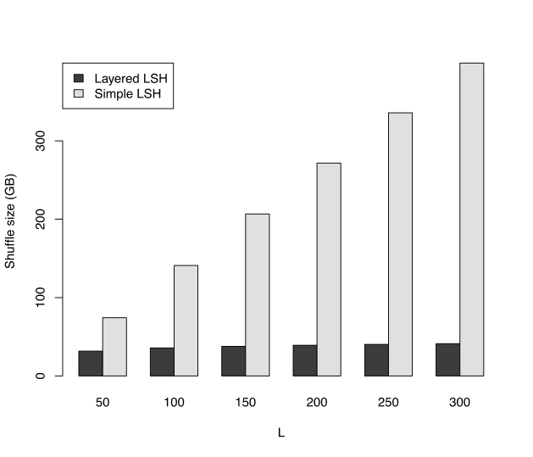
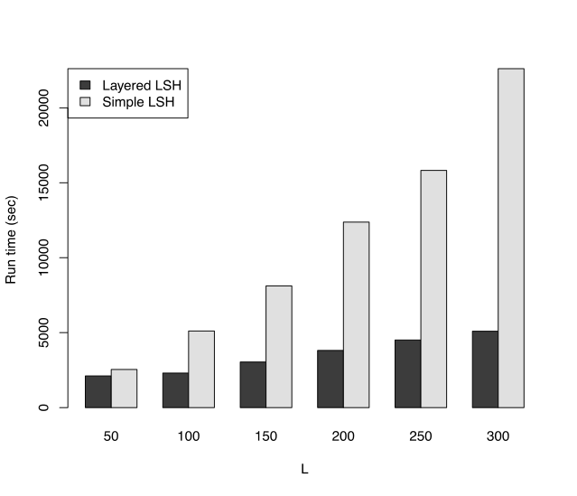
Experiments
Shuffle Size
Runtime

Slide 31
Technique II: Partitioning
Divide and conquer
Avoid “Curse of the Last Reducer”

Slide 32
Graph Clustering Coefficient
G = (V,E) undirected graph
CC(v) = Fraction of v’s neighbor pairs which are neighbors themselves
Δ(v) = Number of triangles incident on v
 | #neighbor pairs | Δ | CC (Δ/#pairs)
 | 1 | 1 | 1
 | 0 | 0 | NA
 | 6 | 1 | 1/6

Slide 33
Graph Clustering Coefficient
Spamming activity in large-scale web graphs
Content quality in social networks
…

Slide 34
MapReduce algorithm
< (u_{i} , u_{j}); v>
<( , ); >
<( , ); >
<( , ); >
<( , ); >
<( , ); >
<( , ); >
Map
Input: <v; [u₁,…,u_{d}]>
Output:
<{u_{i},u_{j}}; v> (1≤i<j≤d)
<{v,u_{i}}; $> (1≤i≤d)
v

Slide 35
MapReduce algorithm
Reduce
Input: <{u,w}; [v₁,…,v_{T}, $?]>
Output: If $ part of input, emit <v_{i}; 1/3> (1≤i≤T)
u
…
v₁
v₂
v_{T}
w

Slide 36
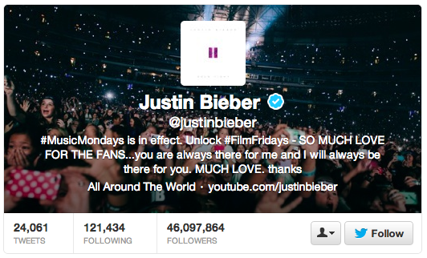
All good, right?
For each node v, Map emits all neighbor pairs
~ d_{v}²/2 key-value pairs
If d_{v}=50M, even outputting 100M pairs/second, takes ~20 weeks!

Slide 37
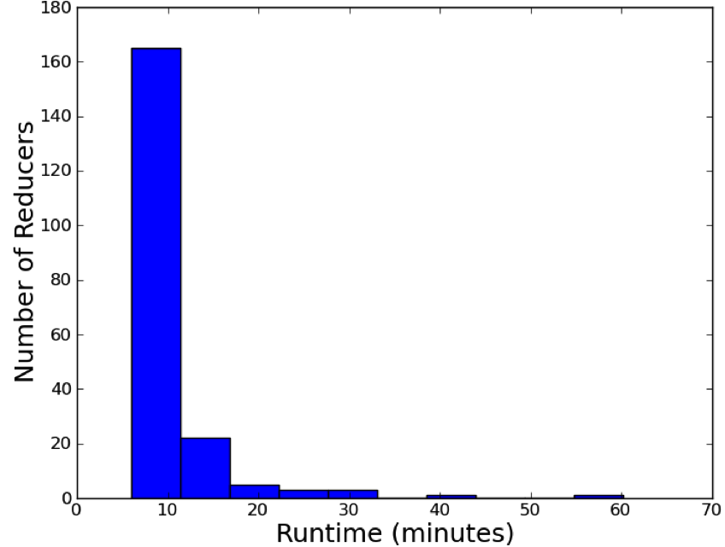
Experiment: Reducer completion times

Slide 38
Partitioning algorithm
Partition nodes: p partitions V₁,…,V_{p}
ρ(v) = partition of node v
Solve the problem independently on each subgraph V_{i}UV_{j}UV_{k} (1≤i≤j≤k≤p)
Add up results from different subgraphs

Slide 39
Partitioning algorithm
Triangle Type | Subgraph
 | (2,3,4)
 | (2,2,3)
 | (1,1,1)
3

Slide 40
Partitioning algorithm
Map
Input: <v; [u₁,…,u_{d}]>
Output: for each u_{t} (1≤t≤d)
emit <{ρ(v), ρ(u_{t}),k}; {v,u_{t}}> for any 1≤k≤p

Slide 41
Partitioning algorithm
Reduce
Input: <{i,j,k}; [(u₁,v₁), …, (u_{r},v_{r})]> (1≤i≤j≤k≤p)
Output: For each node x in the input
emit (x; Δ_{ijk}(x))
Final results computed as:
Δ (x) = Sum of all Δ_{ijk}(x) (1≤i≤j≤k≤p)

Slide 42
Example
1B edges, p=100 partition
Communication
Each edge sent to 100 reducers
Total communication = 100B edges
Parallelism
#subgraphs ~ 170,000
Size of each subgraph < 600K

Slide 43
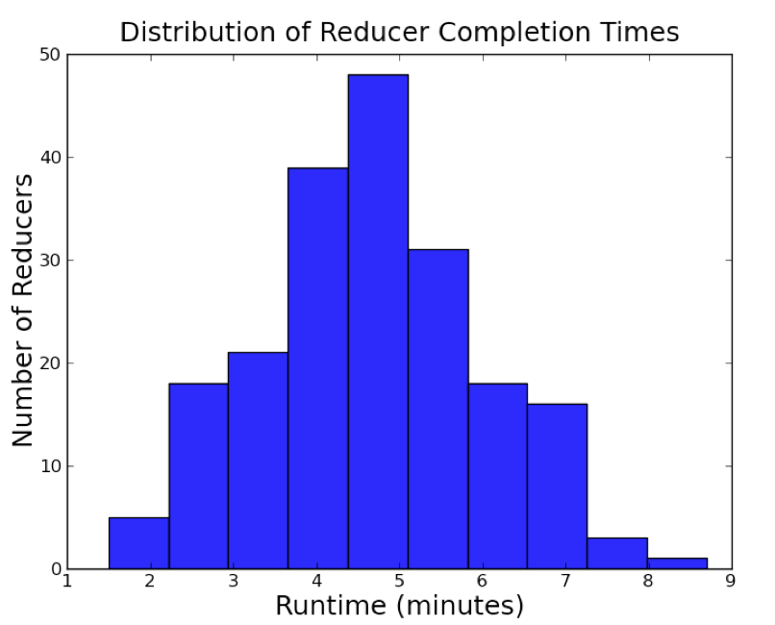
Experiment: Reducer completion times

Slide 44
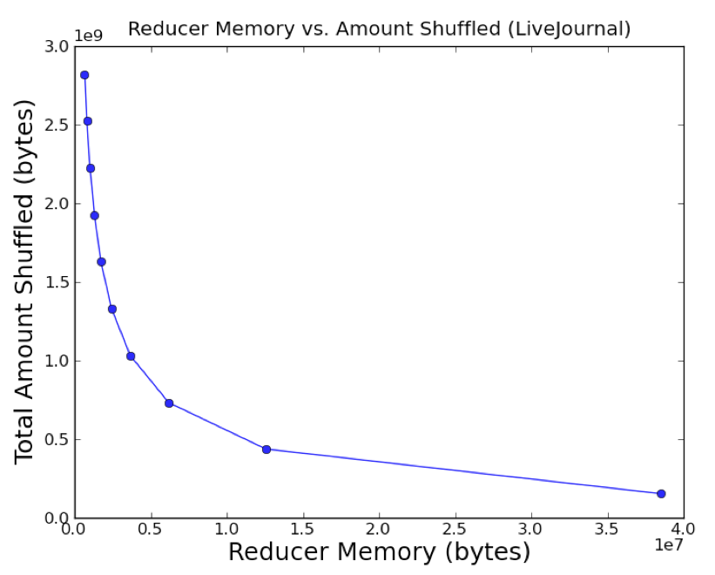
Experiment: Reducer size vs shuffle size

Slide 45
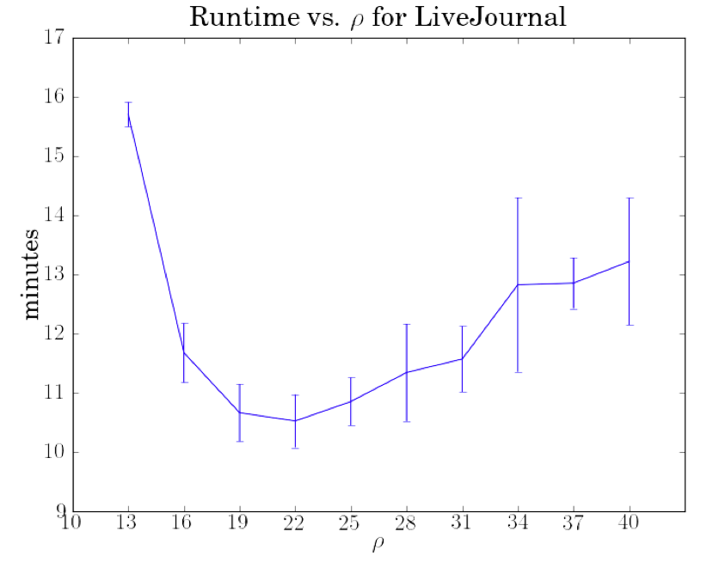
Experiment: Total runtime

Slide 46
MapReduce tradeoffs
Approximation
Communication
Parallelism

Slide 47
Technique III: Filtering
Quickly decrease the size of the data in a distributed fashion…
… while maintaining the important features of the data
Solve the small instance on a single machine

Slide 48
Densest subgraph
G=(V,E) undirected graph
Find a subset S of V with highest density:
ρ(S) = |E(S)|/|S|
|S|=6, |E(S)|=11

Slide 49
Densest subgraph
Functional modules in protein-protein interaction networks
Communities in social networks
Web spam detection
…

Slide 50
Exact solution
Linear Programming
Hard to scale

Slide 51
Intuition
Nodes with degree not much larger than average degree don’t matter

Slide 52
Example
|E(S)|/|S| = 100
Average degree = 200
|S|≥201
v a node in S, d_{v}=205
|E(S\v)|/|S\v| ≥ (|E(S)|-205)/(|S|-1)
= (100|S|-205)/(|S|-1)
= 100 – 105/(|S|-1)
≥ 100-105/200= 99.5
v
…

Slide 53
Algorithm
Choose ε>0
Iteratively remove all the nodes with
degree ≤ (1+ε) × average degree
Keep the densest intermediate subgraph

Slide 54
Example
Highest Density So Far | Current Density | Average Degree
19/12 | 19/12 | 38/12

Slide 55
Example
Highest Density So Far | Current Density | Average Degree
19/12 | 19/12 | 38/12

Slide 56
Example
Highest Density So Far | Current Density | Average Degree
9/5 | 9/5 | 18/5

Slide 57
Example
Highest Density So Far | Current Density | Average Degree
9/5 | 9/5 | 18/5

Slide 58
Example
Highest Density So Far | Current Density | Average Degree
9/5 | 1 | 2

Slide 59
Example
Highest Density So Far | Current Density | Average Degree
9/5 | 1 | 2

Slide 60
Example
Final Result
Density = 9/5 = 1.8
True Densest Subgraph
Density = 11/6 = 1.83

Slide 61
MapReduce implementation
Two steps per iteration:
Compute number of edges, nodes, and node degrees
Similar to word count
Remove vertices with degrees below threshold
Decide each node independently

Slide 62
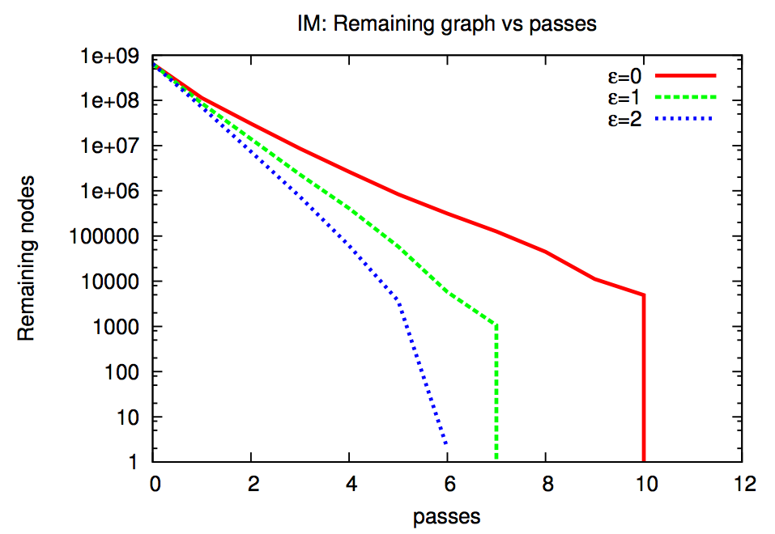
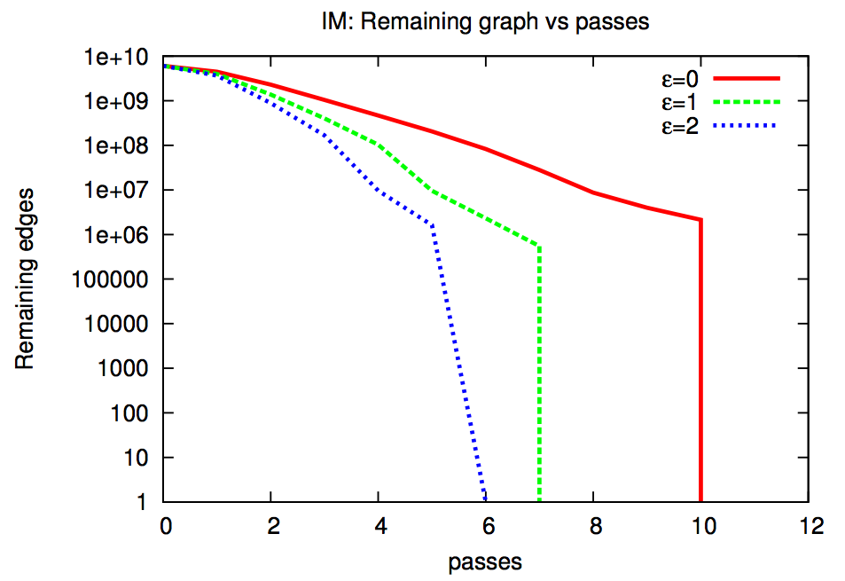
Experiments
Approximation factor ≈ 1
Number of Nodes
Number of Edges

Slide 63
Conclusion
Fundamental tradeoffs
Communication
Parallelism
Approximation
Techniques
Grouping
Partitioning
Filtering

Slide 64
Thanks!
Get in touch:
Office Hour, Tuesday 10:30am
bahman@stanford.edu

