Slide 1
Hadapt Flexible Schema & The End of ETL Enabling Schemaless SQL over Non-Relational Data Stores
Daniel Abadi, Co-Founder & Chief Scientist, Hadapt
@daniel_abadi
Matt Grace, Co-Founder & CTO, Objective Logistics
@mattastica

Slide 2

All SQL on Hadoop Solutions are Missing the Point of Hadoop
Every solution makes you define a schema
SQL (“structured query language”) is expressed over an assumed schema
Major reasons why Hadoop has taken off include:
Ability to load data without defining a schema
Process data using schema-on-read instead of first defining a schema
Hadoop contains a lot of:
Raw, granular data sets with potentially inconsistent schemas
Data sets in JSON, key-value, and other self-describing (non-relational) models designed for schema-on-read processing
SQL on Hadoop solutions that make you first define a schema are missing a major part of Hadoop’s usage patterns

Slide 3
Important Trends
Dramatic increase in utilization of “NoSQL” databases such as MongoDB, CouchDB, Riak, Cassandra, Hbase, etc.
Key value and JSON are increasingly popular ways to represent data
See MongoDB’s $150 million “largest database funding ever”
Emerging data sources continue to evolve notion of “structured” data
Performing analysis inside NoSQL databases not a major use-case
Poor analytics primitives
Poor integration with other data sources (data silos)
Poor scan performance
Poor integration with analytical tools
Hadoop becoming dominant platform for data analysis

Slide 4
Analytic World – Pre Flexible Schema
Relational Datastore
userID | name | email | preferred?
1 | Scott Howser | scott@hadapt.com | no
2 | Jon Millis | jmillis@hadapt.com | yes
3 | CJ Barton | cjbarton@hadapt.com | yes
4 | Brian Murphy | bmurphy@hadapt.com | yes
JSON Datastore
JSON Documents
{“userID”: 1, “action”:”view”, ”productName”: “door”, “price”: 12.50,”color”:”green”,”tags”:[“home”,”green”]}
{“userID”: 3, “action”:”purchase”,”price”: 57.12}
{“userID”: 2, “action”:”view”, ”productName”: “window”, “color”:”orange, “price”:52.50,”tags”: [“home”,”orange”]}
What if you want to send an email to all customers who indicate a potential desire to buy in bulk, with a deal on items they looked at?
Text Datastore
userID | Email
1 | What is your return policy?
2 | Do you have bulk discounts?
4 | I can’t figure out your Website. You should fire your designer!

Slide 5
Analytic World – Pre Flexible Schema
Relational Datastore
userID | name | email | preferred?
1 | Scott Howser | scott@hadapt.com | no
2 | Jon Millis | jmillis@hadapt.com | yes
3 | CJ Barton | cjbarton@hadapt.com | yes
4 | Brian Murphy | bmurphy@hadapt.com | yes
JSON Datastore
JSON Documents
{“userID”: 1, “action”:”view”, ”productName”: “door”, “price”: 12.50,”color”:”green”,”tags”:[“home”,”green”]}
{“userID”: 3, “action”:”purchase”,”price”: 57.12}
{“userID”: 2, “action”:”view”, ”productName”: “window”, “color”:”orange, “price”:52.50,”tags”: [“home”,”orange”]}
Option 1: Extract data from each relevant store, perform join and further query analysis in user code.
Text Datastore
userID | Email
1 | What is your return policy?
2 | Do you have bulk discounts?
4 | I can’t figure out your Website. You should fire your designer!

Slide 6

Analytic World – Pre Flexible Schema
Relational Datastore
userID | name | email | preferred?
1 | Scott Howser | scott@hadapt.com | no
2 | Jon Millis | jmillis@hadapt.com | yes
3 | CJ Barton | cjbarton@hadapt.com | yes
4 | Brian Murphy | bmurphy@hadapt.com | yes
Option 2: ETL separate data sources into unified data store
JSON Datastore
ETL
JSON Documents
{“userID”: 1, “action”:”view”, ”productName”: “door”, “price”: 12.50,”color”:”green”,”tags”:[“home”,”green”]}
{“userID”: 3, “action”:”purchase”,”price”: 57.12}
{“userID”: 2, “action”:”view”, ”productName”: “window”, “color”:”orange, “price”:52.50,”tags”: [“home”,”orange”]}
ETL
Text Datastore
userID | Email
1 | What is your return policy?
2 | Do you have bulk discounts?
4 | I can’t figure out your Website. You should fire your designer!
ETL

Slide 7
Analytic World – Pre Flexible Schema
Post merge
T
userID | name | emailAddr | Preferred? | json | emails
1 | Scott Howser | scott@hadapt.com | no | {“eventID”: 1, “action”:”view”, ”productName”: “door”, “price”: 12.50,”color”:”green”,”tags”:[“home”,”green”]} | What is your return policy?
2 | Jon Millis | jmillis@hadapt.com | yes | {“eventID”: 2, “action”:”view”, ”productName”: “window”, “color”:”orange, “price”:52.50,”tags”: [“home”,”orange”]} | Do you have bulk discounts? .
3 | CJ Barton | cjbarton@hadapt.com | yes | {“eventID”: 3, “action”:”purchase”,”price”: 57.12}
4 | Brian Murphy | bmurphy@hadapt.com | yes |  | I can’t figure out your Website. You should fire your designer!
SELECT name, emailAddr, regex_value(json, ‘“productName”:\s*“([^”]*?)”’, 1, ‘i’)
FROM T
WHERE regex_match(json, ‘“action”:\s*”view”’,’i’)
AND emails like ‘%bulk%’

Slide 8
Analytic World – Flexible Schema
No ETL / MapReduce pre-processing
Provide user a virtual view of their data
Every unique JSON key a separate virtual column
Standard SQL
T
userID | name | emailAddr | Preferred? | product Name | price | tags | color | action | emails
1 | Scott Howser | scott@hadapt.com | no | door | 12.50 | home green | green | view | What is your return policy?
2 | Jon Millis | jmillis@hadapt.com | yes | window | 52.50 | home orange | orange | view | Do you have bulk discounts?
3 | CJ Barton | cjbarton@hadapt.com | yes |  | 57.12 |  |  | purchase
4 | Brian Murphy | bmurphy@hadapt.com | Yes |  |  |  |  |  | I can’t figure out your Website. You should fire your designer!
SELECT name, emailAddr, productName
FROM T
WHERE action=‘view’
AND emails like ‘%bulk%’

Slide 9
Analytic World – Flexible Schema (cont.)
New object added to JSON
Additional column dynamically created
json
{“userID”: 4, “action”:”view”, ”productName”: “door”, “price”: 12.50,”color”:”green”,”tags”:[“home”,”green”],”size”:”standard”}
userID | name | emailAddr | Preferred? | product Name | price | tags | color | action | size | emails
1 | Scott Howser | scott@hadapt.com | no | door | 12.50 | home green | green | view |  | What is your return policy?
2 | Jon Millis | jmillis@hadapt.com | yes | window | 52.50 | home orange | orange | view |  | Do you have bulk discounts?
3 | CJ Barton | cjbarton@hadapt.com | yes |  | 57.12 |  |  | purchase
4 | Brian Murphy | bmurphy@hadapt.com | Yes | door | 12.50 | home green | green | view | standard | I can’t figure out your Website. You should fire your designer!

Slide 10
Hadapt Implementation
Hadapt does not store data according to the virtual view
However, Hadapt reserializes the JSON/key-value pairs in order to:
Accelerate the join
Speed up attribute extraction
Identify which attributes exist
Inverted indexes on every virtual or text column

Slide 11
Key Concepts
Flexible Schema
As JSON, XML, etc. data sources evolve schema dynamically updates logical presentation
Schemaless SQL
Query data in non-relational data stores via SQL and industry standard tools
Multistructured Tables
Store JSON, XML, Text, etc. oriented columns in same tables with traditional structured data
Document Oriented Columns

Slide 12
Hadapt Flexible Schema Benefits
Dramatic reduction of ETL workload and complexities
Time to insights significantly improved
Identify and present dynamically changing attributes within data and make it visible for query / processing
Present analysts with access to multi-structured via tools like Tableau, MicroStrategy, Cognos, etc.
Holistic view of the data delivering Powerful Insights.
Stay true to the values of Hadoop (and the community) while enabling the entire community of SQL users and tools

Slide 13

A Story About a Mill

Slide 14
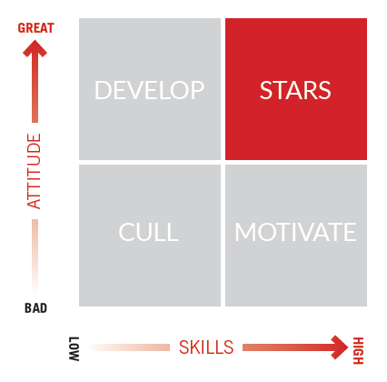
Create a Culture of Excellence
MUSE delivers:
Harder – and smarter – working staff
Measurable and sustained sales lift
Improved service and customer loyalty
A “Culture of Excellence”

Slide 15
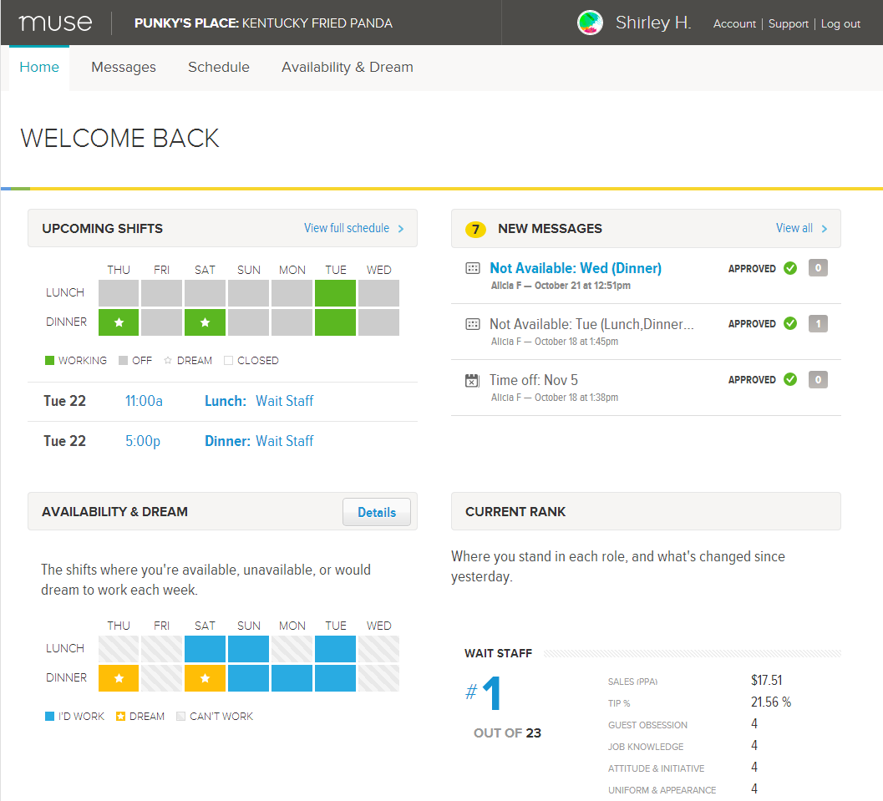
MUSE: Measure, Motivate, and Reward Performance.

Slide 16
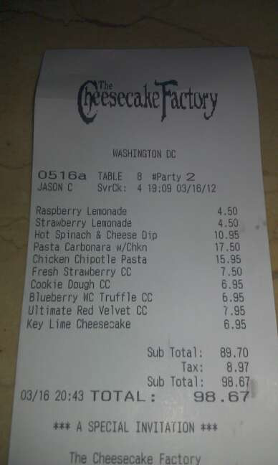
A Call for a Flexible Storage Schema
Checks are the single largest set of external we store.
~18 million checks
~200 million menu items in checks
Grows geometrically with customers, units, and time.
Synchronization and transformation is timely and complex, so we store a snapshot, about:
30% of attributes of checks
30% of attributes of menu items in check.
Re-synchronization and transformation is painful, so we’re often at a loss when excluded attributes would improve our analysis!

Slide 17
Hadapt: Flexible JSON Schema = Save EVERYTHING :)
{
"CheckNumber": 1,
"CloseDate": "/Date(1371571195596-0400)/",
"CostCenter": 98,
"ExternalID": 329194,
"Gratuity": 20,
"OpenDate": "/Date(1371571195596-0400)/",
"PartySize": 2,
"PrintDate": "/Date(1371571195596-0400)/",
"Table": 42,
"Tax": 6.93,
"Total": 103.92,
"TransactionNumber": 24343,
“EmployeeID": 2, “TotalPrepTime:” 840,
“BOHStation1ID” 3, “BOHStation2ID” 4, …
←- INSERT 23 OTHER ATTRIBUTES, …
“MenuItems”: { … }
}

Slide 18
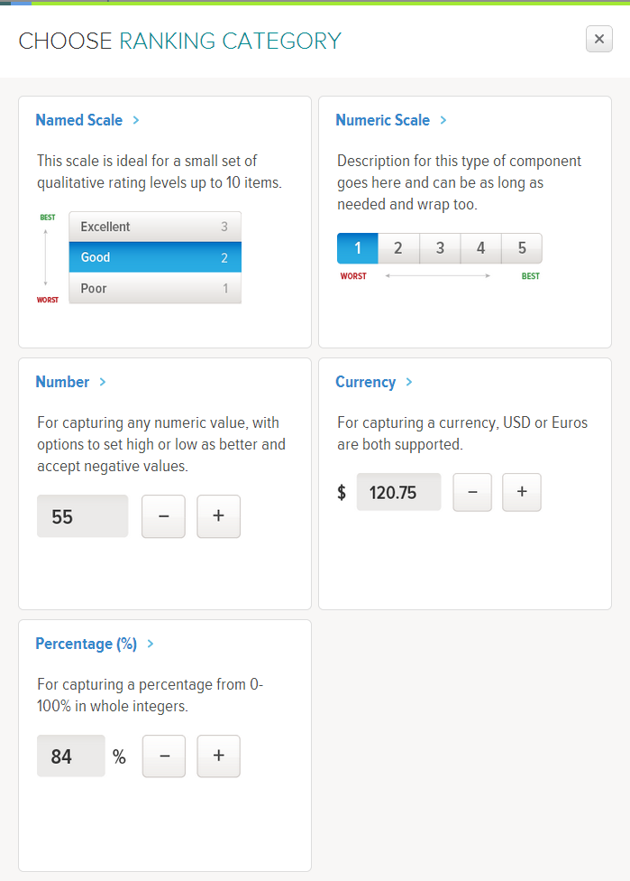
Hadapt: Flexible JSON Schema = More Ranking Categories!
The 13 attribute we currently store on check allow us to rank sales staff.
The remaining 26 unlock new opportunities.
Back of House (BOH) ranking categories, e.g. “Prep Time” or “Send to Bump Time” “Kitchen Error”
Front of House Categories “Staff Order Input Error” “Station Efficiency” “Seat to Greet Time”

Slide 19
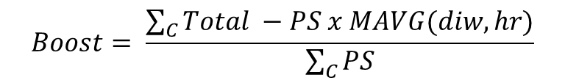

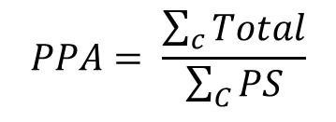
Hadapt: Distributed Per Person Sales Average Calculation
PPA: The Golden Ratio
Calculate Global PPA Matrix
FIRST RUN:
MAVG = get_MAVG(90 days of checks);
SUBSEQUENT:
MAVG_UPDATE = get_MAVG(checks since last ranked); for each MAVG_UPDATE(i, j)
if MAVG_UPDATE(i, j) != null AND MAVG(i, j) !=null
MAVG(i, j) = EWMA(MAVG(i, j),MAVG_UPDATE(i, j) HADAPT DISTRIBUTED NORMALIZATION FUNCTION:
get_MAVG(checks): totSum = matrix(DAYS_IN_WEEK, HOURS_IN_DAY);
psSum = matrix(DAYS_IN_WEEK, HOURS_IN_DAY);
for each check in checks
totSum(check.diw, check.hr) += check.Total
psSum(check.diw, check.hr) += check.PartySize
for each MAVG(i, j)
if (distinct userCount(i, j) > LowerUserCount)
MAVG(i, j) = totSum(i, j) / psSum(i, j)
else
MAVG(i, j) = null
$$PPA= \frac{\sum_{c}{Total}}{\sum_{C}{PS}}$$

Slide 20
6 Pillars of Architecture – Hadapt as our Analytical Core
CDH 4.3
Hadapt Adaptive Analytical Platform v2.0

Slide 21

Hadapt Flexible Schema – Objective Logistics
Technical Challenges
Scale = Legacy architecture limited volume of data to be analyzed
Rigidity = Data schema and associated challenges dramatically reduced attributes available to analyze staff performance
Predictive Modeling = “normalizing” process computationally expensive and inhibiting to analytic models
Time to Insights = Cumbersome data management pipeline and incompatible stores
Results
Dramatically simplified data management pipeline and infrastructure architecture
Normalization process reduced from ~ 9 hrs to ~2 minutes
Data now able to “speak for itself” providing unparalleled insights
Scalable & completely parallelized implementation of advanced analytic models
Business expanding into additional markets, verticals, and use cases

