Slide 1
Getting a Handle on Hadoop and its Potential to Catalyze a New Information Architecture Model Milan Vaclavik, Savvis Big Data Solution Lead Peter O’Kelly, Savvis Big Data Solution Architect
October 29, 2013
© 2013 CenturyLink, Inc. All Rights Reserved. The Savvis mark, logo and certain Savvis product names are the property of CenturyLink, Inc.
All other marks are the property of their respective owners.

Slide 2
Agenda
Big data: what just happened?...
What’s likely to happen next
What it means for information architecture
Growth of data and its implications
The role for big data managed services

Slide 3
Big Data: What Just Happened?...
Market dynamics converging around Hadoop and NoSQL
Mission-critical needs to efficiently manage and analyze massive databases and streams
Inability of earlier technologies to address needs in a timely and cost-effective manner
Breakthrough price/performance and horizontal scaling with commodity hardware
A highly productive Apache open source community, using a flexible license agreement
With market leaders including Facebook, Twitter, Yahoo!, and others contributing huge amounts of code
Based on re-implementing Google innovations, in several domains
Several fast-moving commercial big data vendors
Cloud services offering revolutionary capability/cost equations

Slide 4
Impressive Results, Despite Constraints
Hadoop v1 is a brute-force solution in some respects
Data usually stored in triplicate
A fundamentally batch-oriented, append-only file system
Single point of failure risks (in many but not all distributions)
Limited security, governance, and disaster recovery features
Non-trivial complexity in MapReduce programming model
Somewhat alleviated by extensions such as Hive, for SQL-based access (generating MapReduce jobs)
Generally requires dedicated systems without virtualization and with ample local storage, for large-scale deployments
MapReduce has a dual role, as both resource negotiator and data processing framework, creating bottlenecks and constraints

Slide 5
A Similar Situation for First-Gen NoSQL
Much can be left as an exercise for developers, with some NoSQL systems, such as
Security
Data integrity
Schemas
Transactions
Referential integrity
Query optimization
Disaster recovery
Other aspects of data governance

Slide 6
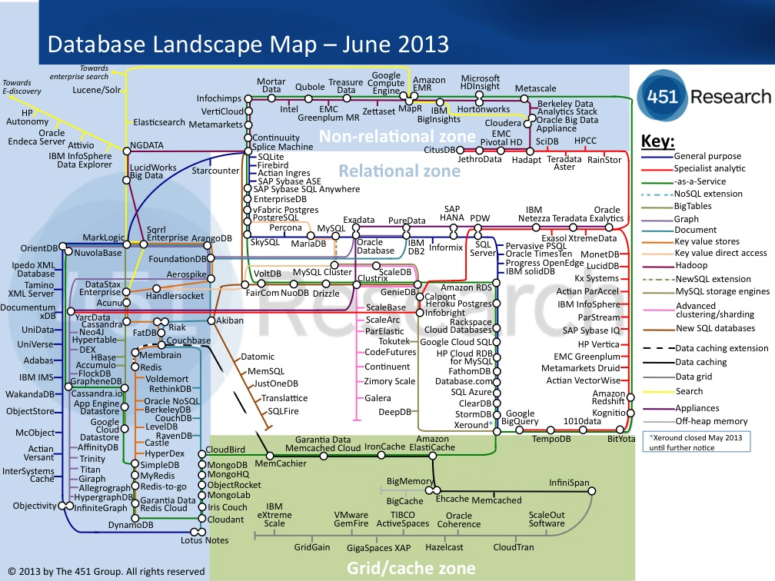
A Valiant 451 Research Map
Source: http://blogs.the451group.com/information_management/2013/06/10/updated-database-landscape-map-june-2013/

Slide 7
Agenda
Big data: what just happened?...
What’s likely to happen next
What it means for information architecture
Growth of data and its implications
The role for big data managed services

Slide 8
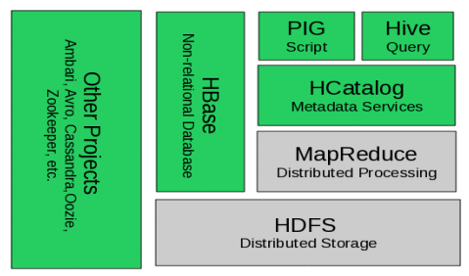
“Hadoop” is Transitioning from This…
Source: “Apache Hadoop YARN: Moving beyond MapReduce and Batch Processing with Apache Hadoop 2,” Murthy, Arun, Addison Wesley 2013

Slide 9
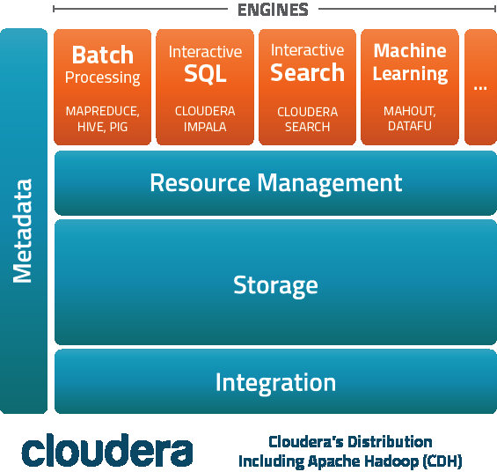
…To This
Source: http://www.cloudera.com/content/cloudera/en/products/cdh.html

Slide 10
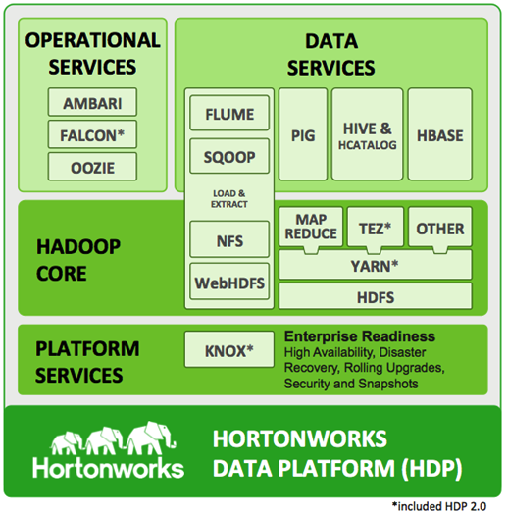
…And This
Source: http://hortonworks.com/products/hdp/

Slide 11
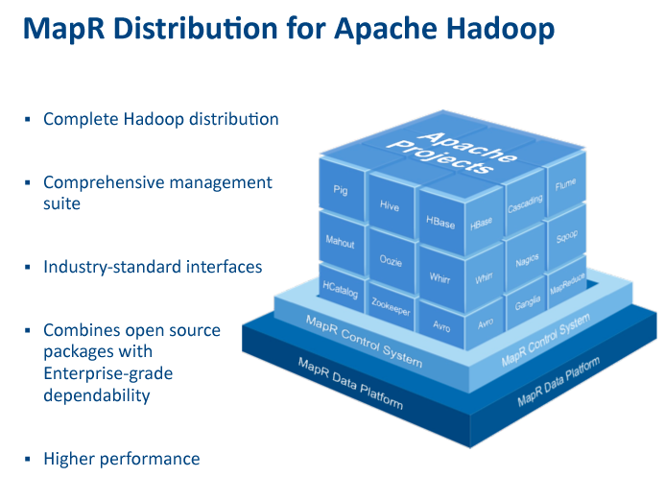
…And This
Source: http://www.mapr.com/products/product-tour#developers

Slide 12
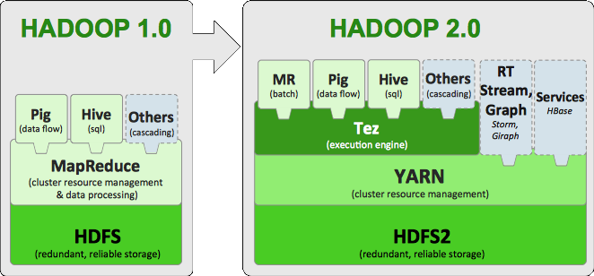
Another Hadoop v2 Perspective
Source: http://hortonworks.com/blog/apache-hadoop-2-is-ga/

Slide 13
Boundaries are Blurring
NoSQL Evolution
New Opportunities
for SQL?
Not Only
SQL
SQL

Slide 14
Boundaries are Blurring
Hadoop Platform
NoSQL
DBMS Dimensions
SQL support
Tables and transactions
Object storage subsystem (with HDFS API support)
Ability to manipulate data in HDFS-based subsystems
DBMSs extended with HDFS interoperability
Hybrid Hadoop/DBMS platforms
+
+

Slide 15
Interesting Apache Discussions Ahead
There are strongly-held differences of opinion in key domains such as SQL-on-Hadoop, e.g.,
Cloudera created and contributed Impala
EMC/Pivotal has HAWQ
Hortonworks is a Stinger contributor and backer
IBM created and offers Big SQL
MapR has bet on Apache Drill
Based on Google Dremel
Teradata/Aster has SQL-H
The vendors can support multiple approaches
E.g., Impala runs on MapR
… but there is clearly room for many areas of Hadoop-related convergence and standardization

Slide 16
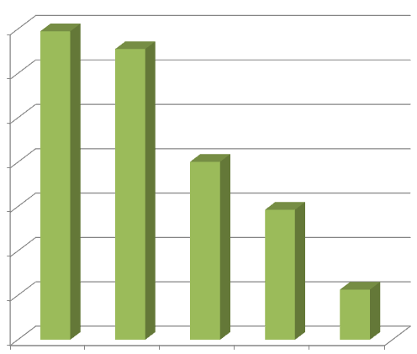
Big Data: Vendor Musical Chairs
Very far from business-as-usual
Several relatively new analytics vendors, e.g., Splunk and Tableau, are doing exceptionally well
7
6
Market Cap ($B)
5
4
3
2
1
Teradata
Splunk
Tableau
QlikTech
MicroStrategy
Financial data from Google Finance, captured 20131019

Slide 17
Agenda
Big data: what just happened?...
What’s likely to happen next
What it means for information architecture
Growth of data and its implications
The role for big data managed services

Slide 18
Revisiting the Separation of Concerns
Clearer distinctions
Application developers and analysts: conceptual level
E.g., fine to focus on Java or JavaScript and JSON, as long as doing so doesn’t mean compromising on effective use of underlying data management systems
Database designers and information architects: logical level
Application/data independence and logical/physical independence are more important than ever before
Database and system architects: physical level
Incredible innovation at the physical level, but conceptual and logical modeling concerns shouldn’t be unduly influenced by physical model considerations

Slide 19
A Simpler Information Model Framework
 | Resources | Relations
Conceptual | Documents and links; focused on hierarchy and sequence | Entities, attributes, relationships, and identifiers
Logical | Model: hypertext Language: XQuery (ideally…) | Model: extended relational Language: SQL
Physical | Indexing (e.g., scalar data types, XML, and full-text), locking and isolation levels (for transactions), sharding, replication, in-memory databases, columnar storage, table spaces, caching, and more

Slide 20
Information Architecture Implications
Strategic opportunities
Consolidation: opportunity to have fewer moving parts
Expect rapid consolidation across
Extended relational DBMS
Hadoop platforms
NoSQL database systems
Distributed file systems
With analytics, developer frameworks, and management tools that work seamlessly across all of the above

Slide 21
Information Architecture Implications
Strategic opportunities
Big data can constructively serve as a catalyst for improving and integrating existing databases
Many enterprises have data management inconvenient truths that must be addressed in order to fully leverage big data opportunities
Focus on fundamentals; back to basics
As the technologies mature and converge, redoubled focus on effective modeling, query formulation, and analysis capabilities will be key to productive and agile data management
The next critical question for enterprises: how do you get there from here?...

Slide 22
Agenda
Big data: what just happened?...
What’s likely to happen next
What it means for information architecture
Growth of data and its implications
The role for big data managed services

Slide 23
Managed Services are Ideal for Big Data
“ Storing all of your data on-premises need no longer be the default.”
Forrester Research, Inc.
The Future of Customer Data Management
March 6, 2013

Slide 24
Growth of Digital Universe is Accelerating
Source: IDC Digital Universe Study
Estimated digital data created, replicated, consumed in a single year
2020
40 zettabytes
~5200 GB / person
(Dec 2012 estimate)
~43% CAGR
2020
35 zettabytes
(Dec 2011 estimate)
~41%
CAGR
2009
Source: http://en.wikipedia.org/wiki/Data_(Star_Trek)
0.8 zettabytes

Slide 25
Starting Point is Often a Basic Use Case
Data Lake
Offload structured data from DW systems
Make data made broadly available, easily queried
Create de-facto data archive
Data Refinery

Slide 26
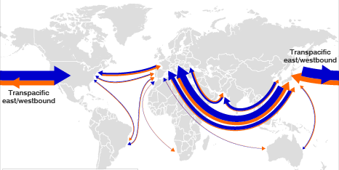
Data Lake Example In Action
Large Retailer Optimizing its Supply Chain
Scenario: Evaluate on-time shipment delivery
25GB of Data: Container status events for previous 18 months
600K containers
30 events / container
Ocean, rail, truck data
Desired Outcomes:
Improved carrier and route selection
Fewer stock outages
Increased revenue

Slide 27
Three Variables Affect Hadoop Needs
Data Sources
Hadoop Environment Requirements
Use Cases
Data Retention Period

Slide 28
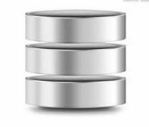
All Three Variables Can Ramp Quickly
Booking, invoice analysis
Price / performance analysis
Analysis by commodity type and port
Affect of weather, labor disputes
Use Cases
Structured, unstructured data
All operational data for shipments
External data (weather, news, LinkedIn)
Data Sources
Data Retention
5+ years for long term trend analysis
25TB
25GB

Slide 29
Scaling in-House is Challenging
eCommerce
Marketing
Capital investment
Data center constraints
Skills shortage
Focus on low-level technology details vs. higher level objectives
“I need it next quarter”
Data is Growing
~43% CAGR

Slide 30
Big Data Managed Services Increase Agility
Time
Results
Reduce
Time to
Results
Accelerate
Innovation
Mitigate
Risk

Slide 31
Big Data Services Must be “Full Service”
Strategy and Business Case Consulting
Diverse range of use cases
Standard services to reduce costs
Add-on products
All data types
Enterprise data integration
Big Data Environment Planning and Implementation
Big Data Operations Management
Security
Analytics (Custom,COTS)
Big Data Software
Infrastructure-as-a-Service
Network Services

Slide 32
Big Data is Moving to Managed Services
Hadoop v2 offers more, so fewer moving parts are needed
Big data is becoming much more accessible
Growth in data, use cases and retention periods will ALL accelerate
On premises resource needs may not be sustainable
Managed services are ideal for big data

Slide 33
Thanks!
Milan Vaclavik
Big Data Solution Lead
milan.vaclavik@savvis.com
Peter O’Kelly
Big Data Solution Architect
peter.okelly@savvis.com
© 2013 CenturyLink, Inc. All Rights Reserved. The Savvis mark, logo and certain Savvis product names are the property of CenturyLink, Inc.
All other marks are the property of their respective owners.

Slide 34
Who is Savvis?
Savvis is an enterprise-grade managed service provider delivering visionary enterprise-class cloud and IT solutions with proactive service, enabling organizations to gain a competitive advantage through IT.
Deep expertise in technical operations, client support, engineering and consulting
Infrastructure extends to 45 countries
More than 50 global data centers with over 2 million square feet of raised floor space
Ironclad security and compliance
Network services for the most demanding enterprise needs

