Slide 1
Hadoop & Data Science For The Enterprise
30 Tips & Tricks + Worksheets https://www.slideshare.net/markslusar
@MarkSlusar
Allstate Insurance Company

Slide 2
Allstate: The Good Hands Company
The Allstate Corporation (NYSE: ALL) is the nation's largest publicly held personal lines insurer.
Allstate provides insurance products to approximately 16 million households.
Allstate was founded in 1931 as part of Sears, Roebuck & Co.
Approximately: 38,600 Employees and 11,200 Agencies
Brands: Allstate, Esurance, Encompass, Answer Financial
Auto insurance, homeowners insurance, life insurance and investment products including retirement planning, annuities and mutual funds.

Slide 3

Mark Slusar
https://www.slideshare.net/markslusar
Part of Allstate Quantitative Research & Analytics (AKA Data Science)
I really like Data…
Since ‘98 in the Workplace
Since ‘88 as a Geek
Early Hadoop Adopter @ Navteq & Nokia
Twitter @MarkSlusar

Slide 4

1 / 30 Hadoop Loves ETL & Datawarehouse Offloading
Don’t hyper-focus only on ETL and DW Offload
Right now, 80% of data science isn’t much science, it’s wrestling with data – Hadoop changes that.
Hadoop rocks at ETL
(and is great for storage)
You’ll find yourself doing more T than E&L
Build your analytics files faster, better, cheaper, and with more flexibility

Slide 5

2 / 30 Play the Right
Hadoop Data Science Game
Descriptive (Easy)
  “What happened?”
Predictive (Medium)
  “What will happen?”
Prescriptive (Hard)
  “What should we do about it?”
Batch, Ad Hoc, Real Time, Others

Slide 6

  3 / 30 Learn To Profile Effectively At Scale
Get comfy with your data
Use a Query tool (Hive, Impala, many others)
If applicable, Use Search
Use workflow systems
(Oozie, et al) for periodic
data collection and
pre-processing from
other operational systems.

Slide 7
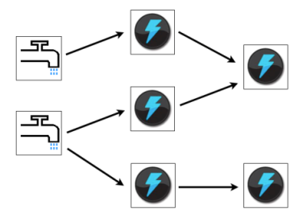




4 / 30 Brace Yourself For Hadoop 2.0
Storm
HOYA (HBase on YARN)
Spark & associated projects
Giraph and similar
And More.. Everything gets better
Hurry Up, Get learning

Slide 8


  5 / 30 Skills
Train (Private, Public, Free, Books)
Network (internets, msg boards)
Consultants
Inside your company: create your own internal user group to share ideas
Hadoop User groups (CHUG if you’re in Chicago :)
(Find a HUG near you on meetup.com)
Image
Credit: Yuko P

Slide 9

  6 / 30 Security
File system, Kerberos
Sentry, Knox, others
Encryption (how much?)
Vendors
Your security organization will need
a Hadoop Intro, keep them in the loop

Slide 10
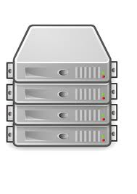
  7 / 30 Use Other Platforms As Needed
Outside of *gasp* Hadoop!!!
Hadoop is not solution for everything..
With Existing platforms,
Compare & contrast:
  Cost
  Performance
  Maintenance
  Scalability
  Extensibility, Reliability,
  High Availability, et al

Slide 11
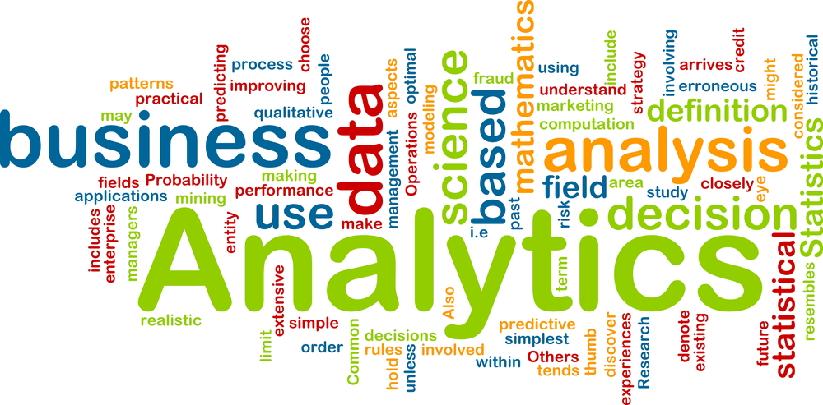
8 / 30 Understand Analytics & Business
Re-learn BI tools as needed
Finance & Accounting Foundations
There’s a lot of tools out there: Many of them are throwing their hat into the ring
Great existing connectors to Hadoop
Think different from traditional way. Adopt open source.

Slide 12



  9 / 30 Use Sqoop, Use Flume
Time savers
Beware of over-usage, start small
Consider querying ‘idle’ backup environments (like DR, disaster recovery if permitted)
Some DBAs may initially dislike Sqoop
Use appropriate connection. (i.e. OraOop)
Understand the nature of the data, relationships, deltas
Avoid a “Ha-Dump” (loading data in for no reason)
Use backup servers when possible, don’t hammer prod servers

Slide 13

  10 / 30 Learn Python
Write less code, Do more, faster
http://learnpythonthehardway.org
  Great starting point
Use Python with
Hadoop Streaming

Slide 14



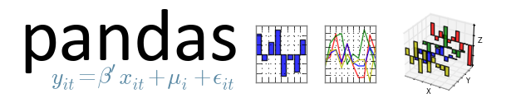
  11 / 30 Learn Python Modules
NumPy & SciPy (math)
Scikit-Learn (ML)
Pandas (data)
Text Mining (NLTK, NLP et al)
Python Version(s) 2.7X or 3? YMMV, not everything is working on 3 yet

Slide 15

  12 / 30 Learn R
Use & Learn R packages,
huge time-savers
Use CRAN, its great & free
Consider a supported
distribution:
(Oracle, Tibco, Revolution, et al)
Not everything can effectively run in parallel, some things are actually SLOWER on Hadoop

Slide 16

  13 / 30 Admin
Treat the environment as a research tool as long as possible – keep administrative channels open
Check your config files into version control – Check everything into version control
Hadoop 2.0 performance management

Slide 17
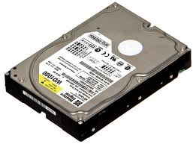
  14 / 30 Back it up?
Yes? No? Sometimes?
Use HDFS as your system of record?
Use another cluster made for archival? Appliance?
Tape is pennies per GB!

Slide 18

  15 / 30 Advanced Predictive Modeling
Understand what algorithms can & cannot be run in parallel (ever?)
This can quickly get complex
Consider single “big boxes”
when needed (no Hadoop)
GPUs are still relevant
Bonus Points: GPUs in your Cluster

Slide 19

  16 / 30 Get Comfy Streaming
Quick, effective, useful
You might be able to port old code (anything that can write to stdin & read from stdout)
Your port may need some tweaking for Map/Reduce
Stream with Pig & Hive when appropriate

Slide 20




17 / 30 Use Hive & Pig
Write your own Hive UDFs
Write your own Pig UDFs
Consider writing UDAFs (aggregators) and UDTFs (transforms)

Slide 21
  18 / 30 Learn The Enterprise Packages
It’s not just about open source
Make sure you get what you pay for
Analogy:
Commercial & Proprietary
Open Source & Standardized?

Slide 22
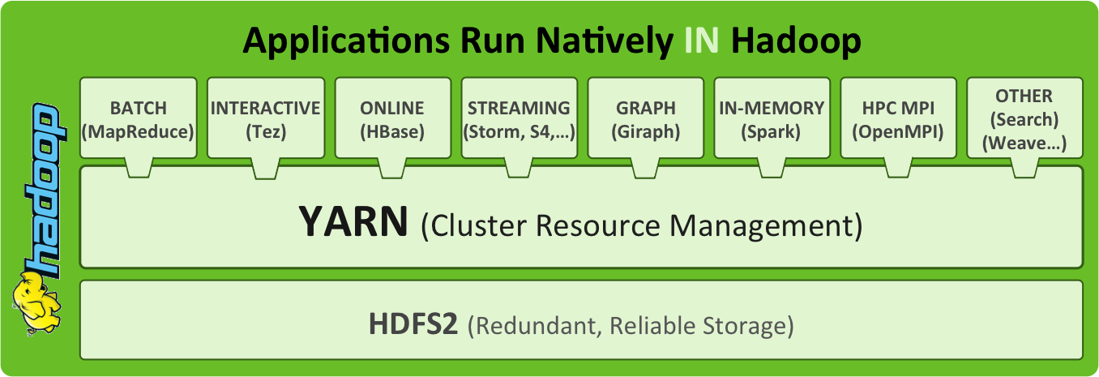
  19 / 30 Get Ready For YARNtacular Analytics
Examples: 0xdata &Skytree
Others: great things to come!
Image credit hortonworks

Slide 23
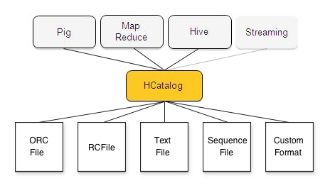
  20 / 30 Know Your Data (Intimately)
Once you know it, re-learn it
Peer review your work
Don’t forget to quality check on raw.
Quality check first, Analysis second
Understand how Nulls work / don’t work
Get comfortable
with Metadata tools
(HCatalog for example)

Slide 24
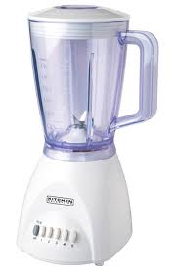
  21 / 30 Compliment Your Data
Find More
Co-mingle new “big” sources
JOINs can be hard: Blending is an
Art and a Science
Use specialized joins when joining small data sets.
Example: Map-Side joins
Seek Corroboration among sources
Build new between structured & unstructured

Slide 25

  22 / 30 Get The Math & Stats Expertise
Learn it; Hire it; Train it
Understand it, Use it, Profit
Common
Sense & Hadoop ☺
Math &
Stats
Domain
Expertise
Coding
Inquisitiveness

Slide 26
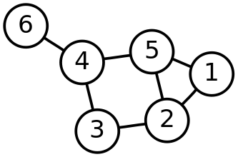
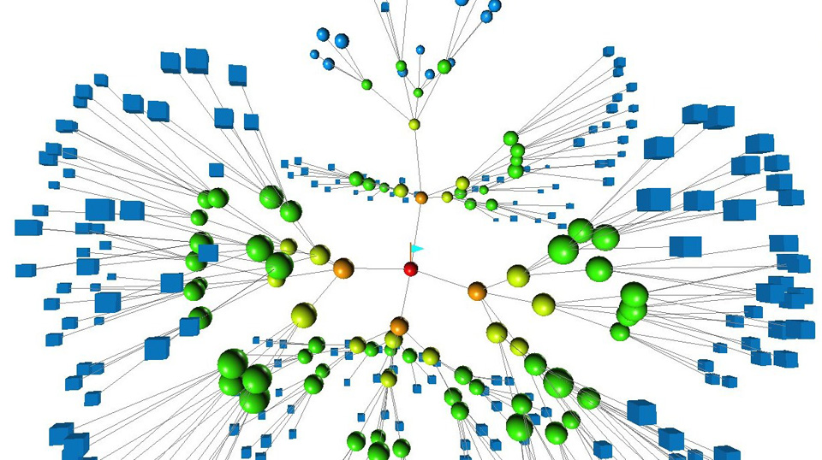
  23 / 30 Get Down With The Graph
Learn about linked data
Use Hadoop to build graphs, query and analyze graphs
Batch vs. Ad Hoc

Slide 27
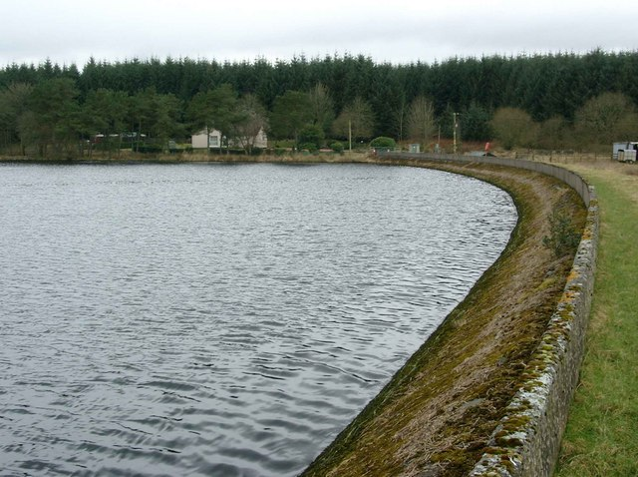
  24 / 30 Go Jump In A Lake
A data lake that is..
Don’t call it a mainframe, warehouse, data mart, etc.
Consider use cases & security vs. traditional approaches

Slide 28

  25 / 30 Mahout is “in”
Use it first, but there’s much more beyond it
Outside of Mahout, try building the models yourself (Streaming, R, or Java)

Slide 29

  26 / 30 Don’t Be Afraid to Flatten Data
Going from RDMS to Hadoop:
Don’t dread De-normalization
For good?
Probably Not…

Slide 30

  27 / 30 Use “Hadoop beat ABC by 400x” Sparingly
Everyone will get the point:
  “A big cluster can totally
  whomp on your other systems”
Be nice.
10⁸

Slide 31

  28 / 30 Ask Questions Of Data
Ask old questions previously unanswerable
  Depth? Breadth?
  Scale? Detail?
Ask new questions:
previously unthinkable

Slide 32
  29 / 30 Data Science Is Science
Response Time is the most important part
of any data science platform’s SLA
Think of Pasteur’s Quadrant..
* Seek Understanding of Data
* Seek Practical Use of Data
Your Lab
* The Lab is not the Factory
* The Factory is not the Lab
Applied and Basic research
Quest for fundamental understanding? | Yes | Pure basic research (Bohr) | Use-inspired basic research (Pasteur)
 | No | – | Pure applied research (Edison)
 |  | No | Yes
 |  | Considerations of use?

Slide 33
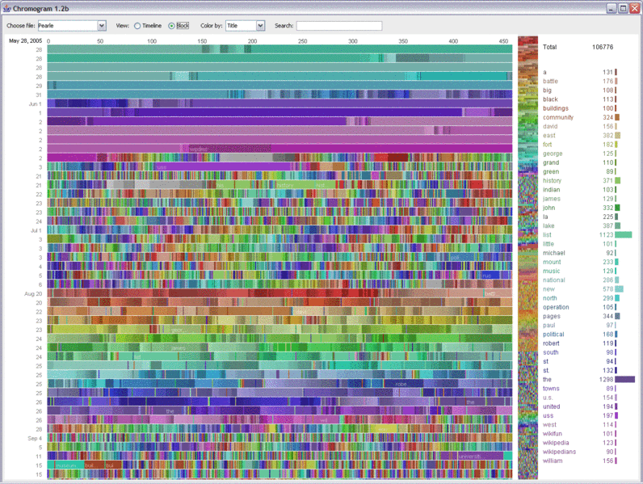
30 / 30 Don’t Forget Visualization
Tools (commercial & open source)
Too Many to mention!
Query tools + Query Engines = Awesome

Slide 34

  31 / 30….. Have Fun!
https://www.slideshare.net/markslusar
For High Level Use Case Worksheets
Huge Thanks to the Organizers! O’Reilly & Cloudera
Contact me @MarkSlusar
Allstate is always interested in Data Scientists & Engineers!
Contact me or visit: http://careers.allstate.com/

Slide 35
Worksheet #1 Hadoop Use Cases
Determine Use Cases, Example Below:
ETL
  Extremely Responsive & Nimble Collection of tools & APIs: Hive, Pig, Streaming API (Python, et al)
Descriptive Analytics (aka BI)
  Using built-in tools (Hive, Pig, Streaming API)
  Using COTS tools (Commercial & Open) with streaming API & query engines (Impala, Hive, et al)
Predictive Analytics
  Using tools like R (streaming) and Python (numpy, scipy, scikit, & anaconda over streaming)
Storage & Archival
  Very low cost, highly fault-tolerant, very responsive
{{ And more, YMMV }}

Slide 36
Worksheet #2 Data Science Ops
Determine Ops Usage, Example Below:
Ad-Hoc Operations: One-off transactions
Sustainment Operations: A repeatable & trusted process
Research Operations:
Trying new queries, software, approaches, methods
Development Operations: Creating a Defined Operational Process for Sustainment
Test Operations: Validating Data Quality, Consistency, Speed, Coverage, et al
Governance Operations: Validating Security Permissions, Lineage, Usage, Importance, De-Duplication.
{{ And more, YMMV }}

Slide 37
Worksheet #3
Crossing “Hadoop Use Cases” with the “Ops Usage”
Your Outcome may vary…
 | Storage & Archival | ETL | Descriptive Analytics | Predictive Analytics
Ad Hoc Ops | N/A | Analysts | Data Science | Data Science
Sustainment Ops | Data Management | Data Management | Analysts And Data Management | Data Science
Research Ops | Data Science | Data Science | Data Science | Data Science
Development Ops | N / A | Data Management | Data Science | Data Science
Test Ops | Data Stewardship | Data Stewardship | Data Science | Data Science
Governance Ops | Data Stewardship | Data Stewardship | Data Stewardship | Data Stewardship

Slide 38
Worksheet #4
Crossing “Hadoop Use Cases” with your Organization
Your Outcome may vary…
 | Storage & Archival | ETL Offload | Descriptive Analytics | Predictive Analytics
Research | X | X | X | X
Marketing |  | X | X | X
Sales & Pricing |  |  | X | X
IT Ops | X | X | X | X
Delivery | X | X
Other
Other
Other

