Slide 1
Hardening Hadoop for the Enterprise: Managing Diverse Workloads, Securing and Governing your Big Data Platform
How does IT balance the tension between “one glorious cluster that serves them all” and “one cluster, one purpose – dedicated for the particular task and not to be interfered with by anything”.
If they are to contain cluster sprawl, folks need help allocating a mixed workload across a shared cluster (beyond the job tracker assigning map and reduce slots), and they want to be sure the cluster is as secure as can be.
Kerberos, C-groups and YARN to the rescue!
This talk describes the current practices and speculates how things get better under YARN.

Slide 2
Agenda
Basics
Cluster Evolution
Vanilla Cluster
Foreign Workload Introduced
Node Specialization
Cluster Specialization
Datacenter Integration
YARN
Security

Slide 3


Hadoop – and her 2 beautiful things
Data
I will spread your data out over many servers to keep it safe
I will facilitate a new idea that you should send the work to the data, not the other way around.
Data
Data
Data
Data
Data
Data

Slide 4







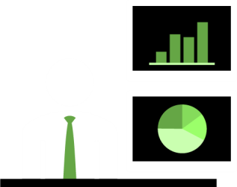
Why Do This?
Because it gets the answers soooo much faster
NameNode
Client
Notes:
Some processes are more complex that fits “nicely” inside the terms & conditions of the container.
We can use the embedded process as a data acquisition channel, and yet perform the mathematics elsewhere (and in the first generation, elsewhere meant other operating system processes on the same server – preserving a symetric or 1:1 balance between the data parallelism and the mathematics parallelism)
2012 – SAS High Performance appliances for teradata, greenplum and hadoop

Slide 5


WOW, that’s awesome. Can we join your cluster?

Slide 6

We’ll be very very good. Really.

Slide 7
Agenda
Basics
Cluster Evolution
Vanilla Cluster
Foreign Workload Introduced
Node Specialization
Cluster Specialization
Datacenter Integration
YARN
Security

Slide 8
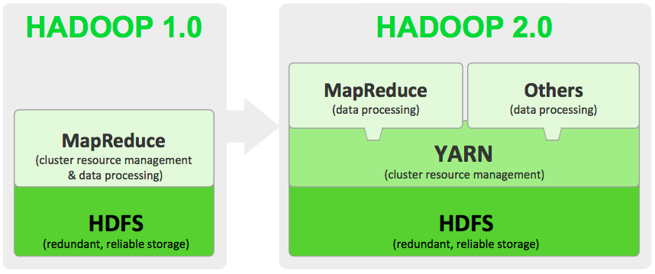
2012 :: Have ☹ Want ☺

Slide 9

Vanilla Cluster
NameNode
SecNmNode
DataNode
DataNode
DataNode
DataNode
DataNode
DataNode
DataNode
DataNode

Slide 10
Vanilla Cluster (with foreign workload)
NameNode
SecNmNode
DataNode
DataNode
DataNode
DataNode
DataNode
DataNode
DataNode
DataNode

Slide 11
Foreign != MapReduce & not only ( SAS )
SAS High Performance Analytics
SAS Visual Analytics
Impala
BDAS Spark
Giraph
Solr
.. Hbase

Slide 12
Vanilla Cluster (with foreign workload)
Add work across entire cluster
Add memory to accommodate
Derate MapReduce to accommodate
Time Slice?
No extra copy of Data
NameNode
SecNmNode
DataNode
DataNode
DataNode
DataNode
DataNode
DataNode
DataNode
DataNode

Slide 13


Slide 14
Node Specialization (for foreign workload)
NameNode
SecNmNode
DataNode
DataNode
DataNode
DataNode
DataNode
DataNode
DataNode
DataNode

Slide 15
Node Specialization (for foreign workload)
Add workload to some … “SASnodes”
Add memory to SASnodes
Derate MapReduce on SASnodes?
Cgroups to make em play nice
Still no extra copy of Data
SAS writes data to SASnodes only. (balancer)
NameNode
SecNmNode
DataNode
DataNode
DataNode
DataNode
DataNode
DataNode
DataNode
DataNode

Slide 16

Node Specialization (for foreign workload)
Add workload to some … “SASnodes”
Add memory to SASnodes
Derate MapReduce on SASnodes?
Cgroups to make em play nice
Still no extra copy of Data
SAS writes data to SASnodes only. (balancer)
NameNode
SecNmNode
DataNode
DataNode
DataNode
DataNode
DataNode
DataNode
DataNode
DataNode
CDH4 Best Practice

Slide 17
Specialty Cluster
NameNode
SecNmNode
DataNode
DataNode
NameNode
DataNode
DataNode
DataNode
DataNode
DataNode
DataNode
DataNode
DataNode
DataNode
DataNode

Slide 18
Specialty Cluster
Create new “Odd Shape” cluster
Optimize Hardware to fit task
Oops! extra copy of Data
Easier to contain variation ☺
NameNode
SecNmNode
DataNode
DataNode
NameNode
DataNode
DataNode
DataNode
DataNode
DataNode
DataNode
DataNode
DataNode
DataNode
DataNode

Slide 19




example
Asymmetric AS an option
NameNode
Controller
Client
Notes:
Finally, we can separate the computers hosting the mathematics from those hosting the data.
We don’t have to preserve the symmetry – we can have a different degree of parallelism in the datasource than the mathematics

Slide 20





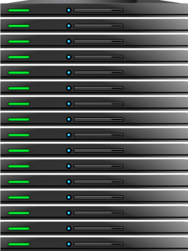




DataCenter Integration
CLIENT
TERADATA
ORACLE
HADOOP
Notes:
Now that we have asymmetric connection models, we can hook one instance of the mathematics to several (different) instances of data providers.
The SAS bigmath idea is now a first class citizen in the datacenter, and in the data architectures being implemented
Terdata UDA: SAS + Hadoop + Aster + Teradata
Oracle: SAS + Bigdata Appliance + Exadata
IBM SAS + BigInsights + DB2 + Puredata(aka Netezza)
EMC Greenplum SAS + Pivotal HD + GreenplumSQL
SAP SAS + {hadoop} + HANA

Slide 21
Agenda
Basics
Cluster Evolution
Vanilla Cluster
Foreign Workload Introduced
Node Specialization
Cluster Specialization
Datacenter Integration
YARN
Security

Slide 22
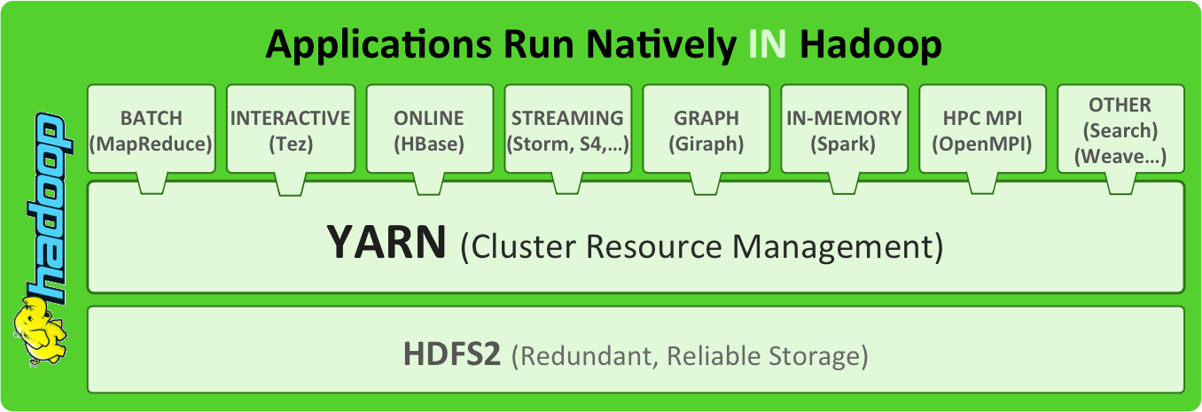
2013q4? 2014?

Slide 23
2013q4? 2014?

Slide 24
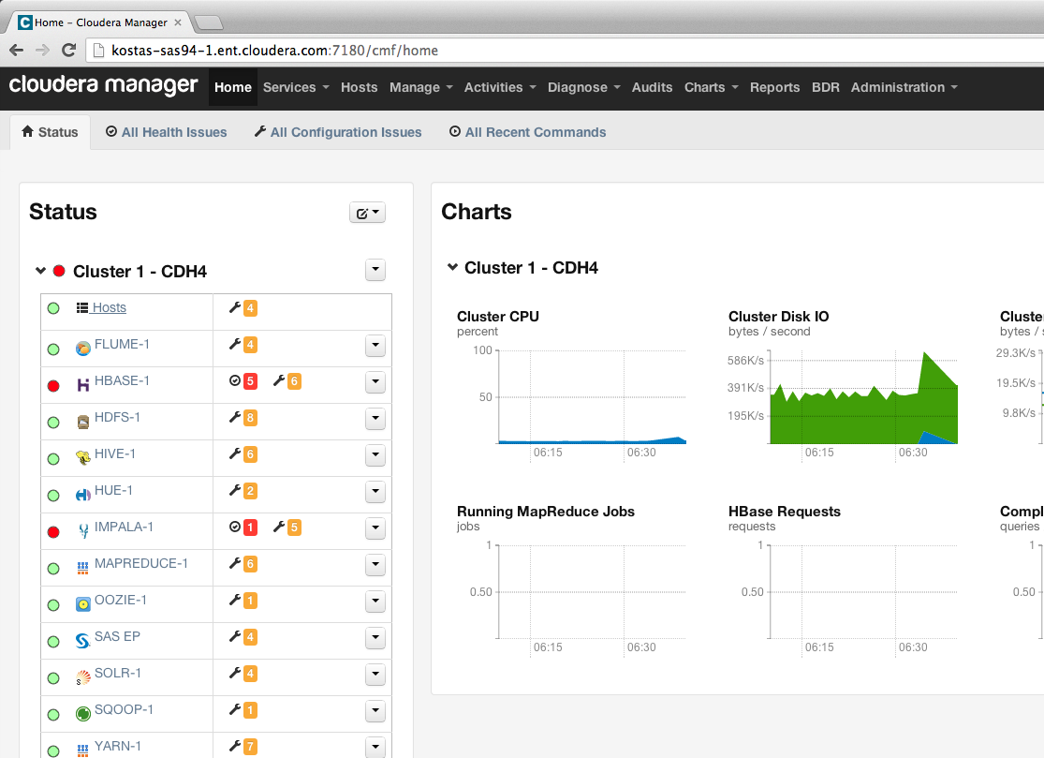

Slide 25
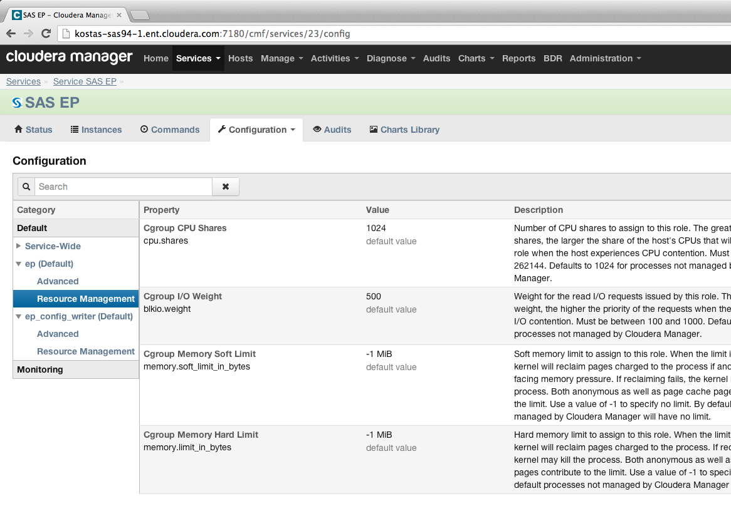

Slide 26
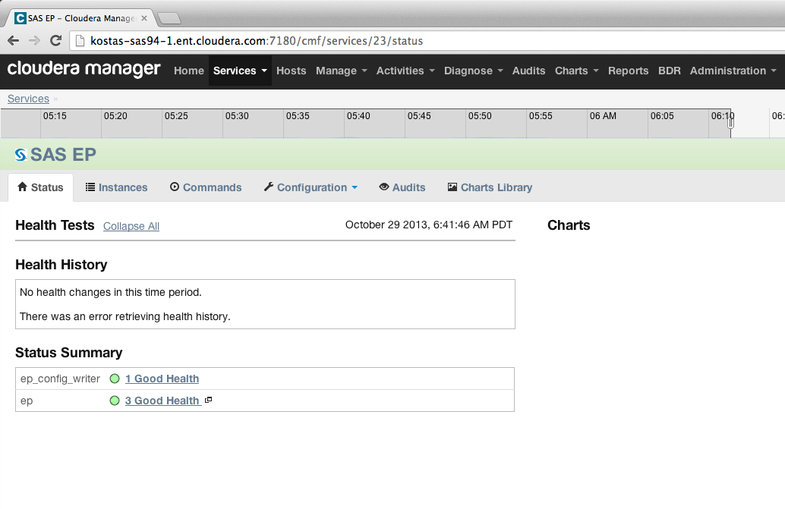

Slide 27
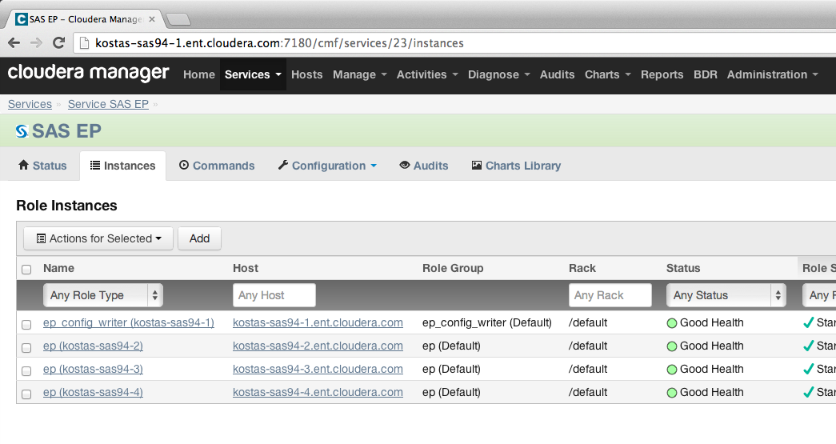

Slide 28
Node Specialization (for foreign workload)
NameNode
SecNmNode
DataNode
DataNode
DataNode
DataNode
DataNode
DataNode
DataNode
DataNode

Slide 29
Agenda
Basics
Cluster Evolution
Vanilla Cluster
Foreign Workload Introduced
Node Specialization
Cluster Specialization
Datacenter Integration
YARN
Security

Slide 30
Security is Hard. Better Start right away.
Add Kerberos to your environment ASAP – right after the first POC
Integrate with the identity management on site
Don’t add unix-users to the cluster by hand!
Automate.
Engage SAS Technical Resources.
Security settings can be hard to get right. Error messages get obfuscated and tracking the true source is difficult
Easier to start with a small working system and add projects
Resist “Oh, we will add the security later”. Your users will have gotten so used to no-security they’l scream!

Slide 31


Thank You!
Paul.Kent @ sas.com
@hornpolish
paulmkent

