Slide 1
Hilary
The Most Poisoned Baby
Name in US History
Notes:
So as you just heard, my name is Hilary. I’m a data analyst at Etsy. I’m going to talk about an analysis I did earlier this year where I found that my name was the most poisoned baby name in US History.

Slide 2
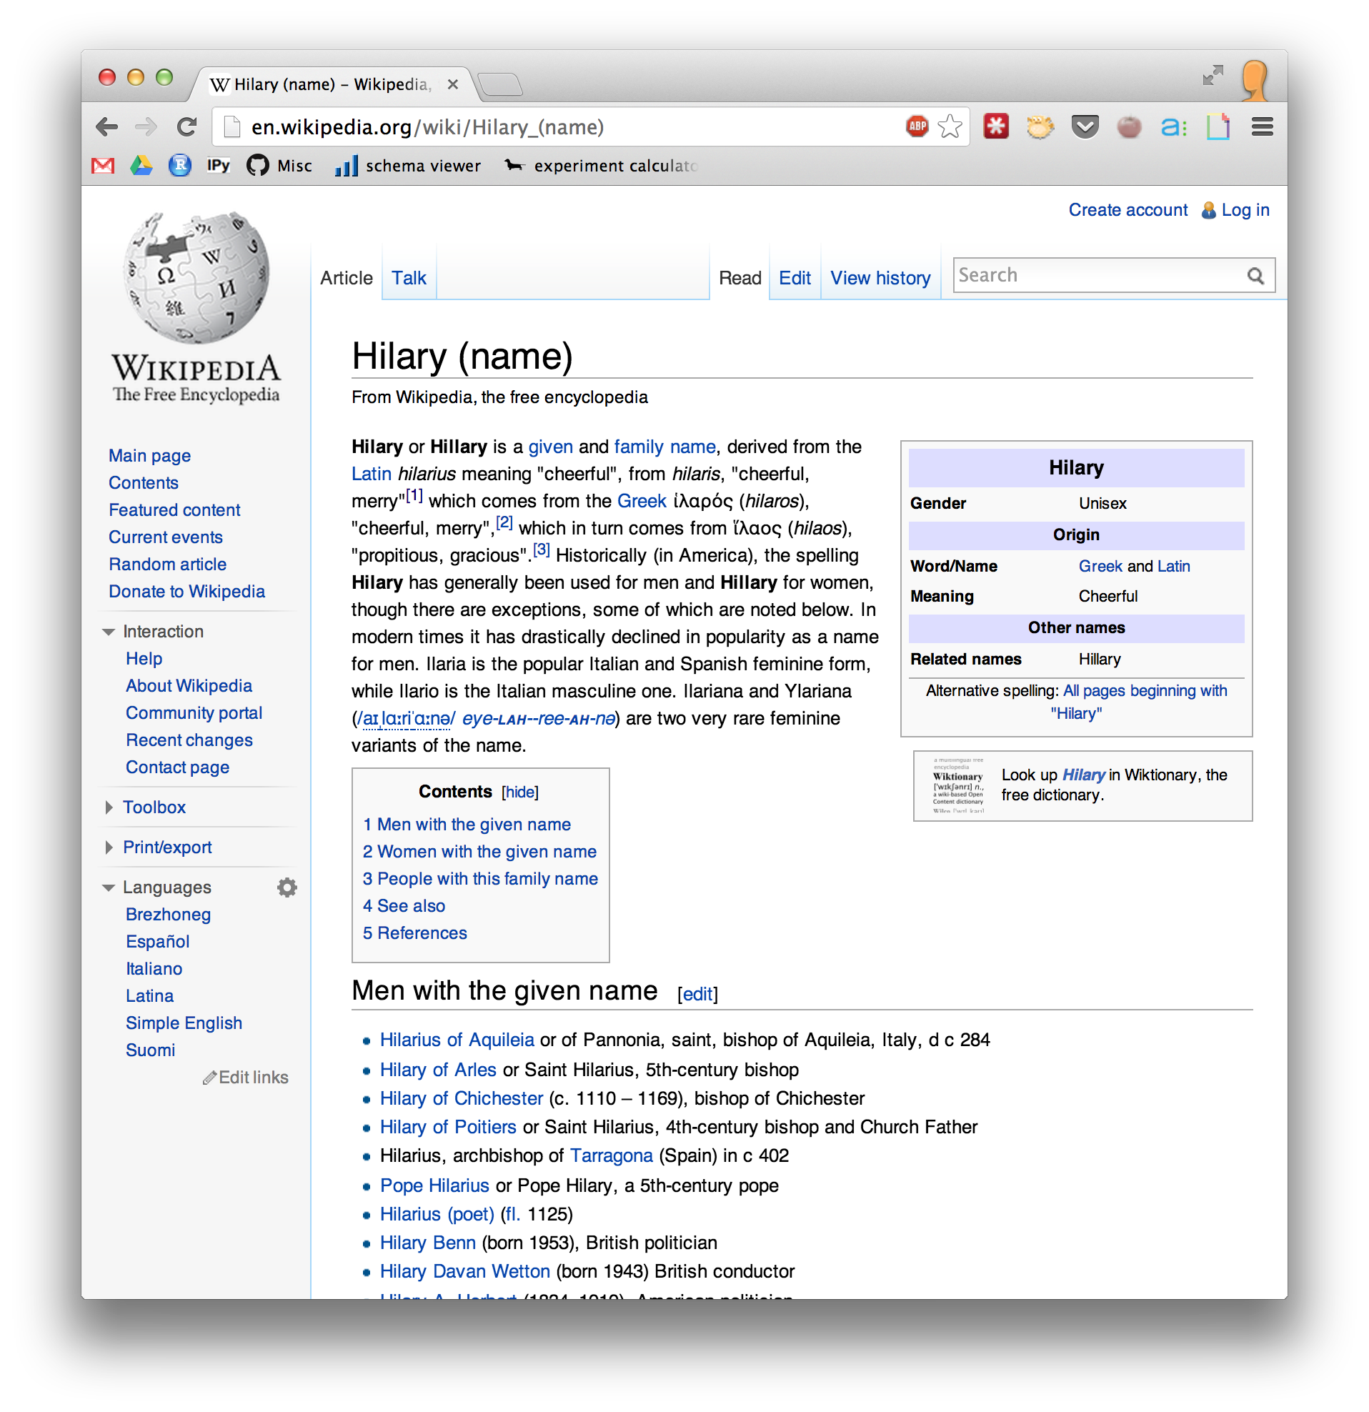
Notes:
So first of all, I always want to start this discussion by saying that I love my name. The name Hilary comes from the same root word for the wordhilarious. It means cheerful and merry. It’s a great name. However, I guarantee you that almost everyone in this room associates the name Hilary with a specific person.

Slide 3
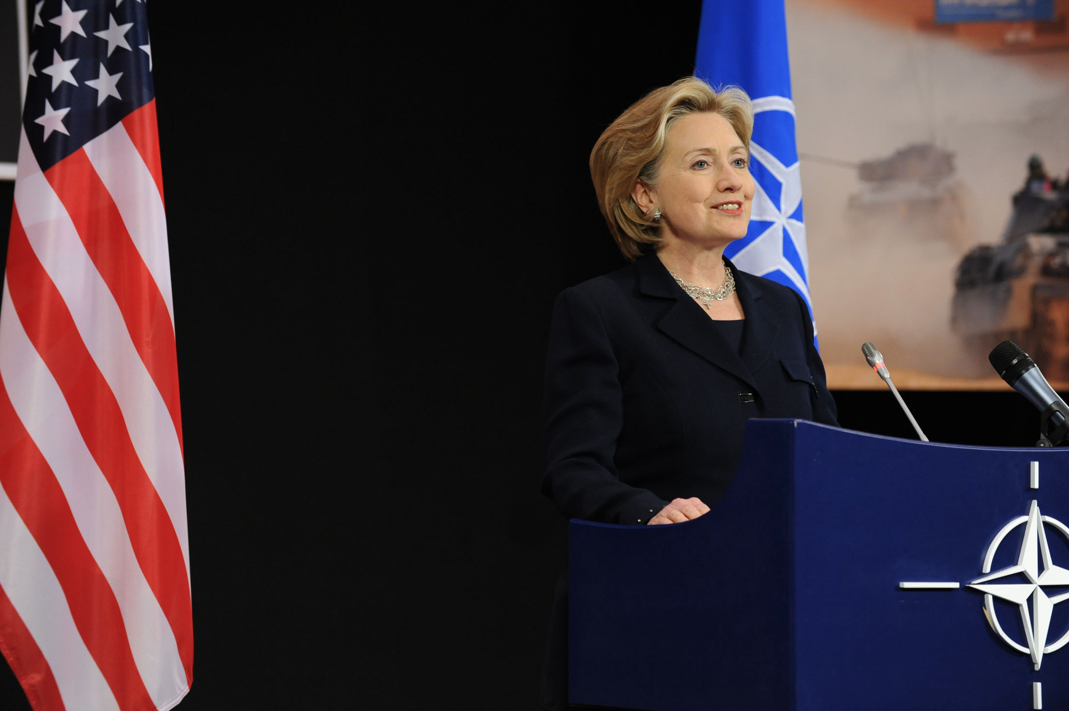
Notes:
The name Hillary is strongly associated with Hillary Clinton. I know this personally because whenever I introduce myself, there’s a high probability that the other person is going to say “Oh Hilary? Like Hillary Clinton!” First of all, to all the jokesters out there, this is not original. Secondly, when I was growing up in the 90s…

Slide 4
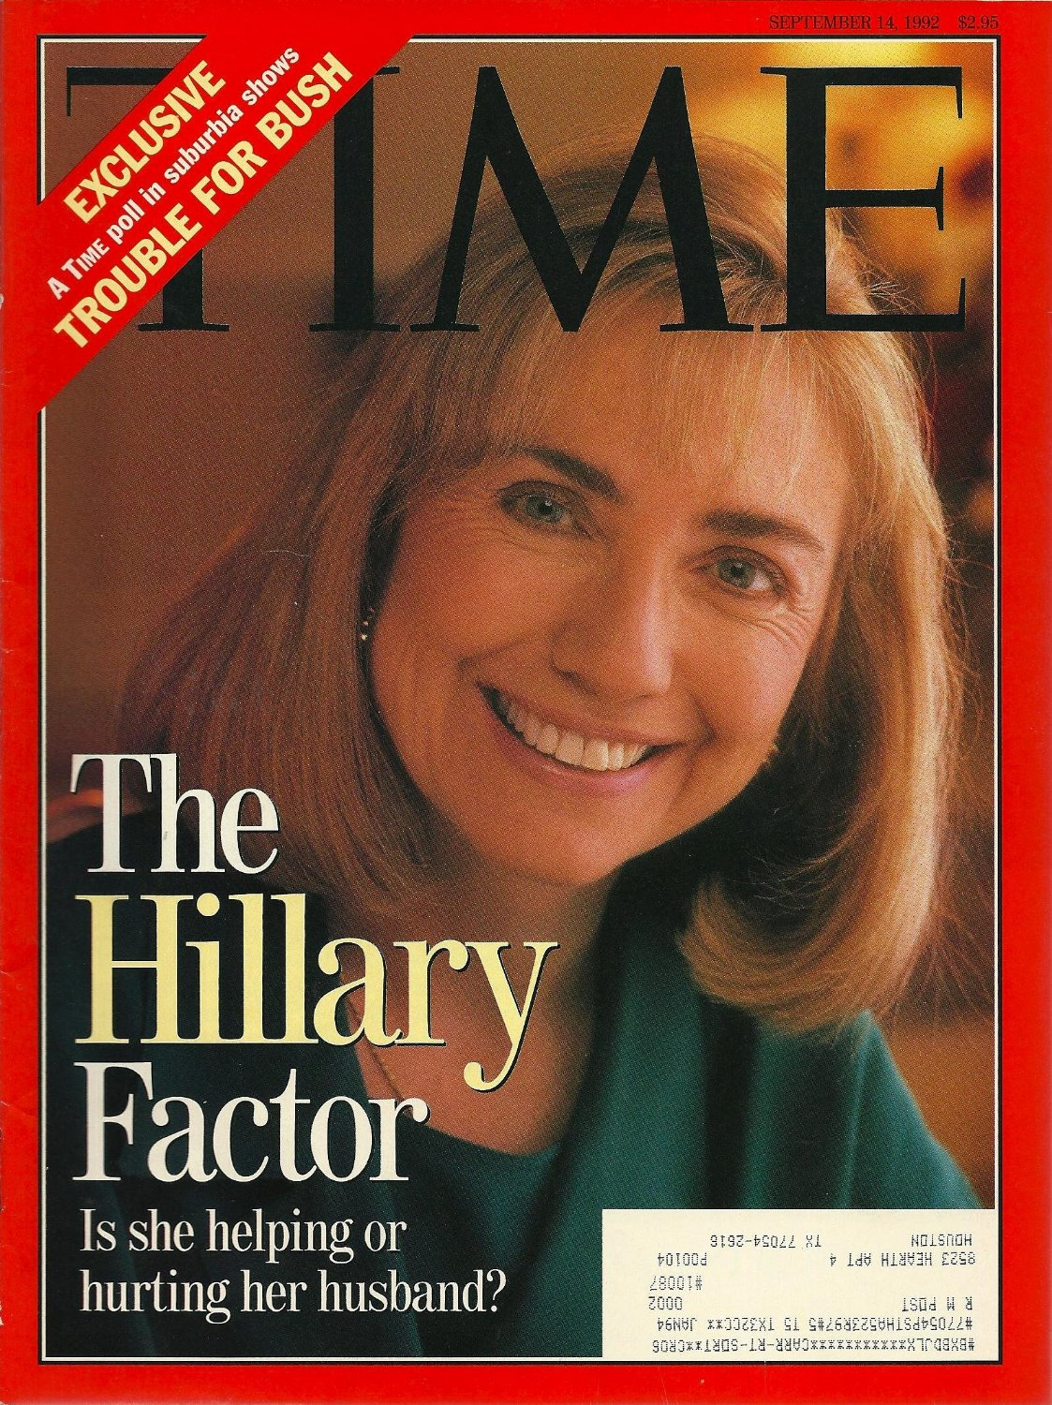
Notes:
…this was really meant in a pejorative sense, because Hillary Clinton didn’t fit into the mold of first lady, and was not a popular person. So I wasn’t surprised when I came across a blog article in college…

Slide 5
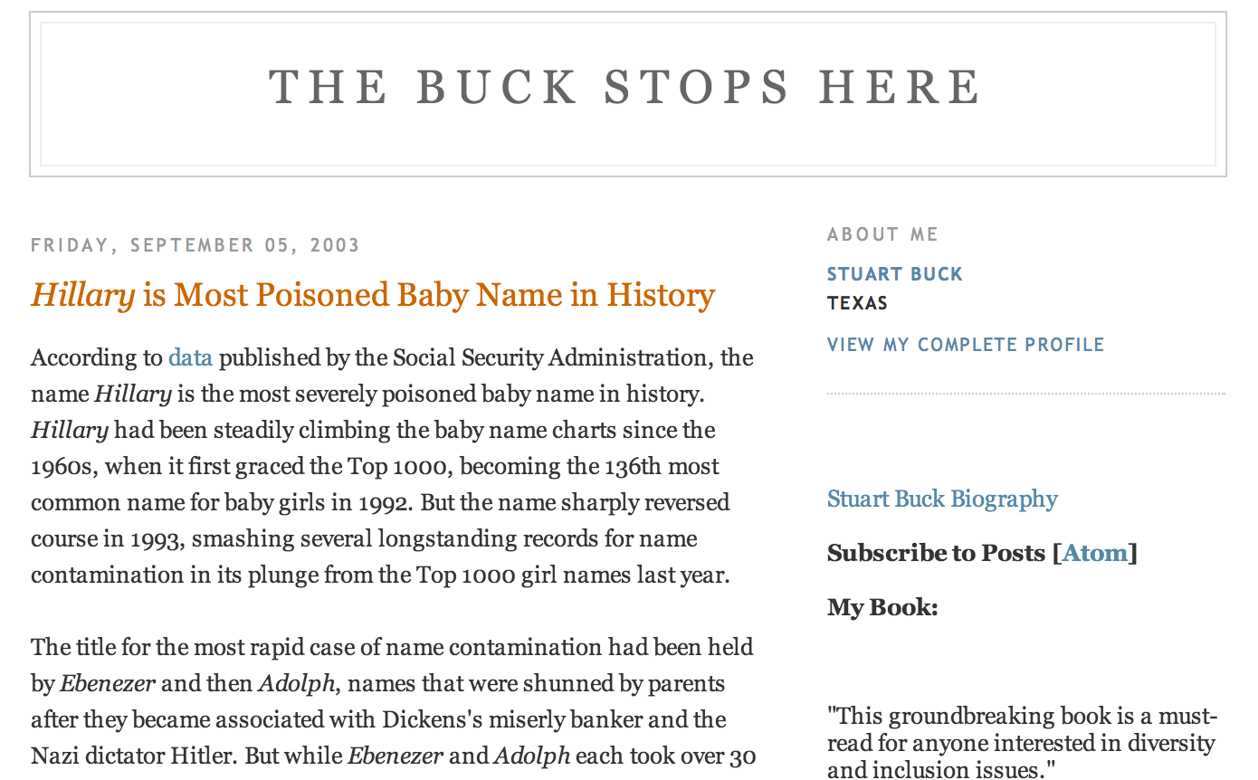
Notes:
That states that Hilary was the most poisoned baby name in US history. The author had looked at the popularity ranking of the name Hilary and compared it to other names around the same timeframe and found that the name Hilary dropped in popularity around 1993.

Slide 6
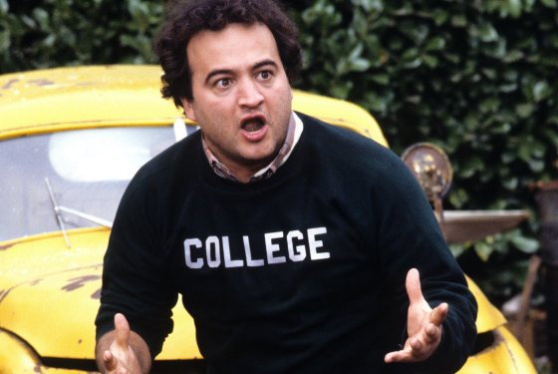
Notes:
I thought this was really interesting and started to tell people this at cocktail parties. I always wanted to compare it to every single name in US history. However, I was in college and didn’t have the technical skills to do this analysis. Fast forward 8 years, and I’m in grad school – I’ve learned some R and some statistics, and I thought to myself “I should really do this analysis.” So I went…

Slide 7
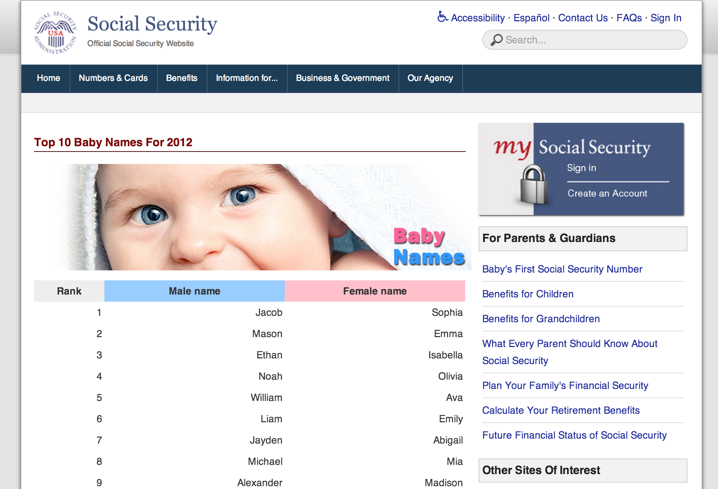
Notes:
To the social security website. Using data I scraped from the website, I calculated the year-over-year change in percent popularity for every single baby name for every single year. Defining poisoned as the largest year-over-year drop in popularity, I ranked the names by “most poisioned.”

Slide 8
Name | Loss (%) | Year
Farrah | 78 | 1978
Dewey | 74 | 1899
Catina | 74 | 1974
Deneen | 72 | 1965
Khadijah | 72 | 1995
Hilary | 70 | 1993
Clementine | 69 | 1881
Katina | 69 | 1974
Renata | 69 | 1981
Iesha | 69 | 1992
Minna | 68 | 1883
Ashanti | 68 | 2003
Celestine | 67 | 1881
Infant | 67 | 1991
#6
Notes:
And I found that Hilary was ranked number 6! This was DEVASTATING. Not only was I extremely upset that I wasn’t the most poisoned baby name, but you have to remember that I had been telling this to people for 8 years!

Slide 9
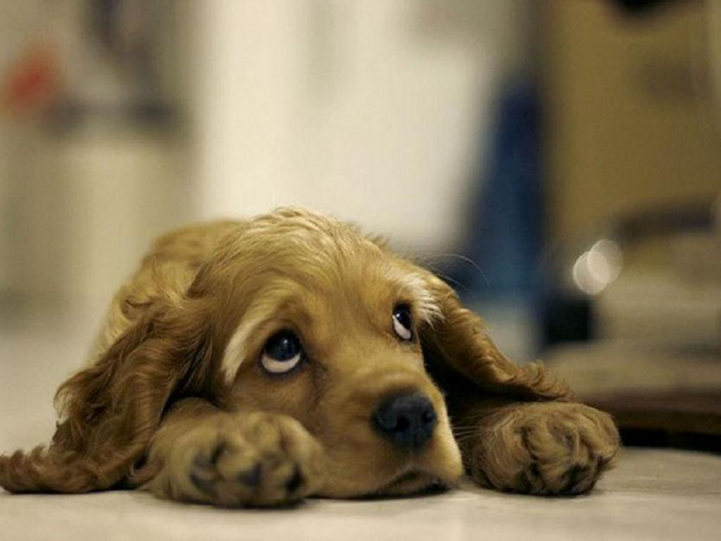
Notes:
I was pretty bummed out. After moping around a bit, I decided to visualize the data. That’s when this project got really interested. Looking at the percent popularity of these most poisoned names over years, I saw a strange trend.

Slide 10
Notes:
For each of the most poisoned names, I saw that the names would have a huge spike in popularity and then drop off the chart. So I started to investigate what was going on. For each of the names, I googled the name as well as the year it spiked into popularity, and I found some interesting results.

Slide 11
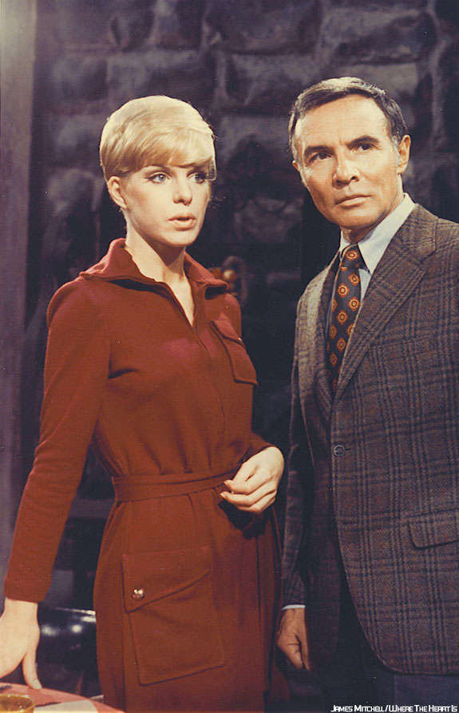
Notes:
All of these spikes were due to the fact that people were naming their kids after people that they saw on TV. For example, in 1970 the name “Catina” spiked into popularity because a baby name Catina was born on the soap opera “Where The Heart Is.”

Slide 12
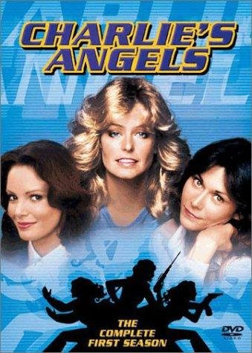
Notes:
Similarly, in 1970 the name “Farrah” became popular because the show Charlie’s Angel’s started, and everyone wanted to name their babies after Farrah Fawcett. And my personal favorite is the name Iesha,

Slide 13
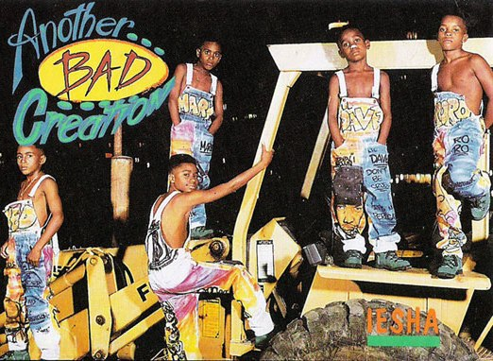
Notes:
Which spiked into popularity in 1991 because of the One Hit song “Iesha” of the One Hit Wonder band “Another Bad Creation”. I highly recommend looking up that youtube video when you get home. So I thought this was all interesting, but these were all fad names…

Slide 14
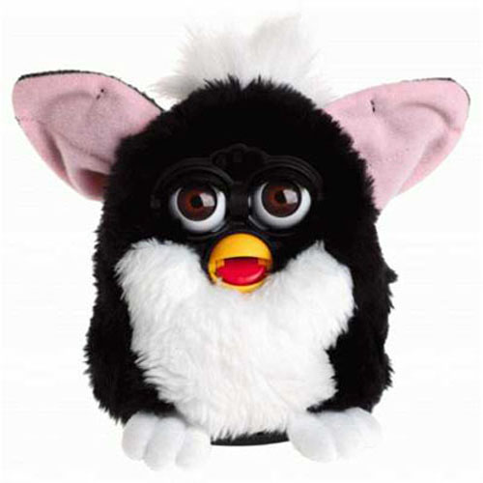
Notes:
And I didn’t feel like it was a fair comparison to look at the fad names versus Hilary. The mechanism that was causing these names to drop in popuarlity was really different. So I filtered out the fad names, and lo and behold,

Slide 15
Notes:
I found that the top two most poisoned names where “Hilary” spelled with one and two L’s. “Hilary” with one L dropped 70% year-over-year in 1993, and Hillary with two L’s dropped 61%.

Slide 16

Notes:
I know that this is a very data-driven crowd, but regardless, I know that at this point everyone asks the exact same questions. True to Godwin’s Law, everyone asks about Adolf Hitler. So, I’m here to assure you beyond a resonable doubt…

Slide 17
Notes:
That the name “Hilary” is FAR more poisoned than the name “Adolph”. In fact, Adolph was relatively unaffected by World War II. Take from that what you will. Similarly, everyone asks about the name Katrina…

Slide 18
Notes:
While Katrina was affected by hurricane Katrina, its drop in 2006 was only about 40%, versus 70% for Hilary. So, all joking aside, I think this entire story is actually a very important message for young women to hear.

Slide 19
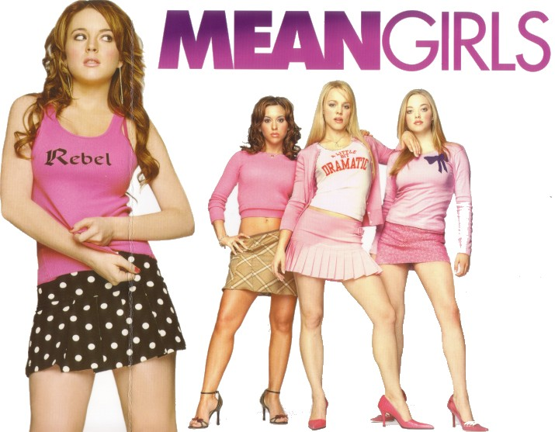
Notes:
Hillary Clinton was so unpopular in 1992 that she poisoned her name more than everyone else in US history. However, she now is one of the most successful and powerful women in US history. So, the moral of the story is that life is not about being popular.

Slide 20
Hilary Parker
hilaryparker.com
@hspter
Notes:
Again, my name is Hilary. If you want to read this full analysis or find the code, you can go to my blog hilaryparker.com. Thanks!

