Slide 1
Are these your goals too?
1) To improve some metric.
2) To do as many tests as possible.
3) To find big breakthroughs…
4) ...and incremental gains.

Slide 2
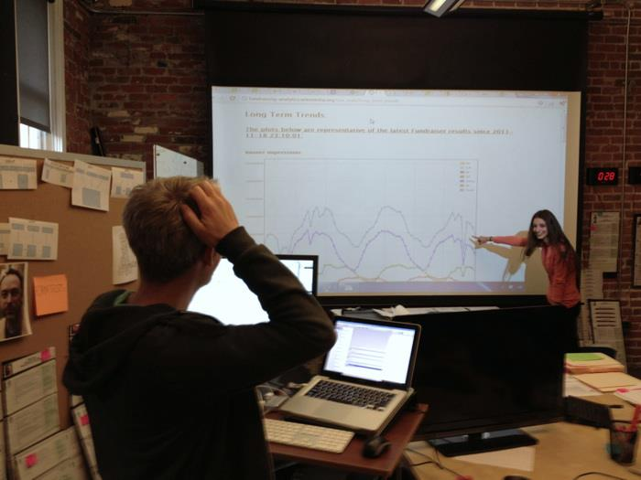

Slide 3
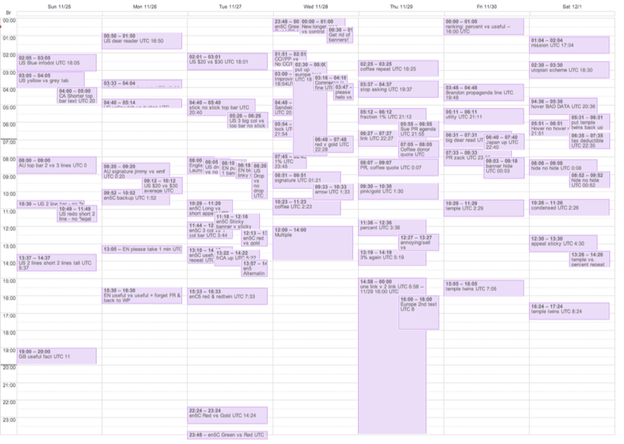

Slide 4
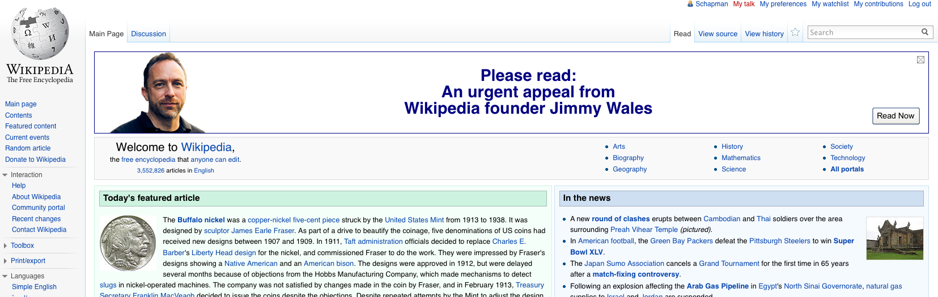
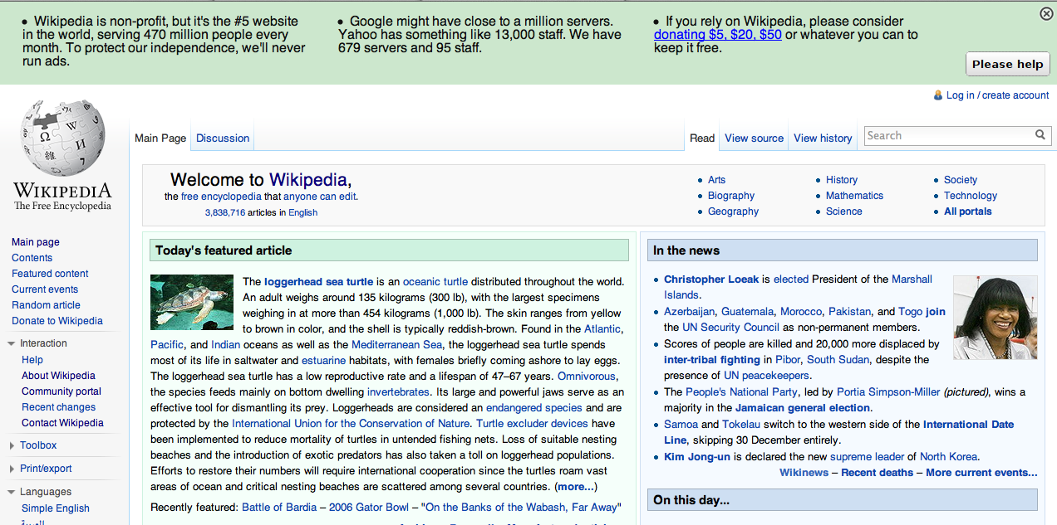

Slide 5
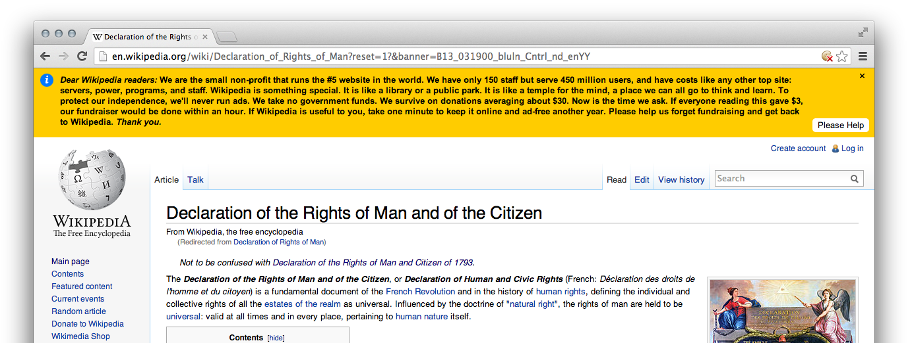
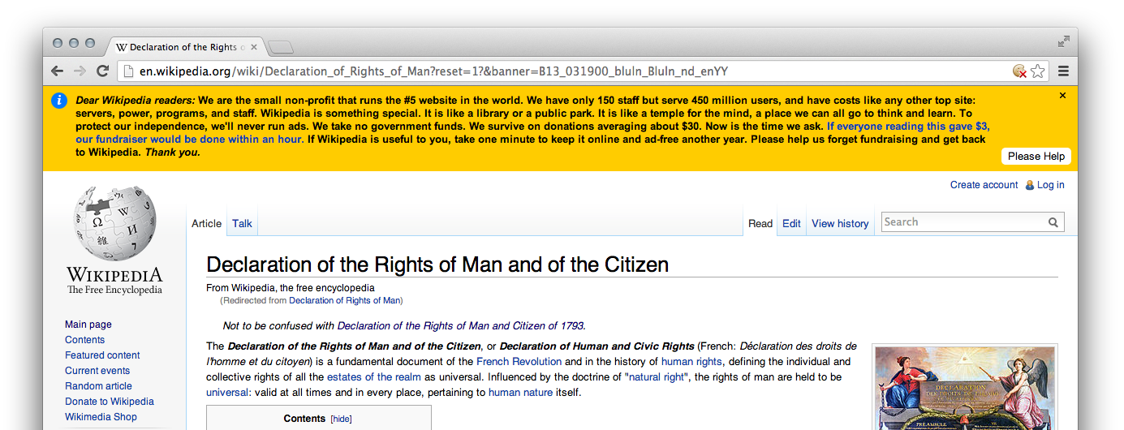
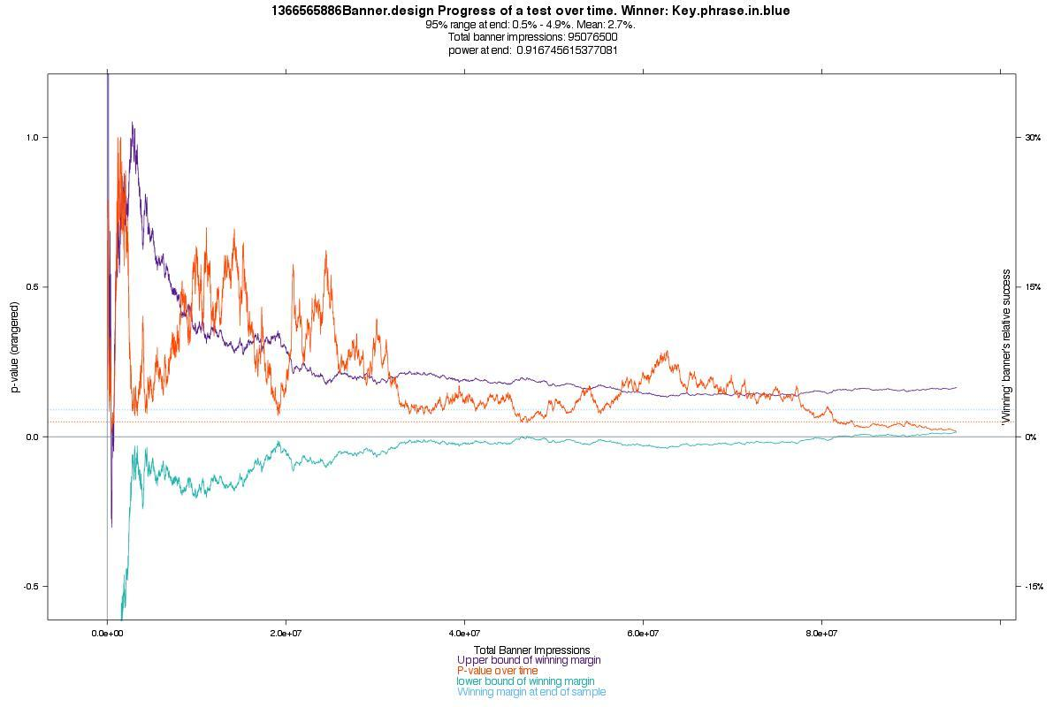

Slide 6
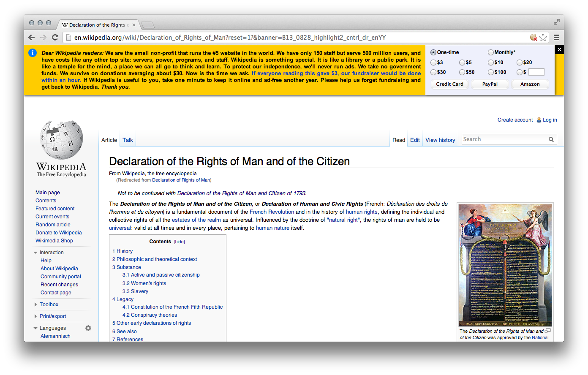
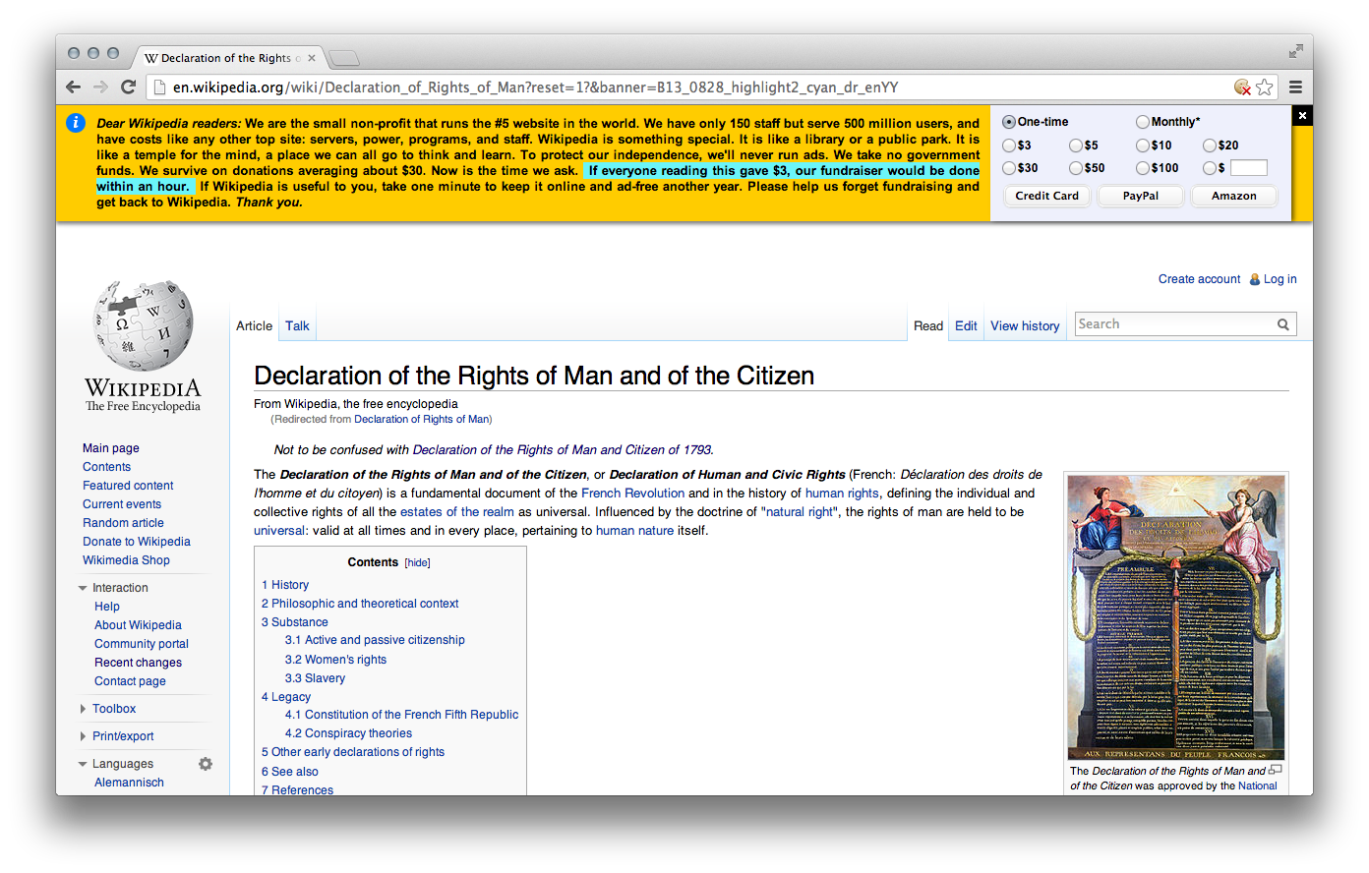

Slide 7


Slide 8
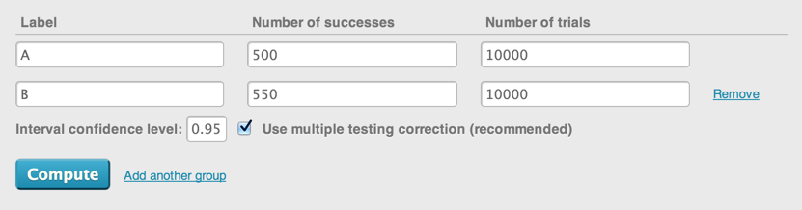
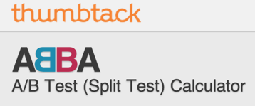

Slide 9
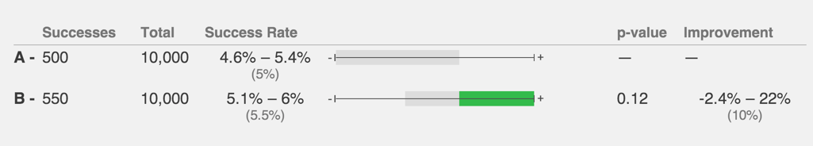
i.e.:
B won in this sample.
But you have a 6% chance of B actually being a loser. (And another 6% chance that B wins by a ton.)
If you keep running this test, B will probably win by somewhere not too too far from 10%.

Slide 10
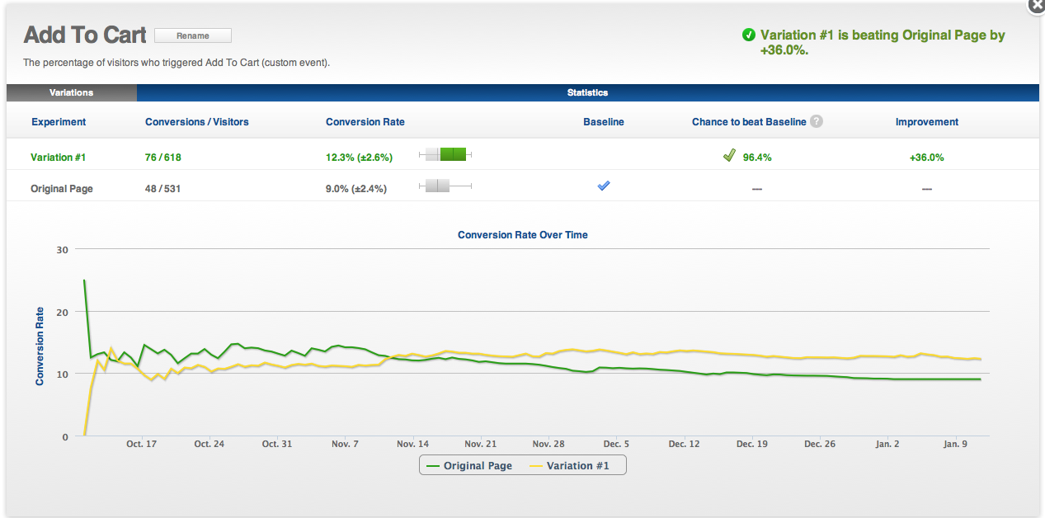

Slide 11
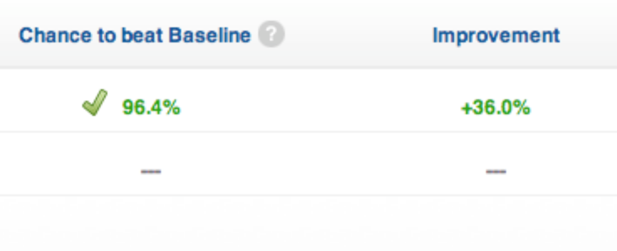

Slide 12
It is OK to peek.
!!

Slide 13
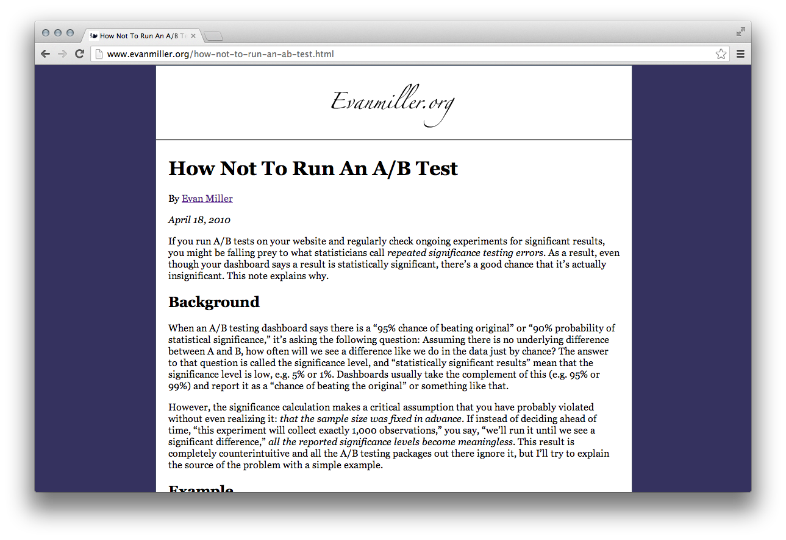

Slide 14
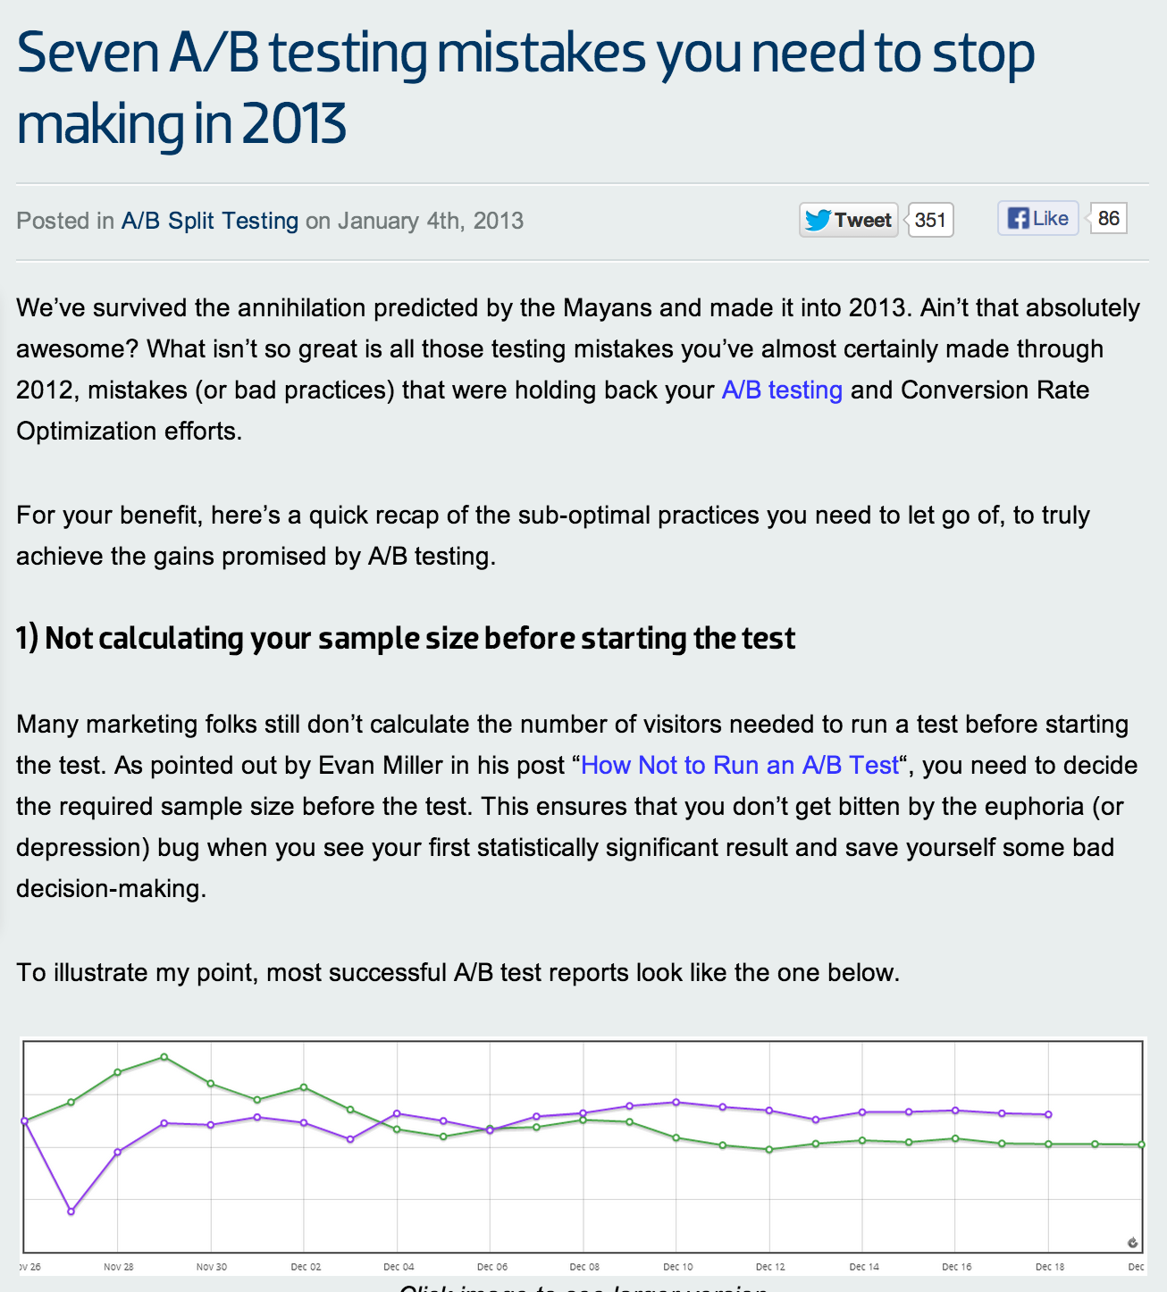

Slide 15
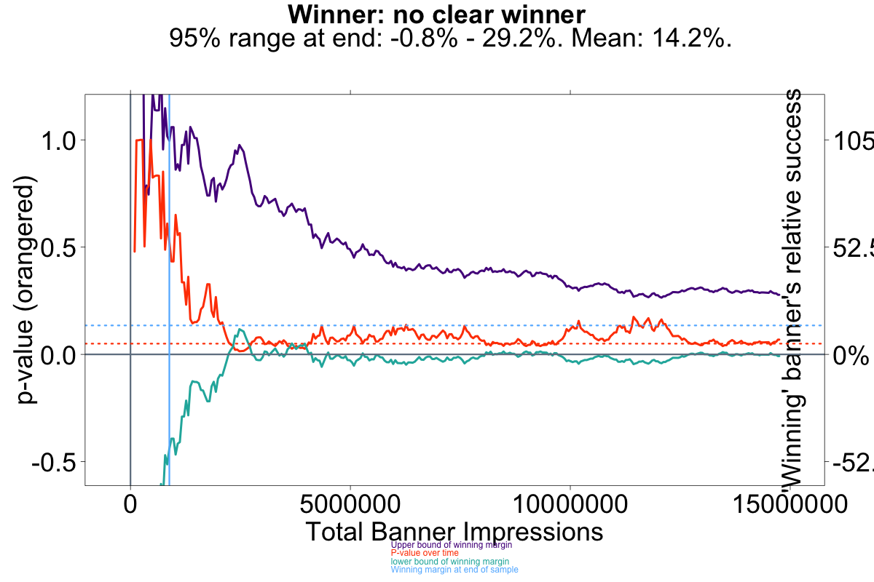

Slide 17
Not only is it OK to peek. You don’t even have to wait for 95% confidence!
There’s no magic at p=.05 or p=.01
Every p value tells you something.

Slide 18
For example:
.3 = “probably a winner!”
.8 = “probably no big difference.”

Slide 21
OK to peek? REALLY? Yes, really. Let’s think it through...
What if you peek during a moment when you’ve “falsely” gotten 95% confidence thanks to a handful of anomalous sales?
What if the ‘true’ confidence is only 90% -- i.e. if you ran the test much longer, you’d eventually get only 90% confidence.
OK, What are you risking?
You are mistakenly thinking that you have a 2.5% chance of picking a loser when you actually have a 5% chance of picking a loser.
BIG DEAL.

Slide 22
But here’s what you gain:
You can move on to test something new!
Something that might make a huge difference!
So go for it!
If you’re making an error, it will soon be rooted out if you’re testing often enough.

Slide 24
OK to stop at 70% confidence? REALLY? Yes, really. Let’s think it through...
That just means you’re taking a 15% chance of hurting performance -- i.e. a 15% chance that you’re using AB testing for EVIL instead of GOOD!!! Oh no!
Before you start hyperventilating: If you ARE hurting performance, chances are you’re only hurting it by a percent or two. There’s only a tiny chance that you’re doing serious harm (to your sales...for a short time).
We’re not landing someone on the moon, just playing with websites.

Slide 25
Out of 214 real Wikipedia tests we analyzed:
If we had stopped at the first sign of 70% confidence (after 15 donations):
We’d pick the winner : 90% of the time We’d pick the loser: 10% of the time.
Our tests were on average 72% too long.
We could have done 3.6 TIMES MORE testing!
(if we were OK with that trade off, which we are!)

Slide 26
Hey, guess what! When the lower bound of the confidence interval crosses zero, you have confidence!
(Now that’s something they didn’t teach you in AB testing school.)

Slide 27
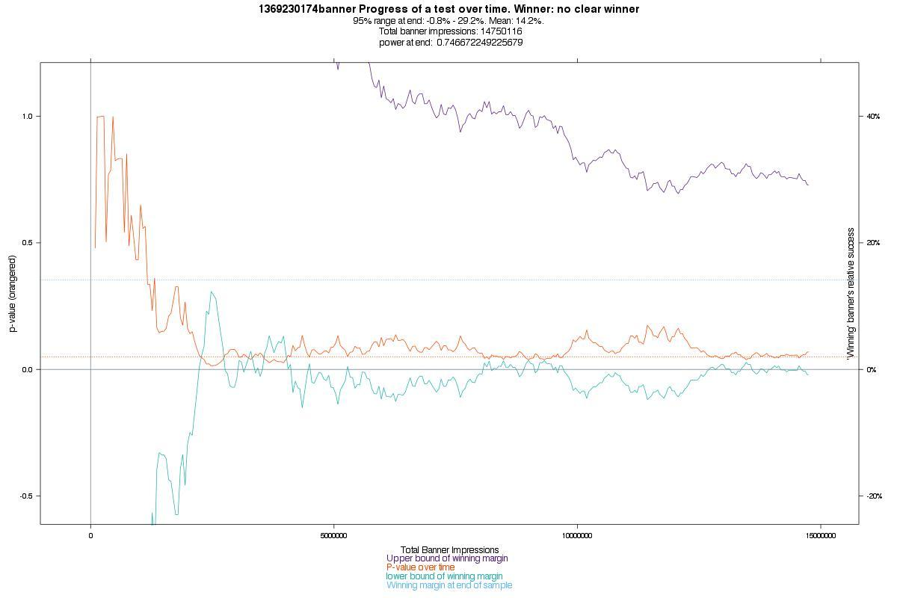

Slide 28
And that’s why we say….
p is nice.
But confidence interval is where it’s at.

Slide 29
There’s no cliff at 95% or 99% confidence.

Slide 30
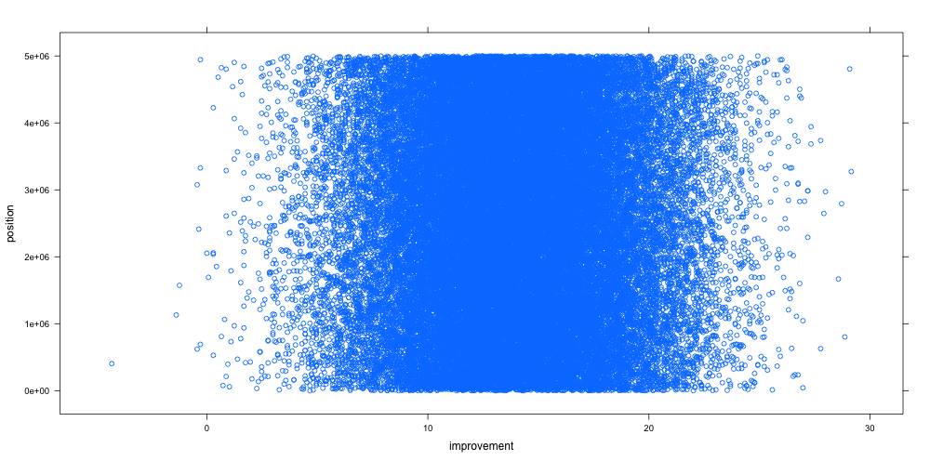
95% of results are in here
But 80% are in here
Notes:
77.37% are between 10 and 20% improvement
mean of 13.91066
median of 13.92128
79.34% are between 8.92 and 18.92
50% are between 11.22% and 16.55%

Slide 32
Now for some finer points and other tips.

Slide 33
Don’t freak out when...
p shoots up for a moment.
It’s just an edge case.

Slide 34
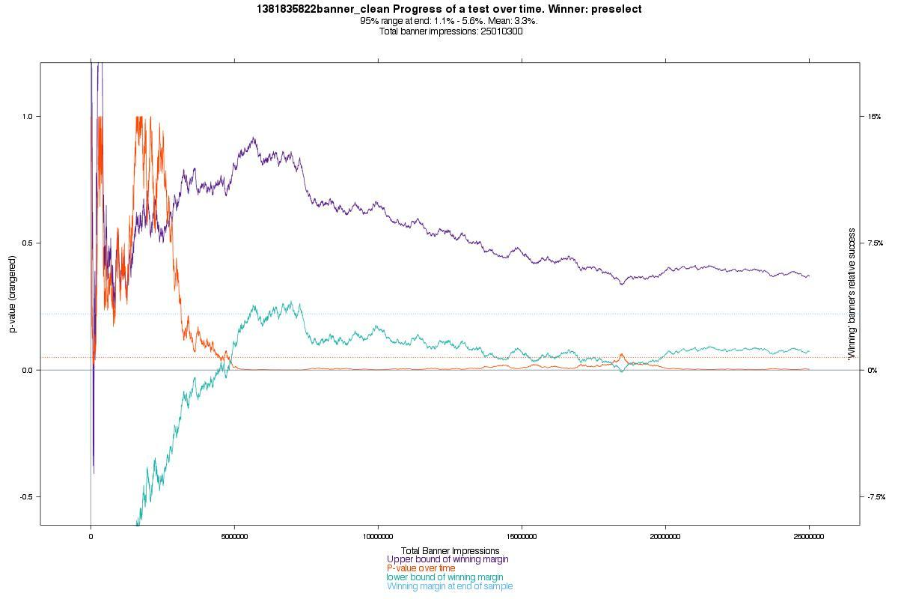
Notes:
Look at how much the interval was jumping early -- but it had no effect on p. But then just a little jump below zero makes a huge impact on p.

Slide 35
Notes:
Look at how much the interval was jumping early -- but it had no effect on p. But then just a little jump below zero makes a huge impact on p.

Slide 36
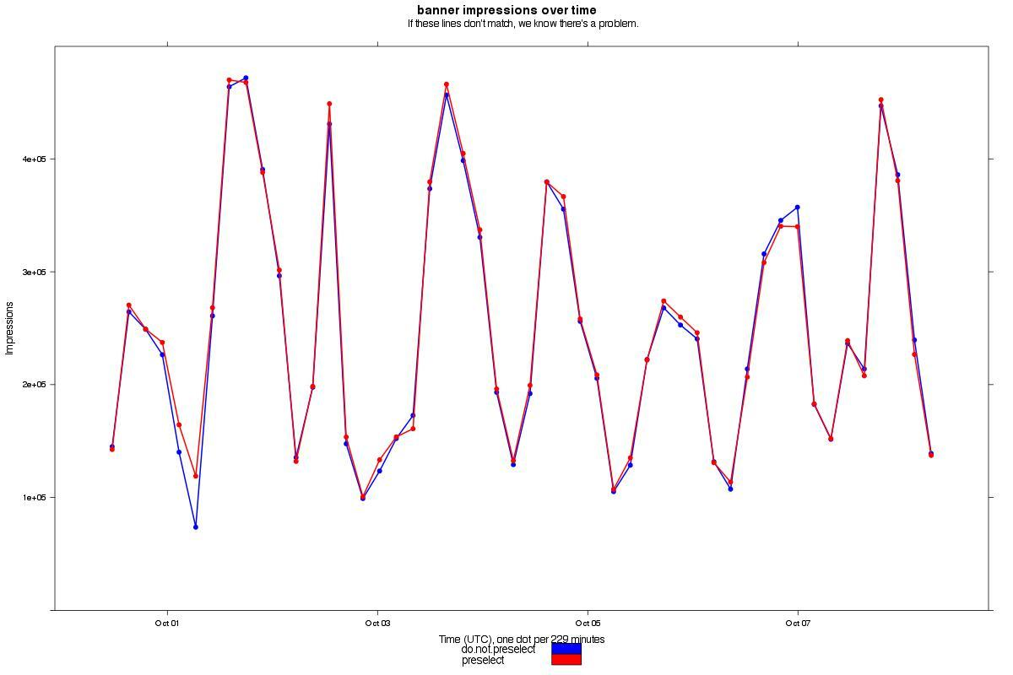
This is the blip.

Slide 37
To halve the confidence interval, you have to roughly quadruple the sample size!

Slide 38
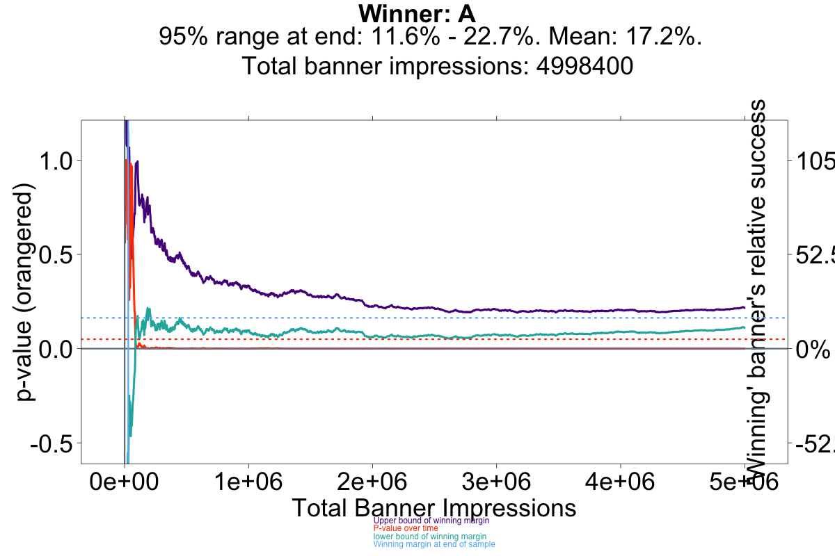

Slide 39
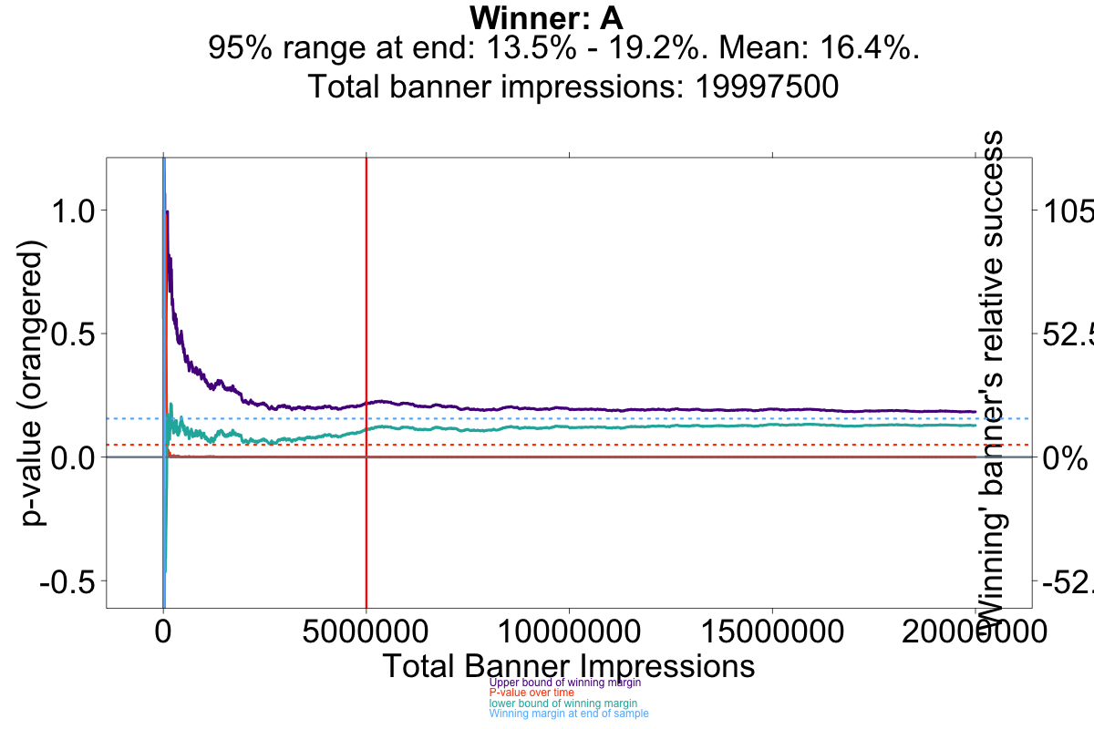
4998400 impressions
11.6% - 22.7% interval

Slide 40
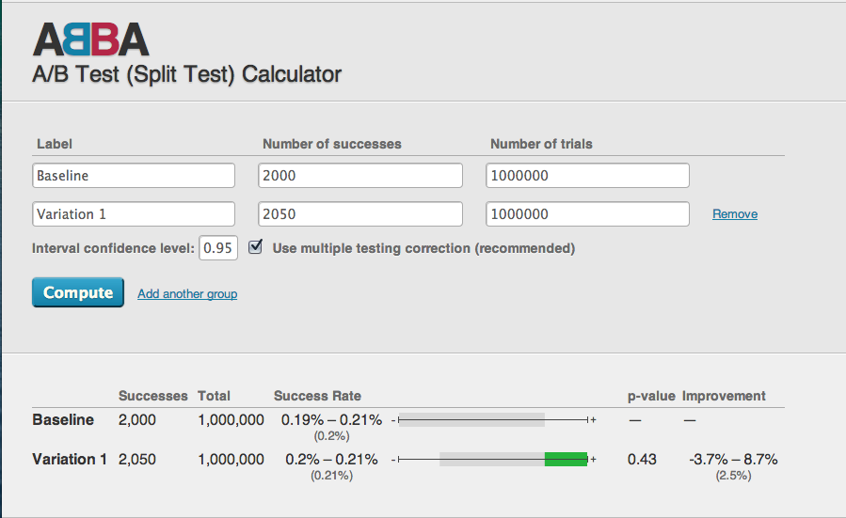
1 million

Slide 41
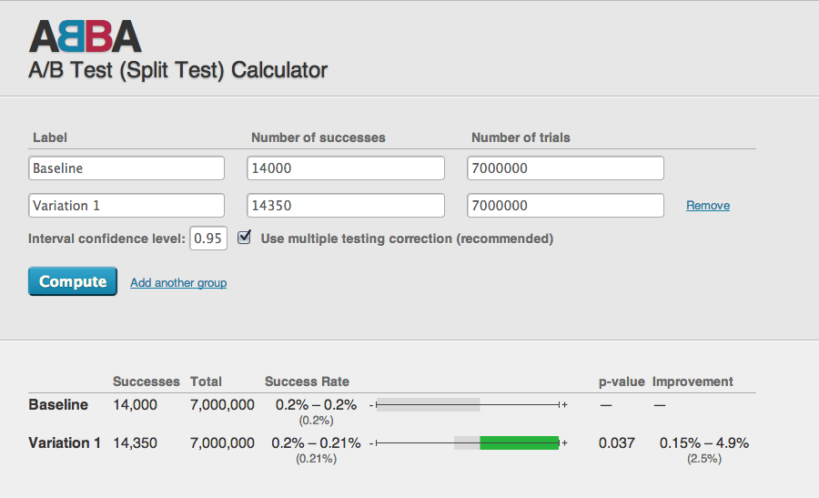
7 million!

Slide 42
Another tip:
WFRs (Wildly Fluctuating Response rates) can mess you up.
Example - WMF donation rates at night are much lower than during the day, and skew our results.

Slide 43
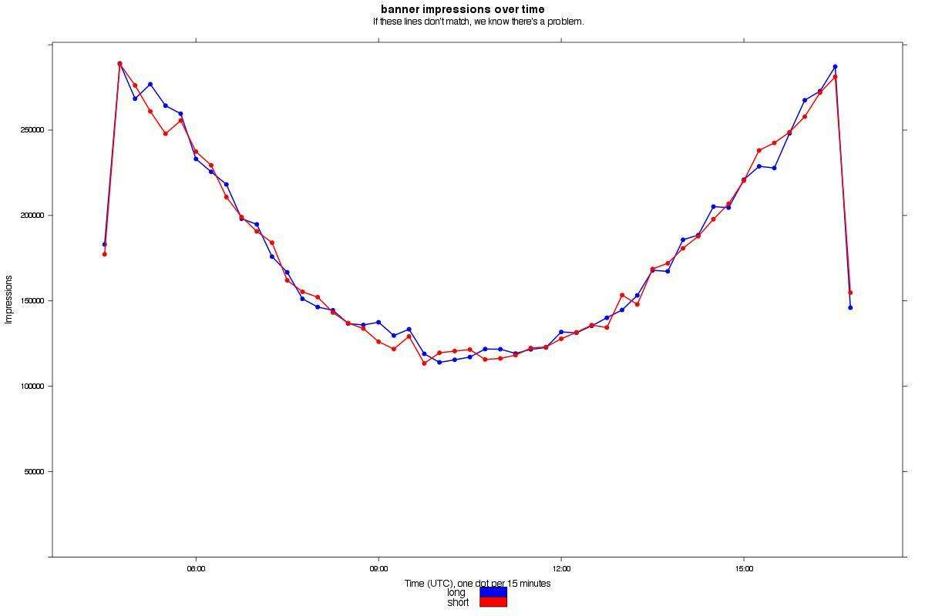
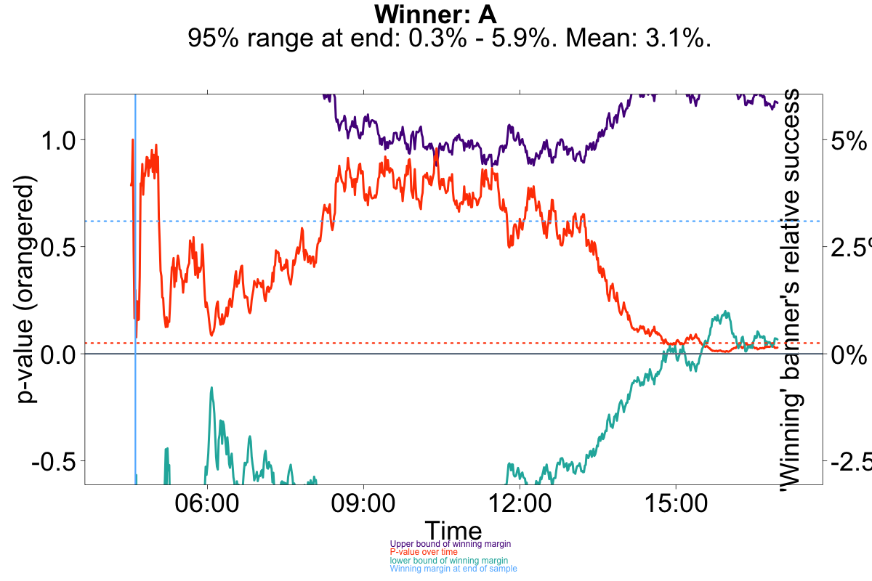

Slide 44
Some good news, if you’re torn between Agresti-Coull and Adjusted Wald...
Any stats test will do.

Slide 45
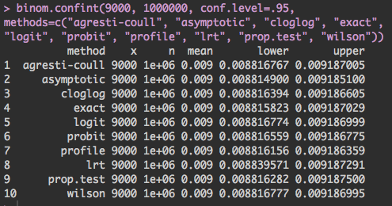

Slide 46
Use diagnostic graphs to detect errors in your testing.

Slide 47
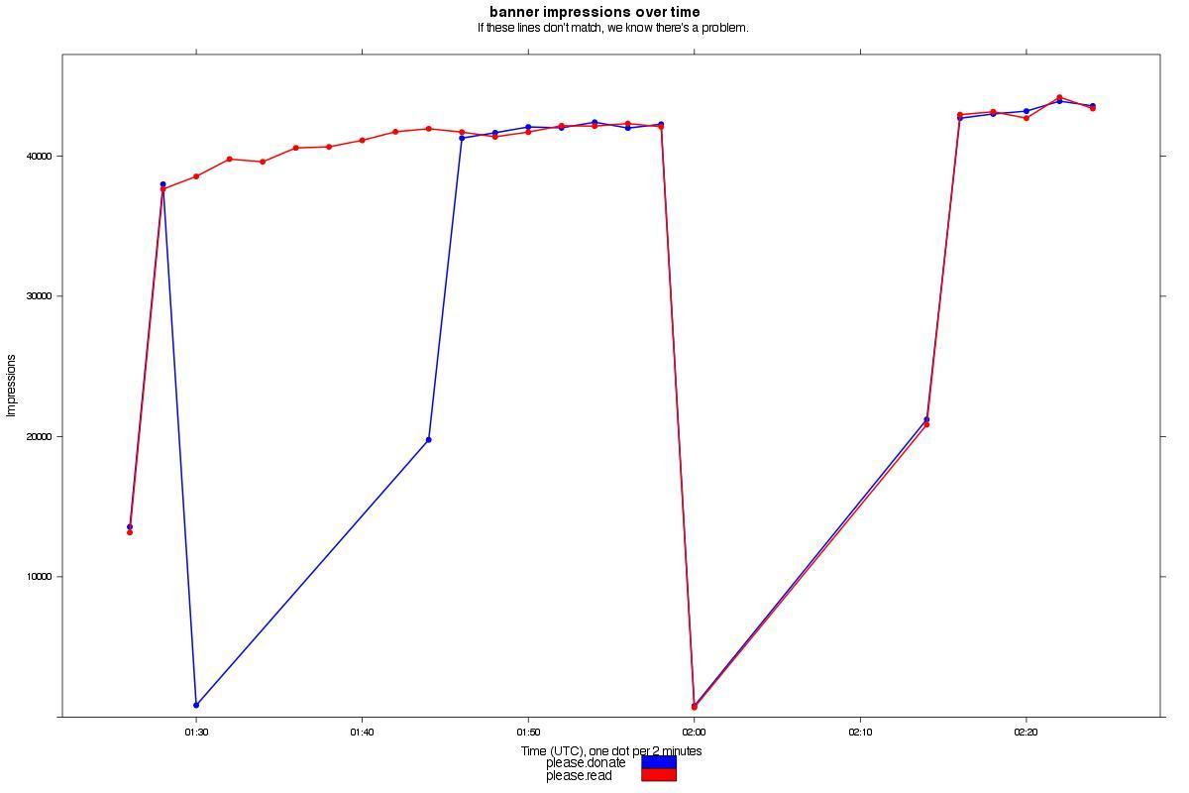
OOPS!
Lucky we found this.

Slide 48
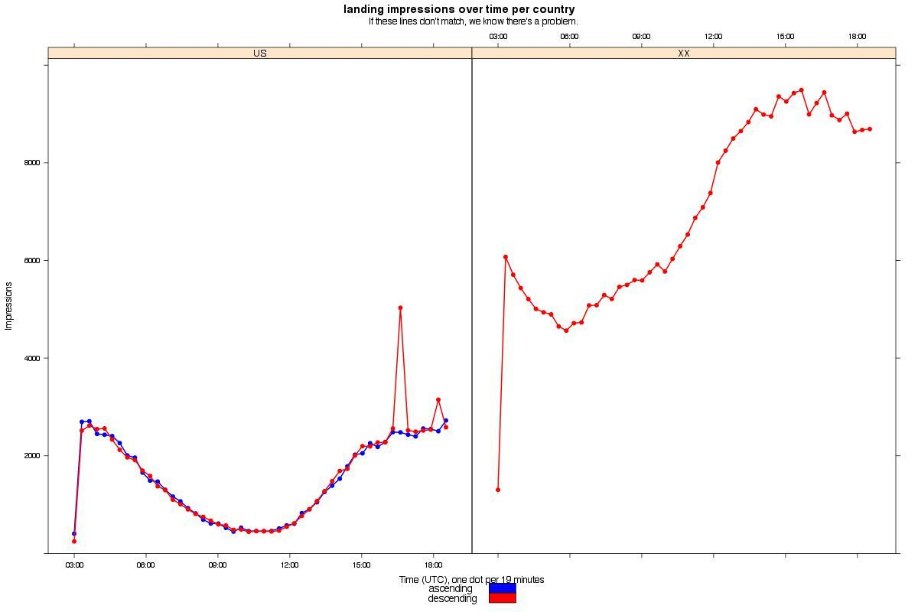
Oops! Someone forgot to turn on B outside the US. Good thing our diagnostic graphs uncovered it.

Slide 49
Let business needs, not stats dogma decide when to stop your tests.
Is B going to be technically or politically difficult to implement permanently, but is winning by 5% to 50%? Then you need to keep running your test!
Are A and B almost the same to your business? And B is 0% to 8% better? Then stop! Time to test something else and find something with a bigger impact!

Slide 50
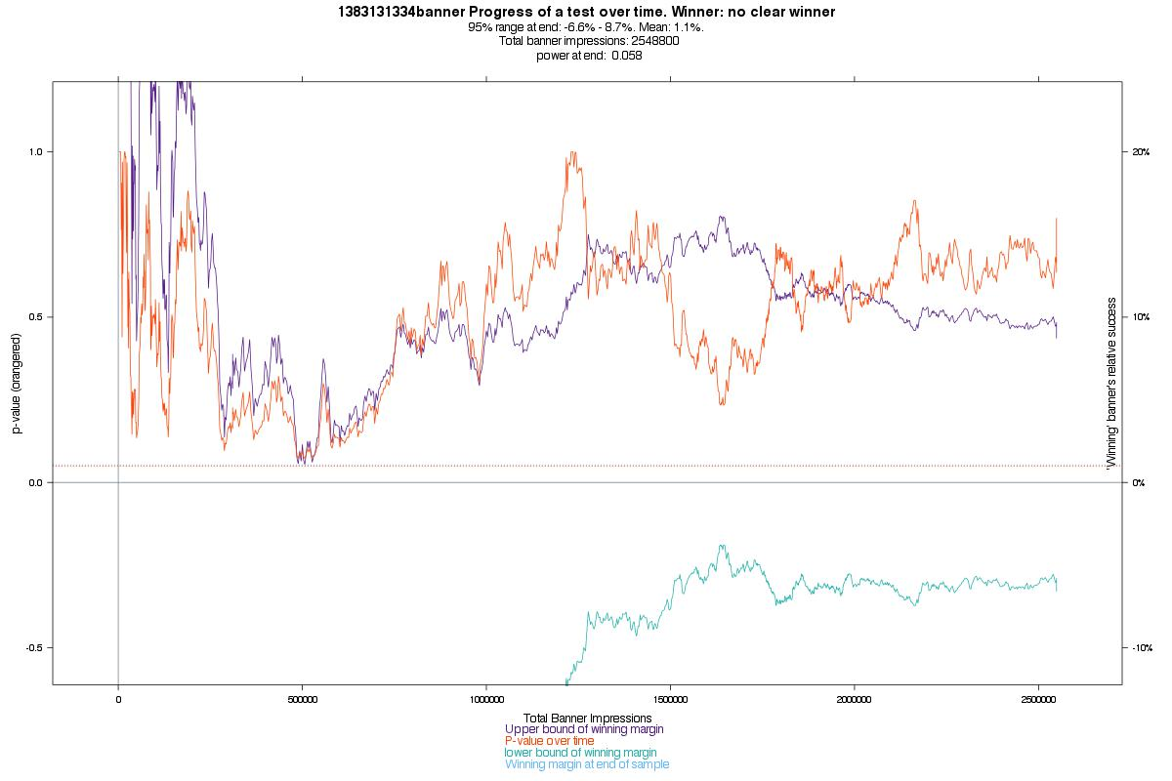

Slide 51
Announcement:
All of our code is free/libre software. We’d love collaborators.
zack@thoughtworks.com
sahar@vlwc.org

Slide 52
Review:
There’s nothing magic about 95% confidence - consider using 70% or 80%.
Decide when to end your test dynamically, don’t fix your sample size ahead of time. It’s totally okay to peek.
Confidence intervals are your new best friend.
The lower bound of your confidence interval will be > 0 when you have confidence. (When p-value is below the threshold).
Don’t freak out if p-value spikes a bit - look at your confidence interval: is it an edge case?
If A & B are very slightly different, you’ll need an enormous sample size to find it - it’s not worth it!
Quadruple your sample size to halve your confidence interval.
Wait until A & B have 15 successes each. &/or run power prop over and over.
Beware of low response rate periods.
Almost any statistical test for finding p/confidence is fine.
Use diagnostic graphs to detect errors.

Slide 53
Extra slides in case we have enough time:

Slide 54
Our back up method:
We use the power prop test in a sort of self-referential way. We continuously run power prop using the proportions we have at the moment and see if our sample is the recommended size.
power.prop.test(p1=p1, p2=p2, power=power, sig.level=alpha)$n

Slide 55
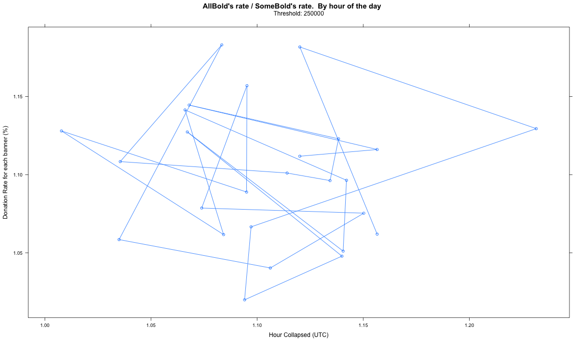
Notes:
Hahaha. Oops.

Slide 56
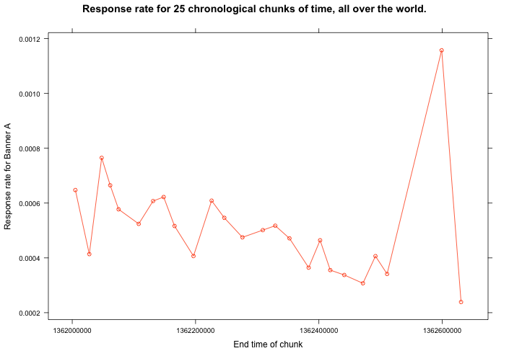

Slide 57
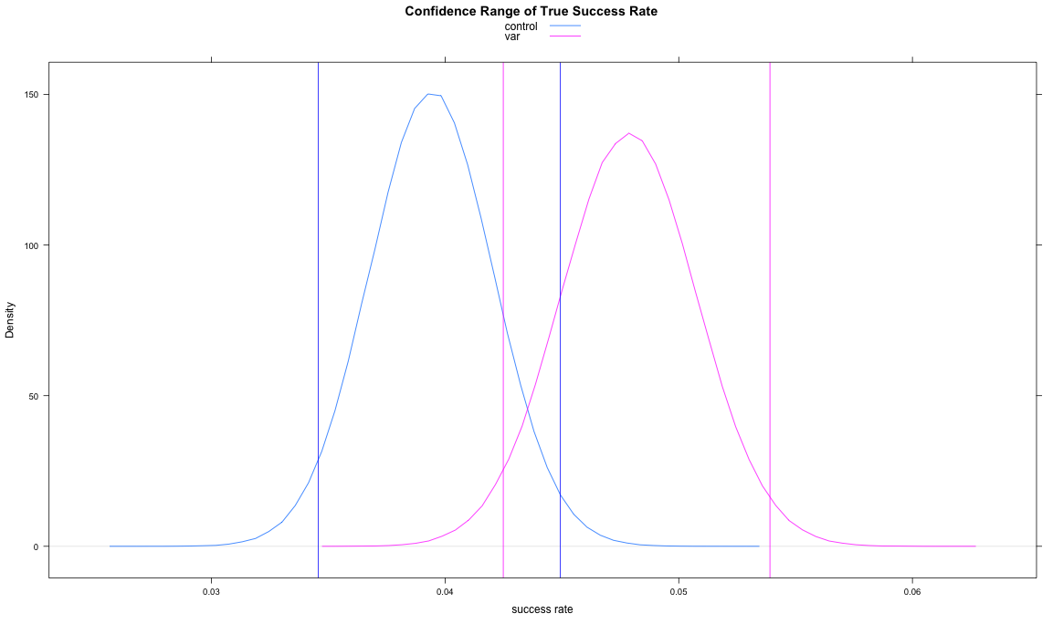

Slide 58
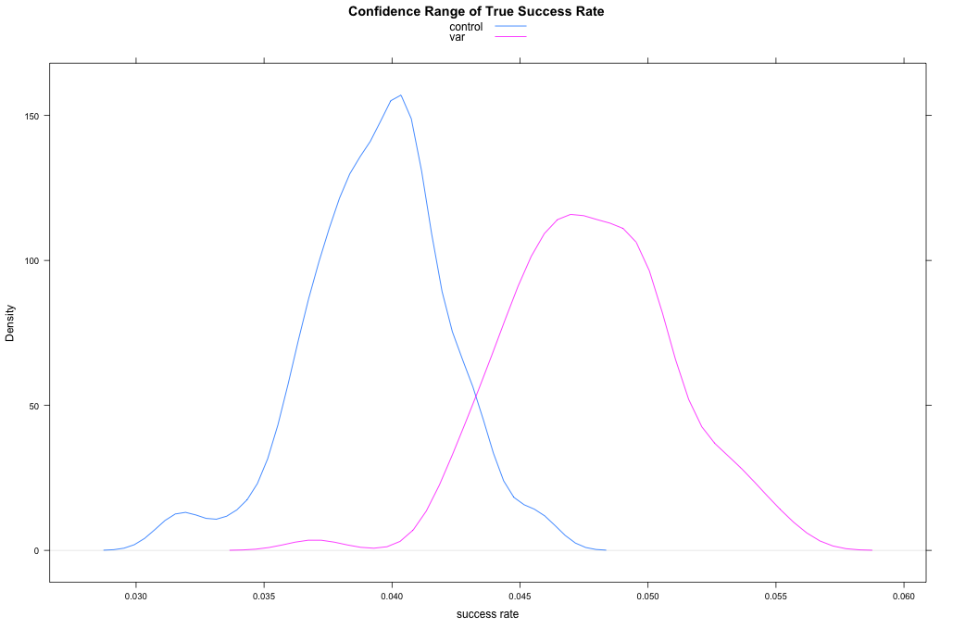

Slide 59
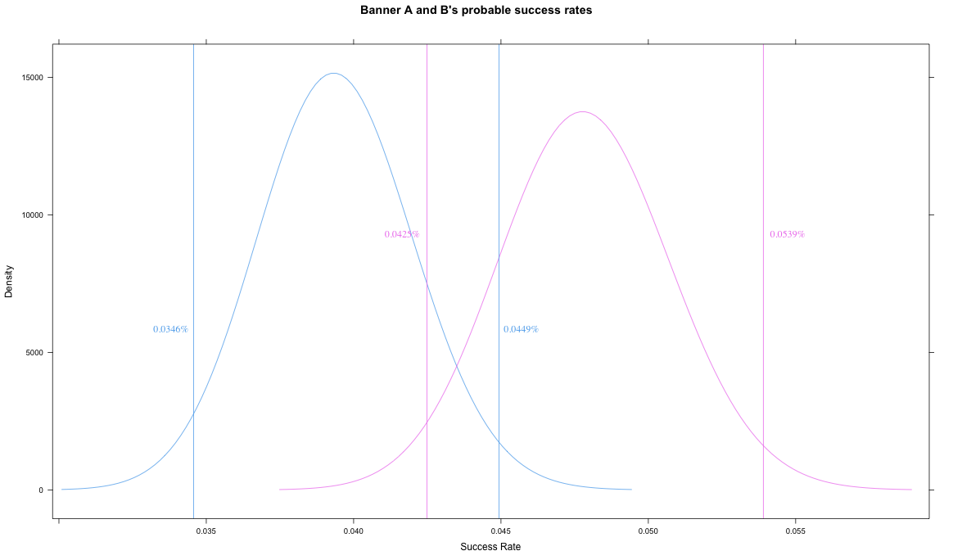

Slide 60
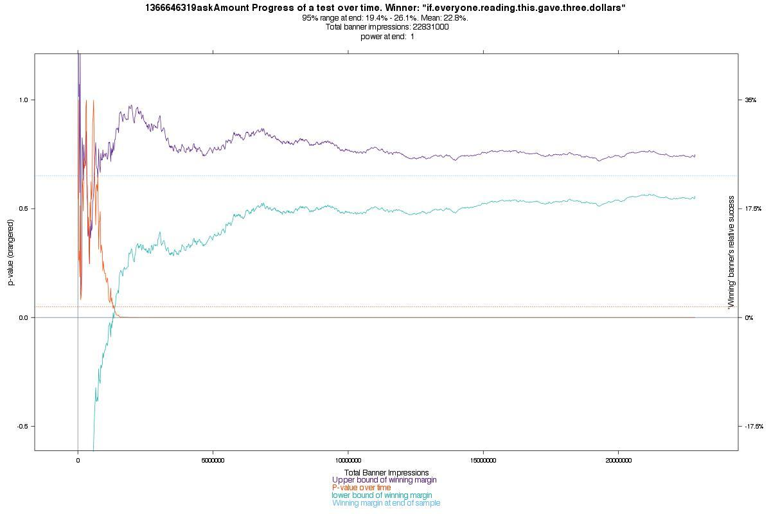

Slide 61
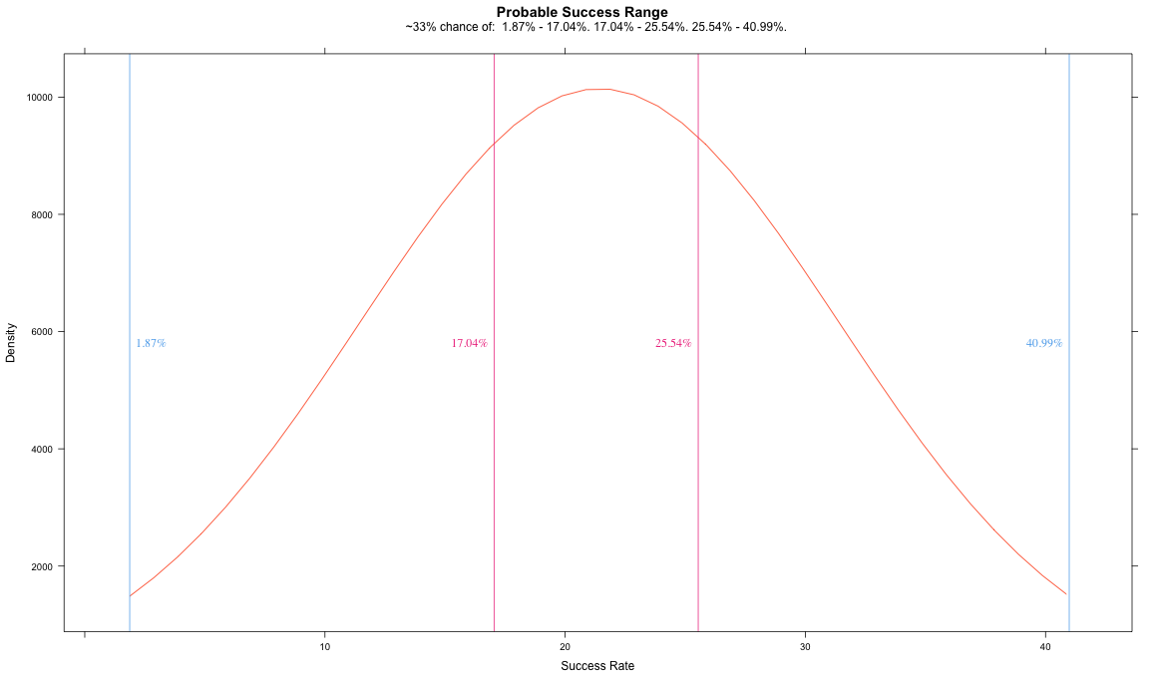

Slide 62
Yes, Zack, you really can trust all these standard statistical tests. They do apply to AB testing on websites too.
Trust p. Trust confidence intervals.

Slide 63
Wide confidence intervals and p values that never get to .05 are signals to move on to a new test. But don’t ignore the results just because you didn’t “get confidence.”

Slide 64
Most AB testing mistakes are caused by stupid errors in your own data or testing, not stats. Make diagnostic visualizations to spot problems in your underlying data that could be causing misleading tests.

Slide 65
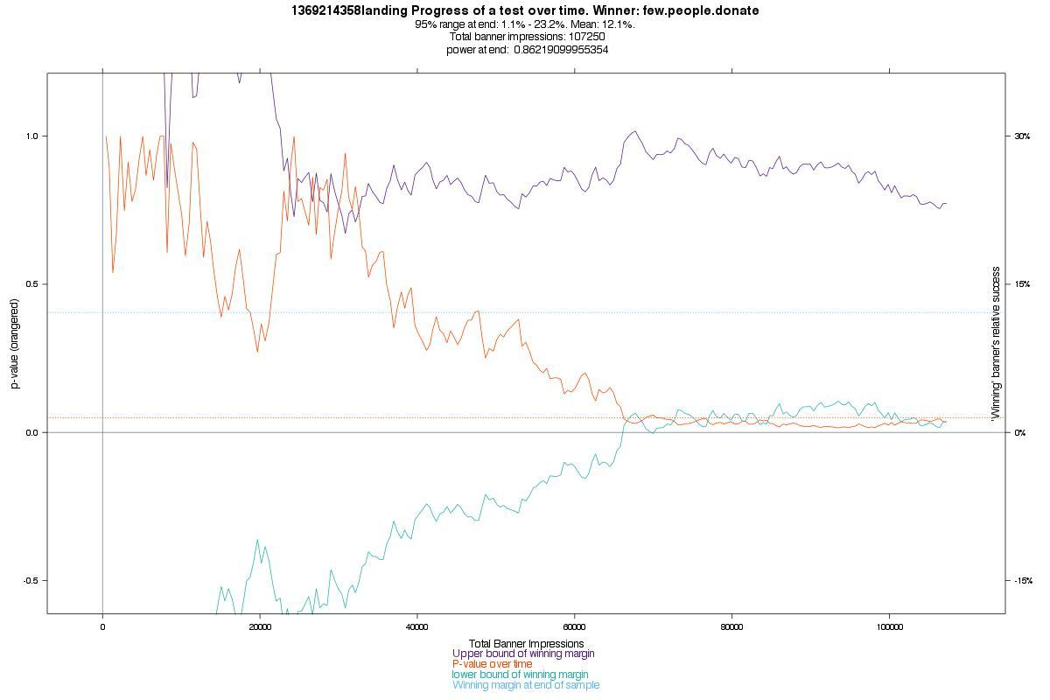

Slide 66


Slide 68
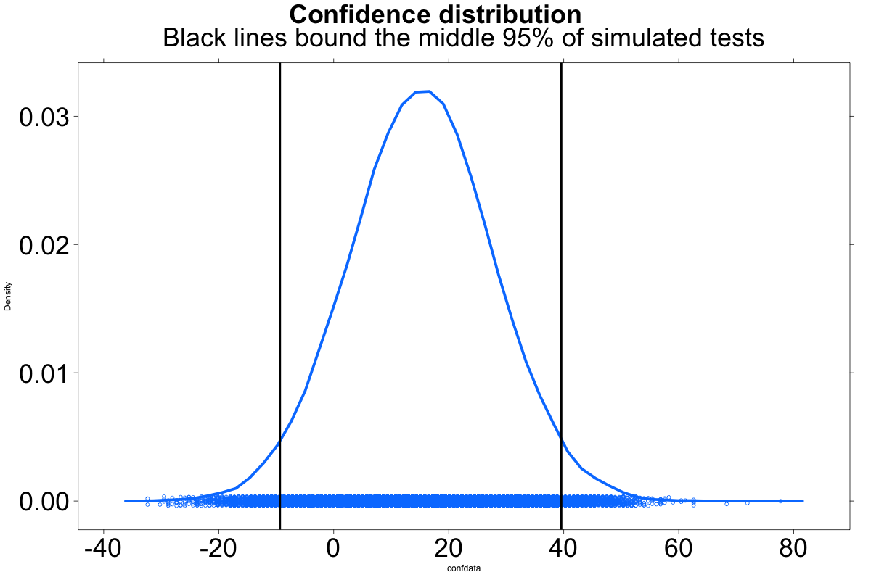

Slide 69
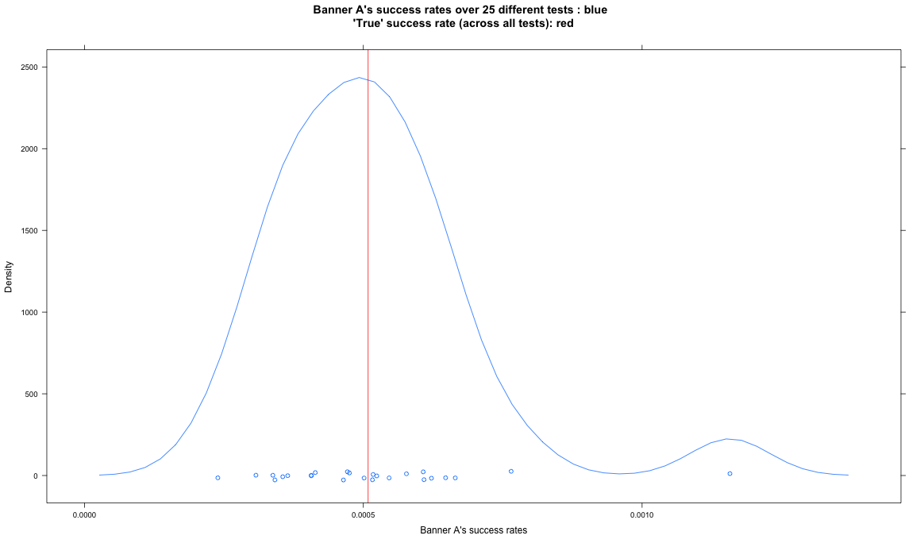

Slide 70
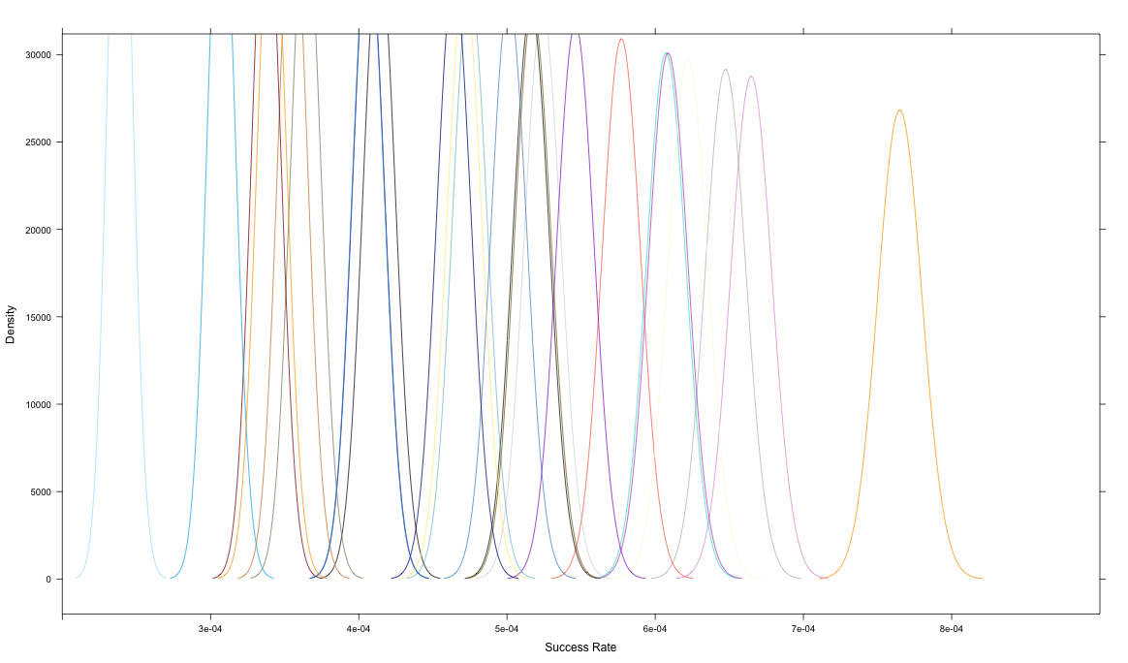

Slide 71
OK, everyone repeat after me...
Not only is it OK to peek. You don’t even have to wait for 95% confidence!

Slide 72
Caveat:
To get through the initial noise, wait until A & B have 15 successes each.
Then you can start peeking!
(There are other methods too.)

Slide 73
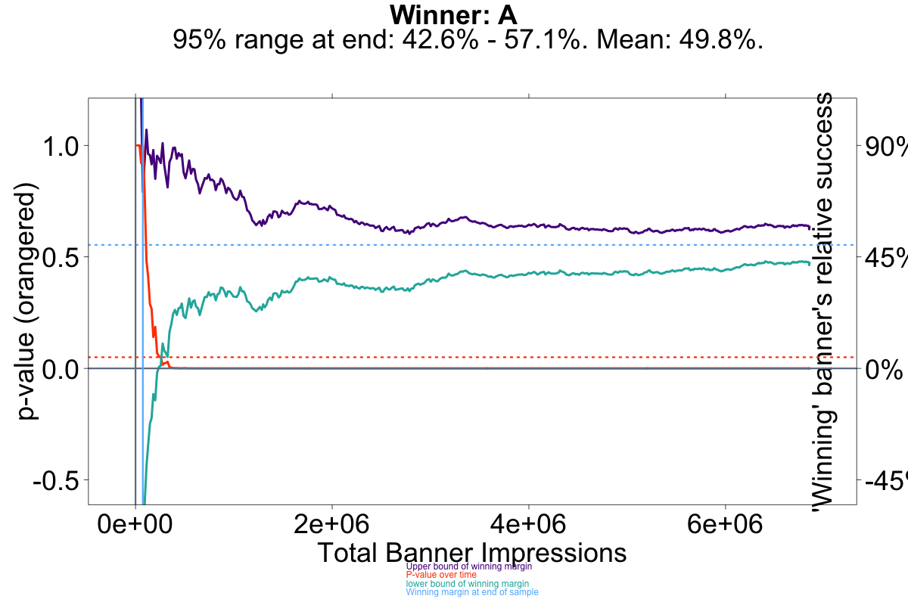

Slide 74
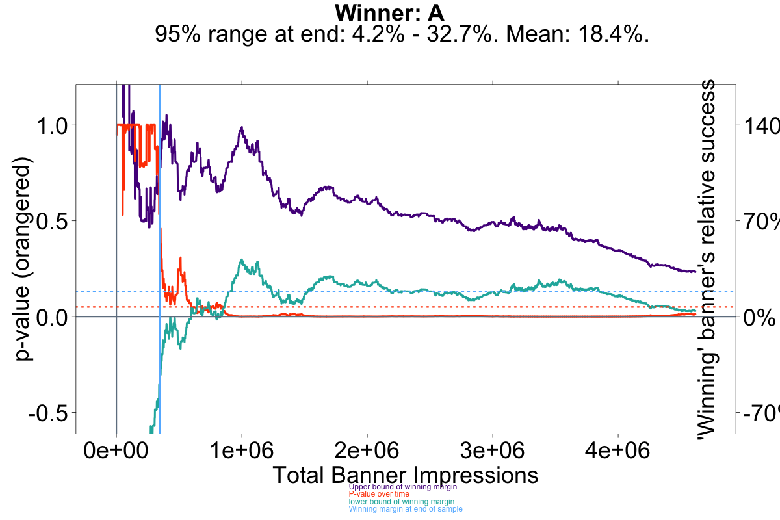

Slide 75
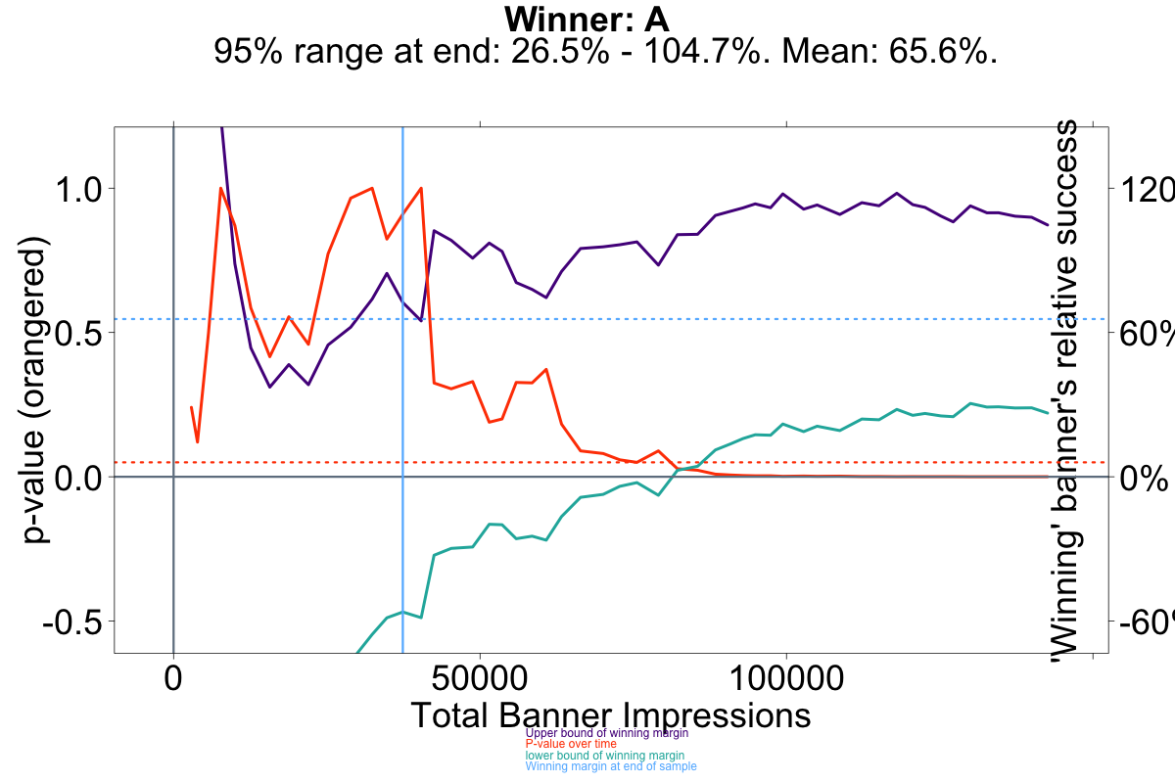

Slide 77
The “true” result is probably near the center of your confidence interval. Therefore, wide confidence intervals are not as useless as they might seem.

Slide 78
Out of 216 real Wikipedia tests we analyzed:
If we had stopped at 70% confidence (with our conservative methods of knowing when to stop):
We’d pick the winner : 93% of the time We’d miss the winner: 5% of the time
We’d falsely find a difference: 2% of the time.
We’d pick the loser: 0% of the time.
Our total test time would be 27% of the time it’d take at 95% confidence.

