Slide 1
Improving Customer Experience One Meal at a Time
Matthew Grace

Slide 2
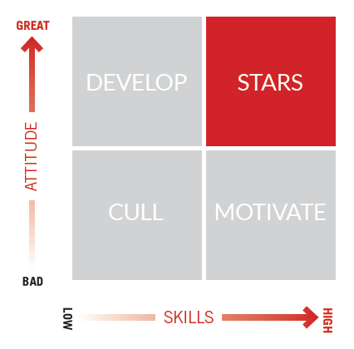
MUSE: Measure, Motivate, and Reward Staff Performance
Delivers:
Harder – and smarter – working staff
Measurable and sustained sales lift
Improved service and customer loyalty
A “Culture of Excellence”

Slide 3

State of the Union - 2013
Technical Challenges
  Scale = Legacy architecture limited volume of data to be analyzed
  Rigidity = Data schema and associated challenges dramatically reduced attributes available to analyze staff performance
  Predictive Modeling = “normalizing” process computationally expensive and inhibiting to analytic models
  Time to Insight = Cumbersome data pipeline and incompatible stores
Business Impediments
  Ability to discover emerging performance attributes = significant value
  Data “currency” weighs on new market development
  Flexibility critical to customer on-boarding and scalability of business model

Slide 4
Decisive Actions Yield Groundbreaking Results
Technical Considerations
  Traditional MPP & Hadoop architecture
  Purely open source “Hadoop stack”
  Hadapt Adaptive Analytical Platform
The Solution
  Hadapt Adaptive Analytical Platform
  Flexible Schema and Schemaless SQL completely change the data management paradigm
Results
  Dramatically simplified data management pipeline and infrastructure architecture
  Time to insight improved > 750x
  Data now able to “speak for itself” providing unparalleled insights
  Scalable & completely parallelized implementation of advanced analytic models
  Business expanding into additional markets, verticals, and use cases

Slide 5
6 Pillars of Architecture – Hadapt as our Analytical Core
CDH 4.3
Hadapt Adaptive Analytical Platform v2.0

Slide 6
Thank You!
Hadapt Flexible Schema & The End of ETL Tuesday @ 11:50AM Rhinelander South
Booth #402 Sponsor Pavilion

