Slide 1


Instant Results with Infinite Storage
David Parker,
VP SAP Big Data Platform

Slide 2
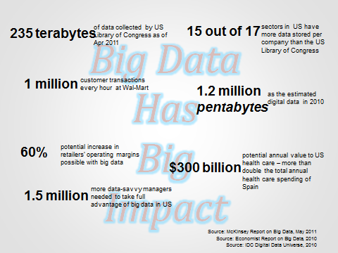
Big Data Economics
Lots of Opportunity
Streaming Data
incl. Sensors, Social and Mobile
Predictive
incl. data mining and machine learning
“Unstructured” Analysis
Incl. text, media, spatial etc.
Scalable Storage
Urgent Need

Slide 3
Open Source Community Gift
Apache Hadoop
Apache Hadoop
[Commons]
[Projects]
[Distributions]
[Data Scientists]
Streaming Data
incl. Sensors, Social and Mobile
Predictive
incl. data mining and machine learning
“Unstructured” Analysis
Incl. text, media, spatial etc.
Scalable Storage
Urgent Need

Slide 4
The Big Data Phenomenon
Big Data is More Than Just Hadoop…
Business Trends
Technology Trends
Exploding data volumes
Storage / Memory /
CPU advances
Hadoop & distributed MPP
“Enterprise”
Big
Data
Increasing data variety
Data Mining/Predictive analysis
In-memory computing
Accelerating data velocity
Complex event processing

Slide 5
SAP HANA + Hadoop
Real-Time Big Data for the Enterprise
Combine INSTANT Results with INFINITE Storage
8
SAP HANA
HADOOP
Real-time
Instant Results
Infinite storage
Modern In-memory platform
Transact/Analyze in Real-Time
Native Predictive, Text, and Spatial algorithms
Distributed Disk platform
Store infinite amounts
of unstructured data
No-SQL Access
Notes:
SAP HANA
In-memory platform
Store billions of records
Analyze in real-time
Built-in predictive, text, and spatial algorithms
HADOOP
Distributed disk platform
Store infinite amounts
of unstructured data
Search in batch
Non-relational data store
Specialized skills to implement and code
Many add-on libraries and packages

Slide 6


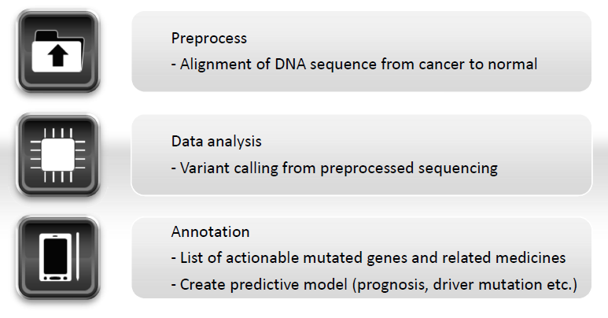
Example: Data Analysis of Cancer Genome
Goal: Analytics for Personalized Medicine
Notes:
Mitsubishi Knowledge Industries is a leader in the bio-science business. They offer services (consulting and systems development) to research institutes, universities, pharmaceutical companies, etc. One solution they are working on is the ability to analyze genome sequencing to provide personalized treatment to cancer patients.
They begin by pre-processing DNA sequences from normal cells and comparing them against cancer cells. Processing is done against LARGE volumes of data – tens of giga bytes. This pre-processing is run against data in Hadoop clusters and can take anywhere from several days to a week.
Next, they move relevant data into SAP HANA, where they perform complex analytical processes to identify variants from the pre-processed sequences. They also analyze what medicines might work against the mutated genes.
With SAP HANA, they take advantage of built-in predictive algorithm libraries (PAL) and R integration to create predictive models to assess best treatment options for the patient.

Slide 7
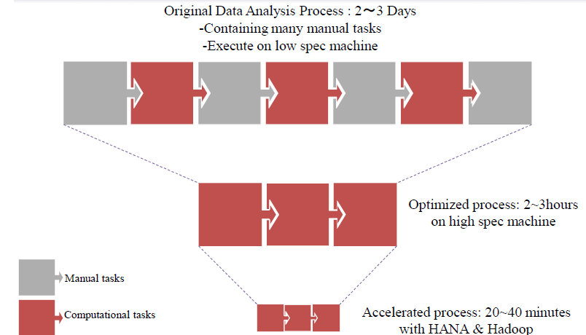
MKI Design Decisions to Improve Speed of Processing
Use Hadoop for Pre-Processing; SAP HANA for Advanced Analytics
Notes:
Initially, MKI was using only Hadoop & R for analysis, but they decided to add SAP HANA into the mix to reduce processing time so that the could deliver personalized results more quickly. Imagine being a patient in a doctor’s office – being told that you have cancer – and that you have to wait for days before a treatment plan could be set. Now, imagine how you would feel if the treatment plan was provided to you on the same day… This is MKI’s goal – to provide personalized treatments to patients as quickly as possible.
MKI still uses Hadoop to pre-process large volumes of DNA (normal and cancerous) so that they have a strong foundation of existing sequences. But they now use SAP HANA to analyze a particular patient’s DNA against related sequences from Hadoop to better predict the best medicines and treatment for the patient.
The result? (next slide)

Slide 8


SAP HANA + Hadoop for Advanced Analytics
Results: Deliver Personalized Results More Quickly
SAP HANA + HADOOP + R
408,000x faster than traditional disk-based systems in PoC
    Benefits
    Accelerated predictive & correlation analysis with in-memory processing
    Reduced time to detect variant DNA
    Optimized treatment plans based on DNA mutations
216x faster DNA analysis results - from
2-3 days to 20 minutes
“
”
Genomic DNA analysis in real-time will transform how we enable comprehensive patient care to fight against cancer. SAP HANA will be the mission critical and reliable data platform to make real-time cancer analytics into a reality. Separately, our internal technical comparison demonstrated that SAP HANA outperforms a traditional disk-based system by factor of 408,000 when performing other types of data analysis.
Yukihisa Kato, Director & Executive Officer, CTO, Research and Development Center, MITSUI KNOWLEDGE INDUSTRY CO.,LTD.
Notes:
The solution combines SAP HANA, Hadoop and the open source R statistical tool. Hadoop is used to align the patient’s DNA sequence with the normal sequence, because the data is in a semi-structured format, can be parallelized across multiple machines. Also, the MKI team is able to use an open source package for aligning genomes.
Identifying the mutations and predicting the best treatment requires a lot highly iterative analysis. This is ideally done in SAP HANA. As a result they have been able to accelerate the overall from 2-3 days down to 20 minutes. Furthermore, MKI believes they can get it under 10 minutes soon when they deploy onto a 64 node Hadoop cluster and a 40-core HANA machine. The solution combines SAP HANA, Hadoop and the open source R statistical tool. Hadoop is used to align the patient’s DNA sequence with the normal sequence, because the data is in a semi-structured format, can be parallelized across multiple machines. Also, the MKI team is able to use an open source package for aligning genomes.
Identifying the mutations and predicting the best treatment requires a lot highly iterative analysis. This is ideally done in SAP HANA. As a result they have been able to accelerate the overall from 2-3 days down to 20 minutes. Furthermore, MKI believes they can get it under 10 minutes soon when they deploy onto a 64 node Hadoop cluster and a 40-core HANA machine.

Slide 9

SAP HANA Platform
More than Just a Database
Supports
any Device
Any Apps
Any App Server
SAP Business Suite
and BW ABAP App Server
SQL
MDX
R
JSON
Open Connectivity
HANA Platform
SQL, SQLScript, JavaScript
Spatial
Search
Text Mining
Stored Procedure & Data Models
Application & UI Services
Business Function Library
Predictive Analysis Library
Database
Services
Planning Engine
Rules Engine
Integration Services
Transaction
Unstructured
Machine
HADOOP
Real-time
Locations
Other Apps
Converges database, data processing and application platform capabilities,
provides libraries for business functions, planning, predictive, text, spatial analytics
to enable business to operate in real-time
Notes:
Stores data (~100TB compressed) in memory, not disk
Makes HANA very, very fast
Combines OLTP and OLAP DBMS into one
Enables analytics on up-to-the-second data
Changes the way businesses work
Jobs that took hours complete in seconds
SAP’s business software runs on HANA
Ready for “mission critical” applications
Fastest selling SAP software ever
1,500 customers since 2010 launch; €600m revenue
More detail from http://www.saphana.com/

Slide 10
SAP HANA Platform for Big Data
End-to-End Environment for the Enterprise
SAP HANA Platform
Consume
Analytics
Applications
Modeling & lifecycle management
Landscape management
Roles, security, governance, compliance, audits
Exploration, Dashboards, Reports,
Charting, Visualization
Machine Learning
& Predictive
Native HANA Apps & Services
SAP HANA In Memory
Apache Hadoop
Distributions
Planning & Simulation
Transactional
Store &
Process
Graph
Analytical
Smart Data Access
Spatial
Extended Storage (IQ)
Tiered Storage (Hot-warm-cold)
Text, Social Media Processing
Ingest
Consume
Process
ESP
Replication Framework
Data Services
IM

Slide 11





SAP HANA Platform for Big Data
Open Hadoop Strategy
Big Data Science Services
Industry/LOB Apps
Analytic Apps
Custom Apps
Visualize and Act
SAP HANA Platform
SQL
R
Predictive
Text Analysis
Geospatial
XS Engine
Analyze
Sybase IQ
SAP HANA
Accelerate
SAP
Data Services
Acquire
Data
Connectors
Notes:
SAP has partnered with the leading Hadoop vendors:
Cloudera
Hortonworks
Intel
… and you can engage any of these partners in sales opportunities.

Slide 12
Enterprise Scenarios: SAP HANA and Hadoop
4 Common Use Cases
Applications
Analytic Tools
Hadoop for advanced analytics
Visualize and Act
SAP HANA Platform
SQL
R
Predictive
Text Analysis
Geospatial
XS Engine
Hadoop
Analyze
Hadoop as a processing engine
Computation Engine(s)
Sybase IQ
SAP HANA
Accelerate
Job Management
Data
Connectors
SAP
Data Services
Data storage (Hadoop Distributed File system)
Acquire
Hive
Hadoop as a simple database
Streaming Data
Social Media
Hadoop as a flexible data store
Reference Data
Transaction Data
Enterprise Data
Notes:
Hadoop as flexible storage
Extract-Transform-Load from other systems to Hadoop (off-load data that is cold)
Hadoop as a simple database:
Store and retrieve of data from Hadoop typically using interfaces provided by HIVE or direct HDFS access
Depending on the scenario, scalable analytical systems like Sybase IQ can also be considered.
Hadoop as a processing engine
Text data processing – push down text data processing queries from SAP Data Services (via model) to Hadoop without coding. SAP Data Services submits to MapReduce framework to distribute across large distributed data sets. Relevant text is returned, which is loaded into SAP HANA or SAP Sybase IQ for contextual analysis with structured data
Hadoop for advanced analytics
* Two-Phase Analytics: Background processing engine refine and feeding data
Long, slow running analytic jobs in Hadoop; Push results to SAP HANA
Combine with other structured data; user access from BI
* Federated Queries: Client side federation across data stores
-- Smart data access: executes queries on multiple data stores. Smart query processing leverages remote database’s unique processing capabilities by pushing processing to remote database; Monitors and collects query execution data to further optimize remote query processing.

Slide 13

New Technology: Smart Data Access
Rapid Analysis of Big Data without Data Movement
Submit a query that accesses remote data like local data
Leverage the full power of SAP HANA – analytics, predictive, text search, geospatial – during processing
Synthesize enterprise data regardless of location, size, representation – without moving it
BI and analytics software from SAP
In-memory
Users
Analytic engine
SAP HANA
SAP HANA
Execute Query
… and/or ...
Split Query
Disk-based data ware-house (SAP Sybase IQ)
Query Feder-ation
Execute
Execute
Analytic engine
Execute
Consolidate
Hadoop
Computation Engine(s)
Hive
HBase
…
Job Management
Data storage (Hadoop Distributed File system)
Notes:
SAP HANA smart data access provides non-disruptive intelligent architecture to provision enterprise-wide data from heterogeneous systems such as Hadoop, Teradata, SAP Sybase ASE and SAP Sybase IQ. As well it provides the capability for SAP HANA to SAP HANA queries which can facilitate SAP NetWeaver Business Warehouse on SAP HANA to SAP Business Suite on SAP HANA query use cases among others. SAP brings in-memory computing to data federation and it will optimize where data is stored and acted upon. Now customers can easily build unified transactional-analytical applications with secure access to data across their business networks without large data transfers. In-memory computing lets then get results from the core process in real-time, providing a single version of truth on which business can act.
Benefits
Enables access to remote data access just like “local” table
Smart query processing including query decomposition with predicate push-down, functional compensation
Supports data location agnostic development
No special syntax to access heterogeneous data sources
Heterogeneous data sources
SAP HANA to Hadoop (Hive)
Teradata
SAP Sybase ASE
SAP Sybase IQ
SAP HANA to SAP HANA

Slide 14
SAP HANA Smart Data Access
How to Use
Data Needs
Decide what remote data sources are needed for the application running on SAP HANA
Sources
Define the remote data source with the appropriate security credentials
References
Create virtual tables which reference the remote data source (table)
Application
Write your application, using HANA tables and virtual tables
Query processor in HANA does the rest of the optimizations and data access

Slide 15
Example: Smart Data Access
Steps For Creating and Using Virtual Tables
Create table in HIVE
On SAP HANA, create DSN, e.g. “hive1”
With SAP HANA Studio or using DLL command, create a remote source:
        CREATE REMOTE SOURCE HIVE1 ADAPTER "hiveodbc" CONFIGURATION 'DSN=hive1' WITH CREDENTIAL TYPE 'PASSWORD' USING 'user=dftest;password=dftest';
Using a DLL command, create a virtual table for Hive:
    CREATE VIRTUAL TABLE "HIVE1_PRODUCT" AT "HIVE1"."default"."default"."product";
Execute a query on virtual table:
    SELECT * FROM HIVE1_PRODUCT;
Drop a virtual table
    DROP REMOTE SOURCE HIVE1 CASCADE;
Notes:
For the above mentioned source, you can simply execute the command to drop a source and all of the virtual tables for that source.

Slide 16
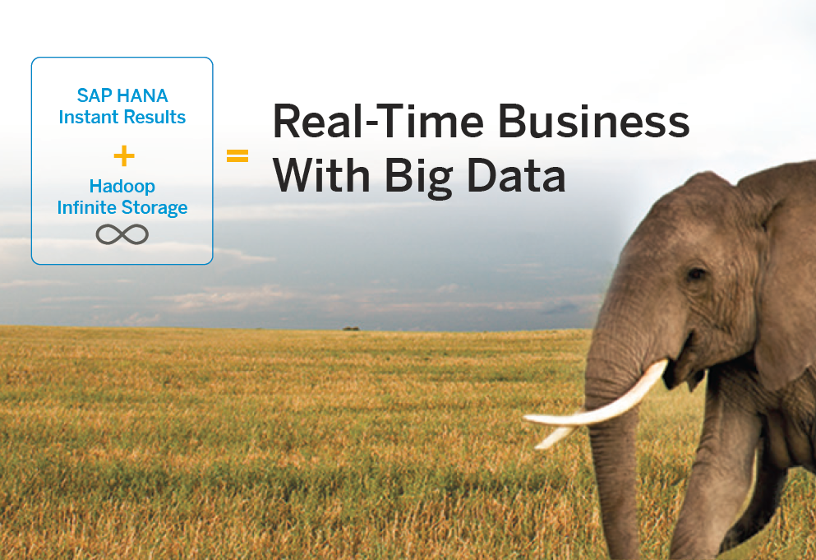
Amplify the Value of Big Data
Marry SAP HANA and Hadoop for real-time business results
SAP HANA Platform
    Unprecedented insights → combine structured and unstructured data for insights never seen before
    Advanced analytics → predictive, text, and spatial analytics
    Instant results with in-memory processing
Apache Hadoop
    Data exploration / mining → uncover nuggets information from large volumes of unknown data
    Infinite storage → offload or archive cold data
Notes:
SAP HANA uniformly amplifies the value of Big Data across this data fabric including large data sets that are stored in Hadoop – enabling you to take advantage of new technologies – such as the Apache Hadoop Distributed File System and MapReduce – to mine large volumes of data located on low-cost storage for new insights. Discover how solutions from SAP and our partners can help your organization:
Access remote information from SAP HANA using smart data virtualization techniques
Extract relevant data from large data sets stored in Hadoop using SAP Data Services without programming
Load high-value data from Hadoop rapidly into SAP HANA or SAP Sybase IQ for real-time analysis
Combine unstructured and structured data for insights never seen before

Slide 17
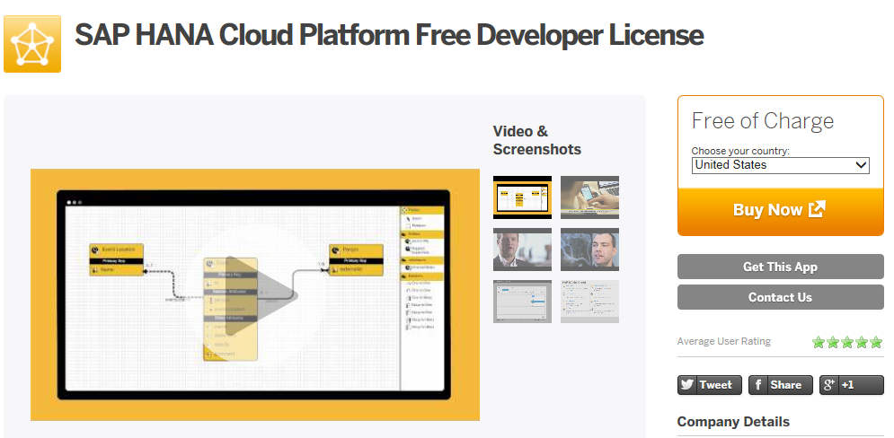
Get SAP HANA for Free www.saphana.com/docs/DOC-369

Slide 18
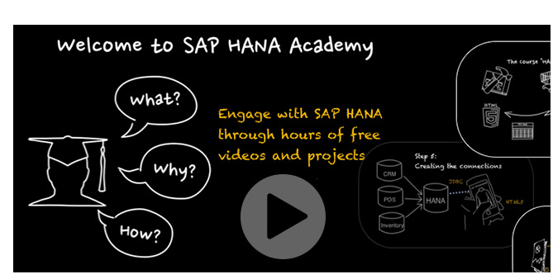
Participate in SAP HANA Academy www.saphana.com/community/hana-academy
Developer Sandbox
    Available for hands-on training
Projects
    Create HTML5 applications
    Create data marts
    Etc.
Online Courses and Videos
    SAP HANA
    Predictive Analytics Library
    R Integration
    SAP Lumira (visualizations)
    And more…

Slide 19
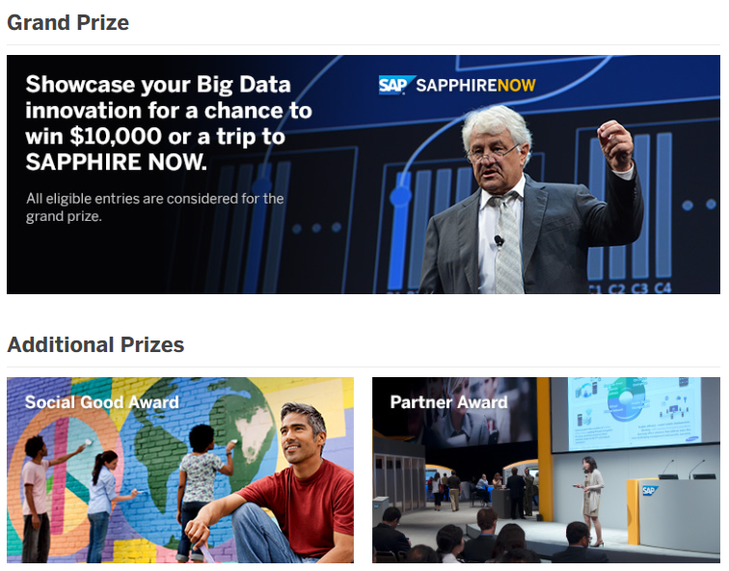
Join the Big Data Geek Challenge by SAP www.sap.com/bigdata/challenge
How to Enter*:
Get SAP Lumira (for free)
Design a data visualization to analyze Big Data quickly
Make a video to present your use case
Submit your entry
Winners to be announced by December 2013
Challenge only available to residents of the United States. See official entry rules for details.

Slide 20
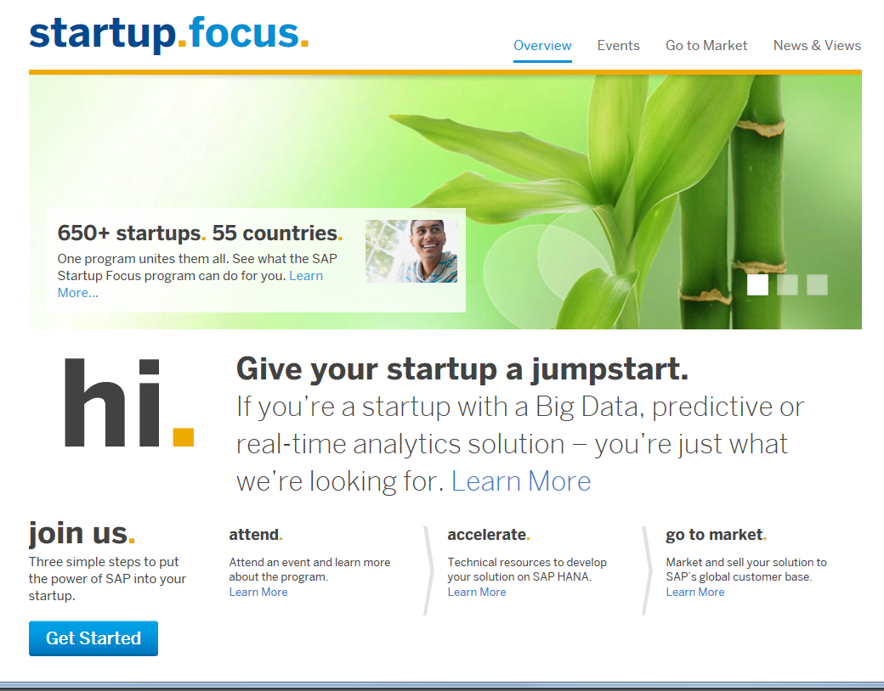
SAP Startup Focus Program www.saphana.com/community/learn/startups

Slide 21

    Visit Booth 311
    SAP HANA + HADOOP
    Instant results + Infinite Storage
    SAP Lumira &
    SAP Predictive Analysis
    SAP Startup Focus Program

Slide 22



Thank you
Contact information:
David Parker
david.parker@sap.com
www.sap.com/bigdata
facebook.com/sapanalytics
twitter.com/#!/@sapinmemory

