Slide 1
The Next Era of Data Analysis
Stephanie McReynolds, VP Marketing
Stephen McDaniel, Freakalytics
Vaibhav Nivargi, Founder
Brian Zotter, VP Products & Engineering

Slide 2
The New Data Landscape
New diverse and disparate data sources result in many different data types, platforms, and APIs.
Data is fluid and fast-changing.
Scale and rate of growth is unpredictable.
Speed and continuous insights are now critical to business users to speed decision-making.

Slide 3

A Need for Speed & Continuous Insight
Scale is unpredictable
↑Volume of data
↑Number of sources
↑Variety of types
But other needs are clear
Fast question to answer cycle
Easier interpretation
Continuous, fresh insights
Now – Quick cycle-times.
Easier data-driven decisions.
?
Question
Insight

Slide 4


Delivering Quick Cycle Times Requires…
?
Question
Analysis & Discovery
Fast, Interactive, Collaborative Insight
More Data, More Sources
More Speed
More People
Easy

Slide 5
Introducing ClearStory Data
The First Data Intelligence Solution
Distributed Teams in Business Units
Business Users
Data Analysts
Data Stewards
A new data-intelligence platform and application
to speed convergence of private & external data for interactive, collaborative insights

Slide 6
Stephen McDaniel
Chief Data Officer & Advisor Freakalytics

Slide 7





Most Organizations: A Data Availability Problem
The Data Availability Problem
?
Question
Analysis & Discovery
Loading
Presentation
Access
Sampling
Modeling
Insight
Data Prep – too slow!

Slide 8


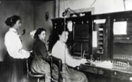
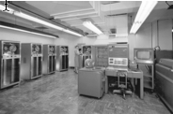
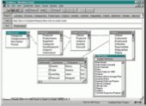
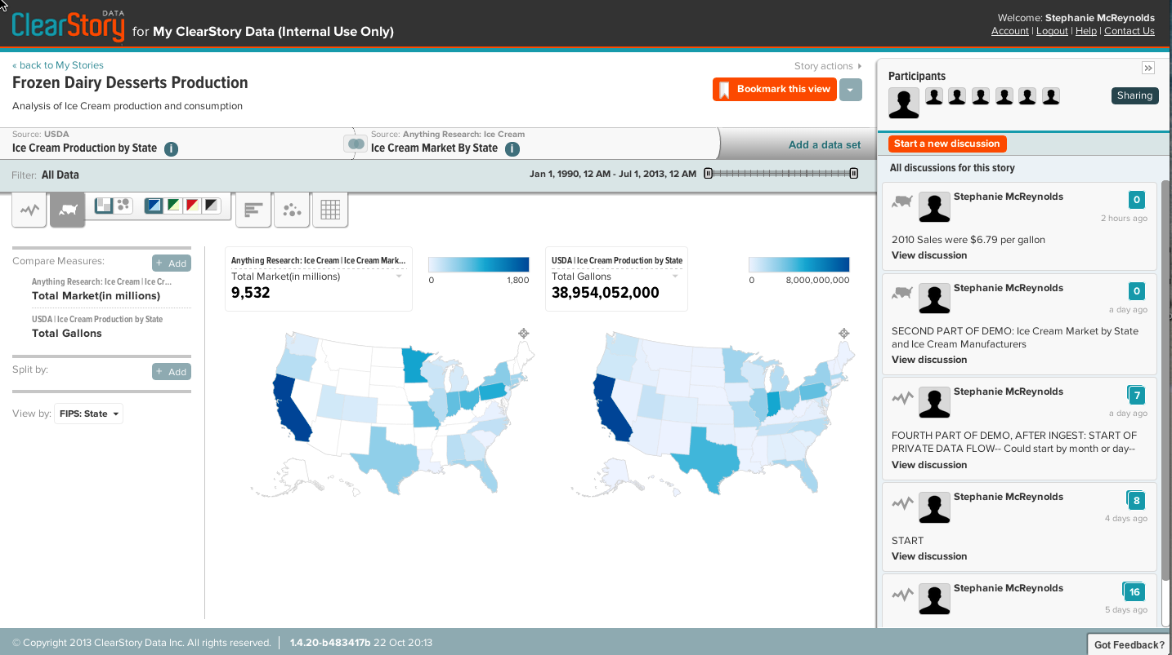
Tech Evolution Through the Three Epochs
Early phones require the intervention of operators.
Initially the meaning of mobile was relative.
With simplicity & diversity of apps, the iPhone.
Early analytics require the intervention of coders.
1990s apps with visual data interfaces.
The third epoch is here – For Everyone.
Proprietary & confidential
8

Slide 9
See It: ClearStory Data
My experience with ClearStory Data…
Data Intelligence – the next epoch in data analysis
More sources, more data
Internal and external sources
Volume and variety of data
More speed - quick cycle time to answers with data discovery
More people - a new collaborative user model – for everyone
ClearStory innovations – an Application and Platform
Data Inference & Profiling - across diverse data
Intelligent Data HarmonizationTM - across sources
Unique, easy user model - for everyone
Data-aware collaboration - in context

Slide 10
See More
Vaibhav Nivargi, Founder
Brian Zotter, VP Products & Engineering

Slide 11
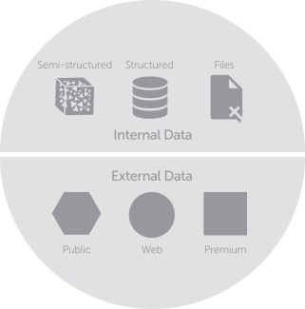
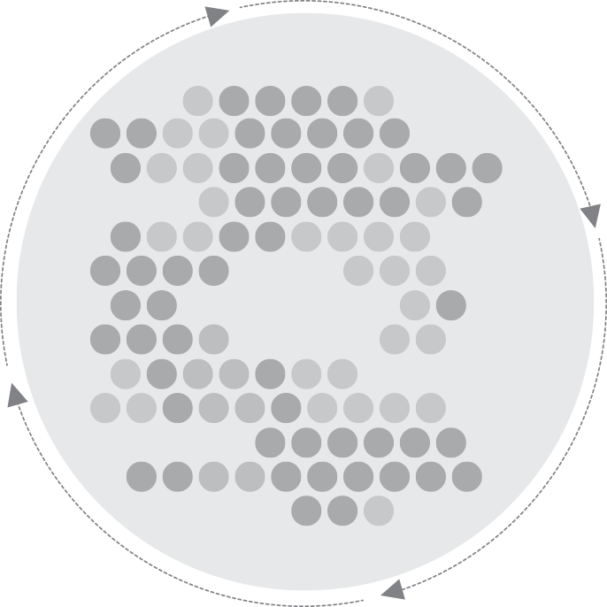
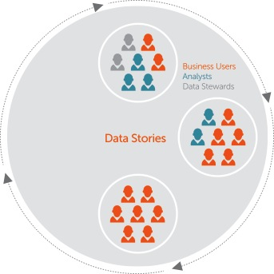
ClearStory Application & Platform
Data Sources
ClearStory Platform
ClearStory Application
Harmonization
Data Inference & Profiling
In-Memory
Data Units
Visualization
Collaboration

Slide 12
Introducing ClearStory Data.
It’s a new way.
It’s Data Intelligence.

Slide 13
In This Example
CPG competitors determine how to optimize ice cream product packaging to increase sales
Answering the question needs…
Private sources + public sources + premium sources
Speed of cycle time
People from different business groups
Let’s see it.

Slide 14

See More.
Booth #407

