Slide 1
Running Non-MapReduce Applications on Apache Hadoop
Hitesh Shah & Siddharth Seth
Hortonworks Inc.

Slide 2
Who am I?
Hitesh Shah
Member of Technical Staff at Hortonworks Inc.
Apache Hadoop PMC member and committer
Apache Tez and Apache Ambari PPMC member and committer
Siddharth Seth
Member of Technical Staff at Hortonworks Inc.
Apache Hadoop PMC member and committer
Apache Tez PPMC member and committer

Slide 3
Agenda
Apache Hadoop v1 to v2
YARN
Applications on YARN
YARN Best Practices

Slide 4
Apache Hadoop v1
Submit Job
JobTracker
Job Client
TaskTracker
TaskTracker
TaskTracker
TaskTracker
Map Slot
Reduce Slot
TaskTracker
TaskTracker
TaskTracker
TaskTracker
Notes:
Jobtracker and Tasktrackers with 4 map slots and 2 reduce slots each
As a job is submitted, the jobtracker runs work in assigned slots.
As more jobs run, more and more slots in the cluster get used up.

Slide 5
Apache Hadoop v1
Pros:
A framework to run MapReduce jobs that allows you to run the same piece of code on a single node cluster to one spanning 1000s of machines.
Cons:
It is a framework to run MapReduce jobs.
Notes:
Talk about a MR job structure – input, map, sort, disk, shuffle, merge, reduce, output. Inspite of all these restrictions, the hadoop ecosystem has grown coming up with innovative ways to do things.

Slide 6
Apache Giraph
Iterative graph processing on a Hadoop cluster
An iterative approach on MapReduce would require running multiple jobs.
To avoid MR overheads, runs everything as a Map-only job.
Map Task:
Worker
Map Task:
Worker
Map Task:
Worker
Map Task:
Worker
Map Task:
Master
Map Task:
Worker
Map Task:
Worker
Map Task:
Worker
Map Task:
Worker

Slide 7
Apache Oozie
Workflow scheduler system to manage Hadoop jobs.
Running a PIG script through Oozie
JobTracker
Oozie
Submit Job
1
2
3
Submit
Subsequent
MR jobs
MapTask:
Pig Script Launcher

Slide 8
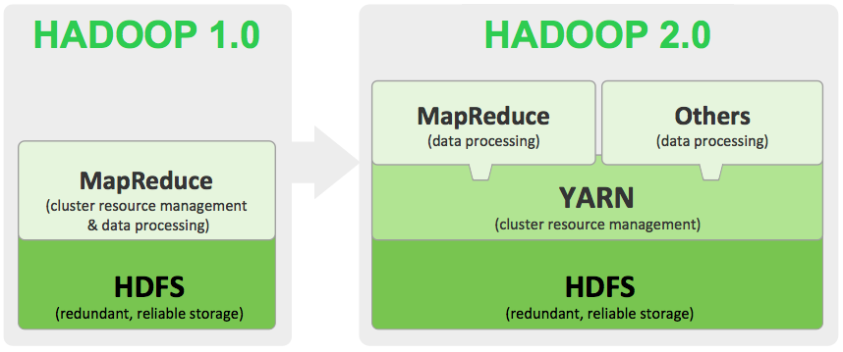
Apache Hadoop v2
Notes:
YARN takes what was a single-use data platform for batch processing and evolving it into a multi-use platform that enables batch, interactive, real-time and stream processing.

Slide 9
YARN The Operating System of a Hadoop cluster

Slide 10
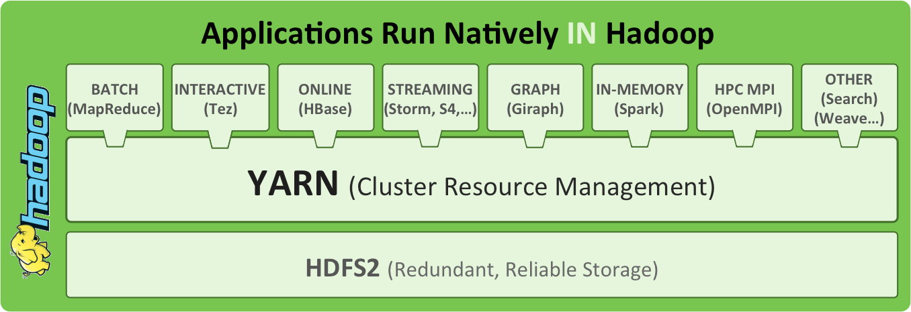
The YARN Stack
Notes:
YARN acts as the primary resource management layer and mediator of access to the cluster, giving anyone the capability to store data in a single place and then interact with it in multiple ways, simultaneously, with consistent levels of service.

Slide 11
YARN Glossary
Installer
Application Installer or Application Client
Client
Application Client
Supervisor
Application Master
Workers
Application Containers

Slide 12
YARN Architecture
Client
ResourceManager
Submit Application
Client
NodeManager
NodeManager
NodeManager
NodeManager
App
Master
Container
Container
Container
Container
Container
Container
Container
App
Master
Container
Notes:
Now, compared to v1, a YARN base cluster has the RM as the central controlling entity and NodeManagers on all the worker nodes. There is no notion of slots ( maps/reduces ). There is only controlled resources. Memory/CPU, disks/network IO in the future.
Explain application flow – client submits application, RM launches Application Master. App Master requests containers from the RM and then launches containers.
Explain how subsequent applications work – containers launched as long as they fit within the resource pool.

Slide 13
YARN Application Flow
Resource
Manager
Application Client
Protocol
NodeManager
Application Client
Application Master
Protocol
YarnClient
App
Container
Application Master
App
Specific API
AMRMClient
Container
Management
Protocol
NMClient

Slide 14
YARN Protocols & Client Libraries
Application Client Protocol: Client to RM interaction
Library: YarnClient
Application Lifecycle control
Access Cluster Information
Application Master Protocol: AM – RM interaction
Library: AMRMClient / AMRMClientAsync
Resource negotiation
Heartbeat to the RM
Container Management Protocol: AM to NM interaction
Library: NMClient/NMClientAsync
Launching allocated containers
Stop Running containers
Notes:
YarnClient
Application Lifecycle Control – submit, query state, kill - .e.g Submit, followed by poll state, and optionally connect to AM for further state
Cluster Information – Query node status, Scheduler queues etc
AMRMCLient
Request Resources from the RM – specifies a priority (within app only), location information, and whether strict locality is required, also number of such containers.
Hides the details of the protocol – which is absolute (i.e. each call to the RM must provide complete information about a priority level)
Once a container is allocated, provides a utility method to link it back to the entity which generated the request (entity optionally passed in while asking for containers)
Allocate call doubles as a heartbeat – must be sent out ever so often.
Also provides some node level information, available resources, etc
NMClient
Once resources are obtained from the RM, an App uses this to communicate with the NM to start containers. Setup the ContainerLuanchContext – cmdLine, environment, resources.
Authorization information is part of the contianers allocated by the RM – to prevent unauthorized usage
Only a single process can be launched on an allocated container, and one must be within a certain period otherwise the allocation times out
Container must launch a process with a certain time after being allocated
Only a single process can be launched on an allocated container

Slide 15
Applications on YARN
Notes:
Covered YARN Architecture, What a YARN application looks like, and Haddop 1 vs Hadoop 2

Slide 16
YARN Applications
Categorizing Applications
What does the Application do?
Application Lifetime
How Applications accept work
Language
Application Lifetime
Job submit to complete.
Long-running Services
Job Submissions
One job : One Application
Multiple jobs per application
Notes:
Application functionality – stream processing, batch, interactive, etc
Rest – Application’s interaction with YARN
Short running – obtain, process, release
Long Running – obtain, keep, scale up and down if required.
How would we categorize applications? YARN is still nascent. We will see more and more applications being built on it. Today, based on the current ecosystem, there are various ways of categorizing applications.
Data-processing execution applications such as MapReduce and Tez
Streaming applications like Samza, Storm
Services like Hbase on YARN
On demand web server scaling
From a framework perspective or from the perspective of building applications, they can be categorized according to How long the application runs, How the application accepts work, Language it’s written in.
Application Lifetime
‘Short’ Running Jobs – expected to finish their processing and complete. Typically one YARN application per job.
- Ask for adequate resources, process and then release the resources once the job completes.
Long Running Services – typically deployed via YARN to share cluster resources.
Will generally reserve certain resources on start-up.
During the lifetime of the job, new resources can be acquired – and it’s up to the application on whether it wants to hang on to these or return them to the cluster.
May define their own job/work submission construct – e.g. Storm starts up the Storm master which then accepts work – each of these is not a separate YARN application

Slide 17
Language considerations
Hadoop RPC uses Google Protobuf
Protobuf bindings: C/C++, GO, Java, Python…
Accessing HDFS
WebHDFS
libhdfs for C
Python client by Spotify Labs: Snakebite
YARN Application Logic
ApplicationMaster in Java and containers in any language
Notes:
Hadoop associated with Java
Simpler to write non Java apps – but not trivial
Implement RPC mechanics in language of choice, and then the HDFS/YARN protocols
OR … listed options
Everyone associates Hadoop with Java. Hadoop RPC → while that’s primarily the case, writing non Java applications should be easier in Hadoop 2
Either build an RPC layer in the language being used – which can then be used to access the HDFS and YARN protocols (disclaimer: may not be a trivial exercise)
HDFS – WebHDFS which is a REST based API, libHdfs which is JNI based C API for accessing HDFS. Folks at Spotify labs have built a Phthon library using Hadoop RPC mechanics – also have detailed out the RPC interactions
YARN – Experimental early stage Go RPC by Arun Murthy – note: this is experimental and very early stage.
- Alternately, write the Applcation Logic in Java – but allow the rest of the application to be in any language
If a language binding exists, barring some caveats, you should be able to write yarn applications. Recently, Arun Murthy came up with a hello world application built in GO. Please do take this with a bucket of salt as there are still some things such tokens and security which need to flush out properly but effectively, soon, we should have applications coming up that in written in other languages apart from Java.

Slide 18
Tez ( App Submission)
Distributed Execution framework – computation is expressed as a DAG
Takes MapReduce to the next level – where each job was limited to a Map and/or Reduce stage.
Tez Client
YARN
Job Submission
Monitoring
Tasks
Launch AM
Resource Manager
Submit DAG
Request Resources
DAG execution logic
Task co-ordination
Local Task Scheduling
Allocated Resources
Tez AM
Launch AM
Heartbeat
Launch Tasks
Node Manager(s)
AM Launched
Tasks Launched
Notes:
Computation expressed as a DAG
MR limited to two stages
Tez allows multiple stages with different types of dataflow between stages
Launch AM, StartContaienr – specify command line, environment, resources etc.

Slide 19
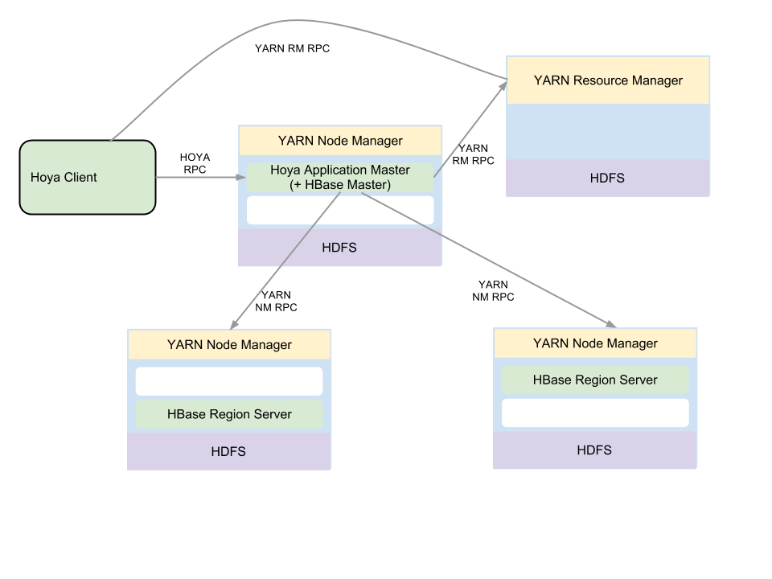
HOYA ( Long Running App )
On Demand HBase cluster setup
Share cluster resources – persist and shutdown the cluster when not needed
Dynamically handles Node failures
Allows re-sizing of a running HBase cluster
Notes:
Deploy Hbase on demand -
Old: Separate node or carve out part of each node.
e.g. If Hbase not always required – hourly / daily jobs – spin up on demand, or running custom co-processors, test clusters
Stores Hbase cluster state
CLI tool for all functionality.
Locality, dynamic resizing, failure handling
CLI Tool + configuration to deploy HBase clusters on YARN
Rather than carving out separate nodes, or resources on each node up-front – allows the cluster resources to be centrally managed by YARN.
Hbase Master starts up directly within the HOYA ApplicationMaster.
Region Servers are run within containers allocated by YARN – based on previously stored state or Locality.
HOYA CLI tool used to manage the cluster – restart, stop, resize etc.
Example usage: Bring up the cluster only when it’s required, and then release resources back once it’s complete – a daily analysis job, isolation between users ?
Resources for the cluster are obtained from YARN – allowing it to share resources with the rest of the cluster. e.g. Daily analysis job, bring up a previously persisted HBase cluster, execute and release resources.
Provides APIs to grow / shrink a cluster
HOYA AM notified by YARN on container or node failure – at which point it can bring up a replacement RegionServer on another node

Slide 20
Samza on YARN ( Failure Handling App )
Stream processing system – uses YARN as the execution framework
Makes use of CGroups support in YARN for CPU isolation
Uses Kafka as underlying store
YARN
Resource Manager
Task Container
Kafka (Streams)
Task
Task
Task Container
Task Container
Container Finished
Task
Task
Task
Task
Get New Containers
Node Manager(s)
Samza AM
Launch Container
Notes:
Stream processing – YARN resource scheduling, rather than starting daemons – which also know how to handle resources.
CGroups,
Samza – A stream processing system built to make use of YARN as the execution framework - no separate daemon for scheduling resources.
Samza AM spun up per job / dataflow.
Takes care of making node local requests for Samza Containers
Re-scheduling failed tasks – new container from YARN

Slide 21
YARN Eco-system
Powered by YARN
Apache Giraph – Graph Processing
Apache Hama - BSP
Apache Hadoop MapReduce – Batch
Apache Tez – Batch/Interactive
Apache S4 – Stream Processing
Apache Samza – Stream Processing
Apache Storm – Stream Processing
Apache Spark – Iterative/Interactive applications
Cloudera Llama
DataTorrent
HOYA – HBase on YARN
RedPoint Data Management
YARN Utilities/Frameworks
Weave by Continuity
REEF by Microsoft
Spring support for Hadoop 2
Notes:
Graph processing – Giraph, Hama
Stream proessing – Smaza, Storm, Spark, DataTorrent
MapReduce
Tez – fast query execution
Weave/REEF – frameworks to help with writing applications
List of some of the applications which already support YARN, in some form.
Smaza, Storm, S4 and DataTorrent are streaming frameworks
Various types of graph processing frameworks – Giraph and Hama are graph processing systems
There’s some github projects – caching systems, on-demand web-server spin up
Wave and REEF are frameworks on top of YARN to make writing applications easier

Slide 22
YARN Best Practices
Notes:
Recommendations / Points to keep in mind

Slide 23
Best Practices
Use provided Client libraries
Resource Negotiation
You may ask but you may not get what you want - immediately.
Locality requests may not always be met.
Resources like memory/CPU are guaranteed.
Failure handling
Remember, anything can fail ( or YARN can pre-empt your containers)
AM failures handled by YARN but container failures handled by the application.
Checkpointing
Check-point AM state for AM recovery.
If tasks are long running, check-point task state.
Notes:
Client libs – mostly thin, AMRM hides details
Resource Negotiation – contending withh other apps
Failure handling – large cluster, failed node, disk, network etc
Checkpointing – depends on apps – long running should maintain AM state, maybe stask state
Use Provided Client libraries
In most part, these are thin wrappers over the YARN protocols – but in some cases do have some additional functionality
Resource Negotiation
Shared cluster, app may be contending with others.
Write your application to work with incremental resource allocations; Be aware of this if the application MUST have certain resources
Locality requests are best effort, unless strict locality is enabled – delays before rack or non, local but no guarantees
Failure Handling
Design applications to manage node failure, container failure etc. YARN will restart AMs, and will notify the AM about Container failure – it’s up to the application to deal with this, which brings us to Checkpointing
Checkpointing
In case of failure or restart, the AM will be restarted by YARN – recovered AMs can be written to restart from scratch, or can store state to recover from where they left off.
Similarly – the AM may need to store task state.
As an example – MapReduce stores task state in HDFS, on AM restart – it’s able to recover successful work from the previous run and continue the job from there.

Slide 24
Best Practices
Cluster Dependencies
Try to make zero assumptions on the cluster.
Your application bundle should deploy everything required using YARN’s local resources.
Client-only installs if possible
Simplifies cluster deployment, and multi-version support
Securing your Application
YARN does not secure communications between the AM and its containers.
Notes:
Trying to avoid complicated cluster deploys
Deploy everything with the App
Client libraries – debugging
Security – Secure cluster – YARN interaction uses kerberos / tokens. Client to AM / Container to AM up to the App
Cluster Dependencies
Application can run on any node in the cluster. Be aware of what’s available on the cluster, or ship all resources and binaries required by an application along with it. Typically, a shell, Java can be assumed.
Client Only Install
Recommended to deploy applications via a client package – YARN will take care of making this available on the nodes where the application runs. Allows for different versions of the same application to co-exist on the cluster.Also simplifies the initial cluster deployment. MapReduce is currently deployed on all nodes – but is moving to a model where it’ll only be deployed on the client. Tez, HOYA etc are already client side only applications.
Quick note on Security
YARN, in secure mode, use kerberos and tokens to secure RM and NM communication. Communication with the AM and between containers needs to be secure by the app-writer. Hadoop RPC security can ofcourse be used.

Slide 25
Testing/Debugging your Application
MiniYARNCluster
Regression tests
Unmanaged AM
Support to run the AM outside of a YARN cluster for manual testing.
Logs
Log aggregation support to push all logs into HDFS
Accessible via CLI, UI.
Notes:
MiniYARN – cluster within process in threads (HDFS, MR, Hbase) – avoid for unit tests – SLOW
UnmanagedAM – debugger, heap dumps, etc
Logs – enable by default – All application logs
MiniYarnCluster
Those familiar with MapReduce, HDFS, HBase – this is a YARN cluster which spins up within the same JVM. Can configure number of NodeManagers etc.
Primarily meant for regression testing – should be avoided for unit tests considering the cost.
Unmanaged AM
Allows the AM to be run outside the cluster. Typically, when running on a cluster – the AM could run on any node which can make it tough to debug. Helps with attaching debuggers, accessing AM logs etc.
Log Aggregation – aggregates logs onto HDFS
Recommend running with log aggregation enabled – enormously useful for debugging.
Can fetch ALL logs for an application after it completes, or logs for specific containers with a simple CLI command.

Slide 26
Future work in YARN
ResourceManager High Availability and Work-preserving restart
Work-in-Progress
Scheduler Enhancements
SLA Driven Scheduling, Gang scheduling
Multiple resource types – disk/network/GPUs/affinity
Rolling upgrades
Long running services
Better support to running services like HBase
Discovery of services, upgrades without downtime
More utilities/libraries for Application Developers
Failover/Checkpointing
http://hadoop.apache.org
Notes:
HA and work preserving – being actively worked upoin by the communitiy.
Scheduler – Additional resources – specifically disk / network. Gang scheduling
Rolling upgrades – upgrading a cluster typically involves downtime. NM forgets containers across restarts
Long Running – Enhandcement to log handling, security, multiple tasks per container, container resizing
HA and work preserving restart are still being worked on in the community – YARN-128 and YARN-149.
On scheduling – there’ve been requests for gang scheduling, meeting SLAs. Also TBD is support for scheduling additional resource types – disk/ network.
Rolling Upgrades – some work pending. Big piece here, which ties in with work preserving restart – restarting a NodeManager should not cause processes started by the previous NM to be killed
Long Running Services support – handling logs, security – specifically token expiry
Additional utility libraries to help AppWriters – primarily geared towards checkpointing in the AM, app history handling

Slide 27
Questions?

