Slide 1
SAS on Your Cluster Serving your Data (Analysts)
SAS is a both a Language and an Application for doing Analytics on all manner of data. Recently SAS has adapted to the Hadoop eco-system and intends to be a good citizen amongst the different choices for processing large volumes of data on your cluster.

Slide 2


Agenda
Two ways to push work to the cluster…
Using SQL
Using a SAS Compute Engine on the cluster
Data Implications
Data in SAS Format, produce/consume with other tools
Data in other Formats, produce/consume with SAS
HDFS versus the Enterprise DBMS

Slide 3
Agenda
Two ways to push work to the cluster…
Using SQL
Using a SAS Compute Engine on the cluster
Data Implications
Data in SAS Format, produce/consume with other tools
Data in other Formats, produce/consume with SAS
HDFS versus the Enterprise DBMS

Slide 4
Using SQL
LIBNAME olly HADOOP
SERVER=mycluster.mycompany.com
USER=“kent” PASS=“sekrit”;
PROC DATASETS LIB=OLLY;
RUN;

Slide 5
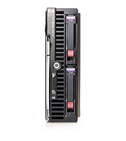



Using SQL
SAS Server
Hadoop Cluster
Hadoop
Access
Method
Controller
Workers
LIBNANE olly HADOOP
SERVER=hadoop.company.com
USER=“paul” PASS=“sekrit”
PROC XYZZY DATA=olly.table;
RUN;
Select *
From olly
Select *
From olly_slice
Select *
From olly
Potentially
Big Data

Slide 6
Using SQL
SAS Server
Hadoop Cluster
Hadoop
Access
Method
Controller
Workers
LIBNANE olly HADOOP
SERVER=hadoop.company.com
USER=“paul” PASS=“sekrit”
PROC MEANS DATA=olly.table;
BY GRP; RUN;
Select sum(x),
min(x) …
From olly
Group By GRP
Select sum(x),
min(x) ….
From olly_slice
Group By GRP
Select sum(x), min(x) ….
From olly
Group By GRP
Aggregate Data
ONLY

Slide 7
Using SQL
Advantages
Same SAS syntax. (people skills)
Convenient
Gateway Drug ☺
Disadvantages
Not really taking advantage of cluster
Potentially Large datasets still transferred to SAS Server
Not Many Techniques Passthru Basic Summary Statistics – YES Higher Order Math – NO

Slide 8
Agenda
Two ways to push work to the cluster…
Using SQL
Using a SAS Compute Engine on the cluster
Data Implications
Data in SAS Format, produce/consume with other tools
Data in other Formats, produce/consume with SAS
HDFS versus the Enterprise DBMS

Slide 9
Hadoop 2.0 :: YARN to the rescue
MAP
REDUCE
Storm
Spark
IMPALA
Tez
SAS
Yarn, or better resource management
HDFS

Slide 10
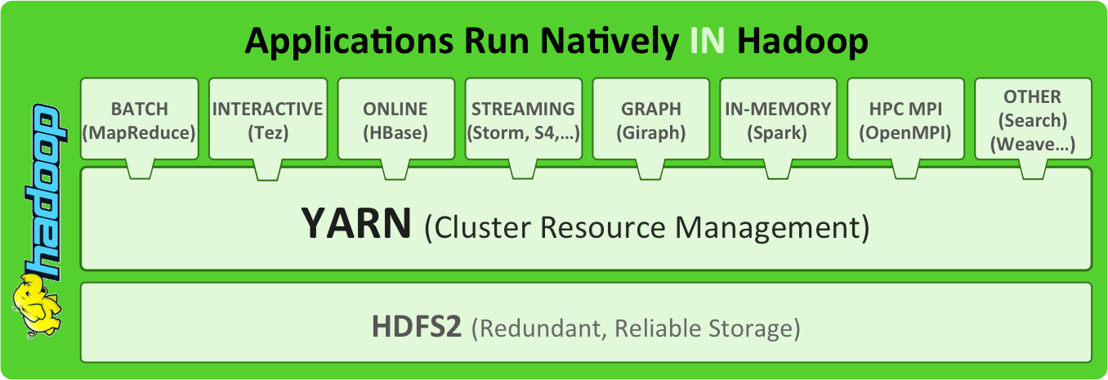

2013q4? 2014?

Slide 11

Hadoop – and her 2 beautiful things
Data
I will spread your data out over many servers to keep it safe
I will facilitate a new idea that you should send the work to the data, not the other way around.
Data
Data
Data
Data
Data
Data

Slide 12








Why Do This?
Because it gets the answers soooo much faster
NameNode
Client
Notes:
Some processes are more complex that fits “nicely” inside the terms & conditions of the container.
We can use the embedded process as a data acquisition channel, and yet perform the mathematics elsewhere (and in the first generation, elsewhere meant other operating system processes on the same server – preserving a symetric or 1:1 balance between the data parallelism and the mathematics parallelism)
2012 – SAS High Performance appliances for teradata, greenplum and hadoop

Slide 13
SAS Server
Appliance
General
Captains
libname joe sashdat "/hdfs/..";
proc hpreg data=joe.class;
class sex;
model age = sex height
weight;
run;
MPI
Math
Math
Math
Math
Math
HDFS
BLKs
BLKs
BLKs
BLKs
BLKs
Controller
Workers

Slide 14
SAS Server
Appliance
General
Captains
libname joe sashdat "/hdfs/..";
proc hpreg data=joe.class;
class sex;
model age = sex height
weight;
run;
MPI
Math
Math
Math
Math
Math
HDFS
BLKs
BLKs
BLKs
BLKs
BLKs
Controller
Workers

Slide 15
SAS Server
Appliance
General
Captains
libname joe sashdat "/hdfs/..";
proc hpreg data=joe.class;
class sex;
model age = sex height
weight;
run;
MPI
TK
TK
TK
TK
TK
MAP REDUCE
JOB
MAPr
MAPr
MAPr
MAPr
Controller
Workers

Slide 16
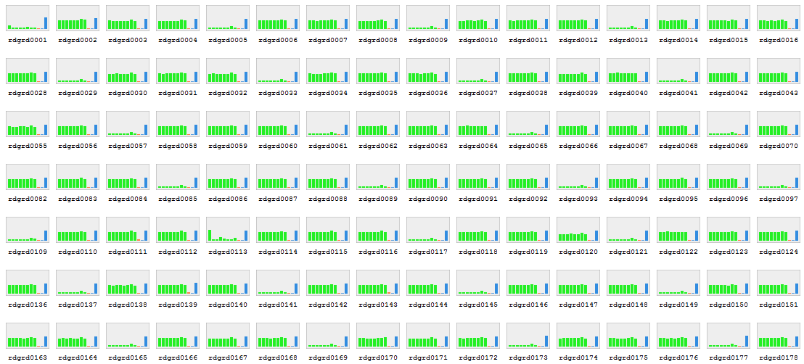
proc logistic data=TD.mydata;
class A B C;
model y(event=‘1’) = A B B*C;
run;
proc hplogistic data=TD.mydata;
class A B C;
model y(event=‘1’) = A B B*C;
run;
Single / Multi-threaded
Not aware of distributed computing environment
Computes locally / where called
Fetches Data as required
Memory still a constraint
Massively Parallel (MPP)
Uses distributed computing environment
Computes in massively distributed mode
Work is co-located with data
In-Memory Analytics
40 nodes x 96GB almost 4TB of memory

Slide 17
SAS® In-memory ANALYTICS
SAS® High-Performance Statistics | SAS® High-Performance Econometrics | SAS® High-Performance Optimization | SAS® High-Performance Data Mining¹ | SAS® High-Performance Text Mining | SAS® High-Performance Forecasting²
HPLOGISTIC HPREG HPLMIXED HPNLMOD HPSPLIT HPGENSELECT | HPCOUNTREG HPSEVERITY HPQLIM | HPLSO Select features in OPTMILP OPTLP OPTMODEL | HPREDUCE HPNEURAL HPFOREST HP4SCORE HPDECIDE | HPTMINE HPTMSCORE | HPFORECAST
Common Set (HPDS2, HPDMDB, HPSAMPLE, HPSUMMARY, HPIMPUTE, HPBIN, HPCORR)
Common set of HP procedures will be included in each of the individual SAS HP “Analytics” products
New recently. More Coming for Xmas!

Slide 18
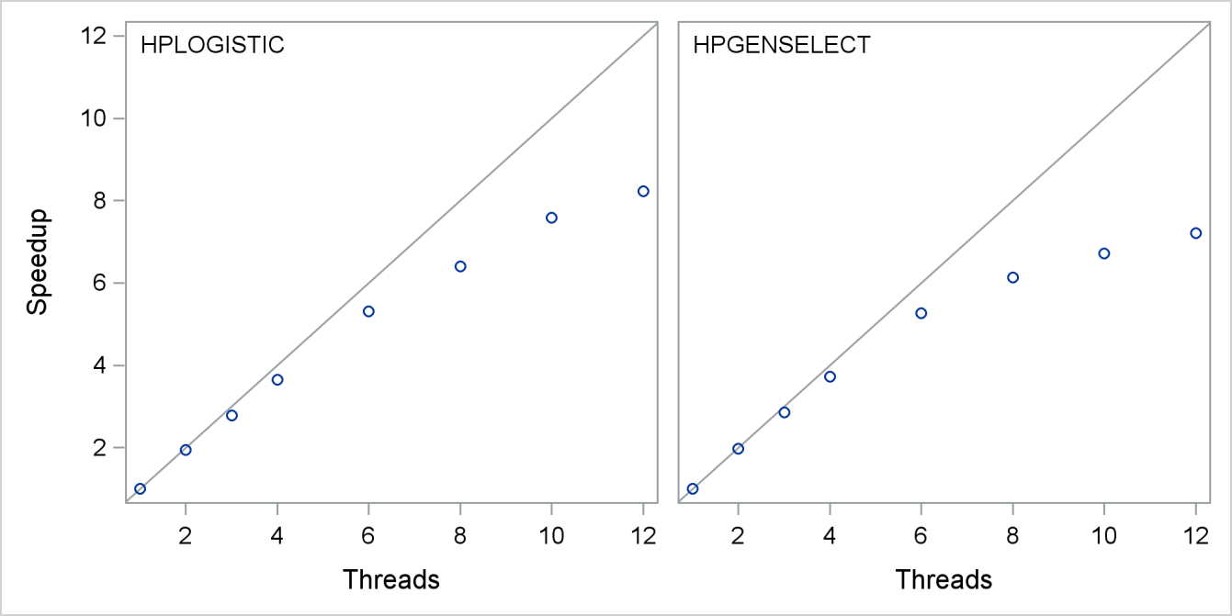
Scalability on a 12-Core Server

Slide 19
32 x
Configuration | Workflow Step | CPU Runtime | Ratio
Client, 24 cores | Explore (100K) | 00:01:07:17 | 4.2
 | Partition | 00:07:54:04 | 19.5
 | Impute | 00:01:19:84 | 7.7
 | Transform | 00:09:45:01 | 13.2
 | Logistic Regression (Step) | 04:09:21:61 | 131.5
 | Total | 04:29:27:67 | 106.1
HPA Appliance, 32 x 24 = 768 cores | Explore | 00:00:15:81
 | Partition | 00:00:21:52
 | Impute | 00:00:21:47
 | Transform | 00:00:44:28
 | Logistic Regression | 00:01:37:99
 | Total | 00:02:21:07
Acceleration by factor 106!
Notes:
Server um Faktor 12, Appliance um Faktor 32 vergrössert.
Würde man das NN zum Vergleich hinzuziehen, so hat man ~19h zu 3 Min.

Slide 20
32 x
Configuration | Workflow Step | CPU Runtime | Ratio
Client, 24 cores | Explore | 00:01:07:17 | 4.2
 | Partition | 01:01:09:31 | 170.5
 | Impute | 00:02:45:81 | 7.7
 | Transform | 01:26:06:22 | 116.7
 | Neural Net | 18:21:28:54 | 478.9
 | Total | 20:52:37:05 | 313
HPA Appliance, 32 x 24 = 768 cores | Explore | 00:00:15:81
 | Partition | 00:00:21:52
 | Impute | 00:00:21:47
 | Transform | 00:00:44:28
 | Neural Net | 00:02:17:40
 | Total | 00:04:00:48
Acceleration by factor 322!
Notes:
Server um Faktor 12, Appliance um Faktor 32 vergrössert.
Würde man das NN zum Vergleich hinzuziehen, so hat man ~19h zu 3 Min.

Slide 21
Agenda
Two ways to push work to the cluster…
Using SQL
Using a SAS Compute Engine on the cluster
Data Implications
Data in SAS Format, produce/consume with other tools
Data in other Formats, produce/consume with SAS
HDFS versus the Enterprise DBMS

Slide 22
Data Choices
Hadoop
Format
Sequence
Avro
Trevni
ORC
Parquet
SAS
Format
SASHDAT

Slide 23
Processing Choices
Hadoop
Format
Sequence
Avro
Trevni
ORC
Parquet
SAS
Format
SASHDAT
Process with Hadoop Tools
Process with SAS
NorthEast and SouthWest Quadrants are the interoperability challenges!

Slide 24
Processing Choices
Hadoop
Format
Sequence
Avro
Trevni
ORC
Parquet
SAS
Format
SASHDAT
Process with Hadoop Tools
✔✔✔
Process with SAS
✔✔✔
NorthEast and SouthWest Quadrants are the interoperability challenges!

Slide 25

Teach Hadoop (pig) about SAS
Hadoop (PIG) Learns SAS Tables
register pigudf.jar, sas.lasr.hadoop.jar, sas.lasr.jar;
/* Load the data from sashdat */
B = load '/user/kent/class.sashdat' using com.sas.pigudf.sashdat.pig.SASHdatLoadFunc();
/* perform word-count */
Bgroup = group B by $0;
Bcount = foreach Bgroup generate group, COUNT(B);
dump Bcount;

Slide 26
Teach Hadoop (pig) about SAS
Hadoop (PIG) Learns SAS Tables
register pigudf.jar, sas.lasr.hadoop.jar, sas.lasr.jar;
/* Load the data from a CSV in HDFS */
A = load '/user/kent/class.csv'
using PigStorage(',')
as (name:chararray, sex:chararray,
age:int, height:double, weight:double);
Store A into '/user/kent/class'
using com.sas.pigudf.sashdat.pig.SASHdatStoreFunc(
’bigcdh01.unx.sas.com',
'/user/kent/class_bigcdh01.xml');

Slide 27
Processing Choices
Hadoop
Format
Sequence
Avro
Trevni
ORC
Parquet
SAS
Format
SASHDAT
✔✔✔
✔✔✔
Process with Hadoop Tools
Process with SAS
✔✔✔
NorthEast and SouthWest Quadrants are the interoperability challenges!

Slide 28
How about the other way?
Teach Hadoop (MAP/REDUCE) about SAS
Hadoop (PIG) Learns SAS Tables
/* Create HDMD file */
proc hdmd name=gridlib.people
format=delimited
sep=tab
file_type=custom_sequence
input_format='com.sas.hadoop.ep.inputformat.sequence.PeopleCustomSequenceInputFormat'
data_file='people.seq';
COLUMN name varchar(20) ctype=char;
COLUMN sex varchar(1) ctype=char;
COLUMN age int ctype=int32;
column height double ctype=double;
column weight double ctype=double;
run;

Slide 29
HIGH-PERFORMANCE ANALYTICS
Alongside Hadoop (Symmetric)
SAS Server
Appliance
General
Captains
libname joe hadoop … ;
proc hpreg data=joe.class;
class sex;
model age = sex height
weight;
run;
MPI
TK
TK
TK
TK
TK
MAP REDUCE
JOB
MAPr
MAPr
MAPr
MAPr
Controller
Workers

Slide 30
Processing Choices
Hadoop
Format
Sequence
Avro
Trevni
ORC
Parquet
SAS
Format
SASHDAT
✔✔✔
✔✔✔
Process with Hadoop Tools
Process with SAS
✔✔✔
✔✔✔
NorthEast and SouthWest Quadrants are the interoperability challenges!

Slide 31
Agenda
Two ways to push work to the cluster…
Using SQL
Using a SAS Compute Engine on the cluster
Data Implications
Data in SAS Format, produce/consume with other tools
Data in other Formats, produce/consume with SAS
HDFS versus the Enterprise DBMS

Slide 32











Reference architecture
CLIENT
GREENPLUM
TERADATA
ORACLE
HADOOP

Slide 33
Hadoop vs EDW
Hadoop Excels at
10x Cost/TB advantage
Not yet structured datasets
>2000 columns, no problems
Incremental growth “practical”
Discovery and Experimentation
Variable Selection Model Comparison
EDW Still wins
SQL applications
Pushing analytics into LOB apps
Operational
CRM Optimization

Slide 34


Thank You!
Paul.Kent @ sas.com
@hornpolish
paulmkent

