Slide 1
Natural Analytics
Donald Farmer
donald.farmer@qlik.com
@donalddotfarmer
October, 2014

Slide 2


Slide 3
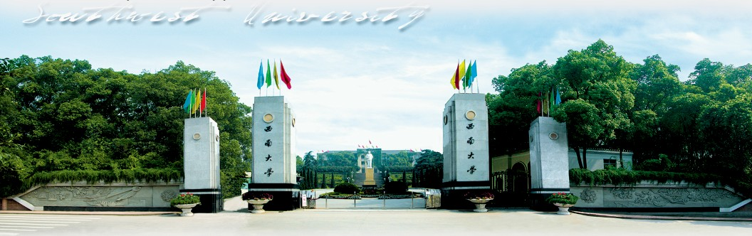

Slide 4
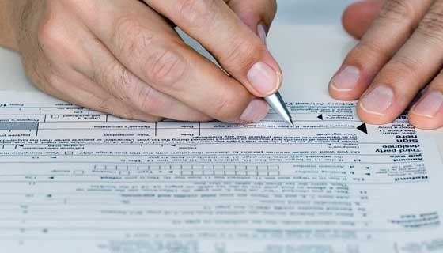

Slide 5
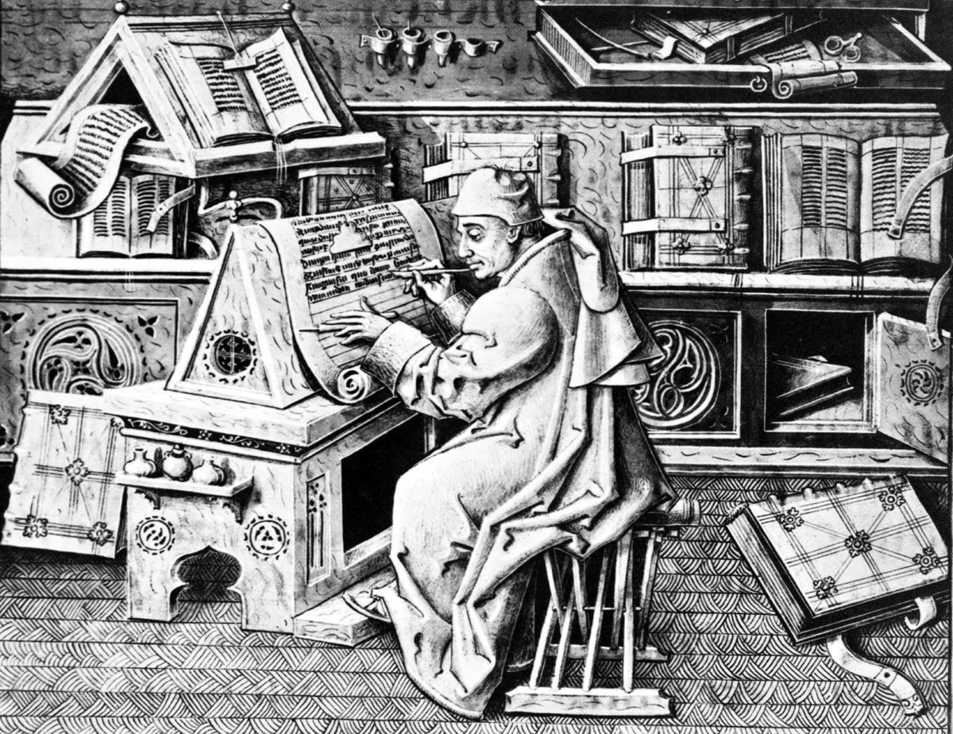

Slide 6


Slide 7
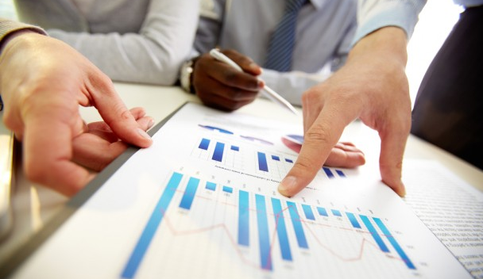

Slide 8
Natural vs. Not

Slide 9
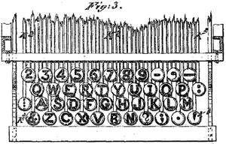
Not Natural

Slide 10

Natural

Slide 11

Not Natural

Slide 12
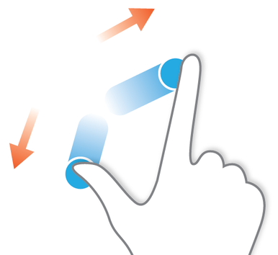
Natural

Slide 13
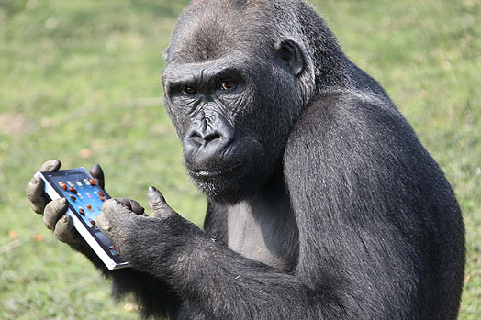
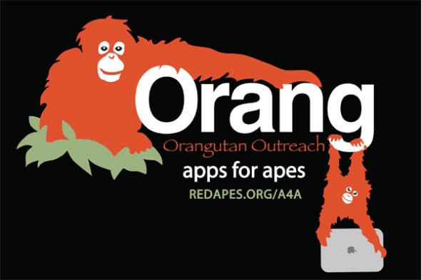

Slide 14
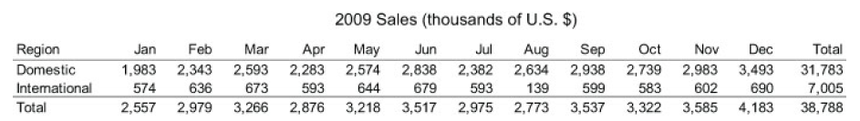
Not Natural

Slide 15
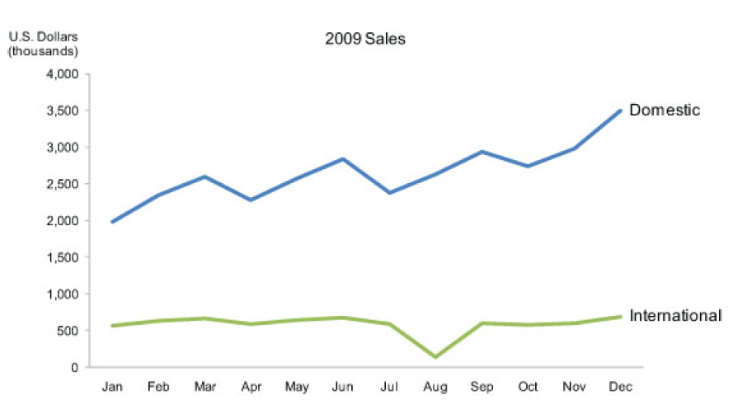
Natural

Slide 16
Natural Analytics: Using Innate Skills

Slide 17
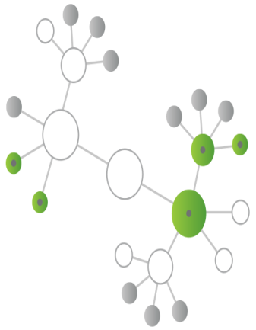

What is Natural Analytics™?
Natural Analytics™ is the technology and design approach that makes the QlikView® platform so powerful
Natural Analytics™ optimizes data structures, the analytical query engine, the interactive user experience, visualizations and collaboration

Slide 18
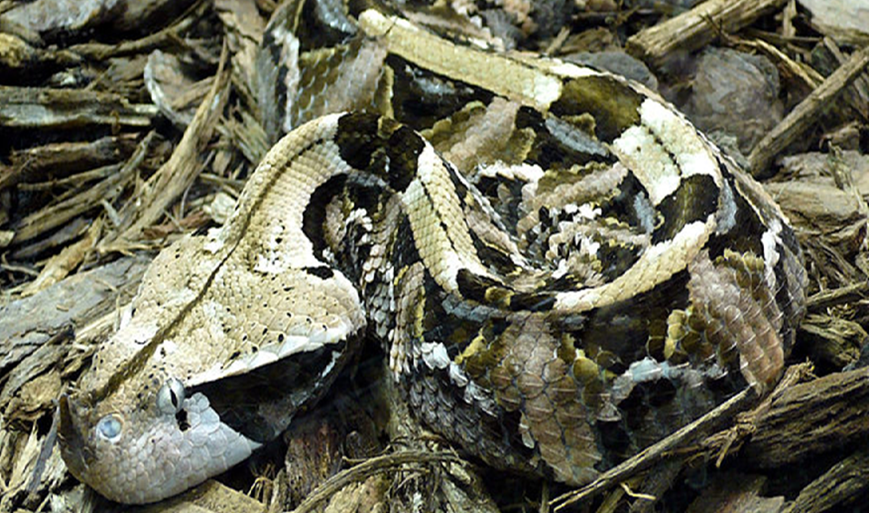
Humans have a natural capability for decision-making under stress

Slide 19
Better Analysis Through Human Behaviour

Slide 20
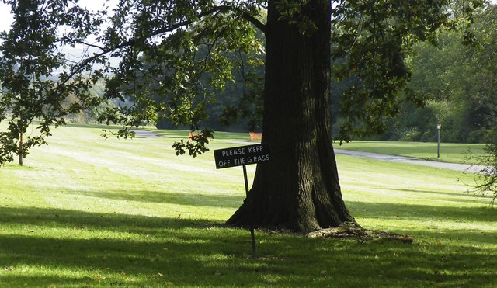
Not Natural

Slide 21
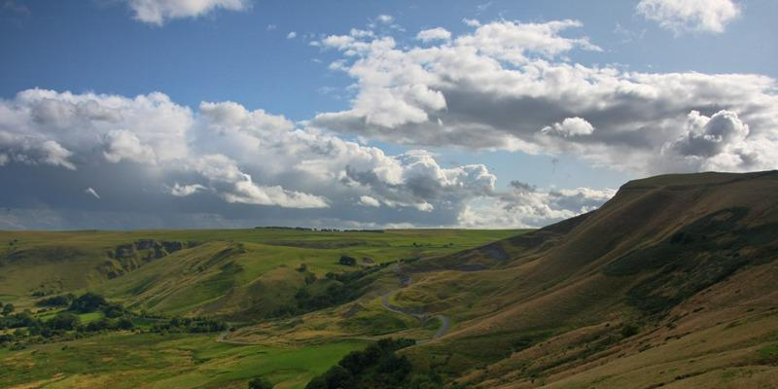
Freedom to Explore

Slide 22
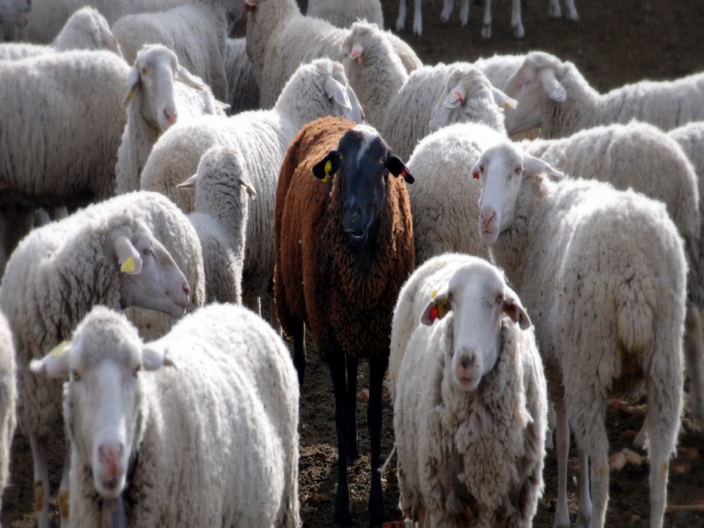
Outlier Detection

Slide 23
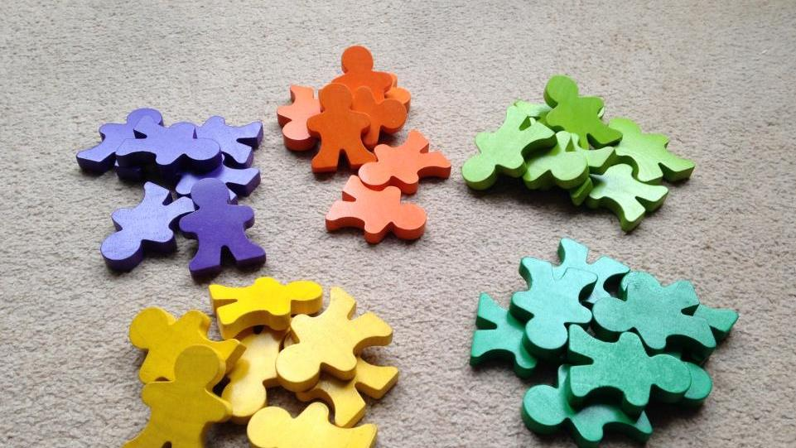
Sorting

Slide 24
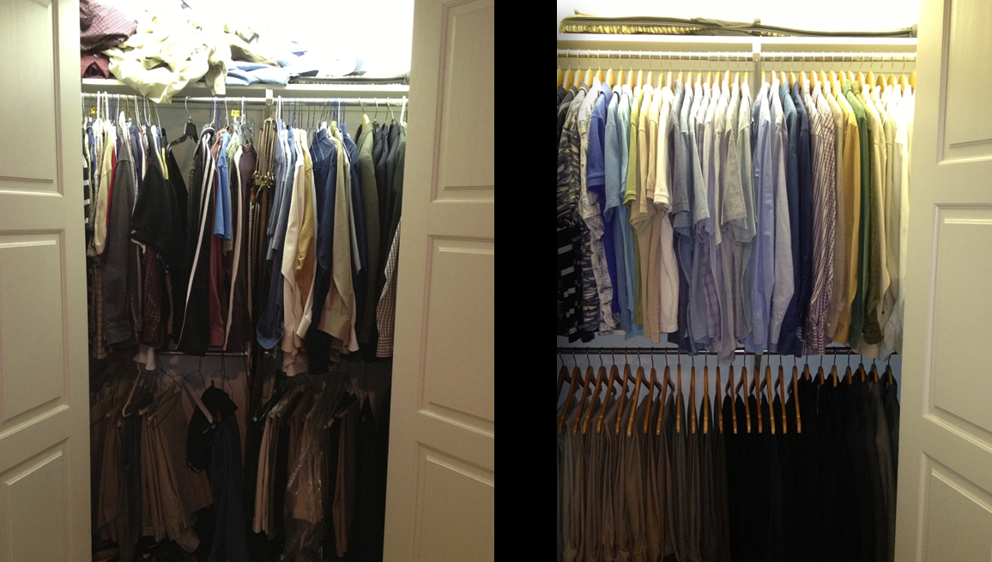
Sorting

Slide 25
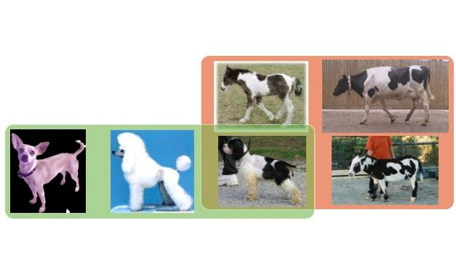
Categorization / Relevance Detection

Slide 26

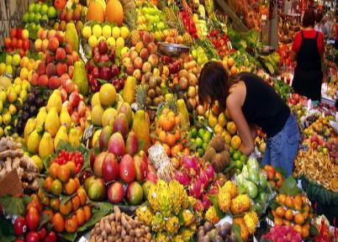
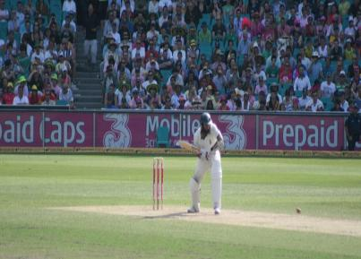
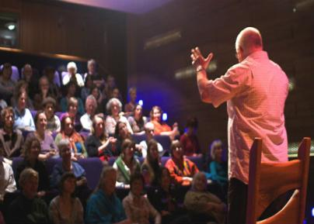
Four innate human analytic behaviors:
Association
Comparison
Anticipation
Narration

Slide 27
Business Discovery is what Qlik does. Natural Analytics is how we go about it. Naturalness fosters adoption and repeated usage, and means greater ROI.

Slide 28
Thank You

