Slide 1
Building Privacy-Protected Data Systems
Courtney Bowman
Ari Gesher
John Grant
(of Palantir Technologies)
Notes:
Outline the basic structure of the class
Why privacy should be of direct interest to engineers (beyond just living the world that we create with our technology, it directly affects our ability to innovate): "Freedom from surveillance, whether public or private, is foundational to the practice of informed and reflective citizenship. Privacy therefore is an indispensable structural feature of liberal democratic political systems. Freedom from surveillance also is foundational to the capacity for innovation, and so the perception of privacy as anti-innovation is a non sequitur. Innovation occurs in commercial and social contexts and is infused with particular commercial and social values; in particular, a commercial culture that sees privacy as threatening particular practices of knowledge production will register privacy regulation as a threat. But a society that values innovation ignores privacy at its peril, for privacy also shelters the processes of play and experimentation from which innovation emerges. In short, privacy incursions harm individuals, but not only individuals. Privacy incursions in the name of progress, innovation, and ordered liberty jeopardize the continuing vitality of the political and intellectual culture that we say we value." --Julie E. Cohen, professor of law, Georgetown Law

Slide 2
Overview
Foundations
Techniques / Architectures
Case Studies (time permitting)
Open Q&A
What’s Next For Privacy
Notes:
Bringing the history of technology and privacy together
Outlining the basic architectural components of a privacy-protective data system
Bringing those elements together in a couple case studies
Note that people should be thinking about a potential real world use case that we can workshop on this
The future of privacy and the role of the engineer in that future

Slide 3
Hour One
Introduction – thinking about privacy
Infosec & Data Collection – important foundations
Break – (5m)

Slide 4
Hour Two+
ACLs
Data Retention
Audit Logging & Oversight
Federated Architecture
Security Architecture & Role Separation
Q & A
Break – (5m)

Slide 5
Hour Three
Pulling it all Together (time permitting)
Audience Participation / Q & A
Break – (5m)

Slide 6
The Homestretch
What’s Next
Q & A

Slide 7
Cast of Characters
Courtney Bowman – Civil Liberties Engineer, Misanthrope, Curmugdeon, Luddite
John Grant – Civil Liberties Engineer, Reformed Lawyer, Privacy Nerd, General Nerd (Dr. Who Fan)
Ari Gesher – Software Engineer, Systems Engineer, Privacy & Security Buff, early Palantir engineer. Talks a lot.

Slide 8
Process Note
This content comes from a work in progress, Architecture of Privacy – a book we’re currently writing for O’Reilly.
We’ve never taught this as a course before. Bear with us.
We know a lot about the subject. Please ask us questions where we’re not being clear – we don’t offend easily.

Slide 9
Thinking About Privacy
Notes:
Quick history of informational privacy law – the significance is not in the specific events themselves, but rather in how they track the interrelationships of privacy and technology over time. Should give us guidance as we move forward into a new era of technological innovation. Should also give us pause as we see just how messy it can be as the law tries to keep pace.

Slide 10
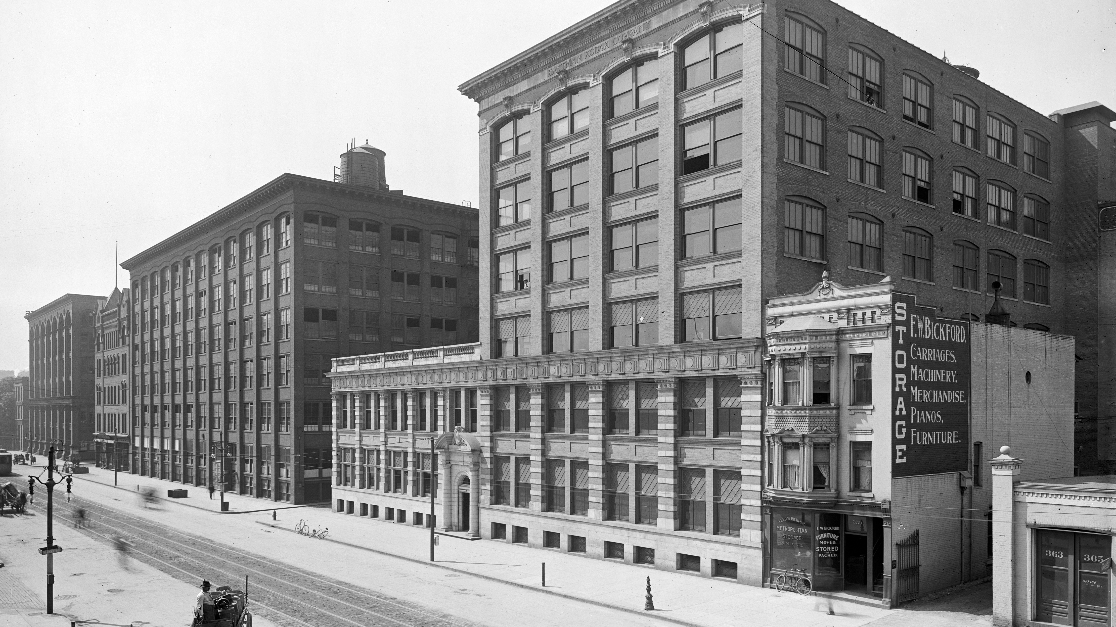
Notes:
Modern privacy law kicks off in 1888 with a new invention – any guess?
Kodak camera – introduces a new age of information availability with the paparazzi press.
“Beware the Kodak, the sedate citizen can’t indulge in any hilariousness without incurring the risk of being caught in the act and having his photograph passed around among his Sunday School children.” – Hartford Courant
1890 – Samuel Warren and Louis Brandeis, The Right to Privacy
“Recent inventions and business methods call attention to the next step which must be taken for the protection of the person…. Instantaneous photographs and newspaper enterprise have invaded the sacred precincts of private and domestic life...’”
Posit the idea of a “right to be let alone.”
Vague definition of the term “privacy” – long standing issue with the concept. We all have a conception of the concept of privacy in our heads but hard to boil that down into a single working definition of privacy. Probably best considered a bundle of interests. (If time, ask the class for thoughts on definitions.)
Freedom of thought
Control over one’s body
Solitude in one’s home
Control over personal information
Freedom from surveillance
Protection of one’s reputation
Protection from searches and interrogations

Slide 11
1928: Olmstead v. United States
Notes:
Louis Brandeis becomes a Supreme Court justice, and tangles with privacy in the context of another technological innovation gaining widespread use: the telephone.
1928 – Olmstead v. United States – Supreme Court finds that wiretapping a telephone was not a violation of the 4th Amendment protection against unreasonable search and seizure
Brandeis fires off a strong dissent reasserting his “right to be alone” idea and arguing that the Court’s short-sighted reading of the 4th Amendment as only protecting the physical home set a dangerous precedent that would allow technology to run rough-shod over individual privacy: “The progress of science in furnishing the Government with means of espionage is not likely to stop with wiretapping. Ways may someday be developed by which the Government, without removing papers from secret drawers, can reproduce them in court, and by which it will be enabled to expose to a jury the most intimate occurrences of the home.”

Slide 12
1967: Katz v. United States
Notes:
Olmstead was eventually overturned in 1967 in Katz v. United States, in which the Court finally recognized that the 4th Amendment applied broadly – it “protects people, not places” – and therefore a warrant was required to tap a telephone. Source of the now famous “reasonable expectation of privacy” standard.

Slide 13
Post-war: (Not so big) Data Explosion
Notes:
Significant that this expansion came after the post-WWII explosion of government data. In three decades, government databases expanded exponentially – “the number of bank checks written, the number of college students, and the number of pieces of mail all nearly doubled; the number of income-tax returns quadrupled; and the number of Social Security payments increased by a factor of more than 35.” Computers were being used to track and analyze this data, and people were concerned about the potential implications of this.

Slide 14
1973: Records, Computers, and the Rights of Citizens
Notes:
1973/1974 – The Year of Privacy! (pretty much been coasting ever since):
1973 – HEW Report, Records, Computers, and the Rights of Citizens – concludes: “Under current law, a person's privacy is poorly protected against arbitrary or abusive record-keeping practices.” Offers a proposed framework for addressing these concerns in the Fair Information Practice Principles (FIPPs) – a set of basic principles for handling data.
1974 – Church Committee report outlines government abuse.
1974 – Nixon resigns due to abuse of Executive power
Leads to a perfect storm for the passage of the Privacy Act (informed by the FIPPs), with some momentum for other privacy legislation over the next several years.

Slide 15
Fair Information Practice Principles
Notes:
Introduction – Where we are today/FIPPs
Unfortunately, legally, this is roughly where we stand 40 years later. The FIPPs are roughly the basis of most major privacy laws around the world. So, imagine the computing world of 1974 and think about all the gaps as you might try to apply rules created then to modern computing.
However, we should not undersell the FIPPs by any means. They have been remarkably effective for a government report and still form a critical foundation for information privacy law to this day.

Slide 16
FIPPs
Collection limitation – Do not collect more information than you need.
Data quality – You have a responsibility not to collect, store, and use inaccurate data.
Purpose specification – Tell people why you want their data and get their permission to use it that way.
Use limitation – Before you try to use already-collected data for an unexpected new purpose, explain why and get permission from the appropriate people.

Slide 17
FIPPs
Security – Protect the data you hold.
Openness – Be as transparent as possible to the people who entrust their data to you.
Individual participation – People should be able to see what you know about them and ask you to correct mistakes.
Accountability – You are liable for responsibly handling information.

Slide 18
FIPPs Shortfalls
How do you deal with the ability to collect mass amounts of open source information?
How do you limit sophisticated analytics drawing non-obvious conclusions from the data?
How do you limit collection and provide up front transparency when you don’t know the potential uses of the data at the point of collection?

Slide 19
FIPPs Shortfalls
How do you obtain meaningful consent in a world in which information is constantly collected about/from us?
How do you give people meaningful participation without curtailing rights to speech?

Slide 20
Technology and Policy
Notes:
Over the course of the day, we are going to talk about the technology that you and your users can use to support policy that protects privacy. Key point: This is not stuff where you can just flip a switch and expect privacy to be protected. You have to think about this in the context of supporting policy.

Slide 21
Infosec & Data Collection

Slide 22
Security is foundational
Notes:
== Data Collection & Information Security
Any architectural considerations regarding data privacy protections begin the moment the data is collected. Privacy issues must be addressed at all stages of the data life cycle -- from collection to storage to analysis to action -- and we will start at the beginning.
Good practices in both information security and data collection are _necessary_, though not _sufficient_, to implement privacy protections. The rest of this book will describe practices and controls that are responsible with respect to privacy, and they are all predicated on authorized access to data. But what of _unauthorized_ access to data? All of the privacy controls in the world are meaningless if they can be circumvented from the start. Information security, therefore, is about limiting unauthorized access to data, and is fundamental in building a privacy protective system.
Meanwhile, all of the privacy controls in the world (and any information security built to protect them) may fall under severe scrutiny, or worse, if administered to irresponsibly collected data. Data collection best practices make sure that data is handled responsibly in every step of the process that moves it from the initial point of collection to its ultimate home in a privacy-protected data store.
On the topic of data collection, consider this a brief overview of questions and best practices; on the topic of information security, this is just the tip of the iceberg. We'll touch on some best practices especially relevant to building privacy protected systems and share some pointers to good places to start learning about the field in-depth.

Slide 23
Infosec
Security is about stopping access by unauthorized users.
Privacy protections control access by authorized users.
If unauthorized access is possible, all is lost.

Slide 24
Infosec
Losing sensitive data is expensive: revenue, fines, customers, reputation, criminal liability… etc.
Security is not a something to build in after the fact – engage infosec teams at the beginning.
Security constraints can deeply impact any systems design – datacenter selection, features, hardware budgets, and predicted performance.

Slide 25
Talk to your infosec team (or hire one)
Notes:
If your organization does not have a dedicated information security team, get one. Nothing will harm your organization faster than losing essential data. If your organization already has a dedicated information security team, bring them into the design process early. As the experts on the security of your network, they will have invaluable advice on building a system that meets the security and compliance requirements for your organization.
Security requirements can have a huge impact on every aspect of system design. Data architecture, the ability of services to be colocated on the same machine, system performance, and even hardware budgets can be significantly affected by security requirements. If you wait until the end of designing your architecture to bring your infosec team into the discussion, you may find yourself throwing out large parts of your design to meet security needs you forgot to consider.

Slide 26
Infosec: Best Practices
Understand that security is risk mitigation not a Maginot Line – enable fast discovery and limiting of breaches.
(at least) Two-Factor Authentication – because passwords are not enough.
Encryption-at-rest – because everyone loses a laptop now and again.
Encrypt all network links – because you don’t know who’s listening.
Notes:
Further Reading
If you’re interested in learning more about the field of information security and some of the topics above, here are a few resources worth checking out:
Secrets & Lies [1] - Bruce Schneier’s book lays out the proper framework for thinking about security: understanding how security technology works and how it fails, understanding the mindset of attackers, and how to look at security as a risk mitigation problem rather a pass/fail challenge. His free monthly newsletter, The Cryptogram [2], is an excellent resource for interesting and notable news covering security research, technology, policy, and incident reports.
"How to Break into Security" [3] - Brian Krebs is a security researcher and prolific blogger. He recently interviewed several experts in the infosec world and published their advice on learning more about the profession and practice.
The SANS Institute [4] - SANS offers training in the practice of information security and cyber defense. They also publish high-quality guides to different aspects of information security. [5]
The Open Web Application Security Project (OWASP) - For more on encryption within a system, the OWASP has published some extensive guidelines on securing the transport (network) layer. [6]
Guide to Storage Encryption Technologies for End User Devices The NIST has more exhaustive information on encryption-at-rest. [7] In addition, most modern operating systems natively support encrypted disks, so your vendor documentation might not be a bad starting place, too.
Electronic Authentication Guideline The NIST also provides useful further information on two-factor (or even three-factor) authentication. [8]
1. https://www.schneier.com/book-sandl.html
2. https://www.schneier.com/crypto-gram.html
3. http://krebsonsecurity.com/category/how-to-break-into-security/
4. http://www.sans.org/about/
5. http://www.sans.org/security-resources/
6. https://www.owasp.org/index.php/Transport_Layer_Protection_Cheat_Sheet
7. NIST Special Publication 800-111, Guide to Storage Encryption Technologies for End User Devices, http://csrc.nist.gov/publications/nistpubs/800-111/SP800-111.pdf
8. NIST Special Publication 800-63-2 Electronic Authentication Guideline, http://nvlpubs.nist.gov/nistpubs/SpecialPublications/NIST.SP.800-63-2.pdf

Slide 27
Privacy starts at collection

Slide 28
Data Collection
Decide what data is sensitive (this is the hard part).
Create a policy.
Implement collection responsibly.

Slide 29
What is sensitive data?

Slide 30
Personally Identifiable Information (PII)

Slide 31
PII (US)
"any information about an individual maintained by an agency, including (1) any information that can be used to distinguish or trace an individual's identity, such as name, social security number, date and place of birth, mother's maiden name, or biometric records; and (2) any other information that is linked or linkable to an individual, such as medical, educational, financial, and employment information."
Notes:
http://csrc.nist.gov/publications/nistpubs/800-122/sp800-122.pdf

Slide 32
Personal Data (EU)
"shall mean any information relating to an identified or identifiable natural person ('data subject'); an identifiable person is one who can be identified, directly or indirectly, in particular by reference to an identification number or to one or more factors specific to his physical, physiological, mental, economic, cultural or social identity."
Notes:
http://eur-lex.europa.eu/legal-content/en/ALL/?uri=CELEX:31995L0046

Slide 33
PII Proxies
SIM card integrated circuit card identifier (ICCID) numbers
SIM card international mobile subscriber identity (IMSI) numbers
Mobile Equipment Identifier (MEID) numbers
Advertising network cross-site cookies
Automobile license plate numbers
Wifi Media Access Control (MAC) address
Bluetooth MAC address
Notes:
PII is _any information that correlates directly to an individual_. A name, a Social Security number, a driver's license number, a national ID number, a phone number, and an email address are all examples of commonly recognized PII. However, there is no universal agreement on what constitutes PII. For example, under U.S. law, an IP address is not considered PII, but under E.U. law, it is.

Slide 34
Crafting a policy
Does the data need to be collected?
Proportionality vs. COLLECT ALL THE DATA
What laws apply to the collected data?
Does the data contain PII/Personal Data? (hint: probably)
Would the individuals described in the data consider the data to be sensitive?
Notes:
Automated License Plate Reader data only becomes relevant when asking the last question

Slide 35
What is the threat model for this data?
Notes:
See http://privacylaw.berkeleylawblogs.org/2013/05/28/paul-ohm-what-is-sensitive-information/
And
http://papers.ssrn.com/sol3/papers.cfm?abstract_id=2501002
Almost every information privacy law provides special protection for certain categories of “sensitive information,” such as health, sex, or financial information. Even though this approach is widespread, the concept of sensitive information is woefully undertheorized. What is it about these categories that deserves special protection? This Article offers an extended examination of this question. It surveys dozens of laws and regulations to develop a multi-factor test for sensitivity.
From this survey, the Article concludes that sensitive information is connected to privacy harms affecting individuals. Consistent with this, at least for the case of privacy in large databases, it recommends a new “threat modeling” approach to assessing the risk of harm in privacy law, borrowing from the computer security literature. Applying this approach it concludes that we should create new laws recognizing the sensitivity of currently unprotected forms of information — most importantly geolocation and some forms of metadata — because they present significant risk of privacy harm.

Slide 36
Implementing Collection

Slide 37
Technical Considerations for Collection
Inadvertent Over-Collection
Unsecured Intermediate Copies
Uncontrolled Intermediate Copies
Source and Use Tagging
Notes:
Inadvertent Over-Collection – it’s easy to collect more than you mean to. Just like the abuse of ‘select *’ in SQL, we default to capturing everything we can because it’s easy.
Unsecured Intermediate Copies – making sure infosec controls are applied to data at the point of collection to stop leakage outside of the system of record
Uncontrolled Intermediate Copies – making sure privacy controls are applied for authorized users at the point of collection. The simplest way to to do this is to make data in the collection pipelines privileged at the highest levels. See also: “Wait – who can log into that machine?”
Source and Use Tagging - Once data lands in a larger repository, it may become difficult to identify or establish the source and context of the original acquisition of that data. Tagging (i.e. appending additional metadata that provides more information about the raw data) can often offset that risk.
As you collect data, tagging it with basic details about when and where it was collected will simplify the task of those ultimately managing the data. Metadata allows users to quickly sort data for access control and other purposes. The more metadata you can add to provide future users with useful context (e.g., a record of consent by the data subject for certain uses), the more options you give those users for managing that data.

Slide 38
Q&A and Break

Slide 39
Privacy Protection Architectures

Slide 40
Access Control

Slide 41
Access Control Models
System-level controls
Datastore-level controls
Data Collection-level controls
Record-level controls
Cell-level controls
Sub-cell/metadata controls
Notes:
Network/System-Level Security – Users in this configuration are given broad access to the data in a system. They can access either an entire network of databases or the entirety of a single database. This configuration would not really be considered multi-level security as all users have the same level of access to the data but it is included here for the sake of completeness. You can envision this as the electronic equivalent of a large filing cabinet with a single lock on it. When the single lock is opened, the entire contents of the filing cabinet are available.
Collection-Level Security – Data within the system is maintained in various distinct data structures, like database tables. Users can access an entire coherent collections of information within the larger data system, but be restricted from others. In this case, each drawer in our filing cabinet has a separate lock with different users having different sets of keys. Once they open the drawers, they have access to all the file folders and their contents within that drawer.
Record-Level Security – Users are restricted from accessing information on a record-by-record basis. In this case, our filing cabinet metaphor starts to become insufficient, but imagine that once a user has opened the file drawer there was some means of controlling which folders she could open at which point she would be able to view all of the documents within that folder.
Cell-Level Security – In this configuration, access is controlled on a data-point-by-data-point basis. For however granularly you can chop the data up in your system, there is a separate access control for that discrete segment of information. By now, our metaphor as all but fled the field, but you could think of this as some means of redacting the documents within the folder on a page-by-page basis depending on each user’s authorization.
Sub-cell-Level Security – Here, you are not only controlling access to the data in your database but also data about the data (the metadata). Metadata may include information about the time and date of the creation of the data in the system, the system user who originally input the data, previous modifications of the data, and other information relevant to the creation and use of the data. At this point, our metaphor is in tatters. One way to understand this would be to imagine a separate filing cabinet next to our original filing cabinet, and that the new filing cabinet has all of the aforementioned data about the first filing cabinet stored with its own cell-level access controls.

Slide 42
Types of Access Permissions
None
Read
Write
Owner
Discovery

Slide 43
Discovery Permissions
Advantages: allows access to necessary data without the risk of all-or-nothing access
Privacy risks: conjunctive searching and can leak information
Offset: use careful auditing to see patterns of abusive searching disable conjuctive searches

Slide 44
Discovery Permission
Permits users to search against data
Rather than results, user gets yes/no as to whether there are hits
Some out-of-band process of justification is used to grant access to results

Slide 45
Role-Based Access Controls (RBAC)
Limits access to parts of the data based on role in the organization
Can be quite granular – rolled up into Access Control Lists (ACLs)
When schemas are created with RBAC in mind, magic can happen

Slide 46
Temporal Access (Administrative)
Allows temporary access to data for a time-limited engagement
Access is automatically removed after time period elapses
Good for audits, temporary assignments, investigators

Slide 47
Temporal Access (Data-driven)
Allows temporary access to data of a certain age
Young data: good for urgent workflows
missing persons
stolen cars
Old data: good for restricting access until abuse is no longer possible
insider trading
Notes:
Originally embodied in things like Warren Commission being under seal for 50 years

Slide 48
Functional Access Controls
Controls on how data is used
Restrict exfiltration – losing controls of privacy protected data
Restrict analysis in the system – protect against certain types of analysis that would lead to sensitive revelations

Slide 49
Implementation Considerations
Data Scale – the bigger the riskier
Data Schema – intimately tied to applying controls
User Scale – higher user scale needs more protections, often finer-grained
System Uses – simple vs. unbound
Dynamism – how dynamic are both these factors and the protection policies?
Administrative Personnel – the human cost of privacy controls
Notes:
Thinking about how to deploy access controls:
Data scale: The number of data points in the system. This does not refer to the number of bytes of data in the system - a massive system could contain a few very large data files. Instead, this refers to the number of discrete pieces of information that could be consumed by a human user. For example, a record contains a person's name and a phone number. This record actually could contain up to seven (or more) data points that could be controlled - first name, middle name(s), last name, country code, area code, prefix, and line number.
Data Schema: The organization of the data itself. This might sit on a spectrum between a hierarchical structure (e.g., databases, records, data points, etc.) or a huge number of single data points with no order at all.
User Scale: The number of system users that will interact with the data.
System Uses: The potential applications of the system. A system could be designed to interact with data for a single use or it could aggregate data and make it available for a nearly infinite variety of uses on the front-end.
Dynamism: The potential for these and other factors to change over time. A static system might involve the same basic users, data, and functionality over a long period, whereas a dynamic system might involve constant flows of new data, new users, and new uses.
Support Personnel: The people who are charged with managing the data and the access control lists. This could range from a single person charged with multiple administrative tasks with little time and/or knowledge for access management to an elaborate regime of multiple data administrators solely tasked with managing system access.

Slide 50
Data Retention

Slide 51
Some of us think holding on makes us strong, but sometimes it is letting go.
-- Hermann Hesse

Slide 52
What is data retention?
Notes:
Data Retention in information systems architecture generally pertains to policy weighing legal and privacy concerns against utility, transparency, and economic concerns to determine retention periods, archival rules, encryption standards, and deletion/purge regimes.

Slide 53
Why is data retention important?
Legal/Regulatory Compliance
Privacy Protection
Data Quality
Resource Contraints
Efficiency & Cleanliness
Notes:
Why is data retention important?
Legal/Regulatory Compliance – most lows pertaining to sensitive records handling involve some kind of data retention requirement
Privacy Protection – avoid repurposing, use beyond scope of initial collection
Data Quality – quality of data erodes over time and may actually become a risk to organizations, muddling critical data application/analysis efforts
Resource constraints –
Perhaps less of an issue as storage costs decrease, but then for some organizations, volume of data collection may outpace decline in storage costs
Efficiency & cleanliness – more data = more problems: data integrity, vetting requirements, etc.

Slide 54
How to set retention policies?
Where laws exists, follow the law!
Otherwise, consider practical implications.
Manual vs. Automatic Purging
Notes:
How to set retention policies?
Where laws exist, follow the law!
And maybe consider going a little beyond the legal requirement. Legal thresholds tend to be somewhat arbitrarily assigned. If there is compelling reason to over-achieve with data purging, do it!
Where laws/policy are not imposed, consider practical constraints:
What’s the shelf-life of my data?
Often an empirical question. Let the evidence guide you. Look at historical usage of retained data, evaluate drop off in usage of older data, self-impose retention standards accordingly.
What are the risks/rewards of indefinite retention?
What costs will I incur by hording data needlessly?
Rule of thumb: If you find yourself reasoning that you’d like to hold on to data without any clearly articulable reason other than, “you never know when it might come in handy,” that’s a good cue to purge.
Manual or Automatic?
Purge regimes can be carried out in an automated fashion, through manual intervention, or various hybrid methodologies.
To determine your purge regime, again, know your policy and legal obligations.
If your data management retention practices are sound and data is well curated, it’s much easier to establish more sophisticated purge processes.
E.g., automated notifications generated by approach retention dates may be used to trigger analyst reviews to manually purge, extend retention dates, trigger additional reviews, etc.

Slide 55
Practical Considerations of Retention
What’s the shelf life of the data?
What are risks and/or rewards of indefinite retention?
What are the costs of needless data hoarding?
What external triggers can cause a need to purge or retain?
Do the audit logs need to be purged too?
How granular can it be?
Notes:
How to set retention policies?
Where laws exist, follow the law!
And maybe consider going a little beyond the legal requirement. Legal thresholds tend to be somewhat arbitrarily assigned. If there is compelling reason to over-achieve with data purging, do it!
Where laws/policy are not imposed, consider practical constraints:
What’s the shelf-life of my data?
Often an empirical question. Let the evidence guide you. Look at historical usage of retained data, evaluate drop off in usage of older data, self-impose retention standards accordingly.
What are the risks/rewards of indefinite retention?
What costs will I incur by hording data needlessly?
Rule of thumb: If you find yourself reasoning that you’d like to hold on to data without any clearly articulable reason other than, “you never know when it might come in handy,” that’s a good cue to purge.
Figure how purge requirements may extend to audit trails that may still preserve sensitive information. Also, what are your reporting requirements for documenting purge events?
To determine your purge regime, again, know your policy and legal obligations.
Purge/Retention decisions need not affect complete records systems. If data architecture/ ontology support granular taxonomies, retention decisions can also be carried out in a granular fashion.

Slide 56
Retention Implementation
At a minimum, keep good metadata to drive retention process
Creation Date
Last Modified Date
Last Accessed Date
Applicable Purge Date

Slide 57
Retention Implementation
When possible, track full data life-cycle and usage
Be able to show the pedigree and age of all data
Helps with record keeping requirements
Enable data-driven self-governance decisions
Be able to check with users to understand purge implications

Slide 58
You’ve Decided You Want to Purge.

Slide 59
Now what?

Slide 60
Non-Deletion Purging
Partial Redaction
Anonymization
Access Restriction and/or Archiving
Notes:
Partial Redaction – some regimes call for (partial) redaction of sensitive records’ fields in order to de-identify the record. Once de-identified, the record may no longer be subject to purge requirements.
Consider the risk of re-identification
Anonymization – stripping Personally Identifying Information fields from records and replacing with, for example, an anonymized identification number may also sufficiently alter the records’ sensitivity so as to no longer mandate deletion/purge.
Access Restriction or Archiving – Stripping access or cordoning off data to a (more) secure storage environment. In this method, the data still persists in its complete form, but is effectively restricted from retrieval.

Slide 61
Deletion
“Soft” Deletion – records removed from use but still present
“Hard” Deletion – records are deleted from the system, possible overwritten
Deletion-by-Encryption – throw away the keys
Notes:
“Soft” deletion – Typically refers to methods of deletion whereby records are effectively removed from end user access, but could (at least temporarily) be retrieved by back-end systems administrators.
“Hard” delete – Typically refers to methods of deletion whereby all front-end and back-end accessible version of data have been destroyed and retrieval is no longer possible. A stricter requirement may necessitate overwriting of all bits containing purged records.
Deletion-by-encryption – Involves using encryption of storage media and destruction of encryption keys such that retrievability of encrypted records is made effectively impossible.
This is increasingly seen as a more viable alternative to the more extreme deletion options applied to cloud hosted environments.

Slide 62
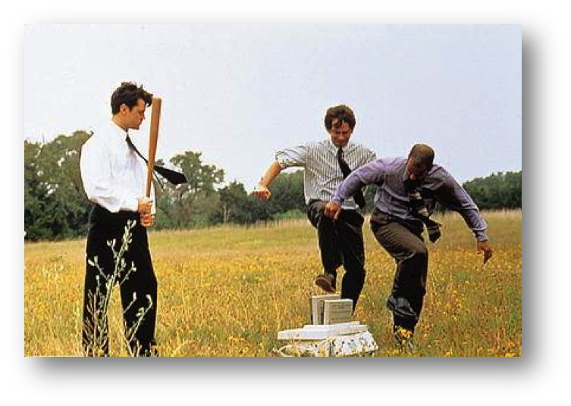
Physical Hardware Destruction
Notes:
Physical hardware destruction – For when flipping bits is not enough and you want to go Office Space on that shit:

Slide 63
Physical Hardware Destruction
Degaussing
Shredding
Disintegration
Immolation
Notes:
More moderate forms include Magnetic Data Deletion (aka Degaussing), shredding, disintegration, immolation.

Slide 64
After great pain, a formal feeling comes –
The Nerves sit ceremonious, like Tombs –
The stiff Heart questions ‘was it He, that bore,’
And ‘Yesterday, or Centuries before’?
The Feet, mechanical, go round –
A Wooden way
Of Ground, or Air, or Ought –
Regardless grown,
A Quartz contentment, like a stone –
This is the Hour of Lead –
Remembered, if outlived,
As Freezing persons, recollect the Snow –
First – Chill – then Stupor – then the letting go –
--Emily Dickinson
Notes:
Finally, relax and let it go.

Slide 65
Audit Logging

Slide 66
Why are audit records important?
Oversight
Trust
Accountability
Liability
Notes:
Why are audit records important?
Trust
Accountability
Liability
Demonstrable proof that all your other privacy architectural features are being used and used effectively.
All access to data is a privacy risk, even with controls. Restriction are necessary but not sufficient, oversight completes the equation of responsibility.
From the chapter 5 conclusion:
A final thought on access controls: you can think of application-level security (as opposed to the system- and physical-level security of the machines themselves) as having two key aspects: restriction and oversight. Restrictions allow the architect to build a system that enforces its own rules without human intervention. Oversight lets careful observations of the use of the system limit the abuse that a user can inflict given the access that they have. Both are necessary and neither is sufficient to create real privacy protections. As such, ACLs play a huge role in creating a privacy-protected system as they are **the** mechanism for application-level restrictions.

Slide 67
Auditing is easy, right?

Slide 68
Logging stuff is easy.
Notes:
But Auditing is easy, right?
Sadly, no. Effective auditing is technologically non-trivial. Challenges abound, particularly in complex enterprises spanning many user types, data systems, and auditing foci. But even basic auditing of information systems’ audit trails entails complexities that are often poorly understood and impede organizations’ abilities to conduct meaningful audit analysis when it matters.
As a consequence, auditing often is relegated as an obligatory function – more of a box to check off than a truly critical function – that inspires little confidence and trust from those whose data is processed/stored by these systems.

Slide 69
Effective auditing is hard.

Slide 70
Format & Readability
Disparate log formats across systems
Coarse-grained configuration of logging
Identifiers to correlate across logs
Requirement: Method for translating potentially disparate audit records into a common, consistent form.

Slide 71
Scale
Machine-generated data gets large fast
Tend towards terse formats, and compression
May be stored on things like tape
Requirement: Determine what level of granularity your audit records need to provide and plan accordingly based on reasonable usage and growth assumptions.

Slide 72
 | User-Centric | Database-Centric | Entity-Centric
Client-Side | Search: “John Doe” | User-query | Person object displayed in browser
Server-Side | Search Application queries for “John OR Doe” | Table x, Row y | Composition of properties a, b, c rendered in object viewer
Notes:
Audit log perspectives

Slide 73
Perspective
Audit log narrative structure is key
Must be based on questions that need answering – not technical operations performed
Requirement: Think about what your audit analytics will need entail in practical terms. Adapt the perspective of your audit records accordingly.

Slide 74
Context
Single entries lack context
Vast majority of individual actions are legitimate

Slide 75
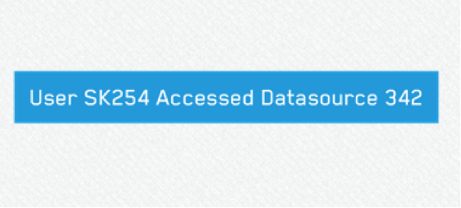

Slide 76
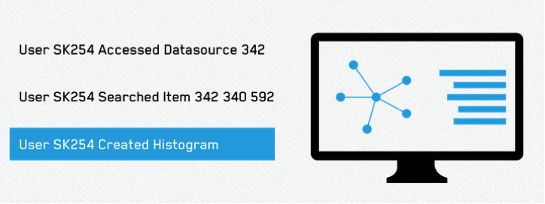

Slide 77
Context
Single entries lack context – innocuous action becomes negligent or nefarious when viewed as a pattern
Vast majority of individual actions are legitimate
Requirement: capture all context necessary in your auditing systems to reconstruct meaningful answers

Slide 78
Usability
Compression and terse formats make standard search tools useless.
Lack of quality indexing and search makes the timely review difficult.
Log data is often not human-readable.

Slide 79
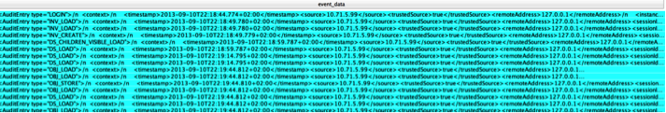

Slide 80
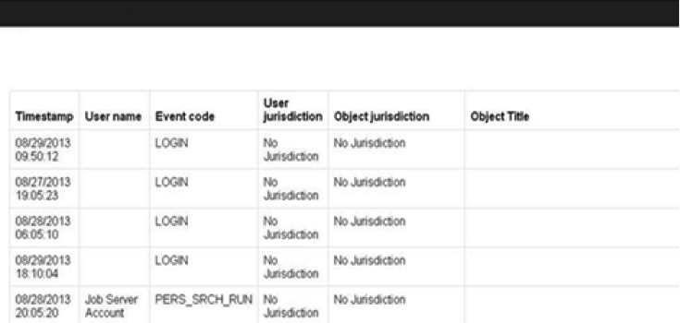

Slide 81
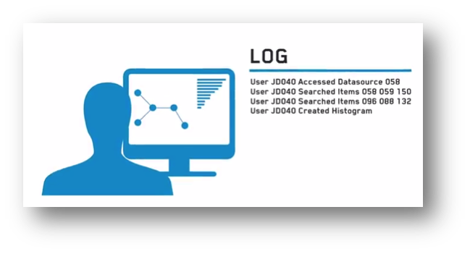

Slide 82
Usability
Compression and terse formats make standard search tools useless.
Lack of quality indexing and search makes the timely review difficult.
Log data is often not human-readable.
Requirement: Provide means for accessing audit records in usable ways, ideally embodying the following features:
Full-text searchable
Indexed for performance
Searchable by property/component
Tailored according for effective auditor perspective and user context

Slide 83
Audit Log Infosec
Audit log data is itself sensitive!
Encrypt-at-rest and in transit for simple security
If logs can be tampered with or destroyed, they can’t be trusted
Requirment: cryptographic hash-chaining to immediately detect log tampering
Notes:
Security
Beyond secure/encrypted transit and storage, how to ensure audit log integrity? What methods are actually feasible?
Immutability?
Sadly, no.
Tamper proof?
Not likely.
Tamper-resistant?
Still pretty difficult, especially when your task is to demonstrably assert purity/integrity of audit logs.
Tamper-evident?
Now we’re talking! To be able to assert the integrity of audit trails, you want to be able to claim that, though a nefarious, malevolent, evil super-genius hacker could in principle, with all stars aligned, break into the audit trails and much around with them, she would never be able to do so without detection, i.e., breaking a hash-chain:
A hash chain is a list of hashes produced by the successive application of a cryptographc hash function, such that every hash depends on the one before it. A modification to a single hash in the list will break the chain, and tampering becomes evident.

Slide 84
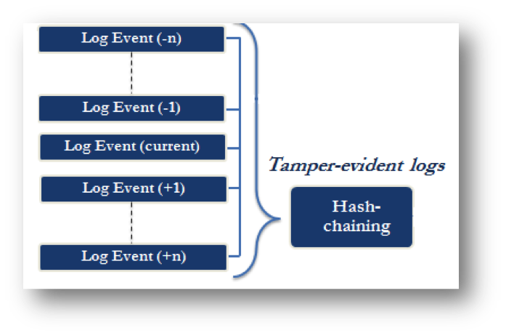

Slide 85
Audit Log Access Requirements
It’s a recursive problem
Different auditors may have variable access to user information
Access should be overseen by owner
Should have ability to withdraw or modify auditors’ permissions as investigation statuses change

Slide 86
Audit Log Access Policy
All auditors see everything
Some auditors see everything, others see only a subset of data
Auditors are subject to fine-grained sets of permissions that control what can and cannot be seen – no end user data!
Support discovery permissions (see: Access Controls)

Slide 87
Federated Architecture

Slide 88
Federated Architecture
Allowing query access into a system, but not bulk data-sharing
Data owners get to set access policy and log usage
Reduces privacy risk by not creating large ‘data lakes’
Notes:
Classic example: 215 Metadata Program

Slide 89
Federated Patterns
Create a search endpoint for the federated datasource
Search index is kept up-to-date in an online fashion
Publish/Subscribe pattern allows the online updating of queried data
Pull/Push model with versioning can enable disconnected use
Notes:
Sharing can be read only or one-way sharing, or allow updates of the data

Slide 90
Federated Features
Unified UX across disparate systems
Centralized data scales with use, not total available data
Simplifies the adding and removal of datasources
Simplifies the tagging of data for privacy controls

Slide 91
Privacy Properties
Data owner controls access restrictions and auditing
Different subsets of datasets can be selectively shared
Different subsets, views, or aggregations of records can be selectively shared
Discovery permissions can be very useful
Easy to take a dataset offline or redact whole datasets

Slide 92
Creating a Federated Service
What: Determine which datasets are to be shared with which users
Who: Determine which users or roles can see what data
How: Determine what view of the data (full, redacted, aggregate, etc.) each user group will see
Notes:
There are a few different forms a federated system can take. The two versions of which we have described above federate out to multiple other systems, and are primarily used for searching the contents of other systems. But another kind functions more as a federated _source_; it is searched by one or more external systems and it requires decisions to be made about what to make available to outside queries. We might call this a shared federated search server, and it offers different benefits.
The first decisions when setting up such a shared federated source have to do with the _what_, in this case, the data. After determing what data to share overall, then you must decide what fraction of that shared data should be shared with each external system that will search it; whether it will always be the same information, or whether one external system only will have access to one subset of the shared data while a different external system will have access to a different subset.
The next set of decisions involve _who_, in this case, your users. It may be necessary to assign variable permissions to the different sets of users of the external systems that are searching the shared federated data. This could require an access control regime that mirror the access control regimes of those systems, or a role-based regime if there's foreknowledge of who will be searching, along with a way to verify the searcher's role.
Finally there is the question of _how_: whether the data will be shared as full, individual records; or as partial views of records; or just the metadata or aggregate statistics on the data. The latter is particularly useful from a privacy perspective because, as noted in the previous chapter on data collection, it is often not necessary to share the specifics of the underlying data. This can reduce or eliminate incentives to release sensitive information.

Slide 93
Implementation Example
System-of-record is large legacy database system
Federated search index is ElasticSearch
Data is projected into the ElasticSearch indexes
RESTful query interface performs authentication and audit logging
ES percolator pattern can be used to implement pub/sub semantics

Slide 94
Federated Systems: Use Cases
Complex Regulatory Regimes: Cross-border, cross-industry
Lack-of-Trust: sharing without fully trusting the counter-party
Public Relations: reassuring stakeholders that abuse is limited
Notes:
== Complex Regulatory Regimes
Though many countries share some baseline similarities regarding privacy (e.g., FIPPs), they can vary greatly in detail. Given the ease and frequency with which data crosses international borders, many data systems are quickly going to find themselves housing data with any number of country-specific handling requirements. One option might simply be to apply the most restrictive data protection to all of the data in the system (the "highest common denominator," if you will). But data protection requirements cannot be so easily grouped into a strict hierarchy of weak to strong. In some cases, regimes even directly contradict each other. Blanket restrcitions may also needlessly undermine the overall utility of your product. A more granular implementation of the individually applicable laws might result in a more effective product while still offering the desired level of privacy protection.
Federated systems facilitate such data handling. By sorting information into databases according to categories dictated by law, such as geography, data type, or others, a federated system can create clear boundaries between data sets. Policy and technical controls can be applied based on the physical location of the data. As long as the data is persistently sourced to those servers, users, administrators, and oversight authorities can quickly identify the applicable handling requirements. In addition, in the event that a particular data set is found to be out of compliance with legal requirements, the particular data set can be taken off line (either permanently or temporarily for remediation) while allowing the rest of system to continue to operate. The fact that a data set can be taken offline individually is helpful when adjusting to comply with ever-changing policies.
== Lack of Trust
Federated architecture obviates the need for the data provider to assume all risk based on trust in the recipient of the data. A significant barrier to free information exchange is a lack of trust in other participants in the data sharing network. Once data slips from the direct control of a data provider, the provider is reliant on the recipient of the data to handle the information responsibly. In many cases, particularly where the data provider may be exposed to significant legal liability or customer outrage should the data be misused, this uncertainty prevents information sharing that would otherwise benefit both parties. As data scale increases, so too does potential liability for breach or misuse, and the willingness to rely simply on contract provisions and trust as protection against potentially crippling damages awards wanes accordingly.
In a federated system, the data provider maintains a server of data that is entirely under their control yet still accessible to the data recipient. The data provider can monitor all search queries and access events, and - if necessary - even approve or deny access requests so as to tightly control the data flow from their servers. Even when data leaves the provider's server, it can remain tethered to its original sources, allowing the data provider to correct or update inaccurate or out-of-date information and push those updates to data recipients. In addition, the system can even be configured to allow the data provider to retroactively revoke access to data that has already been shared, removing it from the recipient's view within a matter or moments. In short, the data provider maintains a high level of control that ultimately encourages a greater amount of data sharing throughout the network.
== Public Relations Imperatives
"Big databases are creepy." While this is not a particularly helpful articulation of the concern, it is one that system architects are likely to encounter as they construct ever-larger, centralized repositories of data. While effective use limitations (discussed later in this book) might address the actual practical concerns that people have about data use, the image of the single gargantuan database remains troubling to many people concerned about privacy.
Federated architecture provides the functionality of a single database while avoiding the negative perceptions associated with centralization. This is more than just window-dressing -- while the federated system still provides centralized access to data, the centralization only occurs when specifically needed in support of a particular use case rather than dumping all the data together at the outset when it may not necessarily ever be needed by the centralized system.

Slide 95
Federated Search Weaknesses
Performance can be constrained by the slowest link
Implementation complexity – dual-edged sword
Account breaches give access to multiple systems
Still no way to truly limit use once a query is answered

Slide 96
Security Architecture

Slide 97
Security Architecture
Systems security and good infosec guard against external threats
What about internal threats?

Slide 98
Humans In the loop
Granting access of any sort implies privacy risk
Technical restrictions only go so far
Oversight, auditing, and monitoring complete the picture

Slide 99
Separation of Powers: Roles
End Users: use the system for its stated purpose.
Application Admins: responsible for configuration and maintenance of the functional system.
Systems Administrators: responsible for the operating system (e.g., Linux, Windows) and other components on which the application depends.
Hardware Administrators: responsible for the upkeep and maintenance of the physical machines on which the software runs.

Slide 100
Overlapping Oversight
End Users: work with the data.
Application Admins/Abuse Team: monitor the users for abusive behaviors.
Systems Administrators: monitors users and admins for access outside of the application sandbox. Can’t view data.
Hardware Administrators: makes sure the hardware is not violated or stolen. Can’t login, can’t view data.

Slide 101
End Users
Can only access data through the official interfaces (e.g. no direct database access)
Rate limited on searches and record access
Audited on operations like export, if allowed at all

Slide 102
Application Administrators
Hold the encryption keys to unlock the data
Only use established admin interfaces
No direct machine level access
Code review required on deploying plugins (if allowed)
Notes:
It’s important to monitor the application administrator, who has significant power because he or she has a legitimate need to see the data. As such, this role is traditionally given login access to view data, system tools access to address problems, file system access to transfer data, and database access to debug software. In addition, the application administrator also controls audit data. Consequently, the administrator could turn off application server audit logs, login as an end-user, and then exfiltrate the data. The application administrator could also deploy malicious code. While textual commands can be audited, as of this writing, binaries cannot be audited in any meaningful way.
To protect against the risk posed by rogue application administrators, organizations can use a standard technique to deny the administrator direct access to servers. Connections instead must pass through a host maintained by a third party, commonly called a “jumphost.” footnote:[See https://en.wikipedia.org/wiki/Jump_Server] The jumphost serves as a policy enforcement mechanism that enables organizations to set export and rate-limiting controls. Perhaps most importantly, the system records audit logs of every action by the application administrator. The insider threat team is then responsible for actively reviewing those audit logs.
This process can even be made transparent to the application administrator through a technology called SSH tunneling. By preventing the administrator from altering or deleting the audit log of his actions, organizations can review the administrator’s actions without requiring synchronous two-person review, a policy which is sometimes impractical to implement. Additionally, since audit logs are machine-readable, organizations can apply rules to detect suspicious behavior patterns and take action in real time. Organizations can also review the audit logs to identify potential areas of risk based on the administrator’s past actions. The insider threat team would be responsible for conducting this type of continuous monitoring and analysis.
Organizations may also consider requiring reviews of all code written by insiders, to prevent the application administrator from deploying malicious code. The primary purpose of the code review process should be to maintain high engineering standards, one element of which is to detect the existence of malicious code or backdoors. The code review process should be conducted in small batches to improve the quality of review. This code should then be securely deployed to the live system from source. In a secure code deployment pipeline, the application administrator checks the source code into a repository that is reviewed by a second developer. The code is then compiled and signed by the source repository. The system administrator enforces a check at the application server level that only permits signed binaries to be deployed. This step prevents the application administrator from deploying code outside the review process. footnote:[See Jez Humble & David Farley. _Continuous delivery: reliable software releases through build, test, and deployment automation_.]
==== The Hardware Administrator
Finally, we turn to how to monitor the hardware administrator, who has physical access to the machines. This presents risks because hardware administrators can copy and steal hard drives or insert malicious hardware, either of which could result in compromised data. Organizations can reduce this risk by employing encryption of data at rest, as described above and in this book's chapter on encryption, and taking physical security steps. For instance, at most commercial data centers or cloud computing services such as Amazon Web Services, hardware devices are separated and locked in physical cages. There are many other steps such as using sensors, locking hardware, and auditing that can further secure this process.
image::images/HardwareAdminAccess.PNG[]
However, the most important step in enforcing adequate physical security is to maintain the proper separation of roles. In a large data center, a hardware administrator should be unaware of the systems he or she is administering, not knowing which is which, instead responding to requests at the level of the server rack and the machine. Sometimes, the hardware administrator role is not carefully separated from others, and some data centers do not control access other than at the border of the facility. Such an approach disproportionately relies on trust, rather than technology and verification, and is not recommended. Instead, care should be taken in selecting data centers that are conscientious about the subtleties of protecting their customers' sensitive data.

Slide 103
Systems Administrators
Day-to-day work done through automated deployment frameworks
Direct root access in emergency situations only
Machines configured to audit all commands on separate host controlled by infosec
Notes:
That brings us to monitoring the system administrator. It is common practice for system administrators to have root or “super-user” access to the operating system. This presents risks because the system administrator can turn off functions in an undetectable way. It is not effective to enforce controls at the system level against any user with superuser privileges. Instead, the most effective way to audit system administrator behavior is proxy shell access through jumphosts, as discussed above.
In a production system with sensitive data, super-user access to a live production server should be reserved for emergencies. The most straightforward way to do this is by implementing control system commands, requiring superuser access in the same way that source code is controlled. To be deployed against a server containing sensitive data, commands should be written into a script, reviewed by another administrator, and automatically deployed. These technical and procedural steps prevent any single administrator from inserting commands directly into a production system as the superuser. These techniques for command scripting and review have become standard engineering practice for companies practicing cloud deployment. In some cases, emergency access may be necessary, but these contingencies are rare, discrete, and easily monitored. In other words, manual access should only be granted in highly controlled special cases and not during normal workdays.
In addition, data should be encrypted at rest and the keys held by the application administrator. If data is encrypted at the application level, then the system administrator should have no access without superuser permissions. If encryption is performed at the system level, the system administrator’s account should not be granted access to the partition with the decrypted data.

Slide 104
Hardware Administrators
Best practices on physical control of machines – badging, biometrics, cameras
No login access to administered machines
Use of encryption-at-rest to make physical not analogous to a data breach

Slide 105
Infosec Team
Watches everyone
Paranoid as hell

Slide 106
Q&A and Break

