Slide 1
Customer Intelligence –
Harnessing Elephants at Transamerica
Stephen Lloyd
BI Architect, Transamerica Life & Protection
Vishal Bamba
Chief Architect Transamerica Life & Protection
Dave Beaudoin
AVP Transamerica Investments & Retirement
#strataconf #hadoopworld

Slide 2
Agenda
About Transamerica
Current State and Data Architecture
Use Cases / Learnings
POC Highlights
Solution Design
Lessons Learned
Questions / Discussion

Slide 3
Transamerica Org Structure
Investments & Retirement
  Retirement and Benefit Plan services to employers/employees
  Mutual funds and variable annuities
  Mission to help people save and invest wisely to secure their retirement dreams, the I&R business unit serves more than 3 million retirement plan participants across the entire spectrum of defined benefit and defined contribution plans.
Life & Protection
  Term and Perm insurance products
  Medicare supplement, long term care, accidental death, final expense
  Mission to protect what you’ve built, secure what’s next.

Slide 4
Data Architecture
Rich data environment across organizational business units, comprised of many source systems across various platforms
A consistent enterprise view of data across business units is required

Slide 5
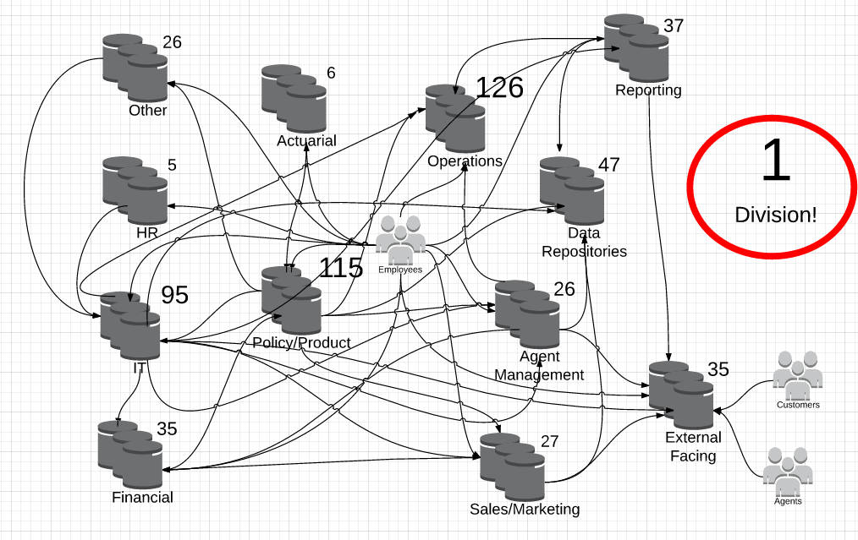
Data Architecture

Slide 6

Data Architecture
As in many industries, we are focused on leveraging technology to build data-driven customer relationships.
How can the current data architecture
support this strategic direction?

Slide 7

Data Architecture
Enterprise Data Management Crossroads
Another traditional warehouse project?
or
Enterprise data hub/lake/ocean with new technologies?

Slide 8
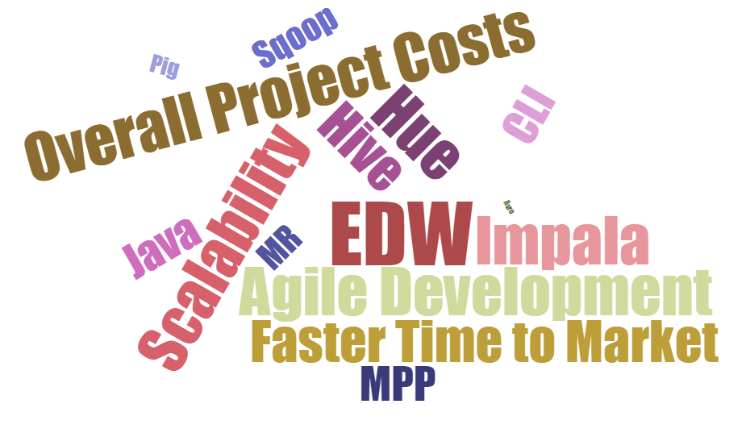
Data Architecture – New Direction?

Slide 9
The Vision
360 degree view of consumers for marketing, planning, and analytics
Discover and mine relationships
Create highly targeted and individualized marketing programs
The How
Co-location, master data management, custom data quality and cleansing rules and more
Which allow integration of data from across and outside of the company to create 360 view of consumers
Enterprise Marketing and Analytics Platform

Slide 10
Use Cases
Complete a Data Append Process
Append Data Elements from Enrichment sources to Customer/Prospect records
Tests: Data Integration, Processing Power
Notes:
Get rid of append

Slide 11
Use Cases
Score Prospects with a Predictive Model
Score prospects with the current model to predict likelihood to respond to a direct marketing offer
Tests: Processing Power, Predictive Modeling

Slide 12
Use Cases
Measure online contracts/sales, create visitor personas, create simple attribution
Match weblog visitor data to Salesforce leads and to policy holders to generate a sales pipeline. Join to enrichment sources to create personas. Join to Direct Mail solicitation history and test for correlation.
Tests: Data Integration, Processing Power, Analytics

Slide 13
POC Success
Web Log
Salesforce
Epsilon
Direct Mail History
83 sent DM after visit
14% in niche
35% income > $100k
4,252 ppl
120k visits
**Use case figures are for illustration purposes only**
Join weblogs > CRM > Demographics > mailings
Enabled:
Connected online activity to offline activity
Created time series of events
Created demographic profile
TOTAL ANALYSIS TIME = 2 hours

Slide 14
Summary of Key Benefits
Provides a single platform to house key customer and prospect data sources,
Establishes persistent keys across previously disparate data sources ,
Provides for rapid intake of new data sources (structured and unstructured),
Eliminates today’s data intake and append bottleneck,
Empowers Analysts to explore all data elements,
Increases processing power for statistical analysis and,
Improves recruiting and retention of Data Engineers and Data Scientists

Slide 15
Solution Architecture
Big Data Analytics
Customer
Data
Visualizations
Informatica Big Data Edition
Cloudera Big Data Platform
Predictive Analytics
Power Center Big Data Edition
Data Quality Big Data Edition
Identity Resolution
Datameer
Visualizations
Predictive Analytics
CRM
Map Reduce
Inputs
Prospects
Hive
Enrichment
HBase
Individual
Household
HDFS
Partner Files
Solicitation History
Cleansed Files
Weblogs
Extract Load & Transform
Consumption
Data Quality –Cleaning, Identity Resolution

Slide 16


Product Value Proposition
Cloudera Enterprise Data Hub
  Strong commitment to community driven, open source platform
  Security & Governance : Authentication; Authorization; Auditing; Data lineage & Data discovery
  Strong presence in Financial Services Industry
Informatica
  Leverage existing skills; Visual development; Increased Productivity
  Prebuilt connectors: RDBMS, VSAM, OLAP, Salesforce, Social Media (Facebook, LinkedIn, Twitter)
  Data Profiling & data quality on Hadoop: Identify data issues earlier; score carding; cleanse, match and standardize on Hadoop; prebuilt data quality rules, data masking
  Natural Language Processing (NLP): Mine semi-structured & unstructured data (emails, twitter feeds, Facebook posts)

Slide 17

Product Value Proposition
Datameer
  Big Data Analytics: Analyze structured & semi-structured; data mining; built for Hadoop
  Easy, Excel-like interface eliminates need to learn new programming languages… Would appeal to more broad analytic user community across the enterprise.
  Create, execute & test data pipelines natively on Hadoop
  Rapidly combine and enrich existing data sets; what-if scenarios
  Pre-stage data for Campaigns / Reporting

Slide 18
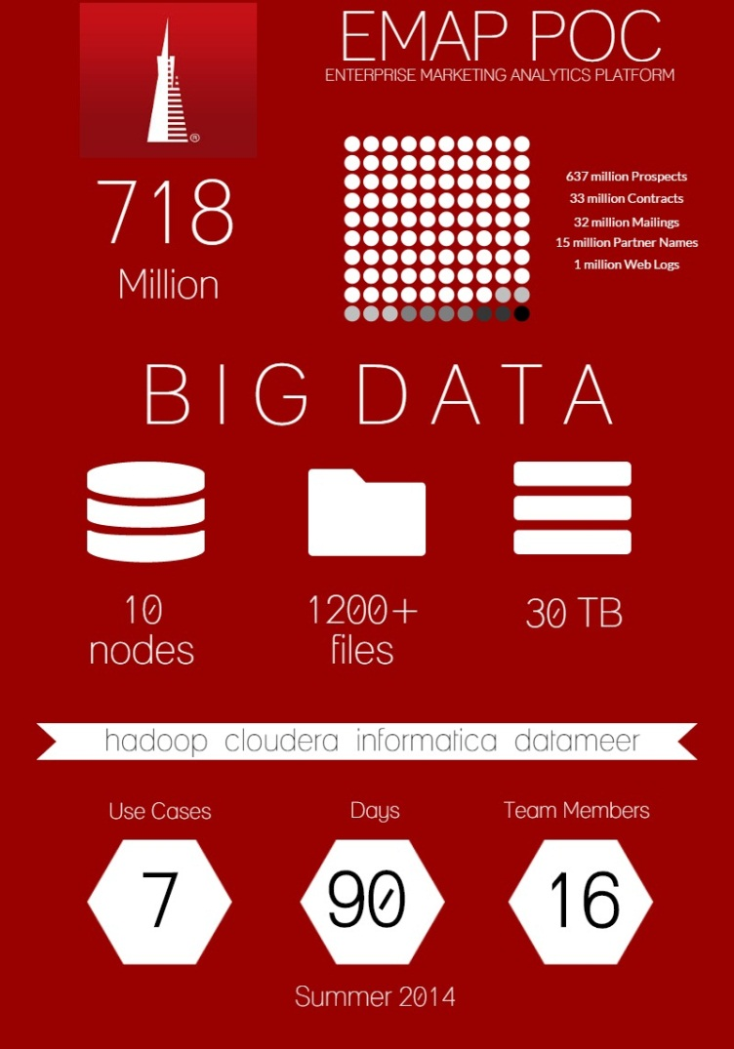
POC Highlights
10 Node Cluster running CDH 5.0
718 Million Rows of data from 1200+ input files
Seven use cases with increasing complexity
30 TB of Data

Slide 19
POC Timeline
Task | Participants | Duration
Cloudera Install, Setup and cluster certification for Enterprise Data Hub, Security review | Cloudera Core Team | 2 weeks
Installation, Data preparation, ingestion, using PowerCenter BigData Edition | Informatica / TA Core Team | 2 weeks
Profiling, Data cleansing and standardization, aggregation, de-duping, customer identification using Data Quality and Identity Resolution | Informatica TA Core Team | 4 weeks
Visualizations, models, pmml, campaign files using Big Data Analytics using Datameer | Datameer TA Core Team | 2 weeks
SAS integration | TA Core Team | 1 week
Wrap up |  | 1 week

Slide 20
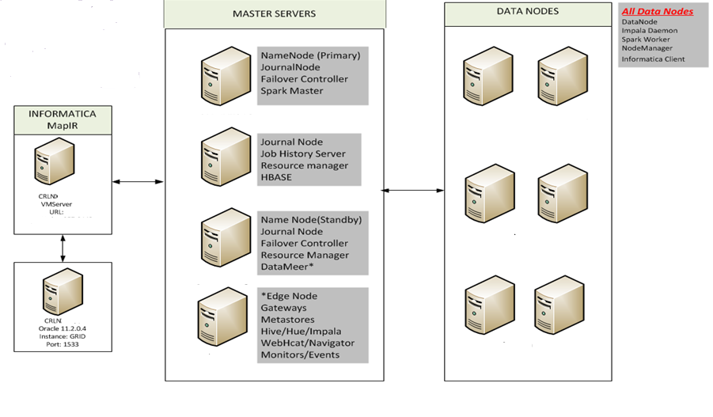
POC Infrastructure

Slide 21
Infrastucuture
      Cloudera
        Enterprise Data Hub (5.0.1)
        Hive (0.12), Hue (3.5), Impala, Hbase (0.96), Pig (0.12), Spark (0.9)
        10 node cluster, 6 data nodes
        RHEL 6.5, 20 cores, 128 GB RAM
        80TB usable space
      Informatica Big Data Governance Edition
        BDE 9.6.1
        Identity Match (MapIR)
      Datameer

Slide 22
Team
      Business (Sponsor, Data, Analytics, Campaign)
      PM
      BA
      IT (6)
      Operations (3 part time)
      Support staff
        Legal
        Procurement
        Security

Slide 23
Why Hbase?
      Faster update processing
        Leverage index to perform seek for upsert processing instead of full scan against hdfs. Huge gains in update processing times.
      Faster Analytics
          Can leverage Hbase index for improved query performance

Slide 24
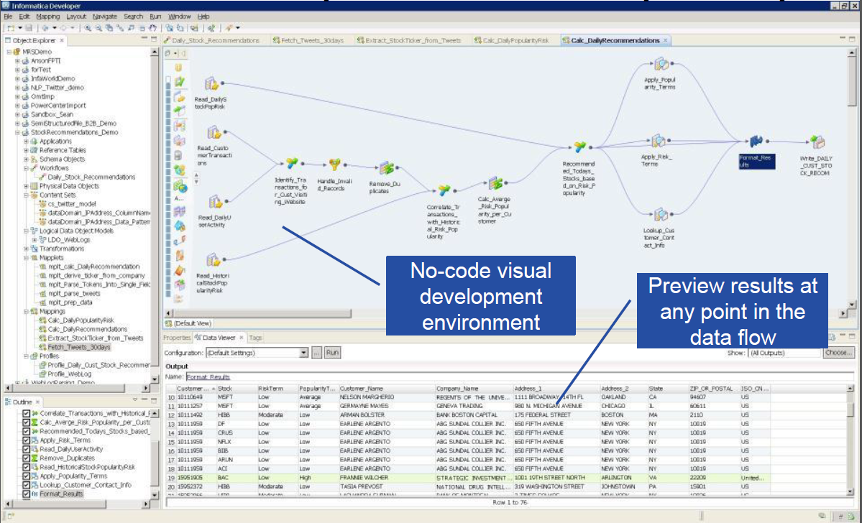
Informatica Developer (Big Data Edition)

Slide 25
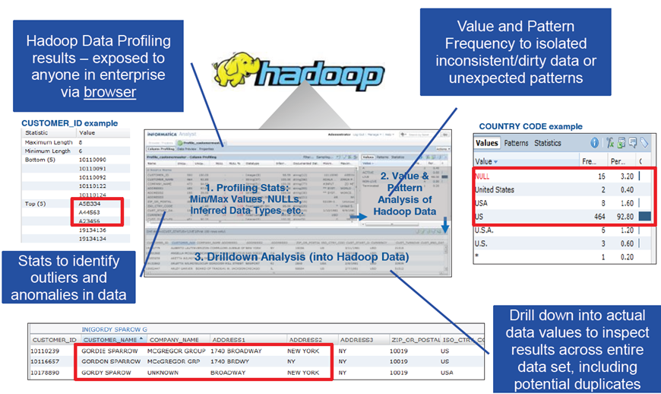
Data Profiling on Hadoop

Slide 26
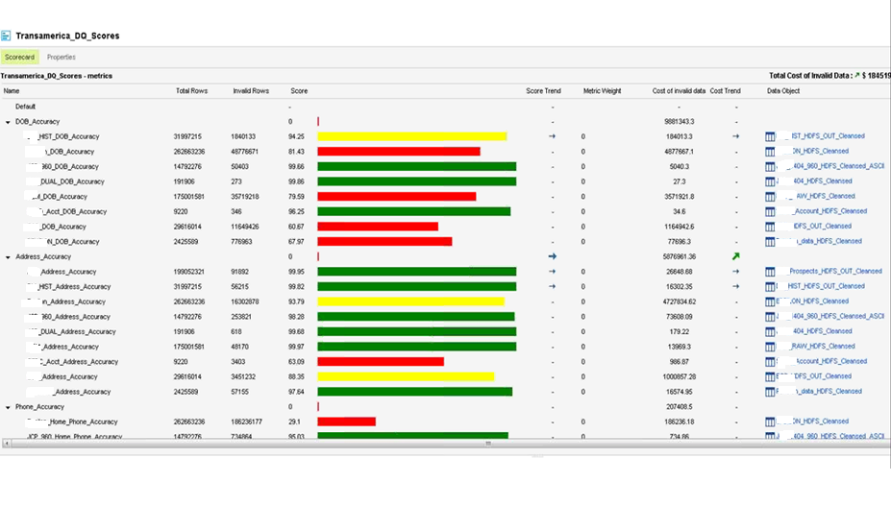
Score carding

Slide 27
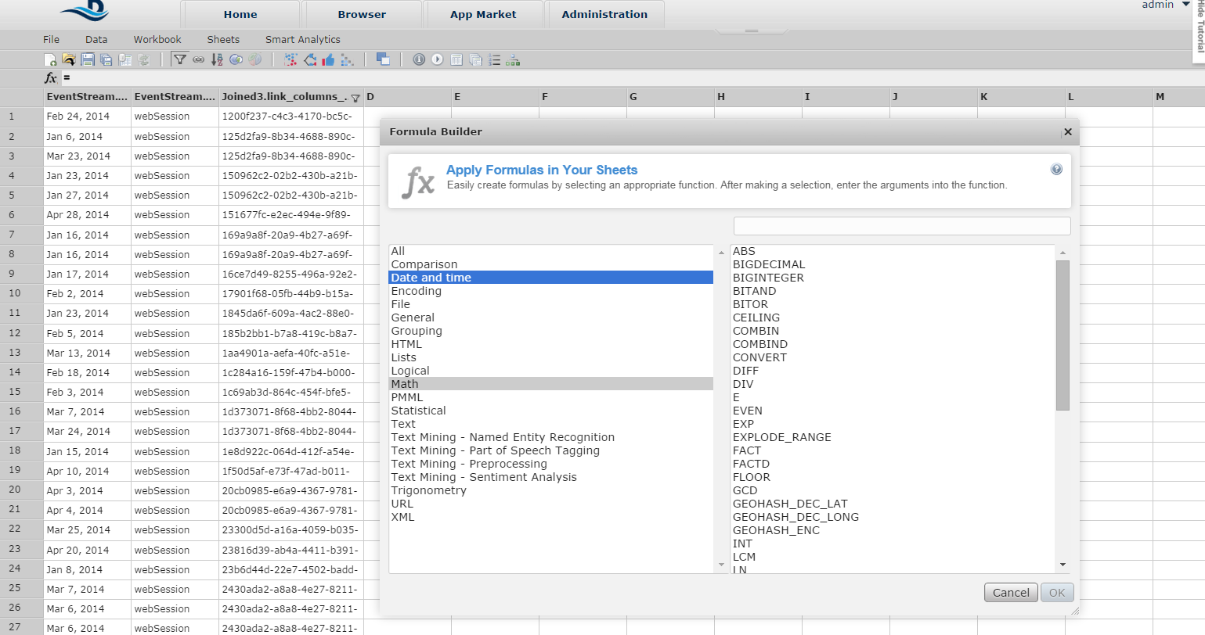
Datameer – Workbooks

Slide 28
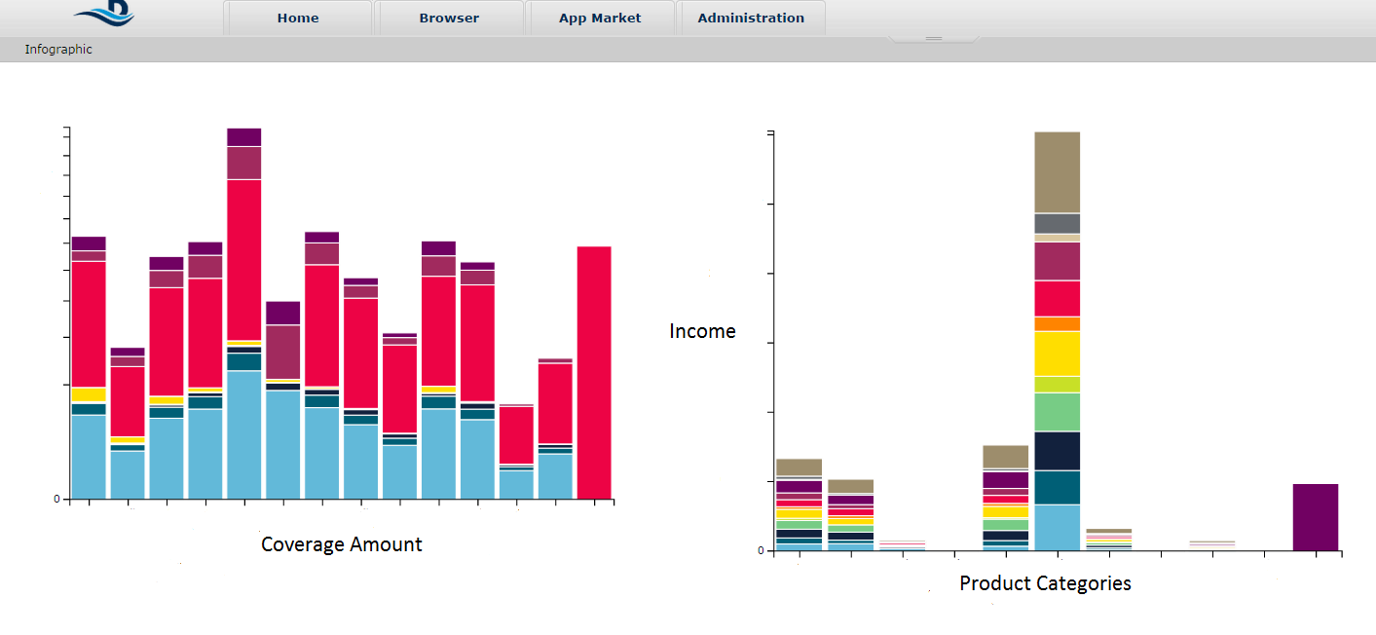
Datameer - Visualizations

Slide 29
Lessons Learned
Invest in a PoC
  Tie to business use cases to demonstrate value
Partner with key vendors
  Technology is changing rapidly
Small team with the right skillset
  Naturally innovative individuals
  Can wear multiple hats
Evangelize & sell your idea
  Partner with business
  Socialize the platform & the vision
Big Data requires Data Governance
  Establish tools & processes to support data governance
  Data Stewards: Profile, validate, catalog, metadata creation, lineage
  Managed & Curated Data
Align with larger enterprise strategy

Slide 30
Questions

Slide 31



Vishal Bamba
vishal.bamba@transamerica.com
Twitter: @vishalbamba
David Beaudoin
david.beaudoin@transamerica.com
Stephen Lloyd
stephen.lloyd@transamerica.com
http://about.me/stephenlloyd

