Slide 1

Bigger is Better, but at What Cost?
Towards Understanding the Economic Value of Data

Slide 2
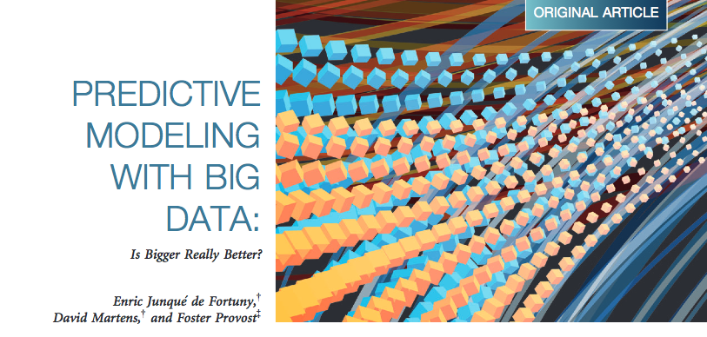
We are often told that bigger is better.
The answer is usually ‘Yes’

Slide 3
but….
“With Great Power Comes Great Responsibility”
- Peter Parker

Slide 4

Big Data = More Statistical Power
And yes
More responsibility

Slide 5

#1 responsibility as a manager/executive
Is that extra statistical power worth it?

Slide 6
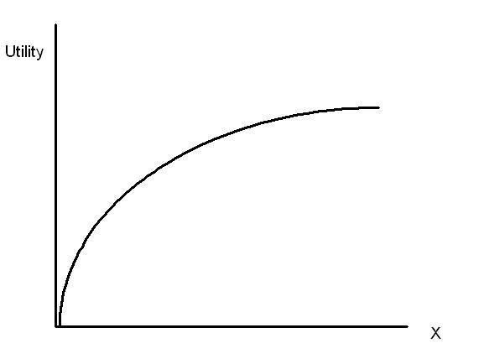
Typical big data trade-off
Doubling the data often doubles the investment, but doesn’t double the performance.
Understanding this tradeoff is key to understanding the economic value of data.

Slide 7






Common Data Sources
Data Vendors ($$$)
Customers(CDB*)
Your CRM
*Cost of Doing Business

Slide 8
2 Follow Up Questions
1. How much should you pay for this data?
2. How much is a customer’s data worth?

Slide 9
In Important Inequality
The value
of a customer
The value of
a customer’s data
Total Revenue
i.e., value(customer data) ≠
Total Customers

Slide 10
An Import Equality
E[ Value of Application | with Data ]
– E[ Value of Application | w/o Data ]
Value of Data
Notes:
A great product can’t be built over night. Through 6 years of continual refinement and expansion, we’ve built something that works at scale. Our history gives us strength and confidence, and as well it is measurable.

Slide 11
An Import Equality
E[ Value of Application | with Data ]
– E[ Value of Application | w/o Data ]
Value of Data
This equation offers important lessons about the value of data!
Notes:
A great product can’t be built over night. Through 6 years of continual refinement and expansion, we’ve built something that works at scale. Our history gives us strength and confidence, and as well it is measurable.

Slide 12

Lesson 1: Data Has No Intrinsic Value
The VOD is tied to applications/actions derived from data.
Show me an ad,
Recommend a product,
Give me a loan etc.

Slide 13
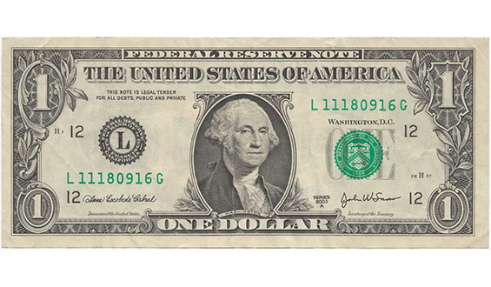

Caveat 1: What is an outcome worth?
With an application defined, need to know the value of various outcomes.
Lets assume a click is worth:

Slide 14
Caveat 2: Application Scale Matters.
If data is free to duplicate, VOD depends on scale too.

Slide 15
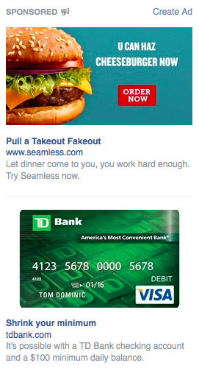
Lesson 2: The VOD is Counterfactual
Data has $ value if using it generates more $ than a baseline
strategy.
Without my data, you show this ad.
P(Click)=1%
With my data, you show this ad.
P(Click)=5%
vs.

Slide 16
The VOD Calculus
Let’s put our equation to work.
V(Click)* [ E(Click|Data, Targeted Ad)– E(Click|noData, Default Ad) ]
EV(my Data in Targeting Ad) = $1 * [ 5% - 1 %] = $0.04

Slide 17
Lesson 3: The VOD is Relative, not Absolute.
The value of a data point/source depends on what other data is being used along with it.
EV[Incremental Data]
EV[Baseline Data]
Baseline Data
Incremental Data

Slide 18
Example of that last point…

Slide 19
Example of that last point…
Not a mistake!
VOD -> $0 when used with existing CRM data.

Slide 20
Takeaways
For data buyers/users:
Use the expected value framework to determine optimal buying price or evaluate ROI
Your own CRM data is likely worth the most
Better models means data is worth more
For data sellers:
The optimal selling price is a function of the buyers individual needs
Auction mechanisms enable fair pricing

Slide 21
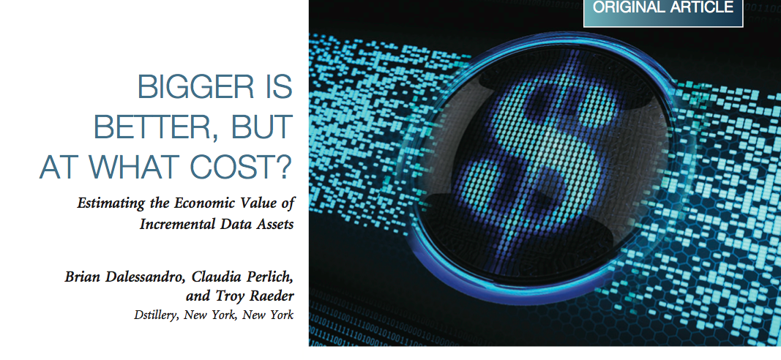
Want technical details? Big Data Journal, June 2014

