Slide 1

Drive Data Quality at Your Company: Create a Data Lake
George Corugedo Chief Technology Officer & Co-Founder

Slide 2
Purpose of MDM
Create correct and consistent data across the enterprise that fosters trust in information and acceleration of growth.

Slide 3


Why It Matters
“ Without data you’re just another person with an opinion.”
W. Edwards Deming

Slide 4
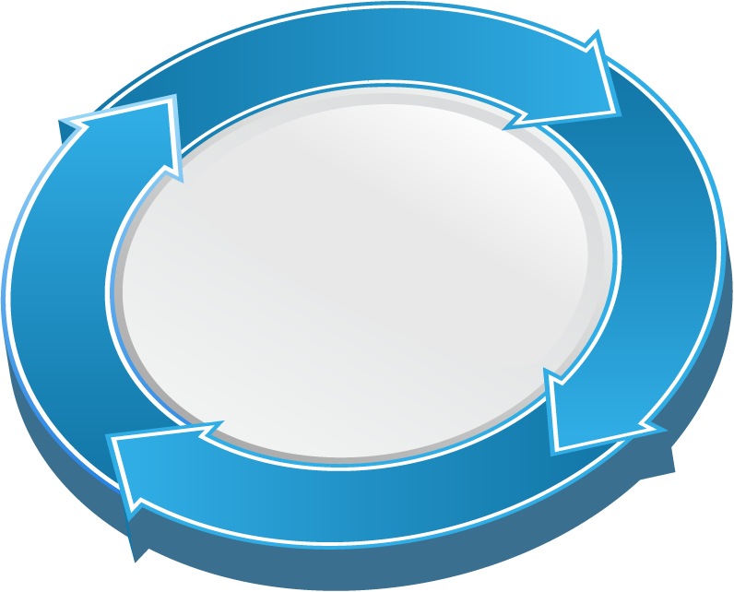
Vicious Cycle of Unmanaged Data
1
Master Data Issues remain unaddressed or unresolved
4
2
Data conflicts reinforce siloed operations
Unmanaged Data
Garbage in/garbage out creates process confusion
3
Lack of process trust slows business momentum

Slide 5
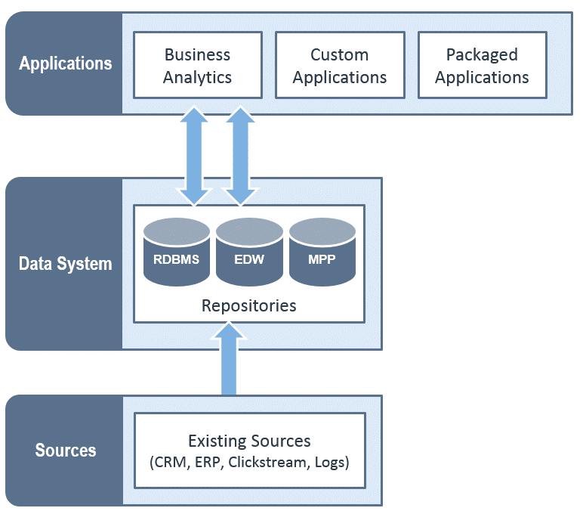











New Data Straining Current Architectures
Unstructured documents, emails
Server logs
Sentiment, web data
Hierarchical data
2.8 ZB in 2013
85% from new data types
15x Machine Data by 2020
40 ZB by 2020
Master data
OLTP, ERP, CRM
Transactional data
Sensor, machine data
Source: IDC
Geolocation
Clickstream

Slide 6
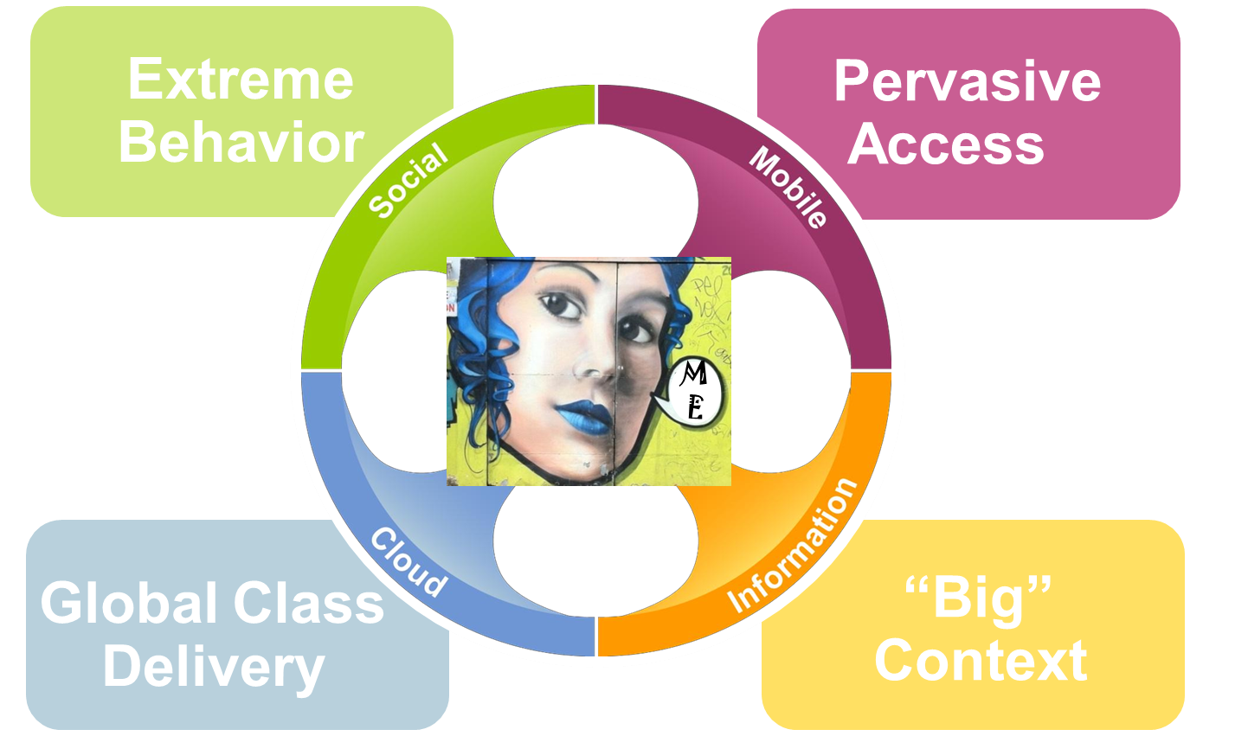

Gartner’s Nexus of Forces

Slide 7
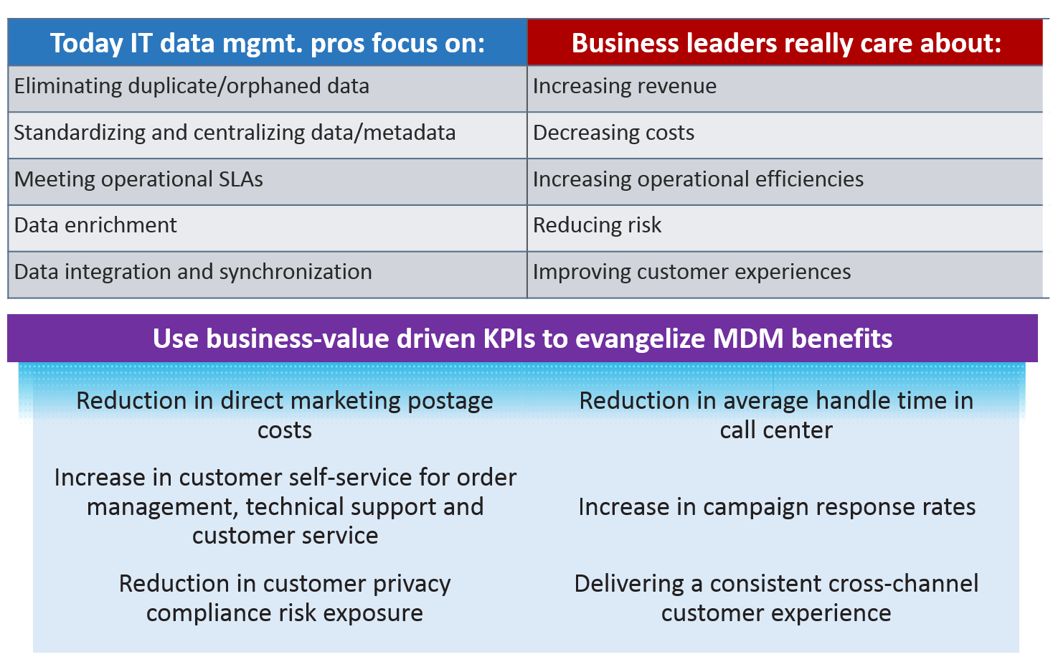
Business Benefits of MDM

Slide 8


How About MDM on a Data Lake?
Data is ingested in its raw state regardless of format, structure or lack of structure
Raw data can be used and reused for differing purposes across the enterprise
Beyond inexpensive storage, Hadoop is an extremely power and scalable and segmentable computational platform
Master Data can be fed across the enterprise and deep analytics on clean data is immediately enabled
Severe shortage of Map Reduce skilled resources
Inconsistent skills lead to inconsistent results of code based solutions
Nascent technologies require multiple point solutions
Technologies are not enterprise grade
Some functionality may not be possible within these frameworks
Benefits of a Hadoop Data Lake
Challenges to Data Lake Approach

Slide 9
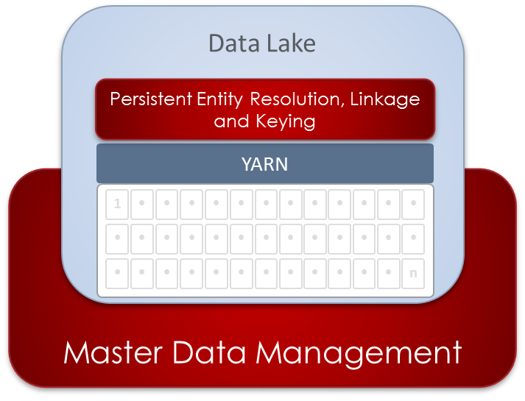

A Data Lake as the Center of Your MDM Strategy
Ingestion of all data available from any source, format, cadence, structure or non-structure
ELT and data transformation, refinement, cleansing, completion, validation and standardization
Geospatial processing and geocoding
Data profiling, lineage and metadata management
Identity resolution and persistent keying and entity profile management
Attribute source and consumer mapping

Slide 10
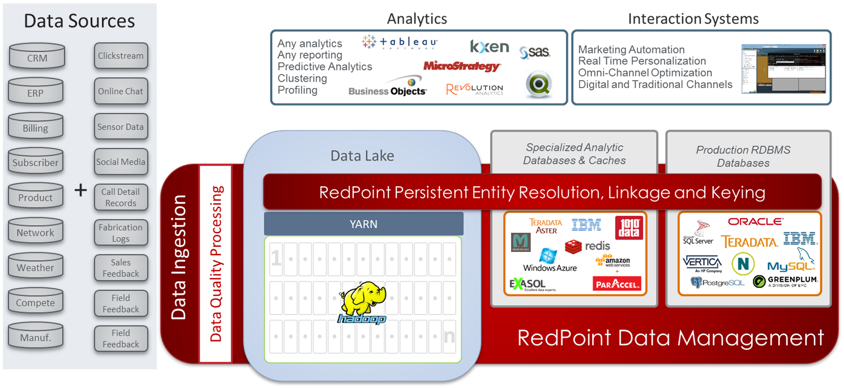
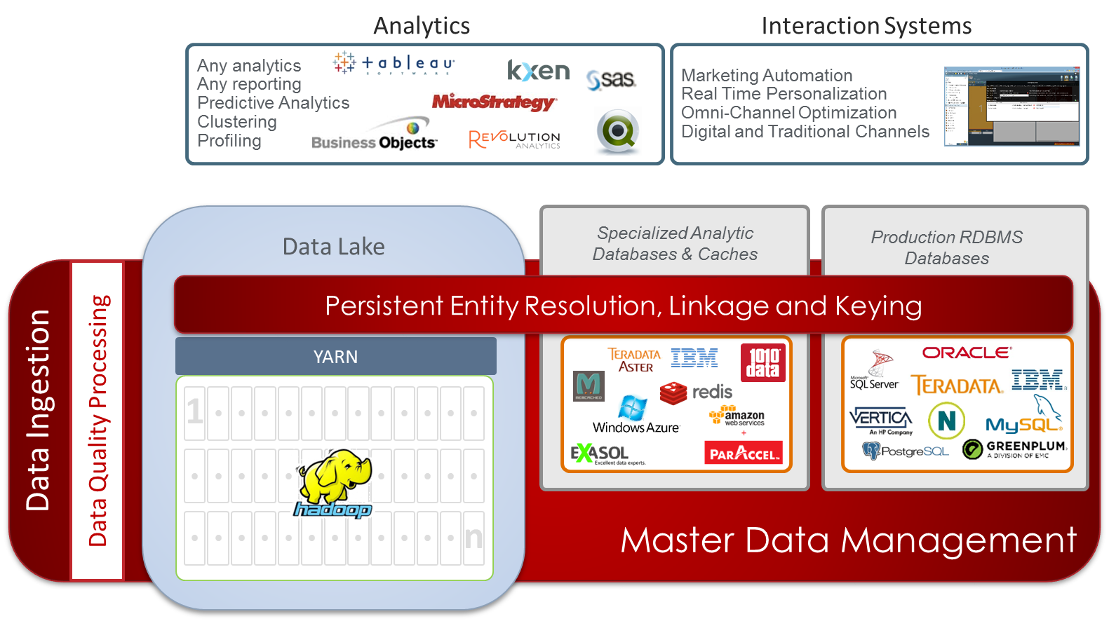
Modern Data Lake Architecture for MDM

Slide 11
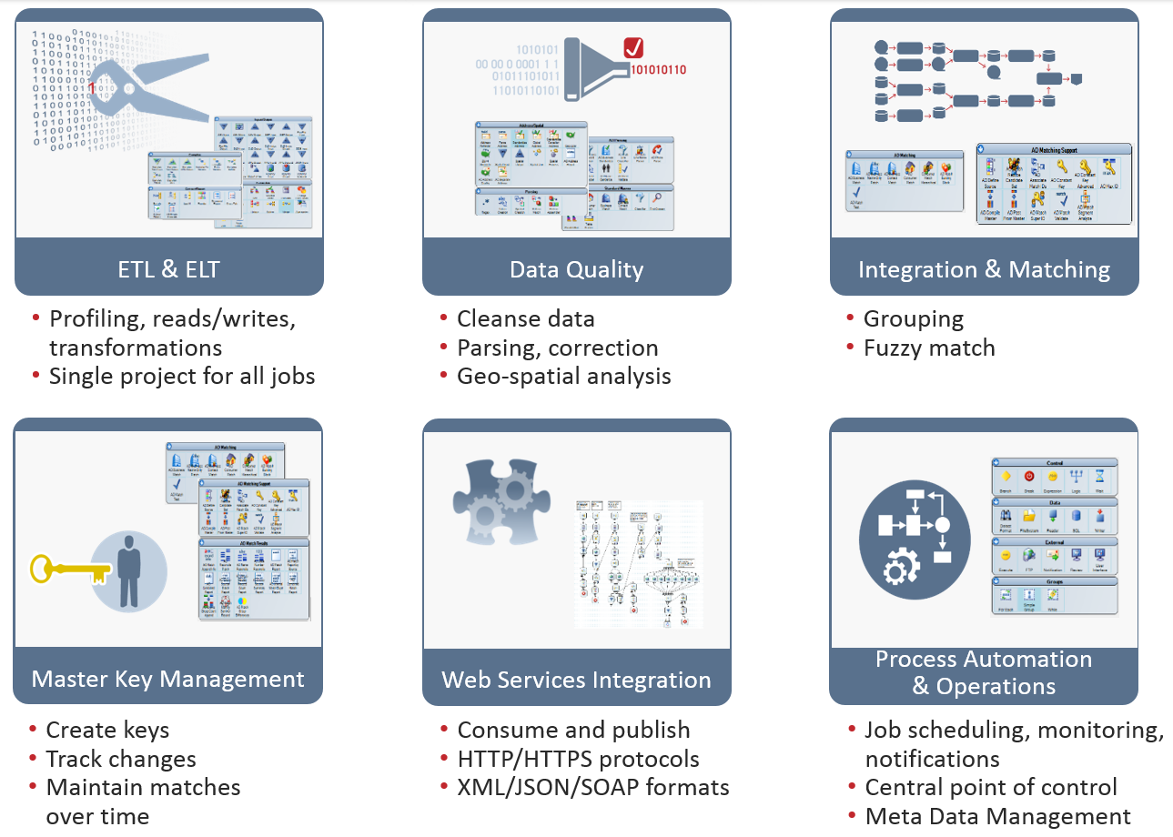
Key Functions for Master Data Management

Slide 12

How Can That Possibly Work?
Map Reduce? Hive?
YARN!

Slide 13
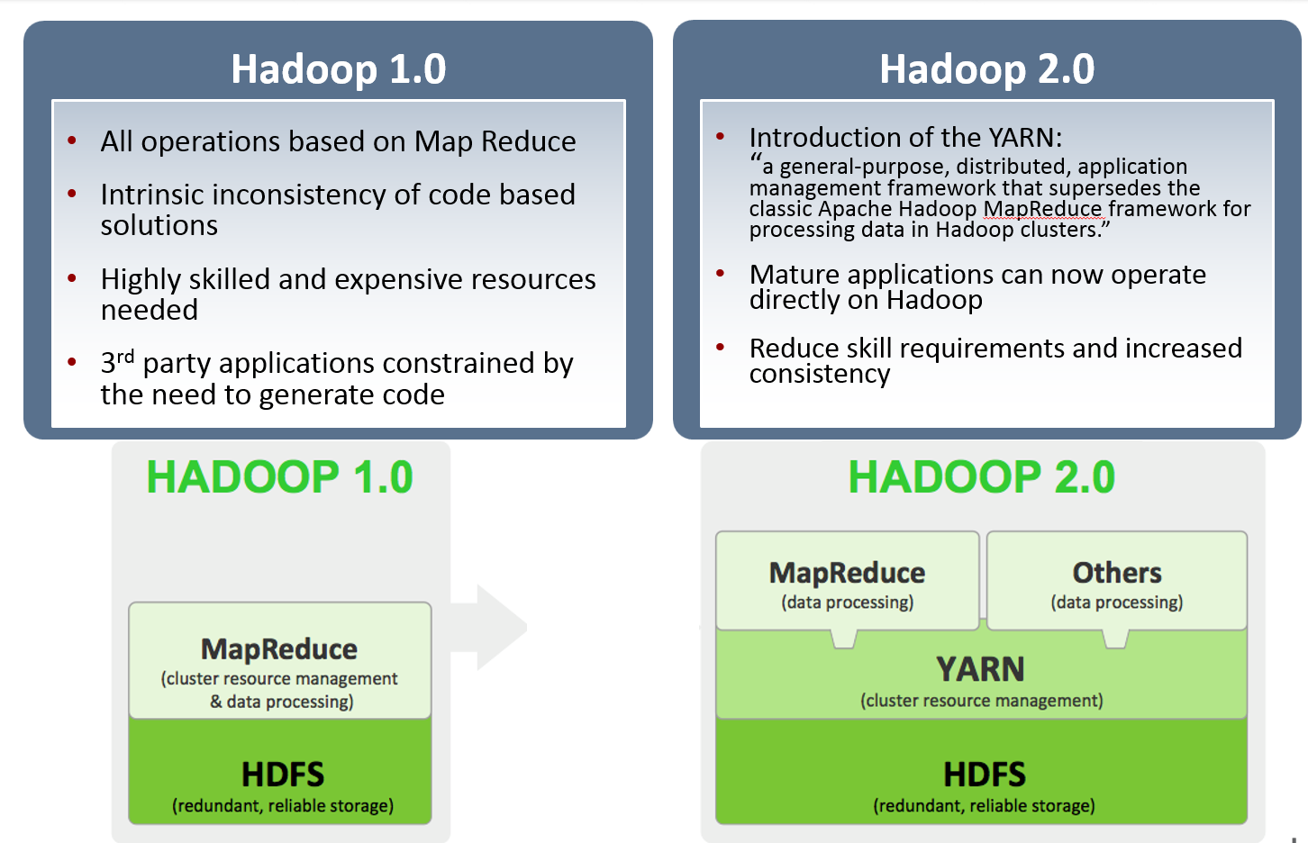
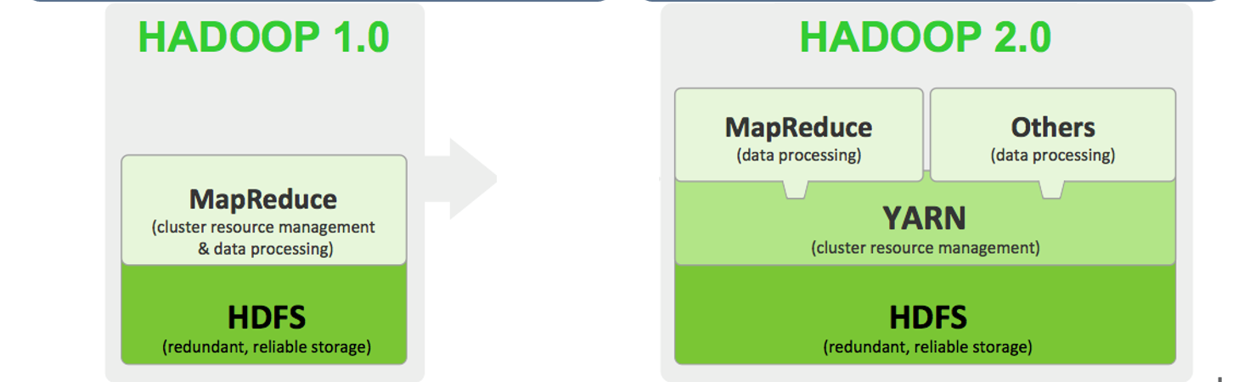
Overview - What is Hadoop/Hadoop 2.0

Slide 14

RedPoint Data Management on Hadoop
YARN
RedPoint Parallel Section
MapReduce
Partitioning AM / Tasks
Execution AM / Tasks
Data I/O
Key / Split Analysis

Slide 15
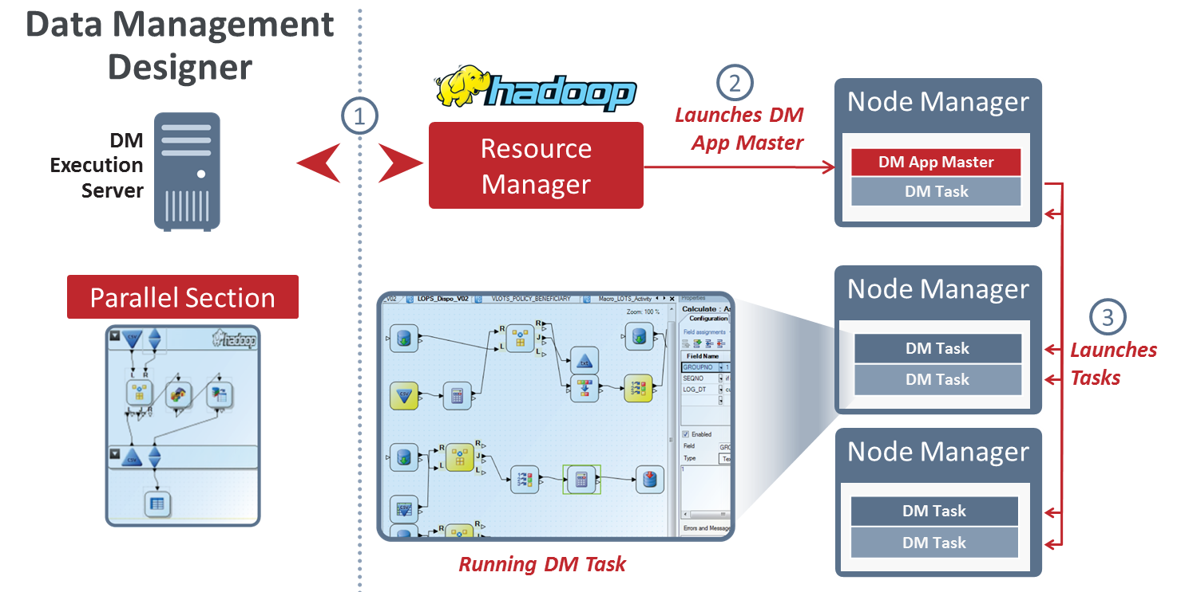
Zero Footprint Installation

Slide 16




Reference Hadoop Architecture
Monitoring and Management Tools
Ambari
Query/Visualization/ Reporting/Analytical Tools and Apps
DATA REFINEMENT
INTERACTIVE
PIG
HIVE
HIVE Server2
MAPREDUCE
STRUCTURE
LOAD
YARN
HCATALOG
(metadata services)
Data Sources
REST
RDBMS
SQOOP
1
•
•
•
•
•
•
•
•
•
•
•
•
•
•
•
•
•
•
•
•
•
•
•
•
•
LOAD
WebHDFS
HDFS
HTTP
•
•
•
•
•
•
•
•
•
•
•
•
•
NFS
•
•
•
•
•
•
•
•
•
•
•
•
•
SQOOP/Hive
EDW
•
•
•
•
•
•
•
•
•
•
•
•
•
STREAM
•
•
•
•
•
•
•
•
•
•
•
•
•
Web HDFS
Flume
•
•
•
•
•
•
•
•
•
•
•
•
n

Slide 17
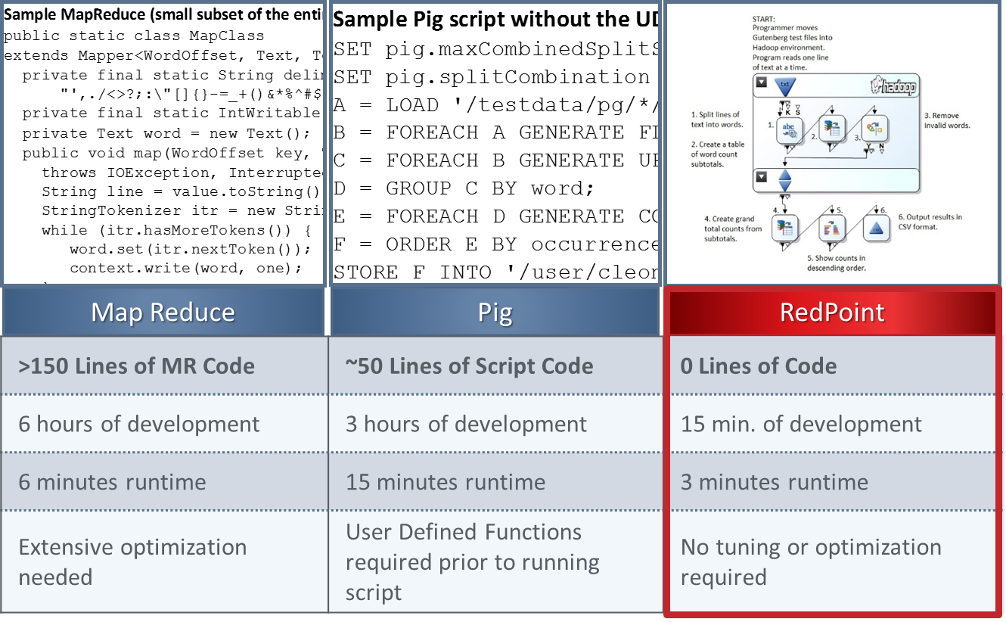
Benchmarks – Project Gutenberg

Slide 18
The Modern Data Architecture for MDM

Slide 19

Recommendations
Make your MDM an iterative project rather than boiling the ocean
Don’t forget that Hadoop is a powerful computational platform; not just cheap storage
Use a tool that gives you agility and ease of use so your people are as productive as quickly as possible
Parallelization is where Hadoop compute power comes from; use tools that leverage it properly.
Come see the future of MDM in Booth 109

