Slide 1
How Goldman Sachs is Transforming Information
into Knowledge Insight
for Strata + Hadoop World 2014
Data-Driven Business Day
Peter Ferns
October 15, 2014

Slide 2




Our Business
Investment
Banking
Investment
Management
Securities

Slide 3

Talented
Engineers
“We’re a technology firm…”
Lloyd Blankfein
CEO
We
BUILD

Slide 4
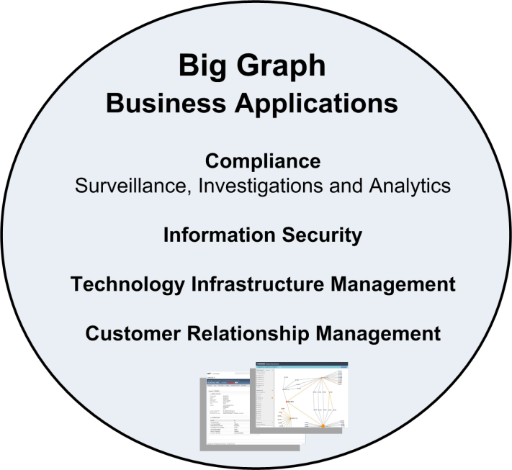
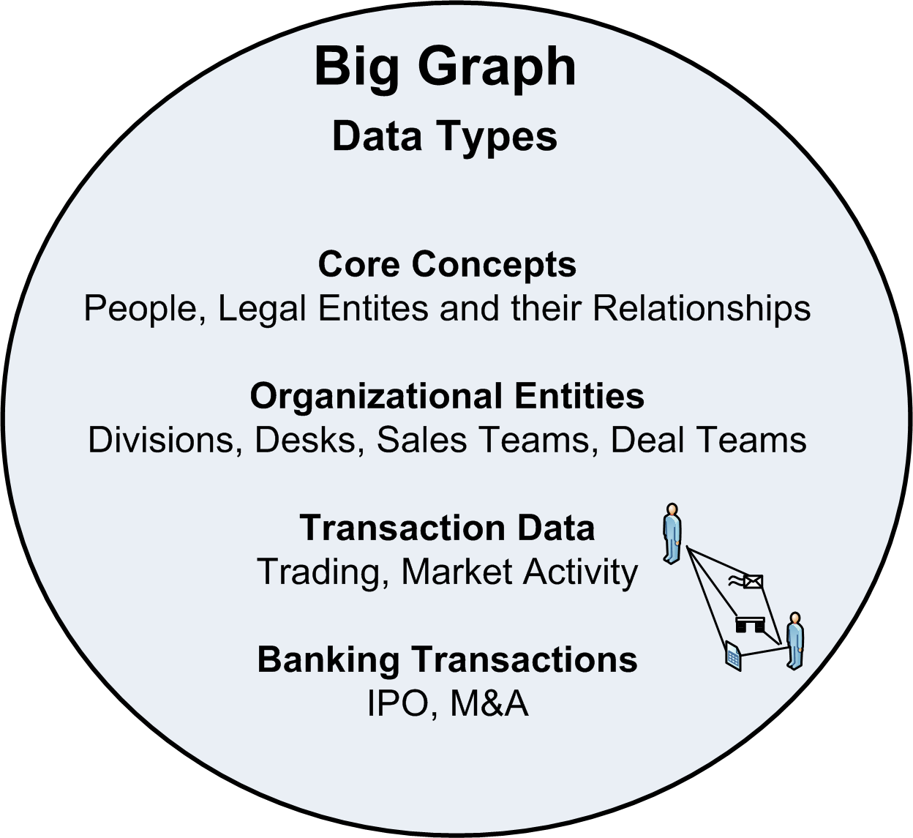
Big
Graph
Big
Data

Slide 5
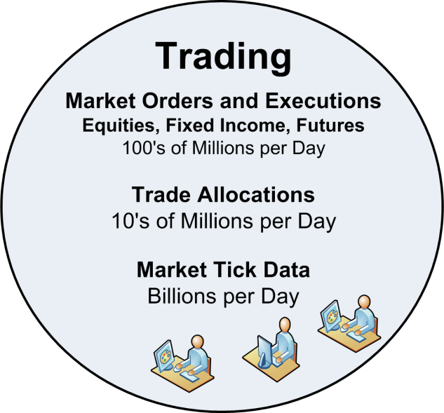
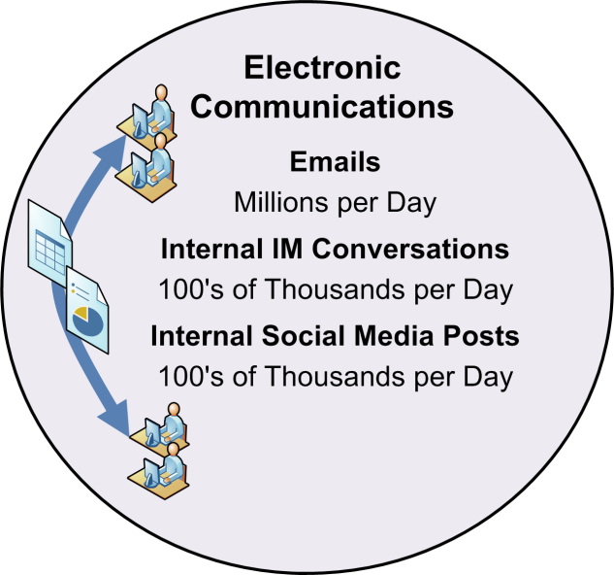
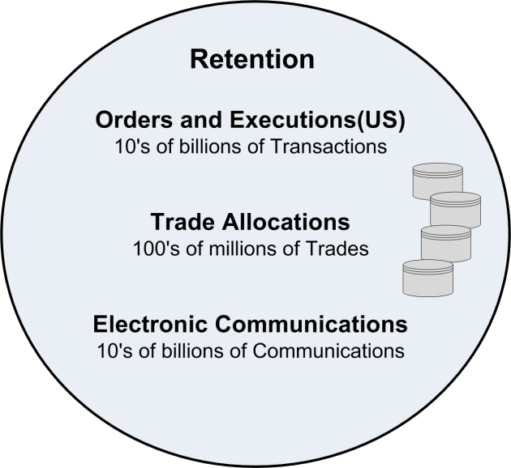
Data
Scope

Slide 6
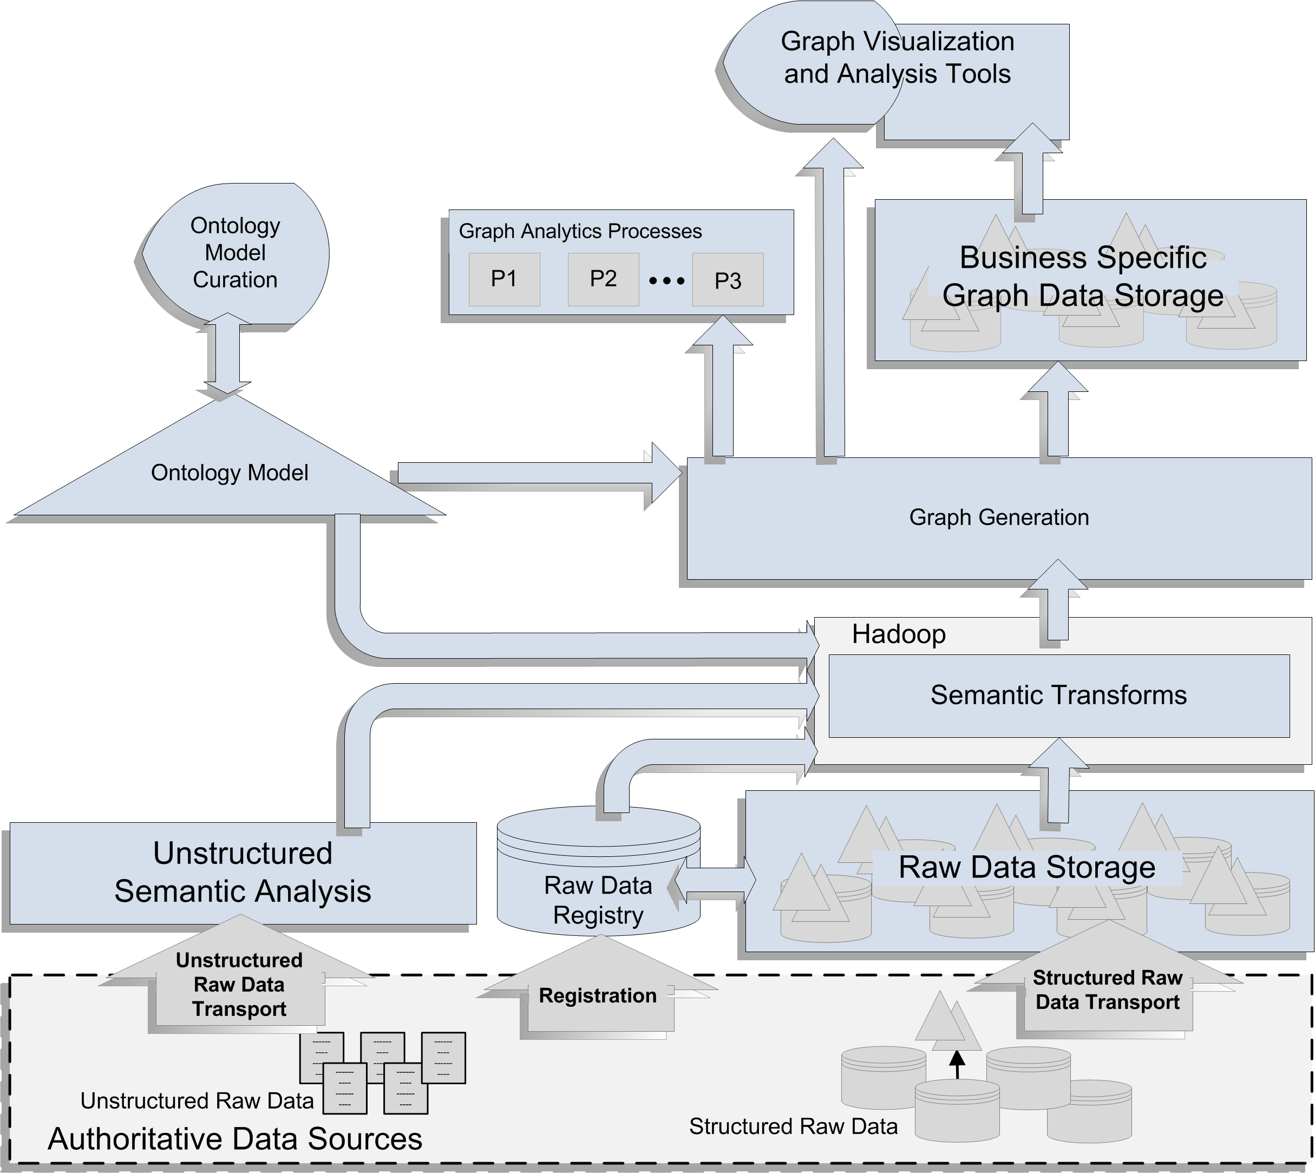

Slide 7
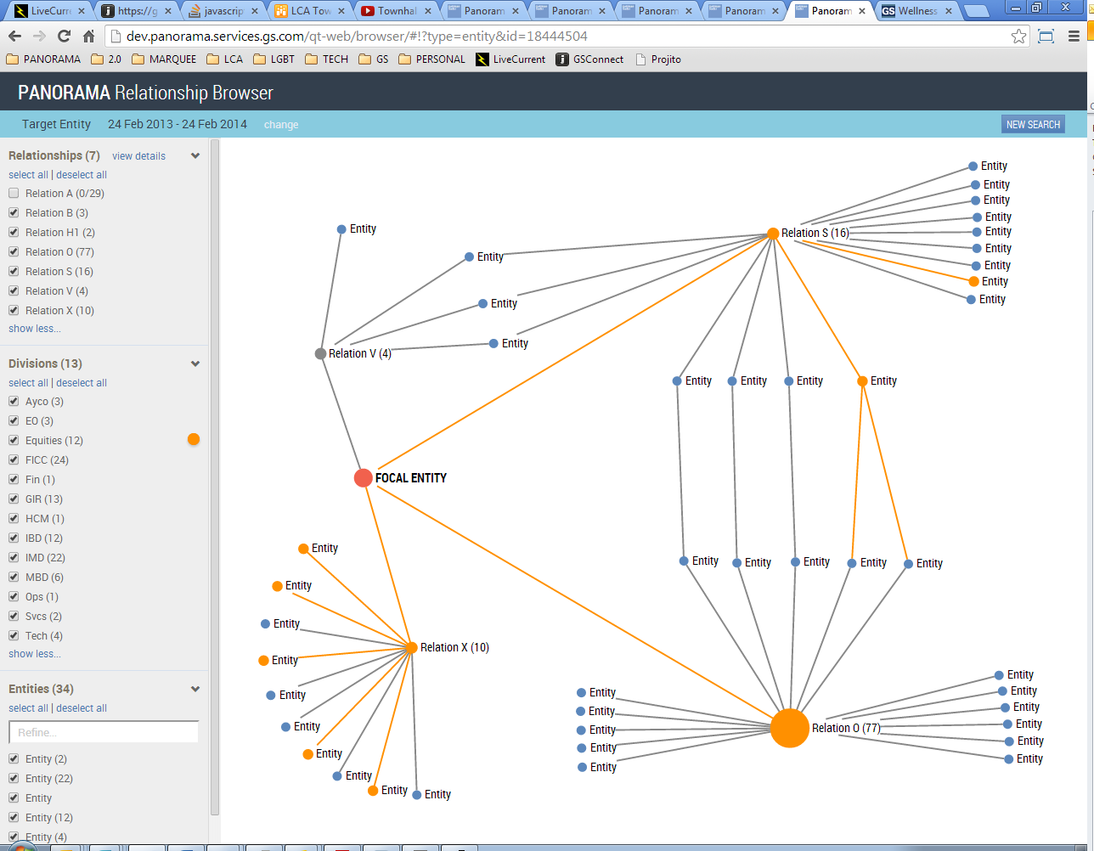

Slide 8

For more information: gs.com/engineering
© 2014 Goldman Sachs. This presentation should not be relied upon or considered investment advice. Goldman Sachs does not warrant or guarantee to anyone the accuracy, completeness or efficacy of this presentation, and recipients should not rely on it except at their own risk. This presentation may not be forwarded or disclosed except with this disclaimer intact.

