Slide 1



Improving Healthcare Business Strategies through lean data partnerships
DDBD Strata Conference Oct 15–17, 2014 New York, NY
Brigitte Piniewski, MD Chief Medical Officer
PeaceHealth Laboratories, Vancouver, WA

Slide 2
The concepts and opinions
presented are solely
those of the author
and do not necessarily represent
the views of PeaceHealth.

Slide 3
Summary
Get started collaborating
Pearl: Lab data
Precision living > precision medicine
MORE: Pairing EMR Data with an Open Commons to Engage Communities,
Provide Work Force Development and Predict Community Health Futures
10/16/2014 4:15pm - 4:55pm EDT
Room: 1 E12/1 E13
Office Hour: Unleashing a swarm of micro-health work
10/16/2014 5:05pm - 5:45pm EDT (40 minutes)
Room: Table A

Slide 4
Problem: Out-dated business models

Slide 5
1) Experience-based Staffing

Slide 6
Case Study Proposed Business models
Experience-based Staffing / Subscription
Cost savings from crowd-based prevention (ACO)
Precision Medicine, pulse therapy, dynamic pill-packs (PHARMA)

Slide 7
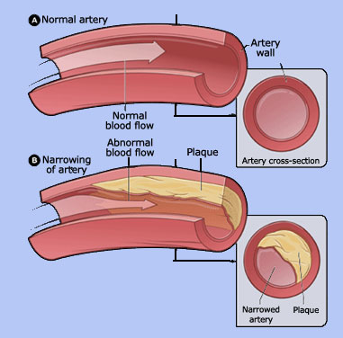
Question: Cardiovascular threat Index
Silent
Event
Stream

Slide 13
Laboratory Marker variance

Slide 14
01/01/2011 to 05/31/2013, with a total of 882 days

Slide 15
01/01/2011 to 05/31/2013, with a total of 882 days

Slide 16
Whatcom Troponin/date n=58,823
01/01/2011 to 05/31/2013, with a total of 882 days

Slide 17
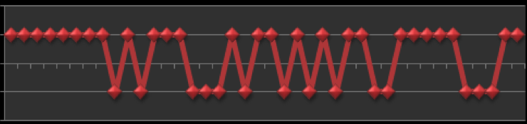
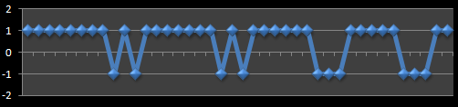







Harmonizing Data > Predict Chest pain
Yesterday
Tomorrow

Slide 18
Kent State Results
First two years’ data as training data and the last half year data as test data.
Error measure is the average of every day’s relative error in a given time period
Eugene 17.2%
Longview 32.37%
Whatcom 13.2%
Eugene
day cycle, start shift, error:
28, 14, 7.4714285714285715,
7, 1, 7.554147465437788,
14, 0, 7.686635944700461,
21, 20, 7.833333333333333,
Dr. Ruoming Jin Associate Professor of Computer Science at KSU is an
expert on Big Data, Complex and Social Network, and a NSF CAREER
awardee. Wei Xiong is the KSU postdoctoral researcher

Slide 19

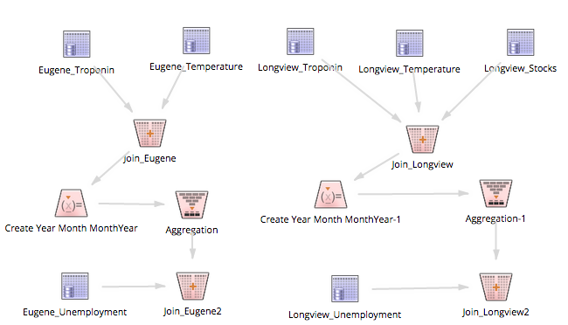
Combine available data sets

Slide 20
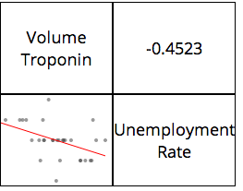
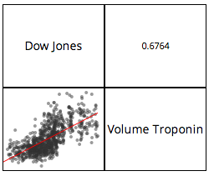
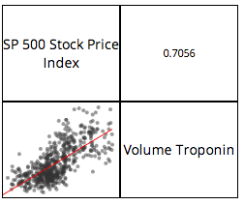
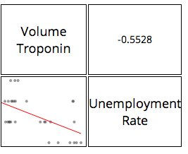
Unemployment and Stock Market effects
Eugene
Longview

Slide 21
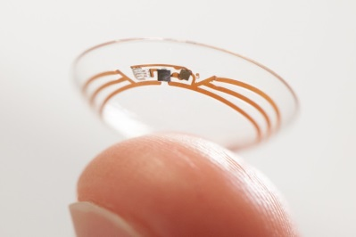

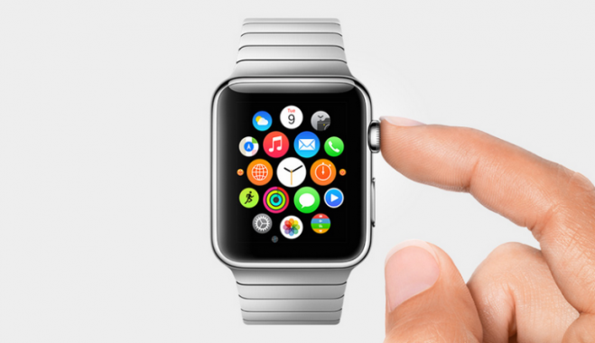
Discussion
Staffing
Prevention
Push notifications
Personalized medicine
Just-in-time Intelligence

Slide 22
Acknowledgements
Dan Nielsen, PeaceHealth
Dejing Duo, University of Oregon
Gabriela Queiroz, Alpine Data Labs
James Boyle, PeaceHealth
Ruoming Gin, Kent State
Wei Xiong, Kent State
MORE: Pairing EMR Data with an Open Commons to Engage Communities,
Provide Work Force Development and Predict Community Health Futures
10/16/2014 4:15pm - 4:55pm EDT
Room: 1 E12/1 E13
bpiniewski@peacehealthlabs.org

