Slide 1


In the Data Lake: Not Waving but Drowning
www.9sight.com
Dr. Barry Devlin
9sight Consulting
@BarryDevlin

Slide 2



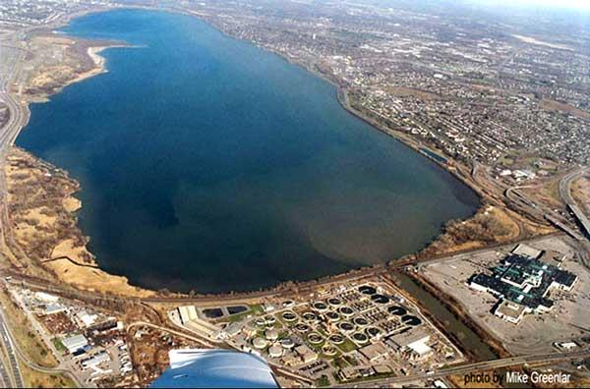

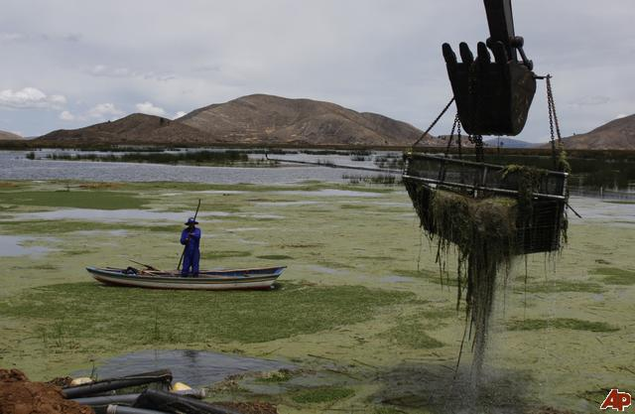
What is a Data Lake?
Words have meanings
Metaphors make images
"If you think of a data mart as a store of bottled water – cleansed and packaged and structured for easy consumption – the data lake is a large body of water in a more natural state. The contents of the data lake stream in from a source to fill the lake, and various users of the lake can come to examine, dive in, or take samples."
James Dixon, CTO, Pentaho (Forbes, 2011)

Slide 3
Data Lake – definitions and questions
Is all data of equal value?
Is quality and consistency no longer needed?
Should we really store everything?
Build it and they will come?
What problem are we trying to solve?
A data lake is a large object-based storage repository that holds data in its native format until it is needed.
Margaret Rouse, WhatIs.com
A data lake is a massive, easily accessible, centralized repository of large volumes of structured and unstructured data.
Cory Janssen, Technopedia.com

Slide 4

The Data Lake Fallacy: All Water and Little Substance
Gartner report, G00264950, 23 July 2014, Nick Heudecker, Andrew White
The main risk of using data lakes is the absence of metadata and an underlying mechanism to maintain it… the lack of which can turn a data lake into a “data swamp”
https://www.gartner.com/doc/2805917
Image: anaxi.deviantart.com/art/Lostless-Swamp-Concept01-173098108

Slide 5

Do we need a new architecture?
Yes!
Original data warehouse is too restrictive
Business needs agility, speed and consistency
Emerging biz-tech ecosystem
Business / IT symbiosis
Speed of decision and appropriate action
Market flexibility and uncertainty
Customer interaction and technical savvy
Competition
Mobile devices
Externally-sourced information
Information abundance and variety

Slide 6
One more time, let’s do architecture
The IDEAL architecture consists of three conceptual “thinking spaces”.
Characteristics
Integrated
Distributed
Emergent
Adaptive
Latent
Also read as a story: People process information
People
Process
Information
Notes:
Latest Update: 22-05-14

Slide 7
The tri-domain information model
Process-mediated data
“Traditional” operational & informational data
Via data entry & cleansing processes
Machine-generated data
Output of machines and sensors
The Internet of Things
Human-sourced information
Subjectively interpreted record of personal experiences
From Tweets to Videos
Structure/Context
Multiplex
Human-sourced information
Textual
Compound
Process-mediated data
Derived
Machine-generated data
Atomic
Timeliness/ Consistency
Raw
In-flight
Live
Stable
Reconciled
Historical

Slide 8
Introducing information pillars
One architecture for all types of information
Mix/match technology as needed
Relational, NoSQL, Hadoop, etc.
Integration of sources and stores
Instantiation gathers inputs
Assimilation integrates stored info.
Data flows as fast as needed and reconciled when necessary
No unnecessary storage or transformations
Distinct data management / governance approaches as required
Machine-generated (data)
Process-mediated (data)
Human-sourced (information)
Assimilation
Context-setting (information)
Transactional (data)
Transactions
Instantiation
Measures
Events
Messages

Slide 9
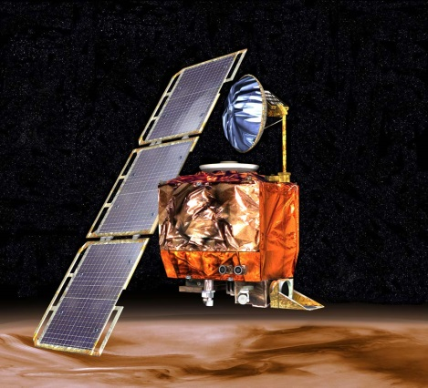
From metadata to context-setting information
Metadata is two four-letter words!
Information (not data)
Describes all “stuff” (not just data)
Indistinguishable (mostly) from “business information”
What was the most expensive metadata error in history?
The Mars Climate Orbiter, lost in 1999, at a cost of $325M, due to metadata error
Context-setting information (CSI)
New image – describes what it is and does
Provides the background to each piece of information, to every process component and to all the people that constitute the business
All information adds context to something else; it is all context setting

Slide 10
m³: the modern meaning model
Ackoff’s DIKW pyramid is no longer viable
Information precedes data
Data is simply information optimized for computers
The Web has fully devalued “facts”
People process information
Meaning
The stories we tell ourselves
Subjective / unique
Wisdom
Interpersonal
Sense-making
Knowledge
Mentoring
Information
Data
Explicit
Knowledge
Articulation
Tacit
Knowledge
Locus
Practice
Mental
Understanding
Insight
Documenting
Learning
Observing
Videoing
Physical
Hard Information
Modeling
Soft
Information
Interpreting
Objective / universal
From Physical World
Data
Content
From Human World
Strict
Loose
Structure
Notes:
Latest update: 23-05-14

Slide 11

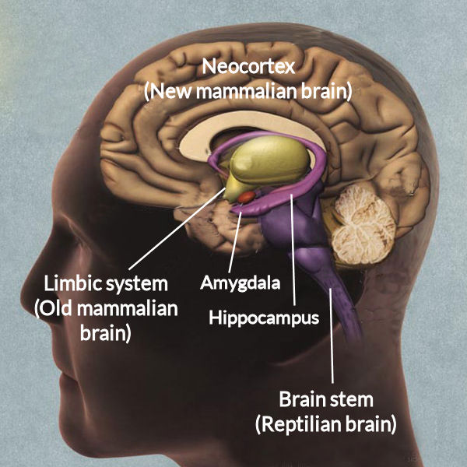
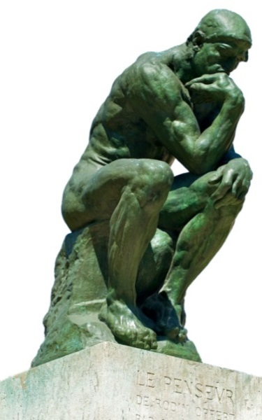
Human, social and collaborative dimension
Meaning is a personal/ social interpretation based (loosely) on information and knowledge
Rationality is only one part
Gut-feel may be more effective than rationality in decision making
Emotional state plays an important role
Intention drives understanding and action
We are social animals
Business is a social enterprise
Innovation is often team-based

Slide 12

From BI to Business unIntelligence
Rationality of thought and far beyond it
Logic of process, predefined and emergent
Information, knowledge and meaning
The confluence of
Reason and inspiration, emotion and intention
Collaboration and competition
All that comprises the human and social milieu that is business
Not business intelligence… Business Intelligence
http://bit.ly/BunI-Technics : 25% discount with code “BIInsights25”
un
^

Slide 13

Conclusions
Speed, flexibility and quality vital in modern business
Biz-tech ecosystem shows direction
Data Lake driven by “Big Data blindness”
Modern information architecture is highly diverse
Structure and consistency where needed
Agility and speed when required
Data Lake ignores need for structure and consistency
Context and meaning are keystone concepts
Flexibility & quality bridged via context-setting information
Business unIntelligence provides overall structure

Slide 14


Not Waving but Drowning
Nobody heard him, the dead man,
But still he lay moaning:
I was much further out than you thought
And not waving but drowning.
Poor chap, he always loved larking
And now he’s dead
It must have been too cold for him his heart gave way,
They said.
Oh, no no no, it was too cold always
(Still the dead one lay moaning)
I was much too far out all my life
And not waving but drowning.
Stevie Smith (1957)
www.9sight.com

