Slide 1
Making Strategic Decisions
@joybeatty
@seilevel
joy.beatty@seilevel.com
Business Requirements for Analytics Projects
Joy Beatty

Slide 2


Analytics Project Checklist
Big data initiative funded
Analytics package purchased
Package installed
Done?
✓
✓
✓
✗
Business Processes
Business Rules
Configuration rules
Data requirements
Integration requirements
?
Packaged Software
Requirements lead to successful analytics solutions

Slide 3
New customers?
Business process changes?
Transform experiences?
Business rule changes?
Information usage?
Why are requirements
for analytics solutions complicated?

Slide 4

Data is boring
Data drives decisions!
HBR and SAS, 2012

Slide 5
Prioritizing on Traditional Projects
Prioritizing on
Analytics Projects
Business objectives
Business objectives
Features
Decisions
requirements
requirements

Slide 6
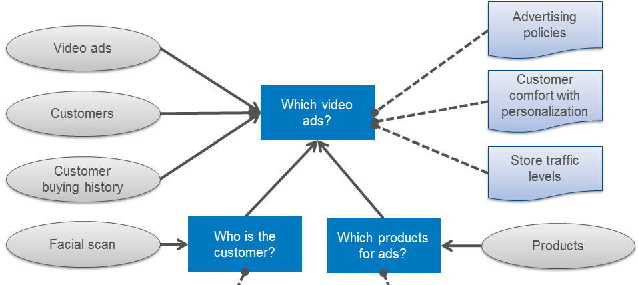
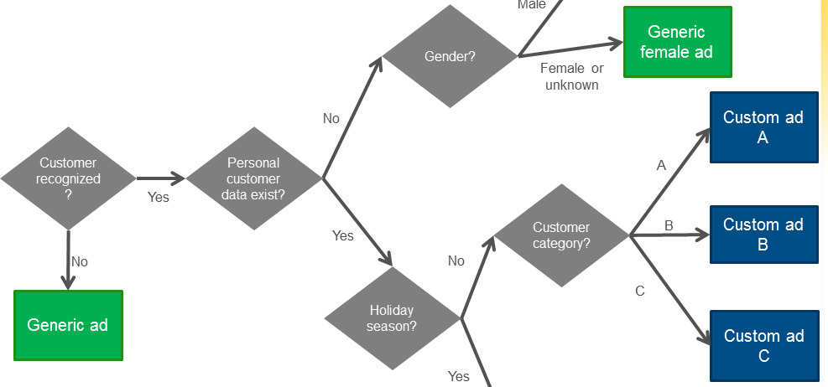
Model Decisions

Slide 7



How is data created?
How is data transformed?
How does data leave?
Sources
Storage
Data Lifecycle
Management
and Governance
Extraction

Slide 8
Data
Analysis
Results!
transformations
manipulations
calculations

Slide 9

“…There are known unknowns….But there are also unknown unknowns. There are things we don't know we don't know.” Donald Rumsfeld
Identify decisions
Past? Present? Future?
Pose “What-if?”
Problems or opportunities
Tool capabilities

Slide 10

People don’t look at data for fun, they use data to make decisions
Decisions
Prioritized Requirements
Desired Outcomes

Slide 11




Learn more about requirements for your big data journey!
http://www.seilevel.com/ba-resources/rml-requirements-visual-models/
Find me
joy.beatty@seilevel.com
S
www.seilevel.com
@joybeatty @Seilevel
search: Joy Beatty, Seilevel

