Slide 1

Reducing Employee Turnover by 75%:
Applying Data and Predictive Analytics to Hiring and Team Assembly
Michael Rosenbaum
CEO, Pegged Software

Slide 2
Applying Data to Hiring and Team Assembly
The Subjectivity of Hiring
One of the most inefficient areas of economic activity (bias, perception, information problem)
The Industry
Early entrants of the Oakland A’s to today
Outcomes

Slide 3
Approaches
Platforms
Pegged Software, Evolv on Demand
Internal Use
Google, Catalyst IT Services
Generalized talent predictions
Gild, Codecademy

Slide 4
Technologies and Methodologies
More sophisticated analysis of existing data (resumes, other application information including code, text)
Public data
Metadata
DEFINING THE DEPENDENT VARIABLE
FOR WHAT OUTCOME ARE YOU OPTIMIZING

Slide 5
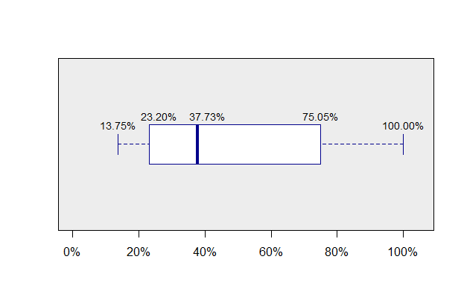
Outcomes - Turnover
Pre-Pegged deployment compared to Post-Pegged Deployment
Across 3M job applications/yr and 119 healthcare facilities

Slide 6
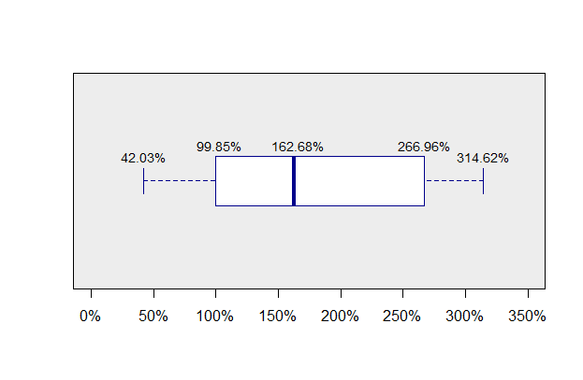
Outcomes – Turnover (Demonstrating Causation)
Turnover improvement in Pegged-deployed job categories
compared to control groups—either rest of the hospital or
same job categories in other hospitals in the same system
over the same time period

Slide 7
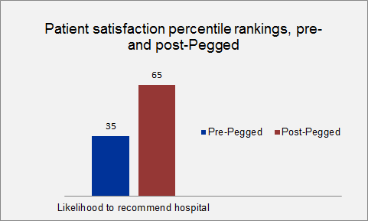
Outcomes—Quality Improvement (Healthcare)
Using HCAHP likelihood to recommend
scores as outcomes

Slide 8
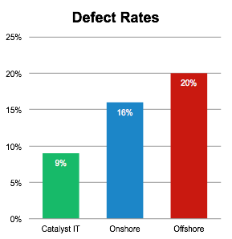
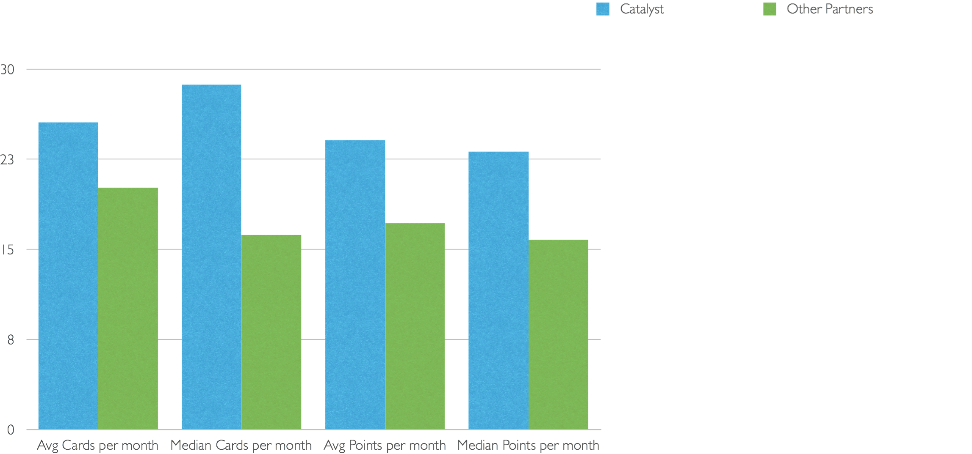
Quality Improvements – Software Engineering

Slide 9
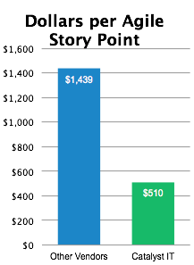
Cost Improvements
Combined teams
Data is on no fewer than 40 software engineers per partner
3 Tier 1 offshore, one traditional onshore, one using data

Slide 10
Call Centers
At Xerox, Evolv found almost no correlation between relevant prior experience and performance
Initial 6 month trial showed 20% improvements in attrition pre-post
At Novo 1, pre-post comparisons showed 39% improvements in attrition

Slide 11
Adoption: Outcomes as the Key
Limitations for HR – budget not tied to P&L
Limitations in sophistication
Regulatory environment
Individual resistance – comparison to online dating industry
OUTCOMES DRIVE ADOPTION

Slide 12
Questions?
Office Hours
Thursday, October 16, at 5:00pm
mrosenbaum@peggedsoftware.com

