Slide 1

Finance, meet Big Data.

Slide 2





Big data meets traditional financial services
Founded and led by Douglas Merrill, the former CIO of Google
Nearly $50M in funding from Lightspeed, Matrix and others
The team is mostly data geeks, math whizzes, and financial analysts from prestigious universities and top companies
Based in Los Angeles
Notes:
.

Slide 3
Our mission:
Make fair and transparent credit available to everyone

Slide 4
We unlock credit in spaces with large amounts of missing or inaccurate data
ZestCash – US consumer lending in deep subprime (FICO 500-600), offering a 50% lower cost payday loan alternative.
Main Street – US consumer lending in near prime (FICO 600-660), offering consumers greater access to credit at better rates.
International – Emerging credit markets where there is huge demand for credit and consumer data infrastructure is not fully developed.

Slide 5
Continually focusing on new and better models improves our underwriting
 | 2012 |  |  |  | 2013 |  |  |  | 2014
 | Q1 | Q2 | Q3 | Q4 | Q1 | Q2 | Q3 | Q4 | Q1 | Q2 | Q3 | Q4
Underwriting | Laplace | Hollerith |  | Hilbert |  |  | Akaike |  |  |  | Neyman
Marketing (ITA) |  |  |  |  |  | Smith |  |  | Wilcoxon
Marketing (PAP) |  |  |  |  |  |  | Jones |  |  | Friedman
Collections |  |  |  |  | Kelly
Models are continually refined as we…
Collect more data
Uncover new data sources
Develop new algorithms

Slide 6
Our models have significantly reduced first payment default (FPD)…
New Model Launches

Slide 7
…while dramatically increasing customer payback
New Model Launches

Slide 8
We use a variety of ML techniques and ensemble models to predict payback
Random Forest
Support Vector Machines
Multivariate Adaptive Regression Splines
Boosted Trees
Models
First Pay Default
Subsequent Pay Default
Prepayment
Repeats
Targets
Heterogeneous Payback
Ensemble
Ensemble
Target

Slide 9
We find subtle, surprising, hidden relationships between signals
Personal information:
For unverified applicants, higher income amount signals higher credit risk

Slide 10
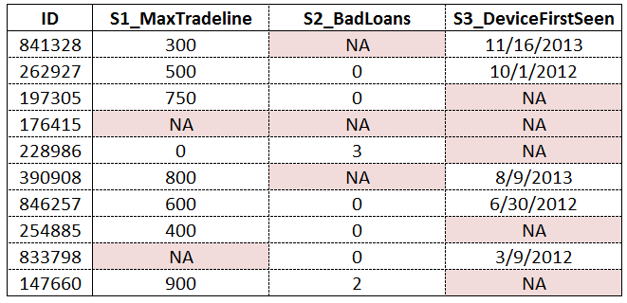
We handle missing data by understanding the dataset and its meanings
Sometimes missing data is just that – missing.
But sometimes missing data is meaningful
Our understanding of the data and underlying biases makes our models far more powerful

Slide 11
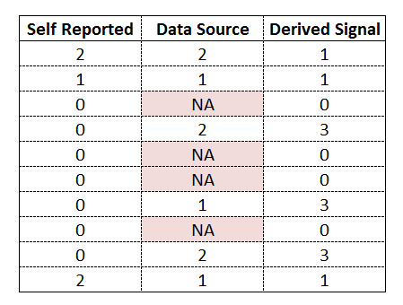
Multiple views of the “same” thing makes models more powerful
Each data source provides overlapping information, so we sometimes see multiple, different copies of the “same” signal
Not all data is correct; but sometimes seeing differences on the “same” value across different sources creates new meaningful signals
Useful in fraud models, but also part of marketing, underwriting models

Slide 12
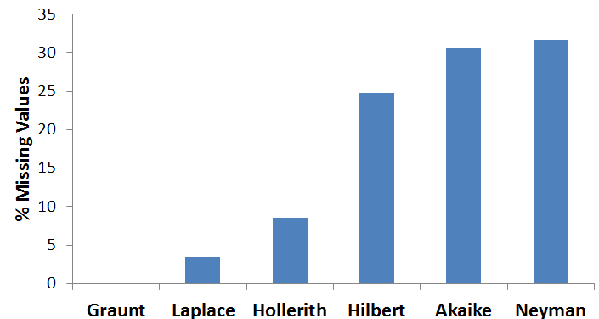
Our models have become increasingly resilient to missing data
Off The Shelf
Segmented Regression
Machine Learning
We are able to include more missing data as we get better at…
deriving new signals across data sources
imputation

Slide 13
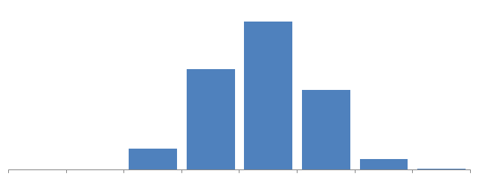
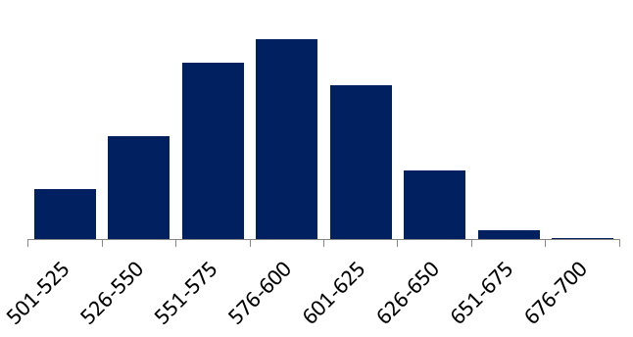
We were once hit by a blind spot
Blind Spot
Training Set
Problem -- Proper model rollout requires understanding of blind spots and relative performance of “swap in” population
Solution -- Zest has built automated tools to identify possible blind spots in our feature space
Entire Applicant Population

Slide 14
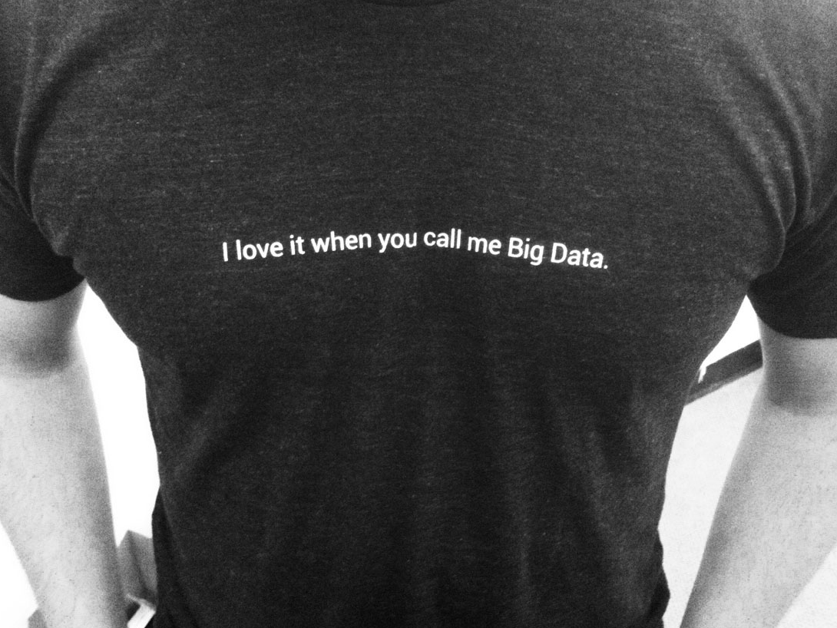

Notes:
Now we get to the buzzword of the day, “big data.”
What really matters about big data is neither the big-ness nor the data-ness.
It’s not about the tools that you use to ask your questions.
It’s about the people who build and train your models.

