Slide 1





The Aha! Moment:
From Data to Insight
Dafna Shahaf
Joint work with Carlos Guestrin, Eric Horvitz, Jure Leskovec

Slide 2
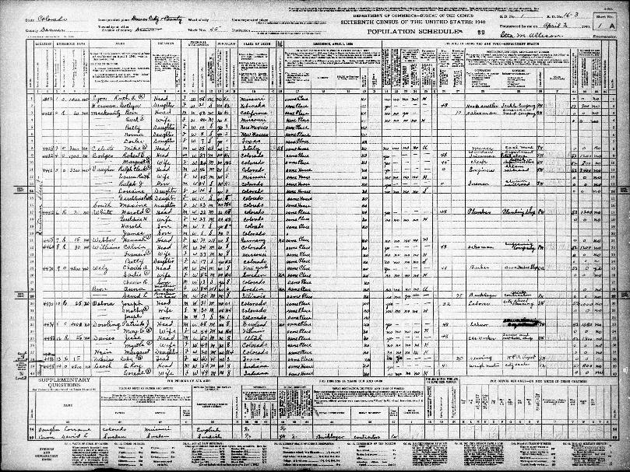
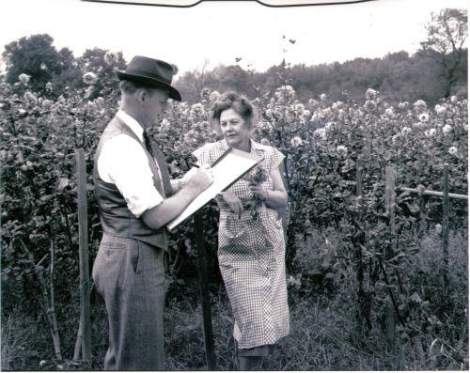
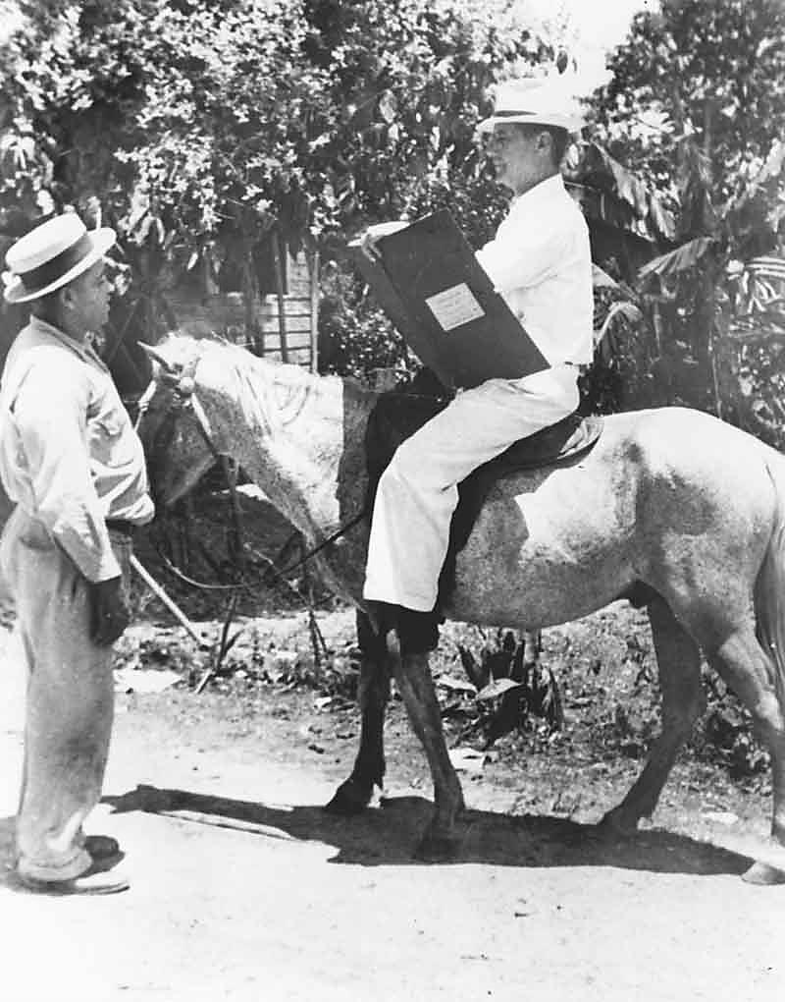
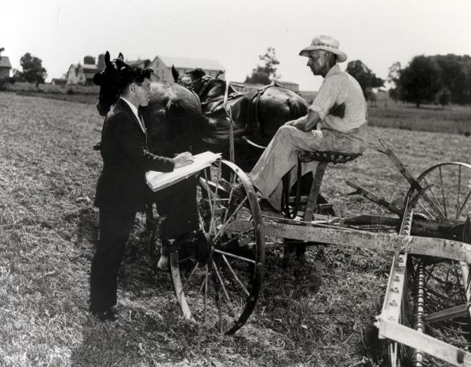
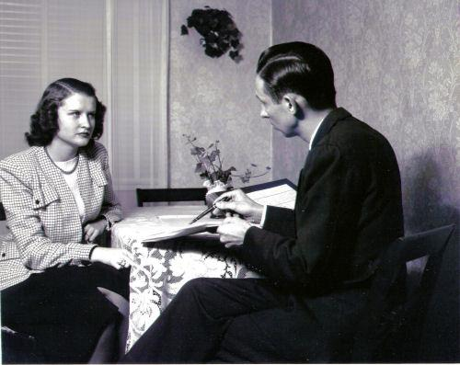
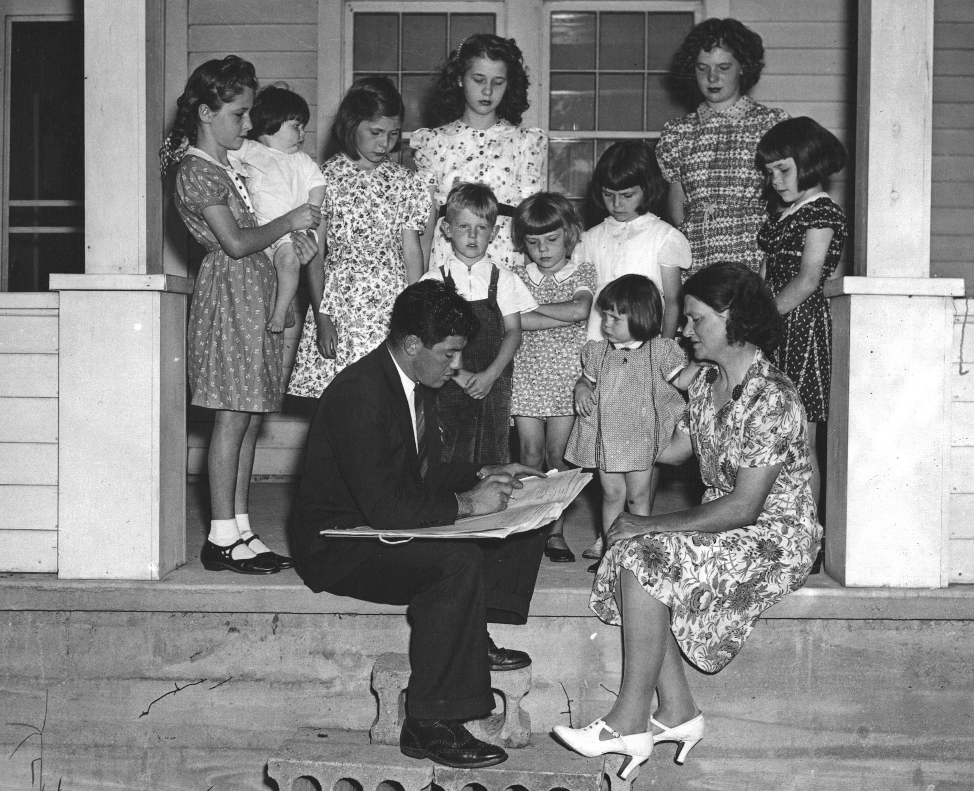
Acquiring Data Used to be Hard Work
Census Interviewer, 1930
How many cows do you own?
Notes:
Department of Agriculture

Slide 3
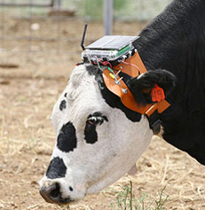
… Not Anymore
Cow Tracking System, 2008

Slide 4


We Have LOTS of Data
Huge Potential
  Science, business, sports, public health…
In order for this data to be useful, we must understand it
  Turn data into insight!
Notes:
Large-scale data has potential to transform almost every aspect of our world, from science to business.
It has potential for addressing some of society’s most pressing challenges

Slide 5

Example: News
My Goal:
Develop computational approaches for turning data into insight
What is insight?
How to help people understand…
  The structure of data?
  What is interesting in data?
How to facilitate discoveries?

Slide 6


So, you want to understand a complex news story…

Slide 7
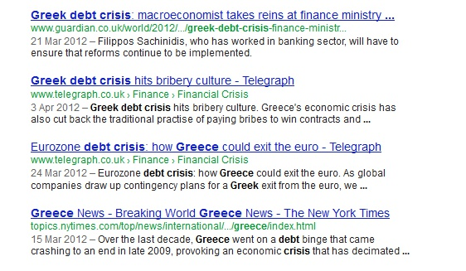
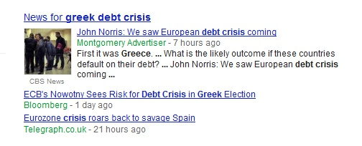
Search Engines are Great
About 57,500,000 results
About 57,500,000 results.
How do they fit together?
But do not show how it all fits together

Slide 8
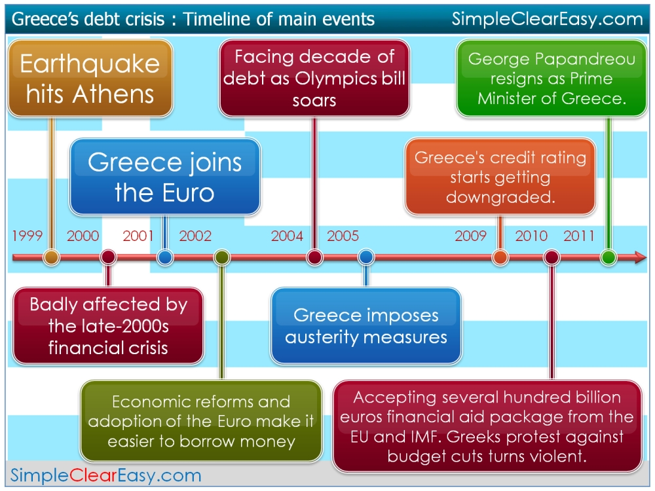
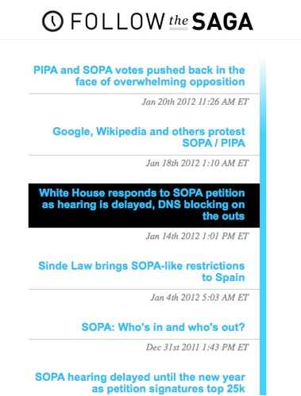
Timeline Systems
e.g., NewsJunkie [Gabrilovich, Dumais, Horvitz]
Notes:
Pacific Campaign of World War II

Slide 9

Real Stories are not Linear
Notes:
Today’s complex stories spread into branches, side stories, dead ends, and intertwining
narratives.

Slide 10
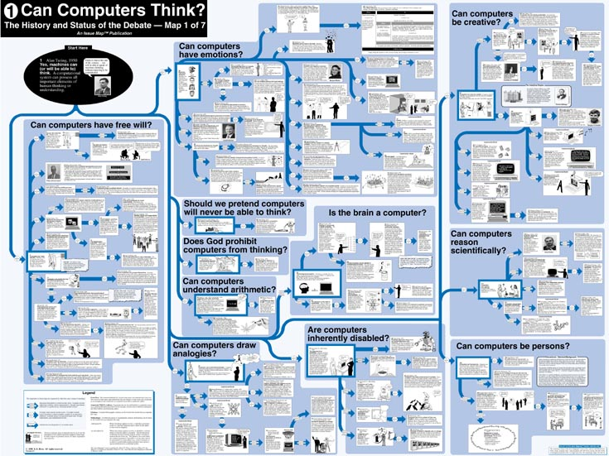
Holy Grail: Issue Maps
Notes:
An issue map (or argument map) is a visual representation of the structure of a topic. It includes components such as a
main contention, premises, co-premises, objections, rebuttals and lemmas. Typically it is a directed graph, with nodes
corresponding to propositions and edges corresponding to relationships (e.g. dispute or support).

Slide 11
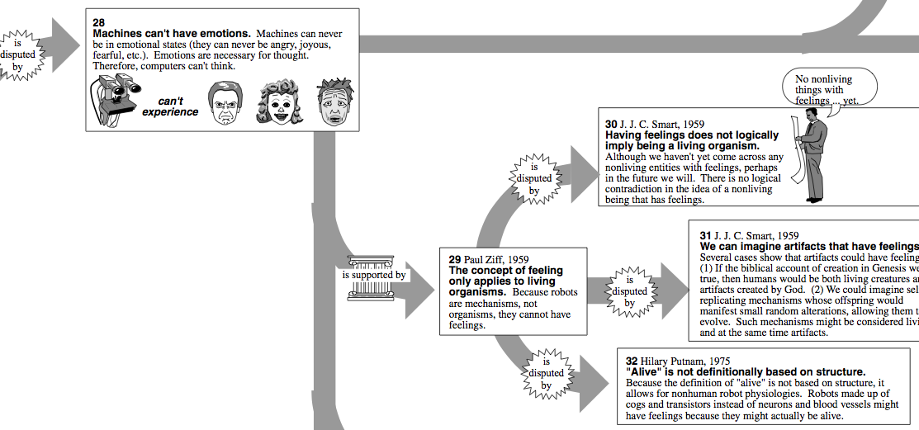
Holy Grail: Issue Maps
machines can’t have emotions
we can imagine
artifacts that have
feelings [Smart ‘59]
Challenge:
Build automatically!
is supported by
is disputed by
concept of feeling only
applies to living organisms
[Ziff ‘59]

Slide 12
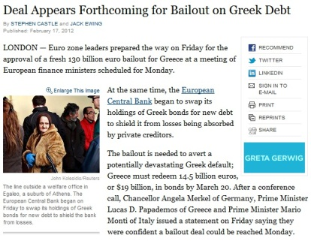
Proposed System: Metro Maps
Input: A set of documents
Output: A map -- a set of storylines
Each line follows a coherent narrative thread
Temporal Dynamics + Structure
  Example: Greek debt crisis Map
labor unions
Merkel
bailout
Germany
protests
junk status
austerity
strike

Slide 13

Finding Good Maps
Metro Maps of Information [S, Guestrin, Horvitz, WWW’12]
Hard problem!
Our Approach:
  What makes a good map?
  How to formalize it?
  How to optimize it?
Notes:
Note that this problem is hard, mostly because we don’t really know what we’re looking for.
I know a good map when I see it, you know a good map when you see it, but it’s a very intuitive property.
We first need to figure out what we are looking for, then formalize it mathematically – in other words, define the problem. Then find a tractable algorithm that optimizes our objective.

Slide 14

Properties of a Good Map
Coherence

Slide 15
Coherence: Main Idea
Connecting the Dots
[S, Guestrin, KDD’10]
How to measure coherence of a chain of documents?
Strong transitions
Global theme
d1
d2
d3
d4
d5
Greek debt crisis
Republicans and the debt crisis
The Pope and Republicans
Protests in Italy
Notes:
The main point was that coherence of a chain of articles is not a property of local interactions
between neighbouring articles. You have to remember the context of the rest of the chain.
Let me show you what I mean by ‘consider only local interactions’.
Consider this article. Bars mean that the word on the left appears in the article above it,
so this article is about the debt default in Greece. Now you start building a chain. You look for similar articles, and find this one,
about Republicans’ opinion of the debt crisis. Next, you forget all about the first article, and start looking for articles similar to the new one.

Slide 16
Properties of a Good Map
Coherence
Is it enough?

Slide 17


Max-coherence Map
Query: Greek debt
Not important
Asian markets higher in holiday-thinned trade
Asian trading sluggish as markets fret about Greece
Japanese stocks plunge on Greece debt problems
Greek Civil Servants
Strike over Austerity Measures
Strike against austerity plan halts traffic
Greece Paralyzed
by New Strike
Redundant
Greek Strike Against Austerity Is Growing

Slide 18

Properties of a Good Map
Coherence
2. Coverage
Should cover diverse topics important to the user
Notes:
Essential, frame as challenges: “black swan”

Slide 19

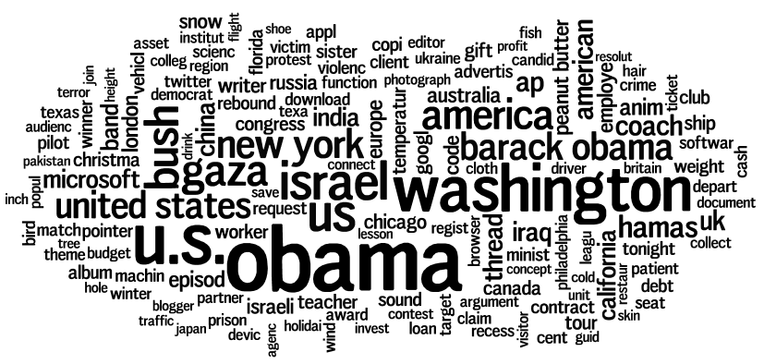




Coverage: Idea
Turning Down the Noise
[El-Arini, Veda, S, Guestrin, KDD’09]
Documents cover words:
Corpus
Coverage

Slide 20


High-coverage, Coherent Map
Query: Greek debt
Greek Civil Servants
Strike over Austerity Measures
Greek Take to the
Streets, but Lacking
Earlier Zeal
Greece Paralyzed
by New Strike
Infighting Adds to Merkel’s Woes
It’s Germany that Matters
UK Backs Germany’s Effort
Germany says the
IMF should Rescue Greece
IMF more Likely to Lead Efforts
IMF is Urged to Move Forward
Related but disconnected

Slide 21
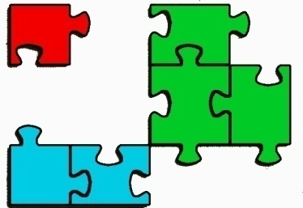
Properties of a Good Map
Coherence
2. Coverage
3. Connectivity

Slide 22
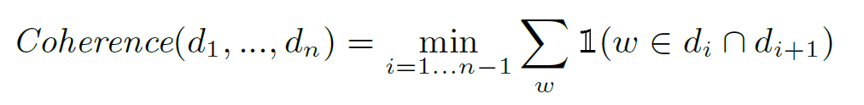
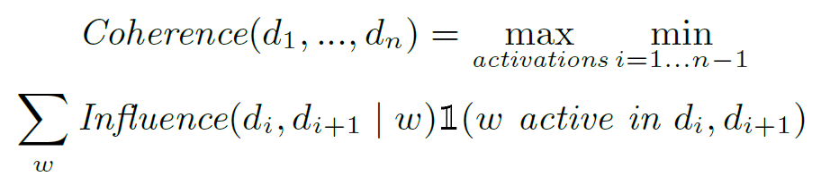
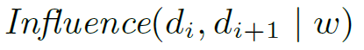
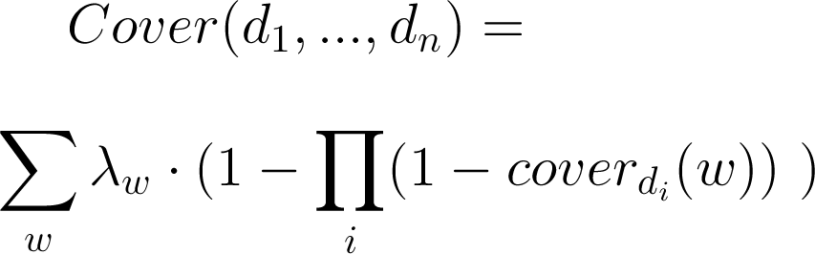
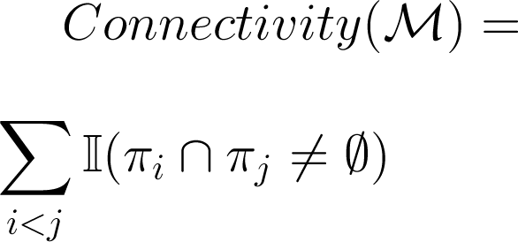

Mathematical Formulation
Optimization Problem: Linear Programming + Rounding
Coherence
Algorithm with theoretical guarantees
Submodular Optimization
2. Coverage
Encourage Line Intersection
3. Connectivity

Slide 23
Example Map: Greek Debt
Greek Civil Servants Strike Over Austerity Measures
Greeks Take to the Streets, but Lacking Earlier Zeal
Greece Paralyzed by New Strike
Greek Workers Protest Austerity Plan
Greece Struggles to Stay Afloat as Debts Pile On
EU Sets Deadline for Greece to Make Cuts
Greek bonds rated 'junk' by Standard & Poor's
Greece Gets Help but is it Enough?
Is it good?
E.U. Official Backs Greece’s Deficit Cutting Plan
Infighting Adds to Merkel’s Woes
Germany Now Says I.M.F. Should Rescue Greece
U.K. Backs Germany’s Effort to Support Euro
Euro Unity? It’s Germany That Matters
Greek economy
Strikes and Riots
I.M.F. More Likely to Lead Efforts for Greek Aid
I.M.F. Is Urged to Move Forward on Voting Changes
Germany and the EU
IMF

Slide 24
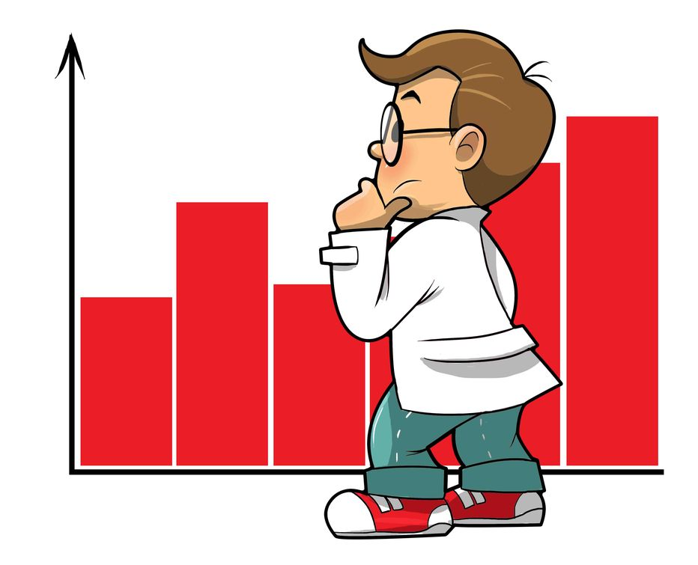
Evaluation
Challenging to evaluate
Many machine learning/ data mining techniques use surrogate evaluation metrics
User studies are fundamental
Data: All New York Times articles (2008-2010)
  Queries: Chile miners, Haiti earthquake, Greek debt
Study Question: Can maps help news readers understand news events?
Notes:
30 million, infrastructure

Slide 25
Task 1: Simple Question Answering
10 questions per task
Measured total knowledge and rate
  Maps, Google News, Topic Detection and Tracking [Nallapati et al, CIKM '04]
338 unique users, minor gains
Question 2: How many miners were trapped?
Maps are not about small details, they are about the big picture!

Slide 26

Task 2: High-Level Understanding
Summarize complex story in a paragraph
Other people evaluate paragraphs:
  Which paragraph provided a more complete and coherent picture of the story?

Slide 27
Task 2: High-Level Understanding
15 paragraph writers, ~300 evaluations per task
Results: big gains, especially for complex stories
  72% preferred maps about Greece
  59% for Haiti
Bottom line:
maps are more useful as high-level tools for stories without a single dominant storyline

Slide 28
So, you want to understand a complex news story…

Slide 29
Maps are Easy to Adapt to Other Domains
Principles stay the same
Use domain knowledge to improve objective
Examples:
  Science
  Legal
  Books

Slide 30
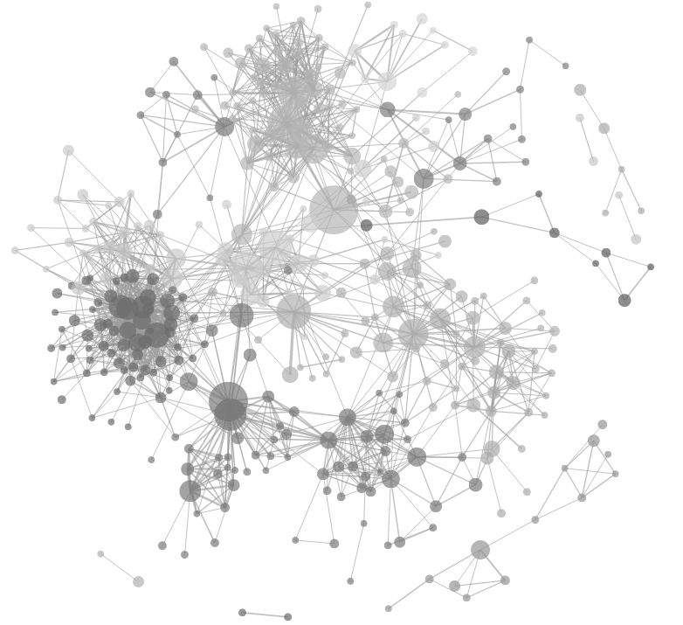

Application 2: Science
Metro Maps of Science [S, Guestrin, Horvitz, KDD’12]
Goal: Understand the state of the art
  What is reinforcement learning up to?
Data: ACM Papers
Slight modifications to the objective
  Taking advantage of citation graph
Algorithm stays the same!

Slide 31
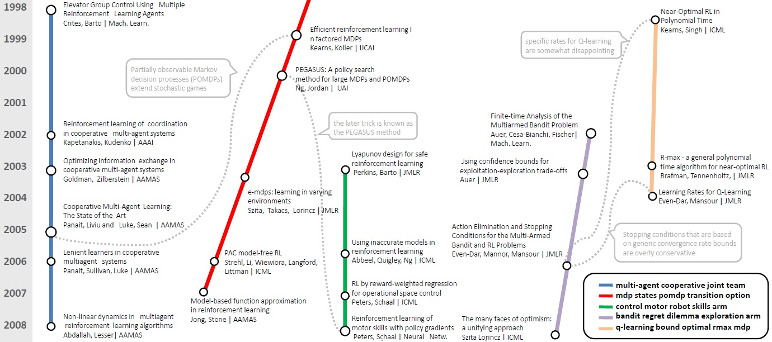
Example Map: Reinforcement Learning
multi-agent cooperative joint team
mdp states pomdp transition option
control motor robot skills arm
bandit regret dilemma exploration arm
q-learning bound optimal rmax mdp

Slide 32
User Study
Study Question: Can maps help a first-year grad student learn a new topic better than current tools?
Update a survey paper from 1996 about Reinforcement Learning
Identify research directions + relevant papers
  Control group: Google Scholar
  Treatment group: Metro Map and Google Scholar

Slide 33
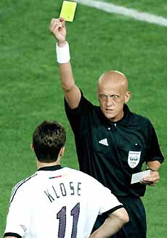
Evaluation
30 participants
Precision: Judge scoring papers
Recall: List of top-10 subareas of
Reinforcement Learning

Slide 34
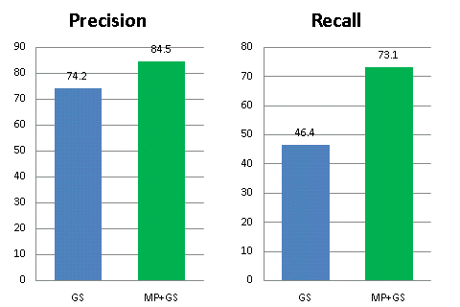
Results (in a nutshell)
Better
Google
Maps
Google
Maps
On average , map users find 10% more relevant papers, and cover 2.7 more of the top-10 areas

Slide 35

Application 3: Legal Documents
Goal: Help lawyers argue a case
Goal: Help lawyers preparing for litigation
Data: Supreme court decisions

Slide 36
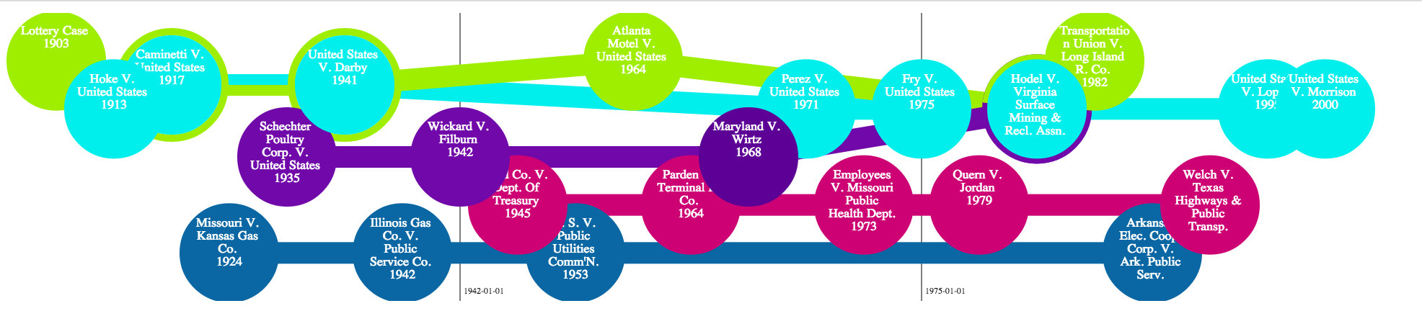
Commerce Clause
Lawyer Labels
Coherence Words
Power to prohibit commerce
Congress's power to regulate
11th amendment, state sovereignty
“Merely” vs “substantially” affects
Regulating wholesale energy sale
interstate, commerce, affect, regulate
congress, interest, regulate, channel
immunity, sovereignty, amendment, eleventh
affects, substantial, regulate
wholesale, electricity, resale, steam, utilities

Slide 37

Application 4: Books
Goal: Structure of a book
Goal: Structure of a book
  Lord of the Rings
Data: Lord of the Rings

Slide 38
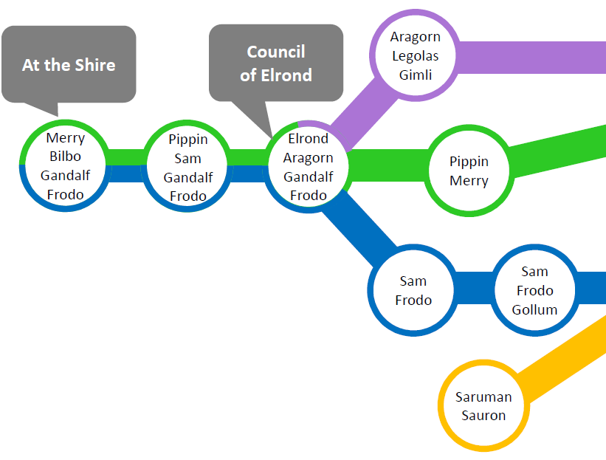
Lord of the Rings Map

Slide 39
Making Maps Useful
Information Cartography [S, Yang, Suen, Jacobs, Wang, Leskovec, KDD’13]
Scalability
  Handle web-scale corpus
Interaction
  Multi-resolution: Zoom in to learn more
  Word feedback: Personalized coverage
Different points-of-view for controversial topics
Website + Open-Source Package

Slide 40
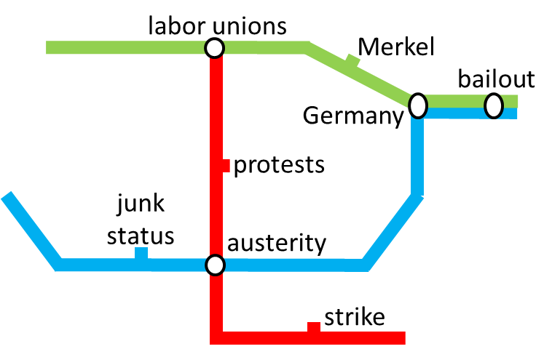

Metro Maps: Recap
A news-reader, a first-year student, a paralegal ...
  Used to rely on search
  Can now get perspective on the field
  See structure and connections
User studies validate our method
What about making new connections?

Slide 41


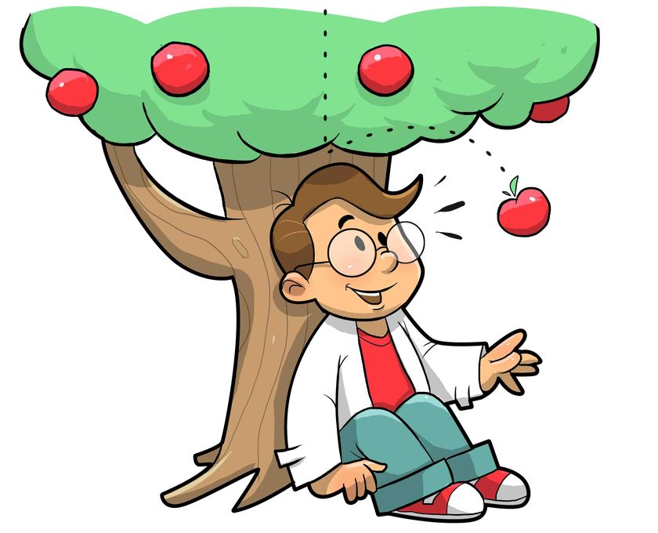
The Aha! Project
Challenge: Finding insightful connections in data
Define insight
Notes:
Content, query, interaction, scaling

Slide 42
Properties of Insight (Abstract)
Surprise
  Not enough!
  We can extract many surprising connections
  Noise, bias, coincidence…
Plausibility
  Well-supported by the data
Very general idea
Goal: Help researchers find gaps in medical knowledge
(Promising research directions)

Slide 43
Properties of Insight (Medical)
Find pairs of medical terms s.t.
  Plausible: co-occur a lot in practice
    Data: Natural-language medical notes
    17 years, 10 million notes, 1.5 billion terms
  Surprising: not mentioned in the literature
    Data: Medline
    11 million papers

Slide 44



System Overview
Dementia
Medical Notes
Publications

Slide 45


System Overview
Dementia
Medical Notes
Publications
1. Find Plausible Candidates

Slide 46

System Overview
Dementia
Medical Notes
Publications
1. Find Plausible Candidates
2. Rank by Surprise

Slide 47
Actual System’s Output
Dementia
Medical Notes
Publications
  donepezil
  alzheimer's disease
  memantine
  hip fractures
  wheelchairs
  atrial fibrillation
  atrial fibrillation
Insight?
1. Find Plausible Candidates
2. Rank by Surprise

Slide 48
Evaluation
Ideally, new discoveries!
  Takes time… and physicians.
Can we do early discovery?
  Interesting recent development
  Truncate the data 5 years back
  Can we identify these developments?
  Precision@3
Strong indication of the utility of our approach

Slide 49

Our Results
2 out of 4 test cases discovered!
Epidemiological data suggest that obesity is associated with a 30–70% increased risk of colon cancer in men…
All patients with type 2 diabetes mellitus or hypertension should be evaluated for sleep apnea …
Evidence of a link between atrial fibrillation and cognitive problems …
Incretin-based diabetes drugs … contribute to the development of pancreatitis …

Slide 50
Properties of Insight (Abstract)
Surprise
  Not enough!
  We can extract many surprising connections
  Noise, bias, coincidence…
Plausibility
  Well-supported by the data
Very general idea

Slide 51
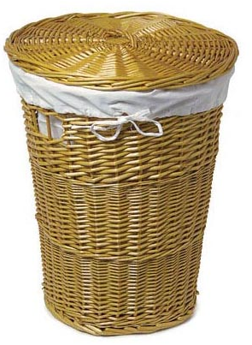

Insight: Commerce
Goal: Serendipitous product search
Find products that are
  Plausible: solve a similar problem
    Data: Common-sense facts
  Surprising: not often viewed together
    Data: 300 million Amazon product pages
Notes:
We have already taken the first steps…

Slide 52

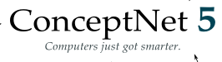
Algorithm
Medical Notes
Publications
1. Find Plausible Candidates
2. Rank by Surprise

Slide 53



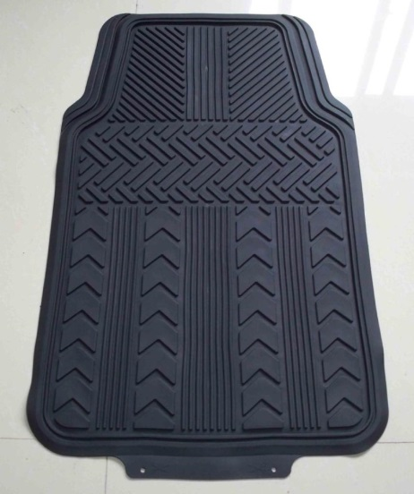
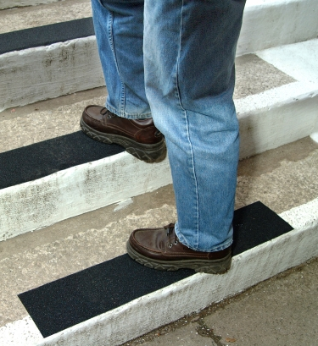
Shopping Tips from Our System’s Output

Slide 54
Aha! Project: Recap
Medical researchers can discover promising new ideas!
Early discovery of medical breakthroughs
Applications in other domains
  Serendipitous product search

Slide 55
My Goal:
Develop computational approaches for turning data into insight
Metro Maps of Information:
Reveal the underlying structure of data
The Aha! Project:
What’s interesting in the data?

Slide 56
Future Applications
Social Science
Medicine
Political Science
Science
Life Sciences
History
News
Personal Data
Legal
Corporate Data
Financial Data
Commerce
Inv. Journalism
Literature
Vision
Notes:
The common thread in my research is the idea of taking intuitive problem definitions (“find a coherent story
line”, “find an insightful connection”) and formulating them mathematically. I then build useful systems
around these formulations.

Slide 57

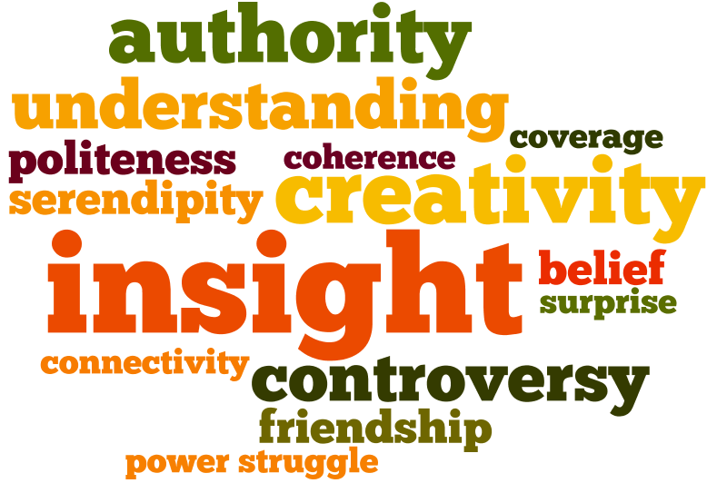

Long-Term Direction:
Bridge the Gap!
Massive, Dull Data
Interesting for People
Notes:
bridge the gap between the massive (dull) amounts of data embedded in machines, and what people find interesting and accessible.

Slide 58
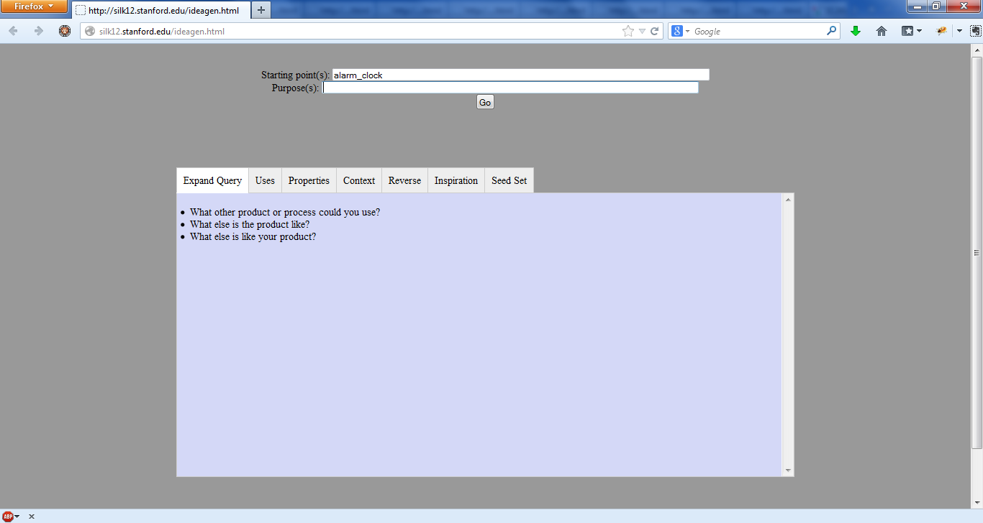

Creativity: Inspiration Generator
Goal: How can I change my product to expand my business?

Slide 59

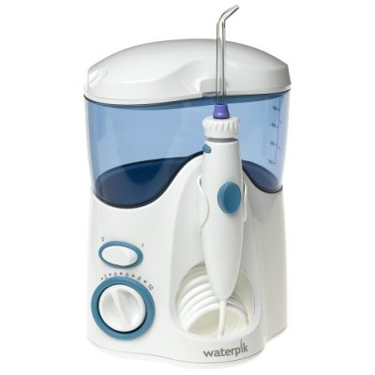
SCAMPER Model
Substitute. Combine. Adapt. Modify. Put to another use. Eliminate. Reverse.
Modify:
Built a prototype system using ConceptNet and Amazon data

Slide 60
Inspiration Generator: System Output
Query: Alarm Clock
Coffee machine with a timer
Alarm clock controls a dimmer
Silent alarm clock (vibrates?)
  Deaf people (or considerate people)
Incorporate in spy gadgets, microwaves
Help people who have trouble sleeping
  Find the best time to wake you up

Slide 61
Closing
Data can help us understand, better decisions
Must make sense of data
Not enough to store (or even retrieve) data
Reveal structure
Discover unknown connections
Validate: User studies, early discovery

Slide 62
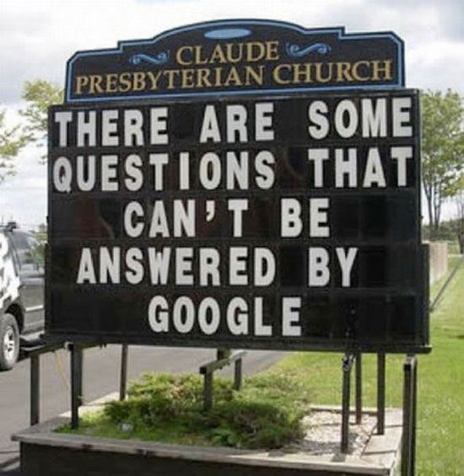
Closing
Data can help us understand, better decisions
Must make sense of data
Not enough to store (or even retrieve) data
Reveal structure
Discover unknown connections
Validate: User studies, early discovery

Slide 63
Closing
Data can help us understand, better decisions
Must make sense of data
Not enough to store (or even retrieve) data
Reveal structure
Discover unknown connections
Validate: User studies, early discovery
Thank you!

