Slide 1
THE DATA LAKE DREAM
Edd Dumbill • @edd
edd@svds.com • svds.com/StrataNY2014

Slide 2







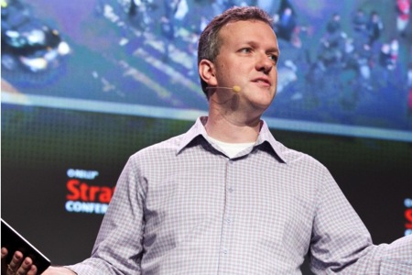














Slide 3
WHAT IS A DATA LAKE?
A scalable, accessible repository of data
(in its natural or processed state)

Slide 4
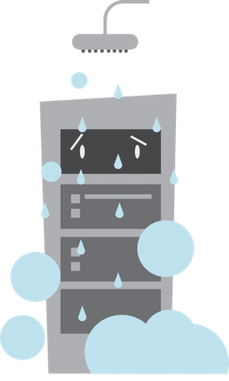



CONVENTIONAL DATA STRATEGY
“WHAT YOU DO TO DATA”
CLEAN
VALIDATE
CONTROL
PROTECT

Slide 5


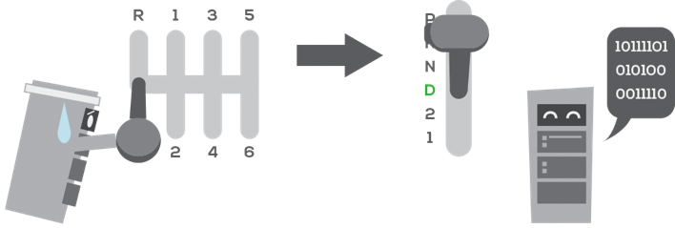
MODERN DATA STRATEGY
“WHAT YOU DO WITH DATA”
ATTRACT NEW CUSTOMERS
TARGET VIP CUSTOMERS
AUTOMATE

Slide 7
TOWARDS THE “DATA LAKE” — Step 1

Slide 8
TOWARDS THE “DATA LAKE” — Step 2

Slide 9
TOWARDS THE “DATA LAKE” — Step 3

Slide 10
TOWARDS THE “DATA LAKE” — Step 4

Slide 11
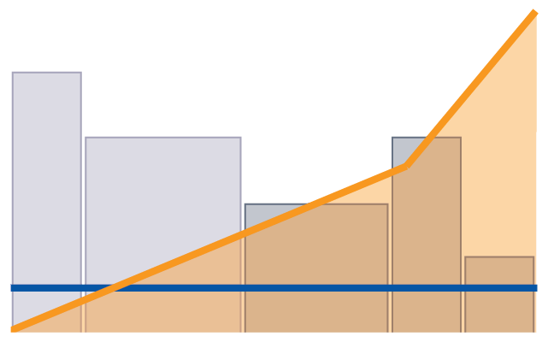
UP vs. OUT — Enterprise Edition
Scale-up cost
Different use cases put different demands on the data infrastructure.
Increasing cost per unit of capability from scale-up architectures causes rationing of resources. Only the most valuable use cases are pursued.
UC1
US Dollars
UC2
UC4
UC3
UC5
Scale-out cost
Data Resource Usage

Slide 12







THE DATA VALUE CHAIN DRAW VALUE FROM YOUR STRATEGIC DATA ASSETS
Discover Ingest Process Persist Integrate Analyze Expose

Slide 13
Make it cheap
Failure as a feature
Ask good questions
Make it quick
Both learning and adaptation
Enable the feedback loop
Don’t break things
Make operations a platform for innovation
APIs, platforms, simulation
BUILD FOR EXPERIMENTS

Slide 14
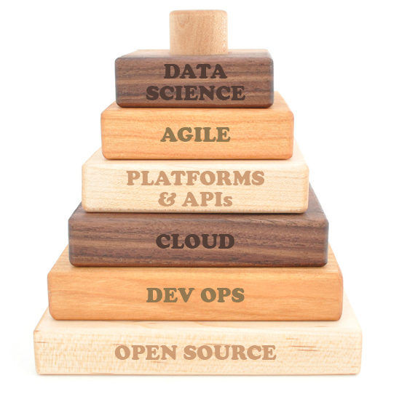
THE EXPERIMENTAL ENTERPRISE
Data science allows us to observe our experiments and respond to the changing environment.
We need to both support investigative work and build a solid layer for production.
The foundation of the experimental enterprise focuses on making infrastructure readily accessible.

Slide 15
Edd Dumbill
edd@svds.com
@edd
@SVDataScience
Yes, we’re hiring!
info@svds.com
Want these slides? Go to:
svds.com/StrataNY2014

