Slide 1
the data future
Kim Rees, Periscopic
@krees, @periscopic
hello@periscopic.com

Slide 2
The Data Now
We are wandering in the weeds
of our data infancy.

Slide 3

Data of Everything

Slide 4

Ubiquitous Data

Slide 5
Data Natives
“Beyond knowledge is wisdom, and
beyond that is clairvoyance.”
// Jack Levis, UPS

Slide 6
Infrastructure
We will soon enter the age of
Data Autonomy.

Slide 7

The Data War
1
0

Slide 8

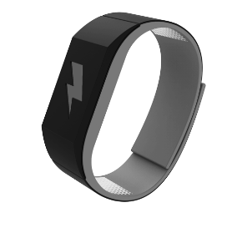

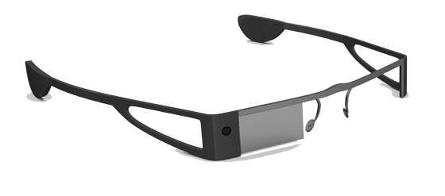
Latent Cycles
Z
Z
Z
Z
Z
Z
Z
Z
Z
Z
Z
Z
Z
Z

Slide 9
Our Data Future

Slide 10

Our Data Future

Slide 11
the data future
Kim Rees, Periscopic
@krees, @periscopic
hello@periscopic.com

