Slide 1
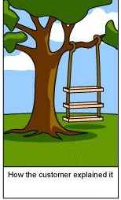
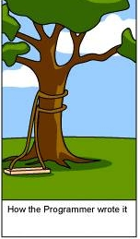
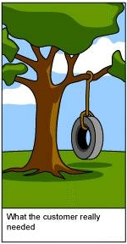
Sounds of Data Silence jana@naralogics.com @jeggers

Slide 2

Perspective on listening
2.5% correct for listeners

Slide 3
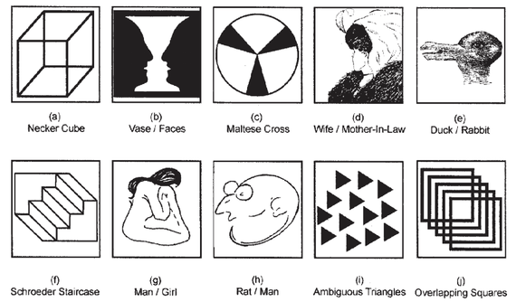
But your brain is amazing!

Slide 4
Exercise 1

Slide 5
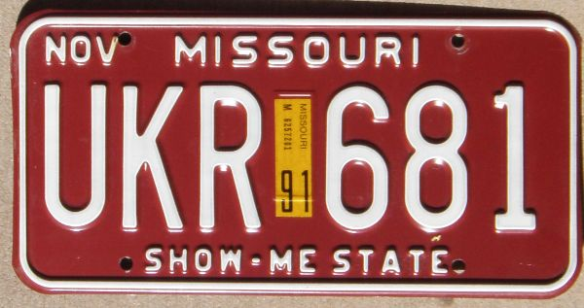

Slide 6
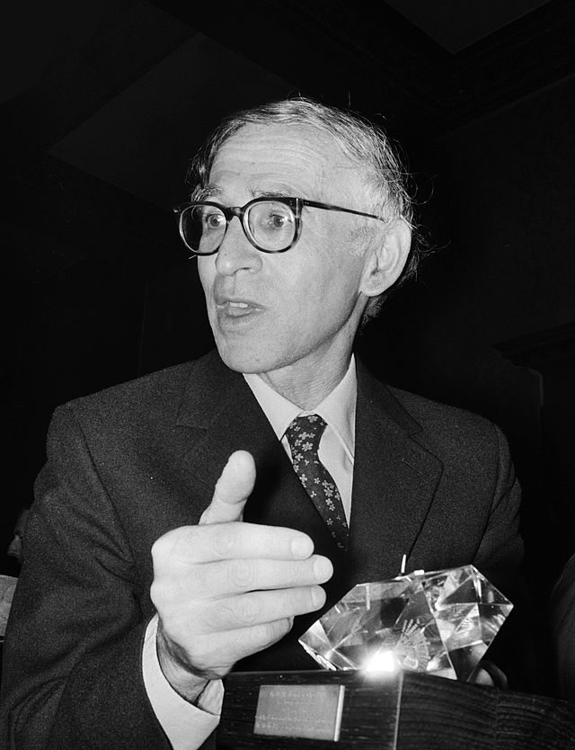
Human curiosity, the urge to know, is a powerful force and is perhaps the best secret weapon of all in the struggle to unravel the workings of the natural world.
Sir Aaron Klug

Slide 7
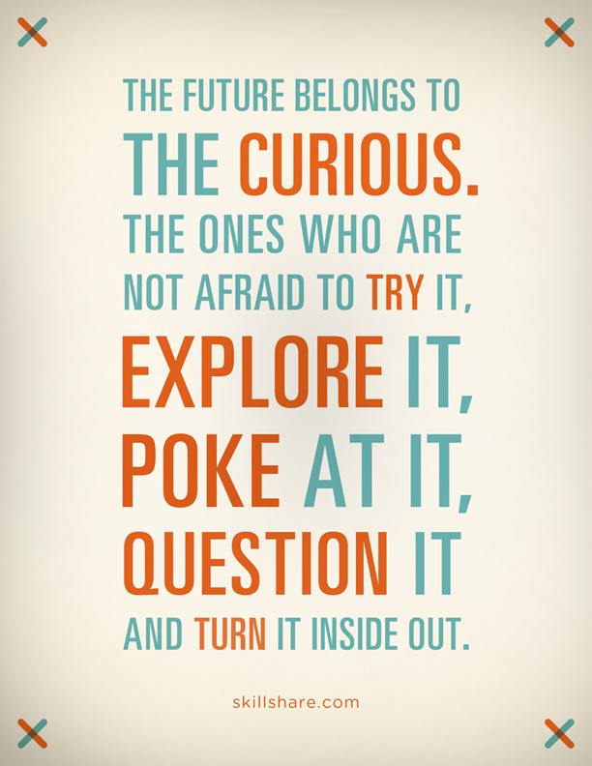
Exercise 1: How to be curious
Take on a different persona
Relish – don’t rationalize – surprises
Bring a buddy, but study silently
Be hyper-curious

Slide 8
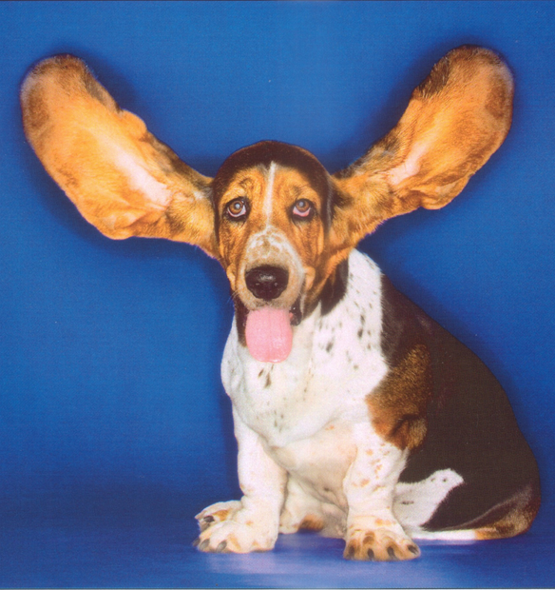
2 ears, 1 mouth
becomes

Slide 9
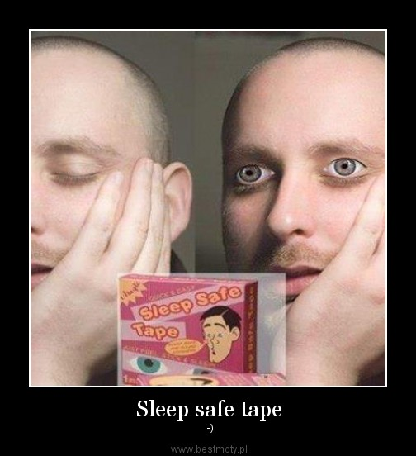
Exercise 2: 2 eyes, 1 mouth
QuickBooks almost never happened
Quicken use write-in candidate: “for my business”
They convinced themselves it was a mistake for years
Where are you sleeping with your eyes open?

Slide 10

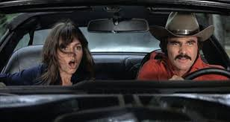
Exercise 3: Walk in Your Data’s Shoes
PTCG/Manhattan Associates: Recommendations for driver to load assignments
Know the data source
Know how different people use the data
Know the quality of the data
Know the objective
Most important: first take off your own shoes!

Slide 11
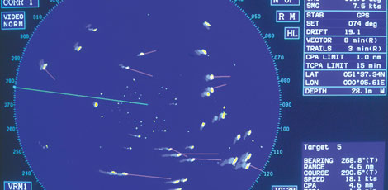
Exercise 4: Step Back from Your Data
UPenn & LockMart: Detecting infections and missiles
Sepsis: #10 leading cause of death, mortality rate is 40%
Current diagnostic tool: vitals
Innovation: watch vitals and lab data over time
New diagnostic tool: missile detection system

Slide 12
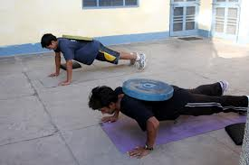
Exercise #5: Add More Weight
Intuit Quickbase: customer retention
Initial test: # of apps, # of users, usage
Learning: undelighted customers will leave
Added: app performance metrics
Once fit, up your game

Slide 13

Hearing the Sounds of Data’s Silence
Be from the Curiosity State
2 eyes, 1 mouth
Walk in your data’s shoes
Step back from your data
Add more weight

Slide 14
