Slide 1

Turning Data into Decisions in a Big Data World
Rachel Hawley

Slide 2
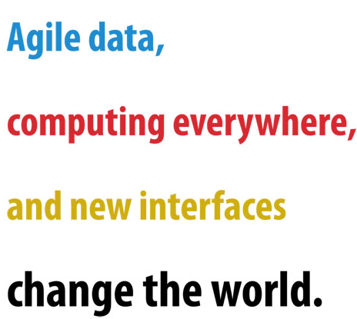

Slide 3




Agile Data
Status Quo
The data you need when you need it

Slide 4






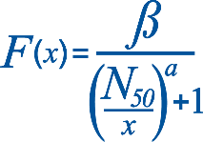










Agile Analytics

Slide 5
Business Value of Agile data vs. Agile Analytics
Business Value
Agile Data
Low
High
Agile Analytics
What is this patient’s medical history?
What treatment will minimize the readmission rate for this patient?
What were product sales last month, by store?
What will sales be next month for every product in each store based on the discounts that we offer?
Do the passengers in this car at this border crossing have valid passports?
What is the likelihood that this car contains narcotics and should be pulled over for secondary inspection?

Slide 6

Take the leap
Agile Data
Agile Analytics

Slide 7
Find out more
Visit the Booth
Attend this talk:
Art of Prediction: Seamless Visualization and Modeling With Hadoop
11:00am
Room: 1 D03/1 D04

