Slide 1
Unseating the Giants
Monte Zweben
CEO, Splice Machine
October 16, 2014

Slide 2
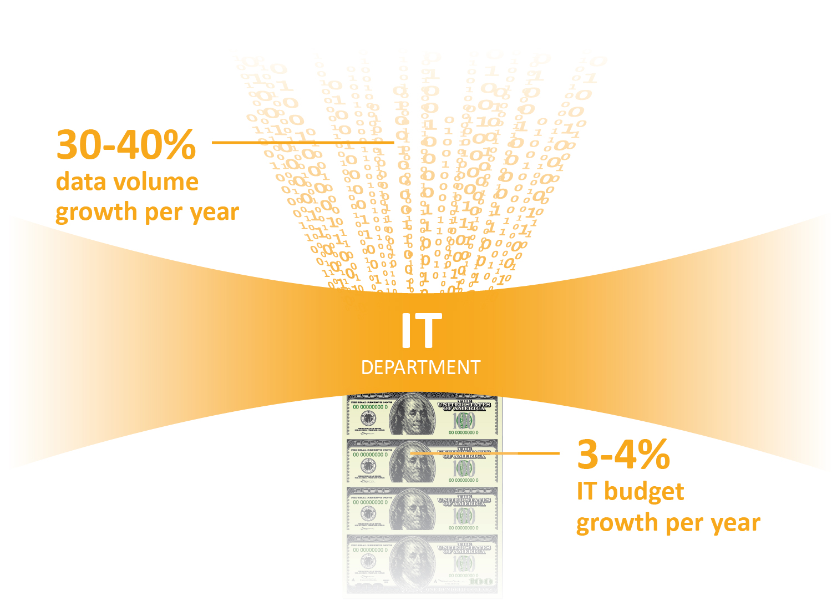
The Big Squeeze
Data growing much faster than IT budgets
Source: 2013 IBM Briefing Book
Source: Gartner, Worldwide IT,
Spending forecast, 3Q13 Update

Slide 3
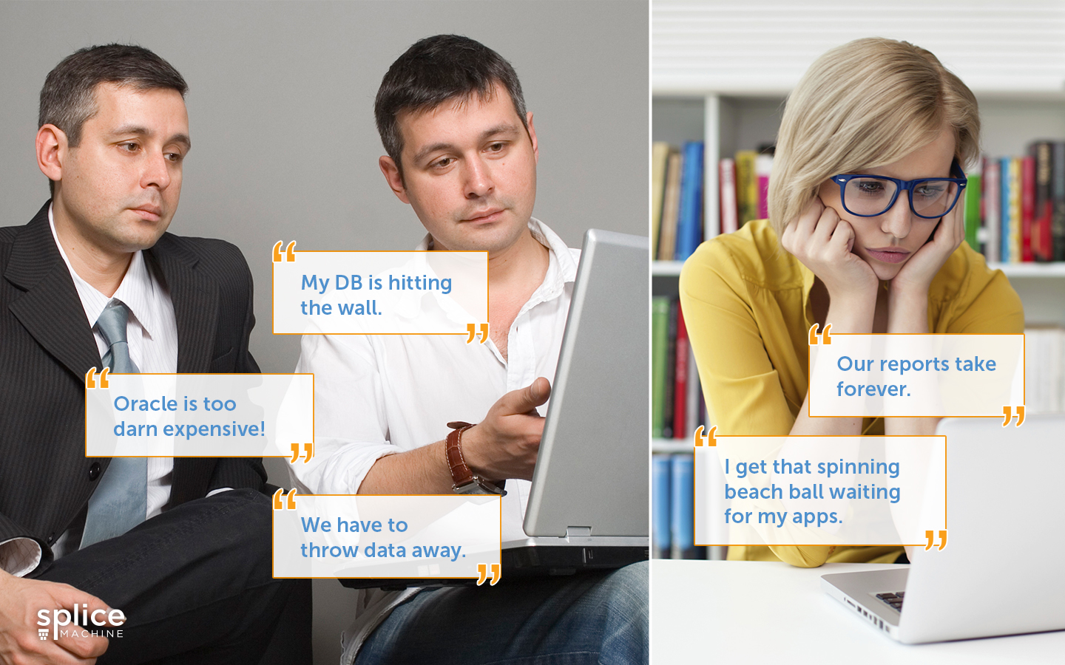
Traditional RDBMSs Giants Overwhelmed…
Scale-up becoming cost-prohibitive
Splice Machine | Proprietary & Confidential

Slide 4


Scale-Out: The Future of Databases
Dramatic improvement in price/performance
Scale Up
(Increase server size)
Scale Out
(More small servers)
$
vs.
$
$
$
$
$

Slide 5






Unseating the Giants
Scale-Up
Giants
Scale-Out Challengers
vs.

Slide 6

Scale-Out Example #1

Slide 7


New application chooses NoSQL
Splice Machine | Proprietary & Confidential

Slide 8


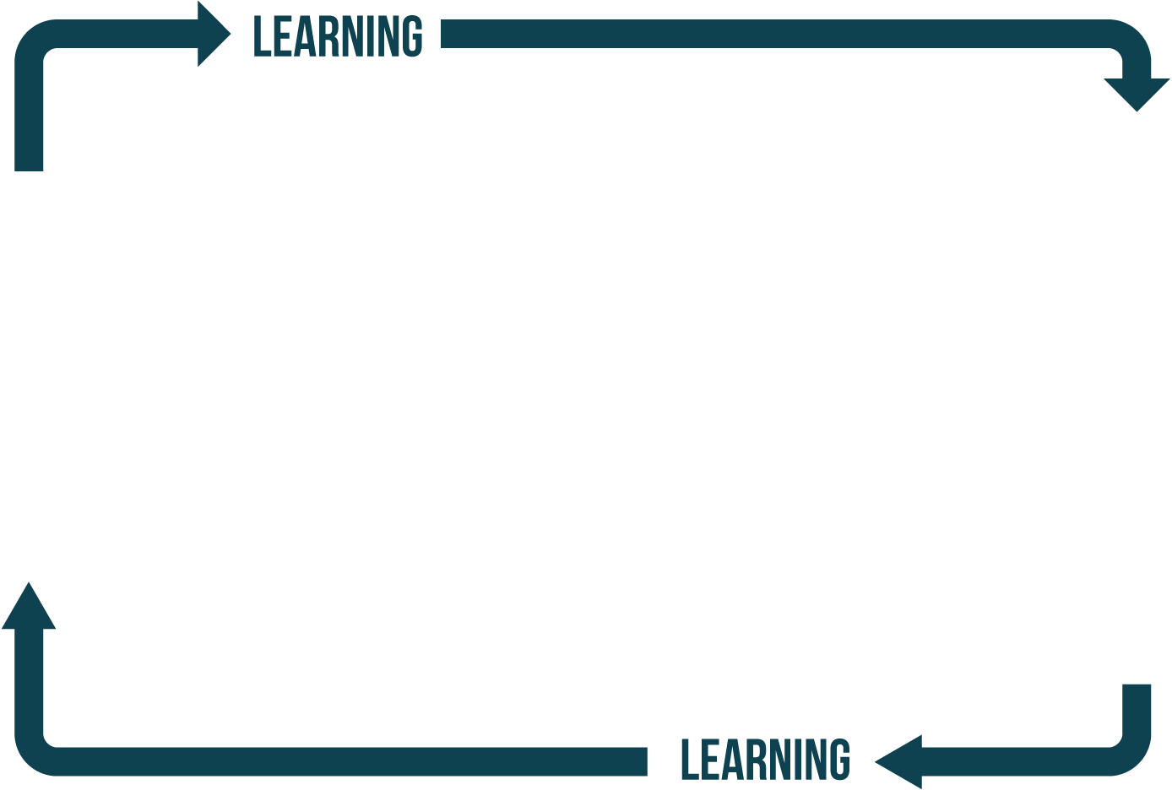






145
RTB advertising
supply partners
21,103,424
Websites
19Bn
Daily impressions
ADVERTISER
ROCKET FUEL
###^{MM} WW CONSUMERS
91,999 DEVICES

Slide 9




















Rocket Fuel: New Application
Publishers
Exchanges
Ad
Exchange
Data Providers
Rocket Fuel Platform
Ad networks
Real-Time Bidding
Auto Optimization
Advertisers
Notes:
TODO:
Add Publisher logos, overlay with Publishers “sell ad slots”
Exchanges “provide market place for selling/ buys ad slots”
Ad Networks do “matchmaking – compute true value of an ad serving opportunity for an advertiser and bid appropriately”
Put advertiser logos, overlay with Advertisers “buying ad slots to sell products or for branding”
Add Transitions

Slide 10
















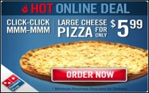








$2.38965
$0.6782
$1.7234
$0.09
$1.78964
$1.6782
$1.7234
$0.809
$2.42
1.25
$2.11
$1.26
$2.178
$2.056
$0.809
$2.42
1.25
$2.11
$1.26
$2.78
$1.56
$1.809
$2.42
1.25
$2.11
$1.26
$2.78
$0.56
$2.42
1.25
$2.11
$1.26
$2.78
$0.756
$0.809
$2.42
1.25
$2.11
$1.26
$2.78
$1.256
$1.809
$2.42
1.25
$2.11
$1.26
$2.78
$0.586
$2.009
1.25
$2.11
$1.26
$2.78
$1.56
$0.00
User
Brand Affinity
Time of Day
Geo/Weather
Site/Page
[ + ]
[ + ]

Slide 11
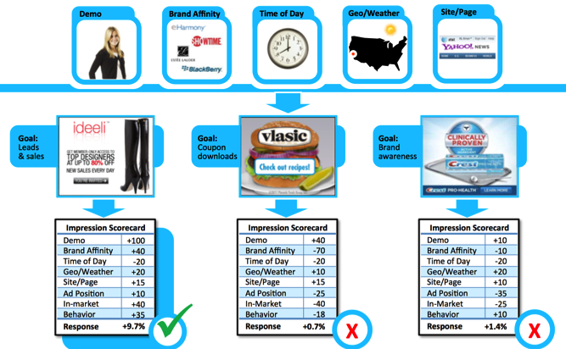

Slide 12





B
S
H
A
E
Apollo Reporting & Campaign Tools
User
Lookup
&
Update
User Profile Store
8
R
T
B
E
X
C
H
A
N
G
E
S
2
User
Lookup
Rocket Fuel Ad Tag
Bid Call
Master Database
1
7
Bid Servers
Ad Servers
Pixel Servers
Load Balancer
Load Balancer
3
Campaign Framework
Evaluate Ads
9
6
Tag for Selected Ad & Bid
Exchange
Publishers
Ad Creative Tag
4
Bidder Logs
Ad Server Logs
5
Direct Publishers
Likelihood
Scores & Bid Value
Eligible Ads
ETL
Response Prediction Models
Ad-Rejection
Hourly
Refresh
Response Prediction Models
H
D
F
S
Hourly
Refresh
Slaves
Apollo Ad-hoc Analytics Tools
Master
Notes:
We have bidders, ad-servers, data platform, online user profile store. I won’t go into details of this architecture.. But, the point is that it is fairly complex.
Our core IP is Artificial Intelligence built on Big Data. And, I will go into this in following slides.

Slide 13
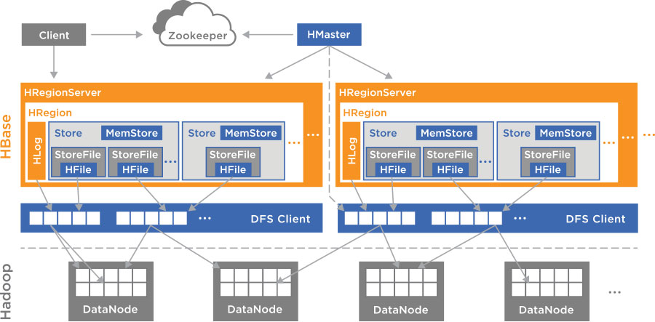
HBase: Proven Scale-Out
  Auto-sharding
  Scales with commodity hardware
  Cost-effective from GBs to PBs
  High availability thru failover and replication
  LSM-trees

Slide 14
Rocket Fuel: Results
World class request velocity on over 10 PBs of data

Slide 15
Scale-Out Example #2

Slide 16


Web application replaces Oracle
Splice Machine | Proprietary & Confidential

Slide 17

Before Architecture: Oracle
Oracle too expensive, too slow, and too difficult to scale and modify
Shutterfly Website
Uploader
App
Consumers
Photo File Storage
Metadata Storage

Slide 18
After Architecture: MongoDB
Flexibility and scalability of NoSQL ideal for simple web app
Shutterfly Website
Uploader
App
Consumers
Photo File Storage
Metadata Storage

Slide 19
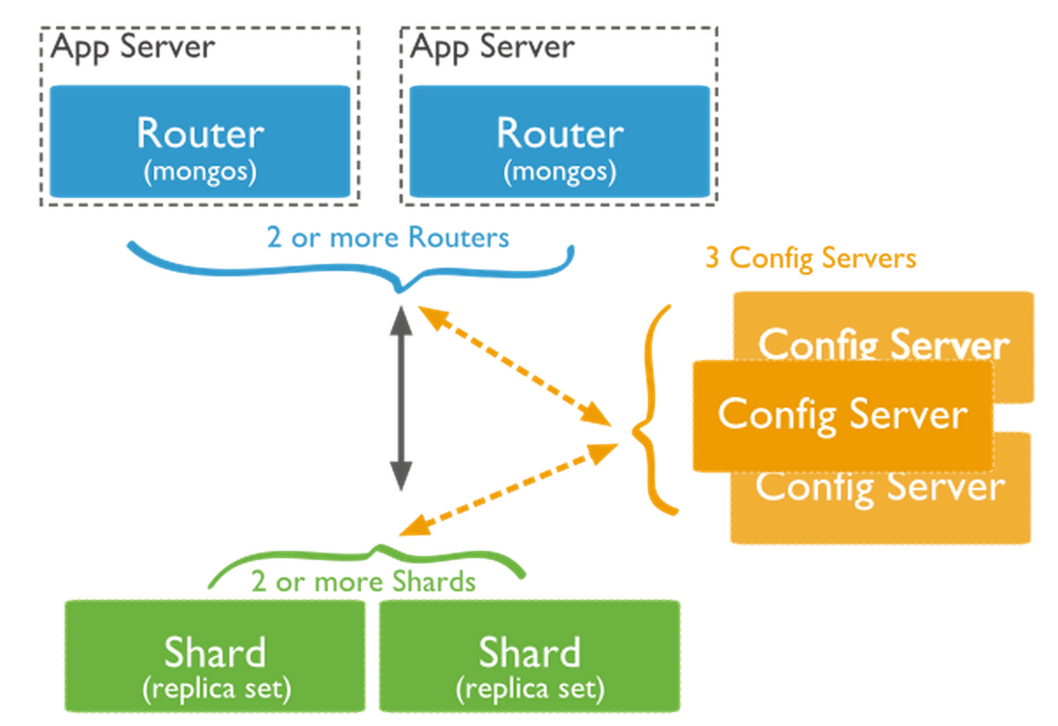
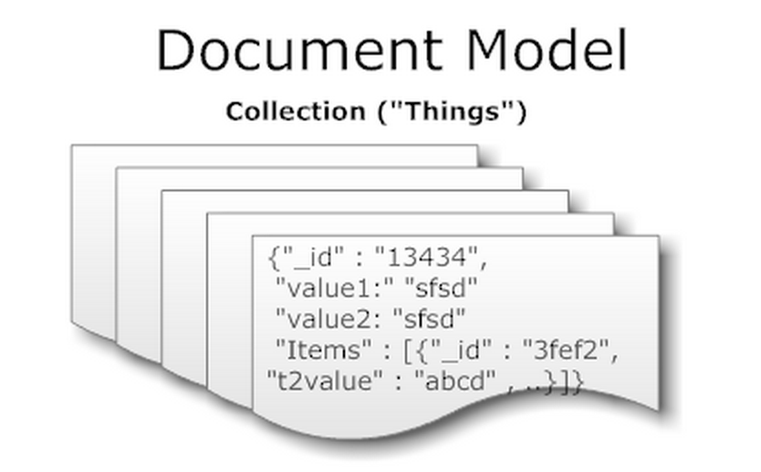
MongoDB Architecture
Document data model sharded across commodity servers

Slide 20
MongoDB: Compelling Results vs. Oracle
9x faster
through parallelized queries
⅕ cost
with commodity scale out
Increased agility
with flexible schema and “shard on demand”

Slide 21
Scale-Out Example #3

Slide 22


Existing OLTP & OLAP Apps Replace Oracle
Splice Machine | Proprietary & Confidential

Slide 23






Before Architecture: Oracle RAC
Oracle RAC too expensive and too slow, with queries up to ½ hour
Email Marketing
Social Feeds
Web/eCommerce Clickstreams
1st Party/
CRM Data
3rd Party Data (e.g., Axciom)
ETL
Operational Reports for Campaign Performance
Ad Hoc Audience Segmentation
POS Data
Data Quality

Slide 24
After Architecture: Hadoop RDBMS
RDBMS functionality with proven scale-out from Hadoop
Email Marketing
Social Feeds
Web/eCommerce Clickstreams
1st Party/
CRM Data
3rd Party Data (e.g., Axciom)
ETL
Operational Reports for Campaign Performance
Ad Hoc Audience Segmentation
POS Data
Data Quality

Slide 25
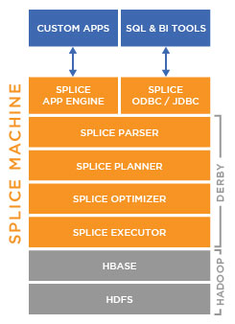
Hadoop RDBMS: Best of Both Worlds
Hadoop
Scale-out on commodity servers
Proven to 100s of petabytes
Efficiently handle sparse data
Extensive ecosystem
RDBMS
ANSI SQL
Real-time, concurrent updates
ACID transactions
ODBC/JDBC support

Slide 26
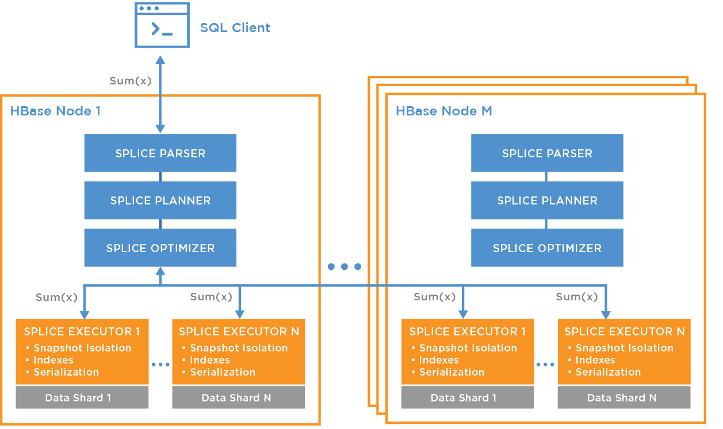
Distributed, Parallelized Query Execution
Parallelized computation across cluster
Moves computation to
the data
Utilizes HBase
co-processors
No MapReduce
HBase
Co-Processor
HBase Server Memory Space
LEGEND

Slide 27
Hadoop RDBMS: Compelling Results vs. Oracle
3-7x faster
through parallelized queries
¼ cost
with commodity scale out
10-20x price/perf
with no application, BI or ETL rewrites

Slide 28
Scale-Up vs. Scale-Out
Scale-Up: Top Reasons
Willing to pay for engineered systems
Lots of custom code (e.g., PL/SQL)
Proven reliability
Avoid risk of newer technologies
Less migration required
Scale-Out: Top Reasons
Reduce costs by 4x-10x
Increase performance by 3x-10x
Ease of scalability
Support for flexible schemas
Huge ecosystem of open source tools

Slide 29
Unseating the Giants: Why is it different this time?
It’s not just technology – user requirements fundamentally changed
Seismic User Shift
Budgets flat
Massive increase in data:
  Volume
  Velocity
  Variety
No longer acceptable to throw data away
Disruptive Tech:
Scale-Out
Leverage commodity H/W
Reduce costs by 4-5x
Increase perf by 5-10x
Increase agility
Notes:
Object DBs – technology – no major user changes – efficiency but no major change in user requirements
Open source – Postgres/MySQL – same technology – no user change – just cheaper

Slide 30
Questions?
Monte Zweben
CEO, Splice Machine
mzeben@splicemachine.com
Visit Booth 246
www.splicemachine.com

