Slide 1
Wonk, Meet Geek
Big Data Tools for Big Data [Governance, Risk, and] Compliance
Jim Adler VP Products & Chief Privacy Officer Metanautix @jim_adler

Slide 2
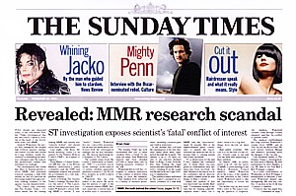
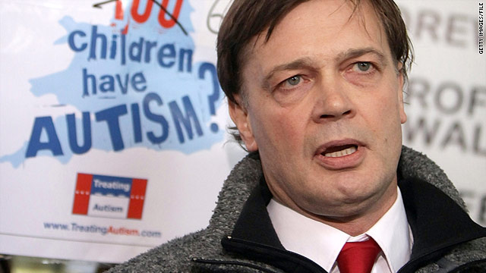
Study Linking Autism to MMR Vaccine Retracted
Results couldn’t be reproduced
4 counts, falsifying data
No informed consent
12 counts, child abuse
No review board
Received $670K from anti-vaccine groups

Slide 3
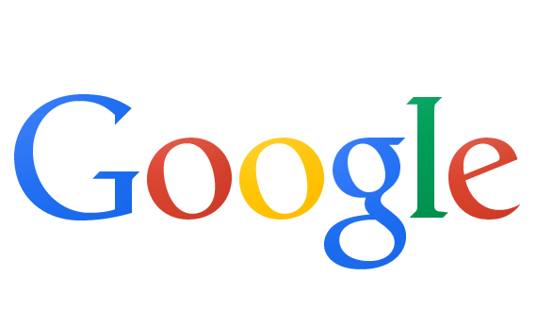








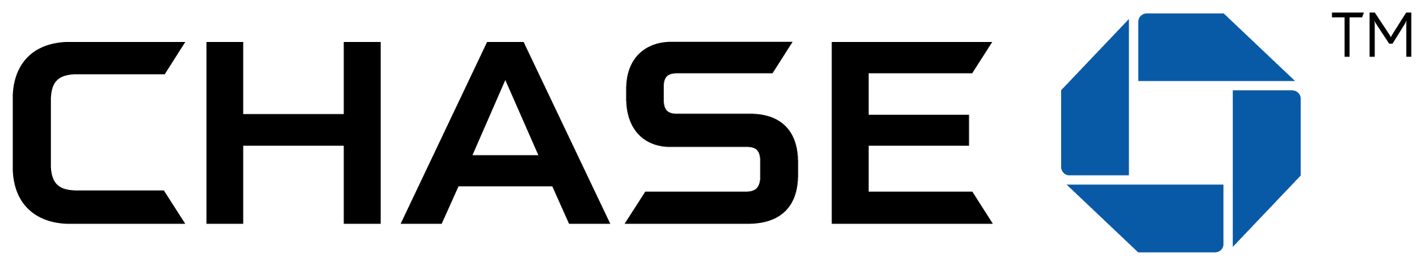





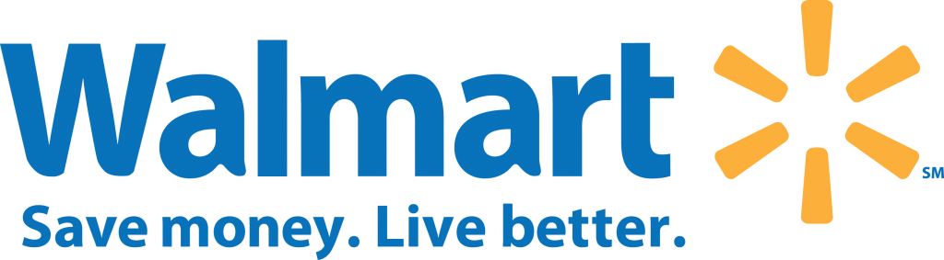



Slide 4
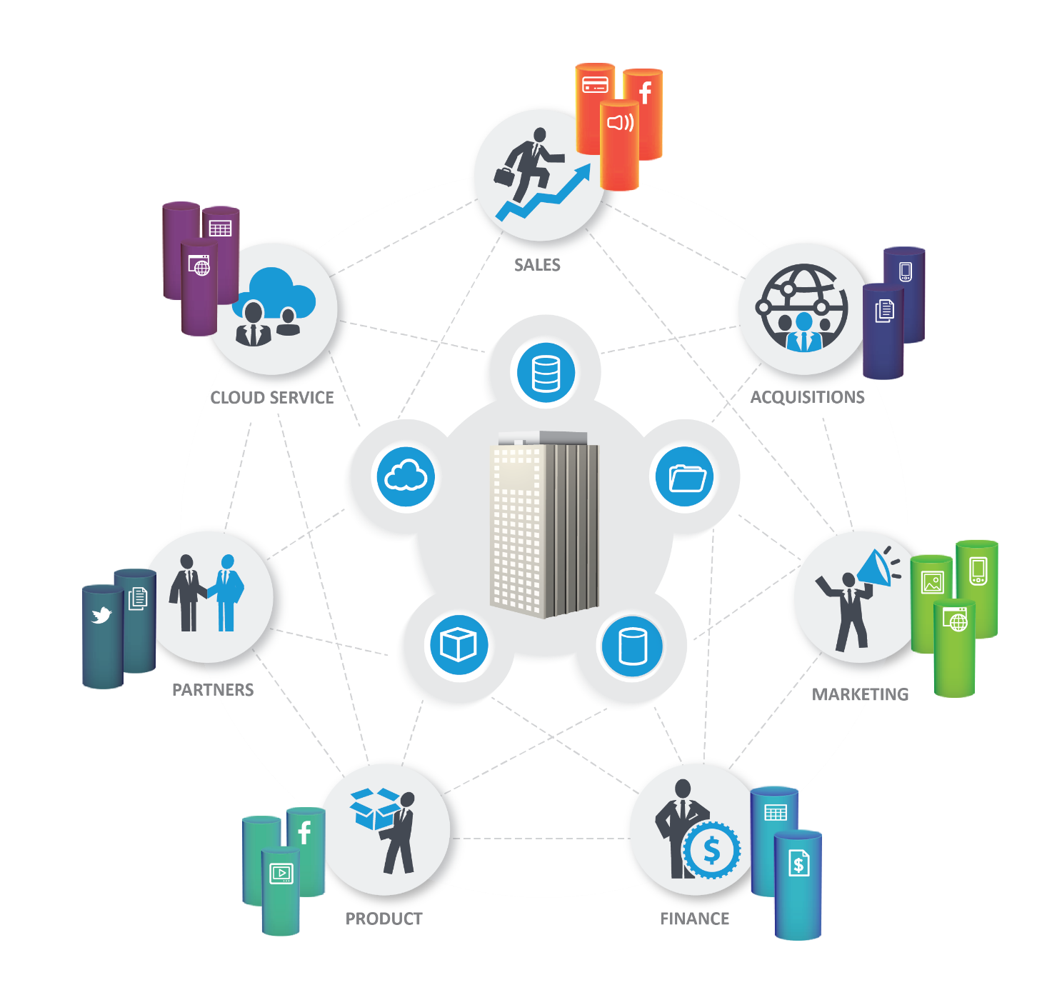
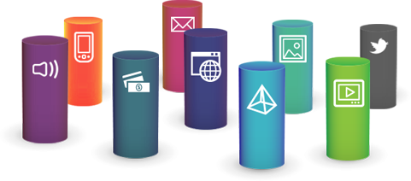
Data Complexity Conundrum is Everywhere
Siloed data, technology, and communities
DIFFERENT
Formats
DISCONNECTED
Silos
LARGE
Volumes

Slide 5
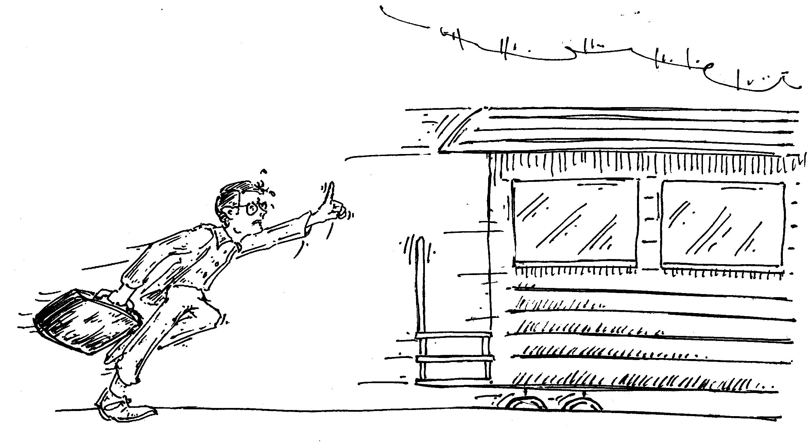
BIG DATA EXPRESS
Governance, Risk, Compliance (GRC) Professional
Austin Alleman, 2014

Slide 6
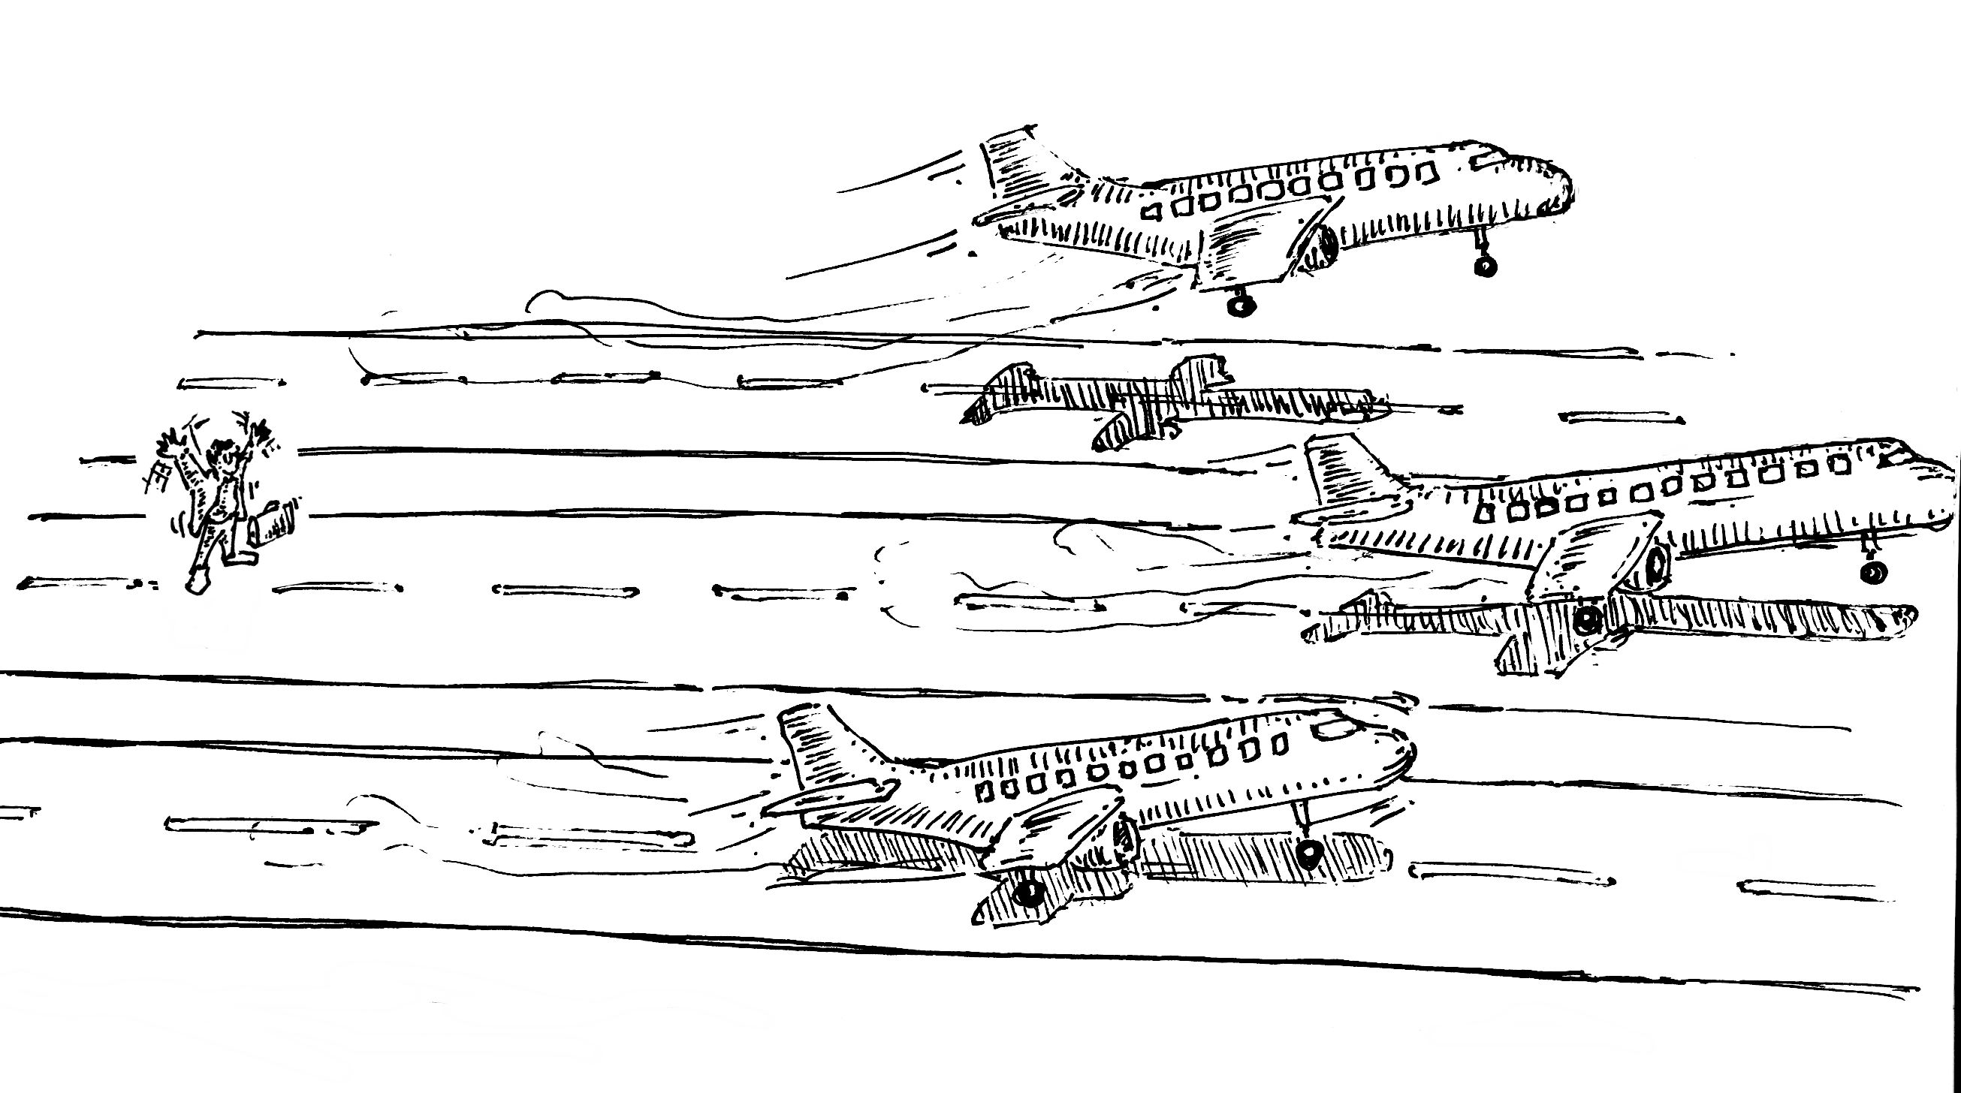
GRC Professional
Austin Alleman, 2014
BIG DATA INTERNATIONAL AIRPORT

Slide 7
“Computers are useless. They can only give you answers.”
− Pablo Picasso
data
wisdom
TIME

Slide 8

What is a paradigm?
Current Paradigm
Crisis
Anomalies
New Paradigm

Slide 9
Newton versus Einstein
Paradigm Newtown Mechanics
Crisis Gravity can’t go faster than light → Newton wrong
Anomaly Unknown how gravity works
New Paradigm General Relativity

Slide 10
Today’s Business Communities and Their Paradigms
Geeks
Make it work
Suits
Make money
Wonks
Stay out of trouble

Slide 11
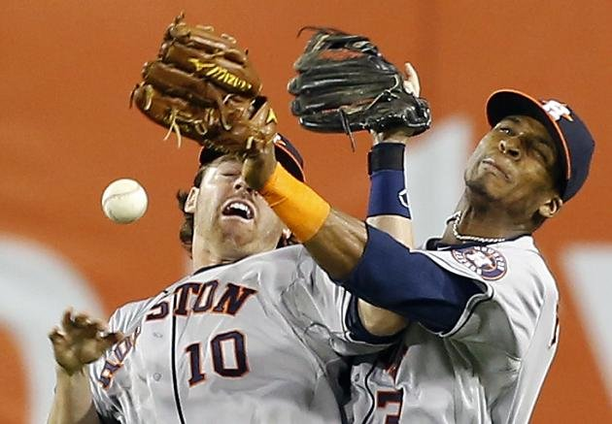
Felton’s 3rd Law:
Lawyers look to technology, and techies look to law.

Slide 12
The Current GRC Paradigm
Fair Information Practice Principles
Belmont & Menlo Reports
Access
Accuracy
Security
Audit
User Consent
Data Minimization
Specific Purpose
Use Limitation
Respect for Persons
Beneficence
Justice
Respect for Law and Public Interest

Slide 13
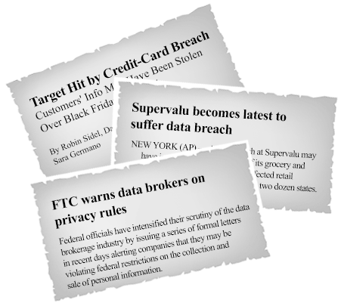
Houston, we have a problem

Slide 14
Source of Anomalies
Everything is digital
Large scale
Diverse technologies
Diverse teams
Legally uncertain environment both in US and abroad

Slide 15
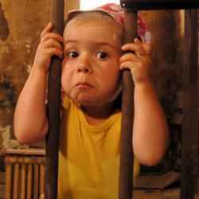
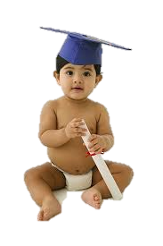
Contracts are too early

Slide 16
Audits are too late
Austin Alleman, 2014

Slide 17



If You Have Something You Don't Want Anyone To Know, Maybe You Shouldn't Be Doing It?
[FIPPs flexibilty] means relaxing data minimization and consent requirements while emphasizing transparency, access, and accuracy.
CNBC, Mar 2010 Eric Schmidt, CEO, Google
Northwestern Journal of Technology, Apr 2013 Omer Tene, Haim Striks Law Jules Polonetsky, Future of Privacy Forum
…shifting policymakers’ and regulators’ focus toward controlling the use of data, rather than just its collection, would empower citizens.
A revolution is afoot in privacy regulation.
Craig Mundie Foreign Affairs, Apr 2014
Former Chief Research and Strategy Officer.
The Potemkinism of Privacy Pragmatism
Slate Magazine, Sep 2014 Chris Hoofnagle, Berkeley Law
“The OECD Privacy Principles … need updating, so that we can ensure effective privacy protection in the future – while enabling the many benefits … that Big Data promises to bring.
Reinventing Privacy Principles for the Big Data Age, Dec 2013 Viktor Mayer-Schönberger, Oxford Professor Fred Cate, Indiana University Peter Cullen, Microsoft

Slide 18
Fracturing FIPPs
Access
Accuracy
Security
Audit
Access
Accuracy
Security
Audit
Consent
Data Minimization
Specific Purpose
Use Limitation
Consent
Data Minimization
Specific Purpose
Use Limitation

Slide 19
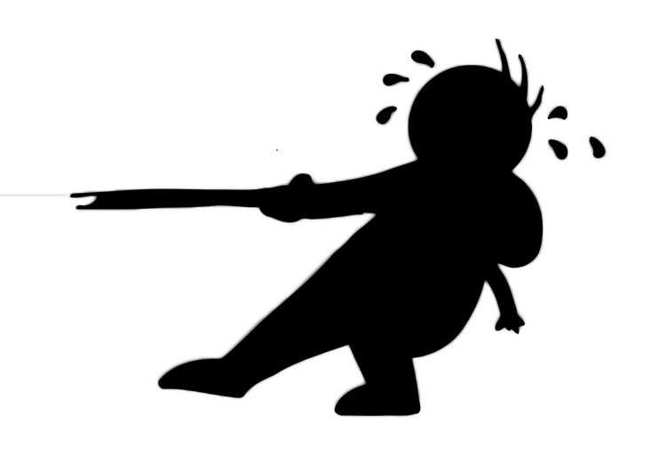
“The beatings will continue until morale improves.”
Overton Window
Unthinkable
Acceptable
Popular
Radical
Sensible
Policy
Facebook Newsfeed
Ad Targeting
Pre-crime
Facebook Beacon
Girls Around Me

Slide 20

Paradigm Change is Uncertain
Progress is not a line toward truth but progress away from what’s wrong.
Structure of Scientific Revolution Thomas S. Kuhn
What the world turns to, when it is cured on one error, is usually simply another error, and maybe one worse than the first one.
H.L. Mencken

Slide 21
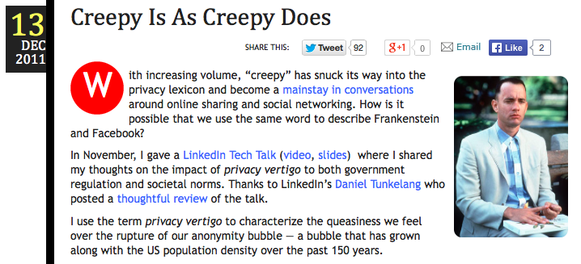
PRIVACY
PLACES
PLAYERS
http://jimadler.me/post/14171086020/creepy-is-as-creepy-does
PERILS

Slide 22
Places-Players-Perils Cases
MORE PLAYER POWER GAP
MORE PRIVATE PLACES

Slide 23
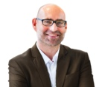

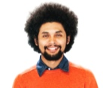
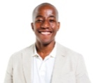
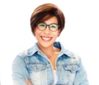
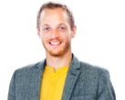
Motive-Planning-Execution
Privacy
Transparency
Incentives
PLACES
PLAYERS
PERILS
Motives
Planning
Execution

Slide 24
“Can’t we all just get along?”
− Rodney King
Geeks
Wonks
Suits
High-Tech Mercenary
Social Entrepreneur
Responsible
Innovator
Traditional Capitalist

Slide 25
Lies, Damn Lies, and NYC’s Stop & Frisk
Incentives
Minorities
50%
Criminals
90% of Criminals are Minorities
Bayes’ Rule
All NYC Residents

Slide 26
“Half the money I spend is wasted; the trouble is I don't know which half.”
Incentives
Minorities
50%
Bayes’ Rule
90% of Criminals are Minorities
Criminals
5%
10% of Criminals are Not Minorities
All NYC Residents
If it’s not ok to stop 99% of the general population for nothing, why is it ok to stop 91% of minorities for nothing?

Slide 27
Felon Classifier
Privacy
Bloomberg: http://bloom.bg/1eMtnug Blog post: http://goo.gl/691pzM
Transparency
Threshold: 1.1
FP Rate: 1%
FN Rate: 40%
ANARCHY
Threshold: 0.66
FP Rate: 5%
FN Rate: 22%
Threshold: -1.82
FP Rate: 19%
FN Rate: 0%
TYRANNY

Slide 28
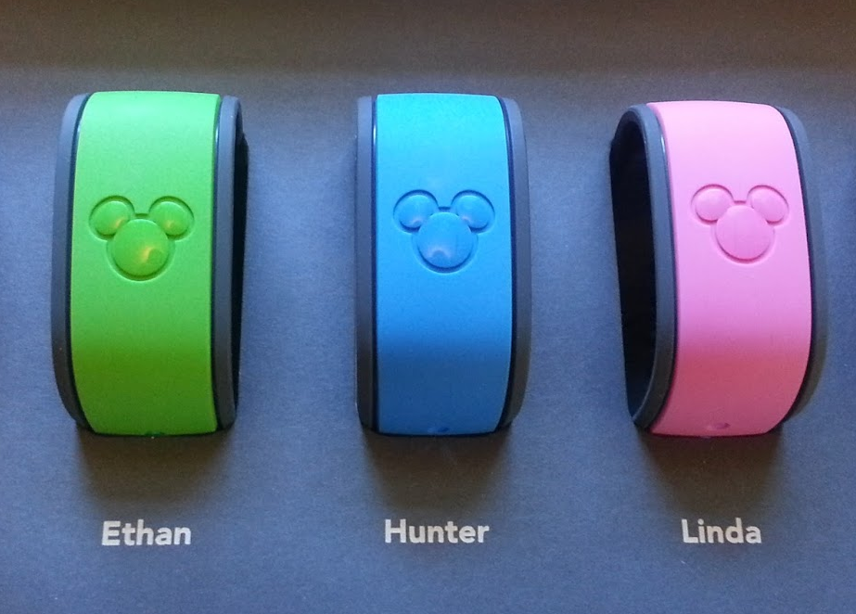
John Foreman’s Excellent Disney Adventure
Transparency

Slide 29
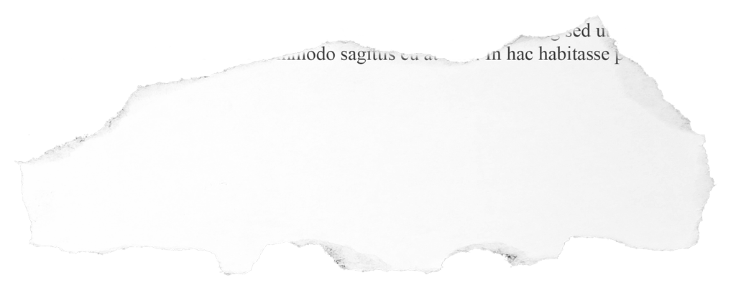
OKCupid: “We Experiment on Human Beings”
Incentives
http://blog.okcupid.com/index.php/we-experiment-on-human-beings/
Transparency
I would love it if transparency truly allayed anxiety in an informed, nonexplosive way. But in practice, it might increase anxiety.
New York Times, Sep 2014 Christain Rudder, President, OKCupid
Sunlight is said to be the best of disinfectants; electric light the most efficient policeman.
Louis Brandeis Associate Justice, US Supreme Court, 1916-1939

Slide 30
Data Mapping Across the Enterprise
Transparency
Who saw what and when?
Database logs
Unauthorized copying
Retention and deletion
What records are moving overseas

Slide 31
Document Similarity
Transparency
MinHash and Jaccard Similarity
A revolution is afoot in privacy regulation.
A revolution is a foot in privacy regulation.
MD5:
8ccd811c0e7d419d101cf43cafe39179
7f6bca28df0f32552962c945eca0683d
regulation
afoot
revolution
foot
privacy
http://infolab.stanford.edu/~ullman/mmds/ch3.pdf

Slide 32
Transparency
Watch your thoughts; they become words. Watch your words; they become actions. Watch your actions; they become habit. Watch your habits; they become character. Watch your character; it becomes your destiny.
Lao Tzu 600 BC
Watch your thoughts, for they become words. Chose your words, for they become actions. Understand your actions, for they become habits. Study your habits, for they will become your character. Develop your character, for it becomes your destiny.
Ralph Waldo Emerson ~1850
Watch your thoughts for they become words. Watch your words for they become actions. Watch your actions for they become habits. Watch your habits for they become your character. And watch your character for it becomes your destiny. What we think, we become.
Margaret Thatcher ~1980

Slide 33
Document Similarity
Transparency
MinHash and Jaccard Similarity
Lao Tzu | LT MT | Margaret Thatcher
character watch character become character watch | habit watch habit thought become word word watch word become word watch watch character it become action watch it become destiny word become action become habit watch character it become watch action become habit become character watch habit become watch word become action watch action watch thought become action become habit | we think we become destiny what become character and and watch character think we become what we think destiny what we character and watch
U

Slide 34
Document Similarity
Transparency
MinHash and Jaccard Similarity
Lao Tzu | LT RWE | Ralph Waldo Emerson
habit watch habit watch habit become become word watch watch character it character watch character become character watch become habit watch become action watch watch action become habit become character word watch word action watch action watch word become | thought become word it become destiny watch thought become character it become action become habit word become action | become word chose become habit study become character develop become action understand chose word become word chose word character develop character will become character develop character it habit study habit study habit will understand action become habit will become action understand action
U

Slide 35
Document Similarity
Transparency
MinHash and Jaccard Similarity
Ralph Waldo Emerson | RWE MT | Margaret Thatcher
become word chose become habit study become character develop become action understand chose word become word chose word character develop character will become character develop character it habit study habit study habit will understand action become habit will become action understand action | thought become word it become destiny watch thought become character it become action become habit word become action | habit watch habit word watch word we think we watch habit become become word watch watch character it become destiny what watch action become become character and and watch character think we become become habit watch what we think destiny what we character and watch become action watch habit become character action watch action watch word become
U

Slide 36

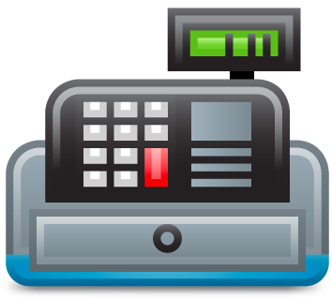
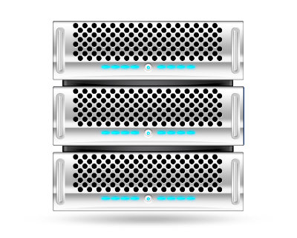

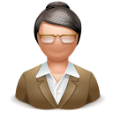
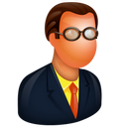
Data Flow Analytics
Transparency
Retail POS Attack
Store 343
78828
6548
18264
In-Store Database
Servers
In-Store Network
Servers
Regional
Network
Servers
Store 729
National
Network
Servers
56613
55032
62244
In-Store Database
Servers
In-Store Network
Servers
Regional
Network
Servers

Slide 37
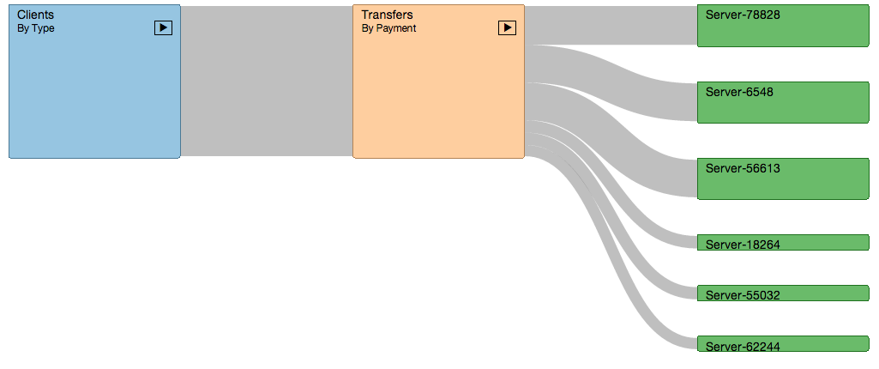
Data Flow Analytics
Transparency
Retail POS Attack
Register POS
Card Txns
In-Store Servers

Slide 38

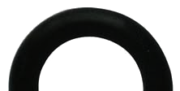
… but then we reshape our tools …
“We shape
our tools …
… and thereafter
our tools shape us.”
− Marshall McLuhan

Slide 39
Toward a Unified Theory of Technology and Policy
Invent
Listen, Learn
Criticize, Scrutinize
Reinvent
Geeks
Wonks
Suits

Slide 40
Questions?
Jim Adler VP Products & Chief Privacy Officer Metanautix @jim_adler

