Slide 1
Recruiting for Diversity in Tech
Velocity Conference, Barcelona
Laine Campbell, Co-Founder
November 17th, 2014

Slide 2
Who am I?
DB Architect, Entrepreneur and super hero…
Good hair, not overly clever, female pronouns

Slide 3
Who am I?
When in doubt, laugh

Slide 4
Working Rules
Diversity is a goal unto itself
Assume good intentions.
Create a culture of forgiveness.
Don’t be afraid to speak up, call out and engage.
Recognize privilege and implicit biases as real
ngs.

Slide 5
Why diversity in tech matters

Slide 6
Only 22% of Employees work for companies that embody both dimensions in their cultures.
Inherent Diversity
Acquired Diversity
Nationality
Religious Background
Gender
Age
Sexual Orientation
Race/Ethnicity
Socio-economic Background
Disability
Cultural Fluency
Generational Savvy
Gender Smarts
Technological Literacy
Cross-Functional Knowledge
Global Experience
Military Experience
Language Skills

Slide 7
Employees at companies with 2D diversity are 75% more likely to have a marketable idea implemented.
Publicly traded organizations with 2D diversity are 70% more likely to capture a new market
Publicly traded organizations with 2D diversity are 45% more likely to improve market share.
http://www.inc.com/lauren-leader-chiv%25C3%25A9e/diversity-helps-maximize-your-innovation-potential-.html

Slide 8
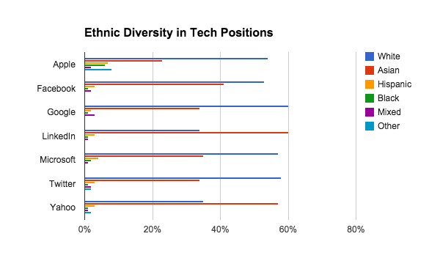
http://fortune.com/2014/08/29/how-tech-companies-compare-in-employee-diversity/

Slide 9
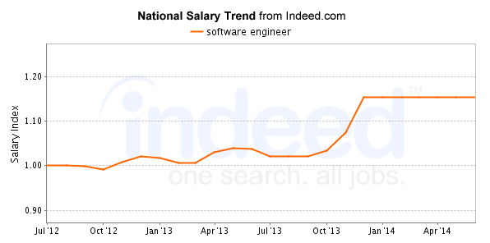
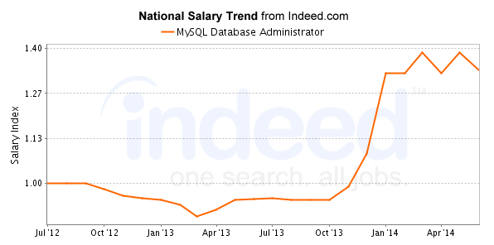
Via Indeed.com
Average software engineer salaries for job postings nationwide are 77% higher than average salaries for all job postings nationwide.
Average MySQL Database Administrator salaries for job postings nationwide are 113% higher than average salaries for all job postings nationwide.

Slide 10
The Power of Diversity
Normalized salaries free up capital.
Freed up capital allows for bigger teams, more code pushes and greater competitiveness.
Diverse teams drive more innovation, translating to greater market share and new market penetration.
Diverse teams create better products for diverse customers.

Slide 11
The Power of Diversity
Wealth redistribution and rebalancing
STEM (science, technology, engineering, medicine) will be the next middle class
A tool to bring us back into balance

Slide 12
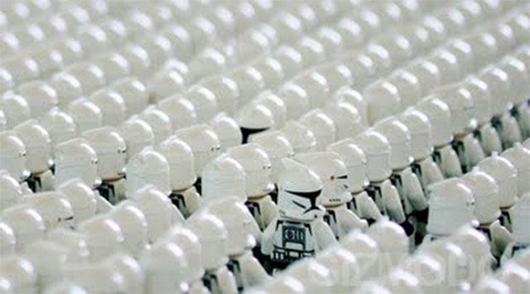
The meritocracy is broken

Slide 13
Challenging the Meritocracy
“governance by those who have skills and ability”
Project
Governing Group

Slide 14
Challenging the Meritocracy
“building the contributing team”
the governing group is responsible for building the contributing community
if they don’t reach out to diverse groups, they immediately self-select

Slide 15
Challenging the Meritocracy
“some never show up to the party”
Project
Governing Group

Slide 16
Challenging the Meritocracy
“day to day beatdowns...”
being hit on and sexualized as women
hearing racist, sexist and homophobic talk in IRC and forums (even if it is managed by moderators)
being talked over, talked down to and having your ideas stolen
other priorities stealing focus (dependents, second jobs, health)
Governing Group

Slide 17
Challenging the Meritocracy
“day to day beatdowns...”
Project
Governing Group

Slide 18
Challenging the Meritocracy
“the governing groups’ selection criteria...”
Looking for people committed enough for the task
Matching human attitudes
Work well with others, particularly in disagreement
Governing Group
where does this mention skills and ability?

Slide 19
Challenging the Meritocracy
“ruled by implicit bias”
generally unconscious, and non-malevolent
snap decisions created by comfort and affinity
creates a culture of “comfort”, not diversity
Governing Group

Slide 20
Challenging the Meritocracy
“after implicit bias...”
Project
Governing Group

Slide 21
Proof is in the pudding
“apache foundation projects”
Apache Board - No women
Hadoop - 6 women out of 105 committers (5%)
Cassandra - 1 woman out of 25 committers (4%)
Subversion - 1 woman out of 78 committers (1%)
Httpd - 2 women out of 120 committers (2%)

Slide 22
Fixing the Meritocracy
“true governance by those who have skills and ability”
Get everyone to the party…
Eliminate the day to day beatdowns…
Eliminate individual and systemic bias...

Slide 23
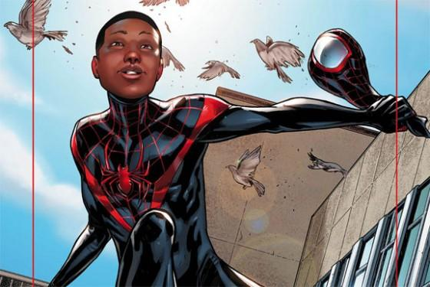
Getting everyone to the party...

Slide 24
“your first and constant job is recruiting”
30% of CS degrees go to women
Y Combinator historically has a 4% admission rate for women
Women did not comprise 30% of applicants however
http://techcrunch.com/2011/11/19/racism-and-meritocracy/

Slide 25
Mind the gap...

Slide 26
Getting Everyone to the Party
“Create goals, track and enforce them”
50% of applicants must be women
25% of applicants must be black/latino
Let your teams drive innovation for meeting these goals

Slide 27
YOU WILL NOT SUCCEED
Without changing your recruiting model

Slide 28
Getting Everyone to the Party
“reaching out and building partnerships...”
Organizations dedicated to bringing underserved populations to the job market
Meetups, online groups, linkedin, etc…
Day to day networking, connections and outreach

Slide 29
Getting Everyone to the Party
“what if it isn’t enough?”
You probably won’t be able to get enough senior staff this way
Mentor and build your own - hire/recruit junior folks with the right soft skills and aptitude
This is not about lowering standards, but creating new avenues

Slide 30
Getting Everyone to the Party
“what if it isn’t enough?”
Be proud of the standards, and welcoming of new members
Build balanced Teams
Encourage collaboration

Slide 31
Eliminate the day to day beatdowns...

Slide 32
“have a code of conduct, and enforce it...”
define acceptable behavior for your organization
be inclusive and recognize those you want to feel welcomed
encourage group participation, self-policing and ensure enforcement
put it everywhere! your site, your materials, your email signatures, your code

Slide 33
“acceptable doesn’t mean overly sensitive...”
mistakes are forgiven when intentions are good
hatred, insults and anger get shut down
education is encouraged
don’t let individuals be isolated, put in teams as 0 or 2

Slide 34
Eliminating implicit bias...

Slide 35
“true color blindness...”
until the 1970s, orchestras were 95% male
much time and energy was given to explaining why
screens were put in place to eliminate bias THAT’S IT
women in orchestras went up 25% - 46%
http://www.princeton.edu/pr/pwb/01/0212/7b.shtml

Slide 36
“true color blindness...”
Eliminate names and pictures from applications, online handles and technical test results
Build balanced interview teams (if you don’t have them, contract out)
Create collaborative testing and problem-solving
Review test questions and situations for bias regularly

Slide 37
Questions and Follow up
lcampbell@pythian.com
www.pythian.com
www.linkedin.com/lainecampbell
www.adafoundation.org

