Slide 1

Madeo: a CAD Tool for Reconfigurable Hardware
Loïc Lagadec
Lab-STICC Architectures&Systèmes
Université de Bretagne Occidentale, BREST
L. Lagadec - Lab-STICC CNRS UMR 3192 - Université de Bretagne Occidentale
1
Notes:
1

Slide 2
Our OO Expert's world
We are all familiar with
  Code refactoring
  Code reuse
  Agile development
Ability to postpone design choices
Fast development
Portability through Virtual Machines

Slide 3
What about real Machines?
Micro processors
Co-processors
  Dedicated instructions set
  Dynamic instructions set ?
Reconfigurable hardware is an option for that
μ
P
Circuit
Out = i1 + i2
i1
i2
out
Target

Slide 4
Reconfigurable Architectures (RA)‏
Circuits
  Customizable
  Partial reconfiguration
  Dynamic reconfiguration
Performances (in between HW and SW)‏
Flexibility (in between SW and HW)‏
“Low” Cost

Slide 5
Targets
FPGAs (several vendors, eg. Xilinx)‏
  Complexity issue
  Application IP composition
  Reconfigurable Datapath (e.g. XPP)‏
eFPGAs (M2000, Mentra, ...)‏
Rsocs (e.g Morpheus project) : RA IP composition
complexity

Slide 6
Requires efficient tools
Programming these circuits is a complex task
Tools are linked to a target (low reuse)‏
Application description “fails” to exploit flexibility

Slide 7
My talk adresses
Applying OO methodology to reconfigurable hardware
  Adapt to new RA “retargetable compiler”
  Produce Circuits from HL code
10 years experience report
Results + Lessons learned

Slide 8
Origin: Compatibility issues
Need to conform to
  standards tools/formats
  vendor's private (unstable) formats
While preserving a stable API
Solution: Build up a framework
  Model : Reconfigurable Architecture (RA)
  Tools : Editing/Programming RA

Slide 9
Our contribution
Tools for HL Code to circuit mapping
HL Code
Covers control structures and libraries
SOFT
2
RTL Code
Floorplaning
Covers more architectures: model's improvements
Place & Route
1
Validation
Bitstream generation
HARD
Execution control

Slide 10
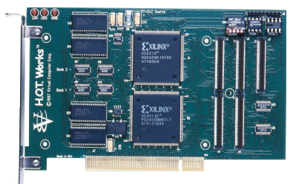
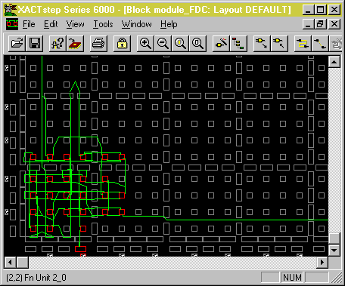
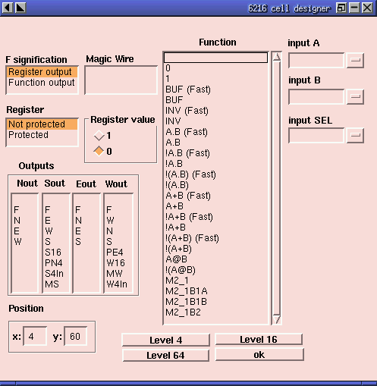
First architecture
XC6200 from Xilinx
Configuration as RAM
Very exiting (late 90s)‏
Program &
Manage execution
Export

Slide 11
Dedicated Tool
A circuit is an object
  Registers = instance variables
  IOs = accessors
Mmap: configuration ∈ main memory
Fine resource allocation
Step by Step execution control

Slide 12
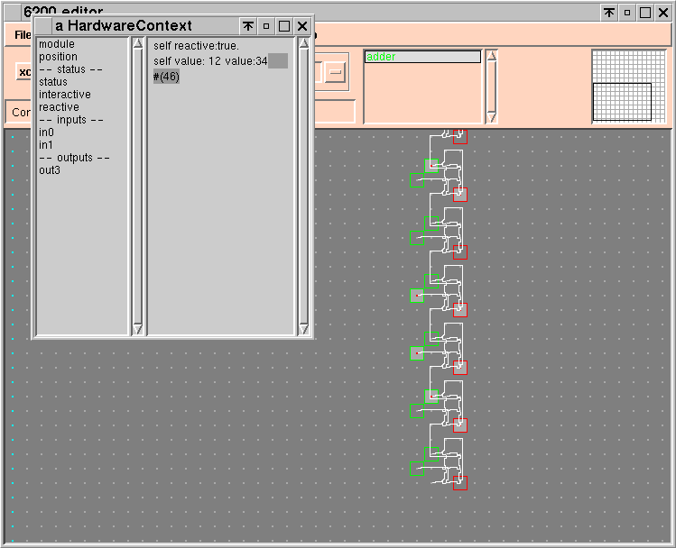

Slide 13
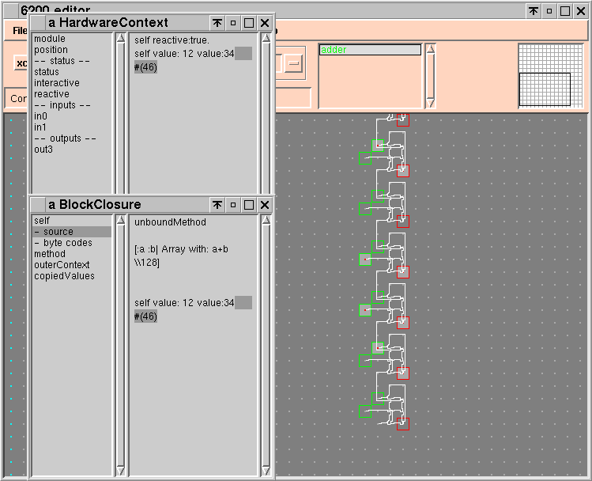

Slide 14
Improvements
1
Coverage
  Learning by doing (reverse is costly)
  Model re-design
    Wire vs Channel
    Directional vs Bi directional resources
    Hierarchical composition
    ...
  Model instanciation (DSL)‏
  Design Space Exploration (DSE)‏

Slide 15
Results
Architectures
  Commercial architecture (VIRTEX) with back end vendor's tools control
  Reconfigurable datapaths (STMicro)
  Generic parameterized architectures (DSE)‏
  Architecture research oriented support (fast prototyping)‏
Two issues
  Compiance to standard
  High Level layer

Slide 16
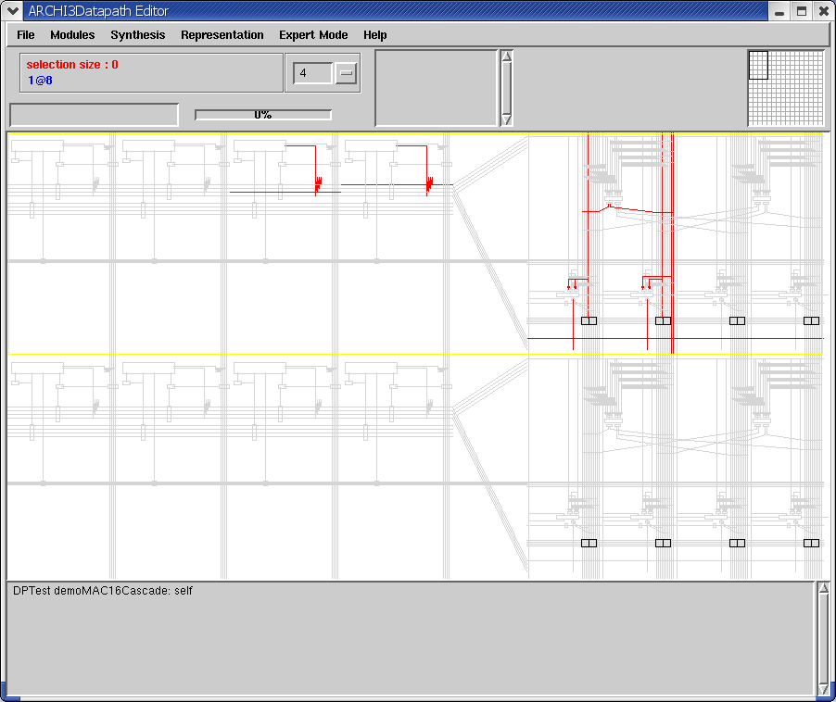
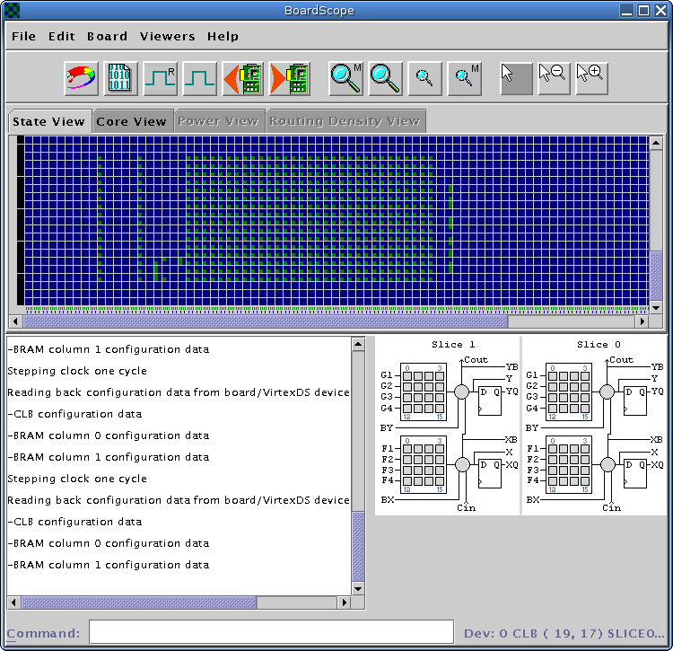
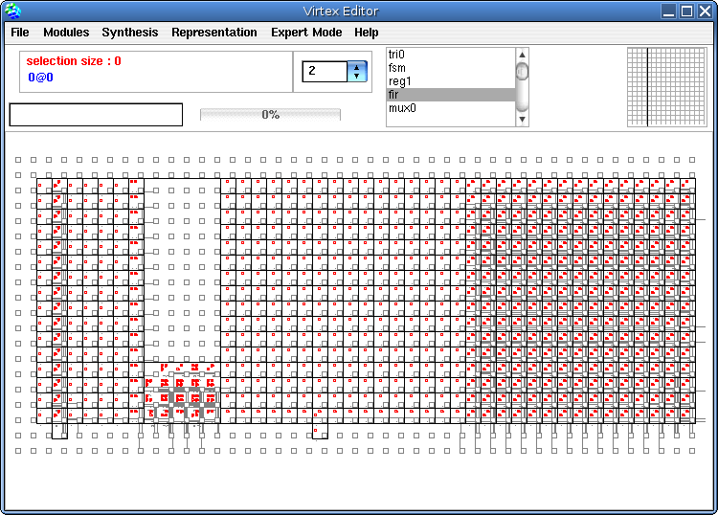
Snaphots
BitStream structure
(e.g K.I.T)
System Use
Interfacing the vendor API

Slide 17
ST as application spec
2
Goal: Fully exploit RA adaptability
How:
  AST from Vw code
  Typing
  Compilation steps (standard + specific)
+ RTL (application) generation

Slide 18
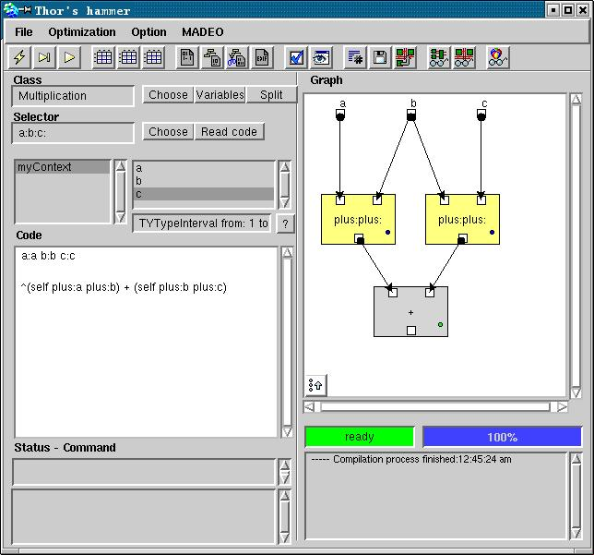
Tool Snapshot

Slide 19
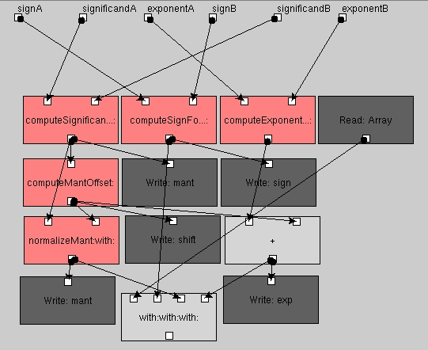
Example:Small FP multiplier

Slide 20
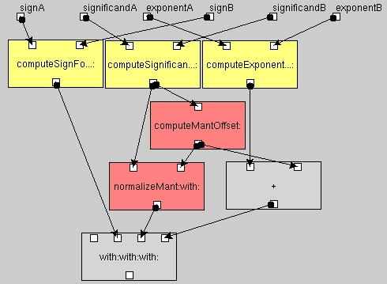
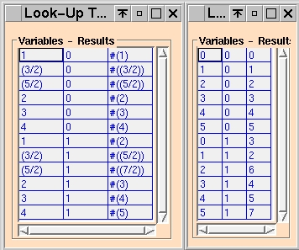
Example:Small FP multiplier

Slide 21
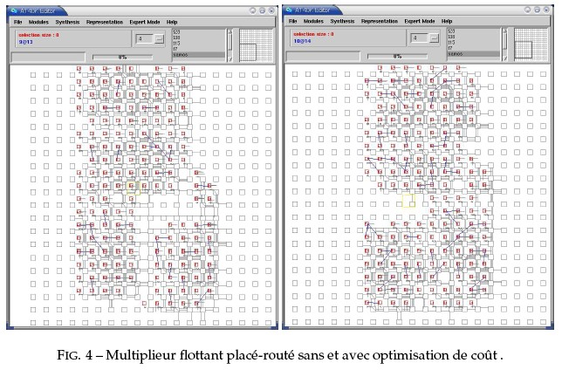
Example:Changing optimization policy

Slide 22
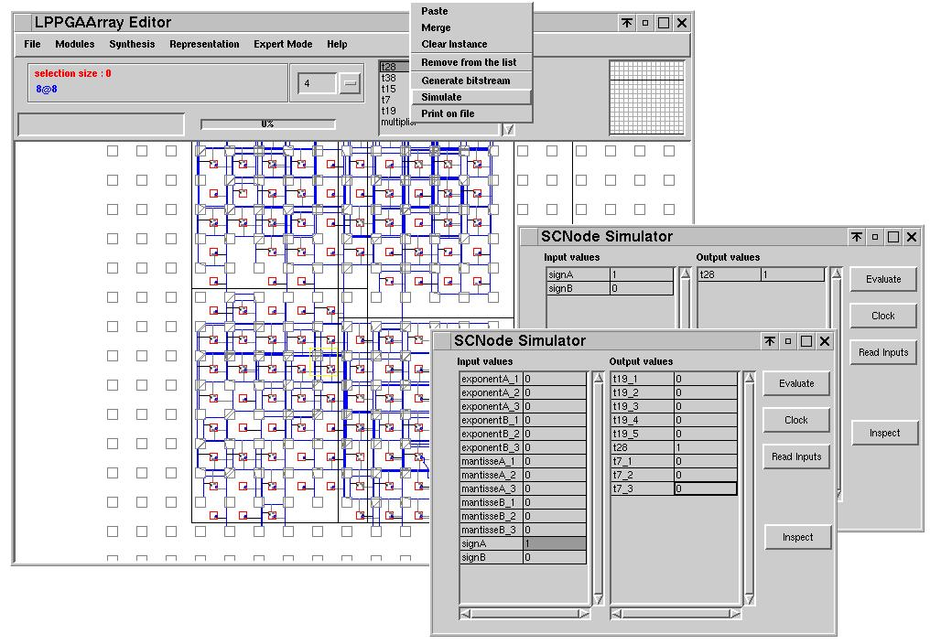
Example: Changing target RA

Slide 23
Pro/Cons
Domain oriented tailoring (ex. Galois field based typing) for free
Logic based simulator hence SW/HW sharing API
Complexity bounded
Restricted to simple control structures (ifTrue:, ...) and loop unrolling
Still relies on third parties logic minimizers

Slide 24
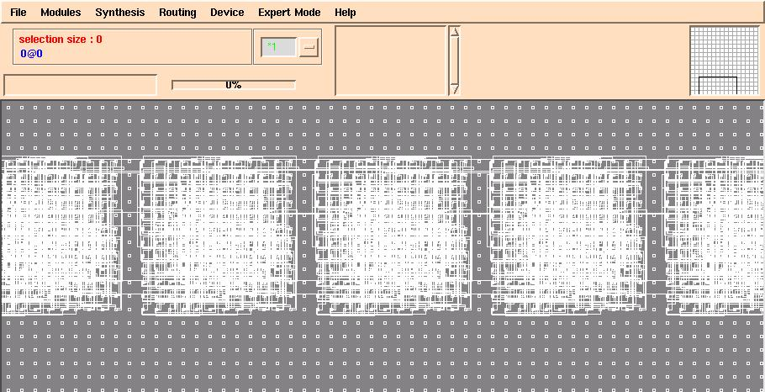
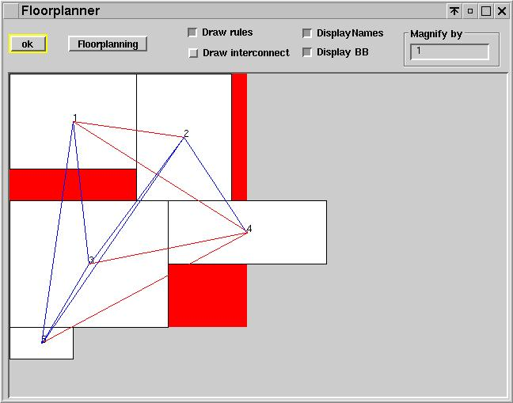
Complexity issue
Well known design patterns
  Soft macros (tiling, ...)‏
  Compositions (divide and conquer)‏
Designing architectures (control structures through structural patterns)

Slide 25
Model/Interchange issues
Standart compliance (e.g. EDIF)‏
Exchange issues:
  Ensure portability
  Prevent semantic losses
  Allow cross-blocks optimizations
Meta modeling: Platypus (A. Plantec)
  STEP/EXPRESS
  Visitors (encoding/decoding, repository, rules checking)‏
  + Visitors (Domain specific e.g. Scheduling)

Slide 26
Flow
APPLICATION
APPLICATION
CDFG Use
Tool X
CDFG design
Tool Y
CDFG
EXPRESS
model
HLL CDFG API (Java)‏
Platypus tool
CDFG instances
(STEP files)‏
ENTITY HierarchicalNode SUBTYPE OF (Node);
localVariables : LIST OF AbstractData;
subOperators : LIST [1 : ?] OF Node;
END_ENTITY;
ENTITY AccumulatorNode SUBTYPE OF (HierarchicalNode);
init : AbstractData; --”AccumulatorNode.init” the initial value we start accumulating from.
toBeAccumulated: AbstractData;
DERIVE
cumulatedArguments : LIST OF AbstractData := subOperators [ SIZEOF (subOperators)].outputs;
WHERE
toBeAccumulatedSource: SIZEOF ( cumulatedArguments )=1;
typeCompat: cumulatedArguments[1].type = init.type;
END_ENTITY;
Target architecture description
Madeo+ synthesis tool
CDFG Checker
HLL CDFG API (Smalltalk)‏
Target 1
EDIF
Target 2
C like code
Target 3
Specific Assembly code

Slide 27
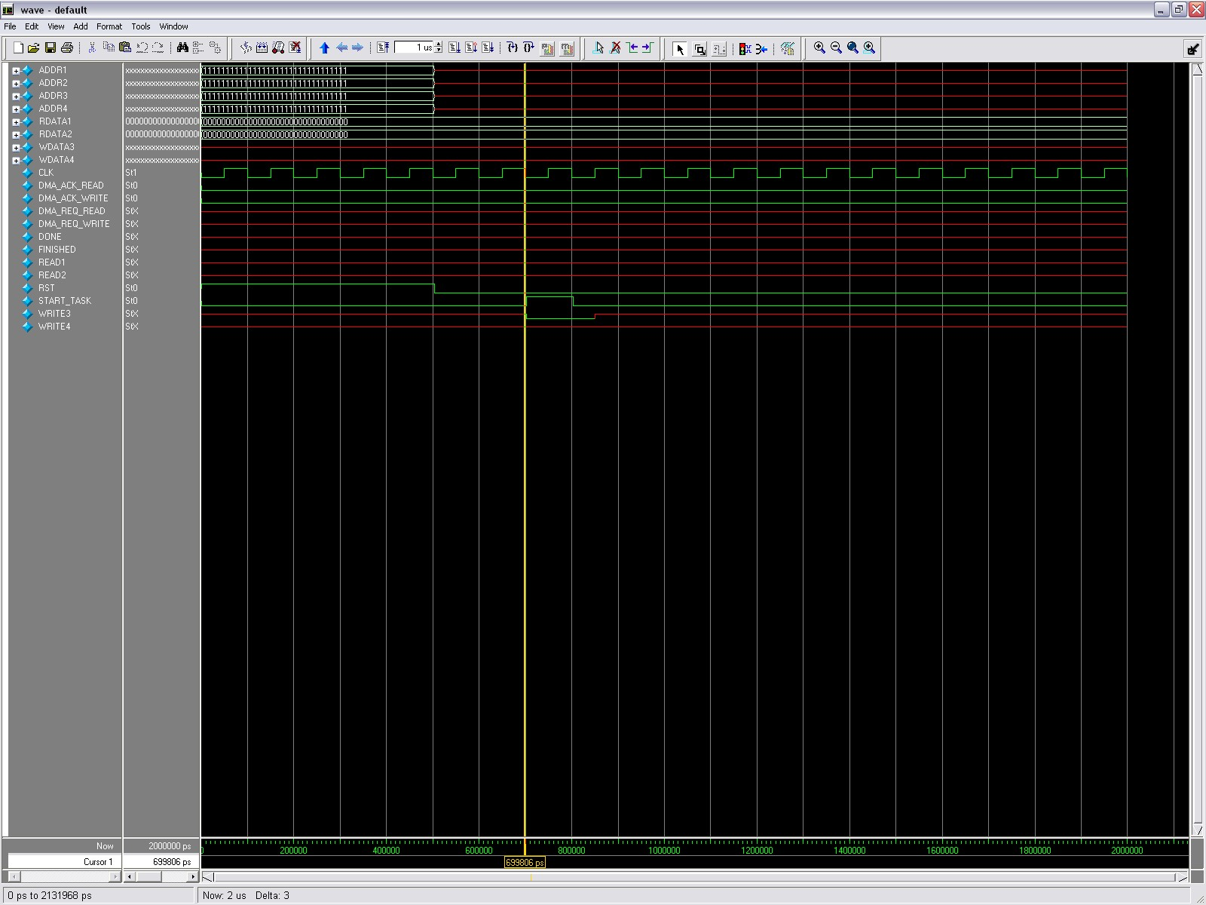
Validation
Key issue
Requires standard tools (Again !)‏
But we want also Sunit capabilities

Slide 28
Combine both
Use external tools as characterization tests for your own tools
Once yours are validated, use them
  Multi level simulation (System, Architecture, Circuit)‏
  Add probes/break points
  Keep the double link between HL code and circuit

Slide 29
Conclusion
Model target (FPGA, eFPGA, ...)
Generate application-code
HL code hardware execution
Open to third parties
Used in several projects (RNTL, PRIR, FP6, ...)
  Benefits from OO
  Provides OO-like
  Nice candidate to RA based VM implementation tool

Slide 30
Lessons learned
Split layers into separate tools with different names
Use Meta Modeling (cost killer)
  Evolution
  Interchange
  Documentation
Export code and always target your partner's reference language (your partner is your client)‏
You may like UGI, partners like command line mode (seaside 's fine for remote access and easy demo)‏
Don't show partners you work faster than they do
Keeping your cooking tips secrets is not a problem

Slide 31
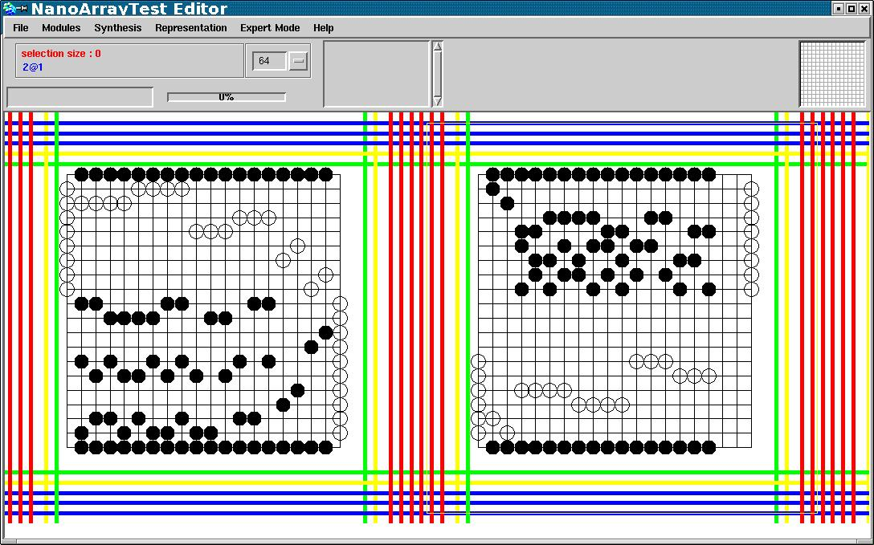
On going tasks
Platypus + STEP/EXPRESS for FPGA modeling
  DSL generation (ExternalLanguageParser -> SmaCC -> gen. smaCC)‏
Probe synthesis (hardware = speed up)‏
Nano devices (e.g. NASICs from Umass)
Virtualize FPGAs

