Slide 1
Percolation
Simulating percolation models
Guillermo Amaral
Caesar Systems - Argentina

Slide 2


Slide 3


Slide 4


Slide 5
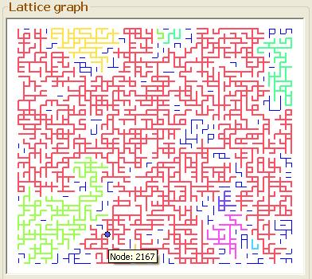
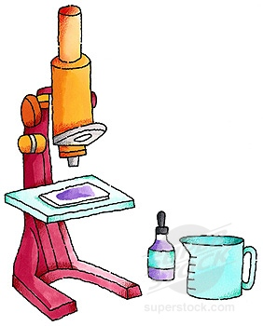
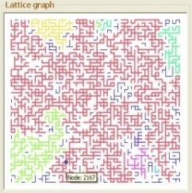
A virtual lab

Slide 6
Percolation deals with…

Slide 7
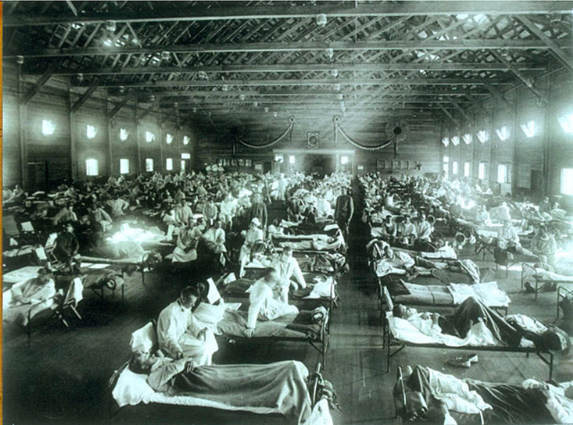
Propagation of diseases

Slide 8
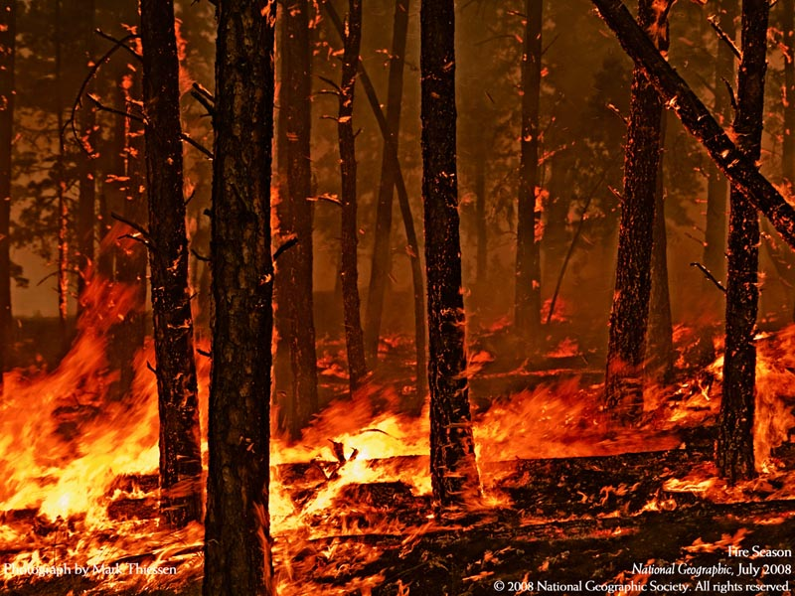
Propagation of fire

Slide 9
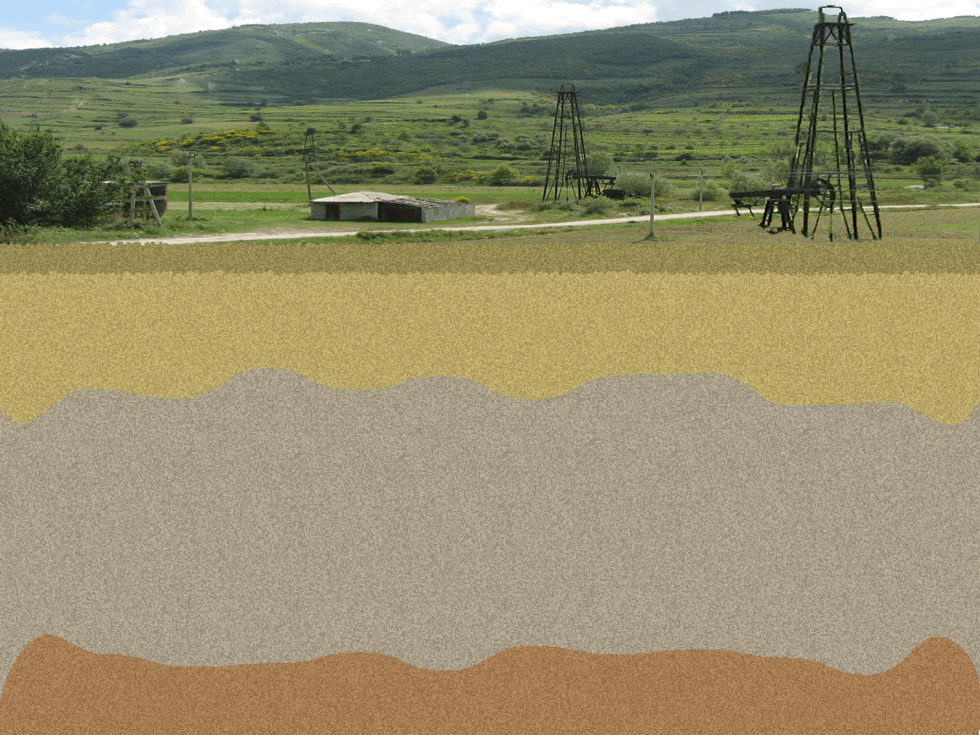
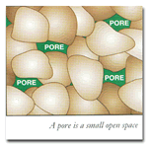
Oil & gas in reservoirs

Slide 10
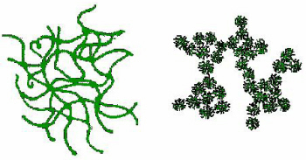
Gelation & Polymerization

Slide 11
The problem

Slide 12
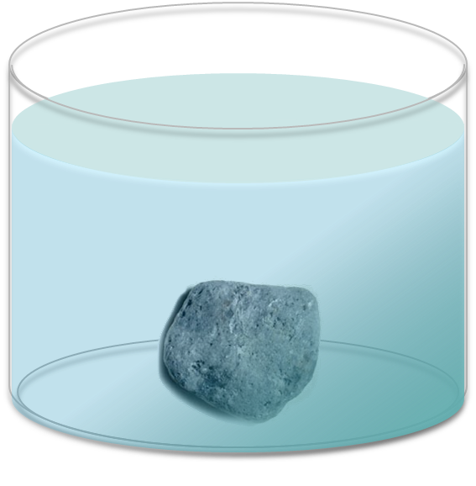
Original problem (Broadbent - Hammersley, 1957)
What is the probability that the water reaches the center of the rock?

Slide 13
The simulation

Slide 14
The mathematical model

Slide 15
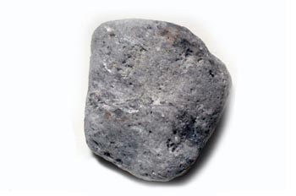
The simplest model
v ϵ ℤ²
u
v
u at distance 1 from v
v
Open path from
u to v
u
Open cluster from v
e
Percolating cluster
v
P(e “open”) = p
P(e “close”) = 1 - p
v

Slide 16

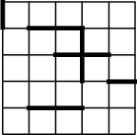
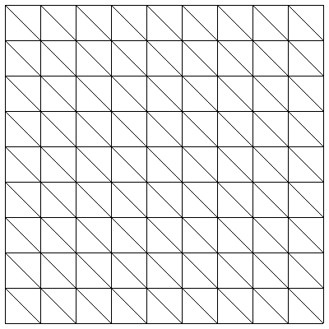
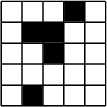
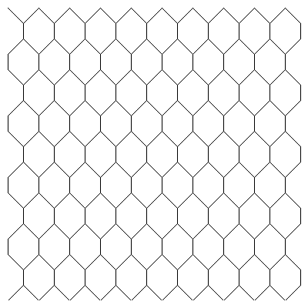
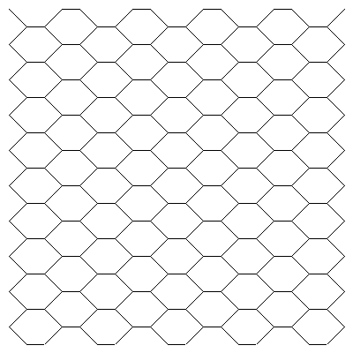
Model types
Element being open/close
Structure
Direction
Dimensions
2-D
Isotropic
Bond
Square
Bow-tie
p
p
3-D
Site
Hexagonal
Kagomé
Anisotropic
p₁
p₂
Both…
Other…
n-D…

Slide 17
Phase transition:
Critical probability
θ(p)
    θ(p) = P_{p}(a given vertex belongs to a percolating cluster)
      θ(p) = 0 si p = 0
      θ(p) = 1 si p = 1
      θ(p) is monotonically non-decrescent
    There is p_{c} Є [0, 1] such that:
      θ(p) = 0 if p < p_{c}
      θ(p) > 0 if p > p_{c}
      When is p = p_{c}?
1
p_{c}?
0
p_{c}
p
1

Slide 18
Known critical probabilities
 | Bond | Site
Square | ½ | 0.5927…
Bow-tie | 1 − p − 6p² - 6p³ − p⁵ = 0 (0.4045…) | 0.5472…
Hexagonal | 1- 2 sin(π/18) (0.6527…) | 0.6970…
Triangular | 2 sin(π/18) (0.3472…) | ½
Kagomé | 0.5244… | 0.6527…

Slide 19
Why simulation?
    Problems very hard to prove analytically
      Square bond model critical probability = 0.5
    Clues for a formal proof
    Application to practical cases

Slide 20
Areas of interest
    Large-graph representation
    Pseudo-random numbers
    Graph exploration
    Analysis of connected components

Slide 21
Simulation variables
Simulation
Open policy parameters
Pattern parameters
Lattice parameters
height,
p
k
width
p_{V,} p_{H}
Estimator θ(p)
Simulation running time
Percolating cluster size

Slide 22
Simulation process
1. Build the model
2. Generate a “random” configuration
4. Collect results of output variables
3. Search for percolating clusters

Slide 23
The simulator

Slide 24
My experience…

Slide 25
    Programming with a solution in mind leads to answers, but modeling the problem also raises new questions

Slide 26
Questions

Slide 27
A case of study

Slide 28
Scope analysis
p_{H}
x₀
(x₀↔v)
(x₀↔v’ )
p_{v}
v
v = (x, y)
v’ = (y, x)
If p_{H} < p_{v},
P(x₀↔v) <P(x₀↔v’)?
v’

Slide 29
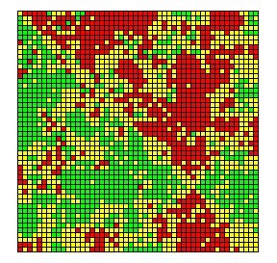
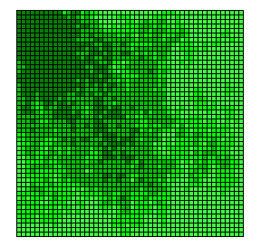

Scope analysis visualization
Mirror coloring
Scale coloring
>
=

Slide 30
Object design

Slide 31
Objects (1)
PercolationModel
OpenPolicy
BondPercolation
SitePercolation
LatticeGraph
BondOpenPolicy
SiteOpenPolicy
IsotropicPolicy
AnisotropicPolicy
Lattice
GraphPattern
SquareVerticalHorizontal
…
SquareLattice
CubicLattice
SubgraphPattern
NodeBasedPattern
AdjacencySolver
Square1KVertical1Horizontal
Square1Vertical1KHorizontal
…
PatternAdjacencySolver
MatrixAdjacencySolver
Caesar

Slide 32
Objects (2)
GraphAlgorithm
AdjacencyMatrix
PSBitMatix
PSSparseFloatMatrix
QuickUnionFind
GraphSearchAlgorithm
PSFloatMatrix
PSSparseMatrix
WeightedQuickUnionFind
BreathFirstSearch
DepthFirstSearch
WQUFPC
ModelSampler
CriticalRangeFinder
NodeScopeAnalizer
…
ModelEvaluator
CompositeSampler
ModelHistory
VariableWalker
UnionFindAnalizer
…
Caesar

Slide 33
Objects (3)
ChartObject
ChartAxis
XYSerieMarker
Chart
RangeMark
ChartSerie
DrawerTool
PieChar
XYChart
NodeLocator
XYChartPointLocator
ClusterPainter
EdgeLocator
PSDrawer
ChartDrawer
CriticalRangeDrawer
SquareLatticeGraphDrawer
BondPercolationGraphDrawer
PieChartDrawer
XYChartDrawer
SitePercolationGraphDrawer
Caesar

